Slide 1
Genesis 1:1-2:2
Hebrews 4:1-3

Slide 2
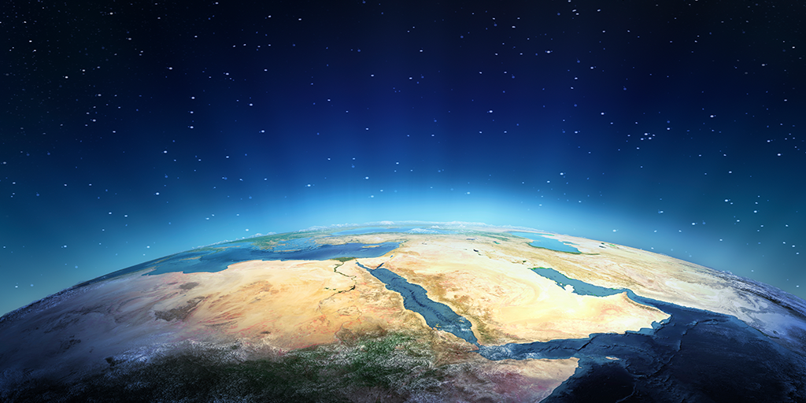
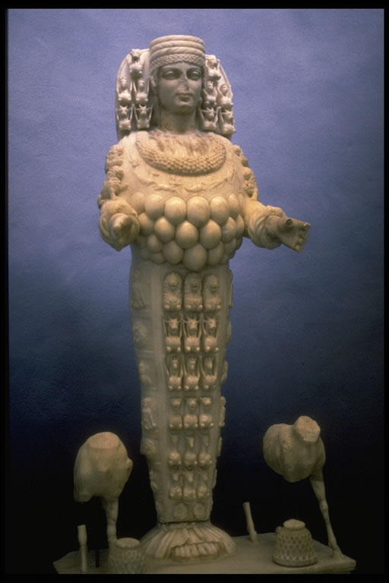

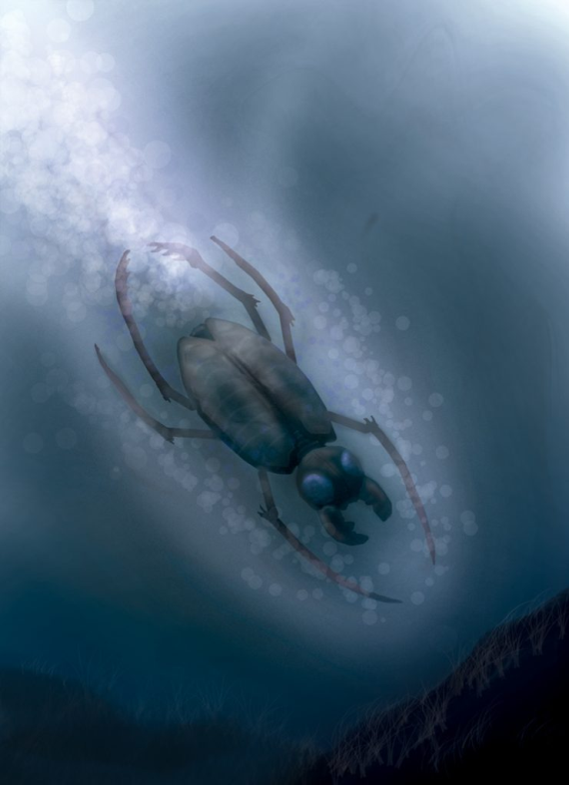
In Greek mythology, Gala, Eros and Tartaros emerged from nothing (chaos) and created the earth
Cherokee Indians believed that the earth was created by a water beetle
Australian Aborigines believe in creation by the rainbow serpent
Ancient Sumerians believed that the female god Nintur created humans and other animals

Slide 3
What does God have to say?
Dr Ron Nellor - Sunday 29th October 2023
The Bible is clear in stating that God created the stars, the earth, and all that dwells on it.
You will see from our reading that there is not a lot of detail given by God on how He created things, just that they came about by His spoken word.

Slide 4
SCIENCE
BIBLE
Molten magma gravitated together to form an intensely hot blob cooled by water and vapour spewed out by volcanic activity.
Day 1 – God created a formless planet, with the Spirit of God hovering over the waters. God gave light and darkness to the earth.
A water vapour cloud encircled the earth. Condensed water and subterranean water settled on the surface of the planet.
Day 2 – God separated the water from under the expanse from the water above it. God called that gap sky.
Amino acids formed protein to create the building blocks of matter. Algae combined with cyanobacteria to form plants. Plants formed on land and underwater.
Day 3 – God formed the seas and dry land. He created vegetation on the land and in the seas.
Millions of years passed as mutations allow plants to change formation.
Day 4 – God created the sun, moon and stars.
The first creatures appear in the oceans and then through further mutation, they move onto the land. Further mutations produced bird life.
Day 5 – God created all of the creatures in the water and the birds of the air.
The birds mutated into small creatures and then eventually mutated into larger and different animals. Eventually, animals mutated into human beings.
Day 6 – God created animals of all kinds, large and small. Last of all, God created man in His own image.
Even though we have seen interbreeding of similar animals, there hasn’t been any mutations that improve over human beings.
Day 7 – God rested

Slide 5
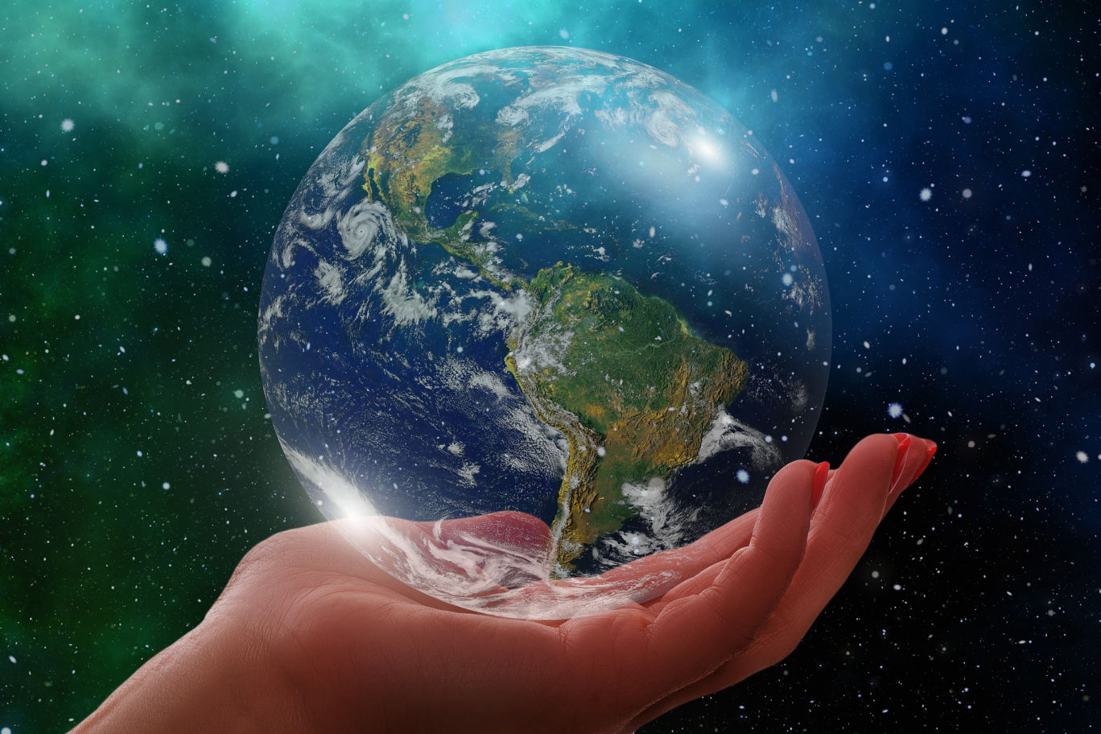
In the first 5 days of creation, God looked at His creation and said that it was good
On the sixth day God created the animals and mankind
At the end of the sixth day, God looked at His creation and said that it was very good
What was the difference?

Slide 6
What does God want for mankind?
We were created to multiply - to have children and populate the earth (verse 28)
We were created to look after the animals and the earth (verses 29,30)
We were created to worship God - Psalm 8:1-3 “Lord, our Lord, how majestic is your name in the whole earth!
You have set your glory in the heavens. You have made sure that children and infants praise you.”

Slide 7
God spoke to mankind. He didn’t speak to the animals. God wanted an intimate relationship with humans
Psalm 139:13-16 “You made all the delicate, inner parts of my body and knit me together in my mother’s womb. Thank you for making me so wonderfully complex! Your workmanship is marvellous—how well I know it. You watched me as I was being formed in utter seclusion, as I was woven together in the dark of the womb. You saw me before I was born.”

Slide 8
Ephesians 2:10 ”For we are God’s masterpiece. He has created us anew in Christ Jesus, so we can do the good things he planned for us long ago.”
God knew you at conception and He knows you throughout life – God cares for you
God created us for His pleasure and so that we, as His creation, would have the pleasure of knowing Him

Slide 9
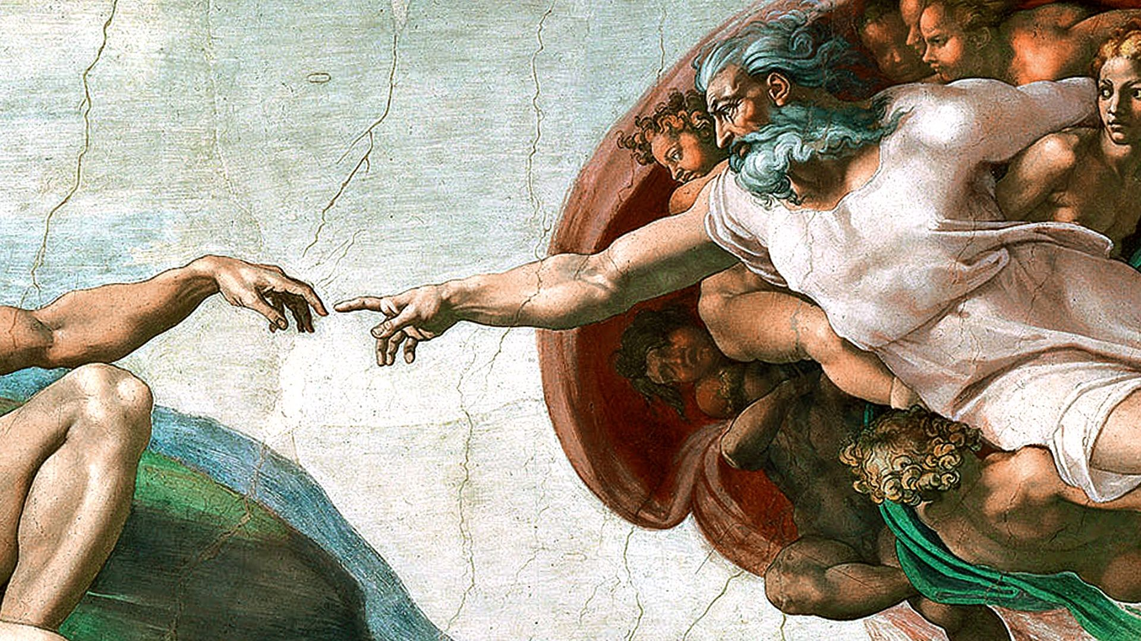
“And on the seventh day God finished his work that He had done, so He rested on the seventh day from all His work that He had done.” (2:2)
The Hebrew word used for rest is Shabat – stopped, ceased, rested.
Sabbath
Colossians 2:16-17
Therefore, do not let anyone judge you by what you eat or drink, or with regard to a religious festival, a New Moon celebration or a Sabbath day. These are a shadow of the things that were to come; the reality, however, is found in Christ.

Slide 10
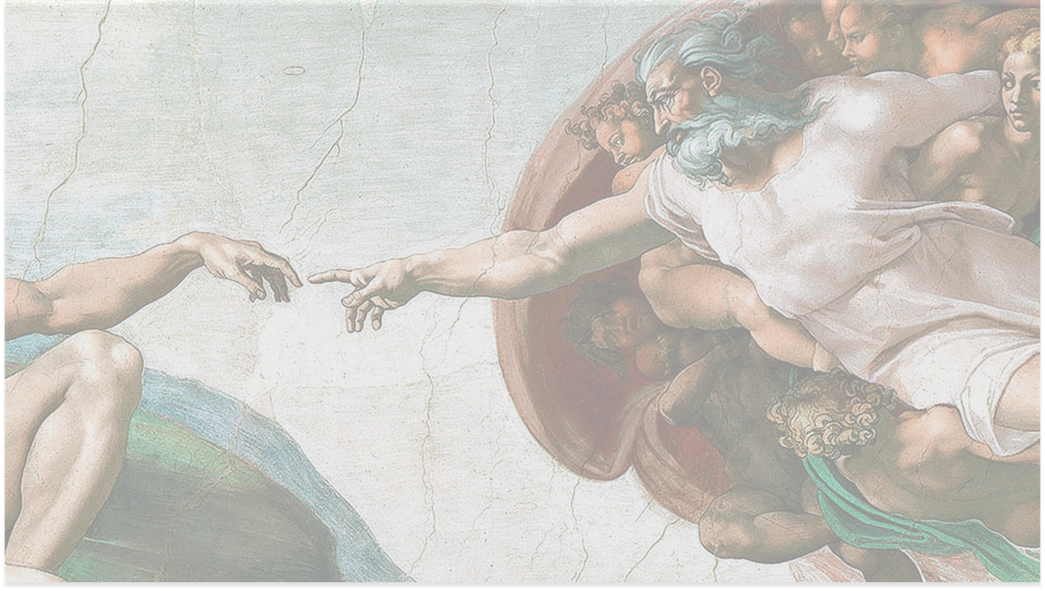
The first six days says there was evening and morning. There was an end to each day, but there was more to come.
There is no such statement on the seventh day.
God had finished,
His plan was finished,
His work was finished
John 19:28-30
Later, knowing that everything had now been finished ……… Jesus said, “It is finished.” With that, he bowed his head and gave up his spirit.

Slide 11
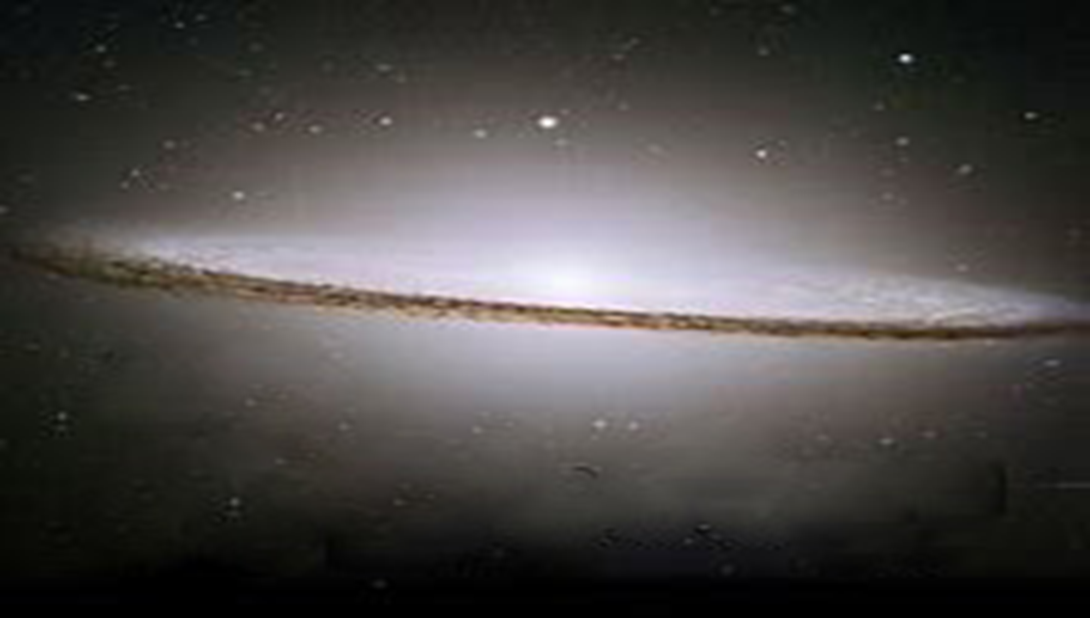
2 Timothy 1:9
For God saved us and called us to live a holy life. He did this, not because we deserved it, but because that was his plan from before the beginning of time—to show us his grace through Christ Jesus.
“Come to me, all who labour and are heavy laden, and I will give you rest. Take my yoke upon you, and learn from me, for I am gentle and lowly in heart, and you will find rest for your souls. For my yoke is easy, and my burden is light.”
Matthew 11:28-30

Slide 12
There was no stated end to 7th day of creation
Every day is a day of rest in the finished work of Jesus Christ. Every day is specially set apart to God
God wants us to fully depend on His provision and His plan for us, even if the world is swirling around us in constant chaos

Slide 13

How do we rest in Jesus?
There is no rest in Christ if you haven’t surrendered your life to Him. There is no re-creation, no being born again
The rest we have in Jesus is when we learn to trust Him at all times, in all circumstances and to recognise that He is always in control

Slide 14
“Do not be anxious about anything, but in everything, by prayer and petition, with thanksgiving, present your requests to God. And the peace of God, which transcends all understanding, will guard your hearts and your minds in Christ Jesus...the God of peace will be with you." Phil. 4:6-7, 9

Slide 15


