Slide 1
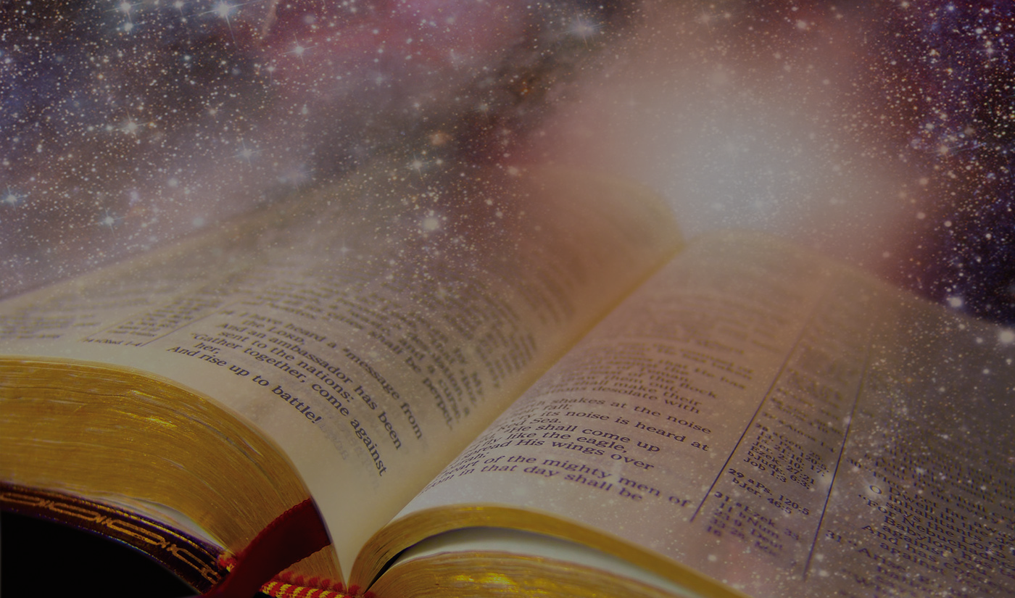
“The first sentence sets the tone for the rest of the book. It should open the reader’s mind, grab their attention and keep them reading.” (Stephen King - Author)
“Every ad, sales page, or blog post you write, must begin with one hell of an opening sentence.” (Robert Bruce – Marketing Guru)
“In the beginning God created the heavens and the earth.”
IN THE BEGINNING….
(BELIEVE IT OR ELSE)
Genesis 1:1-2, Romans 1:16-32
GOD GETS ANGRY
REASON
CONSEQUENCE
SOLUTION
Notes:
Stephen King, the famous horror, science fiction and fantasy author, has written over 60 novels and 200 short stories. And each time he sits down to write he said that he will spend weeks and even months making sure he gets the opening sentence right. The same standard is advised in the business world. Robert Bruce a marketing expert says that the opening sentence is everything when it comes to engaging clients and making an impact on the market. One of the most memorable opening sentences is found in the Bible, the greatest selling book in the history of the world. As we begin our journey into the first 11 chapters of Genesis we could be tempted to overlook these opening words as being just a simple introduction to far greater stories – or to even think that the real story is in the NT – the life of Christ. But this morning I want us to be mindful of how important these opening words are – how vital it is that we not just read or memorise these words, but that we grasp the depth of truth in these words. The extent to which we believe these words impacts on our life in this world and the life to come. In Romans 1 Paul tells us that failing to grasp these words makes God angry. He tells us why it makes him angry, how he responds in anger and the only solution we have to escaping his anger.

Slide 2
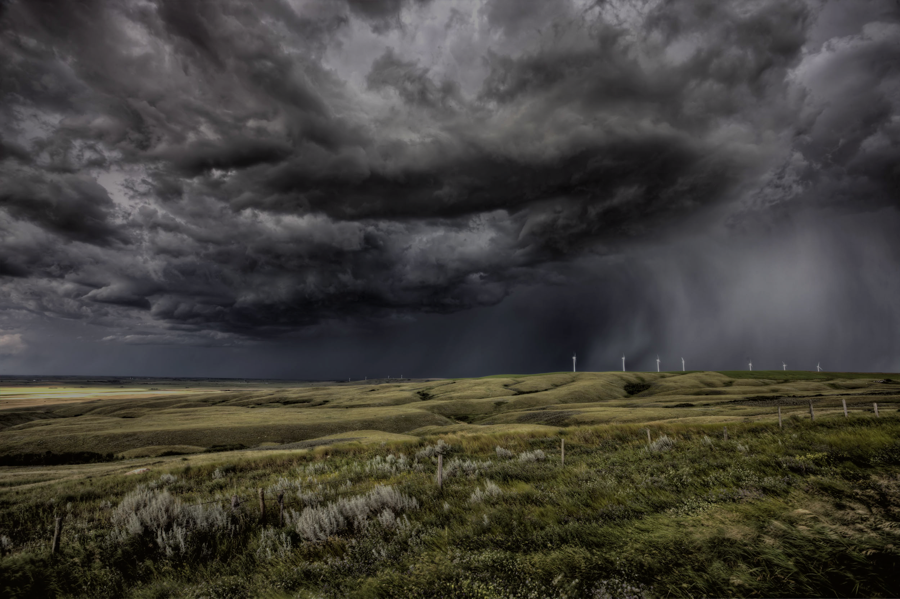
GOD GETS ANGRY – “But God shows his anger from heaven against all sinful, wicked people who suppress the truth by their wickedness.” (v18)
God’s measured, fair and right anger is a present reality = there is such a thing as the wrath of God.
“If you don’t understand or believe in the wrath of God, the gospel will not thrill you or move you.” (Tony Merida)
The target of God’s anger = all sinful (godless), wicked people. Godlessness (de-godding God) > wickedness (hurting others).
“You must love the Lord your God with all your heart, soul, and mind.’ …… ‘Love your neighbour as yourself….” (Matt 22:37-39)
Notes:
The first thing this verse reveals to us is that there is such a thing as the wrath of God. God shows his anger (holy anger, not a wild, emotional or irrational anger) = this is present reality. It doesn’t say God has shown or will show his anger. As much as he shows his love, grace and mercy and everyday, He is also showing his anger every day. While we may not like the idea of God’s wrath its important we understand its real. If God is not an angry God then why do we need the gospel, why Jesus, why the cross?
The target of Gods anger are those who reject Him, attack the majesty of God and who then hurt others (wickedness) The target is essentially all those who break the greatest commandments – the summary of God requirements for mankind.

Slide 3
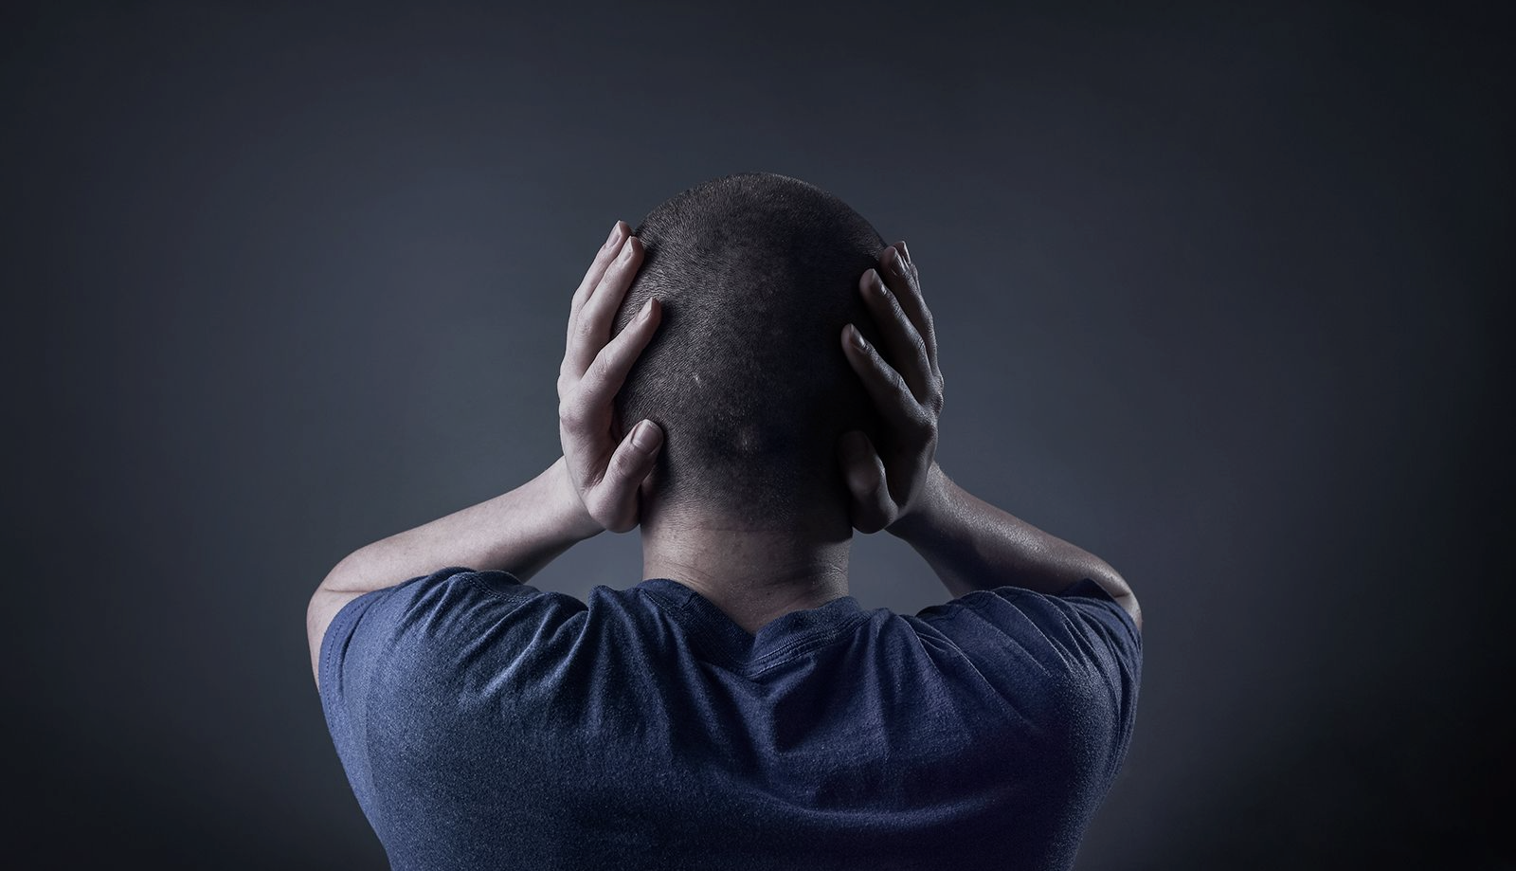
THE REASON FOR GOD’S WRATH
A. We suppress the truth – “They know the truth about God because he has made it obvious to them. For ever since the world was created, people have seen the earth and sky… they can clearly see God’s invisible qualities - his eternal power and divine nature…” (vs 18b -20a)
“So they have no excuse for not knowing God.” (v20b) They are morally, not mentally deficient = God holds us accountable.
The creation story is a dazzling lesson in theology = God alone is God and He is eternal + infinite + self-existent + creator + architect + life + all powerful + all-knowing + sovereign .
Notes:
You can’t suppress something unless you have it. Every human being knows about the qualities of God, but choose not to, Not because they don’t have the mental capacity but because they lack the moral capacity. The creation story reveals to us all of God’s invisible qualities. In the beginning there was only God (no other gods), he created time so he is eternal, such a power is too much for us to understand (Ps 145:3), his qualities are infinite – all powerful and all knowing (created and designed out of nothing), self existent doesn’t depend on anyone or anything to exist, giver of life (Acts 17:28), he made and designed it – he is in control (sovereign)

Slide 4
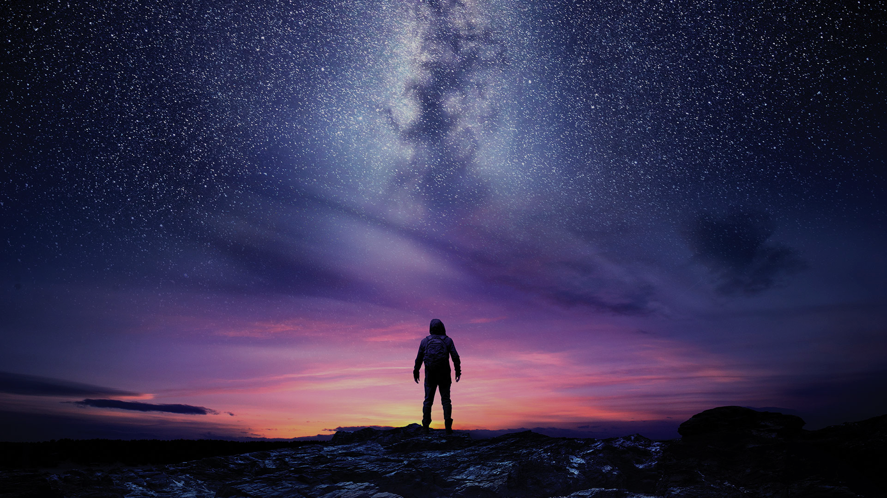
“In the beginning God created the heavens and the earth” =
The universe is God centred – it comes from & exists for Him.
I am his creature & everything I have is from Him.
I am not my own and I belong to Him.
He alone deserves our praise, obedience, honour and thanks.
BUT “The human heart is the most deceitful of all things, and desperately wicked. Who really knows how bad it is?” (Jer 17:9)
“In the beginning..” is too humbling. We want control = eliminate God with evolution = “Nobody times nothing equals everything.”
Notes:
The universe is God centred – from him and for him (Colossians 1:16). But because of our sinful heart we are threatened by the idea of a creator God. We want self determination and we want to be the centre of the universe and therefore we suppress the truth – exchange it for a lie. Rather believe that nobody times nothing = everything which is even harder to believe and justify

Slide 5
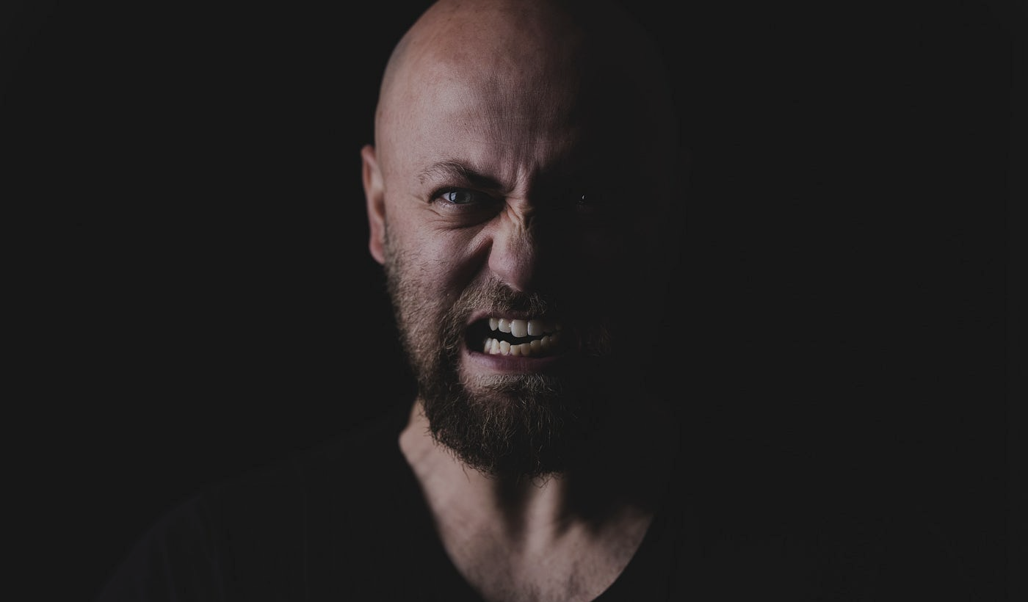
B. We fail to worship or thank God – “They knew God, but they wouldn’t worship him as God or even give him thanks..” (v21a)
Struggling to worship or thank God = we think we are self-sufficient (not utterly dependent on God) and we have control (can live the way we want) – that the universe is ‘me centred’.
“Our ingratitude is like plagiarism – taking someone else’s work and claiming it as your own. It’s not acknowledging dependence on another. It is claiming something that’s not true.” (Tim Keller)
C. We twist who God is – “They began to think up foolish ideas of what God was like.” (v21b)
Notes:
When you question, suppress and tinker with the truth of “In the beginning” it creates a heart that struggles to worship and give thanks to God. No worship or thanks is because we hate the idea that we are utterly dependent

Slide 6
Option 1 = the liberal, loving God = as long as I love everybody, I can live the way I want.
Option 2 = the demanding, religious God = yes there are moral absolutes, but as long as I work hard to obey and please God, he has to reward me.
Both options = you have control. Either you decide how to live or it’s up to you to earn your reward.
D. We replace God with idols – “.. they exchanged the glory of the immortal God for images made to look like a mortal human being and birds and animals and reptiles…. They exchanged the truth about God for a lie, and worshipped and served created things rather than the Creator…” (vs 23, 25)
Notes:
Two of the most popular ways we think up foolish ways of what God is like is either manufacturing God to be a loving God (and that’s all that matters) or a demanding God where we can make God owe us. If we are good enough we get to go to heaven.

Slide 7
The only two options for our human heart = you either acknowledge, worship and thank the creator God (none of us do without the power of the Spirit) or you acknowledge, worship a and thank a created thing.
“We all have to live for something. We all need something to capture the allegiance of our heart and where we can rest our hopes. We all yearn for something that will give our life worth value & purpose. Whatever that is, we worship.” (John Piper)
An idol is anything we love more than God = creation itself, food, mind, body, power, achievement, science, comfort, pleasure, human approval, relationships, family….

Slide 8
CONSEQUENCES FOR GOD’S WRATH = We get what we want.
“Therefore, God abandoned them to the sinful desires of their hearts.. & abandoned them to their foolish thinking..” (vs 23, 28)
“When the gods wish to punish us, they give us what we want.”
(Oscar Wilde)
“God takes away his restraints and gives us up to sink in the swamp we have chosen.”
(R Kent Hughes)
Every sin is rooted in our desire for control and to prefer something over God = sexual immorality, greed, hate, envy, murder, quarrelling, deception, malicious behaviour, gossip, pride, boasting, lying, no mercy…. (vs 29-31)
Notes:
The consequences of the wrath of God = we get what we want. The worst punishment of all is when God gives us the desires of our deceitful, wicked, foolish hearts. Every sin stems from our failure to honour the truth of “in the beginning”. Of not wanting God to have control and thinking that there is something greater than God. Look at those sins – they come about because we protect our idols, serving them (enslaved by them). Greed and envy = idol of materialism. Sexual immorality = idol of pleasure. Gossip, boasting, lying = idol of approval and achievement. Wanting to bring others down and lift yourself up, exaggeration to enhance your reputation etc.

Slide 9
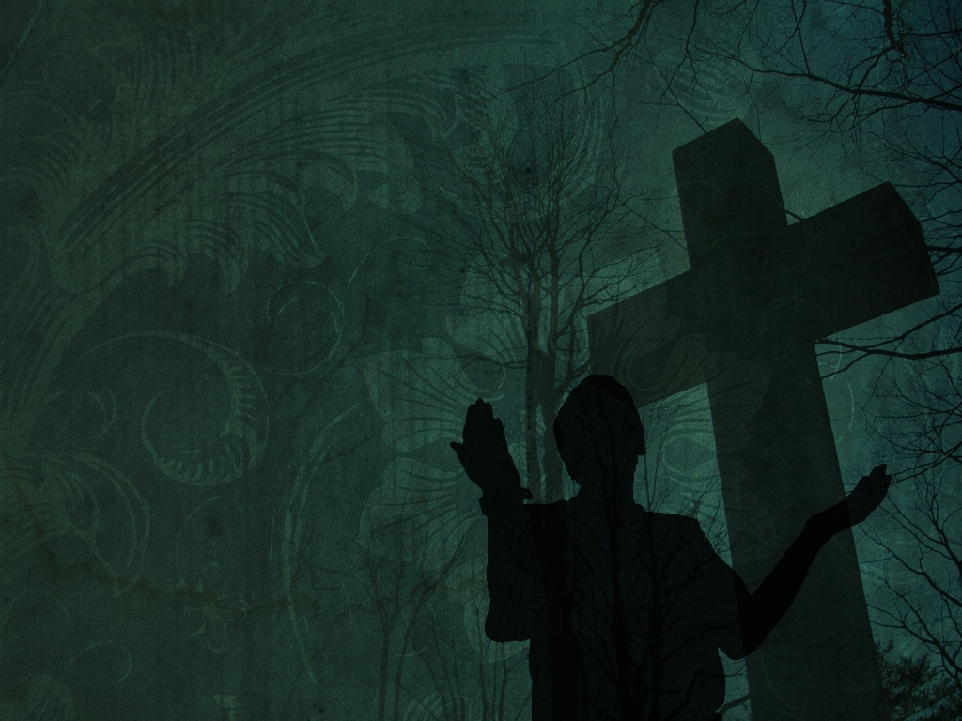
THE ONLY SOLUTION TO REVERSING GOD’S WRATH –
“For I am not ashamed of this Good News about Christ. It is the power of God at work, saving everyone who believes.. This Good News tells us how God makes us right in his sight. This is accomplished from start to finish by faith. As the Scriptures say, “It is through faith that a righteous person has life.” (vs 16-17)
A. Humble yourself before your Creator God - “No one is righteous, not even one. No one is truly wise; no one is seeking God. All have turned away; all have become useless. No one does good, not a single one.” (Rom 3:10-12)
Confess your sins (suppressing truth, no worship or thanks, replacing God) & admit you are utterly dependent on God.
Notes:
To find the solution we have to go back to verses 16-17. To begin with we have to humble ourselves before God. As much as Genesis 1:1-2 paints a picture of the majestry and awesomeness of God, Romans 3:10-12 paints a bleak picture of sinful man in God’s eyes.

Slide 10
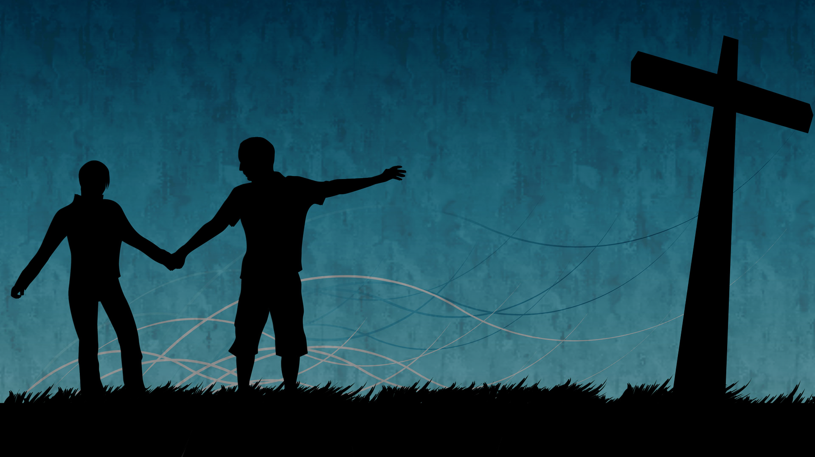
B. Run to our Creator God for mercy – in His grace He ”will never reject a broken and contrite heart.” (Psalm 51:17)
Even though we abandoned God & became His enemy, He was was willing to abandon Jesus on the cross, so we could be reconciled with Him & become His friends. (Rom 5:10, Matt 27:46)
C. Never fear the wrath and abandonment of God anymore - “There is no condemnation for those who belong to Christ Jesus. And.. nothing can ever separate us from God’s love. Neither death nor life, angels nor demons, fears nor worries… No power in the sky above or in the earth below - indeed, nothing in all creation will ever be able to separate us from the love of (our sovereign, Creator) God that is revealed in Christ Jesus our Lord.” (Rom 8:1, 38-39)
Notes:
His grace is greater – always sufficient. His love is greater than our rebellion. God is Creator – nothing in creation is greater than Him. Not even ourselves. He alone is sovereign

