Slide 1
REGISTERING AS A CHRISTIAN MENTOR
Name: |  | Age: (can be general)
Address:
Phone numbers: | Home: | Mobile:
email address:
Ministry experience:
Preferred Mentoring opportunity:
I would like to help people …
COMMENTS:

Slide 3
A HANDY TOOL

Slide 4
PLAN

Slide 5
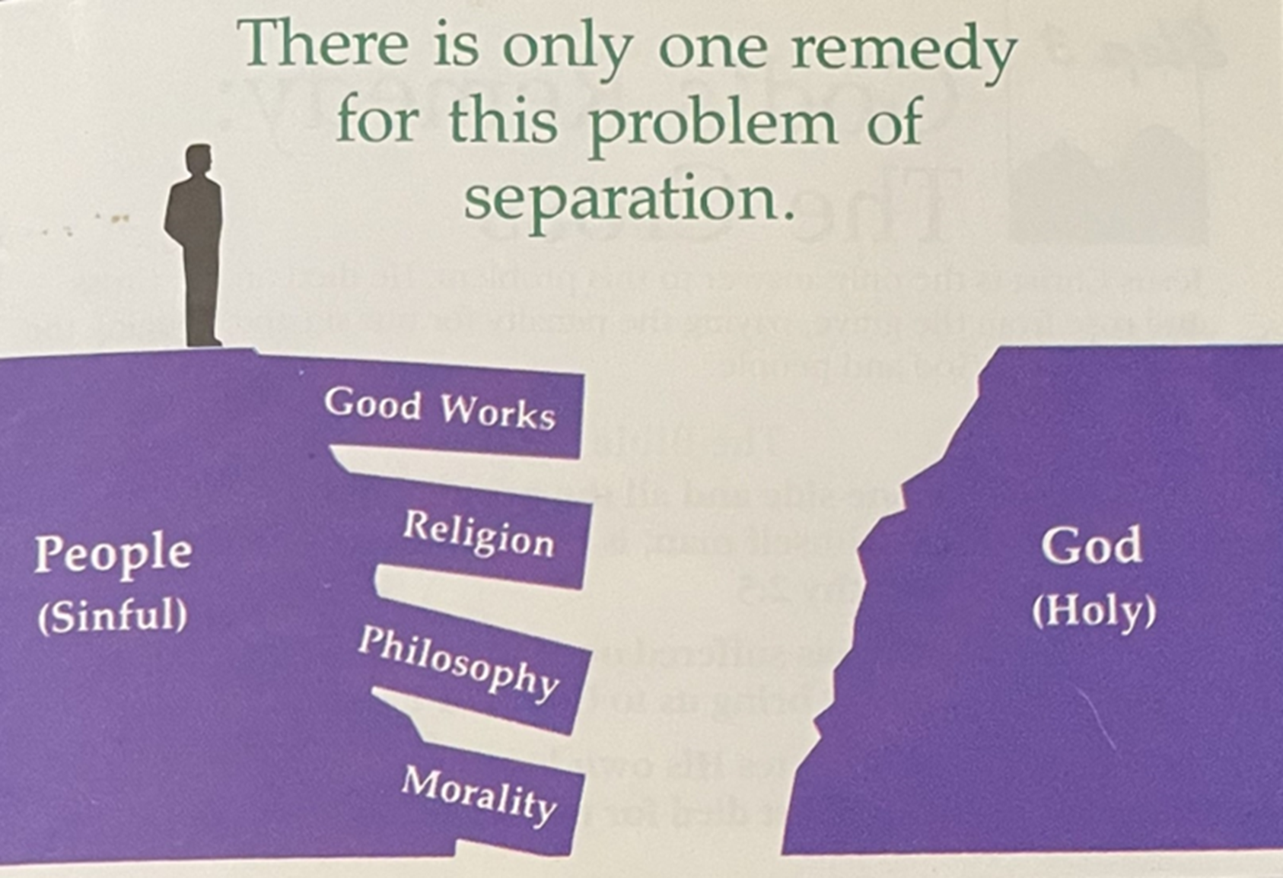
PROBLEM

Slide 6
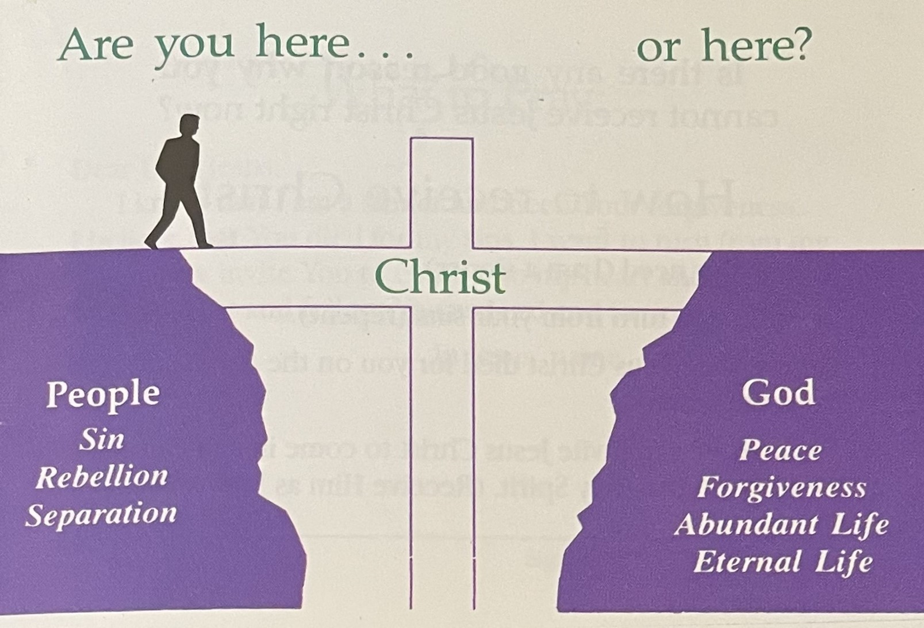
REMEDY

Slide 7
RESPONSE

Slide 8
…here’s HOW

