Slide 1

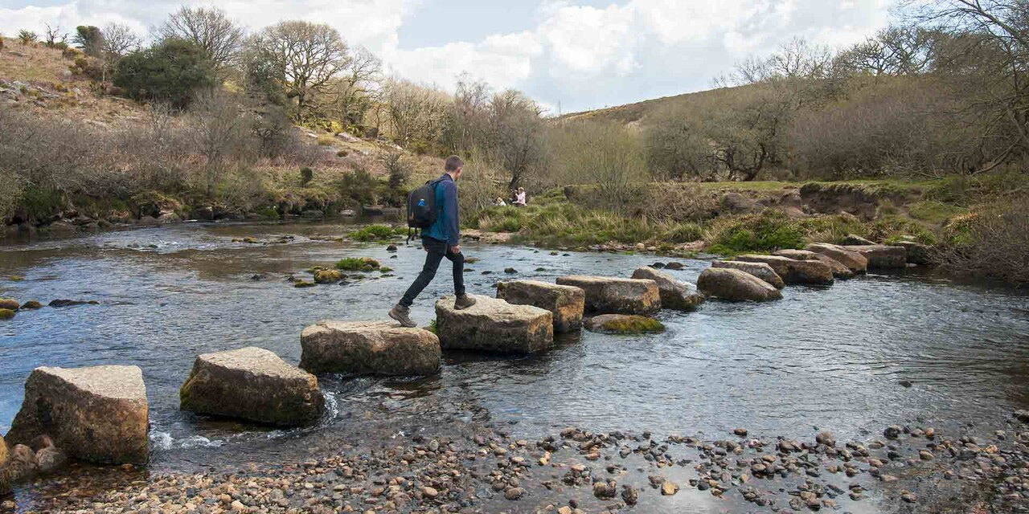
Stepping Stones to Spiritual Growth
What is the NEXT STEP?

Slide 2

"Therefore go and make disciples of all nations, baptising them in the name of the Father and of the Son and of the Holy Spirit and teaching them to obey everything I have commanded you. And surely I am with you always, to the very end of the age." [Mat 28:19-20]
go (lit. ‘going’), make disciples - the heart of evangelism.
baptising them - a key element of integrating people.
teaching them to obey - the foundation of discipleship /
mentoring.
I am with you always - the source of all spiritual blessings &
strength.

Slide 3
Jesus was clearly showing His followers that spiritual understanding and growth involves a personal developmental journey.
Its aim is maturing Christian character and service.
The purposes of the Church can be seen in five key areas:
Evangelism (Matt 28:19-20, Acts 1:8)
Fellowship (Matt 22:39, 1 John 4:21)
Worship (Matt 22:37-38, Rom 12:1)
Discipleship (Rom 8:29, 2 Tim 2:2)
Ministry (I Peter 4:10, Matt 20:26-28)

Slide 4
The best way we can assist folks who come to CBBC is by finding ‘where they are at’ and helping them to move closer to the Lord.
This plan must consider people at different stages of spiritual growth, from the unconverted through to the committed Christian.
On our spiritual journeys,
most of us move closer to the Lord one step at a time,
like walking across stepping stones in a stream
to reach the other side.

Slide 6
CONTACT… Welcome!
Look around you in the various groups and activities you are involved with: is there someone you can introduce yourself to or someone you can genuinely befriend?
ALL people need to know that they are genuinely welcome.
ALL people need to know they are accepted, they can belong (if they choose) and they are valued. This applies equally to Christian and
non-Christian contacts.

Slide 7
RELATIONSHIP… A new friend !
As you meet new people, there are many ways you can develop friendships:
Include them in what you (and the group) are doing
Share a cuppa at morning tea
Give them a call on the phone
Have them over for a meal or go out for coffee
People (usually) don’t care how much you know (about Christ) until they know how much you care
(about them as people)!

Slide 8
FELLOWSHIP… Come and join us!
Every group in OUR CHURCH is encouraged to run its own (fun) ‘fellowship’ times where new contacts are invited to join in!
Church-based activities / events:
Fun nights / concerts / bus trips
“Who’s coming to dinner?”
Ladies’ meetings and coffee
Men’s meetings / fishing / hikes
Picnics

Slide 10
CARE… Can we help you?
As a Church, we may be able to help relieve genuine needs:
Pantry
Emergency meals
Practical help
Transportation to hospitals / shopping
Many in our community today need helpful advice and guidance along with a caring environment in which to experience ‘healing’ from past ‘scars’.

Slide 11
STUDY… Can God help you?
Biblical counselling is offered to assist those facing trials / difficult times who wish to know God’s perspective on their situations.
OUR CHURCH will regularly offer study of God’s Word in the following areas:
Understanding Christianity / ALPHA
Growing as a CHRISTIAN
Equipping of The Saints

Slide 12
CHALLENGE… Come and consider!
OUR CHURCH will provide gatherings geared towards sharing the Gospel:
Dinners / breakfasts with a guest speaker
Evangelistic programs
CBBC Sunday services
Children’s programs
After-school meetings
Vacation Bible School
Soccer Club

Slide 13
WORSHIP… Come and worship!
While worship is primarily for believers, we should invite all to come and share with us, especially for special services such as at Christmas and Easter.
Invite your friends / family to Church

Slide 14
DISCIPLESHIP… Come and grow!
Every new and/or un-taught Christian should be offered ‘basic discipleship’ and opportunities to grow in their Christian life.
Basic Discipleship – follow-up
Discipleship for growth
Mentoring for leadership
People who have made a commitment to Christ should be invited and encouraged to grow
in personal understanding
of their faith.

Slide 15
HOME GROUP… Come and grow more!
General home groups exist for the purpose of helping people to deepen their understanding of God’s Word, to deepen relationships with a smaller group of Christians and to mutually support one another.
Every Christian, as far as possible, is encouraged to get involved in a home group.

Slide 16
SERVICE… Come and serve!
Serving the Lord (through Spiritual Gifts God has given) brings deep satisfaction and a necessary outlet for things learned from the Lord.
Every Christian, as far as possible, is encouraged to get involved in some form of Christian service in and through the Church.

Slide 18


