Slide 1
“Snow White is not going to be saved by a prince. She is not going to be dreaming about true love. She is going to be dreaming about being the fearless, fair and true leader that she knows she is.” (Rachel Zegler)
“We have heard the concerns of our consumers over our position on gender, the environment and other matters of public interest. We will use this time to reflect on the story of Snow White, and her prince, in the context of the 21st century.” (Bob Iger – Disney CEO)
Notes:
Disney is in the process of creating a live version of the film Snow White and the 7 Dwarves. But the movie has been hit by a few controversies. Firstly, it was felt that a modern remake couldn’t have dwarves because that would be offensive to those people who have dwarfism. So they thought about calling it Snow White and her 7 companions but it didn’t sound right. So they just decided to call it Snow White. But then the film was hit by another controversy when the actress playing Snow White, Rachel Zegler, let it slip that the story was being rewritten with regards to her being rescued by a prince. In this day and age women don’t need to be rescued. They don’t need a man, to live a meaningful life and to live happily ever after. She is going to be the leader she knows she is. Disney received more negative criticism about their continual efforts to politicise their movies and Disney decided to delay the movie until 2025. In fact Disney has been losing a lot of money in its streaming service and new release movies, facing a lot of flak from the movie going public. In response the Disney CEO, Bob Iger was forced to put out a statement to say that Disney was rethinking its stance on various issues and taking time to reflect on the role of the two central characters in Snow White – on the role of the prince and Snow White. In ever increasing number the church is also doing the same – increasing numbers questioning the role of the two central characters in God’s creation. What does it mean to be a man and a woman in the church in 21st century?

Slide 2
MEN, WOMEN AND THE FREEDOM TO MINISTER?
(1 Timothy 2:11-14)
WHAT ARE THE TWO VIEWS?
A ‘BIG’ CONTENTIOUS PASSAGE REGARDING MEN, WOMEN & MINISTRY
(TAKE A LOOK AT THE COMPLEMENTARIAN VIEW & THE EGALITARIAN CONCERNS)
Notes:
Looing at role in the church today, not so much the home, but they are the same roles.

Slide 3
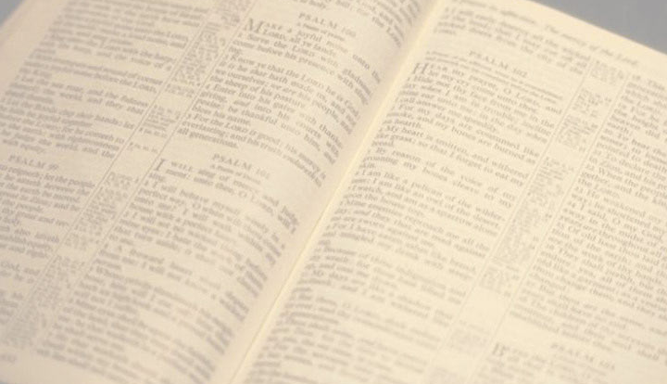
WHAT ARE THE TWO VIEWS?
Complimentary = useful & attractive together, to complete & enhance the quality of the other person.
Egalitarian = all people are equal & deserve equal rights & opportunities.
Agreement = men & women are created equally in the image of God + men & women are equal in dignity, worth and value + men & women should treat each other with kindness, compassion and love + women should be actively involved in ministry.
Disagreement = men and women, by God’s design, have been given ‘functionally different’ roles and responsibilities to fulfill in the home & the church = ‘headship’ & ‘submission’ are still true.
Notes:
What the are the two views? – both based on interpretation of scripture. Like any perspective, there are a number of ranges in those views. Some with the complimentary view will be more sexist, patriarchal, misogynistic, and some on egalitarian side will be driven by a more radical feminist agenda. Do some teach male headship and leadership because its all about holding onto power? Tragically yes. We all bring our biases into these debates and can all tainted by self serving motives but we need to base our position not on emotion but on God’s word. Some will be leaning to the middle and be cautious or careful complimentarians and egalitarians. I must admit that preparing this message has made me an even more convinced complementarian. But I have many friends, pastors, and there are great theologians who would disagree with me and I with them. Its important for us to embrace and articulate our view with passion but should always do it in love. This is not a salvation issue but its an important issue.
Complimentary – not compliment (say something is nice). Like tomato sauce and plain spaghetti, peanut paste and bread = complimentary view.
Egalitarian – all equal and deserve equal rights and opportunities.
Agreement – treat each other with kindness, compassion, no place for abuse, negligence or disregard of anyone (male or female). Can and should be actively involved in ministry.

Slide 4
A ‘BIG’ CONTENTIOUS PASSAGE REGARDING MEN, WOMEN AND MINISTRY – “Women should learn quietly and submissively. I do not let women teach men or have authority over them. Let them listen quietly. For God made Adam first, and afterward he made Eve. And it was not Adam who was deceived by Satan. The woman was deceived, and sin was the result. But women will be saved through childbearing, assuming they continue to live in faith, love, holiness, and modesty.” (vs 11-15)
The Bible won’t contradict itself – “All Scripture is inspired by God and is useful to teach us what is true and to make us realise what is wrong in our lives...(2 Timothy 3:16)
THE COMPLEMENTARIAN UNDERSTANDING OF THIS PASSAGE
Notes:
In some ways it is an easy passage to read, clear in its intent but it also has some difficult themes to comprehend. Before we start this journey we need to remember a few important truths. First, the Bible won’t contradict itself – its all inspired by God (not Paul’s opinion) and its perfect truth. Every time you claim a truth from a verse it has to match up with the rest of the Bible. If it fails that test, even in one instance, then the truth you claim to have is false.

Slide 5
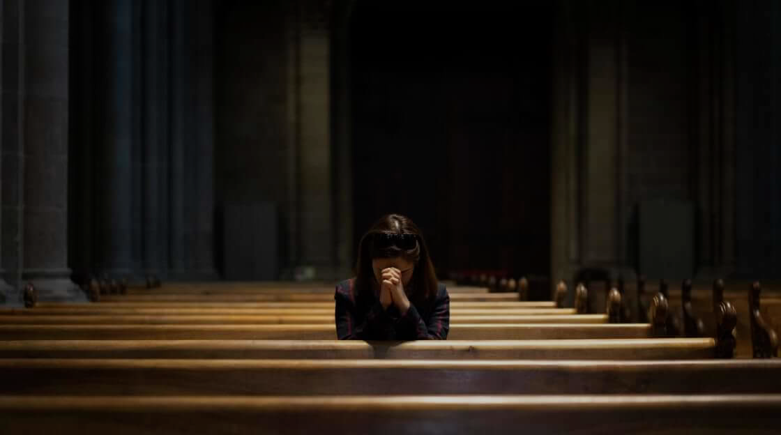
“Woman should learn…” = a radical, anti-cultural statement. It is right and good for women (and men) to learn the gospel, grow in their faith and enhance their Kingdom potential.
“Men have broad chests and narrow hips and have more understanding than women. Women have narrow chests and broad hips and to that end they should stay home, sit still, keep house and bear and bring up children.” (Martin Luther)
“…quietly and submissively.” Does not mean never open their mouth at church, ‘be seen and not heard’. Women prophesied, prayed and worshipped publicly in church (1 Cor 11:9, 13)
Quiet (hesuchia) used 2 other times in NT. “… live peaceful and quiet lives” (2:2) = be untroubled & content living a godly life.
Notes:
First, we see that Paul is not anti-women – starts on a very positive note that egalitarians are OK with. He starts by saying that women should learn in a time and culture where women were not encouraged to learn or progress themselves. They have much more to give than just giving birth. They have potential that God wants to use.
Please note that this is a quote from Martin Luther one of the great reformers. Both Jesus and Paul would disagree with that view.
Quietly – can’t mean never open their mouth in church because that’s would contradict what Paul is inspired by God to teach in 1 Corinthians 11. So to understand what it means we need to see how other verses use this word. Used two other times in NT. Firstly in 1 Tim 2:2. In this verse Paul urges the believers at Ephesus to pray for kings and everyone in authority and live peaceful and quiet lives.

Slide 6
“I do not let women teach men or have authority over them. Let them listen quietly.” (v12) = a quiet, contented, untroubled, godly life = joyfully submitting to (respecting & honouring) the teaching & authority of men who are called by God to shepherd His church.
“I do not let women teach men or have authority (authentain) over them.” = is not a blanket ban on women teaching. Women taught other women (Titus 2:3), children & family (2 Tim 3:14) & teamed up with their husband to teach pastors (Acts 18:26).
It’s a ban on having any teaching role that gives them authority over men. Such authority is given only to elders appointed by the Holy Spirit to teach, lead, nurture, guard & serve. (1 Tim 3:1-7, 1 Tim 5:17, Acts 20:28) = “a church leader must be a man…” (1 Tim 3:2)
Notes:
The second time Paul uses it is in verse 12. This time he is indicating that it is one of the opposite traits of living a godly, contented and untroubled Christian life. A quiet life for women is not striving to exercise authority over men. What does the word authority mean as it is only used this once in the NT – so open to debate. But I believe that in the context of the next few verses we get an answer from Paul. In chapter 3 he talks about the leaders of the church, those who have authority to teach, lead, guard etc and it must be a man. The Holy Spirit has given the primary responsibility of leading God’s people to servant hearted men. Not about coercing, forcing, dominating – but loving, building up, equipping, being a good example…Not having authority over a man means women can’t hold the role of elders.

Slide 7
“For God made Adam first, and afterward he made Eve. And it was not Adam who was deceived by Satan. The woman was deceived, and sin was the result.” = 2 reasons for male authority.
Created order – Both made in the image of God and equal in value (Gen 1:27) but - “…man was not made for woman, but woman was made for man.” (1 Cor 11:9) = Eve was a ‘helper’ for Adam (Gen 2:18) to surrender to, complete & enhance his authority.
The fall – not about Eve being more easily deceived. It’s all about the disastrous results of disregarding God’s design. Eve usurping authority (teaching and leading) and Adam abdicating his role and accepted her authority = Satan’s distortion of God’s design.
Notes:
The word helper appears 21 times in OT and 16 times refers to God being our helper = not meaning weak and powerless. Like when God helps us = more referring to our weakness and failings, same with Eve. Adam needed help – speaks more about his shortcomings than hers. God can’t bless us if we disregard his design – always leads to separation from God, sin and death. Not saying that God will curse every female pastor (he will often work through our failings as he works through mine) but it is still sinful disobedience and will lead to serious, horrible consequences.

Slide 8
“But women will be saved through childbearing, assuming they continue to live in faith, love, holiness, and modesty.”
Two things it doesn’t mean = there is no salvation in the birth of children (only in the death of Christ - Eph 2:8-9) + women don’t have to bear children (1 Cor 7:8).
Is it talking about the salvation that comes through the offspring of Eve (Gen 3:15) = Jesus?
Or does ‘childbearing’ = the universal example of the God given difference between men and women? “As women seek to keep and honour God’s design for their life, and not seek to take a man’s authority, they will more likely nurture a heart attitude that will invite salvation and all it’s blessings.” (R Kent Hughes)
Notes:
This is a tough verse to grasp. Once again though it can’t mean some things because they would contradict the Bible elsewhere. Not saying every women has to have children or that motherhood saves. Ephesians tells us that salvation is by grace alone through faith alone, not by anything we do so we can’t boast. It’s a gift from God. Paul also says it’s a good thing to be single – wouldn’t say that if it impacted salvation. It could mean a few things. One referring to salvation we can only get through Christ – the promised offspring of Eve who would defeat Satan? Or is it a reference to the one great reminder that men and woman have different roles and that women should live joyful contented lives in that different design and as they do that their heart will more likely to be filled with faith, love, holiness and modesty – to conquer the desire to control their husband (overcome the curse of the fall in Gen 3:16) I prefer that one.

Slide 9
THE EGALITARIAN UNDERSTANDING OF THIS PASSAGE
1. Paul was only prohibiting uneducated women from teaching with authority. Paul didn’t say ‘I do not let uneducated women’ but women in general + if lack of education was a concern it would have applied to men too + he would have concerns about them teaching anyone, not just men + he gives the reason in vs 13-14 (creation, not education).
2. It only applied to women who were teaching false doctrine and heresy. Not the reason Paul gave (again) + not the word for false teaching (used in 1 Tim 1:3-4) + if it was false teaching, he would have included men too (Hymenaeus, Alexander & Philetus were men named by Paul as false teachers in Ephesus)
Notes:
He gives the reason in verse 13-14. Its unwise to ignore the reason that is given in order to supply one that isn’t. He didn’t single out uneducated women or even married women as others suggest. This is all women – as was the previous verses relating to women dressing modestly for worship and not drawing attention to themselves.

Slide 10
3. We should be cautious about placing too much emphasis on the word for authority (authentain) as it is only used once in the NT. And it can mean to dominate, misuse or murder. Over 1934 words are used once in the NT but it doesn’t mean we can’t determine their meaning + there is a different word for dominate or misuse + Paul would not just be concerned with murdering men.
4. Paul’s command of “I do not let..” is a present tense verb meaning that this is a temporary command dealing with a specific situation in Ephesus. It is not relevant for us today. Present tense verbs can also have a timeless sense. Paul used present tense verbs to give us many important commands. “I plead with you to give your bodies to God…” (Rom 12:1), “I beg you to lead a life worthy of your calling..” (Eph 4:1)
Notes:
3. Paul was saying that a women should use her authority to dominate others or to murder. That word meaning murder was only found in a manuscript 900 years after gospel was finished.

Slide 11
5. There are many biblical examples of strong women leaders, with some having authority over men. Esther was a queen, Deborah a judge, Miriam and Huldah were prophets, Phoebe was a deacon, Priscilla was Paul’s co-worker, Mary Magdalene was an evangelist….. BUT NONE WERE PRIESTS OR ELDERS.
Women in ministry is not the problem. The problem is women in inappropriate ministry.
6. Headship and submission were not part of God’s original design. It is only a consequence of sin and Christ came to redeem us and reverse the effects of sin.
Genesis 1:27-28 = both male & female were created in his image, and both told to be fruitful, multiply, subdue and have dominion.
Notes:
Absolutely God gifts and calls women to serve in his kingdom. Jesus revolutionised and challenged the norms of the day. Women were important to Jesus ministry and the early church. The fact God used Mary to be the first witness to his resurrection = counter cultural because in those days a woman’s testimony had no value in court. She would never be regarded as a plausible witness. Yet God did use her. God calls and gifts women for ministry even for teaching and leadership – but not for spiritual authority and leadership in the church.

Slide 12
“I will sharpen the pain of your pregnancy, and in pain you will give birth. And you will desire to control your husband, but he will rule over you.” (Gen 3:16)
“There is no longer Jew or Gentile, slave or free, male & female. For you are all one in Christ Jesus.” (Gal 3:28)
Sin didn’t create manhood, womanhood, headship and submission – God did. Sin distorted God’s existing design.
Galations 3:28 = salvation, not gender equality & equal rights.
Headship was there before the fall. Adam was created first, given the role of tending the garden and naming the animals and given God’s commands regarding the garden – all before Eve arrived.
Notes:
A husband ruling over his wife only came in due to the fall. Galatians 3:28 shows that Jesus has reversed all that. Its not about headship and submission. We all have to submit to one another (Eph 5:21). But sin didn’t create the differences between genders – God did, He also created headship and submission. The context of Galatians is about the people in the church trying to rewrite the gospel – you have to be like a Jew (circumcision) if you want to be a Christian. Salvation is not about gender, status or heritage. Its all about Jesus. Galatians = Jesus reversing the curse of sin by defeating death – not creating gender equality.

Slide 13
Adam is deemed the representative head of the human race (1 Cor 15:22, 45-49), Adam named Eve, who God made for him, and the human race is called man, not woman.
Before sin, God ordained Adam to be a loving, caring, strong, selfless leader for Eve.
Before sin, God ordained Eve to help Adam and be a partner to support and honour his leadership and help him carry it through.
Both = the image of God & equal in value, but different in function.
Sin = biblical leadership was distorted (passive, abusive, selfish, immature & uncaring).
Sin = biblical submission, was distorted (manipulation, defiance & selfishness).

Slide 14
“This is not about male or female superiority, or about suitability for leadership or about power. This is about faithfulness to God’s Word and letting His will shape the life of the church, rather than the intrusive winds of culture. And make no mistake, if we don’t let the Bible do it, the culture will.” (Matt Chandler)
The Lord calls and equips us all (both men & women) to partner together to enhance our ministries here at CBBC – to be active in using our gifts in teaching, leading, evangelising, praying, administration, discipling, encouraging, caring….
The only ministry limit that God gives women = “I do not let women teach men or have authority over them.” = I do not permit a woman to be an elder/pastor. Equality does not = uniformity.
Notes:
Not about superiority or suitability – women can be more gifted than men, more passionate, better communicators, more intuitive, more caring – known fact that women read more than men , spend more time in prayer and devotions, there are more women attending church than men. But God has a design and he asks us to keep that design. The Trinity is that = three in one, all equal but with different roles. If Jesus is happy to submit to leadership and authority of God then so should we.

