Slide 1
THE GAME PLAN
Psalm 62
Notes:
Well good morning everyone.
This morning, I wanted to preach on a passage that would encourage all of us to take hope amidst the trials and uncertainties we are currently facing as a church right now with dad stepping down as Senior Pastor
Let me begin with a story of a Father and Son
“One day, while my son Zac and I were out in the country, climbing around in some cliffs, I heard a voice from above me yell, "Hey Dad! Catch me!"
I turned around to see Zac joyfully jumping off a rock straight at me. He had jumped and then yelled "Hey Dad!”
I became an instant circus act, catching him. We both fell to the ground. For a moment after I caught him I could hardly talk.
When I found my voice again I gasped in exasperation: "Zac! Can you give me one good reason why you did that???"
He responded with remarkable calmness: "Sure...because you're my Dad." His whole assurance was based in the fact that his father was trustworthy.
He could live life to the hilt because the father could be trusted. Isn't this even more true for a Christian?
Our game plan has not changed, all the years that dad has preached to us, he has constantly reminded us to trust in God and only God
Despite our change of circumstances, the game plan will not change, we will go forth trusting in God alone, our rock and our salvation, for our God goes before us

Slide 2
TRUST GOD ONLY
“For God alone my soul waits in silence; from him comes my salvation” (Psalm 62:1)
“He alone is my rock and my salvation, my fortress; I shall not be greatly shaken” (Psalm 62:2)
David knows that while he trusts in God he will not be greatly moved
Notes:
“For God alone my soul waits in silence; from him comes my salvation” (Psalm 62:1) - The Hebrew word for alone occurs 6 times in the first 9 verses, 4 of which are in relation to God - I think David is trying to make something very clear here, that our trust ought to be in God alone - For is that not the great doctrine of all of Scripture, that our salvation is by grace alone, through faith alone, in Christ alone - And so it is before God almighty that we are to wait in silence - Waiting in silence, literally means ‘to be silent’. Silence before God expresses openness unto Him, and dependence upon Him - And so, our soul's utmost desire ought to be for God alone, as we await His guidance, as we await Him to go before us
“He alone is my rock and my salvation, my fortress; I shall not be greatly shaken” (Psalm 62:2) - To describe God as a rock, causes me to cast my mind to some form of great rocky mountain range, with summits that pierce the clouds - And as we look, and gaze in wonder in awe, we see how firm, how unmoved it stands, it does not stray, but withstands the test of time - And so it is with God, that if our trust is in God Almighty, the one who makes the thunders roar, who makes the waves rage, who is the Alpha and the Omega, and knows the beginning from the end, we know our trust is not in vain - Our God is sure, immovable and unchanging. Just as we have trusted God over the many years of our lives, and the many years collectively as a church, it is in Him, that even though things seem uncertain, we can, and we must continue to trust in God alone
David knows that while he trusts in God he will not be greatly moved - Like a ship at sea, with its anchor having gone down deep into the sea, firmly embedded. He knows that he may swing with the tide, but he will not be swept away by the storms of life - For if you know assuredly that the Lord is your salvation, you cannot be greatly shaken, and swept away from God, your rock, your anchor, and your salvation - For He will protect you, and it is He who fights and ultimately wins for you

Slide 3
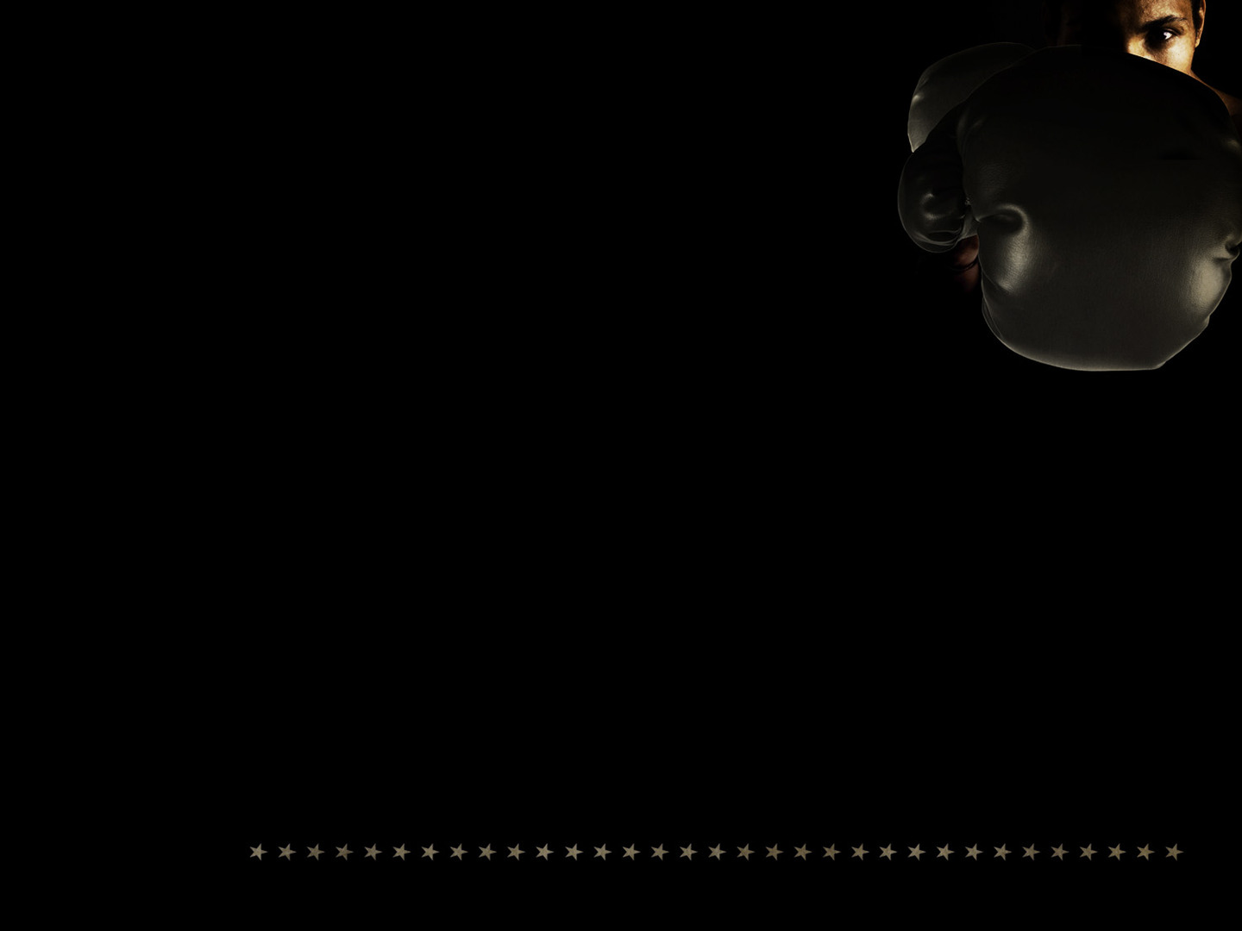
“How long will all of you attack a man… They only plan to thrust him down from his high position” (Psalm 62:3,4)
David’s mind does not dwell on his strength and weaknesses, on the strategies of the wicked, or on his dire circumstances
We find in God all we need, so let us make Him the ONLY object of our trust
Notes:
“How long will all of you attack a man… They only plan to thrust him down from his high position” (Psalm 62:3,4) - It appears there are people trying to attack David’s reputation, trying to bring him down from his position of king, by speaking lies about him - In front of David they bless him and speak well of him, but behind his back they speak ill of him, and seek to topple him off his throne - Friends, brothers and sisters in Christ, this will be a time when Satan will seek to get a foothold - This will be a time when Satan will try and get us to take our eyes off Jesus. He will do whatever it takes to see God’s people suffer, whether it be from the inside through division, or attacking us from the outside - But let us not give in. Let us continue to come together for the building up of one another, let us love another as Christ has loved us - Even if hell makes war, we will trust the Lord, for the gates of hell will not prevail, for in Christ we are more than conquerors, Christ has crushed the serpent, and death has lost its sting - So let us put on the whole armour of God, let us trust in God our rock, our salvation, and our mighty fortress. If God is for us, then who can be against us!
David’s mind does not dwell on his strength and weaknesses, on the strategies of the wicked, or on his dire circumstances - It would be very easy for David to become down, and depressed over what is happening around him, but instead, through the prompting of the Holy Spirit, he is directed towards his heavenly Father - I know that everyone would have mixed emotions with dad leaving, so let us get alongside one another. - Let us mourn with one another, let us encourage one another, let us pray with one another, let us REMEMBER all the times that God has provided for us, and let us REMEMBER the hope we have in Christ, the hope of eternal glory - And as we reflect on these things we will see that our God is the same yesterday, today and forever
We find in God all we need, so let us make Him the only object of our trust - No person can look at two objects at the same time and see both distinctly - As we turn our eyes to Jesus, and fix our hearts on doing only what pleases Him, and brings him glory, we will find our very souls begin to experience the peace that surpasses all understanding - So together, we will trust God alone

Slide 4
TRUST GOD ALWAYS
“For God alone, O my soul, wait in silence, for my hope is from him” (Psalm 62:5)
“He only is my rock and my salvation, my fortress; I shall not be shaken” (Psalm 62:6)
“On God rests my salvation and my glory; my mighty rock, my refuge is God” (Psalm 62:7)
Notes:
“For God alone, O my soul, wait in silence, for my hope is from him” (Psalm 62:5) - Throughout this Psalm you will notice a lot of repetition, but this is very deliberate, very intentional, to make the main point the main point - Whilst this verse is very similar to verse 1, there is a slight difference, and it shifts the emphasis - David now, with the waves getting higher around him, and the people around him are turning their backs on him, he looks inward and upward - He presses deeper into God, His rock and salvation, and cries out to his soul, to keep its eyes fixed on his only hope, the Rock of Ages - And so we must always preach to ourself first, - As a pastor this is something that God is constantly reminding me of, that whenever I preach, whenever I prepare a sermon, I always find myself moved and convicted by the Holy Spirit and reminded where my help comes from, before I even set a foot on this stage. - Every sermon that I preach before you is first preached to myself - The best sermons are ones preached with humility, and the understanding that I am a but poor sinner preaching to sinners. A dying man preaching unto dying people - That is exactly what David is doing here, in desperation he begs that he would find himself open and humble before the presence of God, because He sees that his only hope in the world can be found in God
“He only is my rock and salvation, my fortress; I shall not be shaken” (Psalm 62:6) - This is a Psalm of confidence and if you look closely, it’s almost as though you can see David’s confidence growing with every stanza of this Psalm - In verse 2, David knew that while he trusted in the Lord he would not be GREATLY shaken. And yet now that it seems as though evil may win, by the grace of God it causes David to throw himself further into the loving arms of God - Because now he knows that he WILL NOT be shaken. There is nothing that Satan can do to snatch him out of the hands of God - Trials give us the opportunity to grow in our dependence upon God, that’s why James tells us to consider it pure joy when trials come our way - And so it is my prayer that as the fog of uncertainty lies ahead of us, that collectively, as the body of Christ, we will grow in our dependence upon God, that we would be made stronger in the gospel of our Lord Jesus Christ, and that we would not be shaken!
“On God rests my salvation and my glory; my mighty rock, my refuge is God” (Psalm 62:7) - This Psalm begs the question though, how can David be this confident? - Well, the answer is, the more we take our eyes off this world and ourselves, and instead steer our hearts and mind towards God, the more we see just how little the world can do to us while we are safe in the arms of our heavenly Father - You see the more we live as we were created to live, that is glorifying God in all that we do, the less people can do to you - It’s like in the book of Acts when the Apostles were getting into trouble for proclaiming the gospel, and the authorities realised that the Apostles were not concerned with the consequences that they may give them, for even death did not phase them - For them, to live is Christ and to die is gain - As we hide ourselves in the rock of ages, and live as a people concerned with God and doing His will, and not our own - We too, will quickly find that the burdens of this world will not so easily entangle us, because we live not for this world, but for the next, because “On God rests my salvation and my glory… He is my refuge”

Slide 5
“Trust in him at all times, O people” (Psalm 62:8a)
”Pour out your heart before him, God is a refuge for us” (Psalm 62:8b)
Coolum Beach Baptist, God will not fail us, and so, may we trust Him always
Notes:
“Trust in him at all times, O people” (Psalm 62:8a) - And so now that David has preached to himself, he directs his message to the people - What David has found to be true for him he knows must be true for others. - What God has been for him, He can be for others, and so exhorts us to trust in God
”Pour out your hearts before him, God is a refuge for us” (Psalm 62:8b) - The word for pour is used to express your true self in openness and vulnerability to God - It is to confess your sins to him knowing that He is faithful and just to forgive because of the finished work of Jesus Christ - It is to bring all your troubles, your fears and your needs before Him, knowing that He hears every single one of your prayers - It is to praise God for all His blessings that He bestows upon us and to magnify His holy name for God is a refuge for us
Coolum Beach Baptist, God will not fail us, and so, may we trust Him always - Let us trust in God alone, and let us trust Him always - Let us today be reminded that we serve a faithful God who by His power and grace has sustained us, and preserved us, all the while making us more like His Son Jesus Christ - And yet let us be reminded that God is not finished with us, that He works all things together for the good of those who love Him

Slide 6
TRUST GOD NOT MAN
”Those of low estate are but a breath, those of high estate are but a delusion” (Psalm 62:9a)
“In the balances they go up; they are together lighter than a breath” (Psalm 62:9b)
“Put no trust in extortion…robbery…riches” (Psalm 62:10)
Notes:
“Those of low estate are but a breath, those of high estate are but a delusion” (Psalm 62:9a) - The word for breath here is the word translated vanity in Ecclesiates, or meaningless, and the word for delusion is lie - Those of low estate are but a breath, here today and gone tomorrow, and those of high rank are but a lie, not what they appear to be - This is ultimately saying that we have nothing to fear of mankind, they have nothing to offer us that we cannot find in God
“In the balances they go up; they are together lighter than a breath” (Psalm 62:9b) - When mankind is placed on the scales to determine their weight , they are less than vapour, there is nothing there - And if you put your problems, your very souls on one side of the scales, and you choose to place your trust in man, and you place that on the other side of the scales - You will quickly discover that what humans can do is utterly insufficient to meet the needs of your soul
“Put no trust in extortion… robbery… riches” (Psalm 62:10) - If it is true that even humanity at its best isn’t able to save us, it is even more true that at its sinful worst, it should be shunned - God alone is unfailing, God alone can meet the needs of your soul

Slide 7
“Once God has spoken, twice have I heard this: that power belongs to God” (Psalm 62:11)
“and that to you, O Lord, belongs steadfast love. For you will render to a man according to his work” (Psalm 62:12)
Man neither helps nor rewards, but God does both
Notes:
“Once God has spoken, twice have I heard this: that power belongs to God” (Psalm 62:11) - God has spoken something important enough that David has needed to come back and remind himself of it - This is how it ought to be for us as followers of Jesus Christ, that we keep coming back to remind ourselves of what God has spoken in His Word - The first thing that David reminds himself of, is that power belongs to God - That God is ABLE to save all who will call upon His name
“and that to you, O Lord, belongs steadfast love. For you will render to a man according to his work” (Psalm 62:12) - The word for steadfast love is the word used for covenant love, hesed, - Which tells reader, that because of the covenant established through the death of His one and only Son, Jesus Christ, He will continually love and remain faithful to all those who have believed in Jesus Christ as Lord and Saviour - Not only does He have the power to save, but has demonstrated that He is willing to save by sending His one and only Son through whom is the only way in which we may be saved - And so if we now go back to the scales and place our soul on one side of the scales and the cross of Jesus Christ on the other side, we see that there is no weight he cannot lift, no burden He cannot bear, no circumstance He cannot handle, and no attack which He is unable to defend - Mercy and steadfast love is a promise for all who belong to God through faith in Jesus Christ
Man neither helps nor rewards, but God does both - Do not look to humanity for your help, do not place your trust in the things of this world, for it is but a breath. You will find no reward if that is where your help lies - We know that we are not saved by our good works, but saved unto God works - For our good works do not produce the gospel, our salvation, but rather it is the gospel, it is the power of God at work in us that produces the good works. - Trust only in God, not in people, and you will find all that you need

Slide 8
GOD WILL PROVIDE
“Because he holds fast to me in love, I will deliver him; I will protect him, because he knows my name” (Psalm 91:14)
“When he calls to me, I will answer him; I will be with him in trouble; I will rescue him and honour him” (Psalm 91:15)
“With long life I will satisfy him and show him my salvation” (Psalm 91:16)
Notes:
”Because he holds fast to me in love, I will deliver him; I will protect him, because he knows my name” (Psalm 91:14) - For those who trust in God alone, He gives three promises - The first is a promise of deliverance, a promise that He will protect - John Calvin, the famous reformer put it like this, “God does not promise believers a life of ease and luxury, but deliverance from their tribulations” - Notice it does not say, that whoever is without sin, whoever is worthy and keeps my Word perfectly, those people will be delivered and guarded. - No, it is simply given to those who hold fast to God in love, those who live a life tethered to the cross of Jesus Christ
”When he calls to me, I will answer him; I will be with him in trouble; I will rescue him and honour him” (Psalm 91:15) - Whilst God is our warrior God, our delivering God, we get the image of a loving parent in this particular verse - Charles Spurgeon puts it like this, “The parent hears the slightest moan, rushes to the side of the cradle, takes the child in their arms, kisses its lips, and drops a tear upon its face, asking, ‘What can I do for you my child’ - So it is with the way the Lord deals with His children who have been paid for by the precious blood of His Son Jesus Christ - God hears our prayers, He answers our prayers in accordance with His will, and He will rescue us
“With long life I will satisfy him and show him my salvation” (Psalm 91:16) - Now a long life often symbolised blessings from God - And so, when our satisfaction rests in the presence and provision of God, our souls long not so much for more days in this world, but increasingly for the enjoyment of the glories of heaven with God - God promises to those who call upon His name, “I will deliver them, I will protect them” - Let this serve as our motto for a life of peace, a life of contentment in the arms of our heavenly Father

Slide 9
SUMMARY
God alone is our hope, our rock, and our salvation
In God alone, we can ALWAYS trust
Because it is God alone who will never forsake us
Notes:
God alone is our hope, our rock, and our salvation - There is only one answer to a life of true contentment and it is found in God alone - There is only answer to get through the troubles and trials and uncertainties of life, and it is found in God alone - There is only one answer for us being saved from our sin, that we may enter into the joy of our master, and it is found in God alone
In God alone, we can ALWAYS trust - Come, cast your burden unto the Lord, He has not failed you, nor will He ever fail you - Come, rest in God, your enemies may be mighty, but He is Almighty. Your troubles may be great, but He is greater - And so in God alone, we can always trust…
Because it is God alone who will never forsake us - I am reminded of that great passage in Romans 8: 38-39 – “For I am sure that neither death nor life, nor angels nor rulers, nor things present, nor things to come, nor powers, nor height nor depth, nor anything else in all creation, will be able to separate us from the love of God in Christ Jesus” - He alone is our rock and our salvation, our fortress, and in Him we shall not be shaken

Slide 10
“Trust Him when dark doubts assail thee,
Trust Him when thy strength is small,
Trust Him when to simply trust Him
Seems the hardest thing of all.
Trust Him, He is ever faithful,
Trust Him, for his will is best,
Trust Him, for the heart of Jesus
Is the only place of rest.” - Unknown
Notes:
Let us trust in Him at all times
Pour out your heart before Him, for He hears us, and He will deliver us and He will protect us
For it is in God alone, our rock, our refuge, and our salvation, that we find all that we need
Let us pray

