Slide 1
“Sometimes the things we think are bad, are only bad to us. God has a very different perspective.” (Bill Fong)
THE CHRISTIAN’S
BILL FONG
(Romans 8:15-30)
5 THINGS ABOUT THE GREAT PROMISE GOD GIVES US
3 THINGS IT MEANS FOR US
Notes:
On the night of 18th January 2010, Bill Fong, an amateur bowler, was only three bowls away from greatness. Greatness in the world of ten pin bowling = 3 consecutive perfect games (36 strikes in a row) = 900 points. Only 21 perfect scores of 900 have ever been recorded in the history of bowling. After 2 perfect games and bowling 33 consecutive strikes, a crowd began to gather around Bill’s lane, cheering him in with each bowl. Sweating profusely and feeling a little dizzy, Bill went on to make a strike in his 34th and 35th bowls. He was now one roll away from history. Eying the pins off, he took his usual five steps towards the line and let his ball go. It seemed to be on the perfect trajectory and both Bill and the crowd held their breath. The ball smashed into the middle pins knocking 9 down and leaving the tenth pin wobbling. As everyone watched and willed for that tenth pin to fall it stopped wobbling and stayed upright. 899 – one short of perfection. Heartbroken Bill headed home and as he was driving to his home he noticed that the sweating and dizziness he had experienced at the bowling alley was now getting more intense. On arriving at his home he went to his bathroom and vomited, before collapsing unconscious on the floor. When he awoke he was in a hospital bed and doctors told him that he had suffered a stroke. A few days later he would require open heart surgery at the age of 46 and given only 30% chance of living. He did survive and fully recovered and the doctors said the only reason he did make it was because he missed that last pin. If he had knocked it down and achieved the perfect score, the doctors believe that his blood pressure would have increased dramatically during his stroke and he would have died immediately. What Bill thought was the worst thing that could have happened to him, was actually the thing that saved his life. He would later say, “Sometimes the things…”
Like Bill we have all experienced bad things in our life – perhaps going through them now. Finance, relationship, career, health issues, war, pandemics, uncertainty, consequences of our bad decisions and living in a fallen, sinful world. Many of know that 2024 will probably not be a totally happy year. But for the Christian, God has given us a promise that allows us to find happiness and joy no matter what circumstances we face. So this morning I want us to take a close look at this promise (look at 5 truths) and see what difference it makes in our life and in 2024.

Slide 2
GOD’S PROMISE TO US = “And we know that God causes everything to work together for the good of those who love God and are called according to his purpose for them.” (v28)
1. IT’S A DEFINITIVE PROMISE – “And we know…” It’s not a feeling, suggestion, possibility or fantasy. It is beyond doubt!
We know every part of our life is in God’s hands + He uses all things for his glory & our ultimate blessing + nothing can touch us unless it passes through God’s will + God has a perfect plan for our life.
We don’t know what to always pray for (v26) = we don’t know why everything happens. But we know God controls everything.
Notes:
1. Its definitive – we live in a world that says we can’t know truth. We live in a world ruled where truth and knowledge is not as important as personal feelings and opinions. If I feel that way, then it must be true – at least for me. There is no such thing as absolute truth and to claim there is to be narrow minded and intolerant. Paul uses the phrase ”we know” five times in the book of Romans and every time it means that it is beyond doubt, an irrefutable fact. Its interesting to note that Paul doesn’t say that we know all things (everything). There are things we don’t know. In verse 26 he tells us that we don’t always know what to pray, and thus need the Holy Spirit’s help in our weakness (v26). Why don’t we always know what to pray? Because we don’t always understand why things are happening to us – we struggle to see any possible good and blessing in some things that God allows. But one thing we do know is that God is in control and has a perfect plan.

Slide 3
2. IT’S A DIVINELY DEPENDANT PROMISE – “… that God causes (works)…” = He is sovereign over all and making things happen. He is ceaselessly, passionately and intentionally working for us.
“Since the world began, no ear has heard and no eye has seen a God like you, who works for those who wait for him!” (Isa 64:4)
“God has to work for us because we can’t do it ourselves. We are bankrupt and need a bailout. We are weak and need someone strong. We are foolish and need someone wise. We are lost and need a rescuer.” (John Piper)
“Romans 8:28 doesn’t work unless God is working.” (David Jeremiah)
God must get the glory & praise, not us.
Notes:
2. It’s divine promises – to say that God works for us is not belittling to God. Muslims hate the idea of God working for us and God becoming a man to save us. To them, and other religions, such a notion about God is offensive – it belittles God and elevates us. But that is a misunderstanding we must avoid. This is another reason that proves God is unique. In all other religions their gods say that we (mankind) have to do the work ourselves. It’s up to us as to what good happens in our life. But God says that we can’t do it ourselves. He has to work for us because we are bankrupt and need a bailout. I am weak and need someone strong. I am endangered and need a protector. I am foolish and need someone wise. I am lost and need a Rescuer. ” God working for us is not belittling to God. It actually reminds us of why he has to get all the glory and praise – not us.

Slide 4
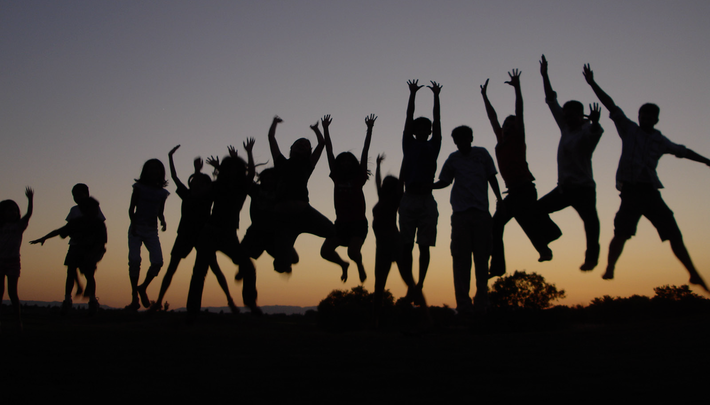
3. IT’S A DEFINITIVE PROMISE - “…everything (all things)..”
“Everything he sends us is necessary. Anything he withholds from us is not necessary.” (John Newton)
‘Everything’ = God takes all things (good, mundane & horrible) that he allows in our life and turns them into our ultimate good.
Good things = if our life is going well, its because God is doing that. If you are healthy, have someone to love you, have a home, have a job, have savings etc = God is causing that. Don’t take them for granted! Acknowledge God, rejoice & be thankful.
Mundane things = God is working even in those, unremarkable, ordinary moments of our life. Don’t underestimate those times.
Notes:
3. It’s a definitive promises – God causes, works in everything (all things). It includes everything that goes on in our life. It also highlights that Christians go through the same things that non-Christians go through. This squashes any notion that because we become Christians we don’t go through terrible things like non-believers or that our lives will only be good and will always be living life on the edge for God.
Good things – often a time where we forget about God and claim all the credit. But if God is truly working through all things then he is causing all your good things as well. Any blessing you have is from God – acknowledge that and give thanks. Ask God how he can use those things to change you – bring ultimate good into your life.
Mundane things – this is those moments in between the mountains and the valleys, the good and the bad. This is those moment which we regard as being unremarkable and forgettable (cooking, cleaning, serving in ministry, brewing coffee, setting up soccer fields, watching TV, helping the next door neighbour, looking after the grandkids….,) God is using them to transform us too. Even in those moments where you think no one is watching, God is working.

Slide 5
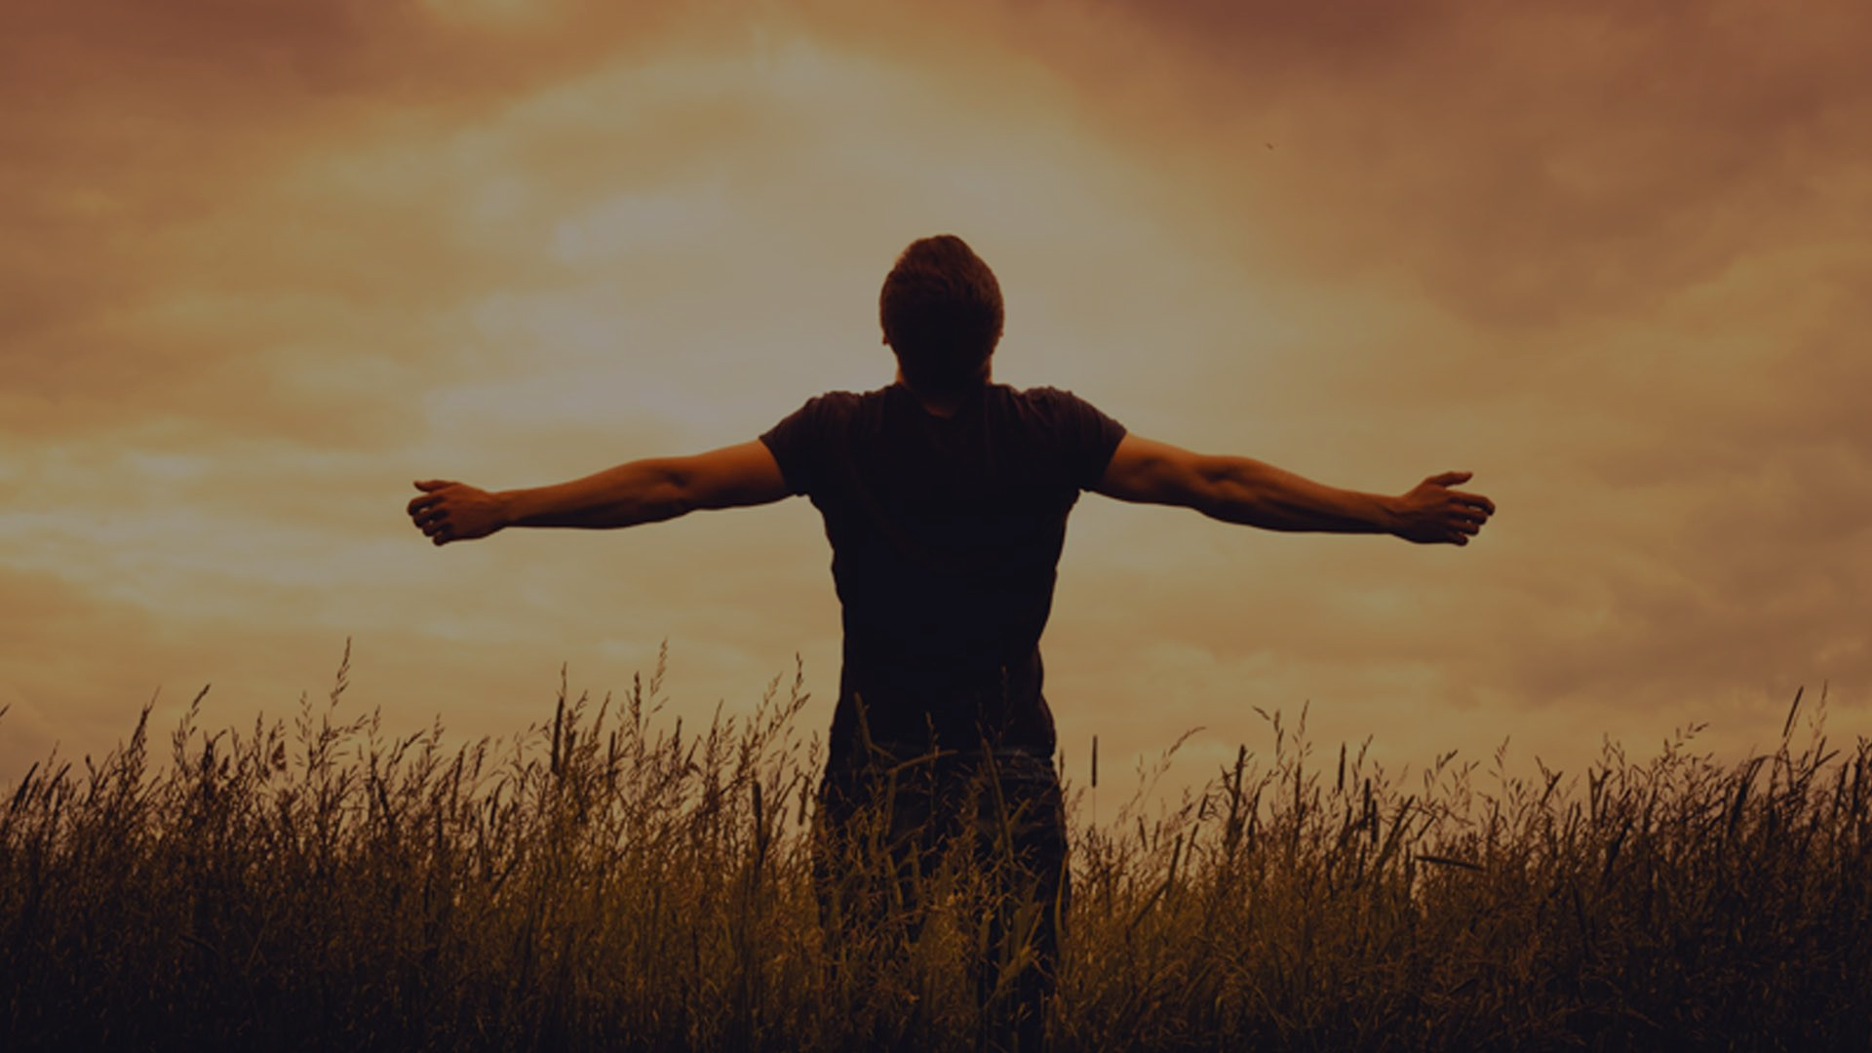
Bad things = sufferings (v17), groanings (v23), trouble, hunger, persecution, destitution, danger & the threat of death (v35).
False = that bad things are good (blessings in disguise)! They are bad and it’s OK to grieve, cry out & be angry in those moments - just like Jesus did when Lazarus’ died (John 11:33-38).
True = bad things are bad! But God will bring ultimate good out of it. Its not about having faith in the goodness of all things, but faith in the goodness of God and his plans for us.
Understanding that God has an ultimate plan for ‘everything’ in our lives = we can know peace & joy in all circumstances.
Notes:
God is not saying (false) that bad things are good. Bad things and evil are not part of God’s plan for this world. They come as result of sin and God hates sin. When Lazarus’ died we read how Jesus was angry in seeing the impact of death and he wept (John 11:33-38). Even though he knew that he was about to bring Lazarus back to life he was still angry and sad at pain and suffering. He didn’t say this is a good thing – wait and see what I am about to do. This verse is not an excuse for us to not care for and listen to those who are hurting. This verse doesn’t give us the right to say to someone who is going through cancer, Don’t worry, God’s in control, just learn to trust him more. Don’t worry about that broken relationship, God must have someone better for you. Don’t worry about that death, God just wanted them more, there is no more suffering now. Don’t worry about that home or job you lost, I am sure God has got a better one in mind. This is verse is saying that bad things are still bad. But even in our times of grief, anger and even fear God will bring ultimate good out of it.

Slide 6
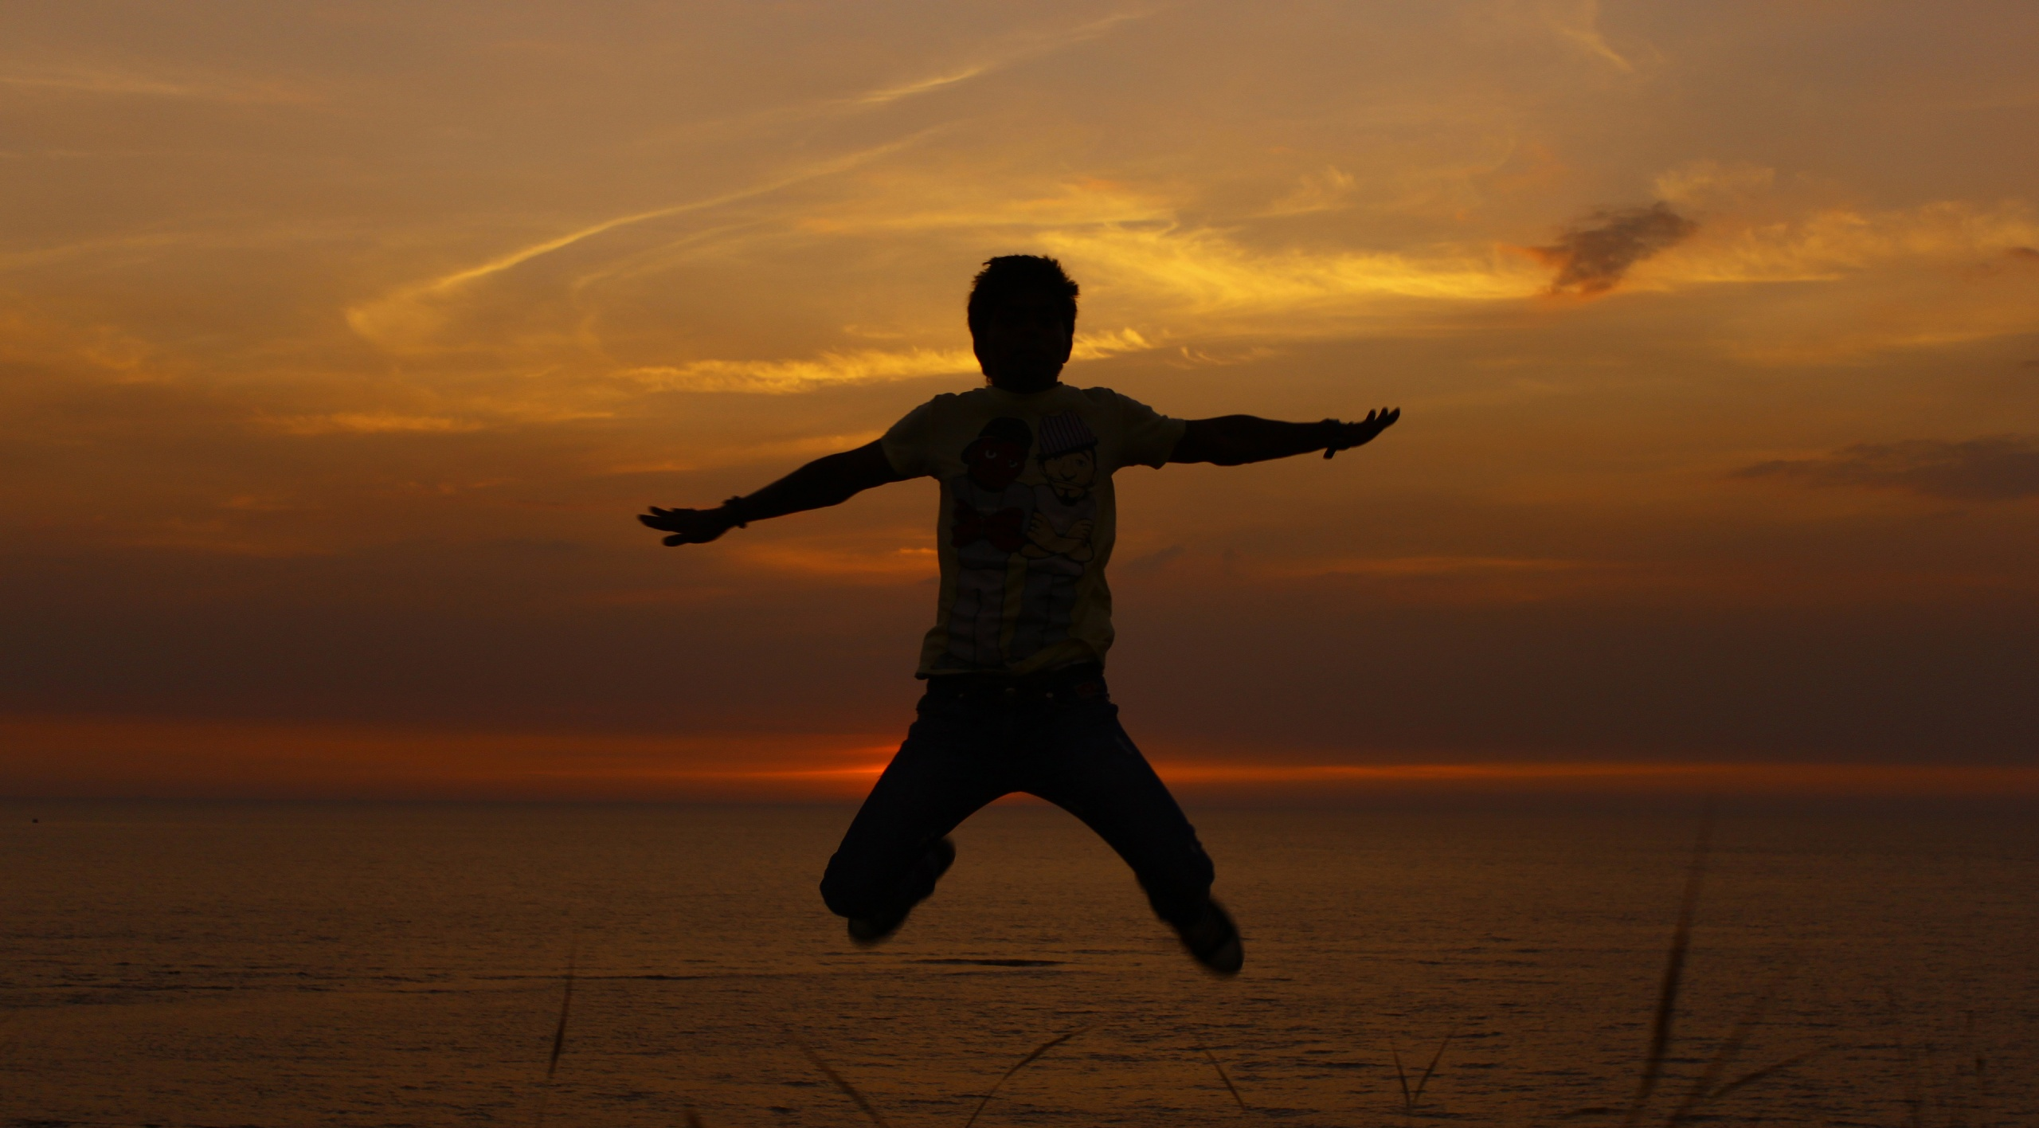
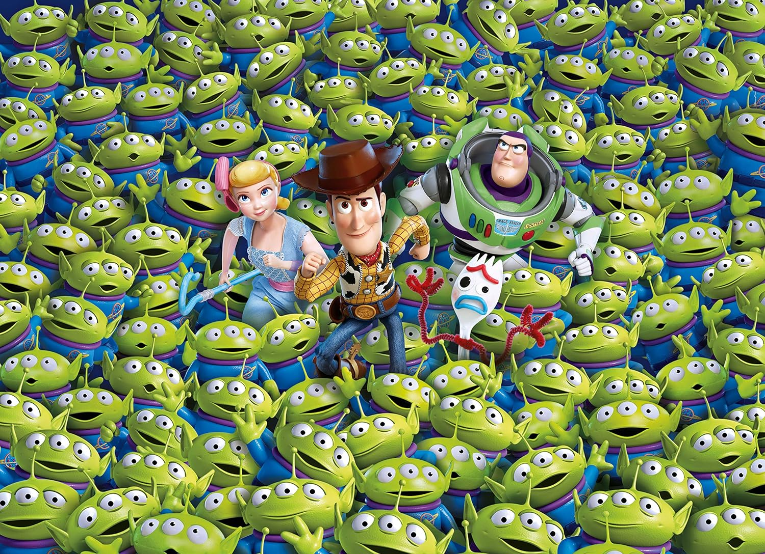
4. IT’S A DYNAMIC PROMISE- “…to work together for the good..”
Not knowing how the pieces of our life fit together can often lead to anger, frustration, despondency & discouragement.
‘Work together’ (sunergeo) > synergism = “The working together of various elements, over a period of time, to produce an affect that’s far greater than, and even completely different from, the sum of each separate element.”
“Not all the ingredients are desirable or delicious. But God is capable of carefully measuring them out and mixing them up in order to make a final product that is ultimately and eternally delicious and desirable.” (Randy Alcorn)
Notes:
I like doing jigsaw puzzles, and 2 years ago I received this puzzle from my family for Christmas. It was only 1000 pieces and it was called the impossible puzzle. It was one of the most difficult puzzles I ever had to put together – took me over 10 days to do (a lot of trial and error) , instead of the usual few days. Throughout those 10 days I would often find myself getting angry and frustrated trying to work out how all the pieces would fit together (so much for it being a way to relax). That’s how it is for us in life too. Some of us are trying to figure out what God is doing in 2024 and we are feeling angry and frustrated. The Greek word for work together is “sunergeo” and it is from this word that we get the word synergism. This is a scientific term and it means using different elements to make something far better and different. Not being a science person at all I actually prefer to use a cooking example (more at home in the Kitchen than the science lab). When you look at all the individual ingredients for making a cake they are not all desirable or delicious. Many of them are bland and horrible. Try tasting baking powder, flour, raw eggs etc. But God will take all things (including the bad) and work it for good. He will do this over a period of time – we may not see that ultimate good (far greater) in a day, week, month or year. We may not grasp it this side of Heaven but we can be sure he is working for our ultimate good. God’s plans will very often be different from ours – we may not like it but it is better. This is not a guarantee that the Christian life here and now will always be better. But it is a promise that the good He gives us will be of ultimate and eternal good. Until we realise that we will struggle to overcome our anger, frustration, despondency and discouragement.

Slide 7
'Good’ = an ultimate and eternal good that can’t be lost.
“For God knew his people in advance, and he chose them to become like his Son, so that his Son would be the firstborn among many brothers and sisters. And having chosen them, he called them to come to him… gave them right standing with himself…. and he gave them his glory.” (vs 28-29)
The ultimate and eternal good that God wants for us =
To shape, polish, sculpt & melt us to be like Jesus.
To ensure we enjoy a personal relationship with Him.
To guarantee us the glory of an eternity with Him.
A promise of a better life, not better life circumstances. (Jn 10:10)
Notes:
To find out what the good means in verse 28 we have to look at verses 29-30 because they are connected (‘for’). This promise of good = an abundant life, not a life filled with better circumstances. They are good things which can’t be lost (unlike the so called good things of this world). The promises in vs 28-29 are all in the past tense (he gave) – it doesn’t say he will give. Its done and guaranteed. To be like Jesus – looking for transformation and a character change. Wants us to get rid of sin in our life, Our biggest danger is not terrible circumstances but pride, selfishness and sin which separates us from God. He want us to be as loving, noble, selfless, forgiving, wise etc as Jesus. In God’s eyes it is all about our salvation and eternity and he will do all that he can to make that happen. That is his purpose for us – to know him and glorify him forever. Not to be rich, famous, healthy, or have long life, power, influence, experiences, fun in this world.

Slide 8
5. IT’S A DEFINED PROMISE – “.. Of those who love God and are called according to his purpose for them.”
This absolute promise doesn’t apply to absolutely everyone. Only to those ‘who love God’ = you have to be a God lover!
“The Lord your God… is the faithful God who keeps his covenant for a thousand generations and lavishes his unfailing love on those who love him and obey his commands.” (Deut 7:9)
‘.. and are called to his purpose’ = joyfully submitting to our Father’s will (not ours) and striving to be like Christ (getting rid of the sin in our life) - v29.
Notes:
There is a precondition on this promise – it is a specific promise, not a universal promise to all people. Only to those who love God. Are you a God lover? It means more than just believing God exists. It is striving to be obedient to His will and to please him as our father. It is surrendering to his will – letting him be Lord of our life.

Slide 9
BE DETERMINED TO KNOW THE WONDER OF THIS PROMISE – “I consider that our present sufferings are not worth comparing with the glory that will be revealed in us.” (v18)
Consider (compare, weigh it up, think it through) that the best is yet to come. Let this promise control your thinking.
BE DETERMINED TO TRUST GOD – No matter what is happening, trust that God is working for your good and for his glory. It’s Ok to grieve & cry out, but never stop trusting
BE DETERMINED TO THANK GOD – in all circumstances
(1 Thess 5:18). We may not understand or agree with his plans, but they are always better than ours.
Notes:
Three things for us to do as we head into 2024 and beyond.
Know this promise – Despite all the sufferings Paul went through – whipped, imprisoned, shipwrecked, sleepless nights, hard work, robbed, threatened with death (2 Cor 11;23-29) he understood the wonder of God’s promise – that the best is yet to come. The Christian life is about knowing, not just feeling. Feelings can lead you astray.

Slide 10
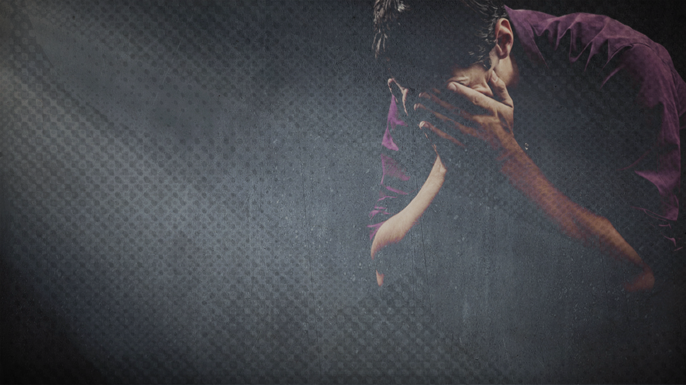
“I can’t make my son’s death fit into Romans 8:28. I cannot see how anything good can come out of it. Yet I realise, that I only see and know in part. It’s like the miracle of our local shipyards. Almost every part of the greatest ocean going vessels are made of steel. If you take any single part and throw it into the ocean it will sink. But when the shipbuilders are finished, that mighty ship is almost unsinkable.”
“Taken by itself my son’s death seems senseless. Throw it into the sea of Romans 8:28 and it sinks. But I believe that when God has finished working out his perfect design, that even this tragedy will somehow work out for His glory and my eternal good.”
Whatever you are going through (good, bland, horrible), be assured that GOD IS STILL WRITING YOUR STORY. Don’t let go of your faith because of what you have yet to see and understand. QUIT TRYING TO STEAL THE PEN AND TRUST THE AUTHOR.
Notes:
A pastor in San Diego, USA, who lost his son to suicide returned to the pulpit 10 days after his death. Visibly struggling with his emotions he read this message to his congregation. “I can’t make my son’s death fit into Romans 8:28. I cannot see how anything good can come out of it. Yet I realise that I only see and know in part. It’s like the miracle of our local shipyards. Almost every part of the greatest ocean going vessels are made of steel. If you take any single part like the rudder, propellor or anchor and throw it into the ocean it will sink to the bottom. Steel doesn’t float. But when the shipbuilders are finished, that mighty vessel is almost unsinkable. Taken by itself my son’s death seems senseless. Throw it into the sea of Romans 8:28 and it sinks. But I know and I believe that when God has finished working out his perfect design, even this tragedy will somehow work out for God’s glory and my eternal good.

