Slide 1
Do NOT Be Deceived
Matthew 24: 4 - 14
Notes:
2023 certainly has been an interesting Year

Slide 2
2023
Decline of Covid 19
Economic Uncertainty
Russia Still at War in Ukraine
Flooding
Bushfires
Referendum
Hamas bombs Israel & kills over 1,000 & takes hostages
Donald Trump is still very verbally animated

Slide 3
7 Warnings from jesus
Others claiming to be Christ
Wars & Nation vs Nation
Famines
Earthquakes
Persecution
Turning of Faith, False Prophets/gossip
Wickedness
Notes:
Will look at each one of these quickly, but
In terms of wickedness, where do we start and where do we end.

Slide 4
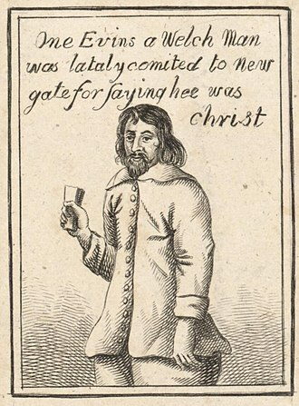
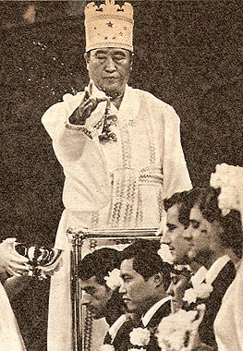
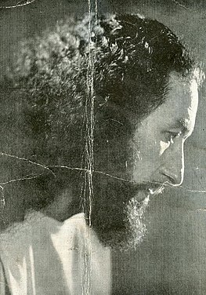
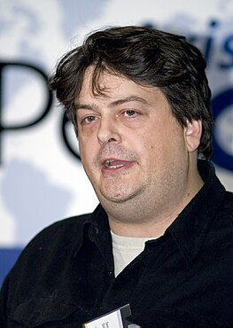
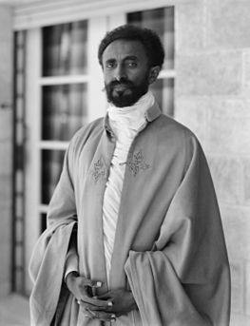
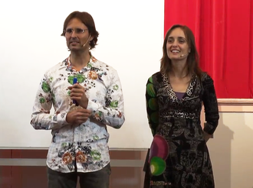
claiming to be Christ
Notes:
1,000’s
Rhys Evans 1600
Krishna Venta 1900
Sun Myung Moon 1900
Haile Selassie 1900
Alan Miller & Mary Luck 2000
David Shayler Now

Slide 5
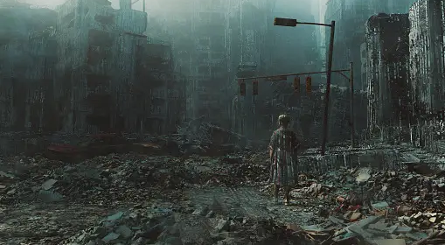
Wars & Nation vs Nation
32 countries currently in conflict.
Number of war deaths has been declining since 1946.
Conflict and violence are currently on the rise.
Religion, Governance, and Politics: biggest cause of conflict in the world.

Slide 6
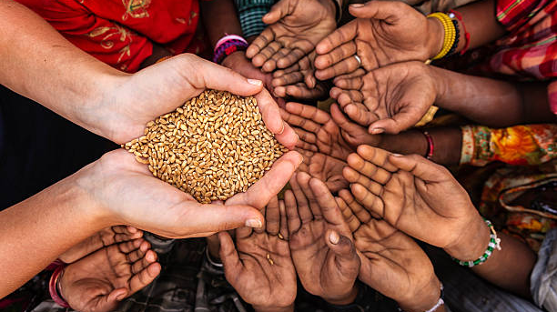
Famines
More than 30 million people in 22 countries and territories.
Conflict, displacement, chronic poverty, food insecurity. Natural disasters and climate change.
Conflict is the #1 driver of hunger in the world, and it's entirely preventable.

Slide 7
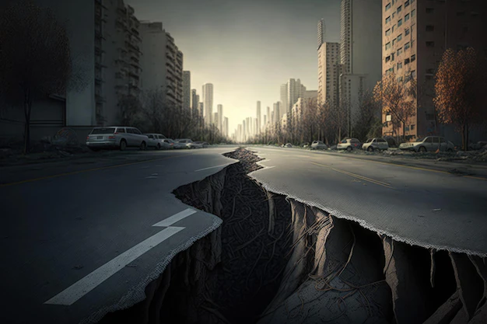
Earthquakes
Japan has the most recorded earthquakes in the world.
Over 80 per cent of large earthquakes occur around the edges of the Pacific Ocean, an area known as the 'Ring of Fire.’
On any one day, around the world there are literally dozens of earthquakes happening in a 24 hour period (35)
The biggest earthquake recorded, of magnitude 9.5, happened in 1960 in Chile.

Slide 8
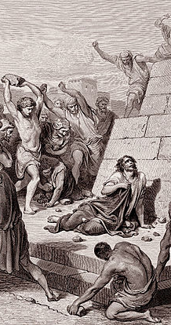
Persecution
North Korea, Somalia, Yemen, Eritrea, Libya, Burma, China, Russia, India, Pakistan, Syria, Iran.
The persecution of Christians can historically be traced from the first century of the Christian era.
By 2050 Islam will equal Christians in world numbers.
31% Christians in 2023 (25% Islam) in the world.
2021 Census - 44% identify as Christian in Australia.
Notes:
Hinduism fastest growing in Aust
China & Sub-Saharian Africa fastest growing for Christians
Jesus also warned about internal threats, as persecution would tempt people to turn away. (Epistles like 1 Peter, Hebrews, and Revelation were written to believers facing this kind of situation.)

Slide 9
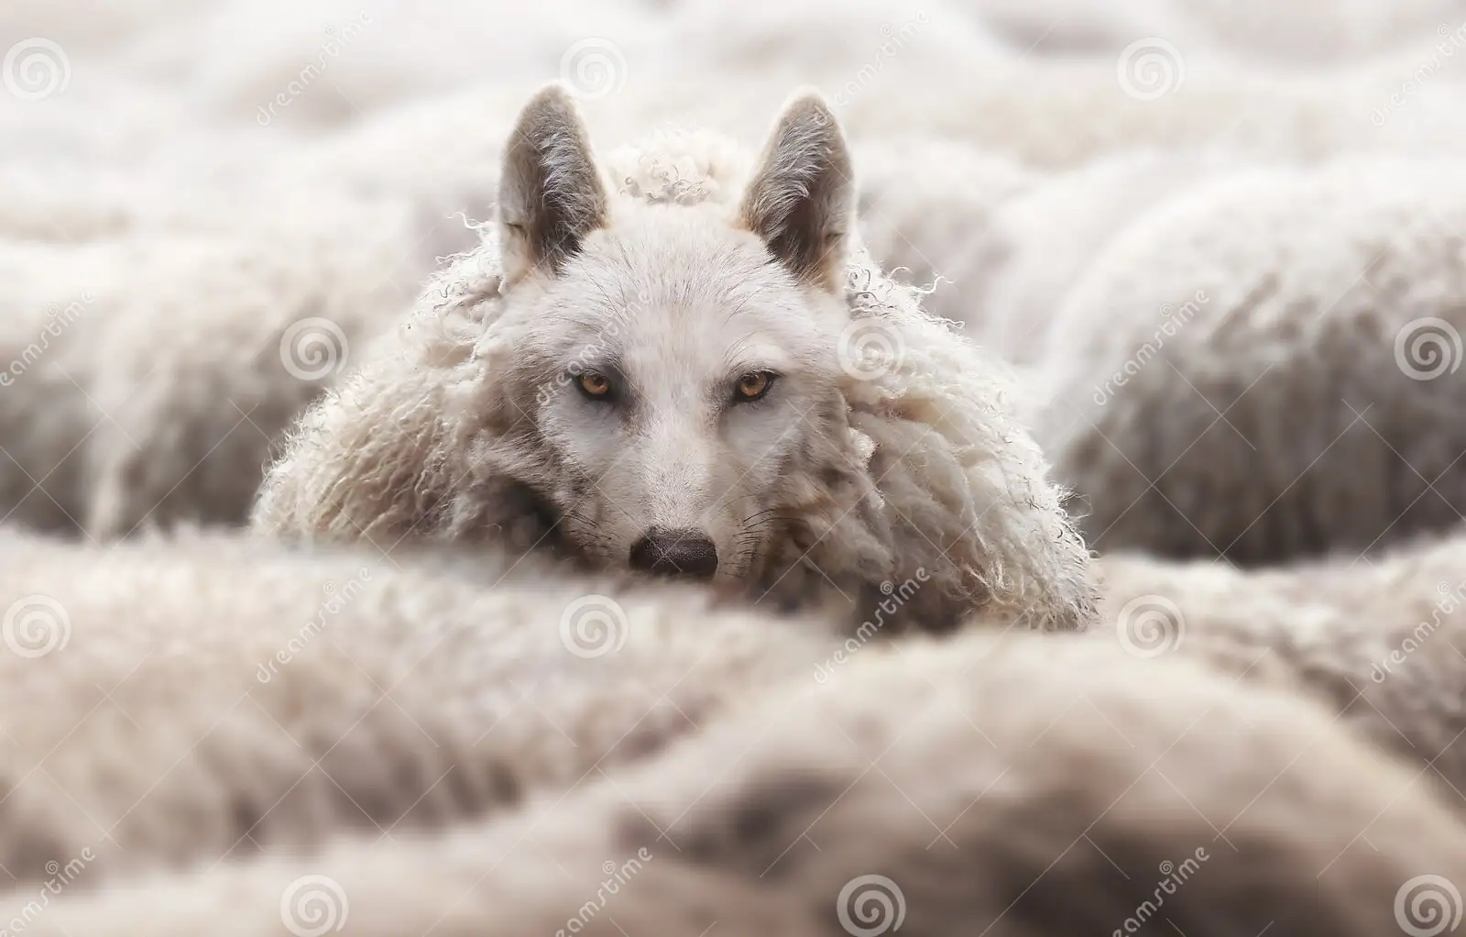
Turning of Faith (Wolf in Sheep’s Clothing)[Matt 7:15]
33,089 Christian denominations world-wide.
Australia is a nation of small churches, with 47% having less than 50 people attending weekly church services.
Around 11,400 local churches in Australia.
The percentage of people belonging to some form of Christianity decreased from 52.2% in the 2016 Census to 43.9% in the 2021 Census. (Australia)
No religion increased from 30% in the 2016 Census to 38.9% in the 2021 Census.

Slide 10
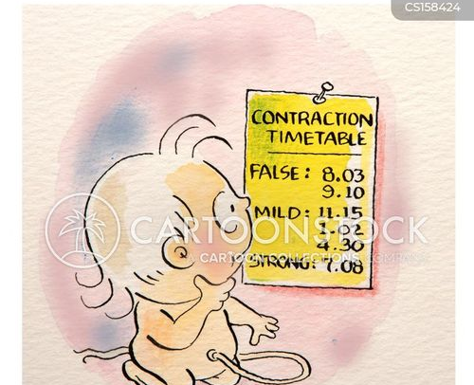
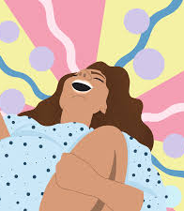
Birth pains
The first thing Jesus tells them is to take a chill pill, because there’s going to be plenty of bad stuff happening – but that doesn’t mean the end is here. They are merely the “beginning of birth pains.” (Isa 13: 8; Jer 6: 24; 22: 23; Mic 4: 9-10)
Notes:
2. This could take place at any time.
3. Jesus said watch, be & ready.
Labour pains are a metaphor for the suffering of nations and cities (Isa 13: 8; Jer 6: 24; 22: 23; Mic 4: 9-10)
It’s going to be a long labour.

Slide 11
Birth pains
The first thing Jesus tells them is to take a chill pill, because there’s going to be plenty of bad stuff happening – but that doesn’t mean the end is here. They are merely the “beginning of birth pains.”
The birth pains include the usual things that people interpret as bad omens: Unrest among nations (wars and rumours of wars), Unrest in the earth itself (earthquakes, such as the one that destroyed Colossae, Laodicea, and Hierapolis, sometime in AD60-62).
Notes:
Catastrophic world events are not in themselves signs of the end times, only labour pains

Slide 12
Birth pains
The first thing Jesus tells them is to take a chill pill, because there’s going to be plenty of bad stuff happening – but that doesn’t mean the end is here. They are merely the “beginning of birth pains.”
The birth pains include the usual things that people interpret as bad omens: Unrest among nations (wars and rumours of wars), Unrest in the earth itself (earthquakes, such as the one that destroyed Colossae, Laodicea, and Hierapolis, sometime in AD60-62).
Jesus questions do not deal with the rapture of the church which is a separate event.
Notes:
So, why do so many people want to jump on this wagon and add to the Bible what is NOT there.
The answer is to suit their own desires.
To make them comfortable and accepted in the world around them.
And to make themselves more like God

Slide 13
Birth pains
The first thing Jesus tells them is to take a chill pill, because there’s going to be plenty of bad stuff happening – but that doesn’t mean the end is here. They are merely the “beginning of birth pains.”
The birth pains include the usual things that people interpret as bad omens: Unrest among nations (wars and rumours of wars), Unrest in the earth itself (earthquakes, such as the one that destroyed Colossae, Laodicea, and Hierapolis, sometime in AD60-62).
Jesus questions do not deal with the rapture of the church which is a separate event.
There are no prophetic signs needing fulfillment for this event.
Notes:
We are told not to Add or Detract what the Bible says.
If you want Prophetic signs, then go to Revelation, Daniel, Isaiah, and the other Prophetic books

Slide 14
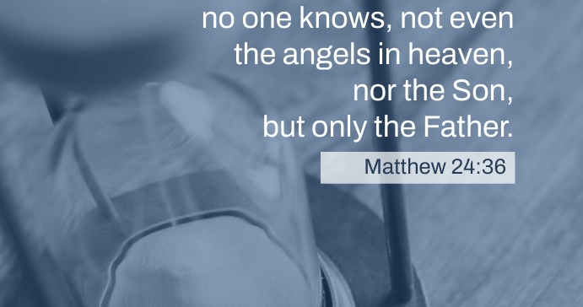

Slide 15
Notes:
Secondly, this tells us not to get hung up on “signs of the end times.” It reminds us that those kind of bad omens (wars, earthquakes, persecutions, Trump presidential campaigns) happen all the time. They happened back in the 60s AD as the “beginning of the birth pains” when Jerusalem was about to fall. They’ll keep happening today. Don’t think that every time something bad happens in the world, that’s a sign that The End is imminent. People have been saying that for millennia. (And have been wrong each time.) Later on in chapter 24, it says that the end will be totally unexpected, again dissuading us from speculation.

Slide 16
2024 - Your commanded duty
The only clear “sign” we’re given of the approaching end is that the Gospel message will go out as a testimony to all the peoples of the world.
Notes:
So if you’re keen for Christ to return and everything to be put right, get out there and tell people about Jesus.

Slide 17
2024 - Your commanded duty
The only clear “sign” we’re given of the approaching end is that the gospel message will go out as a testimony to all the peoples of the world.
Get involved in the work of God’s kingdom and the announcement of God’s rule as king. Particularly to those people groups who are still, as yet, unreached.
Notes:
And we still have LOTS of them here in Australia and even here on the coast.

Slide 18
2024 - Your commanded duty
The only clear “sign” we’re given of the approaching end is that the gospel message will go out as a testimony to all the peoples of the world.
Get involved in the work of God’s kingdom and the announcement of God’s rule as king. Particularly to those people groups who are still, as yet, unreached.
Don’t get worked up about “the end” being near, that stuff’s been going on for centuries.
Notes:
When I hear of Russia invading Ukraine, or Iran’s nuclear programme, or the latest with Israel and Palestine. It is just another Labour Pains
It is the person who remains faithful to the end who will be saved
When people refuse to submit to law and each person does what they desire in their own eyes, then moral disaster follows
Have you ever given your life to Christ?
Are you living your life for Christ?

