Slide 1
“We baptise you in the name of the Father, Son and Holy Spirit” not “I baptise you in the name of the Father, Son and Holy Spirit.”
“He made a mistake. It wasn’t intentional. It just makes me wonder what baptism is really all about and whether it is really that important.” (Maria Moran)
Acts 8:26-40
Father Andres Arango
WHAT IS IT?
WHY IS IT IMPORTANT?
Notes:
In February 2022, St Gregory Parish in Arizona was devastated by a huge controversy that caused Father Andres Arango to resign from his role as priest – a position he had held at the Parish for over 20 years. The scandal was that the local diocese of the Catholic Church had performed nearly 2000 invalid baptisms. Why? Because he had mistakenly said, “We baptise you in the name of the Father, Son and Holy Spirit.” Catholic liturgy demanded that he say “I baptise you….” (not we – makes it sound like the congregation not the “I” of the priest as God’s representative). According to the Catholic church this error not only invalidated the baptisms but also impacted their salvation, their right to take communion (confirmation) and even their marriages. The church is currently in the process of tracking down all those who were baptised in error and seeking to re-baptise them to correct the situation. The situation is messy and has caused many people in the church to question what baptism is really all about – Maria Moran, mother of one of the children needing to be re-baptised.

Slide 2
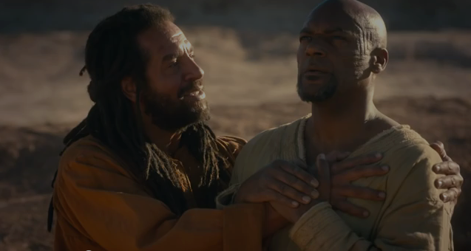
“Then Philip … beginning at this Scripture, preached Jesus to him. Now as they went down the road, they came to some water. And the eunuch said, “Here is some water. What hinders me from being baptised?” Philip said, “If you believe with all your heart, you may.” And he answered, “I believe that Jesus Christ is the Son of God.” So… both Philip and the eunuch went down into the water, and he baptised him. Now when they came up out of the water, the Spirit took Philip away, and the eunuch went on his way rejoicing.” (vs 35-39) = 4 TRUTHS ABOUT BAPTISM
Never been baptised = you see the importance of baptism.
Baptised, but not by immersion = see why we do that & be challenged.
Baptised by immersion = deepen your devotion to Jesus.
Notes:
This is a big topic and essentially needs a book to fully cover it. So in my message today I will give us a brief overview and to do that I will be using this passage in Acts , where Philip baptises the Ethiopian Eunuch. Before we start I just want to recognise that will be some of you who have given your heart to Jesus but not yet been baptised (I’m saved, don’t need to be baptised or will think about it later when the time is right). I trust that this message will show you the importance of baptism and prompt you to make that decision. Many of you are not baptised by immersion – baptised as an infant by sprinkling. I trust that this message will help you see why we baptise by immersion and why we don’t baptise infants. While I am praying that the Spirit will convict you to consider believer baptism by immersion. If you choose not to do that please know that we still welcome you into our church family and ask that you respect our position and not be devisive about it. You are still loved, valued and appreciated as you serve in our church. Thirdly, there are many who are baptised as believers and I trust that this message affirm your understanding of baptism and deepen your devotion to Jesus. Let’s pray.

Slide 3
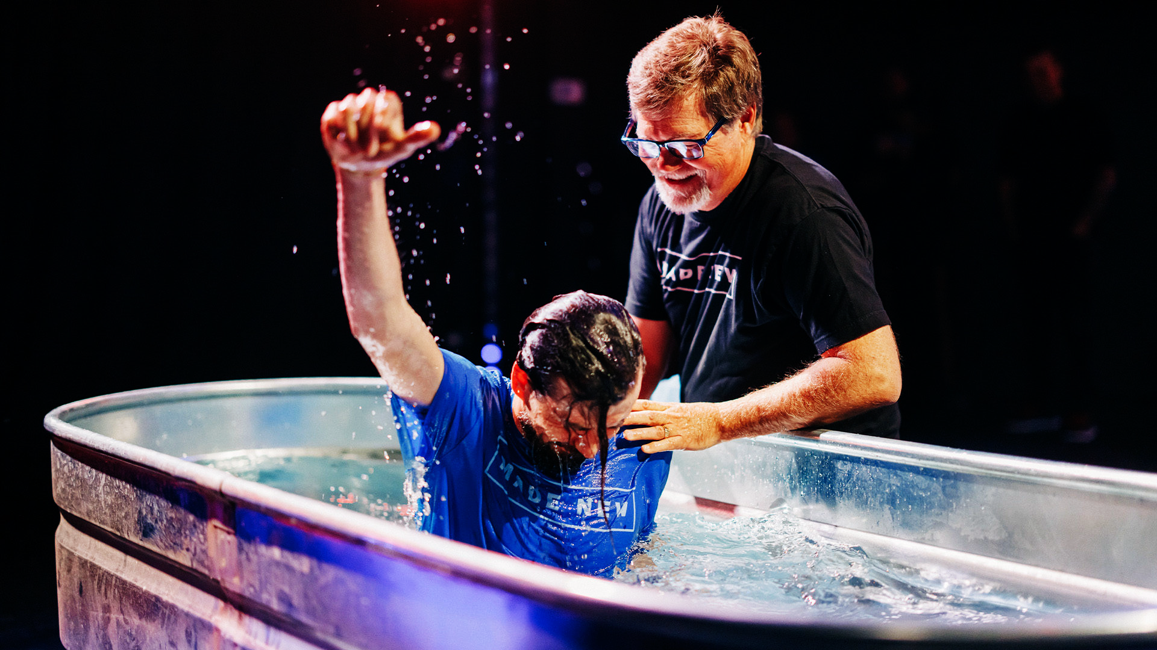
1. BAPTISM IS A RESPONSE TO THE GOSPEL – “Then Philip … beginning at this Scripture (Isaiah 53), preached Jesus to him. Now as they went down the road, they came to some water. And the eunuch said, “See, here is water. What hinders me from being baptised?” Then Philip said, “If you believe with all your heart, you may.” And he answered and said, “I believe that Jesus Christ is the Son of God.” (vs 35-37)
“Each of you must repent of your sins and turn to God, and be baptised in the name of Jesus Christ for the forgiveness of your sins.” (Acts 2:38)
Repent & believe (faith alone = salvation) then be baptised (publicly demonstrate your faith).
Notes:
Baptism is a response to the gospel (the longest of my four points so don’t stress that we take a bit of time on this one) When Philip is miraculously placed in the presence of the Ethiopian Eunich, he overhears the Eunich reading Isaiah 53 (people read aloud in those days – no kindle etc,). Those of you familiar with Isaiah 53 will know that it is the powerful prophesy of Jesus trial before Judas, his silence before his accusers (despite his innocence), his shameful treatment, rejection, suffering and his willingness to be crucified – slaughtered as a lamb on the cross in order to die for our sins and bring us salvation – redeemed us back into God’s family. The eunuch is struggling to understand the amazing grace of God and asked Philip to help him understand. So Philip preached the gospel – we are all sinners deserving death, we need a Saviour and Jesus was willing to leave the glory of heaven to come down to live and die for us (even though we didn’t deserve it = grace). Our works can’t save us, only by putting our faith in Christ. Upon hearing the gospel the Eunich asks to be baptised. Don’t miss the providence of God in the fact that they came upon some water in the middle of the desert at just that right time. Important to note what happens next. Philip asks whether the eunuch has surrendered his life to Christ first – its only if he believes with all his heart in Jesus as his Lord and Saviour before he can be baptised. Belief (salvation) before baptism. You will see I have underlined vs 37 because not all versions include it in the text (only in footnotes) and the reason for that is the earlier manuscripts of the New Testament didn’t include this – only found in later manuscripts. But regardless Luke (writer of Acts) already made it clear that belief follows baptism in Acts 2 – the first baptisms we see after Peters sermon on day of Pentecost. The NT pattern for baptism is repent and believe in Christ and gain salvation through faith alone and then be baptised to publicly demonstrate your faith. Baptism is a public demonstration of what has already happened in the believer’s heart. The moment they surrender their life to Jesus and declare him Lord and Saviour = you have forgiveness of sins, are made right with God and have eternal life. Nothing can change that because its all about what Jesus has done, not what you do.

Slide 4
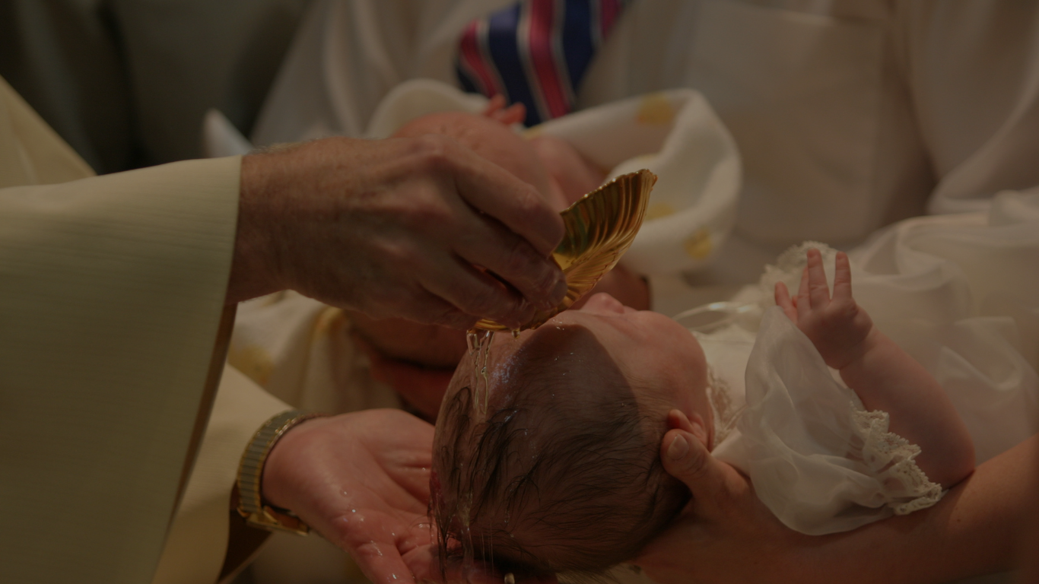
Two views of baptism that disagree with ‘believer’s baptism’.
a) Baptism is a means of salvation (baptismal regeneration) – “Holy Baptism is the basis of the whole Christian life.. It is the gateway to life in the Spirit and the door which gives access to the other sacraments (including confirmation, eucharist & marriage). Through baptism we are freed from sin and reborn as sons of God… Without it nobody can enter the Kingdom of God.” (Roman Catholic Catechism).
“Each of you must repent of your sins and turn to God, and be baptised in the name of Jesus Christ for the forgiveness of your sins.” (Acts 2:38)
It’s not about grace & faith = possible any age & anyone to be baptised.
Notes:
a) Baptism saves – Catholic, Anglican, Lutheran are the main ones. The RC Catechism states that there is no salvation without baptism because it saves. And without baptism (salvation) there can be no confirmation, eucharist (communion) or marriage – thus the dilemma at St Joseph’s Parish where the baptisms were deemed to be invalid. They deny that justification is by grace alone through faith alone. The person being baptised doesn’t even need to have faith – they will receive it through the process of being baptised. Thus they baptise babies and even soldiers dying on battle field or patients in hospital. So how do they get this theology? A big topic to go into but one verse is the one I used earlier in Acts 2:38 – they mistakenly include baptism as part of the salvation process, instead of it being a response to salvation. Anyone can be baptised provided it is done by a priest, using the right words and practices (sprinkling, pouring water over the head).

Slide 5
Biblical reasons why I don’t agree with that view?
“Then the thief said, “Jesus, remember me when you come into your Kingdom.” And Jesus replied, “I assure you, today you will be with me in paradise.” (Luke 23:42-43)
“If you openly declare that Jesus is Lord & believe in your heart that God raised him from the dead, you will be saved.” (Rom 10:9)
“Make disciples and baptise them...” (Matt 28:19) + “Those who believed.. were baptised...” (Acts 2:41) + Acts 17:31, 33 + others.
“God saved you by his grace when you believed. You can’t take credit for this; it is a gift from God. Salvation is not a reward for the good things we’ve done, so we can’t boast.” (Eph 2:8-9)
Notes:
I have biblical concerns regarding this position. Firstly the thief on the cross. He declared his faith in Christ and didn’t have time to be baptised, to join a church or do good works to earn his entry into the kingdom of heaven. The pattern for all recorded baptisms in NT is believe and be devoted to Jesus (become a disciple) and then get baptised. Ephesians 2 is the classic proof of saved by grace alone though faith (belief) alone. No mention of baptism being necessary for salvation. Same with Romans 10:9.

Slide 6
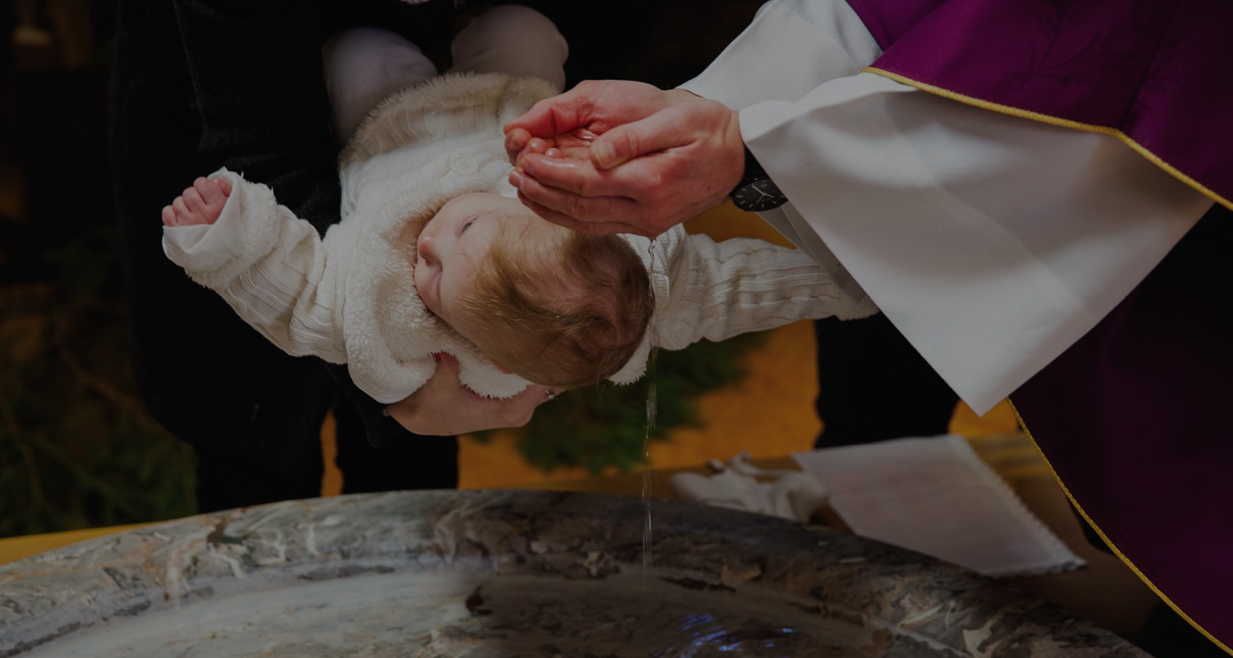
b) Baptism is the way we enter into the covenant people of God = baptism to the church, is what circumcision was to Israel.
Baptism doesn’t save you (only a later, personal profession of faith can do that), but it brings you into the covenant community of God = receive God’s promises and blessings.
“When you came to Christ, you were “circumcised,” but not by a physical procedure. Christ performed a spiritual circumcision—the cutting away of your sinful nature. For you were buried with Christ when you were baptised. And with him you were raised to new life because you trusted the mighty power of God, who raised Christ from the dead.” (Colossians 2:11)
Notes:
b) This view is held predominantly by Presbyterian and Reformed churches. It is based on covenantal theology – that the baptism replaces circumcision in NT church. Baptism does not save you, just as circumcision didn’t save those in the OT. They still had to make a profession of faith when they were able to believe . The person being baptised must have believing parent/s who is already a part of God’s covenant people.

Slide 7
“This is not a parallel between physical circumcision and infant baptism. It is a parallel between physical circumcision and spiritual circumcision of the heart, signifying the regeneration, new life and union we can have with Christ.” (Bruce Ware)
Like the Roman Catholic church, they also claim that the 3 ‘household’ baptisms recorded in the NT must include infants.
“Lydia and her household were baptised..” (Acts 16:15) + “.. I also baptised the household of Stephanas..” (1 Cor 1:16) = an argument from silence, as babies aren’t specifically mentioned.
“They shared the word of the Lord with him & with all who lived in his household…. they were immediately baptised.” (Acts 16:32-33)
Notes:
So what does the Bible say about these claims. Their second big reason is that there are three recorded household baptisms and they must have included children. Well perhaps but its an argument from silence because they don’t actually say children. And in light of all the other accounts of baptism where its believe and be baptized I would strongly suggest it didn’t include infants. The third account is the Philippian jailer – but in the previous verse it says they shared the word of the Lord to all in his house. You don’t normally preach to babies and expect them to understand and make a decision to believe.

Slide 8
2. BAPTISM IS BY IMMERSION – “So… both Philip and the eunuch went down into the water, and he baptised him. Now when they came up out of the water..” (vs 38-39)
Baptism (baptise) = immerse, plunge, dip, go under, bury = “Death by drowning.” (Martin Luther).
“… when we were joined with Christ Jesus in baptism, we joined him in his death? For we died and were buried with Christ by baptism. And just as Christ was raised from the dead by the glorious power of the Father, now we also may live new lives.” (Rom 6:3-4)
“Get up and be baptised. Have your sins washed away by calling on the name of the Lord.” (Acts 22:16)
Notes:
2. Baptism is by immersion – we see that they went into the water and out of the water. Not an indication of sprinkling, but being fully immersed. The Greek word for baptise is word used for a ship sinking beneath the waves, for being buried beneath the ground. The great reformer Martin Luther referred to baptism as being death by drowning. That may sound a bit gruesome but that’s the picture Paul gives us in Romans 6:3-4. Paul says that if we are truly saved we can’t just keep sinning and not care about it. Can’t just keep living for ourselves. Because baptism was a declaration that we died to sin and have been resurrected to a new life where sin has no power over us. Romans 6 describes to us the powerful imagery of what baptism is. It’s dying to self and to sin and being raised to a new life. Can’t have resurrection without death and burial. Can’t have new life without their first being death. Baptism is going down into the water like a grave and coming back up out of the water. Sprinkling can’t show that. The second imagery that baptism by immersion gives us is that we are washed clean of our sins by the blood of Christ - not made righteous by being baptised but by Christ’s death and new life from his resurrection. Immersion is a much better symbol of being fully washed. It is meant to be a significant moment for us – a powerful declaration of being washed clean, dying to self and living for Jesus. Church history shows us that sprinkling for baptism came in about 100 years after Jesus death – for convenience sake. But when has death been convenient? Kyle Idleman (US Pastor) shares a story about a baptism night at church and one of the people was an ex navy seal. He asked if Kyle could hold him down for 2 minutes (he could hold his breath) because he knew he had a lot to wash off – he understood the significance of being baptised. Kyle didn’t agree because he thought it would freak others out – but appreciated the man’s understanding of the significance of what he was doing.

Slide 9
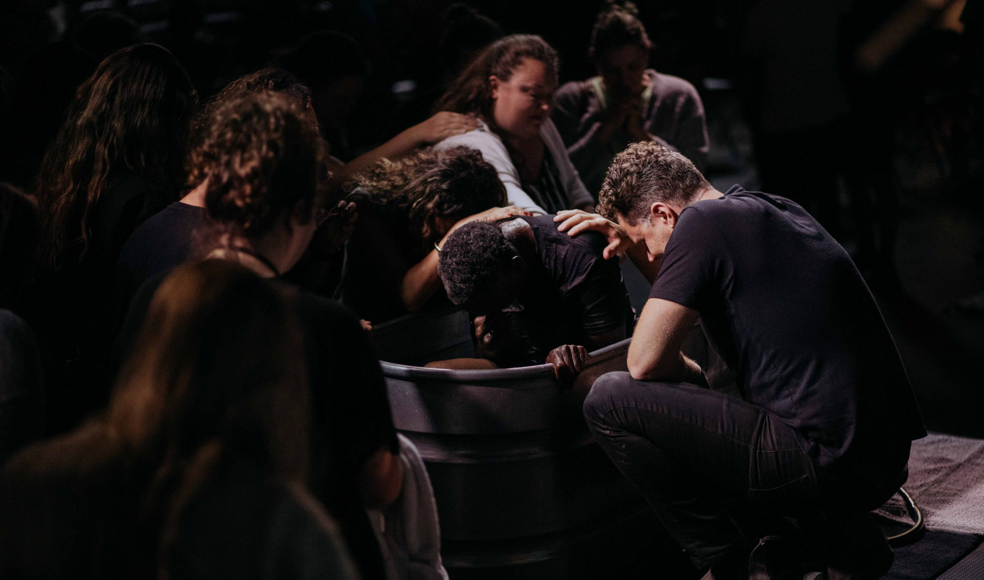
3. BAPTISM IS AVAILABLE TO ANYONE WHO BELIEVES – “Go and make disciples of all the nations, baptising them in the name of the Father and the Son and the Holy Spirit.” (Matt 28:19)
Ethiopian in Acts 8 (Ham) + Saul in Acts 9 (Shem) + Centurion in Acts 10 (Japheth) = “.. All who populate the world.” (Gen 9:19)
“There is no longer Jew or Gentile, slave or free, male and female. For you are all one in Christ Jesus.” (Gal 3:28)
“But as people sinned more and more, God’s wonderful grace became more abundant.” (Rom 5:20) = grace of God > any sin.
“But if we confess our sins to him, he is faithful and just to forgive us our sins and to cleanse us from all wickedness.” (1 John 1:9)
Notes:
Baptism is for all people – go and make disciples and baptise in all nations. In Acts 8 we see the Ethiopian baptised – with dark skin he is descendant of Ham (one of Noah’s three sons – the three great families of the world). In Acts 9 Saul is baptised – as a jew he is the descendant of Shem and in Acts 10 the Roman centurion is baptised – a descendant of Japheth. All the world represented according to Genesis 9:19. Galatians 3:28 – not about gender, race, status, economics. Jesus doesn’t look at those things. And no sin big enough to stop us from being saved.

Slide 10
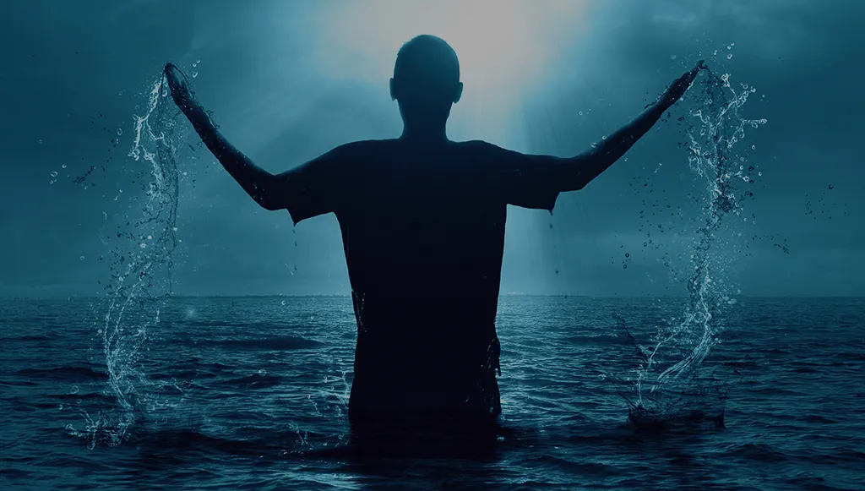
4. BAPTISM IS A MATTER OF PRIORITY - “Here is some water. What hinders me from being baptised?” (vs 36)
Jesus commands (not suggests) we be baptised immediately after coming to faith (Matt 28:19) - “So why do you keep calling me ‘Lord, Lord!’ when you don’t do what I say?” (Luke 6:46)
“Baptism is the initial test of a believing heart. If one won’t obey Christ in baptism, what will he do when he calls him to obey in prayer, evangelism and service.” (Max Lucado)
Baptism is the public declaration of our love for Jesus and our commitment to live for Him. It is the celebration of a sinner with their Saviour. Why would we want to minimise or delay that?
Notes:
4 Baptism is a matter of priority. When I first moved from the Presbyterian church to the Baptist church in Bundaberg I obviously struggled with accepting believer baptism over my infant (covenant based) baptism. I would often hear my Baptist friends proclaim that they did baptism right. But I was amazed at how many baptisms I saw where the testimony was, “I gave my life to Jesus when I was 14 but now I am 24 I think its time I was baptised. The time didn’t seem right up till now but now I am ready.” I questioned the church leaders as to whether they challenged the people on this intentional delay because that wasn’t the biblical pattern for believer baptism. Jesus commands we do it immediately because it is an outward expression of an inward transformation. If we have truly accepted Christ as our Lord and Saviour we should be wanting to be baptised immediately. Max Lucado put it well when he states it is the initial test of a believing heart. We can’t call Jesus Lord but then intentionally keep disobeying him. _____ was a wonderful day of joy and celebration for Shauna and I. The day I proposed and the day she didn’t hesitate to say yes. But can you imagine how either of us would have felt if we had said now I love you and I am committed to you but let’s not have the wedding until I am ready. Or let’s not have a public wedding at all - just the two of us and no one else. I would think we would be disappointed, offended and doubtful of our true love. Its one thing to declare your love for each other in private, its another thing to do it in public. Same with baptism. Its one thing to say to Jesus in private that you love him but that should drive us to tell the world. I couldn’t wait to tell everyone that I loved Shauna – if we could have I am sure we would have got married the next day.

Slide 11
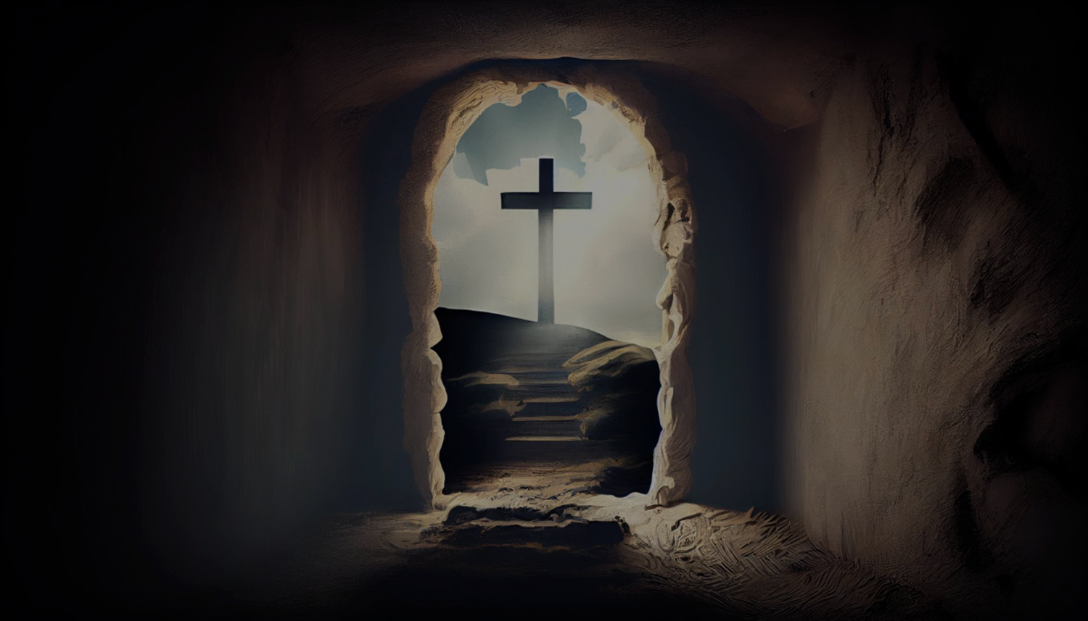
Don’t make baptism to be something it isn’t – either more than it is (deify it) or less than it is (trivialise it).
Apart from the cross & the empty tomb, baptism has no significance. The baptiser, words & water have no saving power.
Baptism is the first step of a believer. It is a willing plunge into the power and promise of Christ. It is a declaration to the world that Jesus died for your sins, that you are saved & now live for Him.
If it is important enough for Jesus to command, it must be important for us to obey.
If it was important enough for Jesus to do himself, it must be important enough for us to follow His example.
Notes:
Don’t allow baptism to be something it isn’t. Our danger is to swing to one of two extremes = we make baptism either too important (deify it = I am saved because I was baptised), or not important enough (trivialise it = I am saved so I don’t need to be baptised). We must let the pendulum stop between the two extremes and let it rest at the foot of the cross. Apart from the cross it has no significance. By itself baptism is nice and appealing but it has no power to save. Baptism is a symbol which reveals the beauty of the cross and the darkness of sin. If you are trusting in who does the baptism, the exact words said at a baptism or in a dip in the water to save you, you have missed the message of the cross. Baptism is the first step of a believer – it is a willing plunge into the power and promise of Christ It is a declaration to the world that Jesus Christ died for your sins and that you are saved and now live for Him. If it is important enough for Jesus to command, it must be important for us to obey. And if it was important enough for Jesus to do himself, it must be important enough for us to follow his example.

