Slide 1
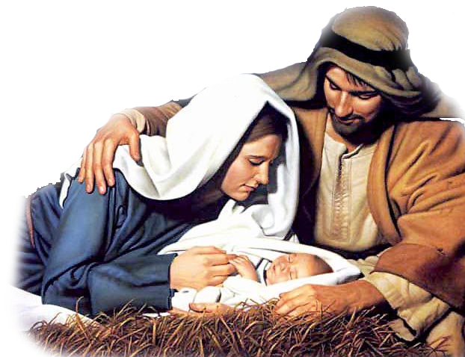
WARS
VIOLENCE – HOME & COMMUNITY
“World peace!”
FEAR & ANXIETY
HATRED & DISUNITY
TREATIES
COURT ORDERS
MEDICATION
CANCEL
TOLERANCE
PLEASURE
MARY-LOU FREEBUSH
(Micah 5:2-5, Luke 2:8-20)
4 THINGS JESUS’ PEACE DOESN’T MEAN
4 THINGS JESUS’ PEACE DOES MEAN
Notes:
In the year 2000, in the movie Miss Congeniality, Sandra Bullock played an FBI agent who goes undercover as a beauty pageant entrant in Miss United States competition. Trained to be the perfect entrant and when it came to her moment of getting interviewed in the pageant. She was asked a question What do you want most and her answer was “World Peace”. Yet our world is more broken than ever. Wars still rage, refugee crisis grows, there is increased violence in the home and community, fear and anxiety grows in people of all ages, hatred and disunity between left and right (politics), city and country, hatred and disunity grows (civic protests) and culture vs culture, generation vs generation. Our world attempts to find peace through human means and it doesn’t work. Treaties are broken, court orders are ignored, people are cancelled, medication is prescribed, others are blamed

Slide 2
WHAT PEACE DOESN’T MEAN - What Jesus’ birth doesn’t achieve.
A. The absence of spiritual conflict – we are commanded to stay alert and be dressed for spiritual battle (Ephesians 6:10-17).
B. The approval to compromise – we can never dishonour God in order to be friends with the world (Romans 12:2, James 4:4).
C. The abolition of wars – we can expect political and international conflict to increase as we get closer to the end times (Luke 21:9-10). But that doesn’t mean we shouldn’t strive for peace (Matt 5:9).
D. The affection of everyone – relationships get messy when you choose to follow Jesus (Luke 12:51, John 15:18).
Notes:
The absence of spiritual conflict – Paul, who was able to find peace in every circumstance (Philippians 4:6-7), also wrote that we have to be ready for the inevitable spiritual conflict with our enemies. We have to stand firm, wrestle and fight against our spiritual enemies (Eph 6:10-17)
The approval to compromise – we are not to compromise God’s truth in order to avoid conflict or to make us more likable. Truth can never be united with lies. Truth should expose lies. Darkness can’t be united with light. Light should always overcome/dispel darkness.
Jesus said we can expect wars and conflict. But doesn’t mean we shouldn’t strive for peace (talk more about that later)
When Jesus comes into your life it can get messy. Your love for Jesus will create division with your loved ones and a wicked world hated Jesus, they will hate us too.

Slide 3
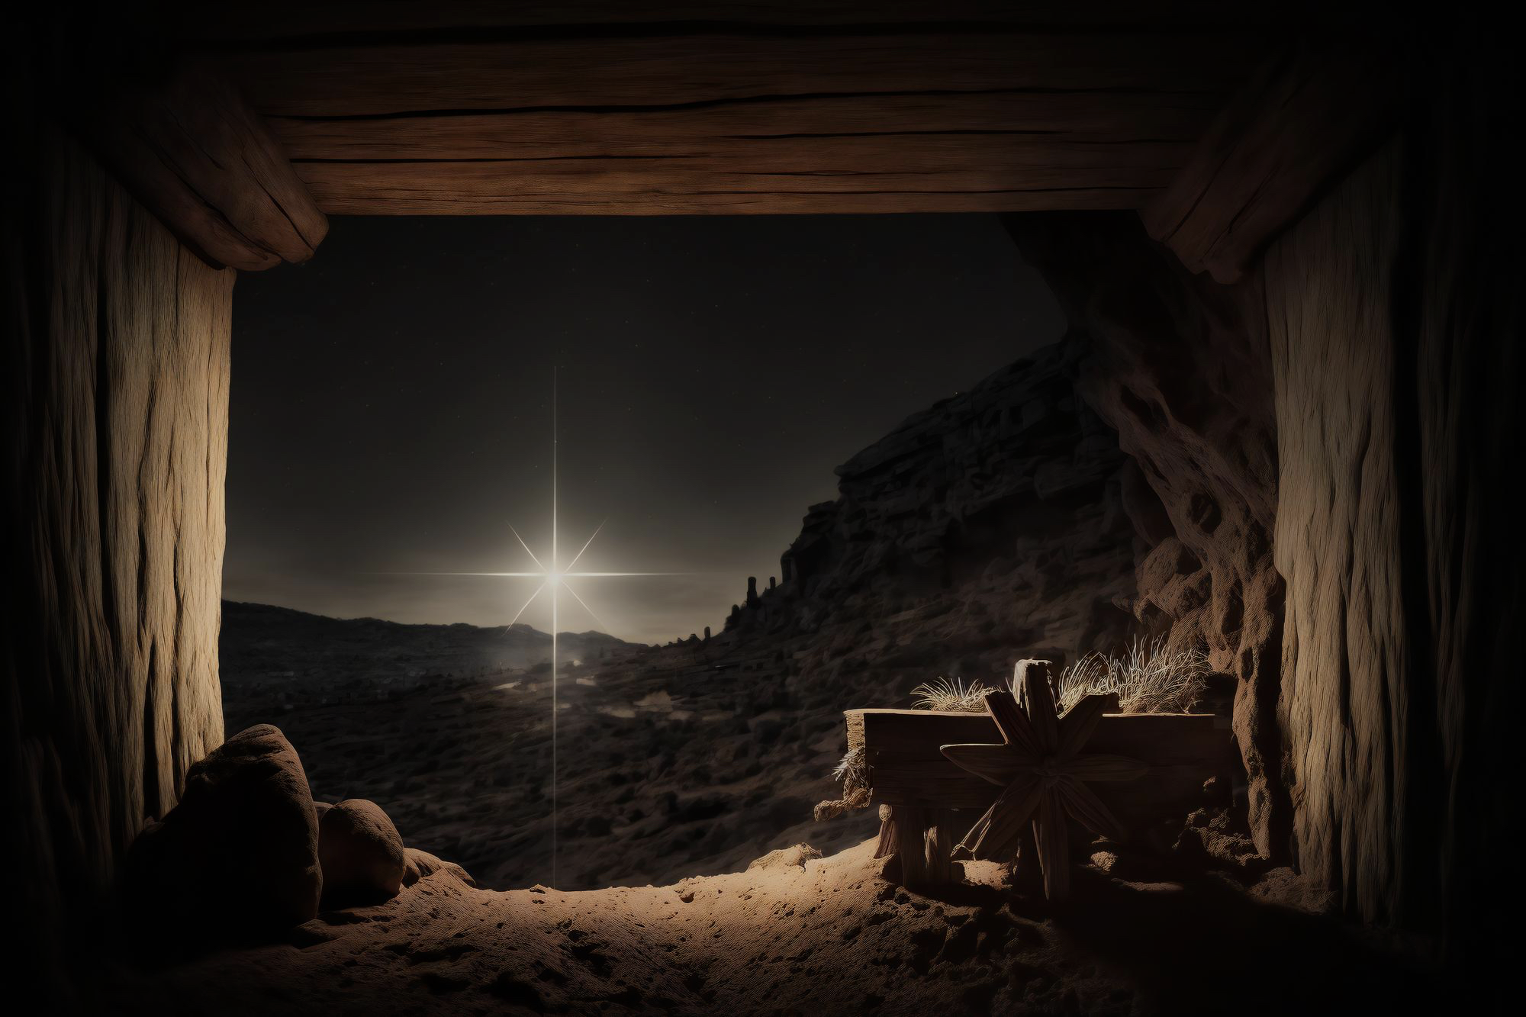
1. IN CHRIST WE RECEIVE UPWARD PEACE – “Therefore, since we have been justified through faith, we have peace with God through our Lord Jesus Christ.” (Romans 5:1)
Justified = when we put our trust in Jesus, we are fully forgiven & our sin is completely erased = just as if I’d never sinned.
Sin serves as a barrier between us and God. It separates us from Him – we are an enemy (Rom 5:10) with a hostile heart (Rom 8:7).
The world’s biggest problem is ultimately not ignorance (information) or indifference (motivation). The world’s biggest problem is hostility with God (reconciliation through Jesus).
Notes:
Upward peace = peace with God. Peace with God can only happen because Christ came down from heaven at Christmas time, lived a life perfectly obedient to God, went to the cross as a perfect sacrifice for us and paid the price for our sin. We are justified before God through Christ – just as if we had never sinned. Notice that we are not justified by our good works – we can never find peace with God through our efforts. Sin is a huge problem for God is a holy God and he can’t tolerate sin. We are separated from Him and he regards us as an enemy with a hostile heart. Now many don’t understand, this is the reason they don’t have peace with God. They would say I like God and I believe in Him and I want to be in heaven with Him. I like the idea of eternal life – who doesn’t want that? Therefore I do have peace with God. But the reality is that if we want God, but don’t think we need Jesus (grace and mercy), or that we don’t need someone to tell us how to live = we are despising God, finding fault with his truth and his plans. The world’s biggest need is reconciliation with God. Its not more information or more motivation (both are good, but neither will justify you). Only Christ can do that. Only Christ the prince of peace can bring the reconciliation

Slide 4
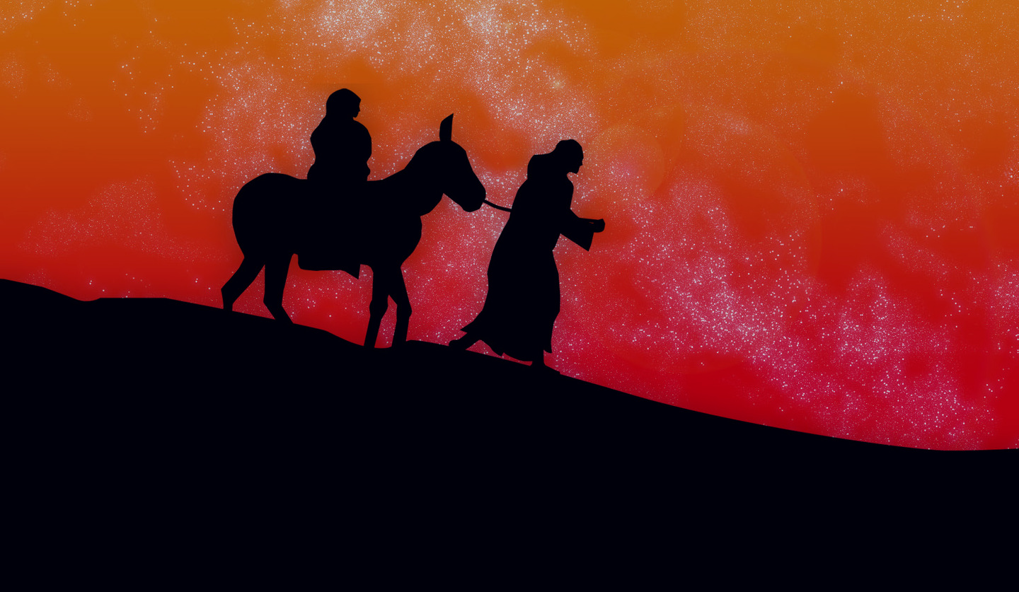
2. IN CHRIST WE HAVE INWARD PEACE (PEACE FROM GOD) – “You were his enemies, separated from him by your evil thoughts and actions. But he has now reconciled you to himself through the death of Christ. As a result, He has brought you into his presence and you are holy in his sight, without blemish and free from accusation.” (Colossians 1:21-22)
Peace with God is absolute. Once you are free from accusation = can’t be freer. Once you are holy in his sight = can’t be holier. Once you are without blemish = can’t be more blemishless.
Be wary of having ‘saving peace’ but not experience ‘living peace’ – “Don’t let your hearts be troubled.” (John 14:1) Double mindedness = instability, doubt (James 1:8). It’s not from God!
Notes:
This is one which we really need to be mindful about - to hold onto and work on. It is possible for us to have troubled hearts even though we have peace with God and all the promises that come with that peace. God looks at Jesus’ righteousness and declares us free from accusation, holy and without blemish. Its not our righteousness he looks at. In saying don’t let your hearts be troubled, Jesus is saying that we need to be doing some things to ensure we experience living peace with God. Like the disciples, we can be guilty of being double minded (James 1:8) = being uncertain of God’s promises and the gospel truth, the reality of our salvation. Double minded, unstable person doubts the love of God. Whatever is causing you anxiety and worry about your worth, God’s love, promises and salvation is not from God. If you have confessed your sins and still feel shame and guilt that is not from God. That’s what sets Christianity apart from other religions. They don’t offer such promises. It is all about you striving to be good – to be freer from accusation, to be holier and without blemish. Its all about your righteousness, not the righteousness of Christ.

Slide 5
There are 4 ways to cultivate this peace (all related) -
A. Peace in the Holy Spirit – “Letting the Spirit control your mind leads to life and peace.” (Rom 8:6)
B. Peace in faithful living – “You will keep in perfect peace all who trust in you and fix their thoughts on you!” (Isa 26:3)
C. Peace in God’s Word – “Those who love your instructions have great peace and do not stumble.” (Psalm 119:165)
D. Peace in prayer – “Don’t worry about anything; instead, pray about everything. Then you will experience God’s peace, which exceeds anything we can understand. His peace will guard your hearts and minds as you live in Christ Jesus.” (Phil 4:6-7)
Notes:
These four ways to cultivate peace are not in any order – they are all interrelated.
Holy Spirit – let him lead you. Don’t let Satan deceive you. We need help to cultivate this peace. The comfort, teaching, training of Holy Spirit.
Faithful living – walk by faith, keeping eyes on God, trusting his truth. An obedient life gives Satan less opportunity to accuse and find foothold for shame and guilt. But knowing promise of confessing sins then forgiveness is guaranteed.
God’s Word – saturate yourself in it. Its hard to be at peace with God if you are at war with God’s will for your life.
Prayer – without ceasing. Ask Spirit to produce right thinking. Ask for strength and wisdom to live faithful life. Prayer = Spirit applying God’s truth. O what peace we forfeit O what needless pain we bear. All because we do not carry everything to God in prayer. (Joseph Scriven – What A Friend We Have In Jesus)

Slide 6
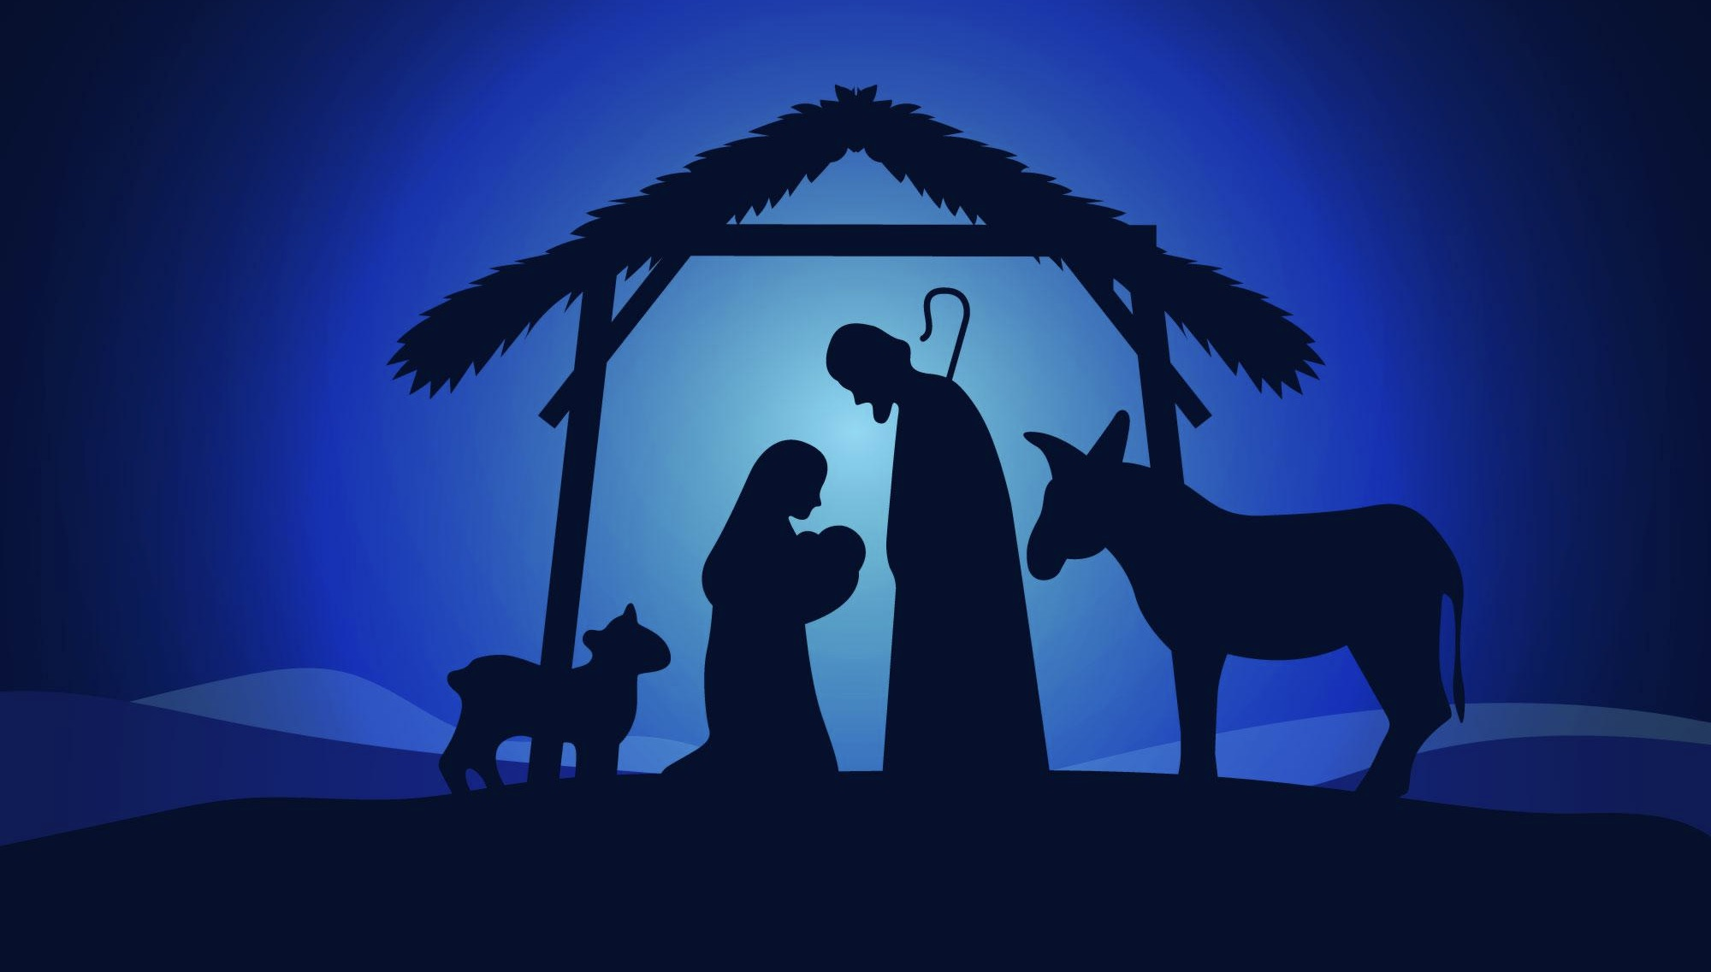
3. IN CHRIST WE DISCOVER OUTWARD PEACE – “Blessed are the peacemakers, for they will be called children of God.” (Matt 5:19) = our duty is to do our part to create peace with others.
“Love each other. Just as I have loved you.. Your love for one another will prove to the world that you are my disciples.” (John 13:34-35)
“Do all that you can do to live in peace with everyone.” (Rom 12:18)
Striving for peace with others (Romans 12:9-21) = really love others (don’t pretend) + hate what is wrong (be fair and just) + work hard (servant heart) + help those in need + practice hospitality + don’t seek revenge + love your enemies.
Notes:
Jesus commands us to strive for peace with those around us – particularly with fellow believers (John 13:34-35). We are to love others as we have been loved by Jesus. We are to forgive others as we have been forgiven. We were loved and forgiven even though we were enemies. But we often struggle to do that – sadly churches can be the most conflict riddled communities. A story is told of a man who was rescued after being alone on a desert island for 10 years. When the rescuers came to get him they were surprised to see three huts built on the beach. They asked him, “Why the three huts?” He said the first was is my house and the second one is my church. Ok! But what is the third hut for? The third hut is the church I used to go to before there was a split. So true, that Christians struggle to get along. But we are to do all we can to live in peace with one another. But understand that there will always be people who will never let you have peace with them. They did it with Jesus, they will do it with you. So how do we do our part to create peace? In Romans 12:9-21, Paul gives us some good strategies to create peace with others. Really love others (be willing to pay a cost and with no conditions), love your enemies (those who are hard to love). Have a servant heart, be willing to sacrifice the comfort of your home and table….

Slide 7
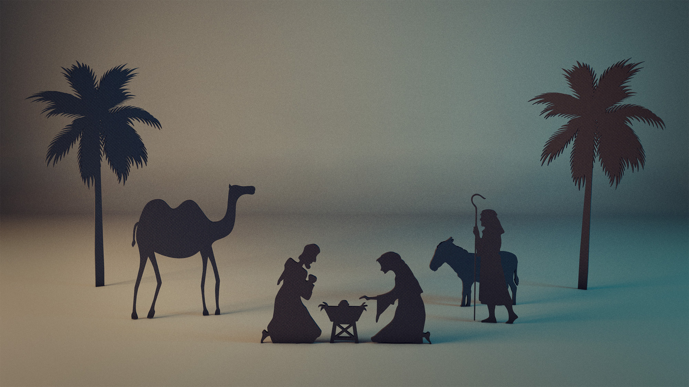
4. IN CHRIST WE HAVE ONWARD PEACE – “For to us a child is born.. and the government will be on his shoulders. And he will be called…. Prince of Peace. Of the greatness of his government and peace there will be no end.” (Isaiah 9:6-7)
“In this world you will have
trouble. But take heart! I have overcome the world.” (John 16:33)
“You, too, must be patient. Take courage, for the coming of the Lord is near.”
(James 5:8)
Jesus, as our Prince of Peace = we can boldly face each day (guarding our hearts) with the promise of the awesome peace that we will eternally experience with Him (Philippians 4:7).
Notes:
John 16:33 =Our peace will constantly be under attack in this world. We are made of flesh (sinful human nature) and so we will subject to ongoing emotional, physical and spiritual struggles. Satan will constantly try to accuse, tempt, entice and deceive us. But that will not always be the case. One day Jesus will return (not as a baby this time) but as a king and take his place on the throne. And we can guard our hearts during the times of conflict and trouble, with the eternal peace which He promises we will have. Its not easy to comprehend that sort of peace now (as we live in a fallen world that is impacted by sin) but here are a few verses to help us get an understanding of what God’s perfect peace looks like.

Slide 8
“The Lord will mediate between nations and settle international disputes. They will hammer their swords into ploughshares and their spears into pruning hooks. Nation will no longer fight against nation, nor train for war anymore.” (Isa 2:4)
“The wolf and the lamb will live together; the leopard and baby goat will lie down together. The calf will be safe with the lion, and a little child will lead them all. The cow will graze near the bear… The lion will eat hay like a cow….. a little child will put its hand in a nest of deadly snakes without harm. Nothing will hurt or destroy in all my holy mountain….” (Isa 11:6-9)
“… there will be no more death or sorrow or crying or pain. All these things are gone forever.” (Rev 21:4)

Slide 9
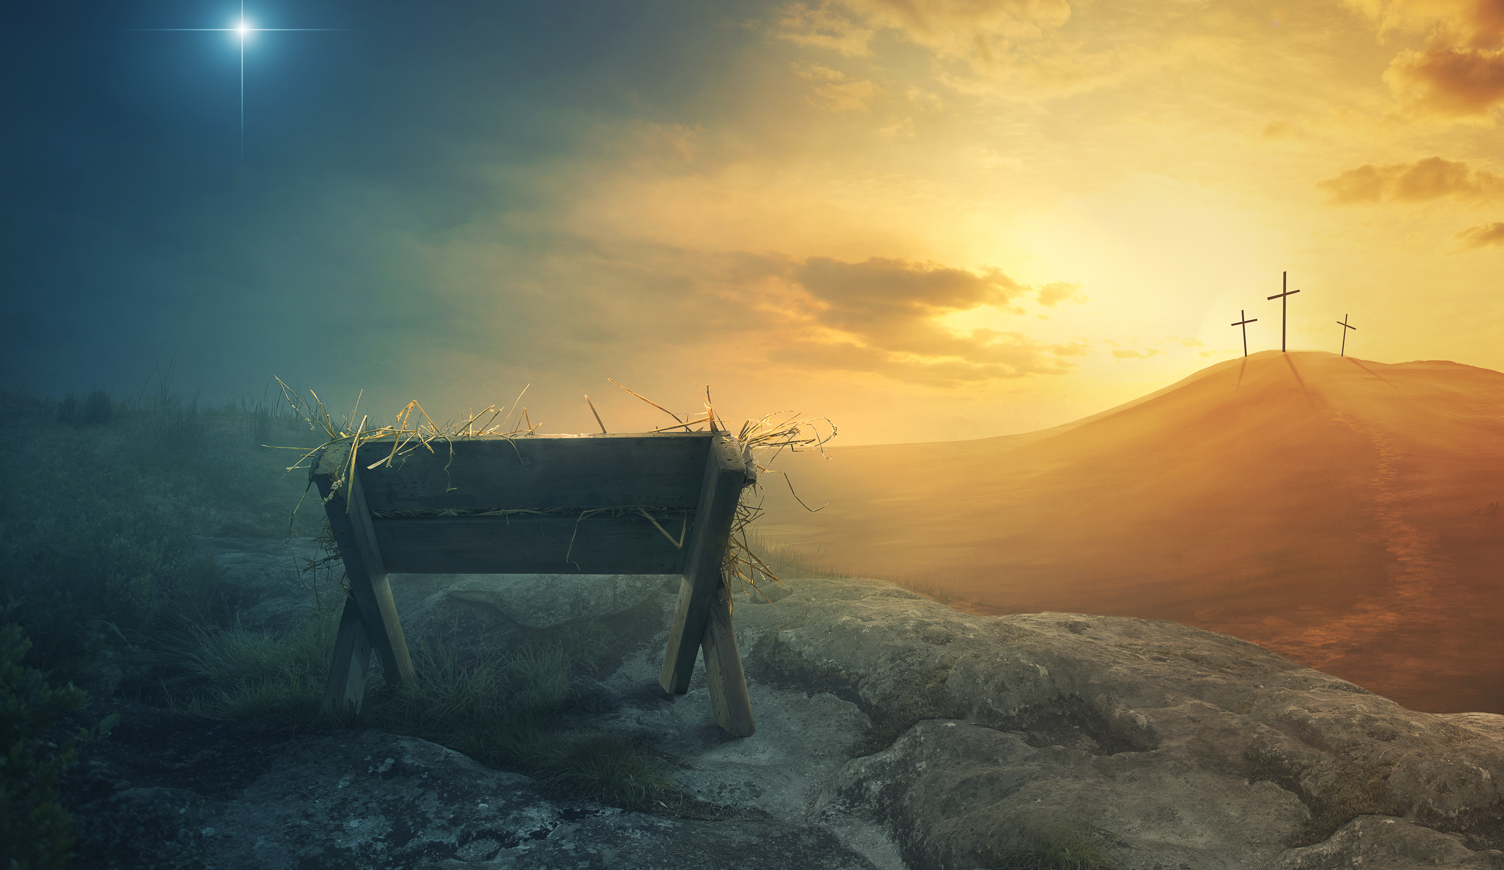
Jesus came to earth for the faithless, the joyless and the defeated. He didn’t come for the righteous. He came for sinners – the hostile, the lost, the guilty, the hurting and the doomed.
By his righteousness (not ours), He came to set us free and bring us the perfect peace we desperately crave – upward, inward, outward and onward peace.
“And if Jesus, the Prince of Peace sets you free, you are truly free.” (John 8:36)
“So come all you faithful, joyful and triumphant! Let us adore Him, Christ the Lord.” Our Wonderful Counsellor, Mighty God, Everlasting Father and Prince of Peace.

