Slide 1
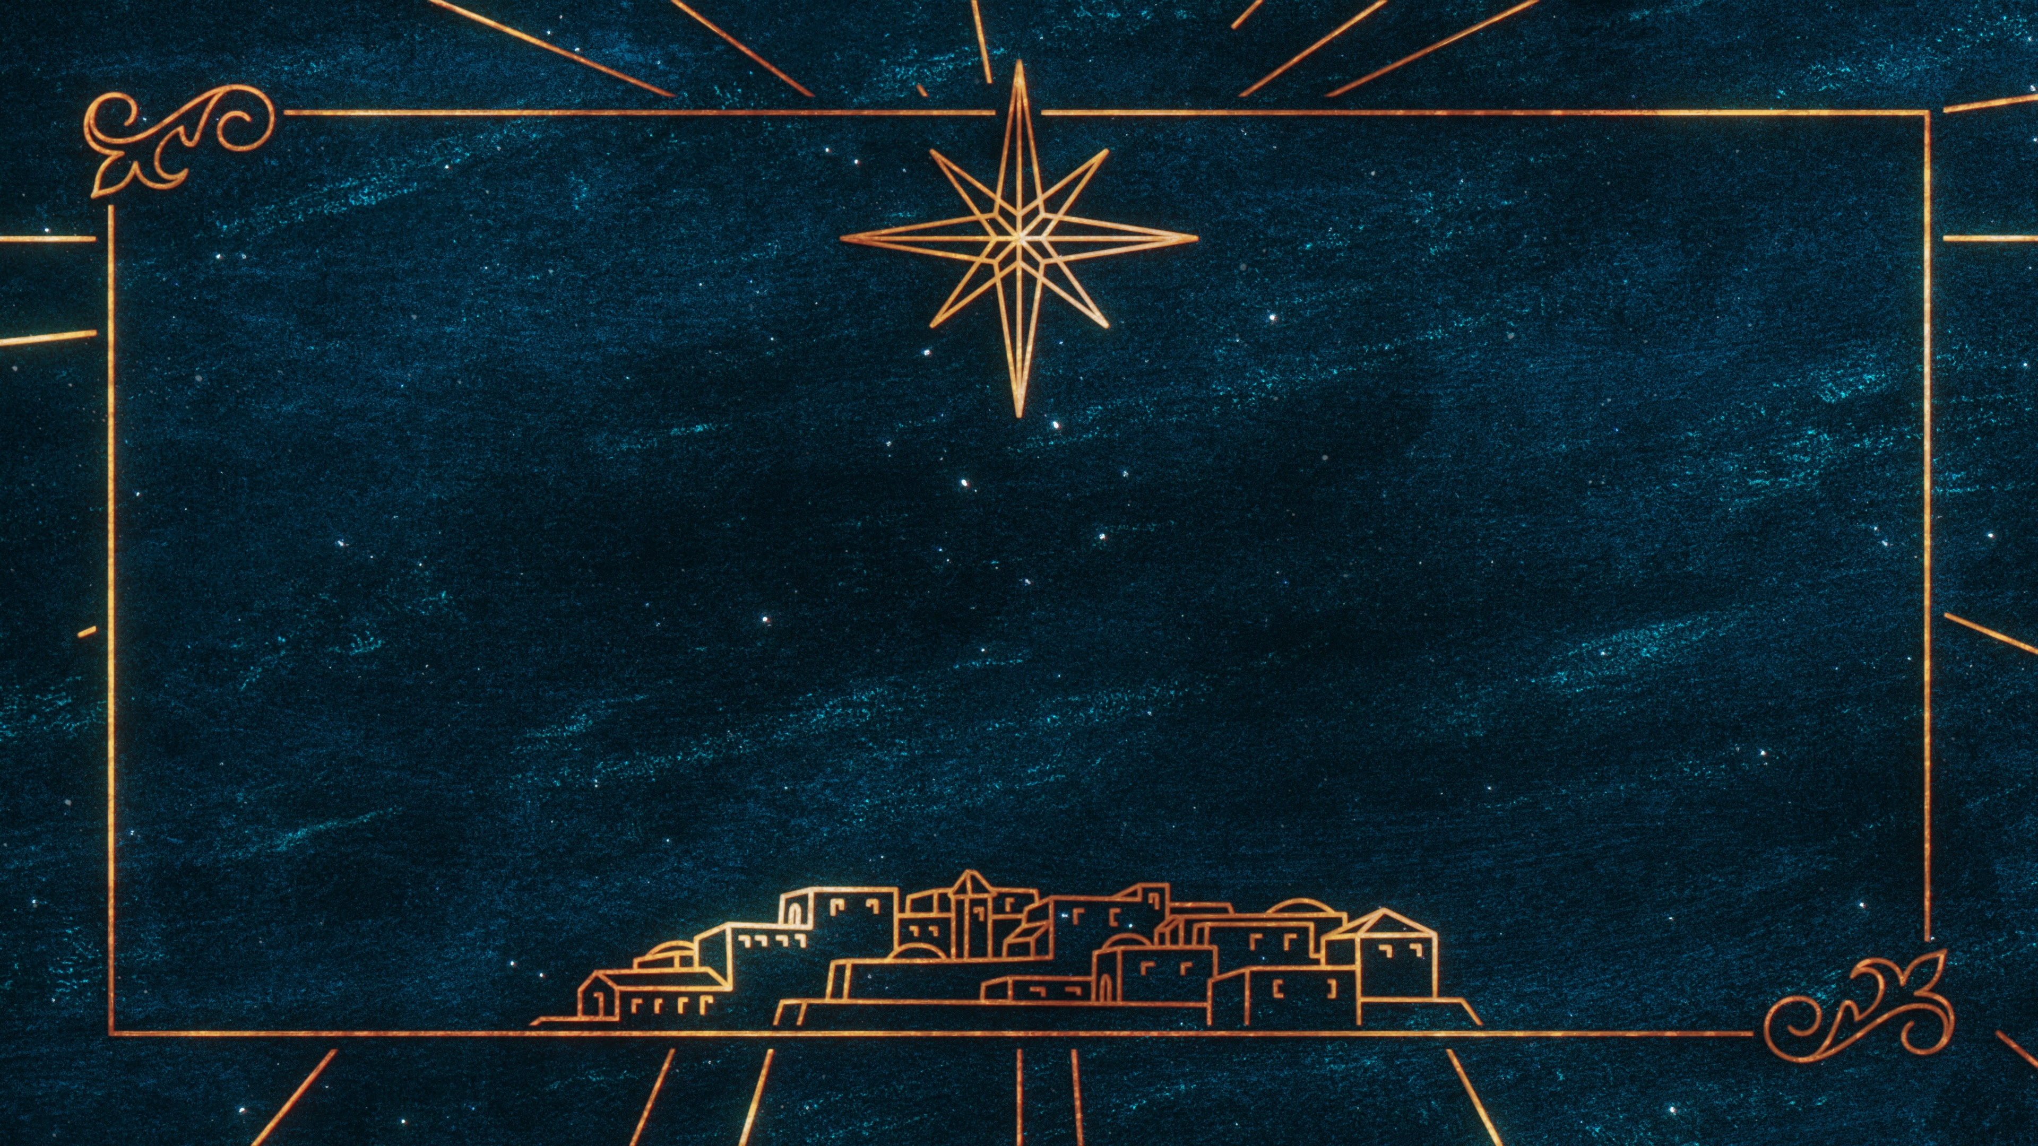
MORE THAN A BABY
Notes:
Good evening everyone. It’s so good to be here tonight as we sing songs with one another and remember the birth of Jesus Christ
My name is Harrison and I am the youth pastor here at this church
Tonight we are here to celebrate the birth of a baby. I have 2 boys, ages 3 and 1, and a third one on the way
And I love my kids deeply, and think they are unique and special and amazing in their own way
And yet, the baby we are going to be talking about tonight is so much more than a baby, for this baby would change the world as we know it

Slide 2
WHY CHRISTMAS?
“In the beginning God…”
God’s plan was that we would walk in close relationship with Him
We have all sinned, we all fall short of God’s glorious standard
Notes:
But before we get into talking about that special baby, we need to first go back even further to help us understand why we celebrate Christmas, why we needed the birth of this special baby
“In the beginning God…” - Before there was anything there was God - And God, the mighty Creator, spoke the universe into existence - He said let there be light, and there was light - And God said let there be plants, and animals and so they were created - God spoke the stars into the night sky and the sun and the moon, and all of this came into being by God speaking - When God speaks, big things happen
God’s plan was that we would walk in close relationship with Him - When God created humans, He made us out of the dust of the ground - There was something different about us. People were the most important part of God’s creation - Because He made us to be like Him, and He loves each and every one of you deeply - He wanted us to be friends with Him, to walk closely with Him, and to listen to Him - You see, God created us, so it makes sense that we should listen to Him - He loves us and created us and only wants what is best for us - The problem is that we don’t listen to God, we mess up, we choose to do the wrong thing because we think we know better than God - All of the wrong things that we do is what the Bible calls sin
We have all sinned, we all fall short of God’s glorious standard - …And as a result, we have made ourselves enemies of God - We turn our backs on God time and time again - God created us to live in close relationship with Him, but because God is a holy, and pure, and perfect God, He can’t be around sin - Sin is offensive to Him, He hates it - And so, we could no longer be with God, we could no longer walk closely with Him
However, God did not and would not leave us in this state of hopelessness - In God’s goodness, and in His love, He promised to send us a king - And this king who would change everything!

Slide 3
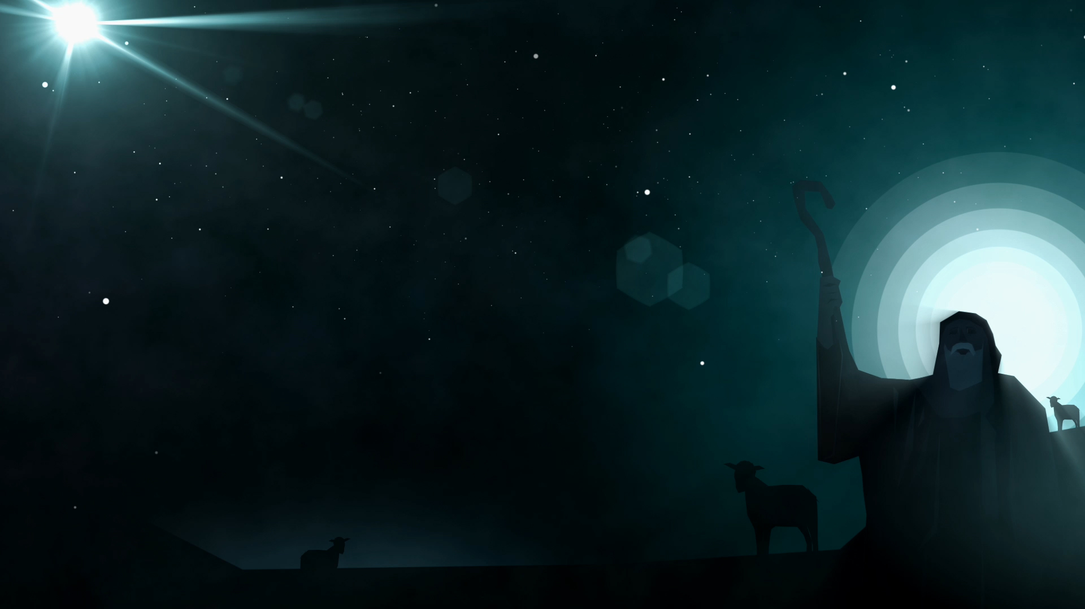
THE HOPE OF CHRISTMAS
The promised King was “wrapped in snugly strips of cloth and laid in a manger, because there was no lodging available for them”
This baby is the Messiah, the Christ = the anointed one, the chosen one
This baby is the Lord = this baby is truly God
Notes:
The promised King was “wrapped in snugly strips of cloth and laid in a manger, because there was no lodging available for them” - Most people born into royalty are born princes or princesses before they become kings and queens - But this baby was born a king. And yet he came into this world in a very ordinary way - There was no red carpet, no fanfare amongst the people of the land, and he was not born into a palace - He was born and laid down in an animal’s feeding trough - But this was to demonstrate to the world that he was born for ordinary people just like you and me. For anyone who will come to him and see that he is the only hope any of us have
This baby is the Messiah, the Christ = the anointed one, the chosen one - When the angels appeared before the shepherds in a bright light, they gave the baby 3 titles, the first one was Messiah, the Christ - It means anointed one, chosen one - The angels are saying that this is the king that was talked about in the Bible, 700 years before his birth - But the Jews thought this king was supposed to come and wipe out their great enemy, the kingdom of Rome - Jesus did come to wipe out an enemy, the world’s greatest enemy, the kingdom of darkness, of sin
This baby is the Lord = this baby is truly God - In the book of Matthew in the Bible, his name was called Immanuel, which means God with us - God is so for us, and loves us so much, that He came to be with us - And because Jesus Christ, this baby in a manger, is God, he was able to meet the standard of perfection, he was able to live his life perfectly, without ever sinning - He came to live the life we never could, so that we wouldn’t have to

Slide 4
This baby is the Saviour = The one who would save people from their sins
We did not deserve God’s love, but the birth of Jesus shows just how much God loves us, in sending him to save us
Whoever you are, Jesus can deliver you, help you, save you
Notes:
This baby is the Saviour = The one who would save people from their sins - Jesus sole purpose in coming to this earth was to save people from their sins - The one thing that separates us from God is our sin - And it is for that reason that Jesus was born into this world. - He stepped out of heaven to be born into this world and to save every single one of us from an eternity apart from God
We did not deserve God’s love, but the birth of Jesus shows just how much God loves us, in sending him to save us - The good news of Christmas and the good news of the Bible is that God being so rich in love does not ask us to fix the problem that we caused - In fact, we cannot fix the problem - Instead, He sends His one and only Son to be born into this world and to die in our place, taking on himself the sins of the world - He dealt with the problem of sin, so that we could enjoy a relationship with God once again
Whoever you are, Jesus can deliver you, help you, save you - I don’t know what this year has been like for you - But here’s what I do know. God loves you! God loves you so much that He would send His one and only Son, Jesus, who was born to die so that we might live forever - And he didn’t stay dead, after 3 days God brought him back to life. Death could not keep him down, Jesus had conquered sin, and Jesus is still alive today - No matter how bad you may think you are, no matter how many bad things you have done in your life, God’s love is bigger. - If you will trust in Jesus, he will deliver you, help you, forgive you, and save you

Slide 5
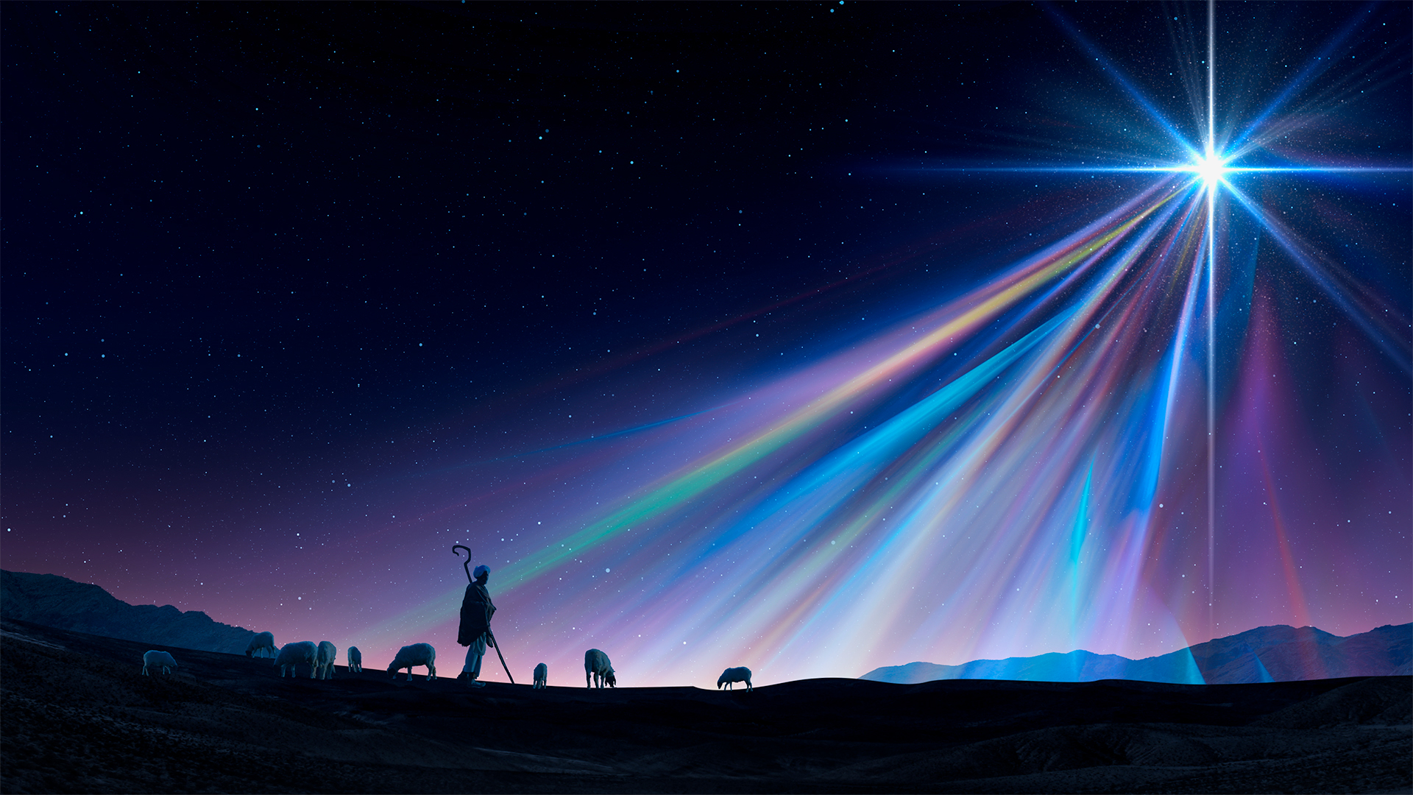
THE NEVER-ENDING CHRISTMAS
When Jesus comes back the second time, it will be to make all things new
We will see God face to face, and He will once again live amongst His people
“He will wipe away every tear, there will be no more death or sorrow or crying or pain. All these things are gone forever”
Notes:
When Jesus comes back the second time, it will be to make all things new - When Jesus came the first time, which is what we celebrate at Christmas, he came with an offer of peace between us and God - When Jesus comes back the second time it will be to make all things new and all those who have trusted in Jesus Christ will spend eternity in heaven with God
We will see God face to face, and He will once again live amongst His people - All throughout the Bible God says no one is able to look upon His face and live - But in heaven we will be able to stare into God’s face - It will be a place so beautiful that we couldn’t even begin to imagine just what it will be like - And it will be a place, just like God planned, where He will once again live amongst His people - “He will wipe away every tear, there will be no more death or sorrow or crying or pain. All these things are gone forever” - Parents of little babies, just stop and think about that for a second. There will be no more crying babies to wake you up in the middle of the night - There will also be no depression, no cancer, no mental illness, and no death. None of the bad stuff that we see in this world will be there - All of sin and evil will be gone forever, which is only able to happen because of the birth of Jesus Christ, because of Christmas

Slide 6
“If our greatest need had been information, God would have sent us an educator; If our greatest need had been technology, God would have sent us a scientist; If our greatest need had been money, God would have sent us an accountant; If our greatest need had been pleasure, God would have sent us an entertainer; But our greatest need was forgiveness, so God sent us a Saviour.” - Unknown
Notes:
“If our greatest need had been information, God would have sent us an educator; If our greatest need had been technology, God would have sent us a scientist; If our greatest need had been money, God would have sent us an accountant; If our greatest need had been pleasure, God would have sent us an entertainer; But our greatest need was forgiveness, so God sent us a Saviour.” – Unknown
In God’s great love for us, He sent us exactly what we needed
If you already know Jesus Christ as Lord and Saviour, then I pray that this Christmas will be a time of remembering and thinking upon the greatest gift you have ever received, which is Jesus Christ himself
If you HAVE NOT entrusted your life to Jesus Christ then let me tell you that your greatest need is forgiveness for your sins, your greatest need is a Saviour, and Jesus Christ was born that you might find forgiveness and be saved.
The question is, will you choose to put your trust in Jesus Christ?

