Slide 1
MIGHTY GOD Colossians 1:15-20
Either this man was, and is, the Son of God; or else a madman or something worse. You can shut him up for a fool … or you can fall at his feet and call him Lord and God.’” C.S. Lewis
Notes:
Good morning everyone. I hope you are all doing well
It’s been a while since I have been up here, but I am excited to be able to bring the message to you all
My prayer today is that we would all walk away being able to trust and lean into Jesus Christ more, trusting that God’s Word is true and that Jesus Christ is the mighty God who will not fail us
I know that for me this week in preparing this message I have certainly found that to be true. Because whilst this is probably one of the easier names out of the four names we are preaching on, it is a big one
It is one that is so central to the gospel message, that you don’t really want to mess it up. So I’m trusting that God will use me, that the words that I speak today will be used by God to draw you closer to Him
Many people today are happy to say, ‘I’m ready to accept Jesus as a great moral teacher, but I don’t accept his claim to be God.’ That is the one thing we must not say. A man who was merely a man and said the sort of things Jesus said would not be a great moral teacher… You must make your choice. Either this man was, and is, the Son of God; or else a madman or something worse. You can shut him up for a fool … or you can fall at his feet and call him Lord and God.’”

Slide 2
JESUS IS GOD
Paul wrote Colossians to fight off heretics who were proclaiming Jesus as one among a series of lesser spirits descending in sequential inferiority from God
”He is the image of the invisible God” (Col 1:15)
”For in him all the fullness of God was pleased to dwell, and through him” (Col 1:19-20a)
Notes:
Paul wrote Colossians to fight off heretics who were proclaiming Jesus as one among a series of lesser spirits descending in sequential inferiority from God - This cult or belief was known as Gnosticism, but there are cults out there today who would believe something similar to this, who would say they believe in Jesus, but not in the Jesus of the Bible - But we have to get Christ’s identity right, it matters what we think of Christ because his authority rests in who he is - So, I trust that today as we look at Jesus being God, the fact that he is Lord, the fact that he is sovereign, you will come to rest in Jesus, and find encouragement in the fact that he is “mighty God”, just as Scripture clearly tells us
“He is the image of the invisible God” (Col 1:15) - The word here used for image is the word we use for icon, meaning image or representation - Now, in Genesis we are told that we are all made in the image of God, we are to represent God, but we have been tarnished by sin - But with Jesus, he is the perfect manifestation of the invisible God. In him the very nature and being of God have been perfectly revealed
“For in him all the fullness of God was pleased to dwell, and through him” (Col 1:19-20a) - Just a couple of verses later Paul again reiterates, that God was simply delighted for his fullness to be expressed in His Son as a human being - He is the full, final, and complete revelation of God. - In the body of one human, Jesus of Nazareth, God was incarnated, God wrapped Himself in flesh

Slide 3
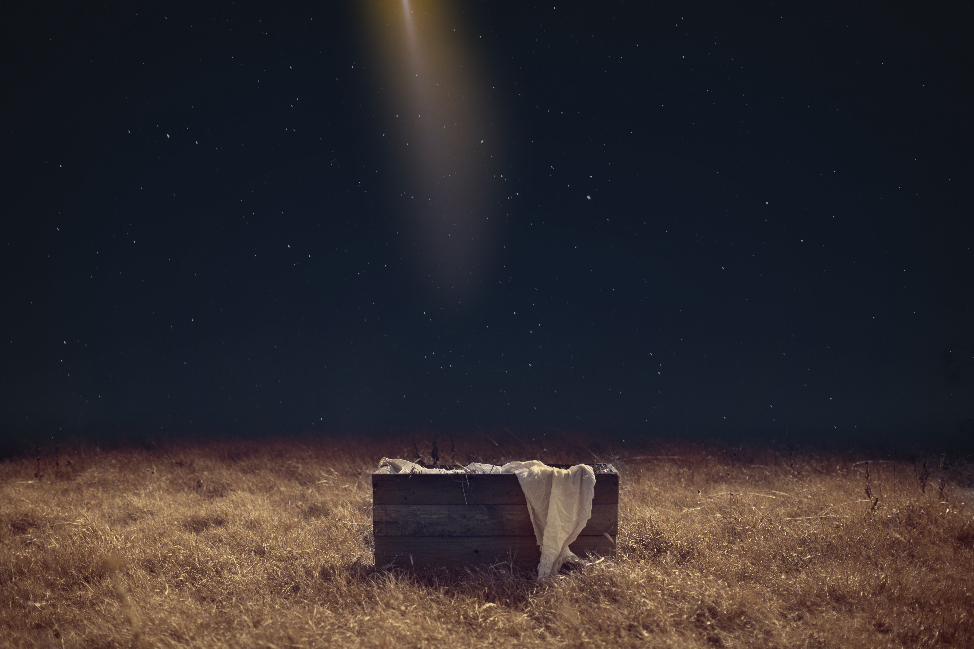
Jesus' name would be called Immanuel = God with us (Matt 1:23)
Jesus own testimony, and the unanimous testimony Scripture is that Jesus is God
Notes:
Jesus’ name would be called Immanuel = God with us (Matt 1:23) - God through His Word, has very deliberately gone to great lengths to make sure we understand that Jesus is God - He didn’t become God at the age of 30 when he began his ministry but has always been and always will be God - From the moment of conception, we are told that he is God, not just in name but even in the very way in which he was conceived - When God created the world, He created man in His image, and he held that man to perfect obedience, and God gave him a command, and promised him life if he kept it and death if he didn’t - And he didn’t, Adam and Eve sinned, bringing death into this world - So all who come from the line of Adam, of ordinary generation, are also born in sin, that’s all of us. - One of my Bible college lecturers put it like this, if you have a he-dog and she-dog, you get a puppy dog, so if you have a he-sinner and she-sinner, you get a baby sinner - But Jesus was not born of ordinary generation, but of extraordinary generation, through the virgin Mary - So he was not born into sin, but conceived by the power of God, so that he could be the perfect, spotless lamb of God, the once for all sacrifice
Jesus own testimony, and the unanimous testimony of Scripture is that Jesus is God - Multiple times in the Old Testament when it is pointing forward to Jesus Christ, we are told that he will be God - And Jesus himself, particularly in the book of John, tells us that he and the Father are one, that he is in fact God, the great I AM. - The testimony of the apostles as recorded in Scripture is that Jesus is God. - And the testimony of the 500 witnesses after Jesus rose from the grave, defeating death, is all the same, ‘Dead on Friday, alive on Sunday’ which is only possible if he is in fact God - And we know that one day when Jesus returns, when he will set things right, his glory will be on full display for all to see and every knee will bow, and every tongue confess that Jesus Christ is Lord - JESUS IS GOD. - But just incase you don’t believe these things, Paul goes onto demonstrate the ways in which Jesus truly is sovereign, truly is above all, so that we would not believe the lie that Jesus isn’t God

Slide 4
JESUS IS CREATOR AND SUSTAINER
“For by him all things were created, in heaven and on earth” (Col 1:16)
“Visible and invisible, whether thrones or dominions or rulers or authorities – all things were created through him and for him” (Col 1:16b)
“And he is before all things, and in him all things hold together” (Col 1:17)
Notes:
“For by him all things were created, in heaven and on earth” (Col 1:16) - Christ created everything in heaven and on earth - Jesus was there with God the Father, in the beginning when they created the heavens and earth, in fact he was there when it was empty, when there was nothing, for Jesus is co-equal and co-eternal as God - What makes this so amazing is that Jesus Christ the Son of God, the Creator of the world, would be willing to become a creature in the world, that we might be saved
“Visible and invisible, whether thrones or dominions or rulers or authorities – all things were created through and for him” (Col 1:16b) - Christ didn’t just create the things we see, but even the unseen world, both physical and spiritual. - Nothing exists without the sovereign working of the trinity, God the Father, God the Son, God the Holy Spirit - And because all has Christ as its originator, and all have him as their final deposer, then Jesus will have the final word. - So those who accept their Creator, believe in Jesus Christ as he has revealed himself, get his acceptance and love, but all who reject the Creator, deserve his wrath, deserve his rejection, which is exactly what will happen
“And he is before all things, and in him all things hold together” (Col 1:17) - Not only did Christ create everything, both visible and invisible, but he sustains everything, both seen and unseen - Christ continues to hold all things together, all things would disintegrate without him. - It is only by his mercy, that I have been given another day here to live, and it is only by God’s grace and His desire to see more people adopted into His family that the world is still in motion - The Godhead is actively involved in sustaining His creation moment by moment

Slide 5
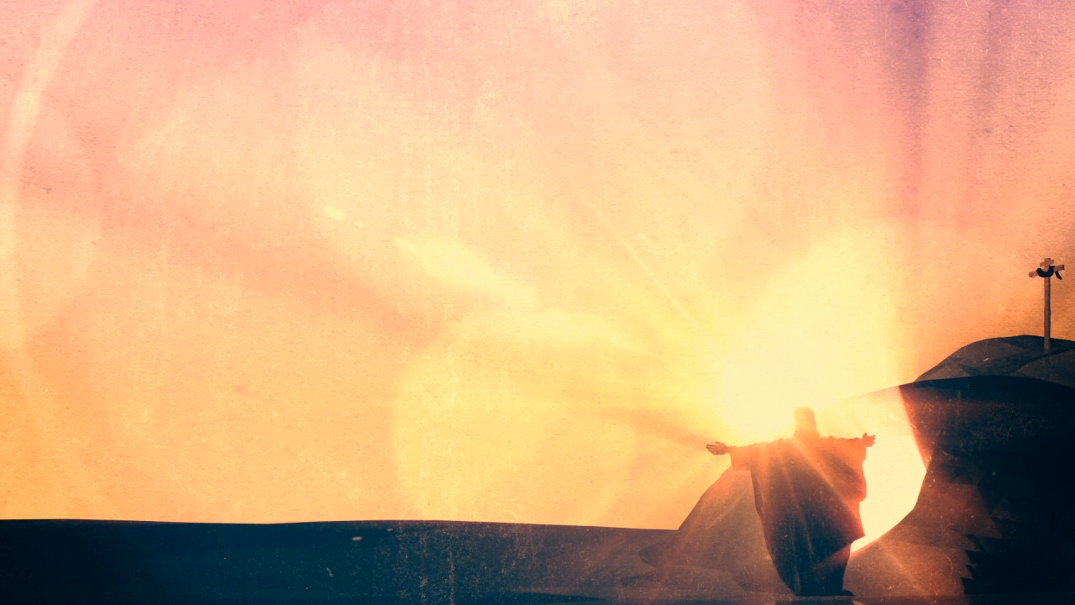
JESUS IS ABOVE ALL
“The firstborn of all creation” (Col 1:15b)
“And he is the head of the body, the church.” (Col 1:18a)
“He is the beginning the firstborn from the dead.” (Col 1:18b)
“That in everything he might be preeminent” (Col 1:18c)
Notes:
”The firstborn of all creation” (Col 1:15b) - Now I have deliberately used the ESV translation, because these verses are often cited by people like JW’s who believe Jesus was God’s first creation, or Mormon’s which believe that Jesus was the spirit child of a heavenly father and heavenly mother - Now obviously firstborn can mean first child, but it is very often simply a term which means first in rank of honour, or first place, supreme over. - Elsewhere in the Bible God calls Israel His firstborn, but clearly this isn’t literal, because they weren’t the very first nation to ever exist, but rather they hold a special place of privilege and blessing among the nations simply because in God’s grace He chose them - So what is being said here is simply that the highest honour belongs to Jesus Christ in creation
“And he is the head of the body, the church.” (Col 1:18a) - As believers, as a church, Christ is our head and it is him that we answer to, it is him that we submit to, because he is the Son of God and it is his blood that has paid the price of sin and given us new life - So he doesn’t just have first place in creation, but in the Church as well
“He is the beginning the firstborn from the dead.” (Col 1:18b) - Again, Jesus wasn’t the first person to be raised from the dead, but his death and resurrection is the only one that secures salvation for all who will believe - It is because of his death and resurrection that we can have hope in our future resurrection, because it means the payment for our sins was accepted, that death has been defeated - We will all die one day. Death is the final enemy, but if we have placed our faith in Jesus Christ, we have already won - That is why he is supreme over all those who have been raised from the dead
“That in everything he might be preeminent” (Col 1:18c) - Preeminent means surpassing all others, or very distinguished in some way - And so, Jesus surpasses everything because he is God - Christ stands at the beginning of the universe, as Alpha, as the one, by and through whom, all came into being, and he stands at its end, as Omega, as the goal of the universe - Jesus Christ is the Alpha and the Omega, he is above all

Slide 6
JESUS WILL MAKE ALL THINGS RIGHT
The fullness of God was pleased to dwell in and through Jesus, to reconcile to himself all things (Col 1:19-20)
The one who is fully God and fully man is able to bring both sides together
“Making peace by the blood of his cross” (Col 1:20b)
Notes:
The fullness of God was pleased to dwell in and through Jesus, to reconcile to himself all things (Col 1:19-20) - The wonder of Christmas is that God’s answer to everything that has ever terrorised us, and the dark world that we live in, is a little baby boy, Jesus Christ, to whom all things are reconciled - To be reconciled to God is an explicitly one-sided process! He does virtually everything. All he asks is for us to count the cost and believe - What this says to me is the ‘Mighty God’ is a good God, because even though he created everything, and sustains everything, and we deserved nothing as enemies of God. - He still, in his love and mercy, chose to come and be the way, the truth and the life, and give his own life so that we could receive eternal life
The one who is fully God and fully man is able to bring both sides together - All things no longer bear the relationship to their Creator that they were intended to have. Thus, we are in need of reconciliation - Salvation is the joyous work of an almighty, all-powerful God, who is both holy and just and yet in sending His Son to die for us demonstrates the depth of His love and grace for a sinful and rebellious creation - It is only because Jesus Christ is the God-man, that God and man are able to be reconciled, that the broken relationship between us and God is able to be mended
“Making peace by the blood of the cross” (Col 1:20b) - Our personal reconciliation took nothing less than the death of God’s Son; but its effects went far beyond any human death - The work of Christ on the cross, has in view not only our reconciliation but the reclamation of the universe - Which will one day happen when Jesus returns to crush Satan and wipe away sin once and for all - Jesus is above all and will one day make all things right because Jesus is God

Slide 7
STATE OF THEOLOGY SURVEY 2022
Survey done by Ligonier/Lifeway Research in 2022 - 3000 participants, 700 called themselves evangelicals
56% of evangelicals believe God accepts the worship of all religions
65% of evangelicals believe everyone is born innocent in the eyes of God
43% of evangelicals believe Jesus was a great teacher, but he was not God
Notes:
Survey done by Ligonier/Lifeway Research in America in 2022 - 3000 total adult participants, 700 of which called themselves evangelical Christians
56% of evangelicals believe God accepts the worship of all religions
65% of evangelicals believe everyone is born innocent in the eyes of God
43% of evangelicals believe Jesus was a great teacher, but he was not God - It is a sad state of affairs when effectively what this is saying is these people have stopped treating the Bible as God-breathed, as inspired by God, as without error, as sufficient - Pastors must labour to preach and teach and live out the word faithfully so that followers of Jesus, the bride of Jesus Christ do not fall into such error - And we all must labour to stay faithful to the Word of God, even if pastors do not teach the Word of God

Slide 8
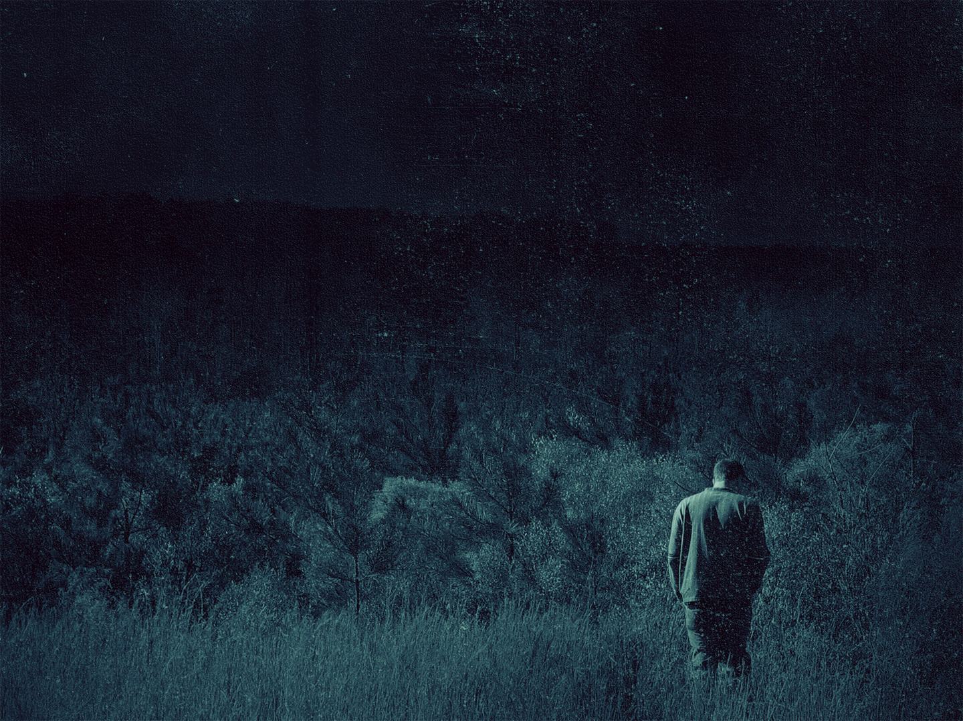
IF JESUS IS NOT GOD…
Then he’s not good man, teacher, or prophet
Then we cannot trust the Word of God
Then his death was meaningless, so far from being the satisfaction for sin, but a death most rightly deserved
Then we have no salvation, no gospel, and no hope
Notes:
Then he’s not a good man, teacher, or prophet - He is not a good man if he goes around lying about his identity - He is not a good teacher if he walks around deceiving - He is none of these things if he is not God. But rather, he was an impostor, the grandest and the greatest of deceivers to have ever lived
Then we cannot trust the Word of God - We cannot trust the promises that Christ gives because he has lied about his very identity, which Scripture declares all throughout - If he is not God, then we cannot trust the word of mere man, for us as humans often fail to live up to our word, Jesus would be no better than us
Then his death was meaningless, so far from being the satisfaction for sin, but a death most rightly deserved - On the day of Jesus’ crucifixion, he was brought before the Sanhedrin and was charged with blasphemy, He was sentenced to death because of his claims of being one with the Father - But if he is not God then his condemnation and death for his blasphemy was the most just sentence ever pronounced, and the most righteous execution that has ever been performed
Then we have no salvation, no gospel, and no hope - If Christ’s death be deserved and just, and if he truly was a blasphemer, then he was just another ordinary man, another sinner like you and me - And his death was no satisfaction for sin - There is no gospel, no good news, no hope. Only the bad news that there is no way out. Our paths all point to one destination, an eternity in hell

Slide 9
BECAUSE JESUS IS GOD…
Then we can trust the Word of God, and every single promise that is in it
We know that he sits at the right hand of God, hearing our prayers and interceding for us
The gospel is indeed good news, we have salvation, hope, and assurance
We know that Satan has been defeated and Jesus will return one day to set everything right
Notes:
Then we can trust the Word of God, and every single promise that is in it - You can trust that when Jesus declared that he would be with us until the end of the age, that it’s true - You can trust that he is the same yesterday, today, and forever - You can trust that when temptation comes your way, that if you will trust in Jesus Christ, you can overcome - You can trust that when you do sin, the blood Jesus shed on the cross is enough, it is sufficient and has paid your debt, and you will be forgiven, cleansed whiter than snow
We know that he sits at the right hand of God, hearing our prayers and interceding for us - He sees your tears, the things that keep you up night - Jesus Christ, the Creator and Sustainer of both the visible and invisible world, the one who is above all, hears your prayers and is interceding for you
The gospel is indeed good news, we have salvation, hope, and assurance - Because Jesus is God then his death is enough, and because he is the perfect spotless lamb of God, without sin, then he truly was the satisfaction for sin and the wrath of God - If you will believe in Jesus Christ as Lord and Saviour, your debt has been paid, and because he rose again you have been justified. - Meaning, that because Jesus took your sin, you get his righteousness, which means that when God looks at you, instead of seeing a sinner, he sees perfection, he sees Jesus, the Son of God - But more than that, it means that you can have complete assurance of your salvation, because it rests not in the hands of a mere mortal, but in the hands of God almighty
We know that Satan has been defeated and Jesus will return one day to set everything right - We need not fear the things this world throws at us, we must press on in Christ Jesus - For there will come a day when Jesus will return with a mighty army, and he will wage war against all those who have rejected him - And at this time our hope will be fully realised and we will spend the rest of eternity living in the light of the glory of God, we will have a seat at the table with the Creator and Sustainer of all things

Slide 10
SUMMARY
Testimony of Scripture, Jesus’ own words and works declare that Jesus is God
Thus, Jesus is sovereign, he is above all in the visible and invisible world
Jesus will one day return to call his people home and to crush sin and Satan once and for all
Notes:
Testimony of Scripture, Jesus’ own words and works declare that Jesus is God - To say that Jesus is God is to agree with Scripture, to agree with what Jesus said about himself - Jesus also healed many diseases, silenced the sea with his words, brought people back from the dead, preached with authority, loved radically and forgave sins - Jesus not only declared with his mouth that he was God, but declared with his deeds that he is God
Thus, Jesus is sovereign, he is above all in the visible and the invisible world - These things we now know to be true. Jesus is first, he is above all, he deserves the place of highest honour in our lives - But is that the case in your own life? Does he truly get the priority he deserves in your life? Do you do all things for the glory of God, or for your own glory?
Jesus will one day return to call his people home and to crush sin and Satan once and for all - Rev 19:11-16 - Sin will have completely lost its sting, Satan will have been cast into hell with the rest of those who have rejected Jesus Christ - And all of those who have turned away from their sin to believe in Jesus Christ as Lord and Saviour will spend forever, free from the very presence of sin, praising the King of kings and the Lord of lords

Slide 11
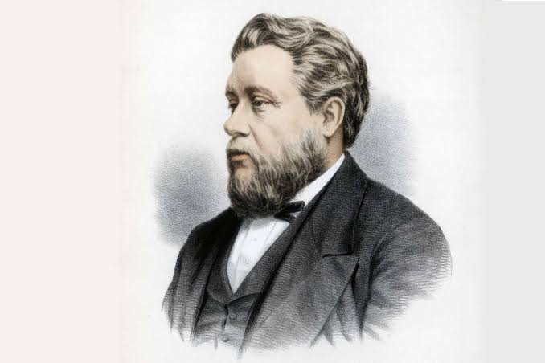
My soul bears record that what has been done for me could never have been done by a mere man; and you would rise from your seats, I am sure, if it were needful, and say, "Yes, he that has loved me, washed me from my sins, and made me what I am, must be God, none but God could do what he has done, could bear so patiently, could bless so lavishly, forgive so freely, enrich so infinitely. He is, he must be, we will crown him such—"The mighty God.” Charles Spurgeon
Notes:
My soul bears record that what has been done for me could never have been done by a mere man; and you would rise from your seats, I am sure, if it were needful, and say, "Yes, he that has loved me, washed me from my sins, and made me what I am, must be God, none but God could do what he has done, could bear so patiently, could bless so lavishly, forgive so freely, enrich so infinitely. He is, he must be, we will crown him such—"The mighty God.” Charles Spurgeon
Christian, cling tight to Jesus Christ, the mighty God
To those who do not believe in Jesus Christ, let today be the day that you believe in Jesus Christ, that you surrender your life to the mighty God, for he is your only hope
Let’s pray

