Slide 1
Father Absence, Father Deficit, Father Hunger (Psychology Today) - “Fatherlessness is the most harmful demographic trend of this generation."
Behaviour, academic performance, delinquency, substance abuse, physical & mental health, unemployment, mortality rate..
‘Father hunger’ is also a spiritual issue.
“Just as we were created to have a loving, healthy relationship with our earthly fathers, we were also created to have a loving, healthy relationship with God, our heavenly father.” (Brian Hedges)
Notes:
A few years ago an article appeared in US magazine Psychology Today that lamented the lack of fathers in our society. A father hunger has huge impact on children – behavioural problems, poorer academic performance, increased use of alcohol, cigarettes, drugs. Also impacts physical health (chronic pain, asthma, headaches) and mental health (anxiety, depression, suicide), poorer life choices leading to unemployment, mortality rate (die 4 years earlier). But father hunger is not just a social issue, it’s a spiritual issue. And that’s where Jesus helps us out.

Slide 2
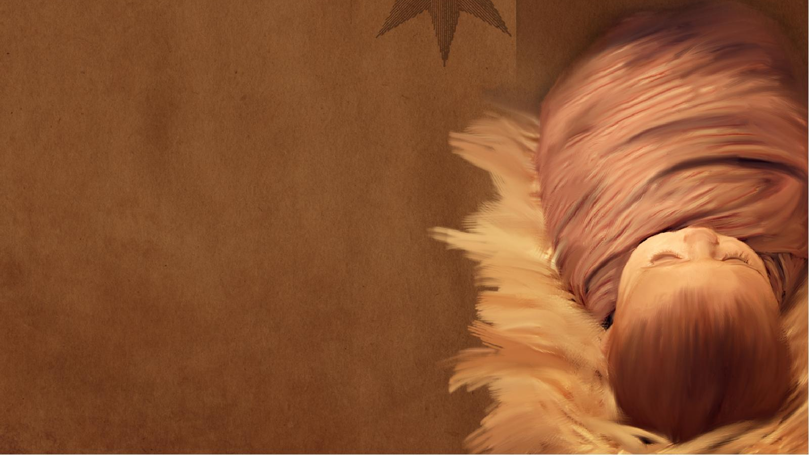
“For a child is born to us, a son is given to us…. And he will be called Wonderful Counsellor (follow Him), Mighty God (take refuge in Him), Everlasting Father, Prince of Peace.” (Isaiah 9:6)
(Isaiah 40:28-31, Romans 8:31-39)
Notes:
Jesus is the greatest gift that God has ever given this world - thank God for his indescribable gift (2 Cor 9:15). But unlike any other baby he is worthy of worship, he is complex, not to be underestimated. The prophet Isaiah reveals how awesome and indescribable Jesus is. This little child that we celebrate at Christmas is anything but helpless. There is so much about him that we struggle to grasp. He gives him 4 titles, which we have been looking at during December. First one was Wonderful Counsellor and we saw how Jesus has the ultimate ideas and strategies for us, so we should confidently follow Him. We also saw that he is also Mighty God – supreme in power and sovereign, able to do what He says, defeat his enemies so we should take refuge in him. Today we are going to look at the the third title – that of Everlasting Father. This is arguably the toughest title to understand – how can Jesus, the son of God, be called Father?

Slide 3
EVERLASTING = this tiny infant is infinite, the centre of God’s eternal plan and the reason for our hope, comfort and joy.
Infinite Jesus = we have valid faith & get no pity. (1 Cor 15:12-19)
He is uncreated, eternal & independent (Col 1:15-17) - the same yesterday, today & forever” (Heb 13:8).
“I am the living one. I died, but I am alive forever and ever! I hold the keys of death and the grave.” (Rev 1:17-18)
“Since I live, you also will live.” (John 14:19)
He never ceases to be, sitting at God’s right hand interceding for us = we can confidently approach God and receive His mercy and find grace to help us when we need it most. (Heb 4:16)
Notes:
Everlasting – sets Christianity apart. Every other religious leader is either alive or dead. Jesus is the only one who was dead and now alive. Our King, Saviour and mediator is alive. Paul tells us in 1 Corinthians that if he had died and stayed dead then our faith is useless, our confidence and hope is misplaced. We are to be pitied by others. But Jesus is infinite. There is not a time where he is not interceding for us. There is nothing we can do that is too bad to undo what he has done. Because he lives, we will live also. Nothing can change that – no need to fear death, doubt our salvation and the promises of God.

Slide 4
EVERLASTING FATHER (WHAT IT DOESN’T MEAN)
Not saying that Jesus the Son is the same as God the Father.
“May the grace of the Lord Jesus Christ (Son), the love of God (Father), and the fellowship of the Holy Spirit be with you all.” (2 Cor 13:14)
Trinity = there is one God, in three eternally existing persons, each fully God, but different in the way they relate to the world.
Notes:
Will firstly look very quickly at what this is not saying. One of the key doctrines of the Christian church is the doctrine of the Trinity. While not specifically mentioned in the Bible there are a number of verses that refer to God in three persons. Now there is a wrong teaching on this called modalism which says that God is one manifesting himself in three different ways. God in the OT, Jesus in gospels and Holy Spirit in NT. When God is God, he is not the son or Holy Spirit. When God is Jesus, He is not God etc; Not saying that Jesus the son is the same as God the father. God the father did not die on the cross for our sins. Jesus did not send the Father to the world, the Holy Spirit was not born of virgin. God didn’t cease to exist when Jesus came to earth. God and Jesus didn’t cease to exist when Spirit came at Pentecost. The Trinity is not an easy concept to grasp but this is not attacking the truth of the Trinity. Scripture (Gods Word) will not contradict itself. So what does everlasting Father mean?

Slide 5
Everlasting Father = “a descriptive analogy pointing to Christ’s character. He is fatherlike in how he relates to us and treats us.” (Sam Storms)
“If you had really known me, you would know who my Father is. From now on, you do know him and have seen him!”
(John 14:7)
You can’t see the Father yourself, but I am revealing Him to you.
Notes:
In Middle Eastern cultures that’s what first born sons did – they represented father in his absence. Jesus reveals God’s fatherlike traits to us. He said that on a number of different occasions to his disciples. When they said we don’t know the father he said that you should because you have seen me and know me.

Slide 6
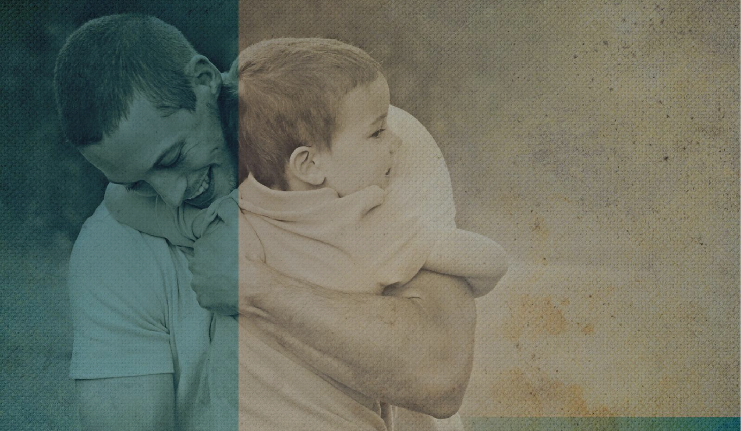
EVERLASTING FATHER – WHAT IT DOES MEAN.
A. Father of eternity = the author and originator of eternity. Satan – lies (John 8:44), Jabal – raising livestock & living in tents (Gen 4:20), Jubal – playing the harp & lute (Gen 4:20).
He controls time – the Alpha and Omega (Rev 22:13) AND we can’t get eternity without him (John 3:16). “He came to earth to reveal and share eternity.” (Warren Weirsbe)
“God has planted eternity in the human heart” (Eccles 3:11) = we were created to live forever in the presence of God = we were made for something more than this life/world can offer.
Notes:
A. Everlasting father in original Hebrew reads father of eternity. Father = originator and author of something. Bible tells us that Satan is the father of lies. Two brothers Jabal and Jubal were fathers of farmers and musicians. In the world we use the same term to describe the originators of things. For example, Michael Faraday is the father of electricity and WG Grace is know as the father of cricket. Jesus controls time and we can’t get eternity without him. He is the only one who opens the door to eternity. In Ecclesiastes 3:11 God tells us that he has planted eternity in the human heart – this is the spiritual father hunger I mentioned at the start of this message. Every human being knows that we were made for something more – part of the reason that human beings struggle to know peace and satisfaction in their lives.

Slide 7
Eternity is not just living forever. Rejecting Christ = living forever in shame, contempt & torment (Dan 12:2, Matt 25:41, Rev 20:10).
“And this is the way to have eternal life - to know you, the only true God, and Jesus Christ, the one you sent to earth.” (Jn 17:3)
The eternity that God has set in our heart = enjoying the greatest, most beautiful, most satisfying and glorious gift ever = HIM = making much of Him, not ourselves.
“Eternity to the godly is a day that has no sunset. Eternity to the wicked is a night that has no sunrise.” (Thomas Watson)
Notes:
Eternity that God promises is not just living forever – for every soul lives forever, but for those who reject Christ live forever in shame and suffering, away from the presence of God. Jesus himself gives us a more meaningful explanation of what he means by eternal life. It is living in the presence of God and enjoying an intimate relationship with him (like it was in the garden of Eden). It is centering our life around God, not ourselves. Living for Him, not us.

Slide 8
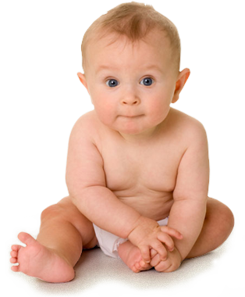
B. Father of new life – “Whoever has the Son has life; whoever does not have God’s Son does not have life.” (1 John 5:12)
“Anyone who belongs to Christ has become a new person. The old life is gone; a new life has begun!” (2 Cor 5:17)
By his life and death we are no longer bound by sin & the fear of death (justified, glorified) – the author & perfector of our faith (Heb 12:2).
By the power of the Holy Spirit, He will give us new desires, priorities, inclinations, loves & truths (sanctified) = be conformed to His image (Rom 8:29).
Notes:
Out of every nation, people and language he will gather people to Him and they will live through the power of the Holy Spirit. Through sanctification we will start to look more and more like Him. We will have victory in our battle over sin. He doesn’t just bring us to faith – he continues to work in our life to perfect our faith.

Slide 9
C. Eternally exercises God’s Fatherly love and tenderness to all who trust in Him – worthy of worship, honour & obedience.
Never abandons us (Matt 28:20, John 14:18).
Provides for & equips us (Acts 1:8, 1 Cor 12:7-15).
Always patient, even when we sin (2 Peter 3:9 & 15).
Guides & disciplines us (John 16:13, 2 Tim 3:16).
Protects, nurtures & cares (Isa 40:11).
Comforts, listens & intercedes (Matt 11:28, Heb 7:25).
Jesus will not lose any of God’s children (John 6:39) = “There is no unfathering Christ and no unchilding us.” (Spurgeon))
Notes:
Never abandons – won’t leave us as orphans, I am with you always (not just in good times).
Provides for and equips us– strength and gifts for all we need to do
Compassionate and understanding – invites us to bring our cares to him, lives to intercede for us.
Protects and cares – our great shepherd, feeding, holding, guiding
Guides and disciplines – through the Holy Spirit he guides us into all truth. Timothy tells us that the truth (scripture) is suitable for teaching, correcting and rebuking.
Jesus will not lose any that the father gives him (John 6:39)

Slide 10
There are substitute ‘fathers’ that will rob us of the ‘abundant life’ that God wants us to enjoy (John 10:10) = father deficit.
Father Abraham (John 8:39) = we can trust in our heritage and traditions, in who we are & what we have done.
Father Christmas = being nice more than naughty. The peace, joy, goodwill & satisfaction we crave = gifts, family, feasting & living for the moment. “Eat drink & be merry.” (Luke 12:19)
Jesus, our Everlasting Father = the only way we can know & eternally enjoy God’s amazing grace & his abundant blessings.
Notes:
Father Abraham (those who are religious) – Jews arguing with Jesus about the need for them to put their faith in Him and obey God as their father. They said we already have a father – Abraham has built up enough credit for us, we belong to Abraham (God’s chosen people), we can rest in who we are and what we do. Its religion not Jesus. Second option is Father Christmas(those who are – its all about naughty and nice. As long as our niceness outweighs our naughtiness then we deserve reward. You can earn the blessings/gifts. Its all about seizing the moment, joy is dependent on the circumstances. Its all about things of this world, family, food. Eat drink and be merry.

Slide 11
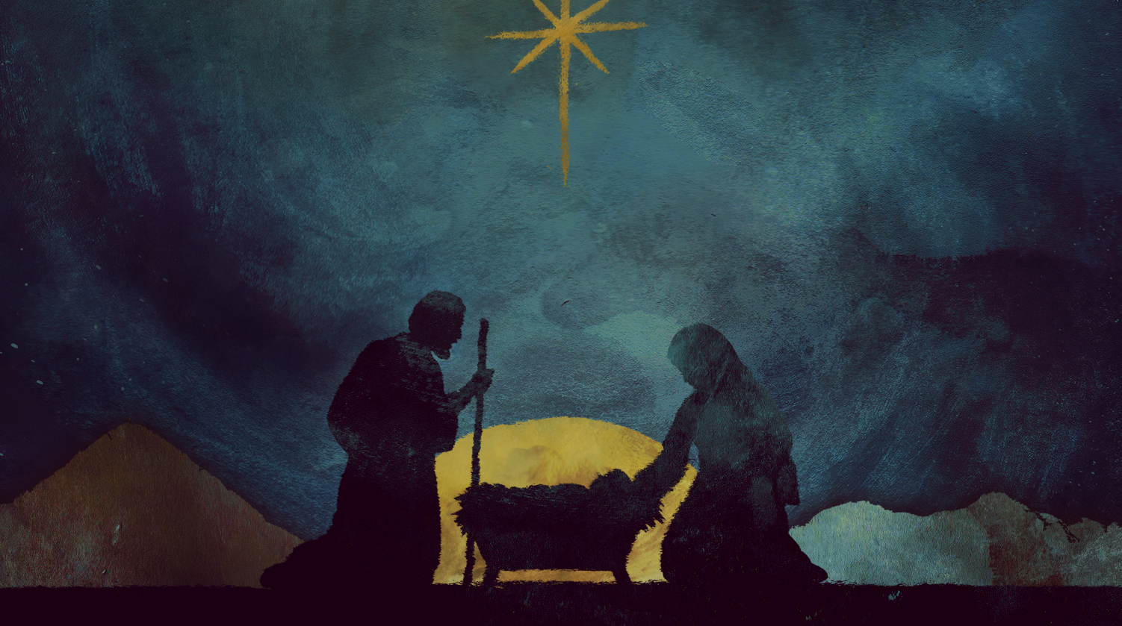
“If God is for us, who can ever be against us? ... Who will ever condemn us? No one - for Christ Jesus died for us and was raised to life for us, and he is sitting in the place of honour at God’s right hand, pleading for us. Can anything ever separate us from Christ’s love? … Trouble, calamity, persecution, hunger, destitution, danger or threat of death? No, despite all these things, overwhelming victory is ours through Christ, who loved us. And I am convinced that nothing can ever separate us from God’s love. Neither death nor life, neither angels nor demons, neither our fears for today nor our worries about tomorrow - not even the powers of hell can separate us from God’s love…. Indeed, nothing in all of creation will ever be able to separate us from the love of God that is revealed in
CHRIST JESUS OUR LORD (Everlasting Father).”
(Rom 8:31-39)
Notes:
This Christmas as we celebrate the birth of Christ lets remember all that He is – He is our Lord, Saviour and everlasting father. And because of that we can claim all of the everlasting promises that God gives us. That’s the eternity that only Jesus, our everlasting Father can secure for us. Joy to the world.

