Slide 1
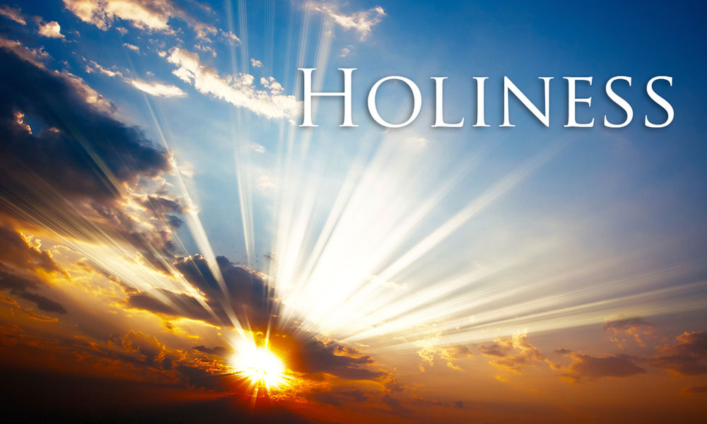
1 Peter 1:13-25

Slide 2
What is Holiness?
Is it separating yourself from the world and living in a monastery or commune?
Is it reading the Bible all the time and preaching to people about us what it contains?
FOR I AM HOLY
Is it denying all of the world’s earthly goods and living a life of poverty?
Is it always being super critical of the world’s attitudes and speaking negatively to those round about us?

Slide 3
What is Holiness?
The Hebrew word for “holiness” is qōdes
The adjective is qādôš
FOR I AM HOLY
So true holiness is something, or someone, who is set apart for God and is perfect
Holy, Holy, Holy

Slide 4
How can we be holy?
Everyone has sinned (Romans 3:23)
Through the salvation offered through Jesus Christ (Romans 10:9; Ephesians 2:8-9).
He cleanses us from sin and makes us holy (1 John 1:7).
Holiness comes from God (2 Corinthians 5:21)

Slide 5
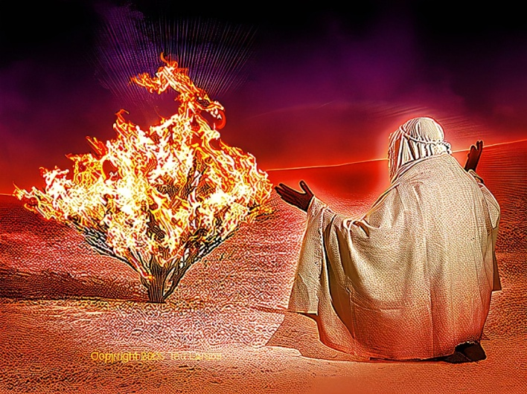
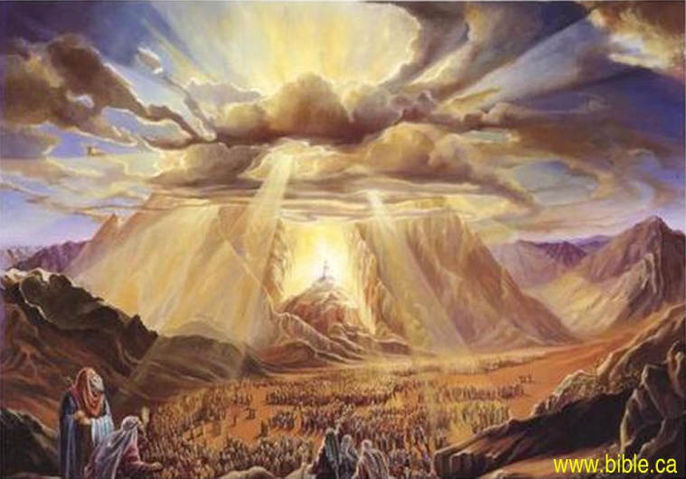
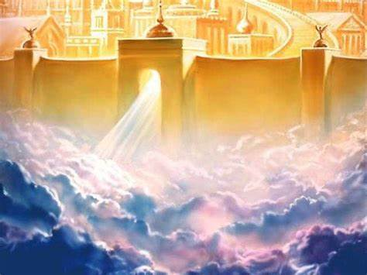
1 Peter 1:23 For you have been born again, but not to a life that will quickly end. Your new life will last forever because it comes from the eternal, living word of God.
Positional Sanctification

Slide 6
But!
‘Now you must be holy in everything you do, just as God who chose you is holy’
Sometimes we fall back into our old ways
Even Paul had the same problem
How can we be holy when we aren’t holy all the time?
Sometimes we fail
Does this mean we are no longer God’s holy people?

Slide 7
No, not at all
Seek to follow God's will each day
Progressive Sanctification
Paul said in Philippians 3: ‘that I might really know Jesus and become conformable to Him…. I haven’t already obtained this or have been made perfect, but I press on..
But how?

Slide 8
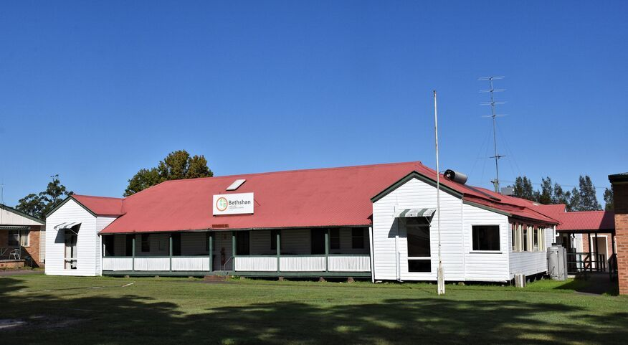
Bethshan Holiness Mission
Elliot John Rien
1908 signed over 120 acres
Productive farm, local church, retirement home and convention centre
Easter 1970 – 140 young people – every long weekend
Elliot Taylor Rien - A Challenge to Holiness

Slide 9
People who haven’t surrendered their life to Jesus
Christians who aren’t living a holy life before God and man
Christians who want to serve God even more faithfully

Slide 10
Repent of our sins
Soak ourselves in the Word of God every day
Each day we need to ask the Holy Spirit to fill us

Slide 11
Romans 12:2: “And do not be conformed to this world, but be transformed by the renewing of your mind [by reading our Bible every day] that you may prove what the will of God is, that which is good and acceptable and perfect.”
Hebrews 12:1,2 ‘Let us strip off every weight that slows us down, especially the sin that so easily trips us up. And let us run with endurance the race God has set before us. We do this by keeping our eyes on Jesus, the champion who initiates and perfects our faith’

Slide 12
“A sanctified (holy) life is not giving up for God, but rather it is receiving from God’
Elliot John Rien

