Slide 1
To RECIPROCATE – out of guilt.
Out of OBLIGATION – it’s expected.
To MOTIVATE someone, to influence change.
To HELP someone.
To APOLOGISE to someone.
To CELEBRATE with someone.
To REWARD someone.
To SURPRISE someone.
To THANK someone.
To show LOVE for someone.
Notes:
As Christmas approaches many of us are thinking about gifts. But as we think about gifts I wonder if you ever realise why we give gifts. Psychologists tell us that there are 10 reasons why we give gifts to others. The number one reason is to show love for someone. The Bible tells us that the greatest gift ever given was motivated by love. John 3:16

Slide 2
JOHN 3:16-21, EPHESIANS 3:14-21
THE REAL STORY OF CHRISTMAS
THE OBJECT OF GOD’S LOVE
THE EXPRESSION OF GOD’S LOVE
THE AIM OF GOD’S LOVE
Notes:
For God so loved – so loved means its amazing, spectacular love that we can’t match – its immeasurable. What makes it so great – why is Christmas the greatest gift ever. Lets look at John 3:16 – most famous passage and one which we know well. Its famous for a reason – because it is the gospel in a nutshell. It is the basis for the Christmas story – what its all about.

Slide 3
THE OBJECT OF GOD’S LOVE – “For God so loved the world…”
‘World’ does not = everyone who has lived, is living or will live on earth. ‘World’ = everyone who has lived, is living or will live who doesn’t believe in, love and obey God.
“No one is righteous, not even one. No one is truly wise; no one is seeking God. All have turned away; all have become useless. No one does good, not a single one.” (Romans 3:10-12)
“All have sinned and fallen short of the glory of God.” (Rom 3:23)
World = the quality of the people, not the quantity. The nature of the people, not the number. It’s moral, not mathematical.
Notes:
The world is not just talking about everyone who lives on planet earth. Its not essentially about the number of people but the kind of people. When the apostle John uses the word world in his gospel and three letters, he nearly always uses it describe the fallen sinful world ruled by Satan. We have all sinned and we all rebel against God. God’s love is measured by the moral nature of the people he loves, not the number. Even if God only loved one or a few people it would be great love because that is who he is. But when he is willing to love all people, even though they hate him, then that is immeasurable love.

Slide 4
God’s love is so great, not because the world is so big, but because the world is so bad.
He loves people who don’t love him back, who take him for granted, who despise him, who reject him and want nothing to do with him.
God’s immeasurable, stunning, breathtaking love = he loves us even while we are are his enemies. (Rom 5:10)
He loves the addicts, sexual predators, terrorists, liars, abusers, thieves, divorced, prostitutes, rapists, murderers, those who abort babies, homosexuals, atheists, Hindus, Muslims, Buddhists, selfish, proud, mean, vicious, lazy, greedy....
Notes:
Imagine a husband or wife saying I love my future spouse and want to marry them because they don’t love me, they despise me, they don’t listen to me, hate being with me and act as if I don’t exist. If someone told me that before I married them, I wouldn’t marry them. I would call off the wedding. But that’s how great God’s love is. He loves all sinners, all those who hate him and despise him. He asks us to do the same – to seek and save the lost. To have a heart for the lost – to show love and share the gospel of salvation with them. Why he can ask us to love our enemies too? Because he loved us when we were his enemy. In 1 Corinthians 6:11 Paul reminds the church that they were sinners like that too before they found salvation in Christ.

Slide 5
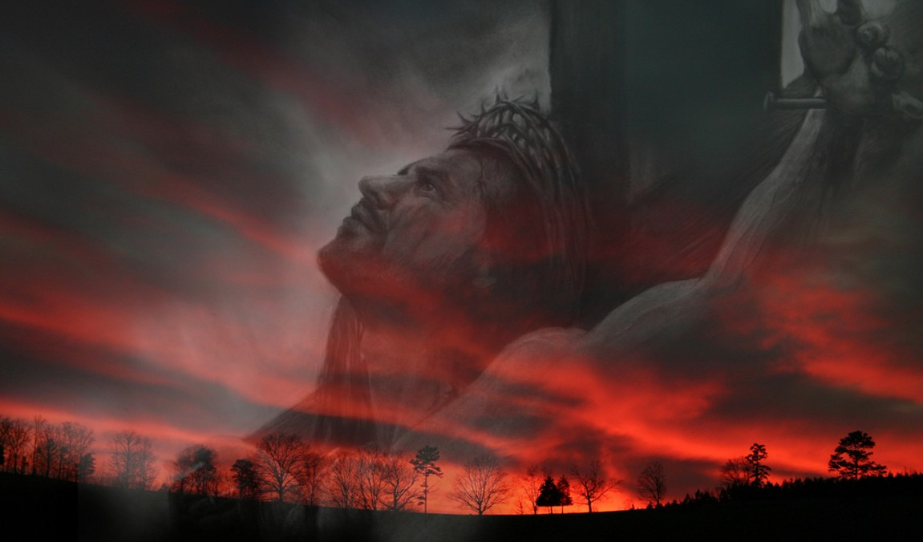
THE EXPRESSION OF GOD’S LOVE (AND HOLINESS) – “… He gave his one and only Son…” to live and die for us.
Jesus is God’s active demonstration of his radical love for sinners (us). It is proof we can depend on His amazing grace. “Since he did not spare even his own Son but gave him up for us all, won’t he also give us everything else?” (Romans 8:32)
Jesus is also an active demonstration of God’s holiness, which is equally as great as His love. God hates sin and can’t just dismiss it = God’s wrath and judgment = death (Romans 6:23).
God feels both love and anger towards those who disobey and disappoint Him. Jesus proves God’s love & satisfies His anger.
Notes:
God didn’t just sit in heaven thinking about how much he loves you – he acted on it by sending Jesus. The Bible also tells us that God is angry against sin and sinners. He hates sin and can’t just dismiss it or overlook it just this once. He is perfectly holy as he is perfectly loving. Sin will always bring God wrath and judgment – and that judgment is death. But because God doesn’t want the story to end that way and so he sent Jesus to live and to die for us. Some might say how can He feel love and anger towards those who disobey him, who anger him and disappoint him? Well, if you are married and/or a parent you will know that it is possible to have both at the same time – toward spouse and children.

Slide 6
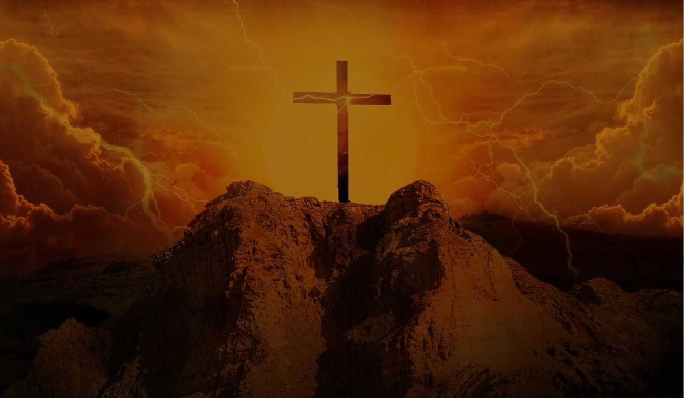
God says to Jesus, His one and only Son – “This world hates me and rebels against me. They are wicked and deserve to be condemned and to suffer eternally. But I want you to become one of them and endure their anger and hatred and to suffer humiliation and shame. I want you to live the life they should have lived, and I want you to die the death they deserve, so that those who embrace and accept this gift may have eternal life.”
The cross of Christ is the demonstration of God’s love – you were loved before the cross, not because of the cross.
Perhaps you are experiencing something that makes you doubt God’s love for you. Look to the cross and be reminded of how much you are loved.
Notes:
The cross of Christ proves God loves you. It is blasphemous to say that Jesus said it is finished. I have died for their sins Father. Now you can love them. Sending Jesus to die for us is proof of God’s love – not the dying on the cross.

Slide 7
THE AIM OF GOD’S LOVE – “.. So that whoever believes in Him (Jesus) will not perish, but have eternal life.”
“Whoever believes in Jesus’ - not you have to be good enough to earn or deserve God’s approval. None of us can be perfect.
The blood of Christ is sufficient for all sinners but only efficient for those who believe in Him = Christ is the only way.
Believing in Jesus = to humbly accept that He died for your sins (Saviour) + to repent & surrender your life to Him (Lord).
“Will not perish” = believers never need to fear God’s final and eternal judgment (Romans 8:1).
Notes:
Whoever believes in Jesus. Note what it doesn’t say. It doesn’t say whoever obeys all my commands, whoever does good works, donates to charity, reads the Bible, prays every day and goes to church every week. It doesn’t say whoever becomes a Baptist. It doesn’t say be good enough so that you can earn God’s approval. His standard of holiness is perfection and as we have already talked about – we can never do that in our own power. Whoever believes in Jesus also makes it clear that eternal life is universal. As much as society would like to think that everyone goes to heaven – the eternal that Christ offers is not for everyone and there is only one way. Believing in Jesus is not just believing he existed – its not just head knowledge, its heart knowledge – believing in such a way will turn your life upside down. You will confess that you are a sinner and need Christ as your Saviour. And you will repent and strive to live for Jesus – follow Him and obey Him (Lord of your life – not you anymore).
“Will not perish” is a promise that believers never need to fear God’s judgment and wrath – Jesus took that on the cross.

Slide 8
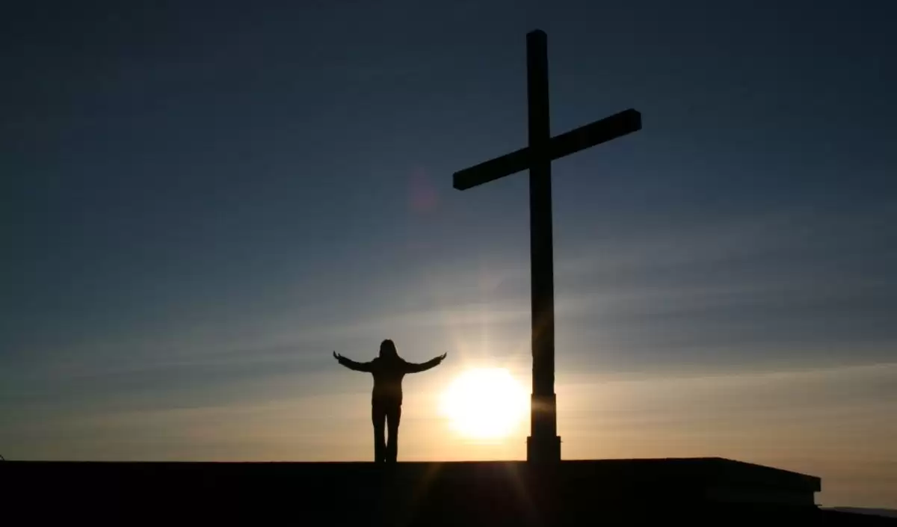
“.. but have eternal life” = more than to just live forever, as even non-believers will live forever in eternal shame, contempt and torment (Dan 12:2, Matt 25:41, Rev 20:10).
“Now this is eternal life: that they know you, the only true God, and Jesus Christ, whom you have sent.” (John 17:3)
The aim of God’s perfect love is to give us an eternity of enjoying the greatest, most beautiful, most satisfying and glorious gift ever = HIM = making much of Him, not ourselves.
“May you have the power to understand how wide, long, high & deep his love is. Then you will be made complete with all the fullness of life and power that comes from God.” (Eph 3:18-19)
Notes:
So what is eternal life? To have eternal life is more than just living forever – Bible tells us that even those who don’t believe in Christ live forever. So what is eternal life? Too often we can misunderstand God’s love and think that if God loves us he is going to give us all we want – the best things in life. Eternal life is walking on streets of gold (yes but not the best thing). Eternal life is not getting old, suffering, crying or having pain. Yes but not the best part. Ruling over celestial kingdoms and having angels under our authority. Yes but not the best part. Jesus tells us what eternal life is – what the greatest gift is. Its God. The best gift we can get is God – there is nothing greater, The secret of having a life to the fullest is making much of God and not ourselves. And it starts the moment we surrender our hearts to Christ – not just when we meet Christ again. That’s why Paul prayed for the believers in Ephesus church – that they would understand how much God loves them – that the greatest gift they will ever have is God. And the foundation for living the fullest and complete life is making much of him, not of ourselves.

Slide 9
Podcast – “The 5 most important decisions in life that will impact 90% of your happiness and avoid unnecessary suffering.”
Will I get married + will I have children + what career will I choose + what pet will I have + when will I retire.
“Then what should I do with Jesus who is called the Messiah?” (Matt 27:22)
The gospel message of John 3:16 is not for next week. It’s for today.
Believer – humbly rest in God’s love, the assurance of salvation and joy of the abundant, eternal life He has given you.
Non-believer – know God loves you, embrace Christ as your Lord & Saviour and receive eternal life - the greatest gift imagineable.
Notes:
. Based on the truth of John 3:16 I think Pontius Pilate gives us a more accurate question to ask regarding our happiness and suffering. What should I do with Jesus? On 8th October 1871, the great US evangelist DL Moody preached on that verse. At the end of the service he challenged his congregation to go home and think about that question and come back the next week to talk about it some more. He later said that it was the biggest regret of his ministry. That night the city of Chicago burned – destroying the church and killing a number of people who were in church that night.
Believer – don’t live in doubt and fear. Don’t be up and down depending on circumstances. Non-believer – come out of the darkness into the light. Don’t be deceived by Satan’s lies – the lies of the world that says your joy depends on what you do – marriage, children, career, pets and retirement. None of those are guaranteed and can satisfy like Christ. And its only for a limited time that God gives the people of the world an opportunity to accept the gift of Jesus and make peace with him.

