Slide 2
The Friends of Israel Gospel Ministry is a worldwide evangelical ministry proclaiming biblical truth about Israel and the Messiah, while bringing physical and spiritual comfort to the Jewish people
We are committed to teaching how scripture reveals…
God’s love for Jewish people
The Biblical significance of the Land of Israel

Slide 3
We do this through:
Speaking / teaching in local churches
Books and other resources
Our bi-monthly magazine, Israel My Glory
Prophecy conferences
Study tours to the Holy Land
Reaching out in love to Jewish people
“Backpacker ministry”
…………………………………………………………
MORE INFORMATION: foiaustralia.org

Slide 4
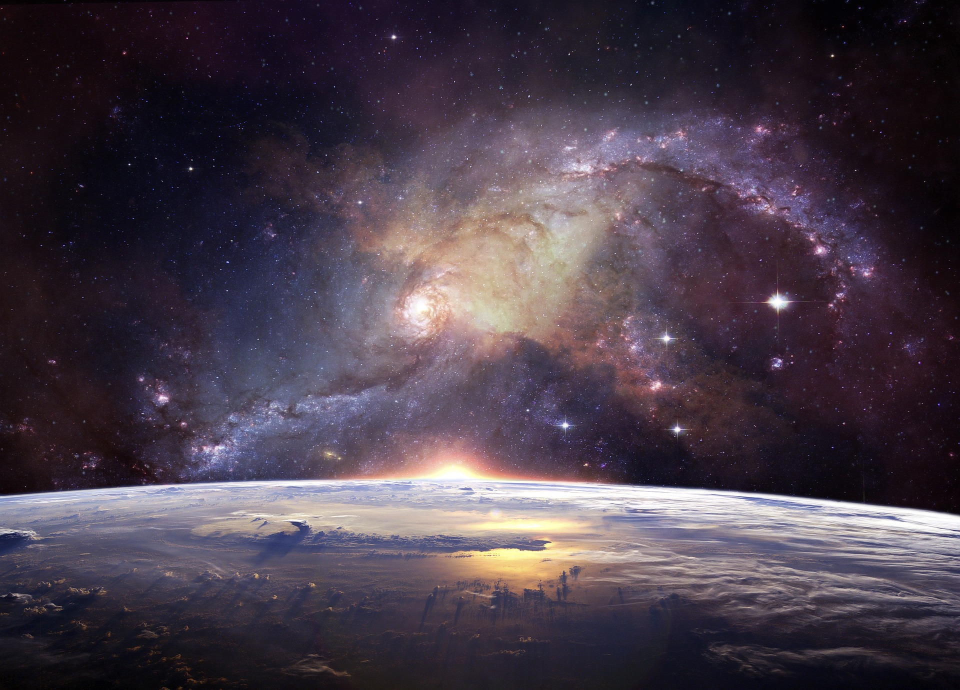
The WONDER of the PRESENT HEAVENS

Slide 5
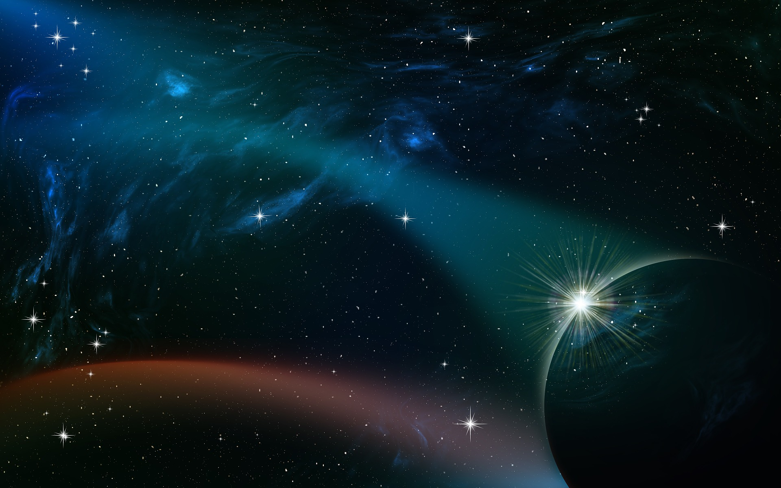
In the beginning
GOD created
the HEAVENS and the Earth
(Gen 1:1)

Slide 6
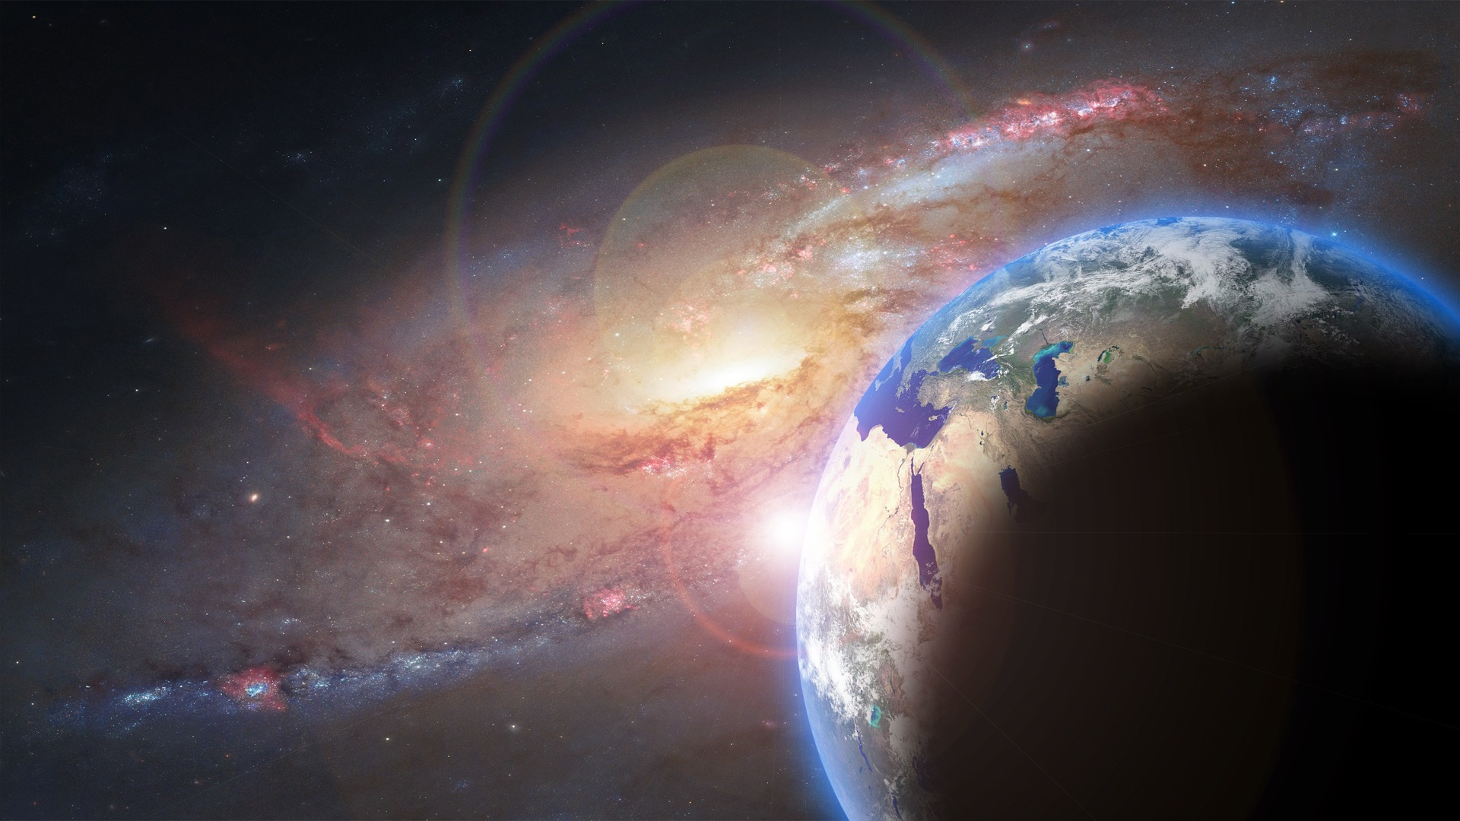
DAY 2:
Then God said, “Let there be a firmament in the midst of the waters… ⁸ And God called the firmament (open expanse) HEAVEN
DAY 4:
¹⁶ Then God made two great lights: the greater light to rule the day, and the lesser light to rule the night. He made the stars also. ¹⁷ God set them in the firmament (open expanse) of the HEAVENS to give light on the earth…

Slide 7
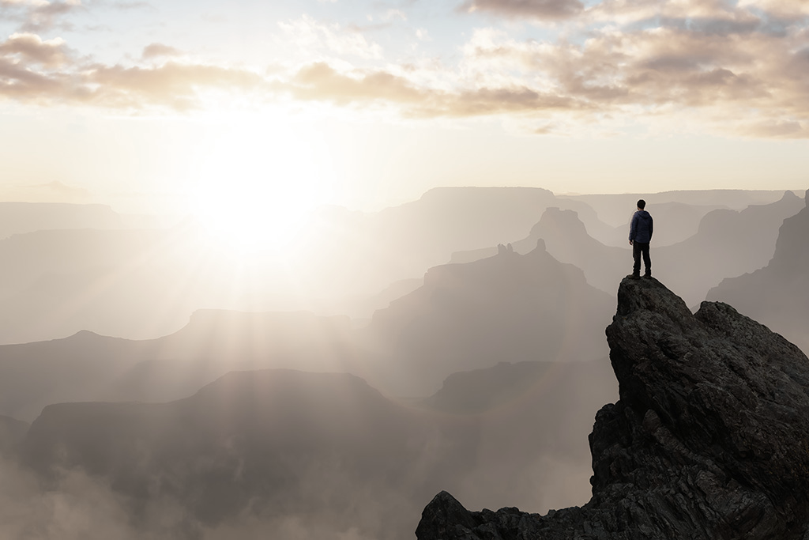
“Can God’s Word give us some clarity concerning ‘Heaven’, or are we free to believe what we like?”

Slide 8
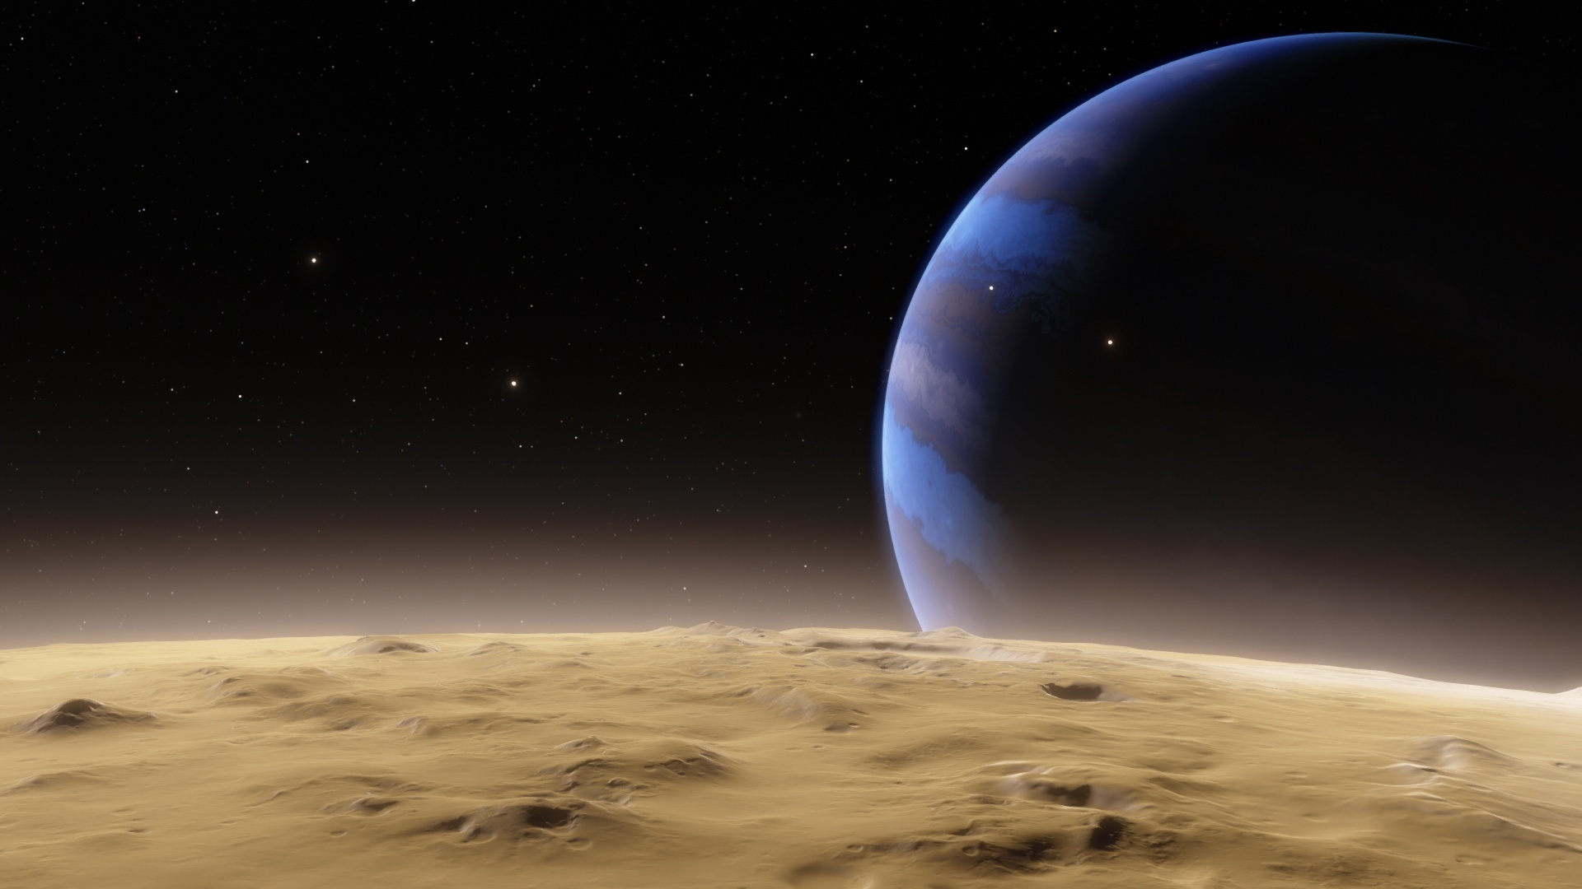
Hebrew word for HEAVEN (used almost exclusively)
shaw-mah’-yim
From a root word meaning: “to be lofty”
Translated in English as: heaven, heavens, sky
Written in a dual form: suggesting > two levels

Slide 9
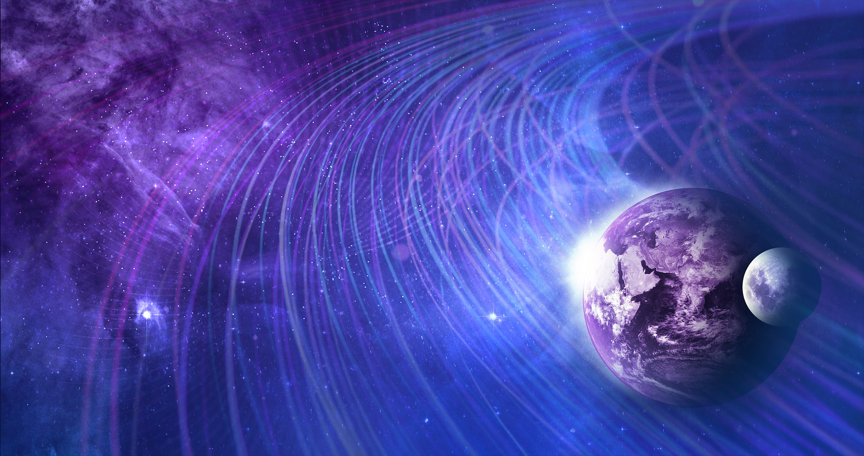
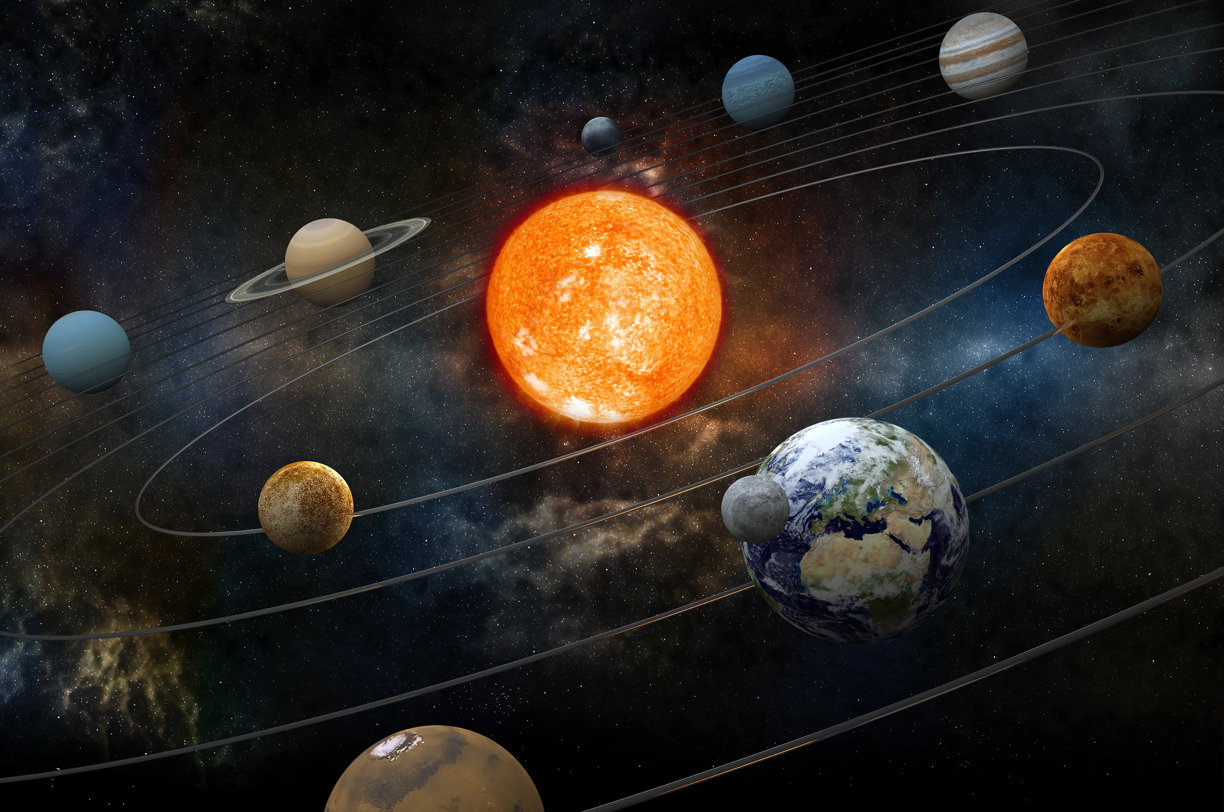
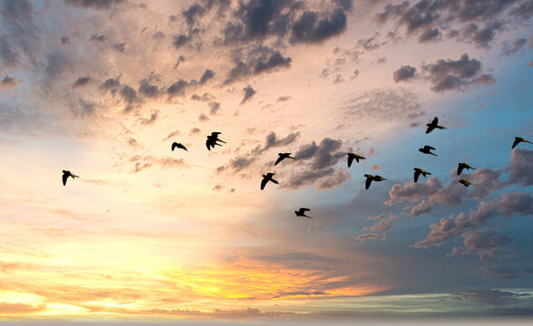
2nd Heaven
The celestial skies
Stars, planets, Sun, Moon
1st Heaven
The atmosphere
Clouds, birds

Slide 10
“The HEAVENS declare the glory of GOD…” (Psalm 19:1)

Slide 11
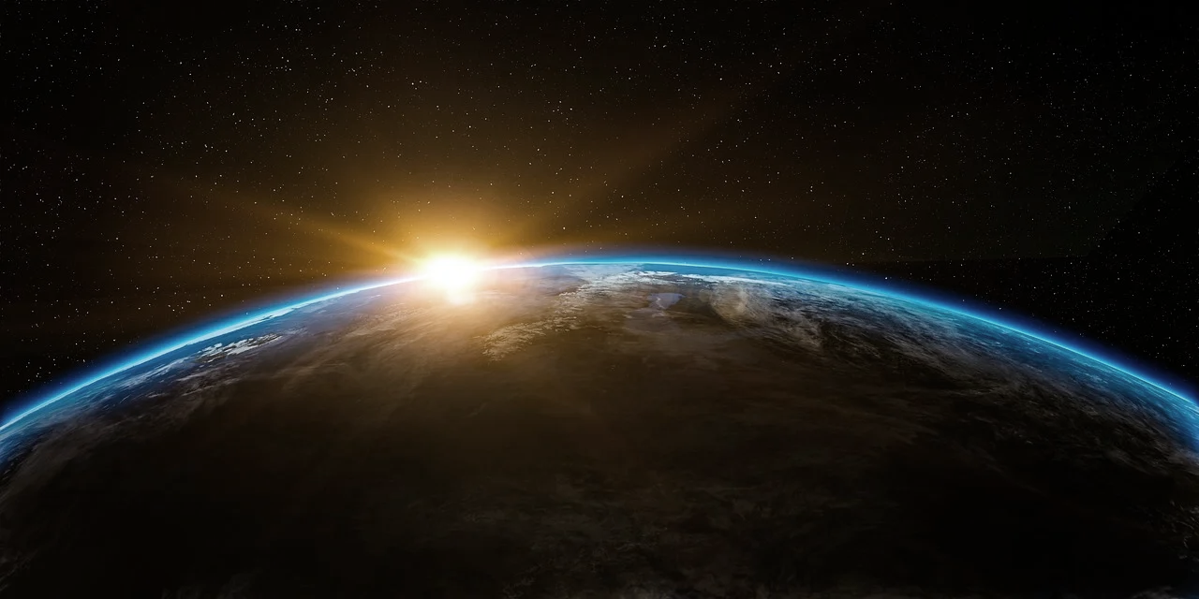
Deut 10:14 (ESV) Behold, to the Lord your God belong heaven and the heaven of heavens, the earth with all that is in it.”
Deut 26:15 (NKJV) “ Look down from Your holy habitation, from heaven, and bless Your people Israel…”
Joshua 2:11 (NKJV) “… the Lord your God, He is God in heaven above and on earth beneath.”

Slide 12
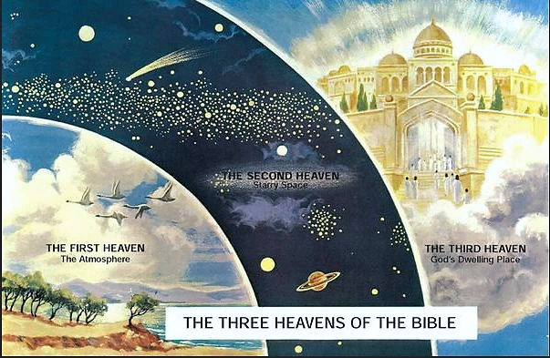
THE SECOND HEAVEN Sun, moon, stars…
THE FIRST HEAVEN The atmosphere
THE THIRD HEAVEN God’s dwelling place
THE THREE HEAVENS OF THE BIBLE

Slide 13
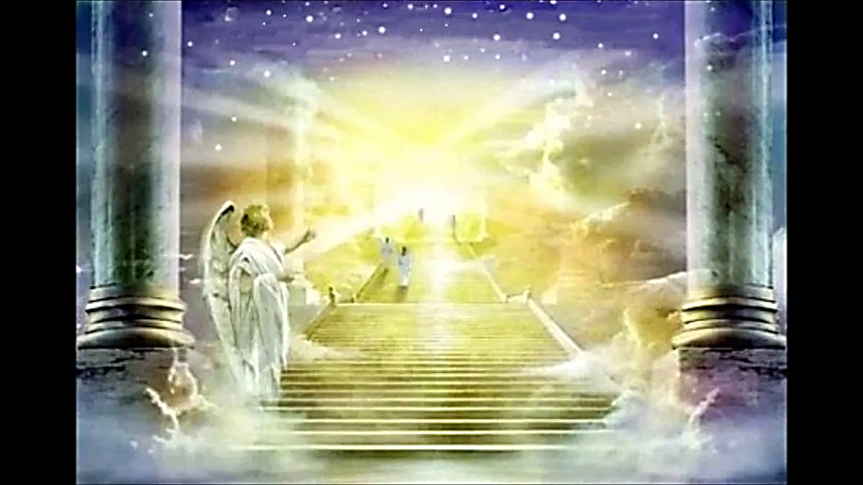
Isaiah:
“I saw the Lord sitting on a throne, high and lifted up, and the train of His robe filled the temple” Isa 6:1-5

Slide 14
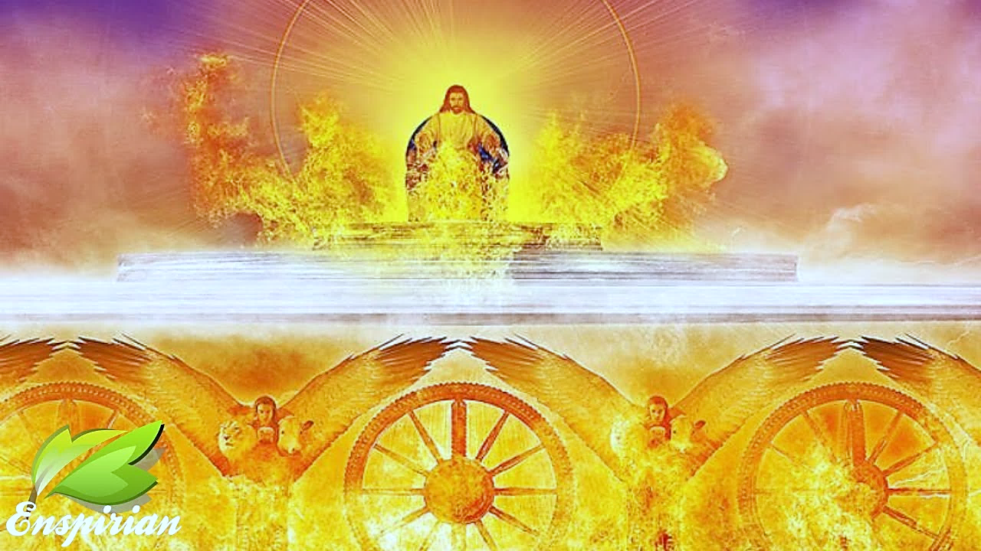
Ezekiel:
“Such was the appearance of the likeness of the glory of the Lord. And when I saw it, I fell on my face” Ezekiel 1:26-28

Slide 15
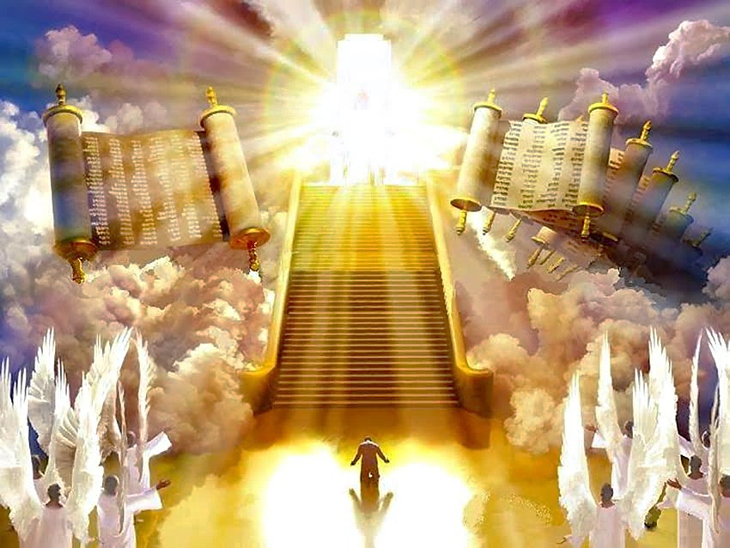
Daniel:
“…the Ancient of Days was seated; His garment was white as snow, and the hair of His head was like pure wool. His throne was a fiery flame”
Dan 7:9-10

Slide 16
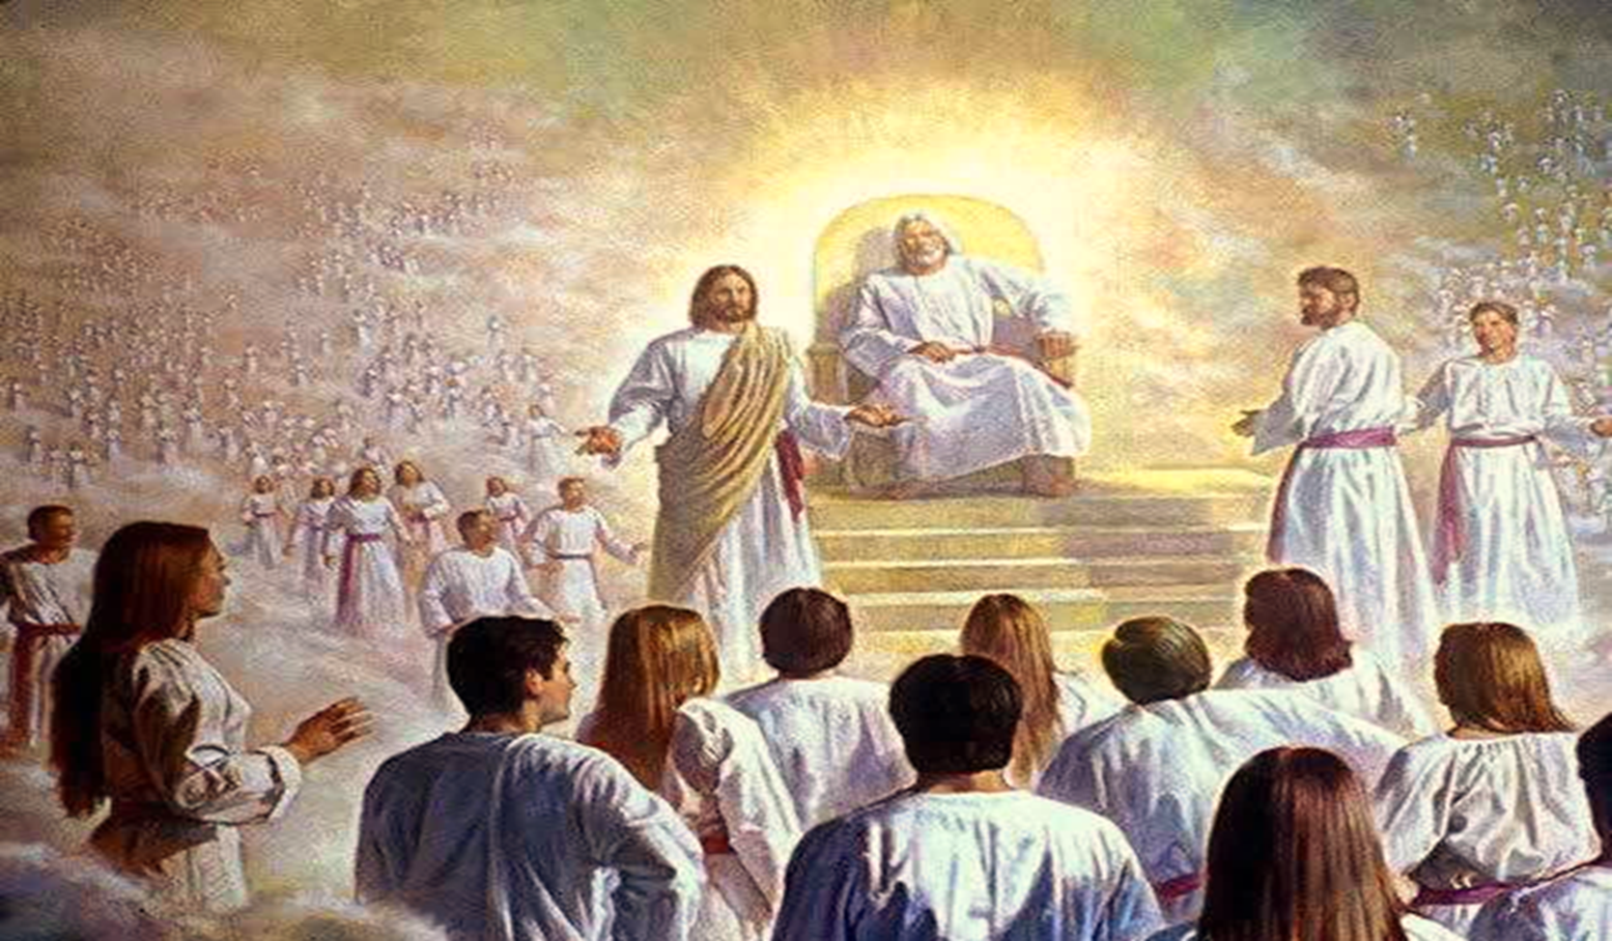
Stephen:
“being full of the Holy Spirit, gazed into heaven and saw the glory of God, and Jesus standing at the right hand of God”
Acts 7:55-56

Slide 17
HEBREWS:
“Christ has not entered the Holy places made with hands, which are copies of the true, but into HEAVEN itself, now to appear in the presence of God for us…” Heb 9:24

Slide 18
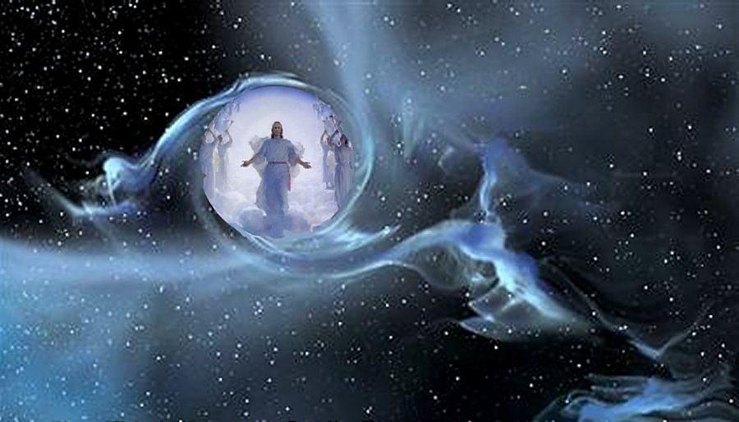
Paul: “I know a man in Christ who fourteen years ago—whether in the body I do not know, or whether out of the body I do not know, God knows—such a one was caught up to the 3rd HEAVEN … into PARADISE 2 Cor 12:2-4

Slide 19
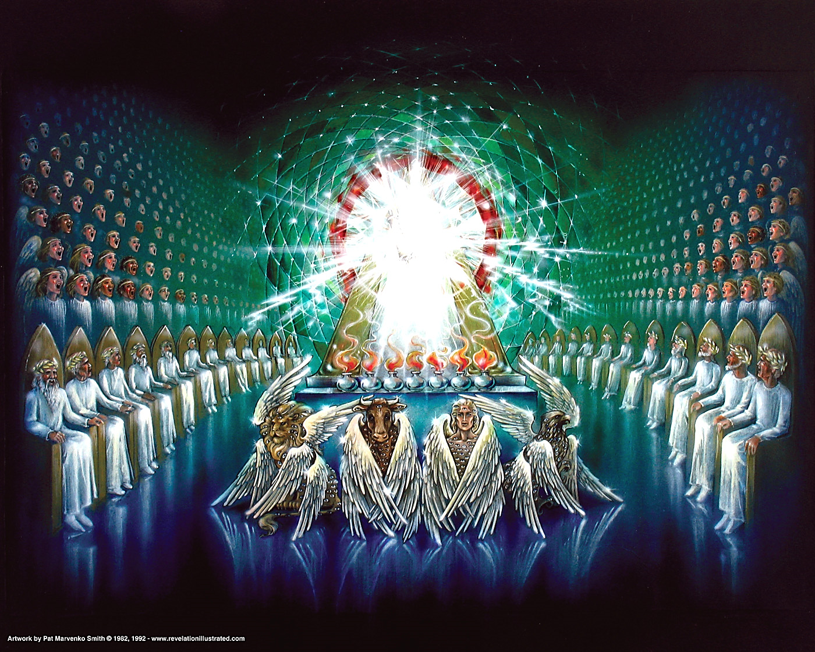
John:
“a throne set in heaven, and One sat on the throne… and there was a rainbow around the throne, in appearance like an emerald”
^{Rev 4:2-3}

Slide 20
They ALL STRUGGLED to find words to describe what they saw
They ALL saw GOD SEATED on a GLORIOUS THRONE with fire and amazing colours and sounds and voices surrounding Him.
They ALL experienced HEAVEN as a place of unceasing WORSHIP with ANGELS and “LIVING CREATURES” giving GLORY to HIM
They were ALL IN AWE OF GOD’S GLORY and MAJESTY
All were AWARE OF THEIR INADEQUACIES in comparison to the HOLY GOD.
And JESUS was right there, AT THE RIGHT HAND OF GOD

Slide 21
2 Corinthians 5:1 & 8-9 “For we know that if our earthly house, this tent, is destroyed, we have a building from God, a house not made with hands, eternal in the heavens...
We are confident, yes, well pleased rather to be absent from the body and to be present with the Lord.
Therefore we make it our aim, whether present or absent, to be well pleasing to Him.”

Slide 22
This will be an immediate, conscious existence in the PRESENCE OF GOD!
Some have called this the INTERMEDIATE HEAVEN or the PRESENT HEAVEN
There is already no suffering or crying or pain in the INTERMEDIATE HEAVEN, but something even more amazing is yet to follow!

Slide 23
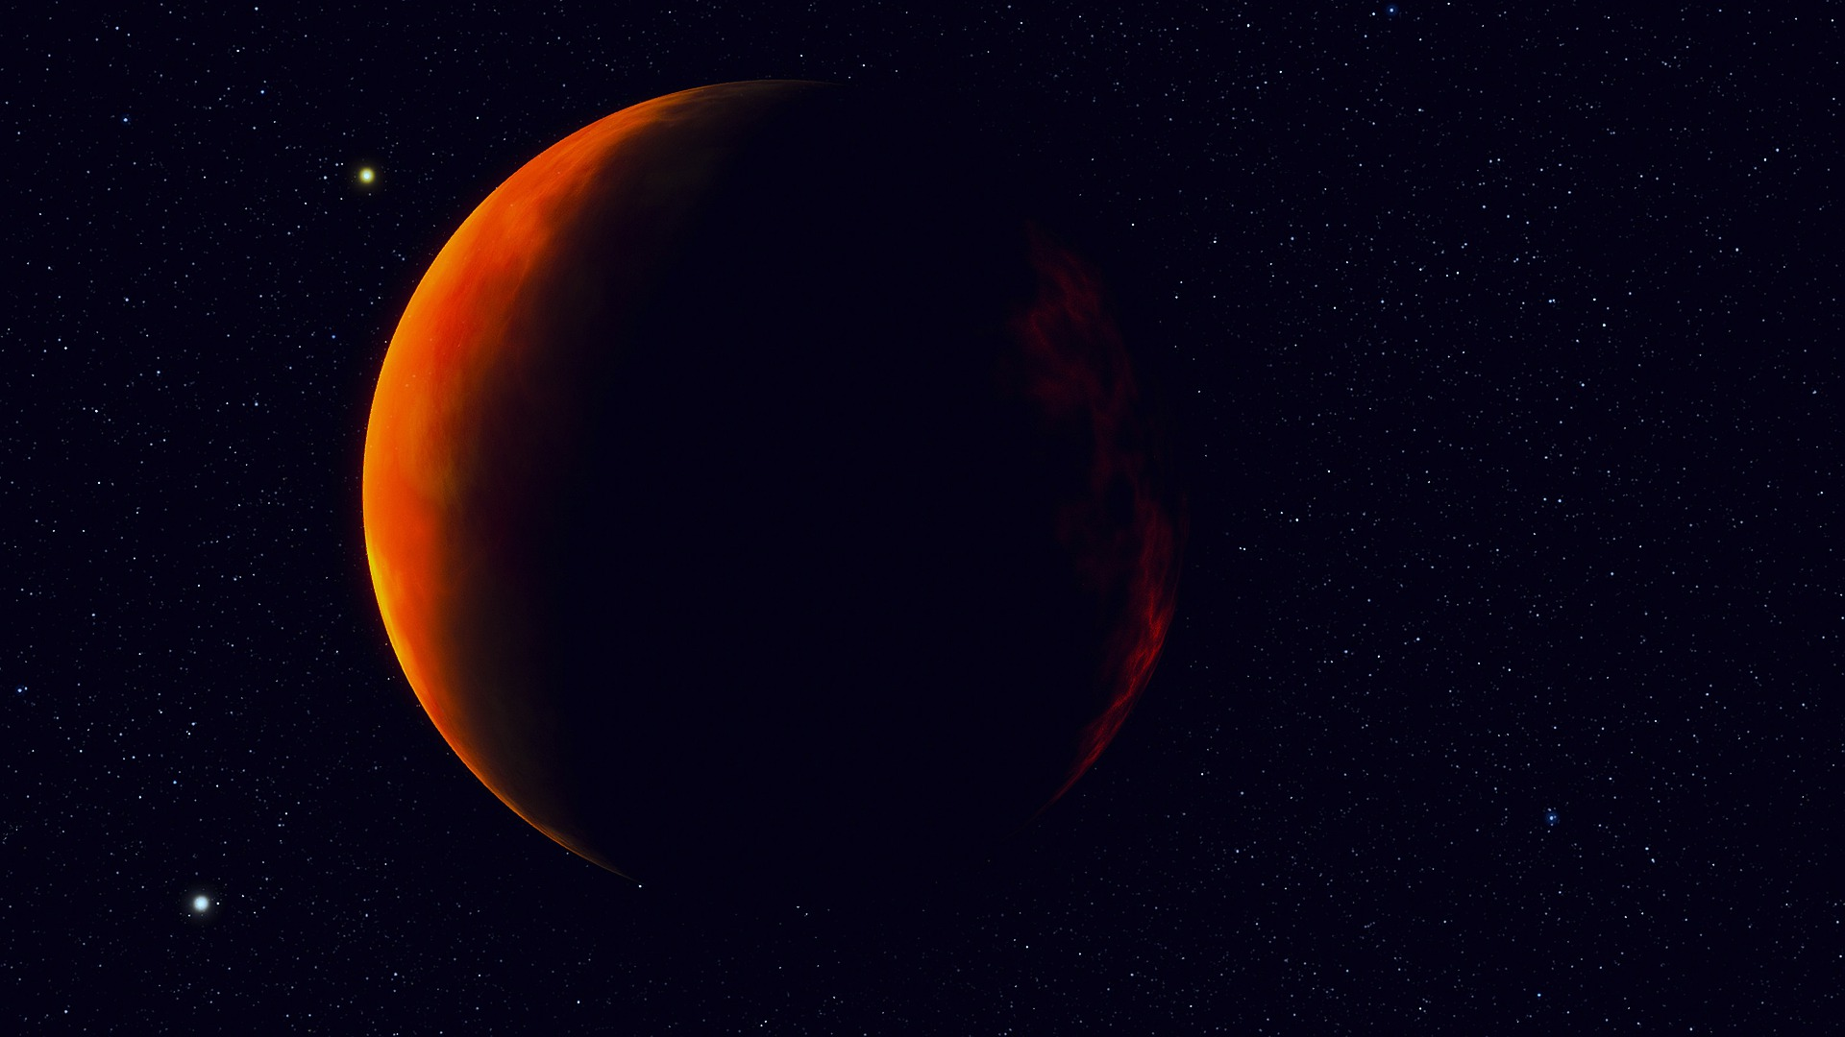
PART 2: “NEW HEAVENS and a NEW EARTH”

Slide 24
An important Question…
“ARE YOU GOING TO BE THERE?”

