Slide 1
“Everything that has truly enhanced and enlightened my experience, has been through affliction and not through happiness.” Malcolm Muggeridge
THE GOD OF ALL COMFORT
2 Corinthians 1:1-11
Notes:
Good morning everyone.
Today’s passage, these verses, are arguably the Bible’s greatest text on comfort.
The word comfort, is used 10 times in its noun and verb forms between verses 3 through to 7 which is 5 verses
And yet whilst it is about comfort we see that there is just as much discussion around affliction and suffering. For without affliction there is no need for comfort
A Christian man by the name of Malcolm Muggeridge, who was a politician in the United Kingdom as well as a journalist and satirist during the 1900’s, once wrote on the idea of affliction, and had this to say:
“Contrary to what might be expected, I look back on experiences that at the time seemed especially desolating and painful with particular satisfaction. Indeed, I can say with complete truthfulness that everything I have learned in my 75 years in this world, everything that has truly enhanced and enlightened my experience, has been through affliction and not through happiness.”
So we need not fear the troubles of this life, for not only we will learn from them, but we have a God who is the God of all comfort who will get us through our afflictions, and that’s what today’s passage is all about, so let’s get into it

Slide 2
BLESSED BE GOD
“Blessed be the God…” (2 Cor 1:3a)
“O friends, if you are afraid of being overcome, take to praising God; if you are in trouble, and do not know how to bear it, divert your thoughts by praising God; get away from the present trial by blessing and magnifying his holy name” Charles Spurgeon
“Blessed be the God and Father of our Lord Jesus Christ” (2 Cor 1:3a)
Notes:
“Blessed be the God…” (2 Cor 1:3a) - Do not miss this line or skip over it. We must always begin with God, and all that He is, and never cease singing His praises - Here is Paul, a man who every day would wake up probably not knowing if he was going to be killed, for his enemies were many, and cruel, and mighty, and yet in this letter and many others he is always able to begin by praising God - We begin with God, because when we fix our eyes on Him everything else, all the troubles of the world begin to fade away because we know that with God, we have all that we need, and so we can boldly proclaim “Blessed be your Name”
“O Friends, if you are afraid of being overcome, take to praising God; if you are in trouble, and do not know how to bear it, divert your thoughts by praising God; get away from the present trial by blessing and magnifying his holy name” – Charles Spurgeon - Nothing else will maintain joy in your heart in the midst of trials. - If you wish to be sustained and prevent the enemy from overcoming you, then take to praising God -Nothing will more quickly destroy the work of Satan and allure of sin than in your darkest hour praising God because you are declaring that even in the thick of all that life has to throw your way, you are declaring that God is all you need
“Blessed be the God and Father of our Lord Jesus Christ” (2 Cor 1:3a) - And because God is the Father of Jesus, that makes Him the Father of every believer - And just as a child may not have a single dollar in their pocket, yet still considers themselves rich if they have a wealthy father - How much more true is this for Christians. For even though we may be very, very poor, we have a very rich Father, who is rich in love and mercy and grace - And our Father has made us a joint heir with Jesus Christ, what more do you need? And so we must comfort ourselves with this blessed truth

Slide 3
“the Father of mercies and God of all comfort” (2 Cor 1:3b)
True lasting and fulfilling comfort is not found in anything that the creature supplies, it is only found in the Creator
If we will but turn to God in our moment of need, our times of trial we will find a God who cares, we will find mercy, and grace and compassion, and we will find comfort
Notes:
“the Father of mercies and God of all comfort” (2 Cor 1:3b) - And so we praise God for the mercy that He shows us, and all the kindness that He showers upon us every single day - But not only is He the Father of mercies but the God of ALL comfort. It is a name of hope. A name that ought to stir our hearts and praise His name for the rest of our days - For He is the God of all comfort and not of some comfort. - If you are in need of comfort God has it and He will give it you
True lasting and fulfilling comfort is not found in anything that the creature supplies, it is only found in the Creator - There are some things which the world calls comforts which are not of God - There are many in the world who do all they can to drown out their misery through pleasure, by drowning their sorrows in alcohol, or drugs and it is sad that many people think these things will restore joy into their lives - Whatever may be considered comfort by the rest of the world, but is not of God, we can be sure that there will be no consolation found, and so we must not turn to these things for our source of comfort
If we will but turn to God in our moment of need, our times of trial, we will find a God who cares, we will find mercy, and grace and compassion, and we will find comfort - And we know this is true, because in Matthew 11 Jesus calls upon people to turn to him and says “Come to me, all of you who are weary and carry heavy burdens, and I will give you rest. Take my yoke upon you. Let me teach you, because I am humble and gentle at heart, and you will find rest for your souls. For my yoke is easy to bear, and the burden I give you is light” (Matthew 11:28-30) - I don’t know what many of you are going through today: - Maybe you have recently lost a loved one, or you are in times of trouble within your own home - Maybe you’re going through a job loss or having trials at work - Maybe you’re losing friends and experiencing persecution for your faith in Jesus Christ - My dear brothers and sisters in Christ, if you will turn to God, His Word promises that you will find a merciful Father, and the God of all comfort

Slide 4
COMFORTED TO COMFORT
“who comforts us in all our affliction” (2 Cor 1:4a)
“so that we may be able to comfort those who are in any affliction” (2 Cor 1:4b)
“with the comfort with which we ourselves are comforted by God” (1 Cor 1:4c)
Notes:
“who comforts us in all our affliction” (2 Cor 1:4a) - The Greek word here for affliction is tribulation, distress, and persecution. It means pressure, whatever it is that constricts us, that makes us narrow. It means to be pressed upon hard - At some point in our lives we will face difficulties for the sake of the gospel of Jesus Christ. And we will get in to this a little bit more later on – But the good news is that God’s grace and comfort will always exceed our afflictions. Why?
“so that we may be able to comfort those who are in any affliction” (2 Cor 1:4b) - You see, as we suffer and are comforted by God it is then our privilege and responsibility to pass on that comfort to our brothers and sisters in Christ - We are encouraged and comforted and built up in order that the body of Christ may be edified and built up and encouraged and comforted - The Spirit works through His people to comfort those downtrodden by the pains and turmoil of life. - And like I preached on last time, this is why the Christian life was always meant to be done in community, this is why the body of Christ exists, this is one of the primary reasons Coolum Beach Baptist exists. - To get alongside one another, to build up on another, to comfort one another
“with the comfort with which we ourselves are comforted by God” (1 Cor 1:4c) - It is essential for the comfort of fellow Christians that we go through times of trial in order that we too may experience the comfort of God, to pass on to others - A person who has never had any trouble in their life would be very awkward and would not be adequately equipped to comfort troubled hearts - So if we are to be of utmost service to God, then the comfort of the gospel has to be real and fresh for us. - And the same comfort will overflow into other peoples lives during their times of affliction

Slide 5
SHARE IN CHRIST
“For as we share abundantly in Christ’s sufferings” (2 Cor 1:5a)
Are you suffering because of your commitment to Christ?
“So through Christ we share abundantly in comfort too” (2 Cor 1:5b)
Notes:
“For as we share abundantly in Christ’s sufferings” (2 Cor 1:5a) - This is referring to the sufferings that come to those involved in the service of Christ - Paul in writing to Timothy tells him of all that he suffered as he proclaimed the gospel and then tells Timothy that “everyone who wants to live a godly life in Christ Jesus will suffer persecution” (2 Tim 3:12) - In the course of godly living, it is inevitable that believers will be afflicted
Are you suffering because of your commitment to Christ? - Then I urge you not to run. Do not curse your circumstances. Instead patiently endure - Remember the words of James when he encourages us to “Count it all joy… when you meet trials of various kinds, for you know that the testing of your faith produces steadfastness” (Jas 1:2-3) - As we suffer, God is conforming us to the image of His Son. - Do not go looking for it, but rather when it comes, stand strong in the God of all comfort, stand strong in the promises of God’s Word, stand strong in Christ the solid rock
“So through Christ we share abundantly in comfort too” (2 Cor 1:5b) - Living for Jesus is hard. God’s Word tells us this. But the great news of the gospel is that our God – Father, Son, and Holy Spirit is committed to supplying the resources, encouragement, correction and resolve that we need to keep living for Him - Having paid the ultimate price for every believer’s salvation and freedom through the death of His one and only Son, God will be with us to love, strengthen, protect and comfort us in every trial of life - In Jesus Christ we have unhindered access to the Father and the Holy Spirit now lives inside of us, and because of that reality, you can be assured that in tough times, when all seems hopeless, you will find hope and comfort in God

Slide 6
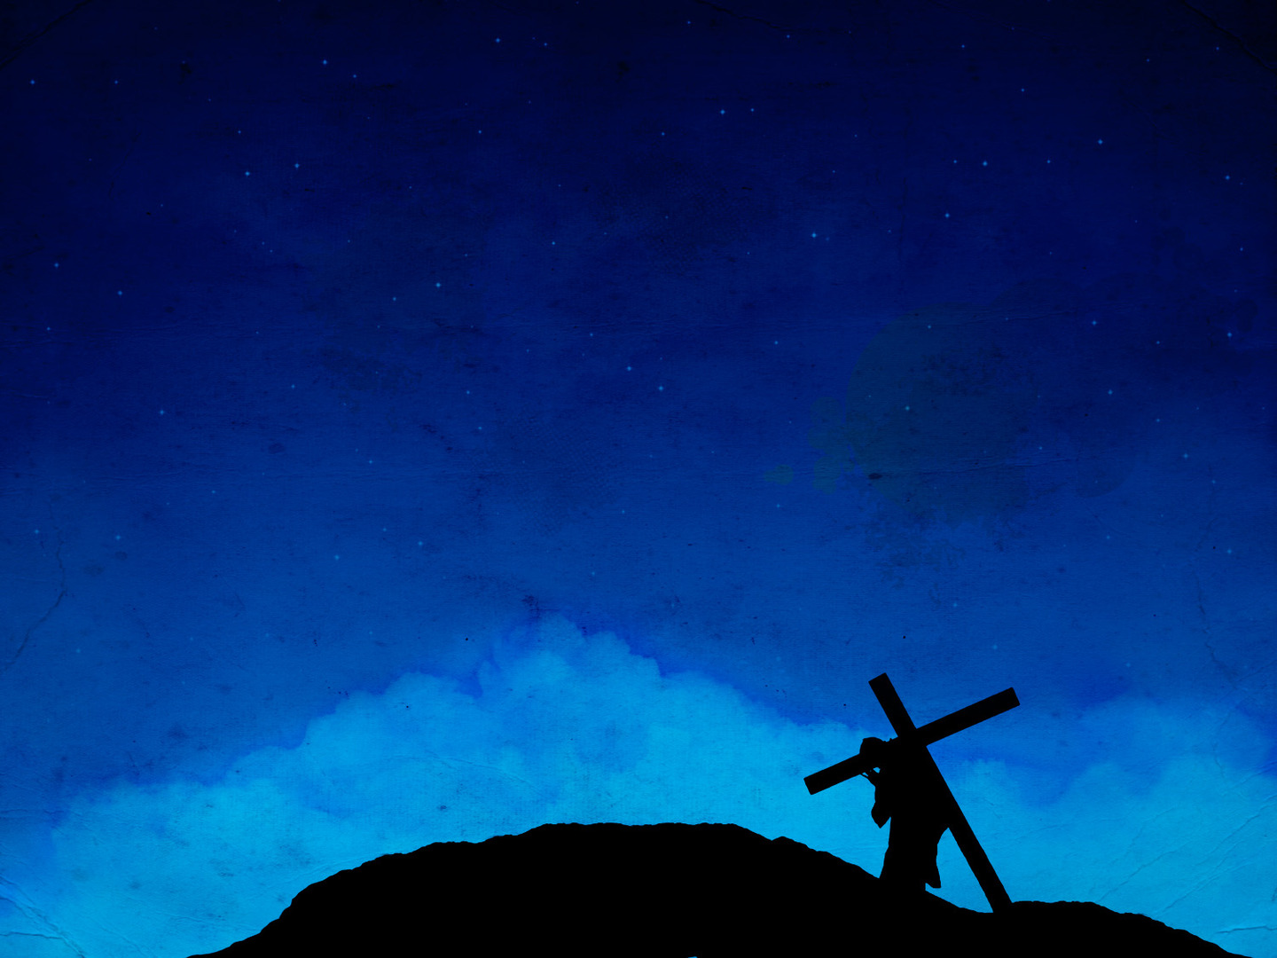
Jesus came to earth as a man and suffered terribly, so as we pray to God we know we have an advocate who can sympathise with us
Many of us feel the allure of success. Paul tells us to aim higher
The honour of sharing in Christ’s sufferings is always accompanied with the joy of sharing God’s comfort
Notes:
Jesus came to earth as a man and suffered terribly, so as we pray to God we know we have an advocate who can sympathise with us - Jesus was rejected by his own creation, he died unjustly, because it was us who should have been put on the cross. He died for our sins, even though he himself was perfect - His own friends turned their back on him. Those who should have been most devoted to him, such as the Pharisees, hated him. - Jesus spent 40 days being tempted by Satan, but never giving in - Jesus came to earth and was persecuted, rejected, mocked and scorned. Jesus came and he died that we might be children of God, the just for the unjust, the righteous for the unrighteous. - Jesus didn’t just suffer, he suffered unfairly - So let us never fall into the trap of thinking that ‘Jesus doesn’t know what it’s like, he could never understand’, because he does, whilst he never sinned, he was certainly afflicted during his time on earth - And so we know that as we draw near to God in prayer, with Jesus as our advocate sitting at the right hand of the Father, we know we have an advocate who understands
Many of us feel the allure of success. Paul tells us to aim higher - Paul tells us to focus on staying faithful through suffering - Everything screams at us in life that it is all about climbing the ladder of honour, respectability and financial security - And yet Paul wants to remind us that life is not about this world, for we are but pilgrims in this world, we look forward to a kingdom that will never perish. - So we ought to stay focused on living for Christ no matter what trials and temptations may come our way
The honour of sharing in Christ’s sufferings is always accompanied with the joy of sharing God’s comfort - Never forget this in your times of trial. - The grace of God will sustain you and enable you to endure all the assaults of the world, the flesh, and the devil - We must cast our affliction before our Father, the God of all comfort, and leave it there and then you will find that God will comfort you in all your afflictions

Slide 7
GOD OUR DELIVERER
“We felt that we had received the sentence of death. But that was to make us rely not on ourselves” (2 Cor 1:9a)
“But on God who raises the dead” (2 Cor 1:9b)
Suffering is a page in the textbook used in God’s school of faith. It brings us to the end of ourselves and before the throne of God
Notes:
“We felt that we had received the sentence of death. But that was to make us rely not on ourselves” (2 Cor 1:9a) - Paul was at the point of death, he genuinely thought he was going to die - And yet Paul knew that by being afflicted he was being forced to turn from himself - Because you see, intense sufferings reminds us of our utter helplessness, something we too often forget when things are going well
“But on God who raises the dead” (2 Cor 1:9a) - Suffering forces us to recall the grace of God and to remember God Himself - The reason we ought to turn to God rather than any man-made comfort is because our God is a God who raises the dead - And He does so both spiritually and physically, I mean we read of Jesus bringing Lazarus back from the dead, we know that it was by the power of God that Jesus was resurrected, never to die again - We know that one day when Jesus comes again, we will be resurrected. - But God also does it today in the hearts of unbelievers. He takes someone who is considered dead spiritually, He takes a wretch like me, a sinner like me and breathes new life into me and gives me a new heart - It is this same God that we are called to rely upon in this life
Suffering is a page in the textbook used in God’s school of faith. It brings us to the end of ourselves and before the throne of God - For it is when we suffer and when we come to the ends of ourselves that we fall upon our knees and cry out to God - And it is there that we are met with open arms, it is there that we are met with grace and mercy and compassion. - Do we deserve this kind of love and grace, absolutely not, that is why it is called grace, but in Jesus Christ we are given it and we can enter freely, and boldly into the throne room of God

Slide 8
“He delivered us from such a deadly peril, and he will deliver us” (2 Cor 1:10a)
“On him we have set our hope that he will deliver us again” (2 Cor 1:10b)
Paul’s resume by the world’s standards was not all that impressive
His only boast is in God
Notes:
“He delivered us from such a deadly peril, and he will deliver us” (2 Cor 1:10a) - And so when Paul turned to God, God delivered them from their deadly peril - And he knows that because God is a faithful God, He will do it again when tough times come their way
“On him we have set our hope that he will deliver us again” (2 Cor 1:10b) - And so because God is the Father of our Lord Jesus Christ, and the Father of mercies, the God of all comfort, the God who raises the dead - We can be sure that our hope in Him will not be in vain because He is also the delivering God - 3 times the word deliver is used in verse 10. The first is past, He has delivered. The second is near future, He will deliver us - The third is the ultimate future, He will deliver us again. This is how that reads “He delivered – He will deliver us – He will deliver us again” - You can be sure that whatever life may throw your way that there will come a day when all who have believed in Jesus Christ will be completely delivered from suffering and sin and death, and we will spend eternity with God in His kingdom
Paul’s resume by the world’s standards was not all that impressive - Paul says “Yes I’ve got nothing. All I can show you are my bruises. All I can do is tell you about the occasions I’ve been run out of town. - All I can boast about is the fact that God has rescued me from death”
His only boast is in God - His resume and our resumes are not about us. - It’s about our God who shows us our weakness, encourages us through weakness, and will rescue us in our weakness through the gospel of our Lord Jesus Christ. Our only boast is in God!

Slide 9
SUMMARY
As Christians in this life, we will suffer, the Bible tells us this. The world hates the things of God
But we suffer in order that we may build up one another and comfort one another by the same comfort we received by God
Our God is a delivering God. We can put all our hope in Him, because He will one day deliver us from all the suffering of this world
Notes:
As Christians in this life, we will suffer, the Bible tells us this. The world hates the things of God - For we are to be a people of light in this world of darkness - We are to go out and tell the truth in love, and expose the lies of Satan - It is inevitable that as we live for God we will experience suffering
But we suffer in order that we may build up one another and comfort one another by the same comfort we received by God - God comforts us and is at work in you and me for the benefit of other people and in particular the body of Christ - For we can only share what we have received ourselves
Our God is a delivering God. We can put all our hope in Him, because He will one day deliver us from the suffering of this world - Christians, turn to your heavenly Father, and you will find the comfort and rest that you need - Or perhaps you are sitting here today and you do not know Jesus Christ as your Lord and Saviour and the burden of your sin is weighing heavily upon your heart - Can I urge you to fix your eyes upon the cross where Jesus died with the weight of your sin upon him - He did that so that if you would cast your sins upon him, and repent of your sins, you would no longer be condemned by them and so the heavy weight you are feeling right now can be lifted - And so for you today, if you will believe in Jesus Christ and surrender your life to him, you too can experience the love of God who is the Father of mercies and God of all comfort. - Let’s pray

