Slide 1
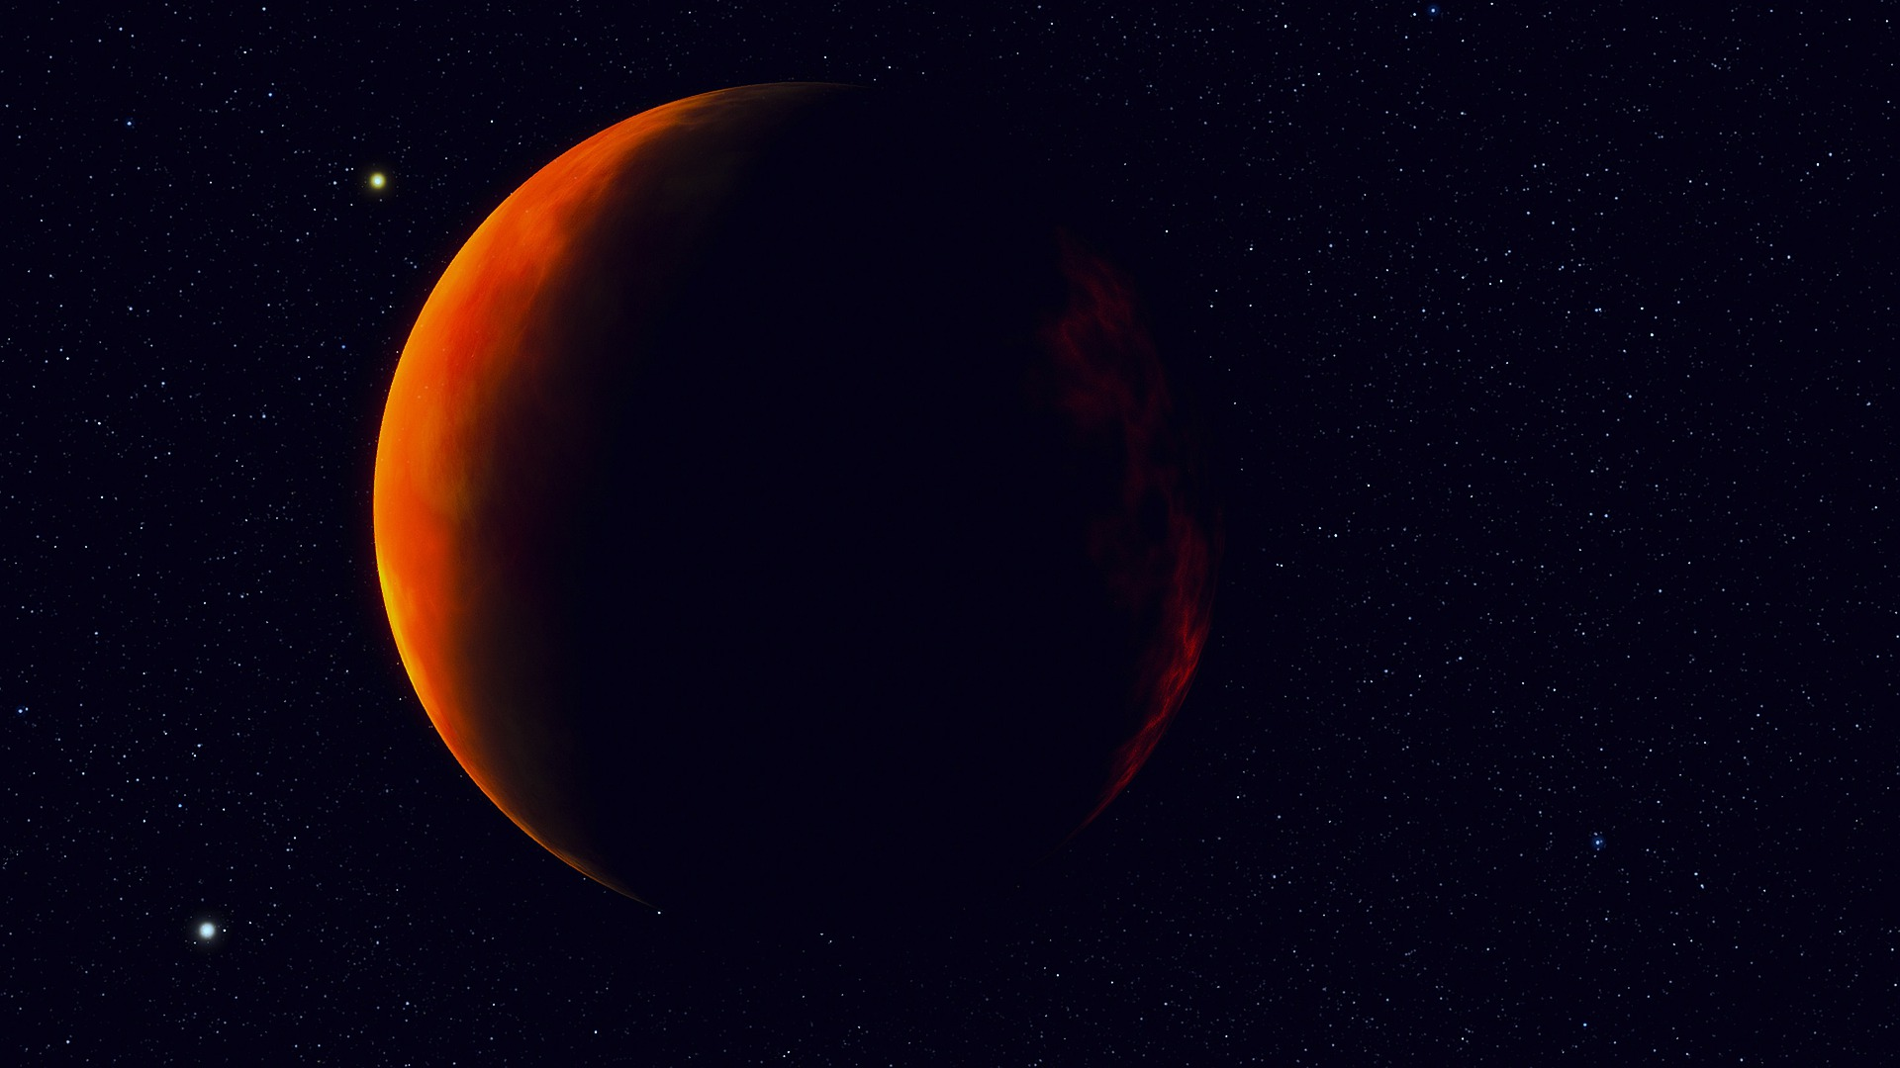
NEW HEAVENS…
NEW EARTH

Slide 2
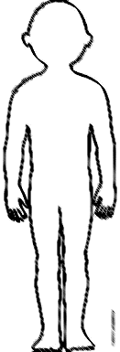
At death
Spirit
Soul
body
Resurrected glorified
body
GRAVE
ALL PEOPLE

Slide 3
HEAVEN with Christ
death
believer
Spirit
Soul
body
Resurrected glorified
body
GRAVE
All people

Slide 4
HEAVEN with Christ
death
believer
Spirit
Soul
body
Resurrected glorified
body
unbeliever
GRAVE
All people
HADES
waiting place of the unsaved dead

Slide 5
HEAVEN with Christ
Great White Throne Judgement
death
Spirit
Soul
body
Resurrected glorified
body
unbeliever
2nd resurrection
GRAVE
All people
HADES
waiting place of the unsaved dead

Slide 6
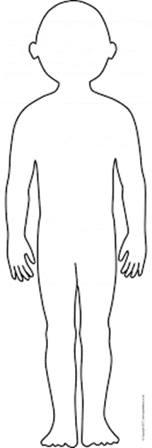
HEAVEN with Christ
RAPTURE
death
believer
Spirit
Soul
body
resurrected glorified
body
1st resurrection
GRAVE
All people

Slide 7
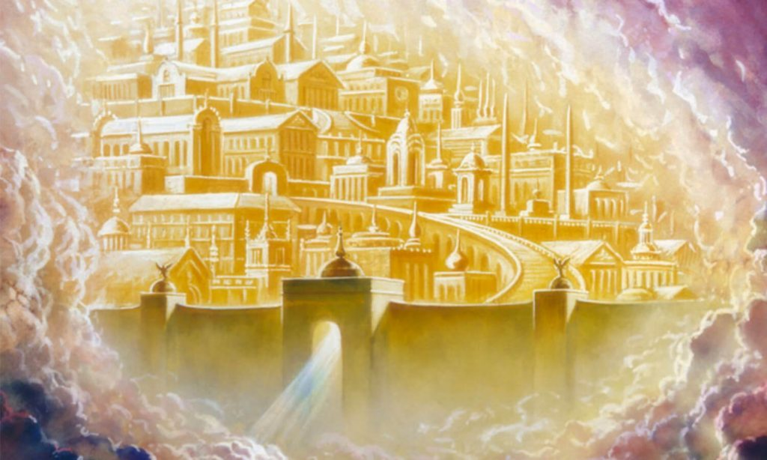
Heb 12:22-24 “… you have come to Mount Zion, To The City Of The Living God, The Heavenly Jerusalem. You have come to thousands upon thousands of angels in joyful assembly, to the church of the firstborn, whose names are written in heaven. You have come to God, the Judge of all, to the spirits of the righteous made perfect, to Jesus the mediator of a new covenant…”

Slide 8
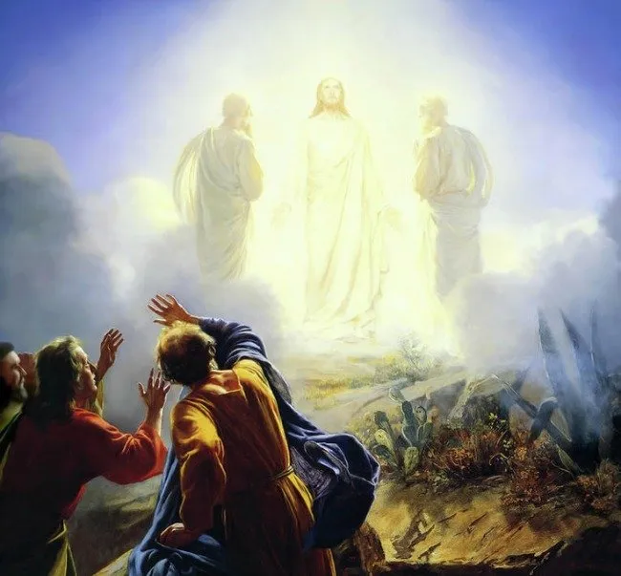
Luke 9:29-31 “As He prayed, the appearance of His face was altered, and His robe became white and glistening. And behold, two men talked with Him, who were Moses and Elijah, who appeared in glory and spoke of His decease which He was about to accomplish at Jerusalem.”

Slide 9
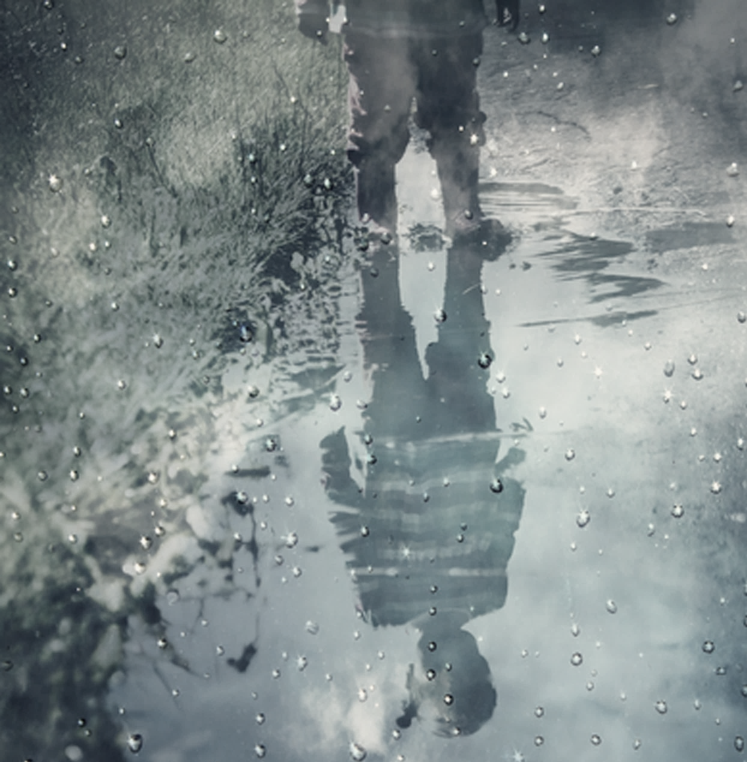
Luke 16:19-31 2 Cor 5:10
1 Corinthians 13:12 “For now we see only a reflection as in a mirror; then we shall see face to face. Now I know in part; then I shall know fully, even as I am fully known.”

Slide 10
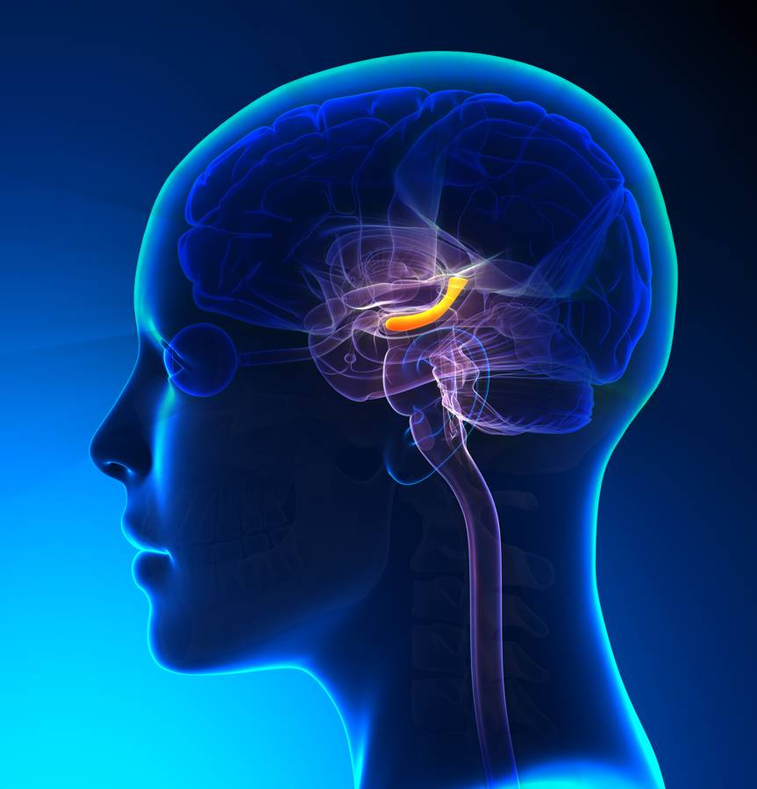
In heaven, we DON’T LOSE OUR MEMORY; rather, we add to it! We have every reason to believe we will KNOW EACH OTHER in heaven
Death is not the end of existence, it is a RELOCATION!
It is in these RESURRECTED, GLORIFIED BODIES that we enter the New Heavens and the New Earth

Slide 11
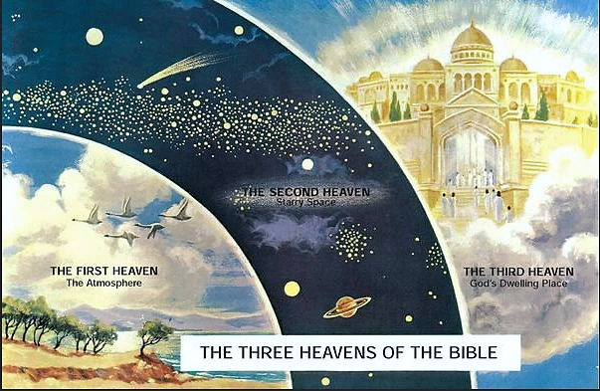
THE SECOND HEAVEN Sun, moon, stars…
THE FIRST HEAVEN The atmosphere
THE THIRD HEAVEN God’s dwelling place
THE THREE HEAVENS OF THE BIBLE

Slide 12
Isaiah 65:17 “… behold, I create new heavens and a new earth; and the former shall not be remembered or come to mind.” Psalm 102:25-26 “Of old You laid the foundation of the earth, and the heavens are the work of Your hands. They will perish, but You will endure; Yes, they will all grow old like a garment; like a cloak You will change them, and they will be changed.”

Slide 13
Revelation 21:1-5 “Now I saw a new heaven and a new earth, for the first heaven and the first earth had passed away. Also, there was no more sea. Then I, John, saw the holy city, New Jerusalem, coming down out of heaven from God, prepared as a bride adorned for her husband.”

Slide 14
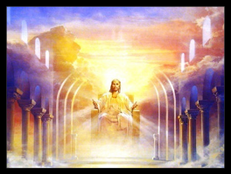
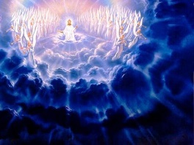
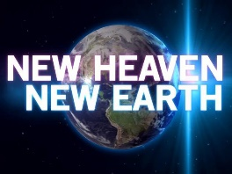
The CHURCH AGE
The RAPTURE of the Church
7 yr. TRIBULATION on Earth
Christ’s 2nd COMING – to Earth
Christ’s MILLENNIAL KINGDOM
Great White Throne JUDGEMENT
The ETERNAL STATE
New HEAVENS / New EARTH

Slide 15
2 Peter 3:7 “…the heavens and the earth which are now preserved by [GOD’S] word, are reserved for fire until the day of judgement and destruction of ungodly men…”

Slide 16
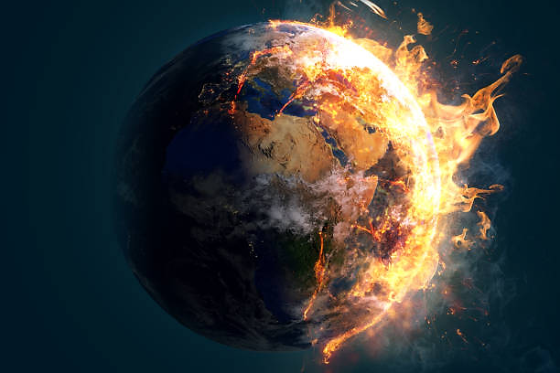
2 Peter 3:10-13 “But the day of the Lord will come as a thief in the night, in which the heavens will pass away with a great noise, and the elements will melt with fervent heat; both the earth and the works that are in it will be burned up... Nevertheless we, according to His promise, look for new heavens and a new earth in which righteousness dwells.”

Slide 17
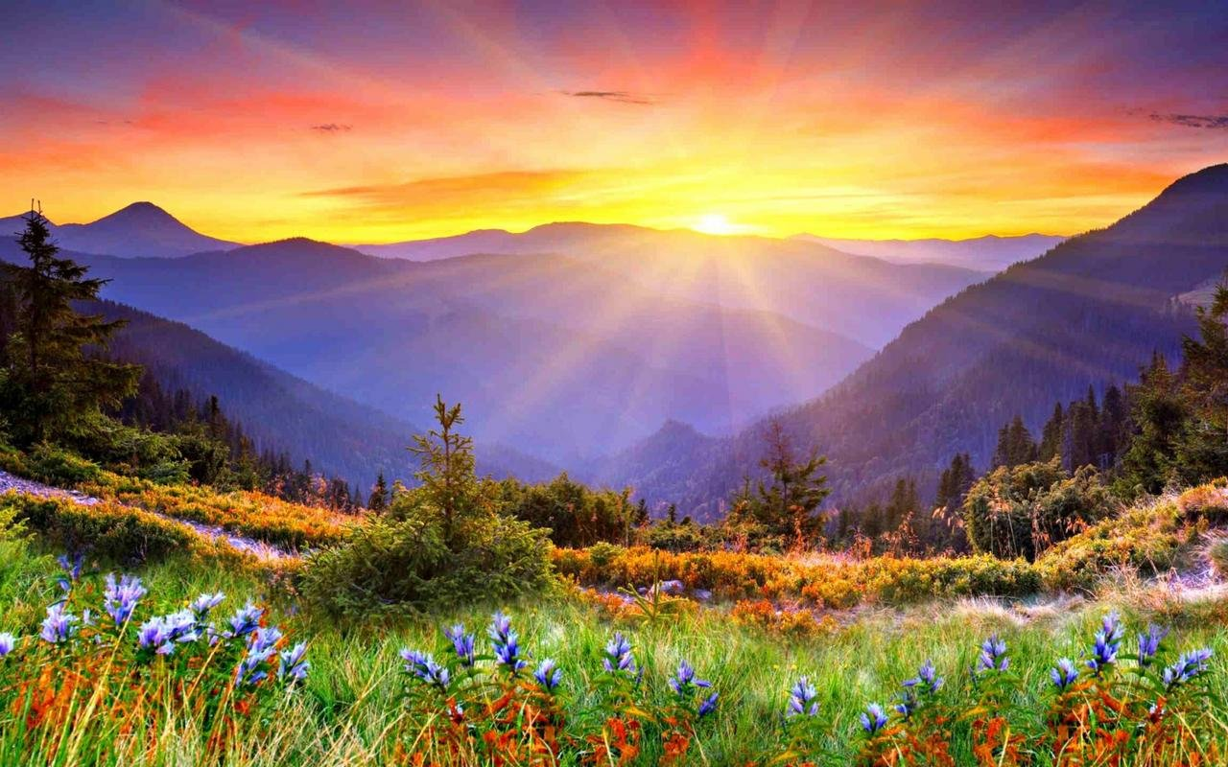
The CURSE will finally be over, forever, and “the restoration of all things” spoken of by Peter (Acts 3:21) will become eternal reality

Slide 18
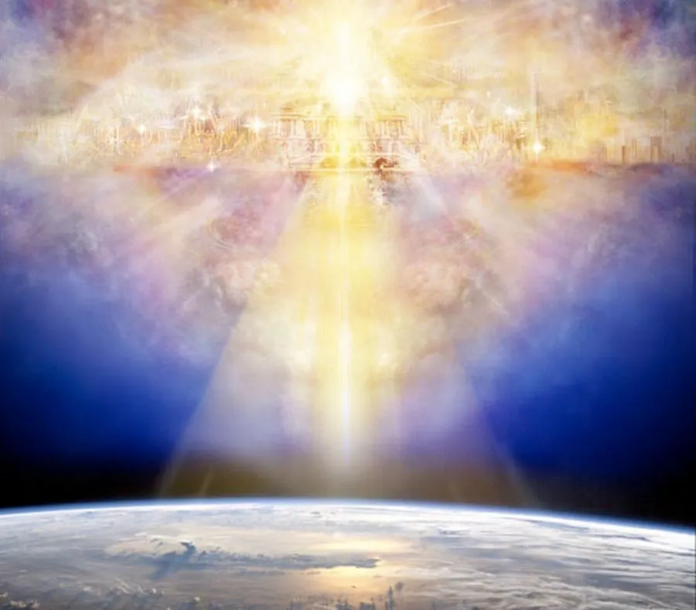
Rev 21:2 “the holy city, New Jerusalem, coming down out of heaven from God…

Slide 19
Abraham: “…waited for the city which has foundations, whose builder and maker is God.” Heb 11:10 All who died in faith: “…desire a better, that is, a heavenly country. Therefore God is not ashamed to be called their God, for He has prepared a city for them.” Heb 11:16

Slide 20
Revelation 21:3-4 “And I heard a loud voice from heaven saying, “Behold, the tabernacle of God is with men, and He will dwell with them, and they shall be His people. God Himself will be with them and be their God. And God will wipe away every tear from their eyes; there shall be no more death, nor sorrow, nor crying. There shall be no more pain, for the former things have passed away.”

Slide 21
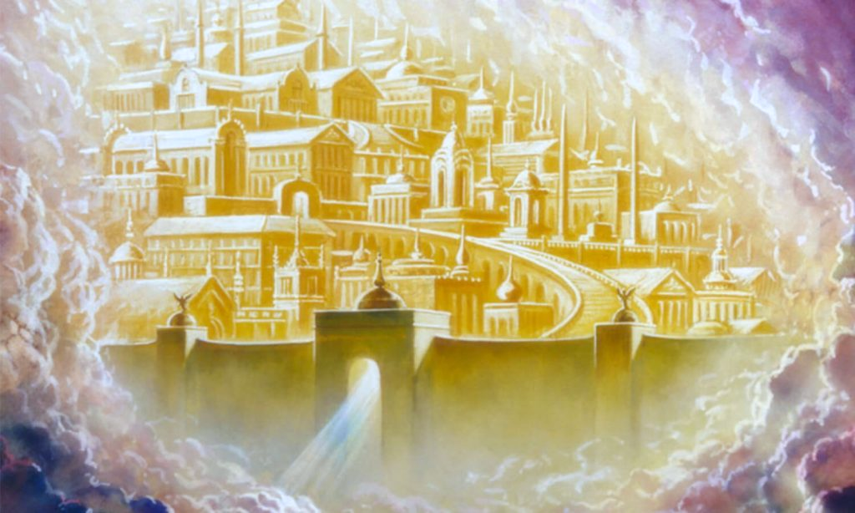
GOD’S HEAVEN and the NEW EARTH will no longer be separate places, but they will be merged into one realm.
It’s a HOLY CITY where righteousness dwells
GOD will dwell with His people there forever
Everything negative that was part of the CURSE will be gone: tears, death, sorrow, crying, pain
The CITY will be filled with GOD’S GLORY
There will be NO MORE SEA (A full description of its exquisite structure and beauty is given vv 11-21)

Slide 22
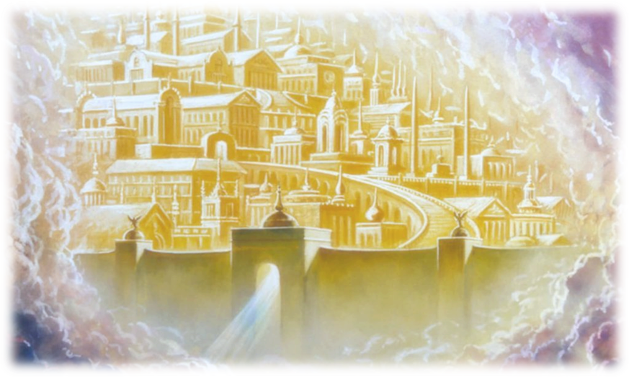
There will not be a separate TEMPLE there because God Almighty and the Lamb will be its TEMPLE
There will be NO NIGHT
There will be NO SUN or MOON because the glory of God will be its light
This is a literal city of immense proportions: 2,400 km long, 2,400 km wide, 2,400 km high
About Brisbane to Hobart on one side!
The surface area is about 5.76 M sq km (all of City of London is 16.08 sq km)

Slide 23
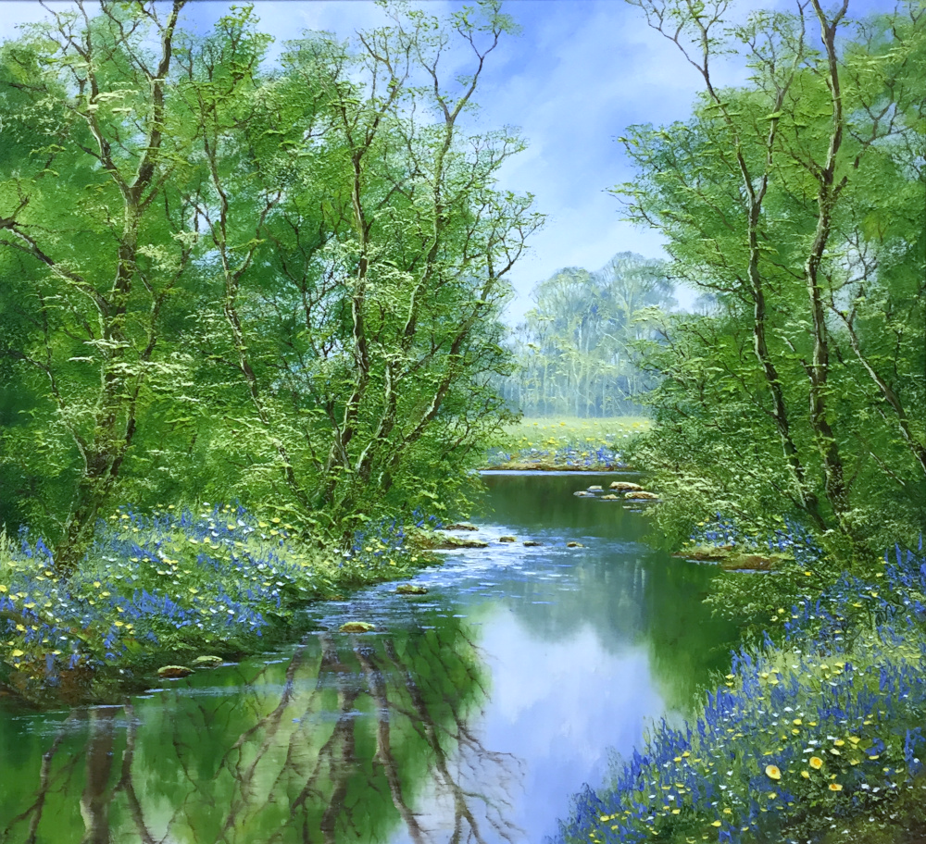
A beautiful RIVER will flow through it with the WATER of LIFE
The TREE of LIFE will be there
There will be PERFECT RIGHTEOUSNESS and UNHINDERED FELLOWSHIP
And there will be things to do there. Rev 22:3 says, “His servants shall serve Him”

Slide 24
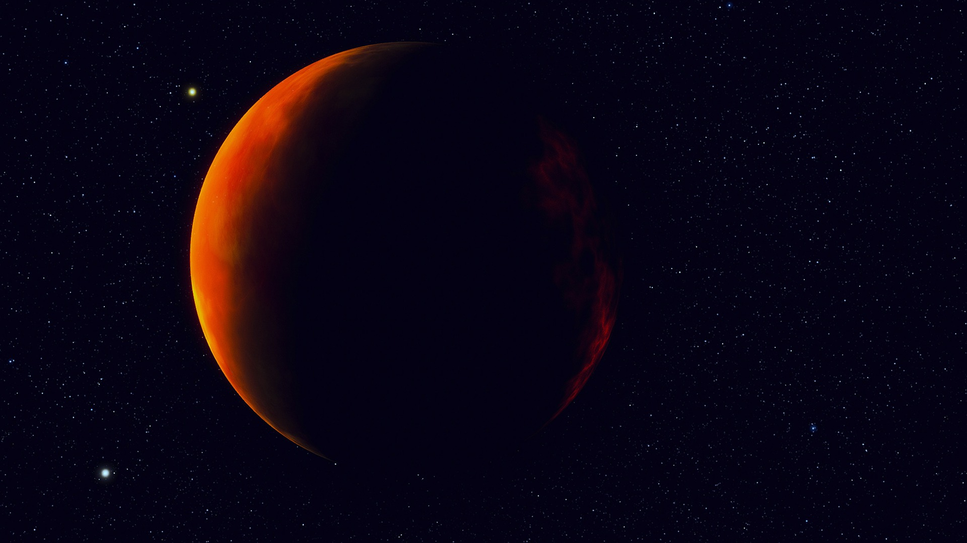
NEW HEAVENS… NEW EARTH
“…the best is yet to come!”
Challenge 1: “…since all these things will be dissolved, what manner of persons ought you to be in holy conduct and godliness, looking for and hastening the coming of the day of God…”
Challenge 2: Since we have received such an open and gracious invitation from the Lord Himself, won’t you respond in faith and receive the blessing of ETERNAL LIFE?

