Slide 1
From Evolutionist to Creationist!
Dr Ron Neller
Ph.D. (UNE); Adj Professor (Turku)
Director, Australian Christian Tertiary Education Ltd.

Slide 2
Notes:
To do this I travelled the world. Travelling the globe and studying different topics led me to ask the question what is science?

Slide 3
Landscapes
Floods
Sediments
Fossils
Microbes
Notes:
To do this I travelled the world. Travelling the globe and studying different topics led me to ask the question what is science?

Slide 4
Landscapes
Floods
Sediments
Fossils
Microbes
China
Finland
Libya
Peru
Pacific Islands
South Africa
Australia
Notes:
To do this I travelled the world. Travelling the globe and studying different topics led me to ask the question what is science?

Slide 5
The Bible
Sediments and Landscapes
Fossils
Evolution
Notes:
It was taught that landscape and biological evolution makes good sense of the data – a good interpretation
Lets now look at
Landscapes
Sediments
Fossils

Slide 6
Experimental
(operational) Science
historical
(forensic) Science
Notes:
Nature of science and regardless it is all good.

Slide 7
How Are Fossils Created?
Notes:
How are fossils formed?

Slide 8
Notes:
How are fossils formed?

Slide 9
Notes:
How are fossils formed?

Slide 10
Notes:
How are fossils formed?

Slide 11
Notes:
How are fossils formed?

Slide 12
Johnicara
gallaghdous
Notes:
How are fossils formed?

Slide 13
How Are Fossils Created?
Rapid Burial
Continued sediment
accumulation
Notes:
All agree that this is how fossils are created

Slide 14
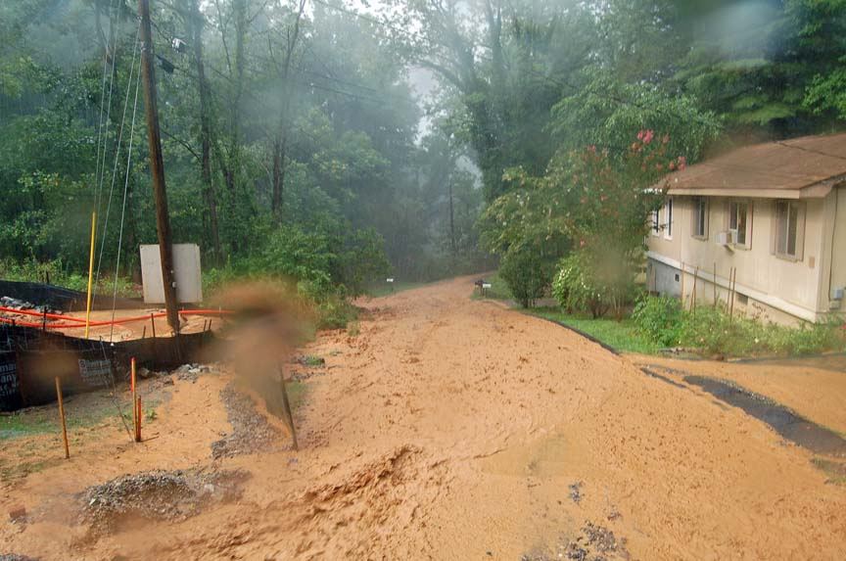
Sediments and Fossils

Slide 15
Takitumu Lagoon, Cook Islands
Notes:
Sediment transfer much lower than perceived

Slide 16
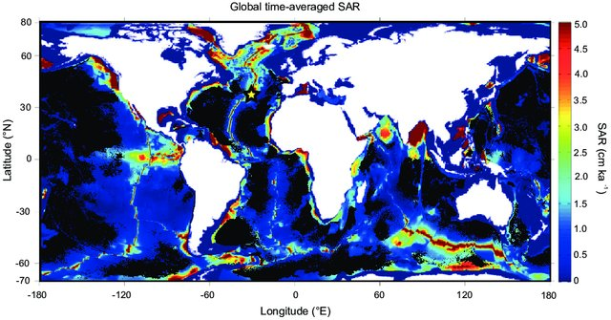
Ocean Sedimentation Rates?
1 – 50 mm / 1000 years
Source: Lougheed.et. al. 2018
Notes:
Moving beyond the age-depth model paradigm in deep-sea palaeoclimate archives: Dual radiocarbon and stable isotope analysis on single foraminifera, Bryan Lougheed
Brett Metcalfe
Ulysses Silas Ninnemann
L. Wacker
Climate of the Past 14(4)
2018

Slide 17
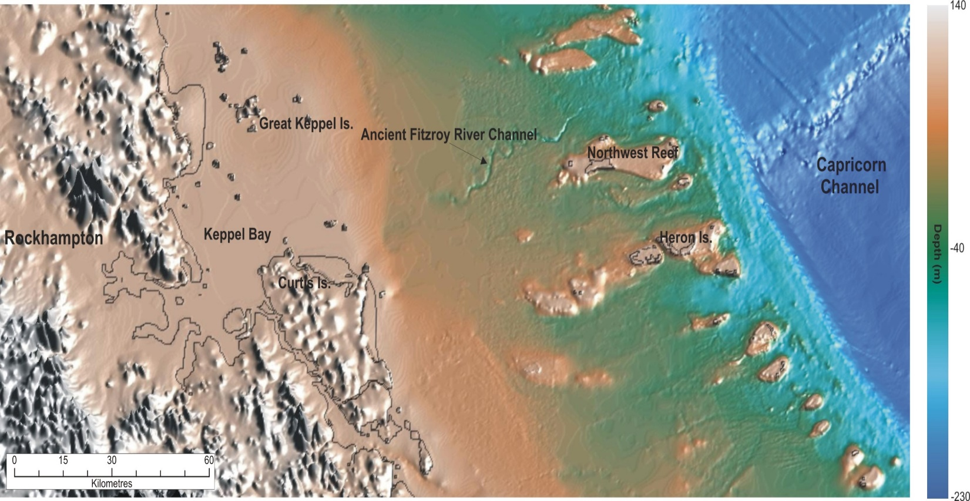
Continental Shelf Sedimentation Rates?
Average rate of 300 mm/1000 years
(ranging between 150 – 400 mm)

Slide 18
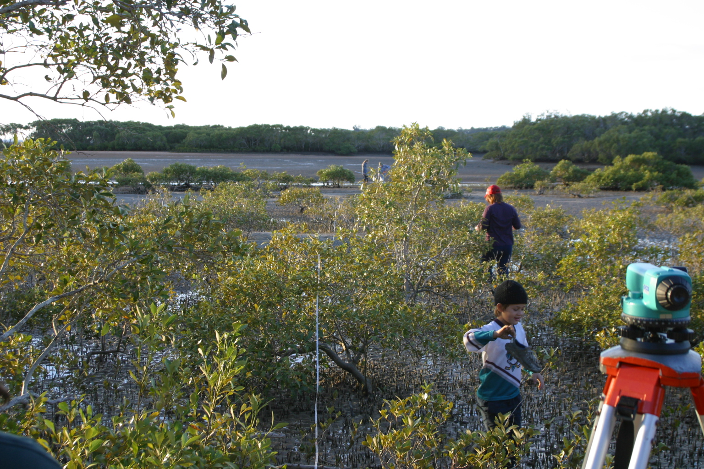
Estuarine Sedimentation Rates?
3.6 mm year (global)

Slide 19
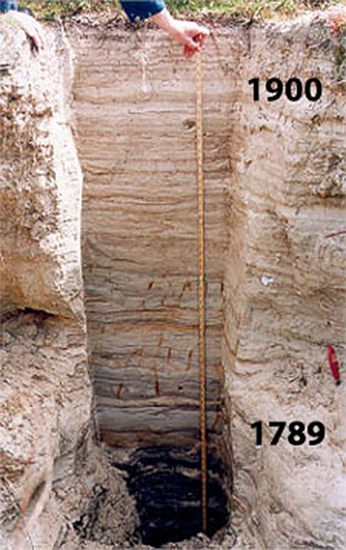
Floodplain Sedimentation Rates?
0.14 – 0.18 cm year
0.07 and 0.59 cm year
3.2 cm year
0.3 – 4.0 cm year
10 cm / major event NSW.
Notes:
Tsunami’s move little sediment? Then what does?

Slide 20
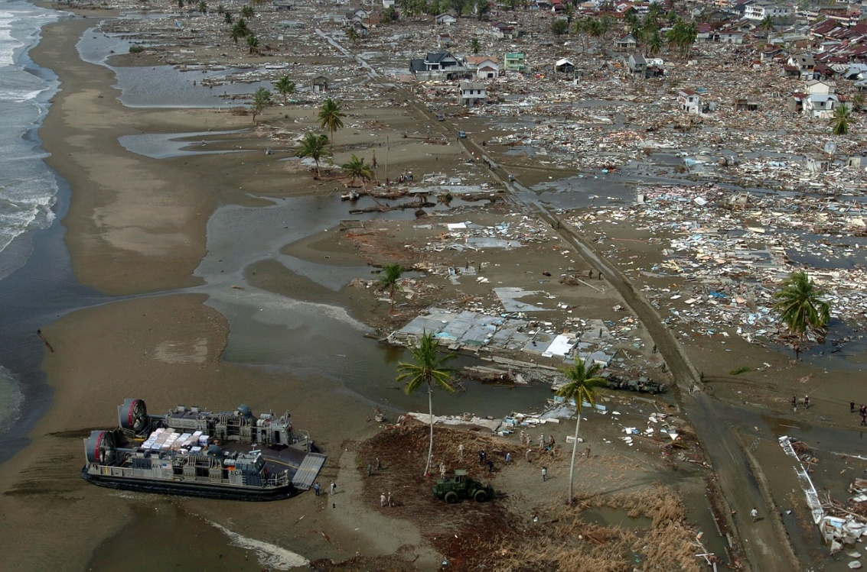
Tsunami Sedimentation Rates?
Up to 10 cm deposited
Notes:
Tsunami’s move little sediment? Then what does?

Slide 21
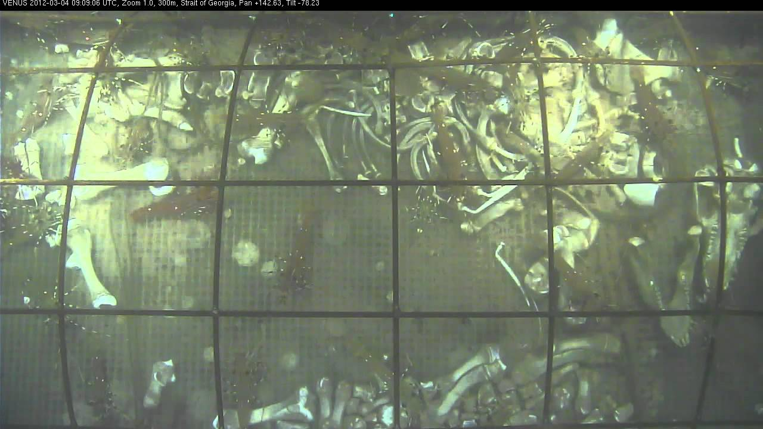
https://www.youtube.com/watch?v=xXtSw1FPkhM

Slide 22
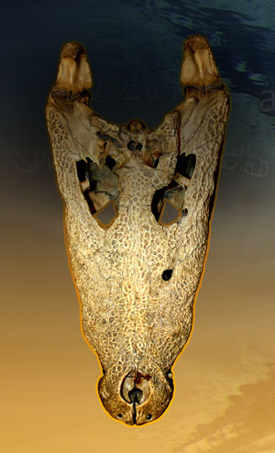
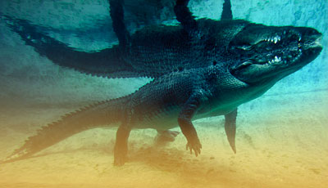
Dead crocodiles down under:
How croc decomposition helps confirm a crucial element of Bible history
Sabena Jane Blackbird / Alamy Stock Photo

Slide 23
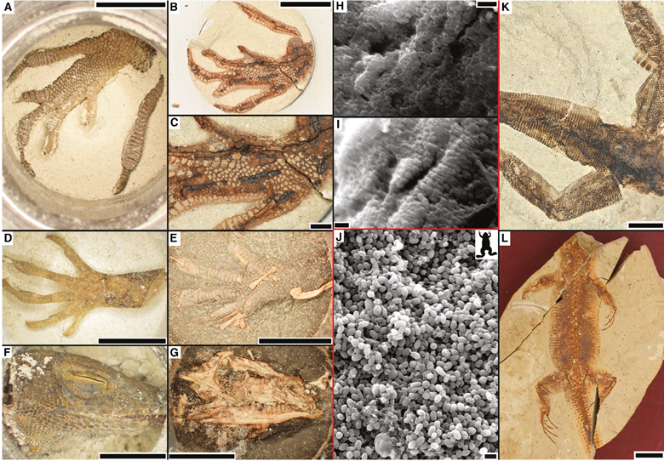
Fossils in a day?
Source: Palaeontology, 2018 p. 5

Slide 24
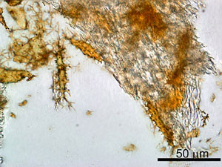
Dinosaur soft tissue and red blood cells
Source: Science via AP From www.msnbc.msn.com/id/7285683/)
Image: Dr Mary Schweitzer

Slide 25
Focal Points:
Fossils are buried in deep flood sediments

Slide 26
Focal Points:
Fossils are buried in deep flood sediments
Sediment supply rate needed to create fossils today is insufficient

Slide 27
Focal Points:
Fossils are buried in deep flood sediments
Sediment supply rate needed to create fossils today is insufficient
Fossils were not formed millions of years ago

Slide 28
Focal Points:
Fossils are buried in deep flood sediments
Sediment supply rate needed to create fossils today is insufficient
Fossils were not formed millions of years ago
Scientific Interpretation:
A Global Flood did occur

Slide 32
GET CONNECTED
Creation INFObytes
connect.creation.com

Slide 33
God Said...
And behold, I myself am bringing floodwaters on the earth… (Genesis 6:17)
Notes:
So I was now in a dilemma because the Bible agreed with my scientific interpretation.

Slide 34
But ‘science’ says…
No such flood has occurred (a regional flood occurred in the Black Sea)
Notes:
But we were taught otherwise.

Slide 35
The Bible
Sediments and Landscapes
(rate, distribution, volume, frequency)
Fossils
(abundance, sorting, role of sediment)
Evolution
Notes:
The Bible makes better sense of the data

Slide 36
Take Home Message….
… casting down arguments and every high thing that exalts itself against the knowledge of God, bringing every thought into captivity to the obedience of Christ, (2 Corinthians 10:5)
Notes:
The title of my talk today is “Did God Really Say?” and I think it’s an important talk not only for the church but for every individual’s faith.
One of the biggest challenges Christians face from non-Christians comes in the form of the question “Did God really say..?” And most of these questions challenge areas of our faith rooted in Genesis. Current examples are Did God really say….read all
It is interesting that the original question that the enemy asked Eve in the Garden hasn’t changed over time.

Slide 37
Take Home Message….
See to it that no one takes you captive through hollow and deceptive philosophy, which depends on human tradition and the basic principles of this world rather than on Christ. (Colossians 2:8)

Slide 38
Take Home Message….
Read:
2 Corinthians 10:5
Colossians 2:8
Discuss these passages (and other similar passages) with others and pray together.

Slide 41
Defending Genesis
Celebrating the best from 40 years of the world’s most widely-read Creation magazine

Slide 42
Creation magazine

