Slide 1
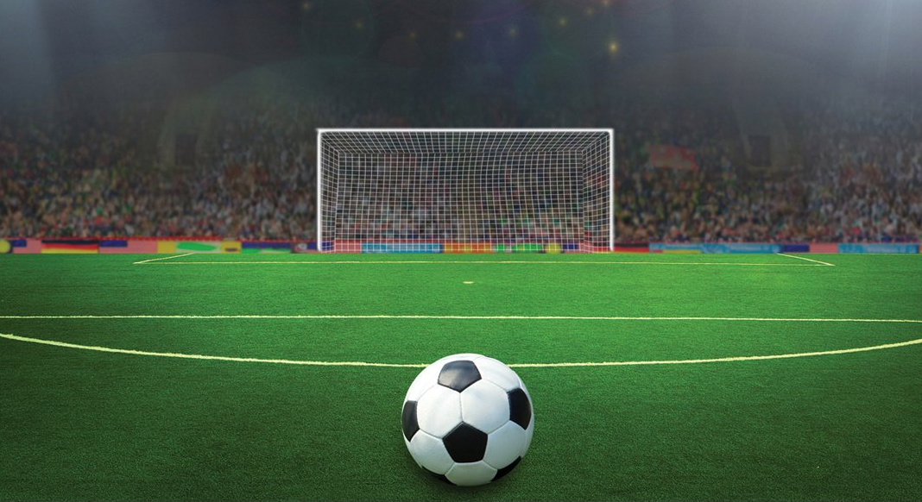
“The fear of shame prevents soccer players from considering their greatest option.” (Steven Levitt)
2%
57%
41%
“The fear of man will prove to be a snare, but whoever trusts in the Lord is kept safe.” (Proverbs 29:25)
Fear = to be overwhelmed and controlled.
17%
Snare = a baited, hidden trap designed to entice, capture and destroy.
Notes:
In the recent Women’s Soccer World Cup we got to enjoy the tension that is penalty shootouts. While it may look easy many of the world’s best players hit the post or missed the goal altogether. Statistics show that when it comes to penalties a goalkeeper will dive right 57% of the time, left 41% of the time and only stay in the middle 2% of the time. Therefore the safest place to shoot is straight down the middle, but stats also show us that only 17% of penalties are kicked down the middle. Why? Sports writer Steven Levitt suggests it is because of the fear of ridicule – players would look a lot more silly to kick it straight and have the kick saved, rather than kicking to a side and having it saved. Better to not look foolish than to score a penalty. This is what the Bible calls the fear of man and in Proverbs 29 it gives us a good description of the danger of living in fear of man and highlights the option we have in life. Either fear man or fear God.. When the Bible talks about fear it is referring to being overwhelmed (in awe of something or someone) to the point that you are controlled by it. The fear of man – seeking human approval is described as a snare. A snare is baited with something that looks attractive in order to entice you but once you take the bait you are then captured and destroyed – it leads to misery and suffering.

Slide 2
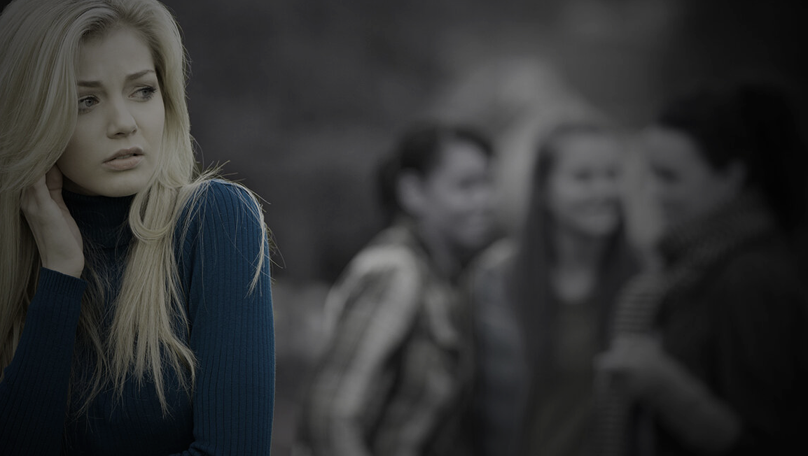
Do you do whatever it takes to fit in?
Do you need to be liked by all?
Are you easily crushed by criticism?
Are you overcommitted because you can’t say no?
Do you avoid people who don’t like you?
Are you embarrassed easily & often?
Do you tell ‘white lies’ to make yourself look better?
King Saul sinned & disobeyed God because he “was afraid of the people and did what they demanded.” (1 Sam 15:24)
Some hid their faith for fear of being rejected - “they loved man’s approval, more than God’s approval.” (John 12:42-43))
Notes:
Now many of us may say that we don’t seek the approval of mankind, that we are not people pleasers, but I want to ask you a few questions – get you to take a test. If you answer yes to these questions = a strong indication that you do struggle with people pleasing. If that is the case you are not alone – we have struggled with that throughout history and we see a number of instances in the scriptures as well. King Saul’s downfall was built on the fact he was a people pleaser – he feared man more then he feared God. And in the New Testament we read how some followers of Jesus lived a fruitless life for Jesus because they loved man’s approval more than God’s.

Slide 3
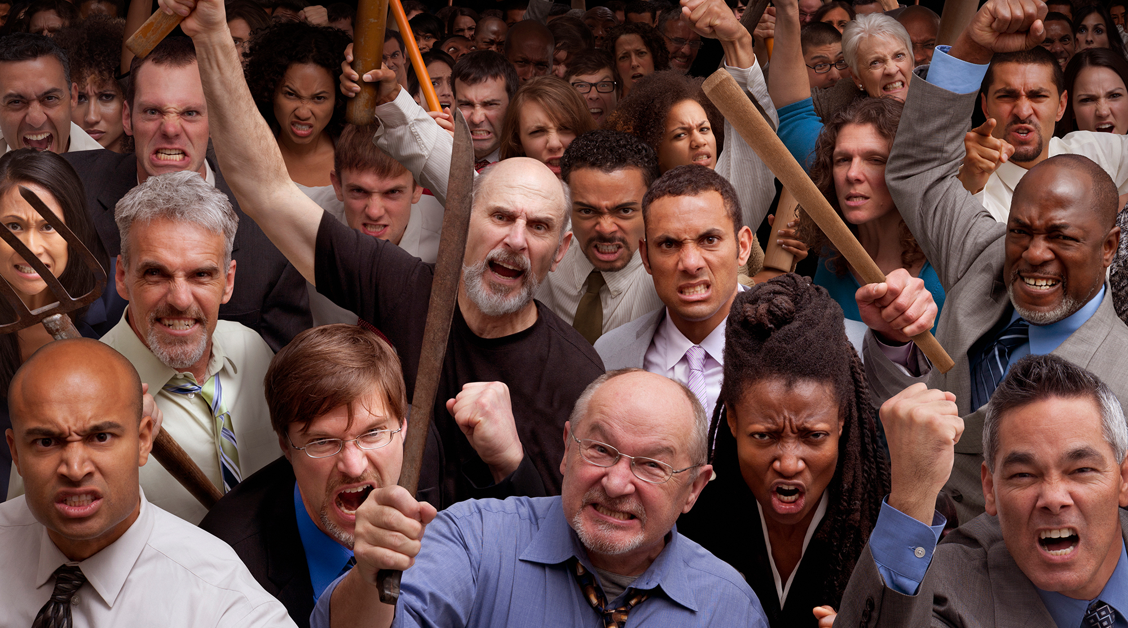
“The fear of man is cruel tyranny. It’s exhausting & complicated. It’s servitude to 1000 masters instead of one. Once you begin chasing human approval, you will never stop running.”
(Andree Seu Petersen - US author)
ARE YOU TRAPPED BY MAN OR SECURE IN CHRIST?
(Luke 22:54-62, John 21:1-19)
THE REASONS WE FEAR HUMAN DISAPPROVAL.
THE RESOLUTIONS TO THE FEAR OF HUMAN DISAPPROVAL.
THE REVERSAL OF THE FEAR OF HUMAN DISAPPROVAL.
Notes:
US author Andree Seu Petersen describes the misery and struggle that always comes with seeking the approval of man, over the approval of God. But my purpose is not to discourage you this morning but to encourage you and show that through the grace and power of Christ we can overcome our fear of man and find security and joy in living for Christ. This morning I want to look at the story of Peter – denying Jesus three times - arguably the greatest example of fearing man over God and secondly to see how he overcame that fear to live a powerful and effective life for Jesus. We will see the reasons, the resolutions and the reversal.

Slide 4
THE REASONS WE FEAR HUMAN DISAPPROVAL
1. We are filled with ourselves – Peter was impulsive, brash & proud = a calamity waiting to happen (1 Corinthians 10:12) = Satan saw him as a prime target (Luke 22:31)
“The pleasure of pride is like the pleasure of scratching. As long as we have the itch of self-regard, we will always want the pleasure of self-approval.” (C.S Lewis)
2. We fail to pray – after Peter boasted in his loyalty to Jesus, he struggled to pray (Matthew 26:41).
People who depend on themselves rarely pray. But lack of prayer = being prone to temptation (Luke 22:45).
Notes:
Filled with ourselves. Peter was impulsive and proud. He was the one to jump out of the boat to walk to Jesus (Matt 14:25-31), rebuked Jesus when he talked about his impending death (Matt 16:21-22), the first to declare he wouldn’t deny Jesus Matt 26:34-35 – that he would die or go to prison before he would do that. He rushed in to cut the ear of the servant of the High Priest when they came to arrest Jesus (John 18:10). He had appointed himself as the unofficial spokesperson for the disciples – not afraid to say what others were thinking. Felt that you were entitled to his opinion whether you liked it or not. When we are filled with pride we will always become pre-occupied with what others think of us. When we build our life, (value) on what we do and who we are then we always crave validation from others.
Fail to pray – need to rely on strength of God. Prayer is an admission and confession of dependence on God – asking for help, strength, wisdom, patience etc. We need to be praying for an increase in fear of God – keep asking for what you need to fear him more (Matthew 7:7, James 4:2) – its in accordance with his will to do that.

Slide 5
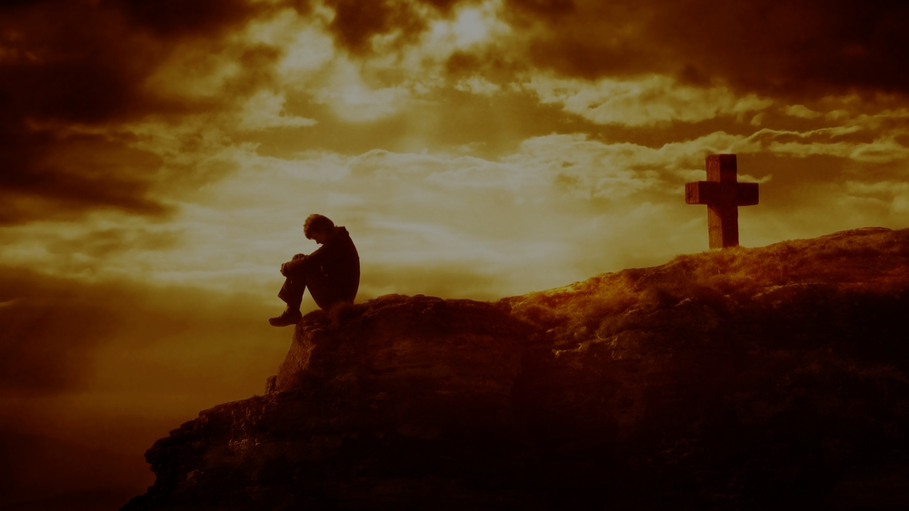
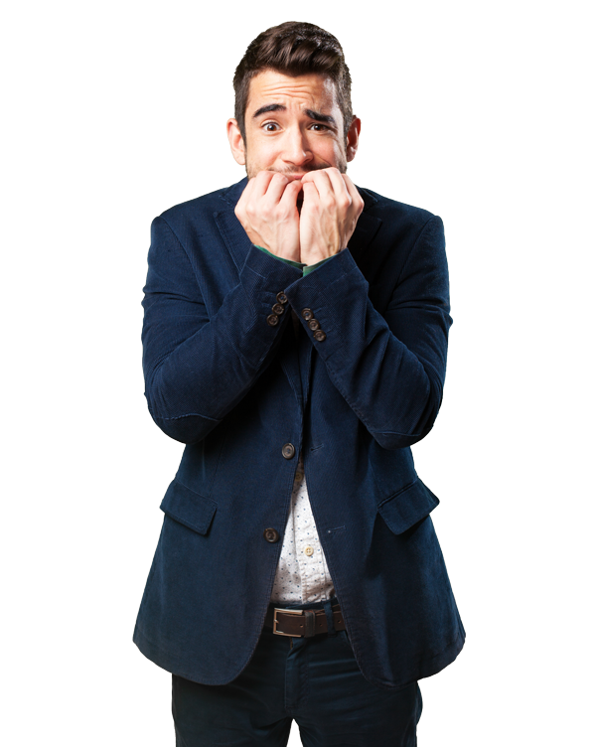
3. We follow Jesus from far off – “So they arrested Jesus and led him to the high priest’s home. And Peter followed at a distance.” (Luke 22:54)
You can’t fear a distant and forgotten God. He must be constantly near and always remembered – His Word, power, grace, mercy, blessings, strength, holiness, promises ….
4. We find fellowship in the wrong places – “The guards lit a fire in the middle of the courtyard and sat around it, and Peter joined them there.” (Luke 22:55)
“Those that warm themselves with evildoers, grow cold toward good people and good things.” (Matthew Henry)
Notes:
3. Follow from afar – if we don’t spend regular time in God’s word we will struggle to be in awe of him – to be overwhelmed and controlled. Same for our kids – parents we can’t expect them to fear God more than man if we rarely bring them close to God – Bible Study, prayer etc.
4. Find fellowship in wrong places – essentially a result of number 3. In the garden Peter stood with Jesus against the soldiers and servants of the high priest. Now he is standing with them against Jesus. He was getting comfortable and warm with those who opposed Jesus and the gospel. Trusted in Jesus and then trusted in the soldiers. Double-mindedness, trying to serve two masters – their loyalty is divided between God and the world and as such they are unstable and shouldn’t expect God to bless them (James 1:6-8). There is a power of imitation and absorption whenever we associate with others – bad will influence us, good will influence us. Bad company will corrupt good character (1 Corinthians 15:33)

Slide 6
THE RESOLUTIONS FOR THE FEAR OF HUMAN DISAPPROVAL
In John 21 Jesus pursues Peter and restores him, even though he failed miserably.
In Acts 2 the Holy Spirit empowers Peter to do even greater things for Jesus.
Pursue, restore & empower = the Gospel = same for us too.
1. Replace our fear of others with His approval for us – the approval of God is the only one that matters. “Yes I, am the one who comforts you. So why are you afraid of mere humans, who wither like the grass and disappear?” (Isaiah 51:12)
Feed your soul with the reality of the forgiveness of God – “If God is for us, who can ever be against us.” (Romans 8:31)
Notes:
After Peter had denied Jesus I have no doubt that Peter thought his place in the kingdom of God was in jeopardy – that his relationship with Jesus could never be the same. But in John 21, on the shore of the Sea of Galilee Jesus intentionally comes to seek Peter out and restore him (message of the gospel). Then a few weeks later Peter is filled with the Holy Spirit. He is now restored and empowered to do even greater things for Jesus. Same can happen to us. Even though we have failed miserably we are never rejected and powerless because of Christ and the Holy Spirit. The same is true for us. So how can we overcome the trap of fearing man.
1. Replace fear of others with his approval for us – human approval doesn’t last, it doesn’t forgive and it doesn’t restore like God does. When you fail miserably the world cancels you, turns it back on you, constantly changes the standards of what deserves approval. God is the same yesterday, today and forever. At the end of life, when we face God, the only approval that will matter will be the approval of Jesus. We need to grasp the absolute truth that if God doesn’t like us, it doesn’t matter who likes you in the end. It won’t help us. (Isaiah 51:12) We also need to believe that people are small (mere) and fleeting. God is big and eternal. So it doesn’t matter what the world thinks of us – it only matters that we please God. If God is for us who can be against us – Paul is not saying that we won’t have people oppose us (we absolutely will experience that) but that it doesn’t matter who opposes as as long as we have God’s approval.

Slide 7
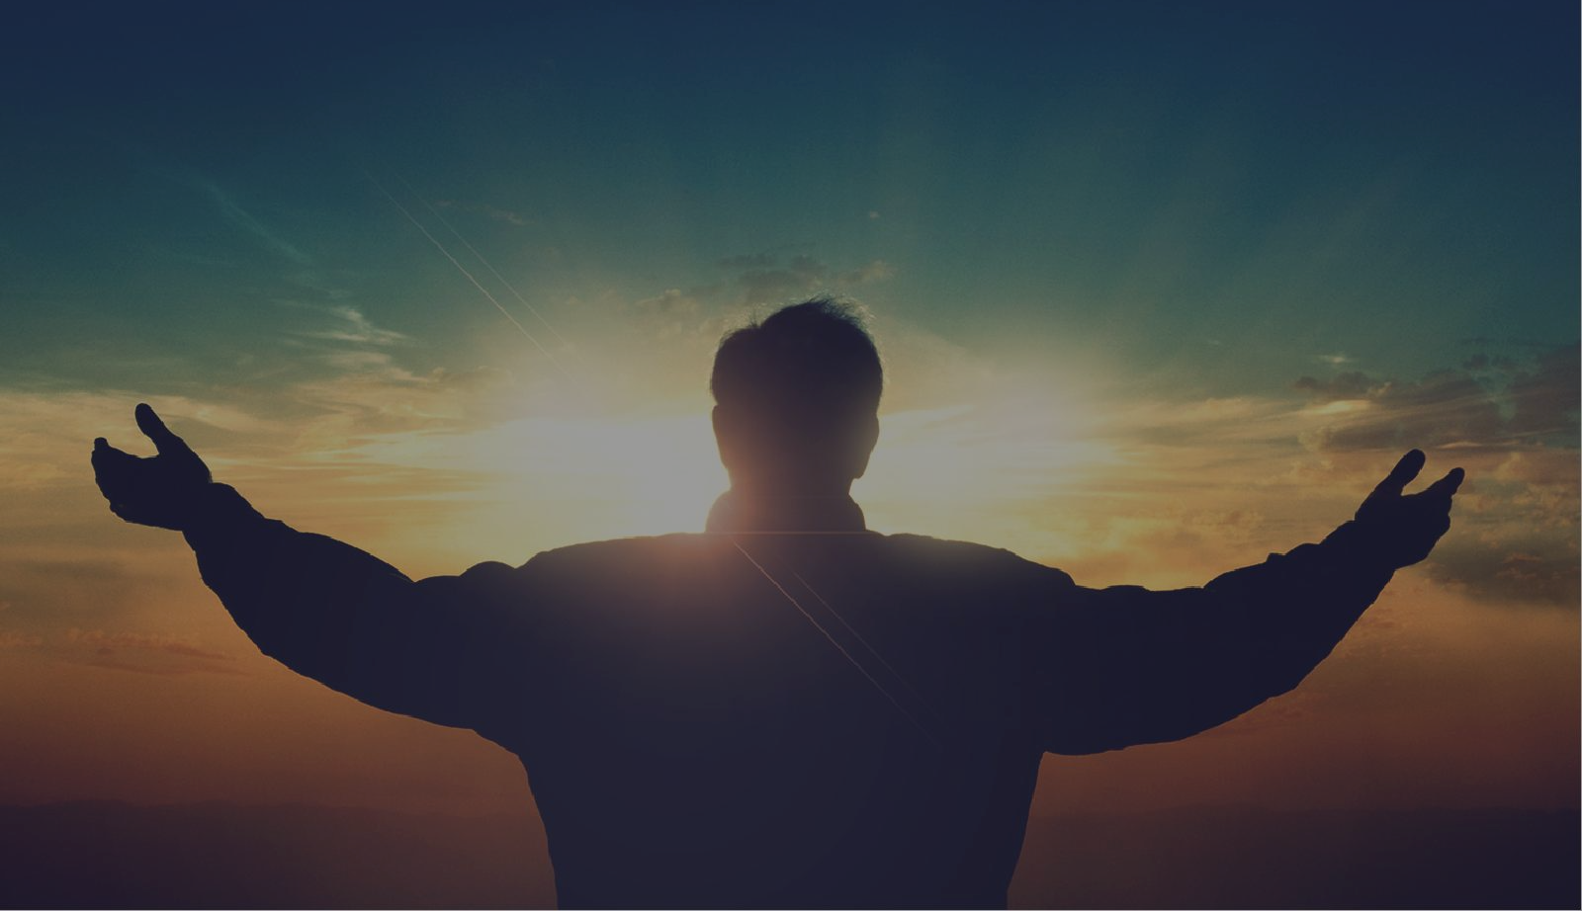
2. Replace our fear of others with love for Jesus – “Simon son of John, do you love me?” three times (John 21:15-17).
To overlay Peter’s three denials with three declarations of unconditional love + to affirm that you can’t truly claim Jesus as your first love, if you fear man more. “No one can serve two masters.” (Matthew 6:24)
3. Replace our fear of others with love for others – “Simon, son of John…. feed and take care of my sheep.”
“Don’t be selfish. Don’t try to impress others… Be humble.. Take an interest in others too.” (Philippians 2:3-4). Don’t fear others, love others. Fear drains us, while love empowers us.
Notes:
2. Replace fear of others with love for Jesus – Jesus asks Peter three times whether he loves him. It grieved Peter that Jesus kept repeating that question, so why would he do that? I believe two reasons – firstly I think to overlay his three denials with three declarations of love. Secondly, because no one can boldly and continually proclaim that they love Jesus if they fear man more. You can’t fear man and give all your love to Jesus – Can’t serve two masters.
3. Replace fear of others with love for Jesus – Up until now Peter’s life had pretty much been all about him – he said and did what he wanted even if it got him in trouble. In calling him Simon son of John I think Jesus was making a point. I know I called you Peter the Rock but before me you were Simon the pebble – that was all me not you. So get over yourself and stop trying to impress others. Paul says the same thing in Philippians 2. Don’t fear others but love them. We can’t sacrificially and unconditionally love others if all our energy is directed towards impressing others and protecting ourselves. The Christian life is not about us – its about loving and serving others. Its hard to fear others if you are loving them. Be empowered by love not drained by fear.

Slide 8
4. Replace our fear of others with faith in him - “I tell you the truth… when you are old, you will stretch out your hands, and others will dress you and take you where you don’t want to go. Jesus said this to let him know by what kind of death he would glorify God. Then Jesus told him, “Follow me.” (John 21:18-19)
“Here on earth you will have many trials and sorrows. But take heart, because I have overcome the world.” (John 16:33)
We will find disapproval in this world and have reason to fear, but our faith can prevent us from giving into fear.
“The presence of fear doesn’t mean you don’t have faith. Fear visits everyone. But keep your eyes on Christ and make sure your fear is a visitor, not a resident.” Max Lucado)
Notes:
4. Replace our fear of others with faith in him. Jesus is not saying that the consequences of the disapproval of this world would be easy. Tells Peter that he will die serving Jesus but still says follow me. Jesus was afraid in the garden on the night before he died but he never lost faith in God and it never stopped him from being obedient to God’s will. His new commission doesn’t mean he would never be afraid but it did mean he could be confident that Christ has overcome death – the best is yet to come. Because of what Christ has done we should never let fear get the upper hand. The Gospel doesn’t minimise suffering but the cross helps us to see its ultimate purpose and gives us the strength to endure.

Slide 9
THE REVERSAL OF OUR FEAR OF HUMAN DISAPPROVAL - Restorated by Jesus & empowered by the Spirit = Peter went from wanting to deny Jesus to being willing to die for Jesus.
Acts 2 = Peter warned thousands to put their trust in “this Jesus whom you crucified” (v36) so they could be saved from this “perverse generation.” (v40) = 3000 saved.
Acts 4 – they amazed the Temple leaders “when they saw the boldness of Peter and John” (v13) preaching about Christ (v10).
When told to stop, Peter replied, “Do you think God wants us to obey you rather than Him?” (v19) = faith & love over fear.
Church leaders feared them (gospel power) & let them go (v21)
Notes:
The reversal = we see the change that came over Peter following his restoration – no longer fearing man more than God. He was no longer overwhelmed and controlled by the man, but by God. Preached to thousands, proclaiming Christ and inviting them to accept him as their Saviour. That was just the beginning. They were imprisoned for their preaching and when they came before the church leaders they boldly preached to them about Jesus (not ashamed of Jesus’ name). Even the church leaders were amazed by their boldness. When the leaders told them to stop they said we must obey God rather than man - - faith over fear. Then the church leaders decided to let them go because they didn’t know how to punish them without starting a riot. Who was afraid of who now?

Slide 10
The same can happen to us if we learn from Peter’s example.
He came to the end of himself and realised his desperate need for Jesus.
He experienced the unconditional love of Christ – the one who he denied, restored him as a newly humbled and fully forgiven follower.
He experienced the life changing power of the Holy Spirit = a radical transformation.
He came to the realisation, by the grace of God, that it is better to fear God, then it is to fear man.
In our hostile world we must ask God to lead, empower and fill us with a desire for His approval above human approval.
Notes:
In our increasingly hostile world (particular to Christians) we need to be filled with fear of God, not man – if we are to stand strong and not compromise , to be most effective for God, to be the light we are called to be then we need to ask God to empower us. We can’t do it on our own.

Slide 11
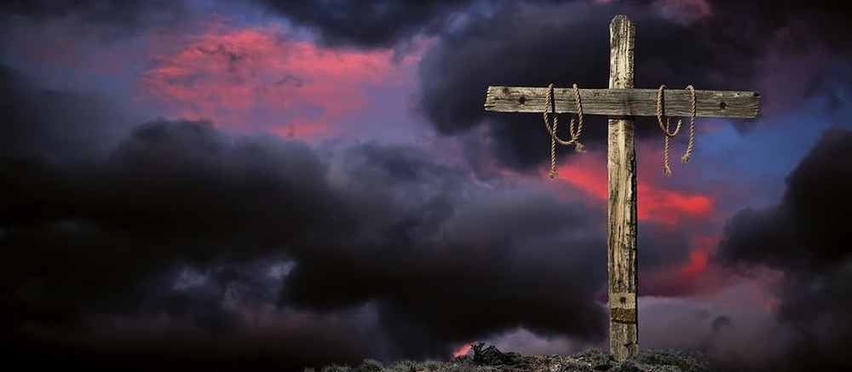
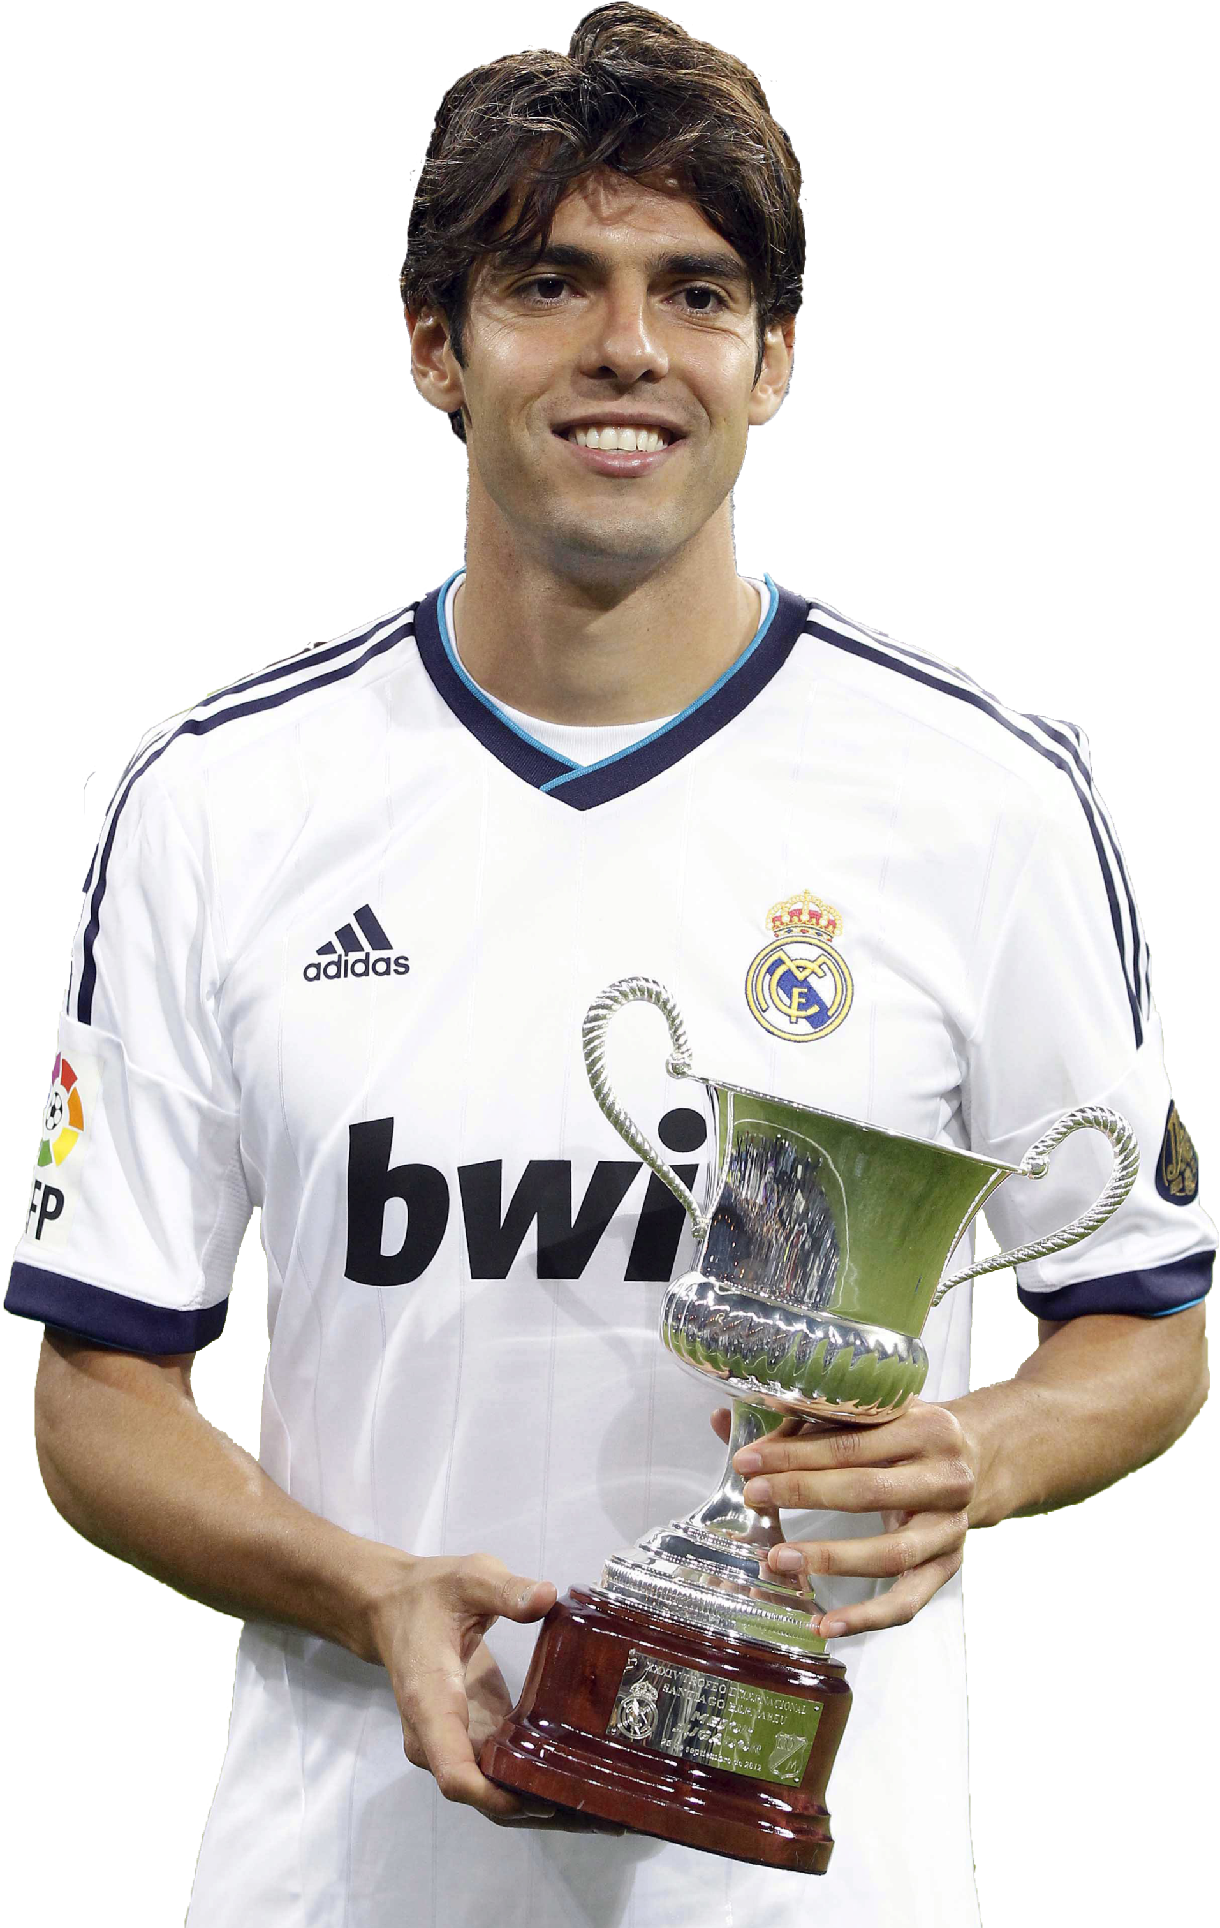
The cross proves how much Jesus loves us & how much he valued God’s approval more than he wanted man’s approval.
He did not let the fear of shame stop him from winning the victory over sin and death = giving us the joy of salvation and eternal life (Heb 11:2).
As Jesus was willing to stand and be counted for us, we must be willing to do the same for Him.
“Living for the affirmation of others will never fill the void in my heart. Only Jesus Christ can do that and that’s why I am secure. If my God is for me who can be against me.” (Kaka)
Notes:
Jesus doesn’t ask us to do anything more than he did himself. He knows it not easy (understands our struggles) but it’s the only way we must live for God. Unlike soccer players across the world he didn’t let the fear of shame stop him from considering the greatest option – from winning the victory over sin and death. Kaka is a famous Brazilian footballer who played early years of this century and won World Cup, Premierships with AC Milan and European Championships. Also won player of the year and ranked 42nd best player ever. Strong who boldly wore a shirt that said I belong to Jesus under his uniform and showed it after AC Milan defeated Liverpool in 2007 EUFA final.

