Slide 1
"Individually they're nothing but when I curl them together like this into a single unit, they form a weapon that is terrible to behold.” Lucy
UNITY IN CHRIST
EPHESIANS 2:11-22
Notes:
Good morning everyone. I hope you are all doing well
Today I want to take us through the second half of Ephesians chapter 2. Which serves as a powerful reminder of the unity we have in Christ because of the blood that he spilled on the cross
In a Peanuts cartoon, Lucy demanded that Linus change TV channels, threatening him with her fist if he didn't. "What makes you think you can walk right in here and take over?" asks Linus. - "These five fingers," says Lucy. "Individually they're nothing but when I curl them together like this into a single unit, they form a weapon that is terrible to behold.” - I want us to be encouraged today, that together, as we hold to the gospel as a community of believers and as we press on as a family united in Jesus Christ, we are a weapon that is fearsome and awesome to behold, a weapon that the gates of hell will not prevail against
The focus of my sermon is mostly on verses 19-22, but I’m going to go quickly through the rest of the passage to give context and help us to better understand the concluding four verses
So let’s get into it

Slide 2
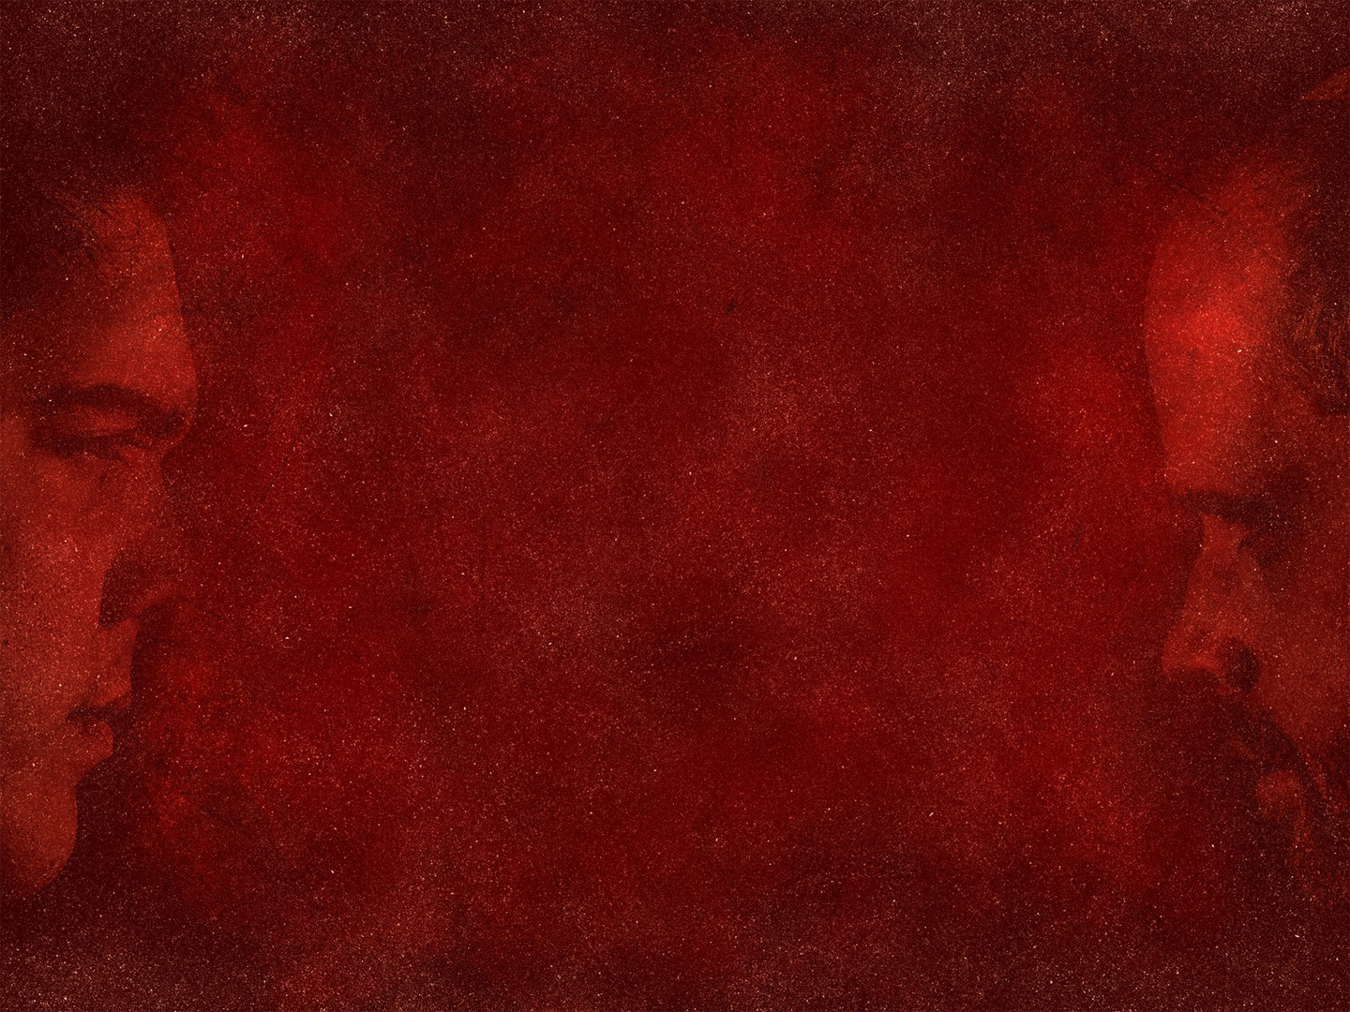
FAR OFF
“Therefore remember that at one time you Gentiles in the flesh, called ‘the uncircumcision’ by what is called the circumcision” (Eph 2:11)
Gentiles were (us) separated from Christ, alienated from the people of Israel, strangers to the covenant God had with Israel, “having no hope without God in the world” (Eph 2:12)
Just like everyone else in the world today, the Gentiles greatest problem was their separation from God
Notes:
“Therefore remember that at one time you Gentiles in the flesh, called ‘the uncircumcision’ by what is called the circumcision” (Eph 2:11) - The uncircumcision is referring to the Gentiles and the circumcision the Jews. - There has probably never been a more significant divide than that between 1st century Jews and Gentiles - For a Jew to even come into contact with a Gentile was like coming into contact with something dead, something unclean and they would need to cleanse themselves of the filth that was known as a Gentile
Gentiles were (us) separated from Christ, alienated from the people of Israel, strangers to the covenant God had with Israel, “having no hope without God in the world” (Eph 2:12) - As Gentiles, they were Christless, they were not part of the Messianic people - They were stateless, excluded from the citizenship of Israel which was a theocracy, a nation under God - They were strangers to the covenant which God had bound Himself unconditionally to bring blessing upon and through Israel. The Gentiles had no such promise - They were hopeless and Godless, strangers, aliens to hope and to God
Just like everyone else in the world today, the Gentiles greatest problem was their separation from God - For the Gentiles history was going nowhere. There was no Messiah and thus no hope. - They were outsiders with no hope and with nothing that they could do in their own strength to bridge that gap of separation - And that is the way it is today for all who are without Christ in their life - Apart from Christ we are all strangers, aliens, outsiders, with no hope - And so, something big, something significant would have to be done to overcome this level of separation. It could only be an act of God’s grace

Slide 3
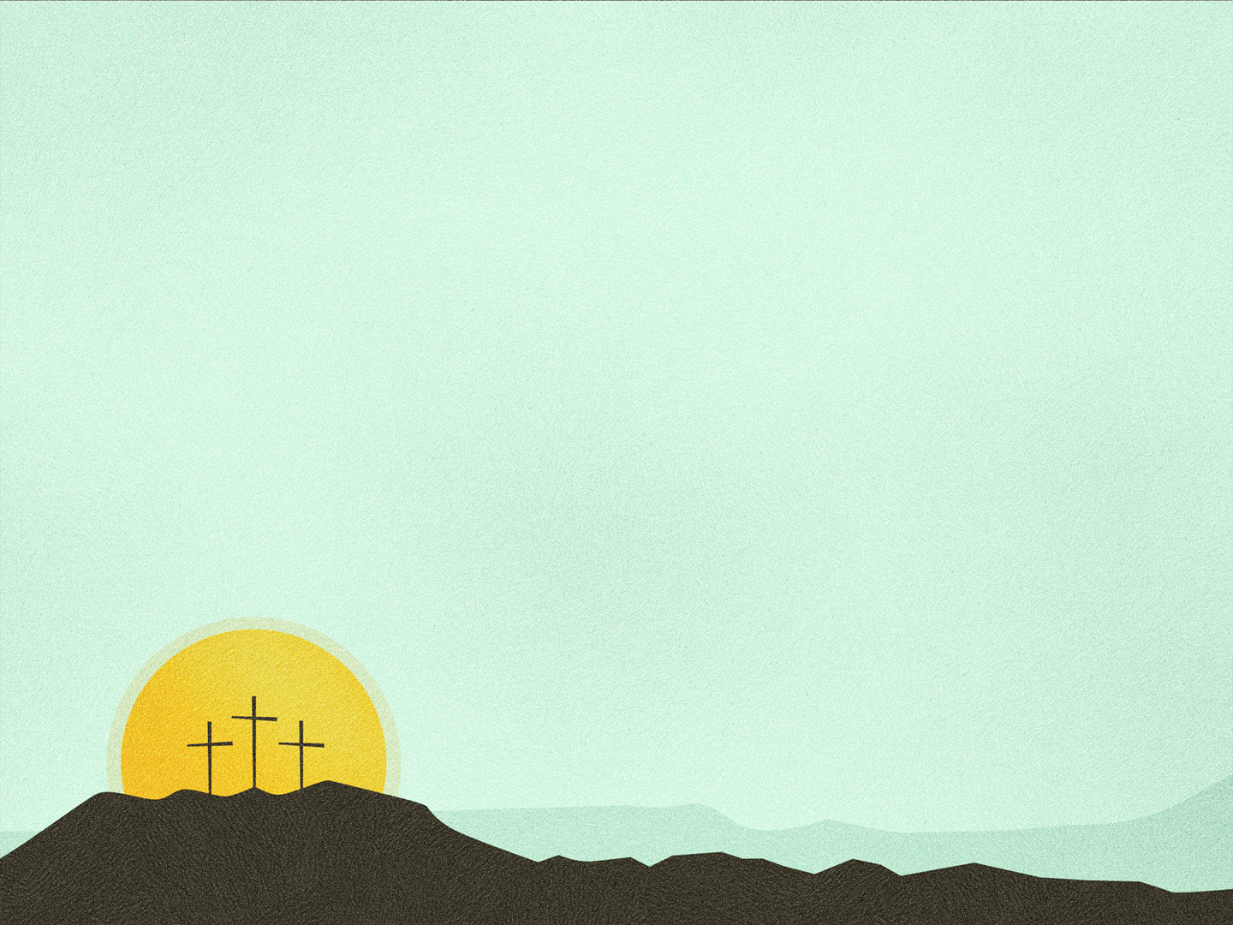
RECONCILIATION
“But now in Christ Jesus you who once were far off have been brought near by the blood of Christ” (Eph 2:13)
In himself, Jesus created “one new man in place of the two, so making peace, and might reconcile us both to God in one body through the cross, thereby killing the hostility” (Eph 2:15b-16)
Jesus came and preached peace to both Gentile and Jew, “for through him we both have access in one Spirit to the Father” (Eph 2:17-18)
Notes:
“But now in Christ Jesus you who once were far off have been brought near by the blood of Christ” (Eph 2:13) - But now in Christ Jesus. Because of Christ’s death we who were once outcasts and outsiders have not just been brought close, not just been brought side by side, not just face to face - We are now in Christ Jesus. It doesn’t get much closer than that. We were once strangers and aliens because we weren’t of the right blood line - But now by the blood of Jesus Christ we have been brought near
In himself, Jesus created “one new man in place of the two, so making peace, and might reconcile us both to God in one body through the cross, thereby killing the hostility” (Eph 2:15b-16) - Christ tore down the wall of hostility, not just between Jew and Gentile - But primarily between sinners and God, by satisfying the wrath of God on the cross we can now be reconciled to God, we can now have right relationship with God, and we can now call God almighty, Father - And because Christ fulfilled the Law he was able to bring unity to the Jew and Gentile - Taking two separate people, two people groups who hated each other and yet by the blood of Jesus Christ we are made a new people, and we are made one in Christ Jesus
Jesus came and preached peace to both Gentile and Jew, “for through him we both have access in one Spirit to the Father” (Eph 2:17-18) - And so now because Jesus not only preached peace, but is himself the prince of peace, we have peace with God - And because we have peace with God, we have been granted access by the blood of Jesus Christ to the throne room of God and we may now enter boldly ”in one Spirit to the Father”. - On the cross Jesus flung the door open – in fact he nailed the door open so that it could never be closed again – so that all who believe will always have access to the presence of God - So then Paul goes on to state the implications and realities that now face this “one new man” that is made in Christ Jesus

Slide 4
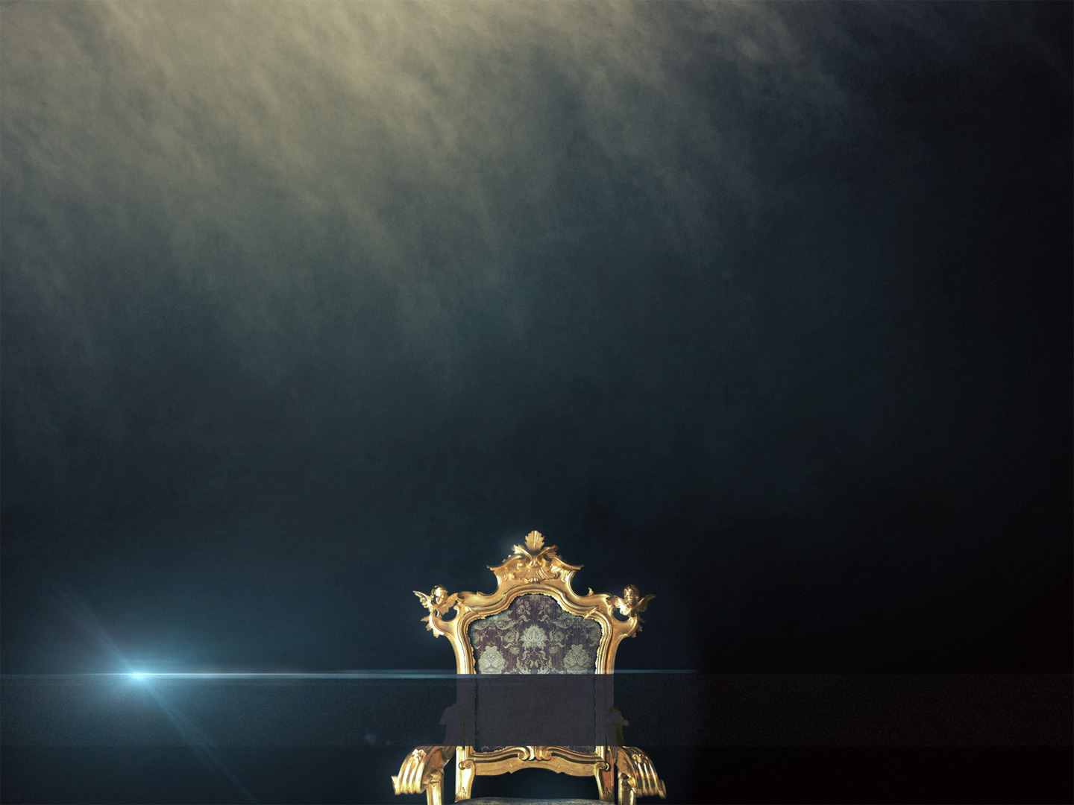
ONE KINGDOM, ONE FAMILY
“So then you are no longer strangers and aliens” (Eph 2:19a)
“But you are fellow citizens with the saints” (Eph 2:19b)
“And members of the household of God” (Eph 2:19c)
Notes:
“So then you are no longer strangers and aliens” (Eph 2:19a) - What Paul is doing here is reversing the order of what he stated about the Gentiles in verses 11-12 - In Christ, all who come before the foot of the cross and cast themselves unto the grace of God, are no longer separated from Christ, but in Christ - As a believer you are no longer excluded from citizenship, but given entry by the blood of Jesus Christ into a new heaven and new earth - And we enter into the New Covenant, we are no longer without hope but have a hope that is both a present and future reality, because it is sealed by the death and resurrection of Jesus Christ
“But you are fellow citizens with the saints” (Eph 2:19b) - All who believe in Jesus Christ are now citizens of the eternal kingdom of God which far outweighs any earthly citizenship - In God’s Kingdom we are not strangers or aliens, but we belong, we all have a common allegiance, and that is to Christ, the king of kings - And we all share a common goal and that is to see God glorified here on earth for the remainder of our days, as we all look to a common future reality where we will one day reign with our Lord and Saviour in the presence of God
“And members of the household of God” (Eph 2:19c) - Now this would have been borderline blasphemous to the Jews and Gentiles of the first century. - They could probably tolerate being part of the same kingdom, but belonging to the same family would have been absurd - But God doesn’t take enemies and help them tolerate each other, and He doesn’t take them and make them friends - God takes enemies and makes them brothers and sisters in Christ -And as brothers and sisters in Christ we have one Father, one Saviour and one Spirit, who are all together one God - Now Paul broadly speaking here, is talking about belonging to the universal Church, about every single individual who has believed in Jesus Christ as Lord and Saviour

Slide 5
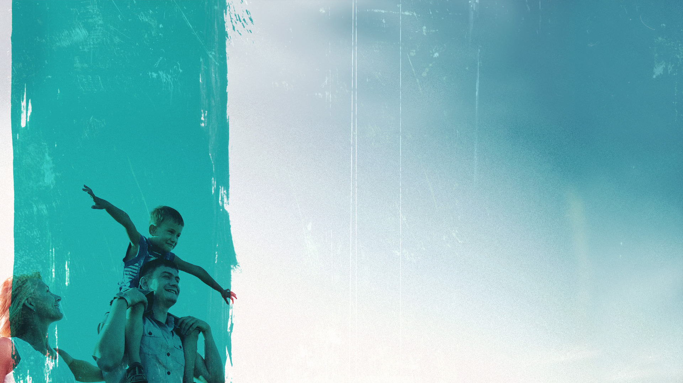
We show we are part of the universal Church by identifying with a tangible people locally
The church is made up of adopted brothers and sisters in Christ. We have responsibilities in the family
The church is a family living life together on mission with the common goal of seeing God glorified
Notes:
We show we are part of the universal Church by identifying with a tangible people locally - Many people treat the church as unnecessary, as unimportant or even as a hindrance to doing great things for God - Or they say things like “I’m a part of the universal Church, I don’t need to join a local, visible church” - But to do the Christian life in isolation is to go against not only what Scripture commands but the very pattern of the New Testament - The pattern of the New Testament and commands of Scripture talk very clearly of submitting to elders and deacons, to come together as one body, to worship together, to share our gifts with one another, to have the Word of God preached. How can a person do that in isolation? - And what’s even more, is how could we possibly think that we are going to be fruitful in the Christian life apart from being connected to a local body of believers, where we can reprove, rebuke and encourage one another towards godliness
The church is made up of adopted brothers and sisters in Christ. We have responsibilities in the family - As members of the household of God, just like in other families, the work of our heavenly Father is not left to a few select people, but is the work of all who belong to the family - Read Romans 12:6-11 - If we are part of God’s family we have all received a gift, and by His grace we are to use it do His will here on earth - Not begrudgingly, but with joy and gratefulness saturating our every word and every action
The church is a family living life together on mission with the common goal of seeing God glorified - We are to see the church as part of our Christian identity. - Sometimes brothers and sisters fight, but we remain unified while we remain in Christ, because we all share the common goal of seeing our heavenly Father glorified - We gather to encourage one another, to build one another up with our gifts, to pray for one another and to sit under the preaching of God’s Word. - We gather to bear one another’s burdens, to cry together, and to celebrate together - And so together we urge one another on to the prize that awaits each one of us which is Christ Jesus himself and the day in which we receive our crown of righteousness - It is an incredible gift of God’s grace to have a family of faith, so let us not forsake gathering together, rather let us prioritise it

Slide 6
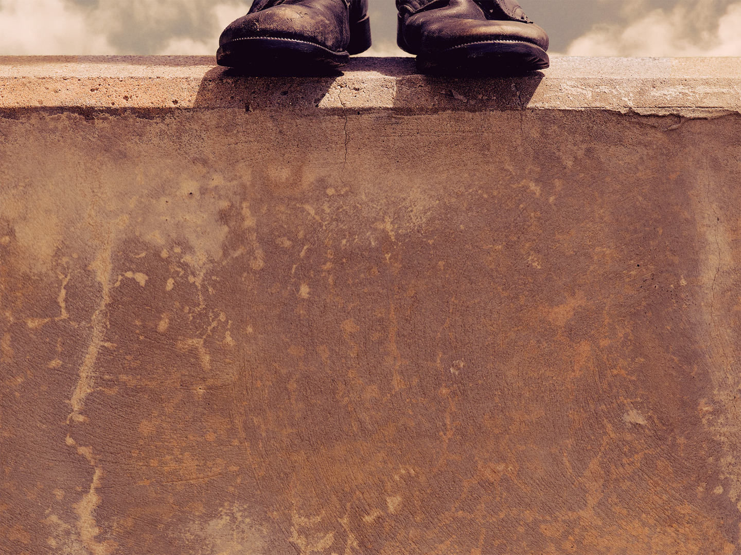
ONE FOUNDATION, ONE CORNERSTONE
“Built on the foundation of the apostles and prophets” (Eph 2:20a)
The church stands or falls based on its faithfulness to God’s Word
We’re not free to remove any truths regardless of what our culture may say
Notes:
“Built on the foundation of the apostles and prophets” (Eph 2:20a) - Now there is bit of contention here between whether prophets here is talking about New Testament or Old Testament prophets - But all scholars agree that regardless of whether it was New or Old testament, Paul is saying that the household of God is built upon God’s Word - Paul is not saying that it is built upon these men, the apostles and prophets, but rather it is built upon their ministry which is proclaiming and clarifying the Word of God to His people
The church stands or falls based on its faithfulness to God’s Word - Isaiah 40:8 tells us that “The grass withers, the flower fades, but the word of our God will stand forever” - Pastors and preachers must labour to remain faithful to God’s Word - For any church that is not built upon God’s Word is a false church that will eventually crumble and fail
We’re not free to remove any truths regardless of what our culture may say - Many pastors have given into the temptation of preaching what the culture would like them to preach so that they can have a better reputation among men, a bigger church, so that they can have more people who give more money - But we aren’t free to remove any of the truths of God’s Word, like the uniqueness of Christ, that there are 2 eternal destinations, heaven and hell, that in our world saturated with sexual temptation we are to show sexual restraint, that God created marriage for one man and one woman - The truth of God’s Word is not something we have the freedom to mess around with or change as we see fit - We must preach the truth in love, but the truth must be there, for it is upon the truth that God’s church stands

Slide 7
“Christ Jesus himself being the cornerstone” (Eph 2:20b)
All of our theology matters but it has to crystalise and focus on the person and work of Jesus Christ
It’s God’s building and He has completed its foundation
Notes:
”Christ Jesus himself being the cornerstone” (Eph 2:20b) - The cornerstone holds everything together. It determines the stability of the foundation and the integrity of the entire building - The cornerstone is put in place before the foundation is even built - The lay of the walls, the dimensions of the structure were a result of the chief cornerstone because everything in a building must align with the cornerstone. - The shape and stability of God’s temple is determined by Christ and Christ alone who is the chief cornerstone
All of our theology matters but it has to crystalise and focus on the person and work of Jesus Christ - The uniting focus is not just theology but mostly who and what we believe Christ to be - If the church is the body of Christ then this has to be where we stake our claim. - It has to be a gospel centred focus. Because when it is the gospel that holds us together nothing can tear us apart - Many people in today’s day and age go looking for a church that has a particular music style, or particular building style, or is catering to young families, or to older people - Listen to me. None of those things are evil in their own right, but if they come become the number one priority, if these churches water down the gospel, and diminish the person and work of Jesus Christ for the sake of these things, then when tough times come, it will crumble - Our foundation and cornerstone are not those things. Our foundation is God’s Word and Jesus Christ is our cornerstone - I’m not saying that a gospel centred church won’t have difficulties and disagreements. - But if the gospel holds us together, it is God’s grace, and God’s Word and God’s power that holds us together - We will be able to move forward passionately and in mutual love in order that we may see God glorified in His church
It’s God’s building and He has completed its foundation - We don’t need to take away from it or add to it - The foundation of Jesus Christ and the teaching of His Word is sufficient, complete and available in Scripture, and Christ has been building his church on it for the past 2000 years - It does not need adapting or improving - And it is upon this foundation that we can press forward in confidence knowing that the church and our lives rest in the hands of Jesus Christ the solid rock

Slide 8
A HOLY TEMPLE
“In whom the whole structure, being joined together, grows into a holy temple in the Lord” (Eph 2:21)
Because it is Christ’s building, the church is perfect, spotless, without defect or blemish
“In him you also are being built together into a dwelling place for God by the Spirit” (Eph 2:22)
Notes:
“In whom the whole structure, being joined together, grows into a holy temple in the Lord” (Eph 2:21) - In whom is referring to Jesus Christ, and so it is in him that not only are we held together and joined together, but it is in him that the temple grows - What happens in the temples of the Old Testament? It is where the glory of God dwells, where worship happened, where the Word of God was read and taught - And not only these things but we are to be holy, set apart unto God both individually and as a community - And so all who believe in Jesus Christ are the stones which are placed on top of the foundation which make the holy temple
Because it is Christ’s building, the church is perfect, spotless, without defect or blemish - Now I’m not saying that as Christians or churches there is no sin, that there is no longer any brokenness, that churches will never hurt anyone - Many people have been burned and hurt by churches, but don’t walk away from gathering with fellow believers. Don’t hate the church - The church is the bride of Christ, and ”Christ loved the church and gave himself up for her “(Eph 5:25) - The bride of Christ is beautiful, broken and yet made whole, and because we are now in Christ, and because of his death and the blood that was spilled on our behalf - We are complete and yet being completed, we are perfect and yet being perfected, how? - Because we have been saved and are being sanctified by Jesus Christ and so when God looks at His people, He sees His perfect Son, Jesus Christ, and sees a forgiven people
“In him you also are being built together into a dwelling place for God by the Spirit” (Eph 2:22) - So in case you missed it the first time Paul reiterates that through Jesus Christ, by the Spirit of God, God dwells in us personally and as a community. - It is in Christ that we grow as believers, it is in Christ that we grow in likeness to him. - Everything depends upon being rightly related to the chief cornerstone - Truly this temple begins and ends with Jesus Christ – he is the means by which it fits together. Christ is the ultimate goal

Slide 9
SUMMARY
We are welcomed into the precious family of God, so love each other deeply
We are being built upon the foundation of Scripture which is rooted in Christ, so listen closely to sound biblical teaching
We are being constructed as a dwelling of the Spirit of God, so be holy and set apart unto the Lord
Notes:
We are welcomed into the precious family of God, so love each other deeply - Each and everyone of us has a gift and work to do inside this family, inside the church - We all worship and live under the same roof, sit at the same table - We all have the same older brother Jesus Christ, we all serve and live for the same God - And so by His power we also love and serve one another
We are being built upon the foundation of Scripture which is rooted in Christ, so listen closely to sound, biblical teaching - To deviate from the Word of God, to build upon a different Christ than the one taught in the Bible is to build falsely and in vain without authorisation from the master builder, God - Pastors and preachers must be diligent to ensure they remain faithful to the Word of God - Christians, brothers and sisters cling to the cross of Jesus Christ, believe in the resurrection and know that because of Jesus you are justified and declared a child of God
We are being constructed as a dwelling of the Spirit of God, so be holy and set apart unto the Lord - In Christ and by God’s Spirit, Jesus makes a new race, a new man which is made up of sinners saved by grace through faith - And because we are in Christ, this new man is God’s chosen dwelling place – a habitat for divinity - Jesus is the chief cornerstone, the teaching of the apostles and prophets is the foundation, and we are the living stones – God lives in us! So live a life surrendered unto Him

Slide 10
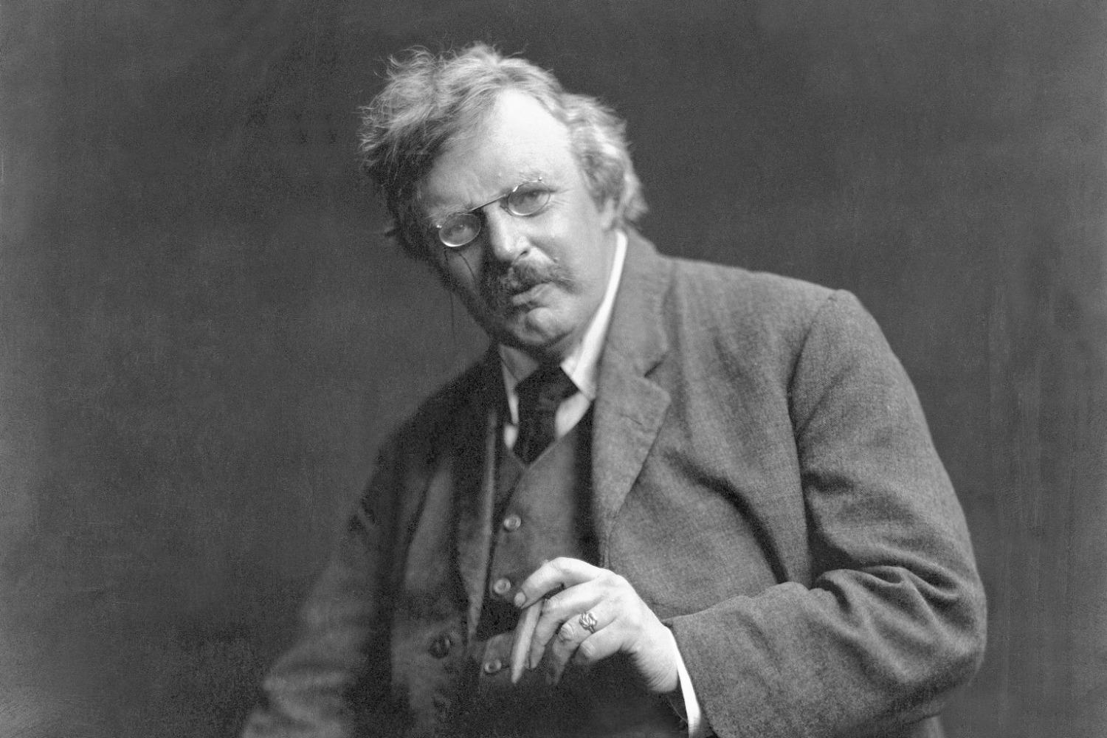
”We do not want a church that will move with the world. We want a church that will move the world” – G.K. Chesteron
Notes:
”We do not want a church that will move with the world. We want a church that will move the world” – G.K. Chesterton
We do not want to be a church that is moved by the things of this world.
God’s church is moved by the things of God, by the Word of God, by the grace of God, by the Spirit of God, and by the gospel of Jesus Christ our Lord and Saviour.
It is in the gospel that we stand united in Christ Jesus, and it is the gospel that has and will continue to shake the world. For it is the gospel that is the power of God unto salvation
Let us pray

