Slide 1
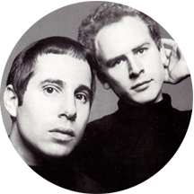
First line of Sound Of Silence = “Hello darkness my old friend…” = alienated & forgotten.
Psalm 88 by Heman the Ezrahite. Last line = “Darkness is my closest friend.” = clinical depression.
He is crying out, having troubles, fearing death, feeling forgotten, weighed down and engulfed by anger, weak, blinded by tears, begging for help, rejected and ignored, paralysed by terror and feeling friendless.
“It’s good we have a Psalm like this, but it’s good we only have one. It reminds us that the Christian life can still be filled with trouble and despair.” (James Montgomery Boice)
Notes:
On the 17th January 1966, two young singer/songwriters released a song called, The Sound Of Silence – went on to become a huge hit for Simon and Garfunkel. Can anyone recall the first line of the song? It was a song written about being alienated and unheard. Centuries before, another song writer Heman the Ezrahite wrote a song on the same topic. The last line of this song was very similar = Darkness is my closest friend. When you look at the words to this Psalm they have a close resemblance to clinical depression. While there are many other laments in the Psalms this is the only one that doesn’t end with an expression of hope. It’s not a popular Psalm because in a day where prosperity is preached, some would say that believers can never be depressed or feel hopeless. But this passage of scripture says otherwise. James Montgomery Boice (US Bible teacher and author) talks about the significance of this Psalm.

Slide 2
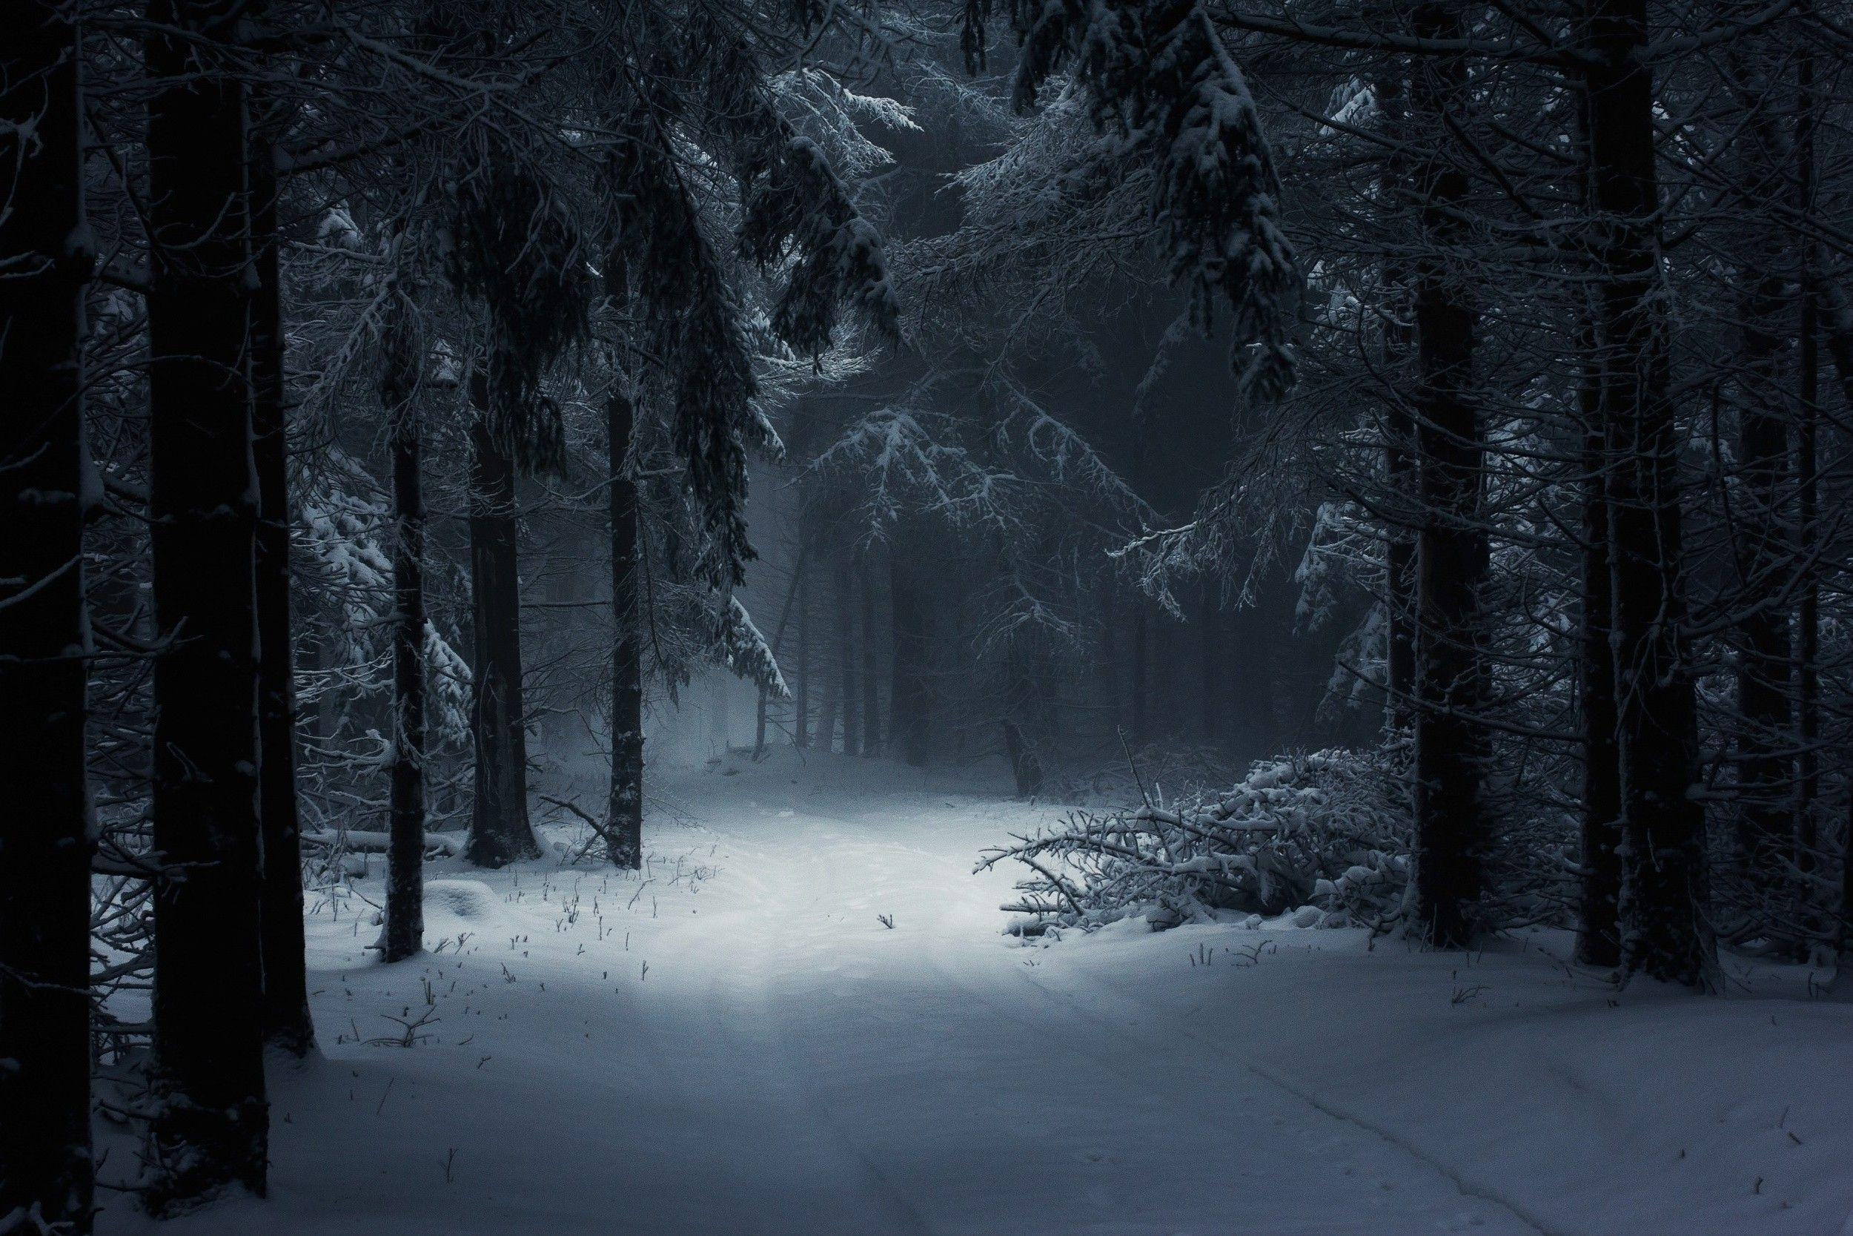
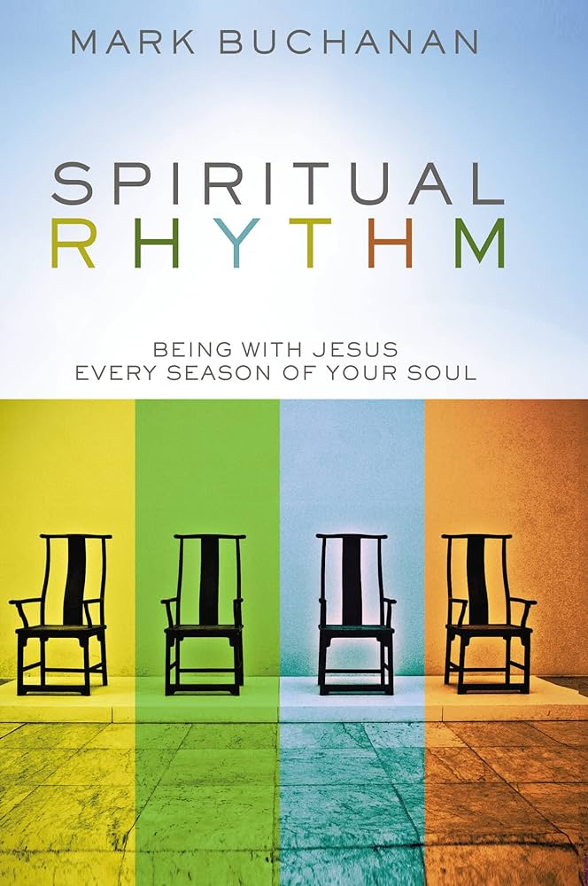
“For everything there is a season..” (Eccles 3:1) = seasons that define our life (spiritual) rhythms.
“Winter is bleak, cold, dark and fruitless. It’s the season where Solomon says he can find no pleasure in and where everything seems meaningless.” (Mark Buchanan – Spiritual Rhythm)
FINDING HOPE IN THE DARKNESS
PSALM 88
THE FEEL OF WINTER
THE TASKS OF WINTER
DARKNESS IS NOT THE END
Notes:
Solomon the wisest man to ever lived, told us to expect different seasons in our life. Wasn’t talking about the physical earthly season but the seasons that define our life – our spiritual rhythms. Preacher and author Mark Buchanan wrote a book on this truth and in that book he describes the spiritual seasons of summer, autumn, spring and winter. It’s a book that I would recommend – it is one that is true for us all. In the book Buchanan the author talks about the seasons we can go through – don’t always follow in order and they can last for days or far longer. He labels winter as the time of darkness – the time when things that used to give us joy, pleasure and meaning no longer do that (I can find no pleasure – Ecclesiastes 12:1 and where everything seems meaningless – Ecclesiastes 12:8.) That even refers to living for Jesus, worship etc. It is a time where things just seem so hard. We all experience these different seasons and I think Heman was describing the winter he was going through. And I am sure many of us have experienced winter times in our life – no pleasure or meaning in what we are going through. I know I have been going through a wintertime for some months now – not to the extent of Heman, but none the less a period of bleakness, where nothing seems to be growing or happening. Struggling to celebrate – even to worship and experience God. So lets look at Heman and this Psalm 88 and see what lessons we get with regards to finding hope in the darkness.

Slide 3
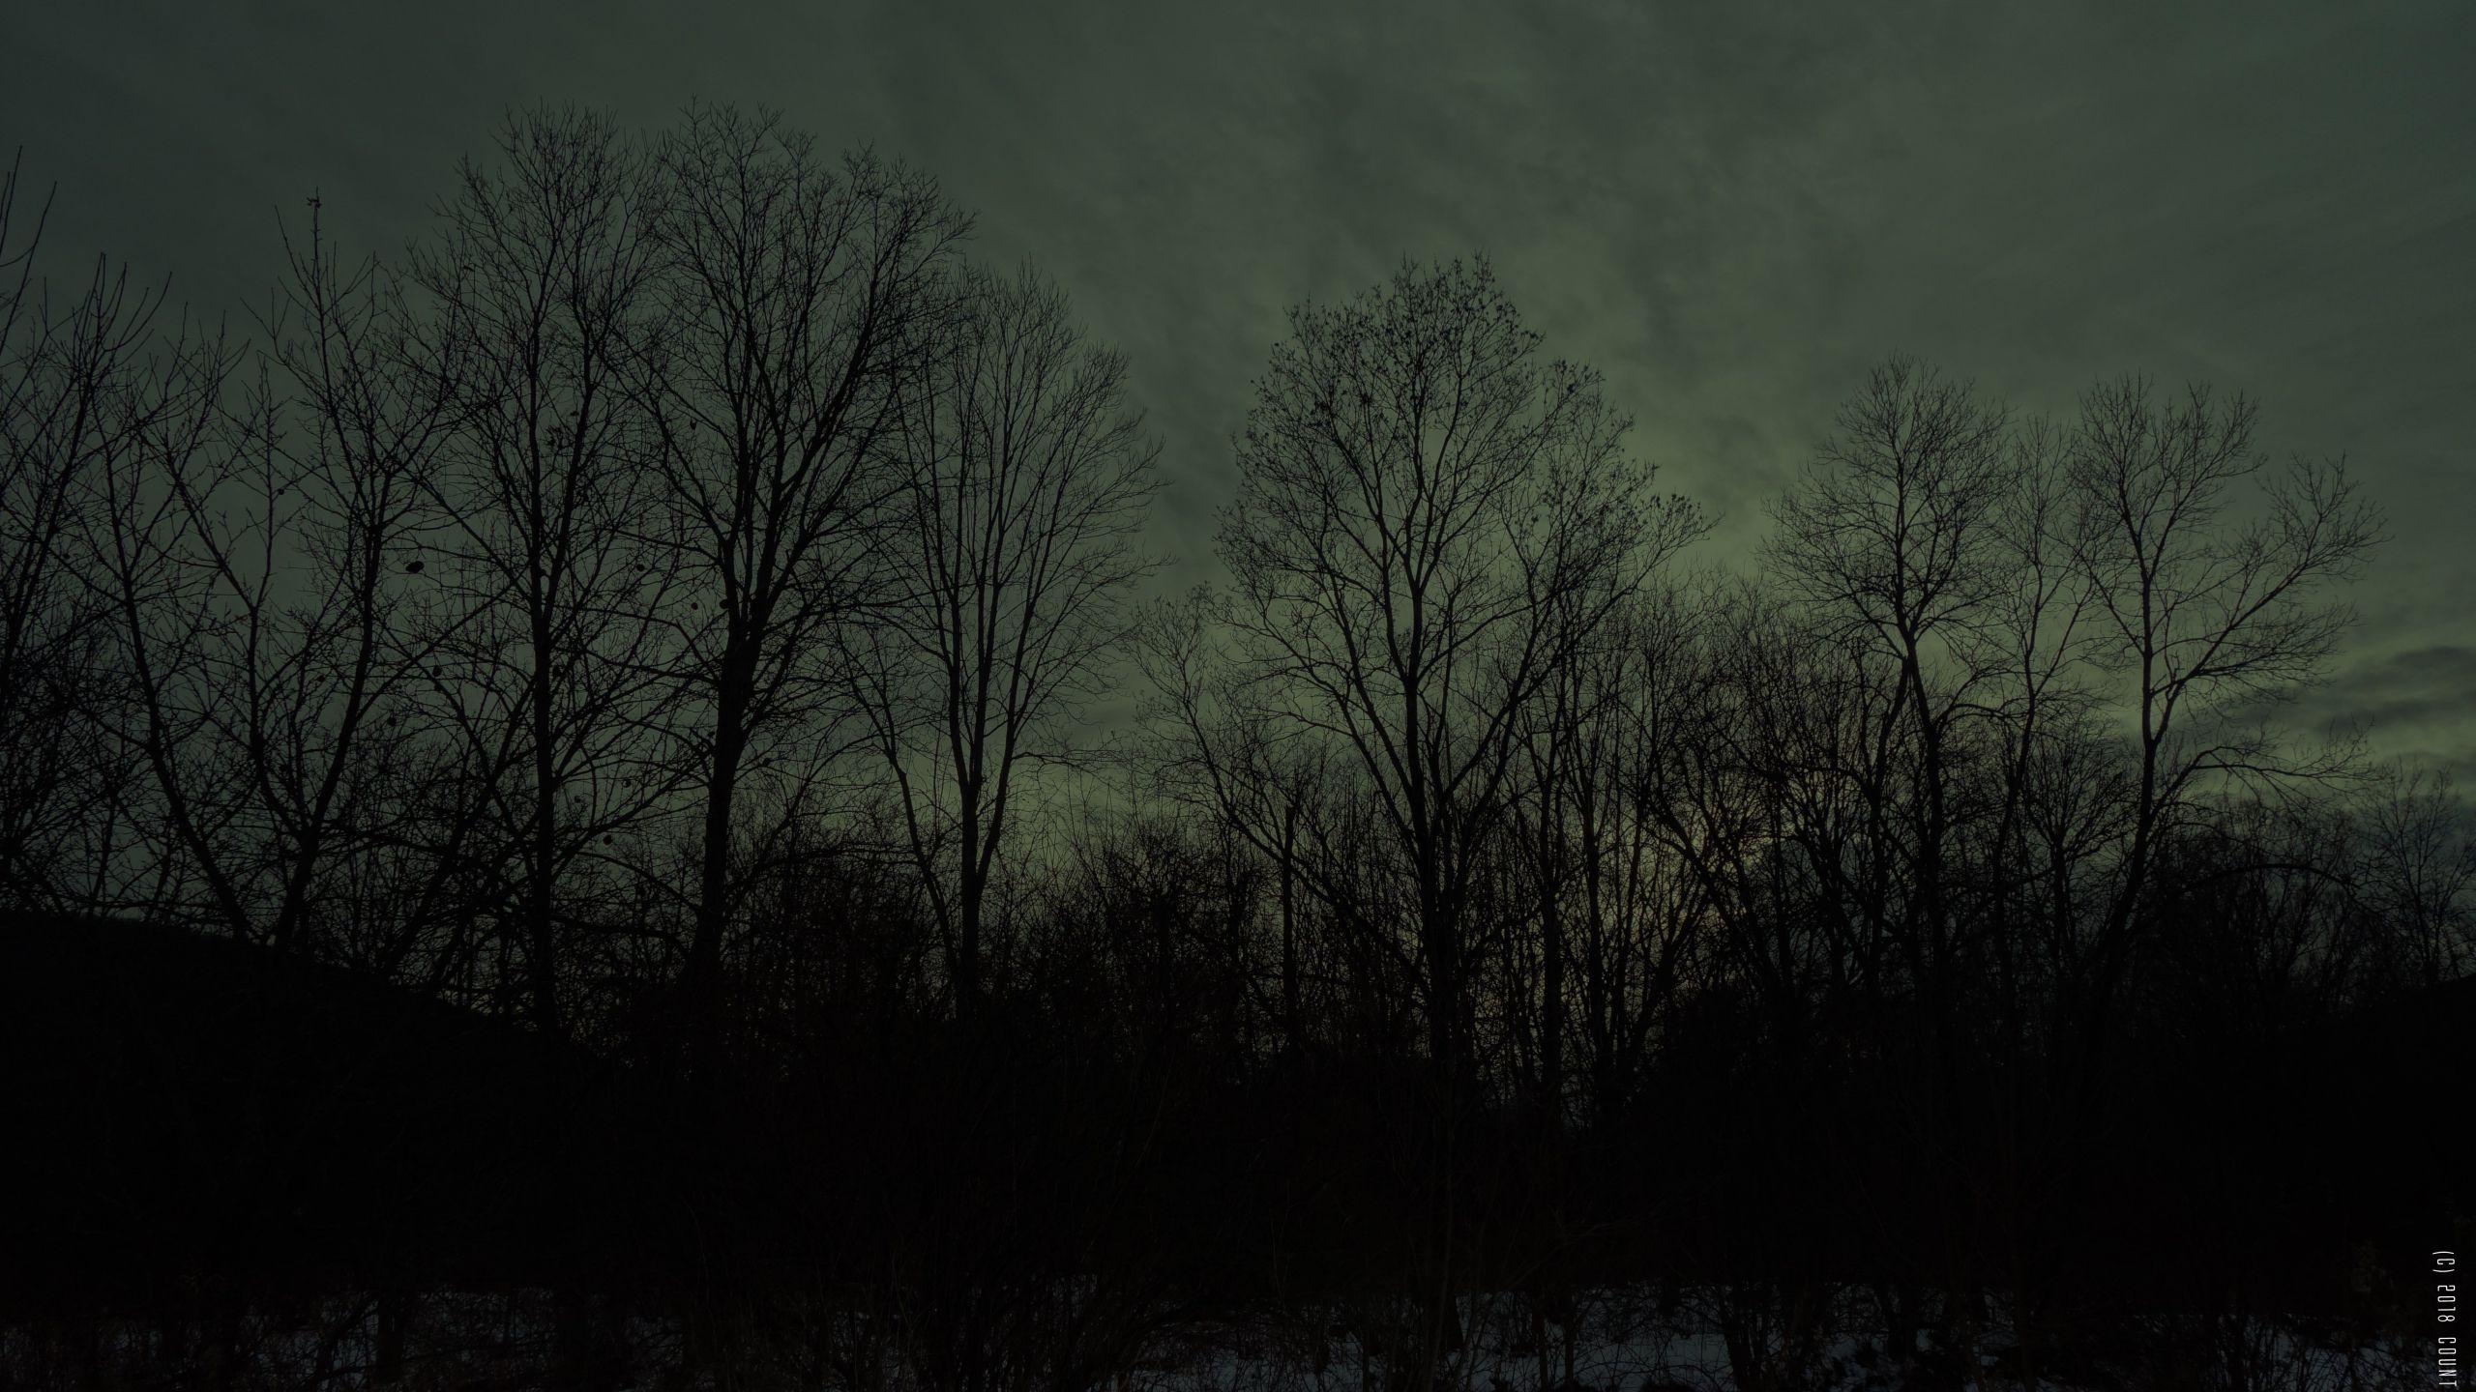
THE FEEL OF WINTER
a) The absence of light – “Darkness is my closest friend.” (v18)
Hopelessness, uncertainty, lostness (dreams, friendships), no growth, no clarity, no confidence, fear, anxiety, vulnerability…. – all consuming, never ending.
b) The absence of God – the winter darkness hides God = it severs our knowledge of God from our experience of God.
Knows about God’s salvation (v1) + unfailing love & faithfulness (v11) + wonderful deeds & righteousness (v12).
Experiences God’s silence, indifference, rejection & anger.
Notes:
Living in darkness is not good for us – lack of light, not seeing the way ahead, uncertain of where to go, lost (feeling alone) can’t see friends (is anyone really with me) or dreams becoming a reality, no growth – are you getting anywhere, fear, vulnerable (no immunity, protection against dangers), no clarity (am I getting anywhere, am I going in circles)
The absence of God – our theology and reality are not reconciled.

Slide 4
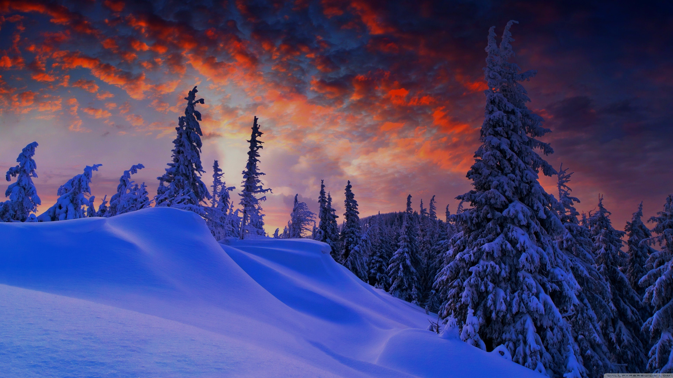
c) Absence of friends – in winter we can often experience a terrible and terrifying loneliness (vs 8, 18).
A sense of abandonment, rejection, disconnection and isolation, even when we are surrounded by others – unlovable, misunderstood.
d) The presence of doom – going through the ‘valley of the shadow of death’ while doubting God’s presence & promises.
As John the Baptist was brooding and dreading in the dark, he asked Jesus – “Are you the Messiah we have been expecting, or should we keep looking for someone else.” (Luke 7:20)
Notes:
c) Absence of friends – darkness can hide the reality that others are with us, but we think they don’t understand, or don’t care.
d) The presence of doom – John the Baptist is a great example – this is how he felt. In Luke 7 we read how he is doubting who Jesus is. He is in prison for challenging Herod about his sin, in all likelihood knowing that he will be killed (which he was). As he languished in Prison he had heard how Jesus was healing, saving and blessing beggars, sinners, prostitutes, tax collectors etc; but what about him? He was brooding and dreading in the dark but he was doubting who Jesus was and whether Jesus was with him. John had leapt in his mother’s womb, at Jesus’ name. He had boldly declared that Jesus was the lamb who would take away the sin of the world, about whom he said I must decrease and he must increase. But there was no rescue, the Romans were still in power, Herod was still in power – where was wickedness being destroyed? Why am I rotting in prison alone?

Slide 5
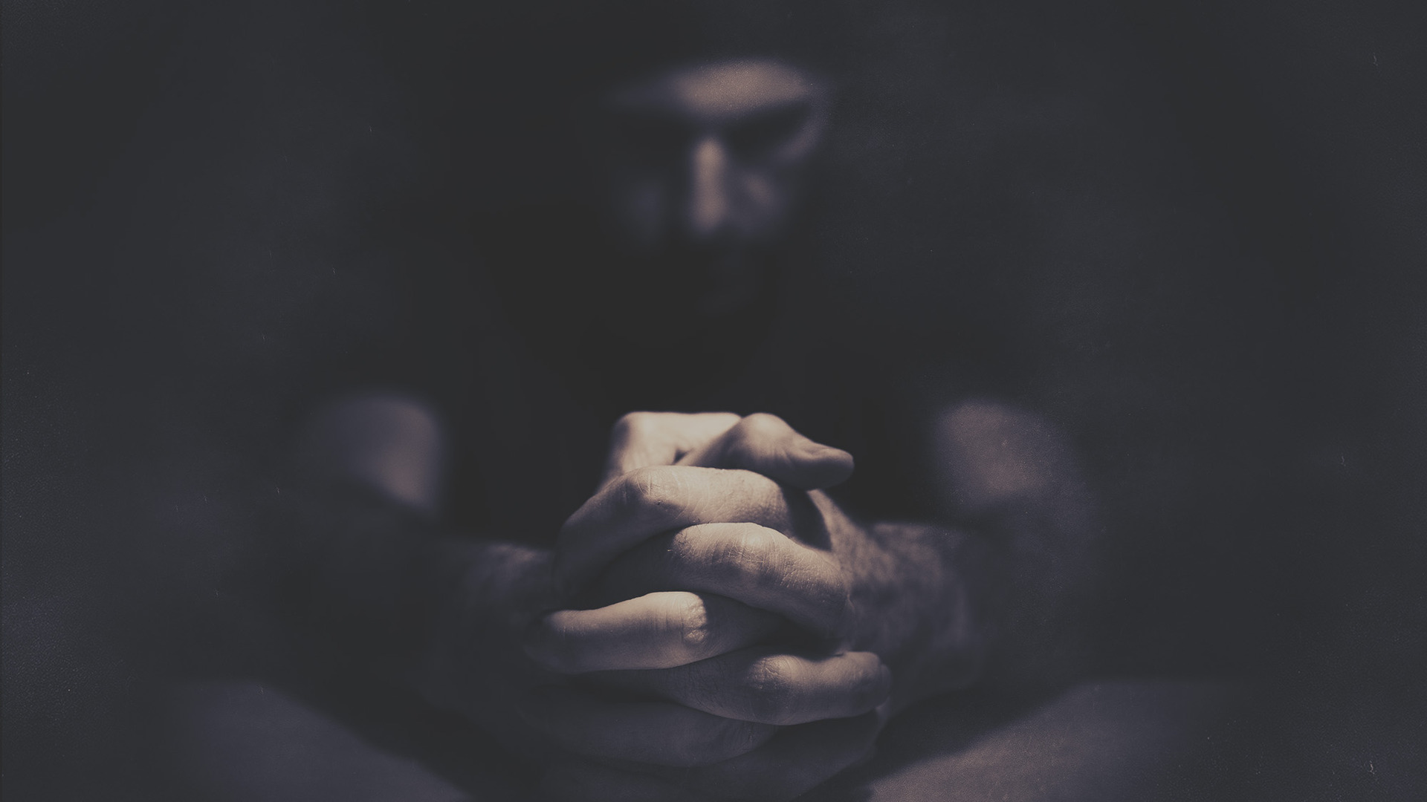
THE TASKS OF WINTER
a) Faithful prayer – “I cry out to you by day and I come to you at night. Now hear my prayer; listen to my cry.” (vs 1-2)
“… we believers groan, even though we have the Holy Spirit within us as a foretaste of future glory, for we long for our bodies to be released from sin and suffering.” (Romans 8:23)
Runs to God (trusting), not away from Him (cynical). He talks to God, not about God. God is not put off by anger & desperation.
Based on trust in God, not experience = biblical faith . Winter is the season when we learn most to walk by faith & not by sight.
Notes:
a) Faithful prayer – this is the prayer that talks about the ‘groaning’ all believers ultimately do in this sinful world. He doesn’t pray because he can taste and see God is good. This is not about experience but about trust and hope in God’s Word – that he is who he says he is and will do what he promises he will do. He prays in spite of his circumstances – not because God is good to him. That’s biblical faith = walking by faith, not by sight. Winter will either build your faith and trust or make you more cynical. It will either awaken prayer or bury it. God is not put off by doubt, questions and desperation. He wants us to talk with him, share our heart with him. Too often we can fall into the trap of becoming cynical and that leads us away from God – leads us to focus on talking about God, not talking to him.

Slide 6
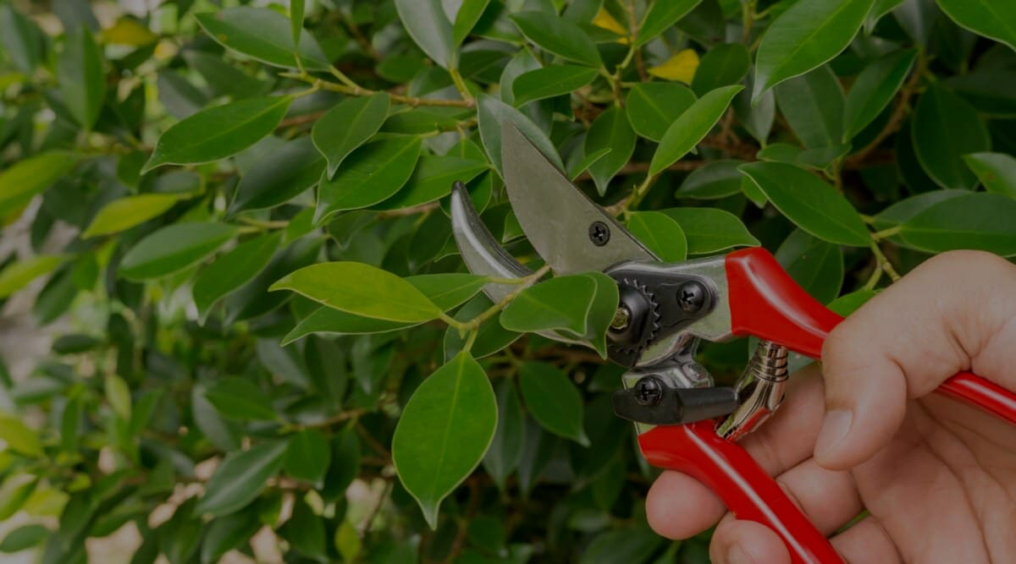
b) Pruning – if it’s done right the tree will be better for it when spring comes (better shape, more vigorous & fruitful) = a loving, abiding, fruit bearing relationship with Jesus (Jn 15:1-8).
“Winter is not the time for adding things but cutting things – to look at the tangled branches of our life and ask if they are bearing fruit or sapping energy.” (Sam Storms)
“We were crushed and overwhelmed beyond our ability to endure… But as a result, we stopped relying on ourselves and learned to rely only on God….” (2 Cor 1:8-9).
Heman knew God was sovereign – talks about God’s salvation, anger, unfailing love, terrors, wonderful deeds, faithfulness…
Notes:
a) Pruning – any garden guru will tell that pruning is essential to the health, growth and fruitfulness of a plant. Pruning initially makes it look deader and more unsightly but it is actually helping us to grow. In Paul’s case the pruning led him to get rid of any thought that ministry and life was all up to him, taught him to stop looking at his own strength, wisdom and ability and to solely rely on God. That’s what happened to the Psalmist – he still knew that God was sovereign – his salvation, his faithfulness, his mercy, anger, terrors etc. He got rid of all illusion that it was up to him.- he had to keep trusting in the will, plan, power of God.

Slide 7
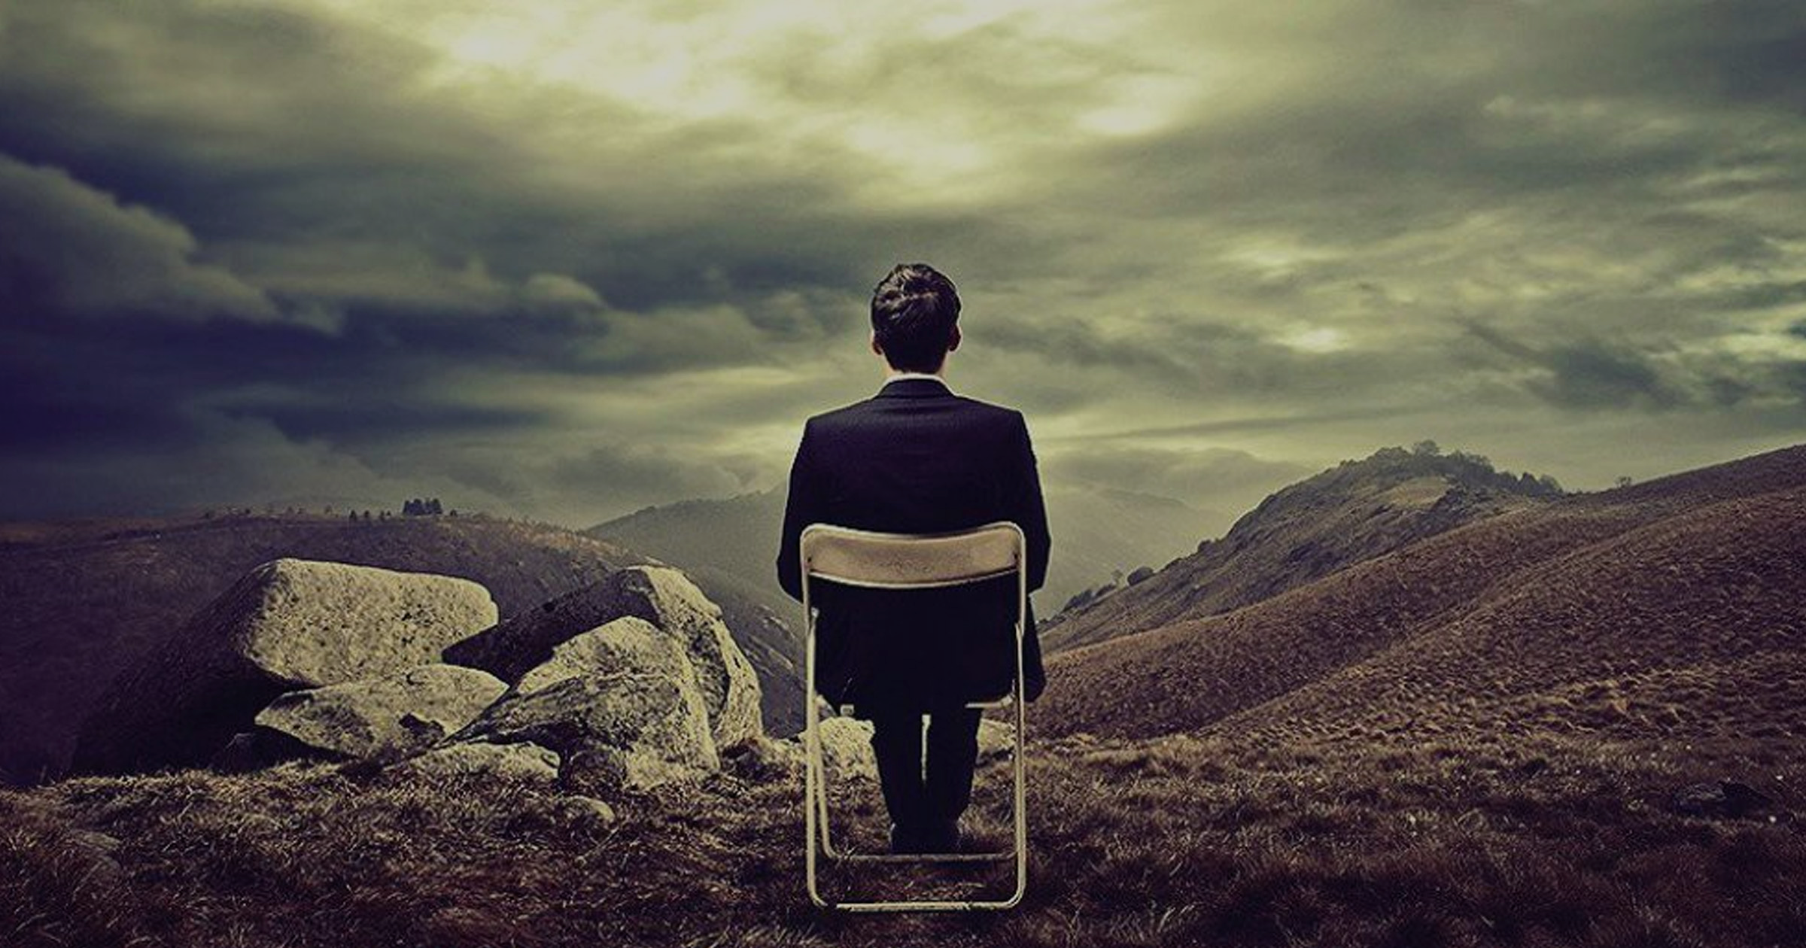
c) Waiting – “We believers also groan… for we long for our bodies to be released from sin and suffering. We, too, wait with eager hope …” (Romans 8:22-23)
Jesus’ response to John the Baptist – “God blesses those who do not fall away because of me.” (Luke 7:23) – those who can trust in His salvation, even if darkness is their closest friend (even if God does not meet your expectations).
Waiting builds a faith worth dying for = that takes time to grow.
Waiting = not giving into your doubts or letting doubt have the final word. Doubt = being shortsighted, faith = a long view.
Notes:
Waiting – go back to Paul talking about the need for believers to persevere through trials – through the darkness of winter. Remember John the Baptist – asking Jesus if he was really their promised Messiah. Jesus’ response is pretty brutal in a way – God blesses those who endure, who can wait and trust in him and not fall away because of their lack of understanding, suffering, doubt and uncertainty. In essence saying I am busy being the Messiah and I am not coming to rescue you – just trust in me. Endure and wait for my will to be done. Blessed are you when you are in the dark of winter and you can still rest in me. We are most blessed when we can endure and rise above times of personal tragedy, pain, suffering, uncertainty etc; and trust in the salvation of God. Even if he has disappointed us. When God forces us to wait it builds faith. Always doubt your doubts. Never treat them with certainty. The disciples, both then and now, would go on to die for their faith. 11 disciples killed for their faith, John only one who wasn’t but he suffered in exile. Estimated that 360 million (1 in 7) Christians have suffered for their faith, 6000 died for their faith = 16 every day on average. That kind of faith doesn’t grow in a day or week. It takes time. Waiting builds backbone – allows the roots to grow deep = hardiest plant and fruitful growth. Its not giving power to your doubts – being shortsighted, looking at the immediate circumstances, rather than the hope to come.

Slide 8
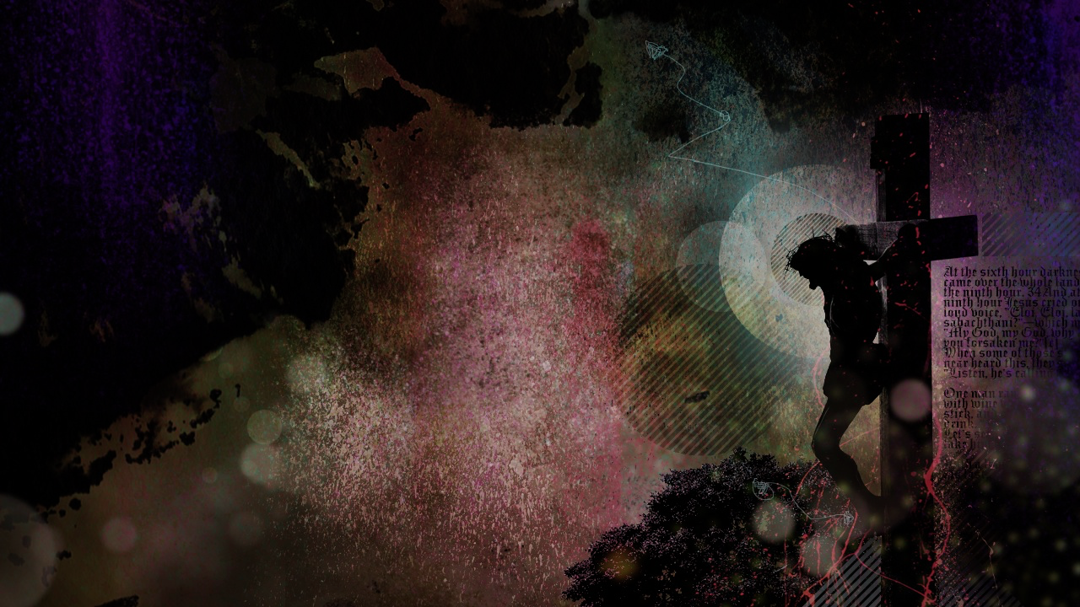
DARKNESS ISNT THE END – “O Lord, God of my salvation.” (v 1)
Darkness will happen to all believers – it doesn’t mean you are lost.
Darkness can happen to people who don’t seem to deserve it – it doesn’t mean you are condemned and despised.
Darkness can happen at any moment and last for any length of time – but it doesn’t mean you have been forsaken.
Because Jesus entered our world and took up the anguish of Psalm 88 - the only one to ever be truly forsaken by God.
In the ultimate darkness he pleaded, “My God, my God, why have you forsaken me.” (Matt 27:46)
Notes:
Darkness isn’t the end – even though his final words were darkness is my only friend, his opening words were O lord God of my salvation. He still faithfully held onto hope in the darkness –and we should too. Because of God’s grace we aren’t lost, condemned, despised or forsaken. Why aren’t you lost, condemned, despised or forsaken? Because he took the anguish of the Psalm 88 – he experienced the ultimate darkness - the absence of light, absence of God, absence of friends and the presence of doom on the cross. Absolute darkness – suffering, pain, separation etc; swept over him on the cross.

Slide 9
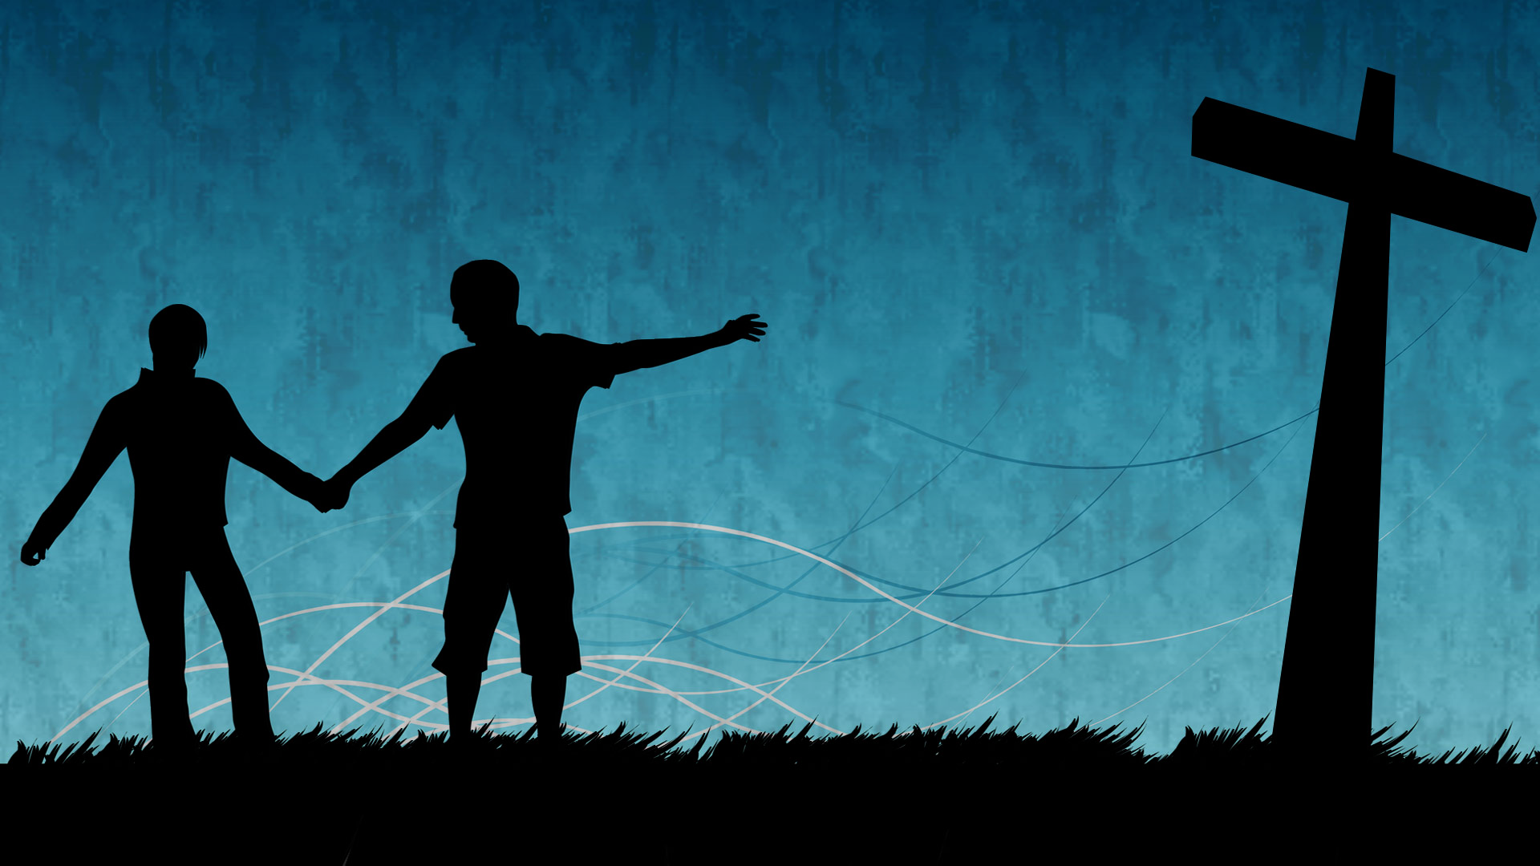
He was despised, condemned, crushed & forsaken, so we wouldn’t be - abandoned so we could be friends with God.
“For he has rescued us from the kingdom of darkness and transferred us into the Kingdom of his dear Son, who purchased our freedom and forgave our sins.” (Col 1:13-14)
Cross & empty tomb = a happy ending awaits all who trust in Christ. Darkness will never be the last thing we experience. Until then pray, prune and wait confidently for His amazing grace.
In your wintery darkness pray Psalm 88 to God and then preach Psalm 89 to yourself. “I will sing of the Lord’s great love forever.. I will make your faithfulness known through all generations.”
Notes:
Until we meet Christ again, we still need Psalm 88 because we still live in the kingdom of darkness (not yet in the kingdom of heaven) So cry out to God, pray faithfully, prune and wait and in that time preach Psalm 89 to yourself.

