Slide 1
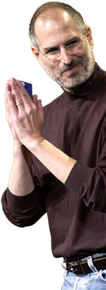
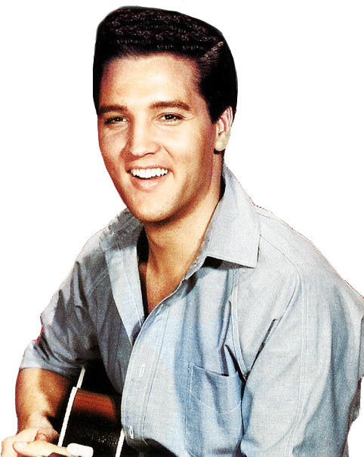
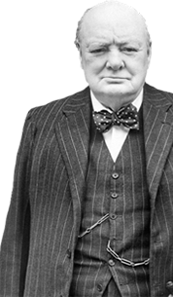
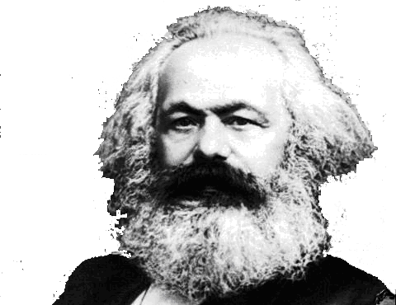
FINAL WORDS FROM FAMOUS PEOPLE
“I’m going to the bathroom to read.”
(Elvis Presley)
“I am bored with it all.” (Winston Churchill)
“Oh wow! Oh wow! Oh wow!” (Steve Jobs)
“I’m losing it.” (Frank Sinatra)
“Last words are for fools who haven’t said enough.” (Karl Marx)
Notes:
History is filled with people who impacted the world with their lives – inspired, challenged, encouraged, entertained. Yet, quite often their final words were not so impacting - they were cynical, hopeless, sense of resignation or just plain ordinary. Here are some examples.

Slide 2
MOSES
ANGELS
SANCTUARY
COVENANT
REST
ABRAHAM
INHERITANCE
HOME
SACRIFICE
WORSHIP
HOPE
MEDIATOR
HIGH PRIEST
LIVING A SUPERIOR LIFE
HEBREWS 13:1-19
REMEMBER OTHERS
REMEMBER YOUR HEART
REMEMBER YOUR LEADERS
REMEMBER JESUS
Notes:
As we come to the end of our journey through Hebrews we see that the author of Hebrews is not going to waste his final words to their readers – Jewish Christians who were struggling with persecution, opposition, trials and doubts. Throughout the book the author has focused on the supremacy of Jesus – highlighting again and again that Jesus is better. He is better than angels, Moses, Abraham + he is a better sacrifice, mediator, High Priest… As a result we have a better sanctuary, rest, inheritance, worship (enter presence of God), home, hope – all unshakable. Now in their conclusion, the author is teaching us that if we truly understand and know that Jesus is better then it should change how we live. Because Jesus is superior, we should be living a superior life, even in the face of opposition, fear, rejection and persecution. In order to live a superior life for Jesus we need to remember four things – others, your heart, your leaders and Jesus. A reminder we are not in this Christian life by ourselves – can’t do it alone or in our own strength.

Slide 3
REMEMBER OTHERS – “Keep on loving each other as brothers and sisters. Don’t forget to show hospitality to strangers, for some who have done this have entertained angels without realising it! Remember those in prison, as if you were there yourself. Remember also those being mistreated, as if you felt their pain in your own bodies.” (vs 1-3)
We should always have a priority of selfless, unconditional love & commitment to others – just as Christ loves us.
a) Brotherly love – church should be a community characterised by family love, linked by their bond in Christ. “Your love for one another will prove to the world that you are my disciples.” (John 13:35)
Notes:
This is about a priority of commitment to others – unconditional, selfless love – just as God loves us (so loved the world). The reality is that when we face opposition, fear, uncertainty our natural tendency can be to circle the wagons, isolate ourselves, bunker down and focus primarily on ourselves – to look after no 1. The writer gives three examples of what this love should be like.
1. Brotherly love – while we must love unbelievers too, our love begins in our Christian family, community. This brotherly love must be the universal mark of the church. We can’t do the Christian life in isolation – we are meant to do it in community. To encourage, care, pray, grow, strengthen, see how others endure, give….

Slide 4
b) Show hospitality to strangers (angels) – the home was the primary tool of the early church – “Long before pulpits and baptistries, there was kitchens and tables.” (Max Lucado)
Displays & enables God’s love – creates unique opportunities for relationship, discipleship and evangelism. Treating outsiders, like insiders without expectation of reciprocity (more than ‘entertaining)’).
“You have never talked to a mere mortal… All have an eternal destiny… eternal horrors or eternal splendours.” (C.S Lewis)
c) Remember those in prison and being mistreated – pray, visit & care for them. “If one member suffers, all suffer..” (1 Cor 12:26)
Notes:
b) Hospitality – this was a central value of the early church (Rom 12:13, 1 Peter 4:9). But in today’s compartmentalised living, hospitality is less significant. Too busy. Too hard and inconvenient – but that’s what makes it special. We can easily have friends over but having strangers in your house will take you out of your comfort zone. Hospitality is more than entertaining – having those you know over for a time of fun (nothing wrong with that – there is a place for it). This is about meeting needs of others. Author reminds them that some have entertained angels (probably referring to Abraham in Genesis 18 or Lot in Genesis 19). But I don’t think they are saying this because we can expect to have angels visit us – but more a reminder that you don’t know who you could be inviting. I like C.S Lewis comments – every soul is immortal, there are no ordinary people. Some might think you are qualified to do hospitality (while it is gift – some better than others) but we are all required to practice it. So if you have a front door, a table, chairs and food in the pantry/fridge = you are qualified.
c) Those in prison and being mistreated – a lot of believers were in prison in those days, being mistreated (mocked, beaten, whipped, tortured and even killed). We need to make sure we remember those being persecuted – suffering and being opposed because of their faith. Pray for those being unfairly treated.

Slide 5
REMEMBER YOUR HEART – “Give honour to marriage, and remain faithful to one another in marriage. God will surely judge people who are immoral and those who commit adultery. Don’t love money; be satisfied with what you have. For God has said, “I will never fail you. I will never abandon you.” So we can say with confidence, “The Lord is my helper, so I will have no fear. What can mere people do to me?” (vs 4-6)
This is about guarding your heart (contentment) against the dominating idols of the world – sex and money.
a) Honour marriage – a call to the married to enjoy a sexual relationship with their spouse and a call to the unmarried to submit their sexuality to the will of God.
Notes:
Remember your heart – don’t just look to those outside and worry about them. Examine your own heart. This is about the priority contentment – be on the lookout for the danger of sex and money. Reminds us that the world hasn’t changed much – still dominated by the idols of sex and money.
a) Honour marriage – talking to married and unmarried. Sex is for marriage, and its between a man and woman only. World says that there is nothing special about sex – its just a product to sell or an urge to satisfy (like hunger or thirst).

Slide 6
God designed marriage between man and woman only (Gen 2:22-25) + the basic building block for families and society + the picture of redemption – Christ & his church (Eph 5:22-27).
Sexual immorality will be judged – but forgivable if we repent (1 Cor 6:9-11). Keep our heart & marriages pure & healthy.
b) Don’t love money (too much) – “Money is like fire. It can keep you warm or it can burn your house down.” (Michael Kruger)
Be satisfied with God’s provision & blessings (1 Tim 6:6-10).
“Contentment is the product of a heart resting in God. It is the blessed assurance that God does all things well and works all things together for my ultimate good.” (Arthur Pink)
Notes:
Marriage is designed by God, the first institution he established in the garden of Eden. It is the building block for familes and communities and pictures Christ love for his bride (redemption). When we don’t honour sex and marriage it leads to a break down (practical, physical and psychological) in families and society – seeing that today. God will judge sexual immorality – not popular to say that today. But this is not about us going out and judging others, but about guarding our own hearts.
b) Don’t love money too much – hold it loosely and be content with God’s provision. You don’t have to be rich to have a problem with money. Poor people can also crave money they don’t have – doubting God why he won’t bless them with more. Paul warns Timothy about the importance of being content – it’s the love of money (not money itself) that is wrong. When we love it too much it will lead us into all sorts of sin and compromise.

Slide 7
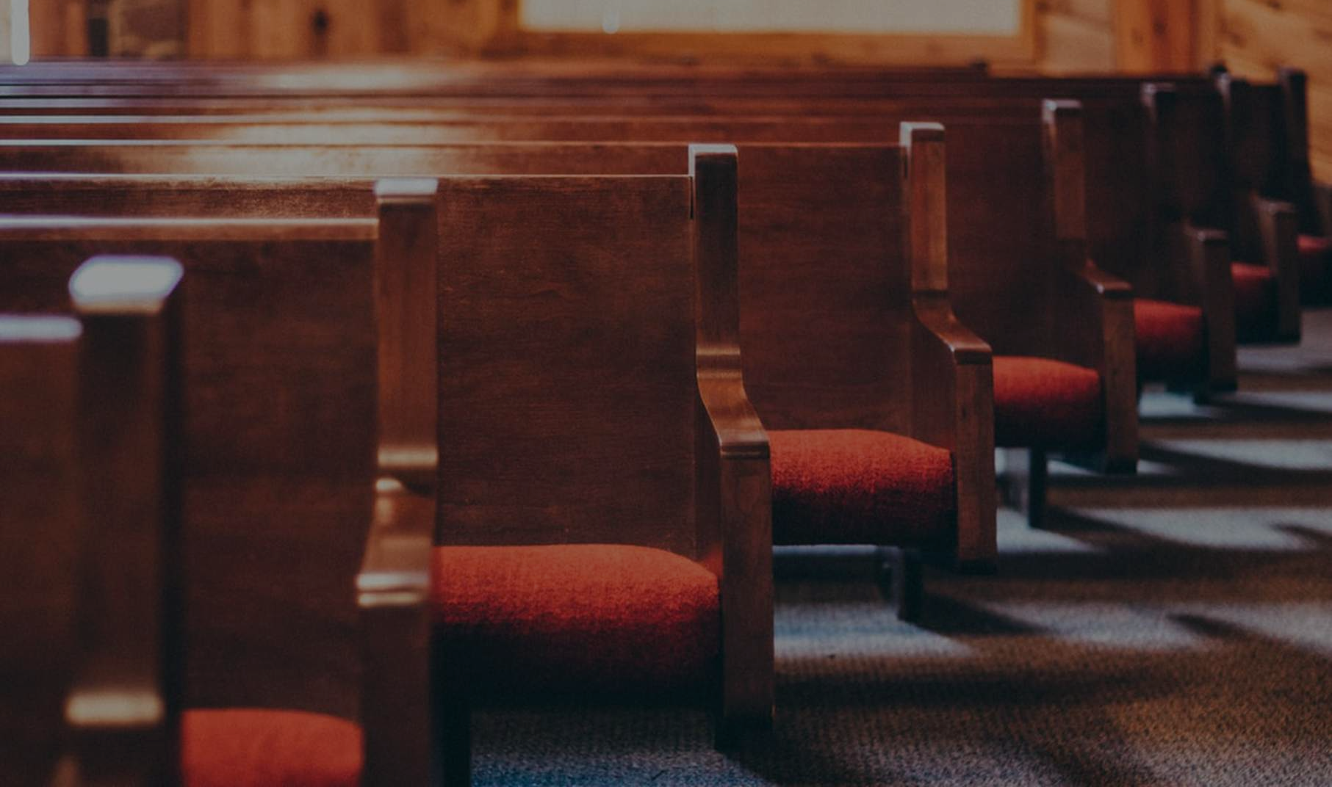
REMEMBER YOUR CHURCH LEADERS – “Remember your leaders who taught you the word of God. Think of all the good that has come from their lives, and follow the example of their faith…. Obey your spiritual leaders, and do what they say. Their work is to watch over your souls, and they are accountable to God. Give them reason to do this with joy and not with sorrow… Pray for us, for our conscience is clear and we want to live honourably in everything we do.” (vs 7, 17-18)
a) Pay attention to them – preaching in the local church is the primary way that God gives his word to his people (2 Tim 4:1-4).
b) Imitate them – as they imitate Christ (1 Cor 11:1). They won’t be perfect, but how they deal with sin can be a good example.
Notes:
Pay attention to them – because they teach the word of God (at least they should) and they are God’s servants. They should rebuke, teach and correct. Not saying that we shouldn’t read and study word ourselves but the central way we should learn is Spirit speaking through leaders. Provided it is sound teaching, truthful, not self serving and only to tell people what they want to hear. No compromising the truth. Becomes harder today with so many good teachers/preachers available in digital format – but still must obey and and pay attention to local church preacher – get along to church.
Imitate them – leaders shouldn’t just point out the way, they should walk it as well. Not saying they will be perfect (and we shouldn’t hold them to that standard). But not being perfect can be a good example – repenting when they sin, model what it is to be a sinner saved by grace.

Slide 8
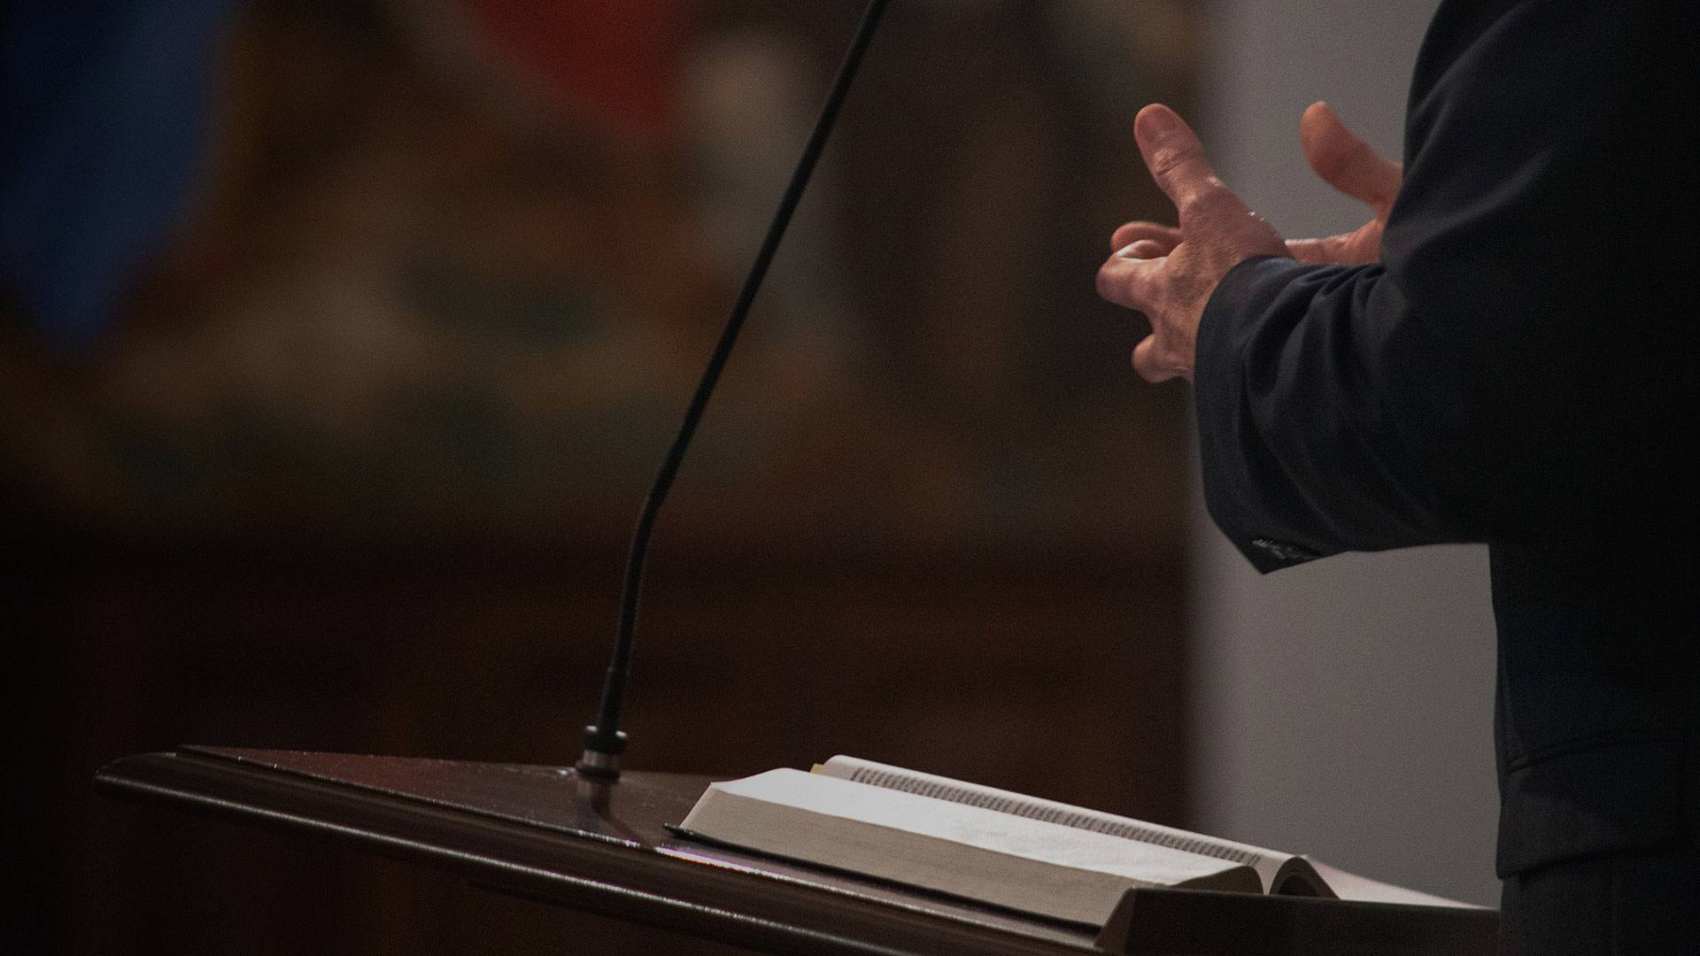
c) Obey them – if you have trouble submitting to church leaders, you will have trouble submitting to Jesus (head of the church).
Don’t obey blindly. If they compromise God’s Word, are authoritarian, abusive, self seeking.. = false shepherds.
d) Respect & honour them - they keep watch over you = a great responsibility and heavy burden (1 Thess 5:12-13). Help to make it a joyful experience.
e) Pray for them – 70% battle fatigue & depression, 42% thinking of leaving ministry, 40% experience serious conflict, 37% quit after 5 years, 54% overwhelmed, 70% don’t have a close personal friend, 38% divorce, 50% pornography or affairs…
Notes:
c) Obey them – we don’t like authority in our western culture. We don’t like being told what to do – we can decide for ourselves, after all truth is subjective. But if you struggle to obey them and submit to them then you will have trouble submitting to Jesus, who is the head of the church, and who appoints his leaders. Like saying I hate the church but love Jesus. The church is his bride and you can’t love him unless you love his bride – he will not have a close relationship with you if you don’t appreciate and honour his bride and his leaders.
d) Pray for them – so they may stand against temptation and compromise, life may reflect their faith, humility, strength, faith etc. There is a range of statistics on church leaders, many are questionable (based on research used) so I went for most moderate and proven stats. Not trying to put a case for a pity party but they are under attack. And a lot can be bought on by themselves – poor health or leadership style or personal boundaries.

Slide 9
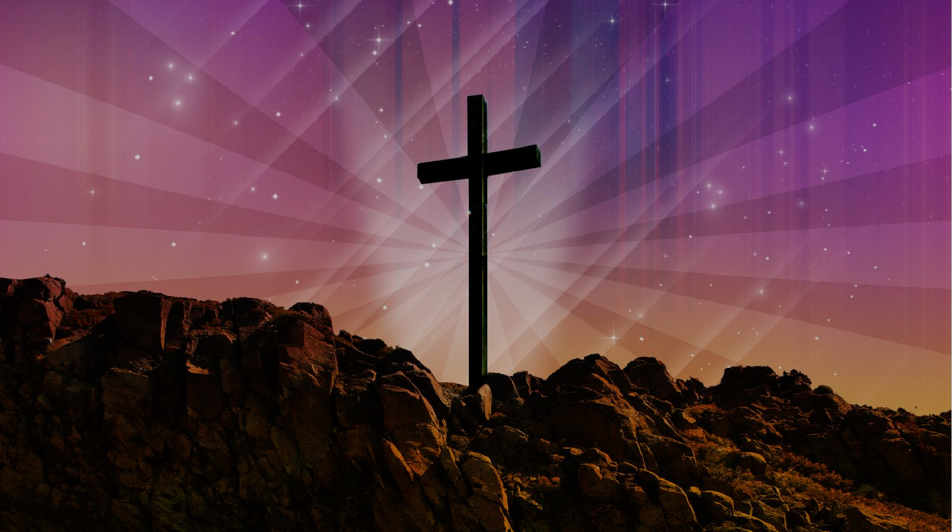
REMEMBER JESUS – “Jesus Christ is the same yesterday, today, and forever. So do not be attracted by strange, new ideas. Your strength comes from God’s grace, not from rules about food, which don’t help those who follow them.” (vs 8-9)
a) Beware of false teaching – Jesus never changes, nor does His Word (Isa 40:8). The church must not change with the times.
“Ask for the old, godly way, and walk in it. Travel its path, and you will find rest for your souls.” (Jer 6:16)
“Hold on to the pattern of wholesome teaching you learned from me… carefully guard the precious truth that has been entrusted to you.” (2 Tim 1:13-14)
Notes:
a) Beware of false teaching – just as Jesus doesn’t change, nor does the gospel message. Sadly you hear people say that as times change, then the church must change with it. We should be happy to be unoriginal – there are no appendix in the Bible, nothing added by God. Teachings, warnings and blessings Jesus gave his disciples are the same he gives us today. Changeless word helps us to stand firm – no need for strange new ideas that add or subtract from his word. Be wary of any new trendy teaching – particular ones which minimise the grace of God – claim salvation by what you do or eat. Holding onto the unchanging truth and having an unchanging Saviour gives us something powerful to share with our confused, misinformed, disorientated, deceived world. We can tell them what to believe and how to live confidently – unshakable Word. Salvation comes by faith alone in Christ alone (grace alone).

Slide 10
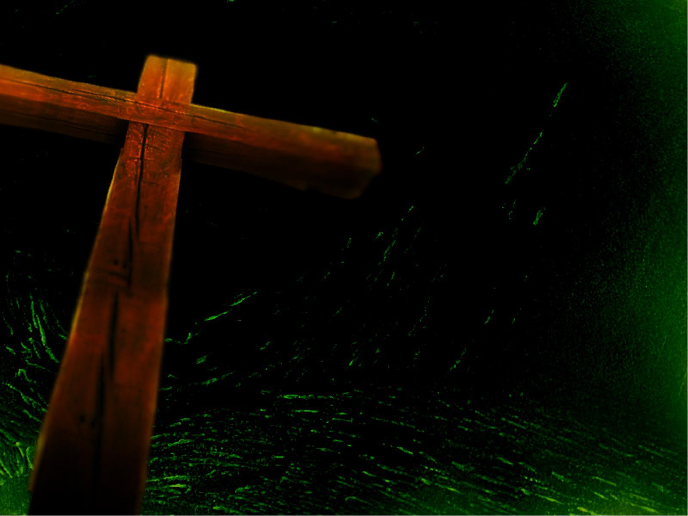
“We have an altar from which the priests in the Tabernacle have no right to eat. Under the old system, the high priest brought the blood of animals into the Holy Place as a sacrifice for sin, and the bodies of the animals were burned outside the camp. So also Jesus suffered and died outside the city gates to make his people holy by means of his own blood. So let us go out to him, outside the camp, and bear the disgrace he bore. For this world is not our permanent home; we are looking forward to a home yet to come.” (vs 10-14)
b) Don’t be surprised by persecution - Living for Jesus will offend some & be foolish to others = hatred & persecution (1 Cor 1:22-24, 2 Tim 3:12, John 15:18-19). Be willing to suffer for Jesus, because he was willing to suffer and die for us.
Notes:
These is some tough stuff in these verses – what does it mean? Referring to the day of Atonement when the bull and lamb was slain – the body was taken outside the camp and destroyed because it carried the sins of the people. The blood saved them – allowed them to draw near to God. Remember what Jesus did for us. Jesus was willing to take that suffering and shame – to be despised and rejected so that we could draw near to God. He was rejected so we could be accepted. But being accepted and living for Christ = persecution and opposition. We must be willing to suffer and be disgraced for Jesus, because that’s what he did for us. And we can endure this by looking forward to the unshakable home to come – not worried about losing the unshakable things of this world. Our hope.

Slide 11
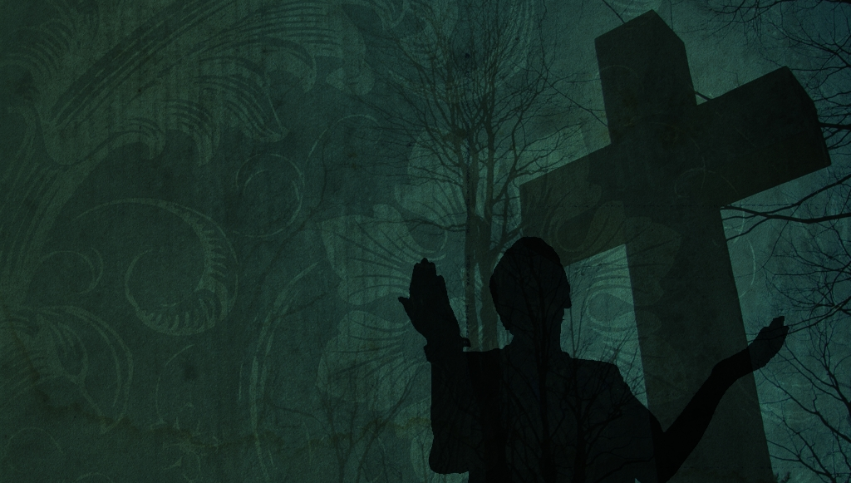
c) Live as citizens of heaven – “Our hope is in the enduring city of God, not the fading city of men.” (C Swindoll)
Living as citizens of heaven = standing & fighting together for the gospel + not being intimidated by our enemies. (Phil 1:27-30)
“Therefore, let us offer through Jesus a continual sacrifice of praise to God, proclaiming our allegiance to his name. And don’t forget to do good and to share with those in need. These are the sacrifices that please God.” (vs 15-16)
d) Continually worship Him and serve others – “Satan is allergic to praise. When he hears it, he is paralysed and banished.” (Paul Billheimer) – 2 Chronicles 20, Jonah 3:9, Acts 16:25-26.
Notes:
c) Citizens of heaven – in the end they can’t do anything to us that we should ultimately fear. Death only makes us better – enter into eternal rest with Jesus.
d) Continual worship – in the Old Covenant God required a sacrifice of animals. In New Covenant it’s a sacrifice of ourselves – our hearts and lip praising him and serving others in his name. Essentially the great commandment in Matthew 22:37-40. The entire law of God = love God with all you have and love others as yourself. Satan hates it when we worship all the time and God loves it. Never underestimate the power of singing praises – it’s the sacrifice that God wants from us. In 2 Chronicles 20, Jehosphat and Isrealites are facing a huge army (coalition of surrounding nations) and goes up against it with vastly inferior number. But he puts the worship team up the front of the army and victory is theirs. Jonah sings praises from the belly of the whale and he gets vomited up on the beach and goes to share the gospel with Ninevah = revival. Paul and Silas in prison and singing at midnight and they are rescued.

Slide 12
“Now may the God of peace - who brought up from the dead, our Lord Jesus, the great Shepherd of the sheep, and ratified an eternal covenant with his blood - may he equip you with all you need for doing his will. May he produce in you, through the power of Jesus Christ, every good thing that is pleasing to him. All glory to him forever and ever! Amen.”(Hebrews 13:20-22)
YOUR LEADERS
OTHERS
REMEMBER
REMEMBER
YOUR HEART
Notes:
May you truly grasp that Jesus is better. And as we seek to live for him may we remember others, your heart, your leaders and most importantly remember Jesus. We are not in this journey alone and shouldn’t be focused on our needs. We need to also guard our hearts – can only endure with power of Jesus. Finish with the blessing that the author of Hebrews gives his readers.

