Slide 1
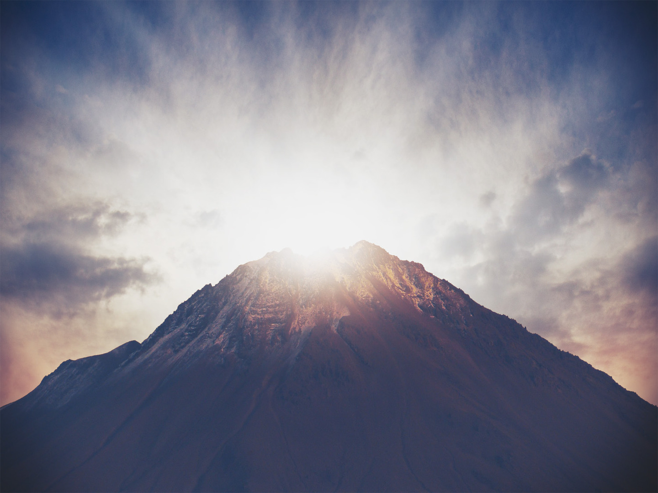
A BETTER MOUNTAIN
Hebrews 12:18-29
Notes:
Good morning everyone. I trust that you have all had a good week
Well, we are now into our second last sermon in our Hebrews series, which means that it is the last time that I have the privilege of preaching to you all during this series
Before we get stuck into today’s passage, I just want to share something on a more personal note
I don’t know about everyone else, but this has probably been one of the most impactful sermon series in recent memory for me
Reading and preaching through this letter has been so timely for me
It has reminded me of God’s grace. It has reminded me of the inerrancy and the sufficiency of Scripture
It has reminded me of the faithfulness of God to His people, and that He truly is the same God of both the Old and the New Testament
And ultimately it has reminded me that JESUS IS BETTER, and I trust that many of you have also got something out of this rich book in the Bible and our preaching series
Anyways, let’s get into today’s sermon.
Hebrews 12 presents us with wisdom for living the Christian life by employing the metaphor of a marathon, a long distance race in which we must persevere, and last week we looked at how in order to do that, God will discipline us
Today the author is giving us something to fix our eyes on. Not looking back to the things that once were at Mount Sinai
But looking forward in faith to the things that are both now and yet to come on this better mountain, Mount Zion

Slide 2
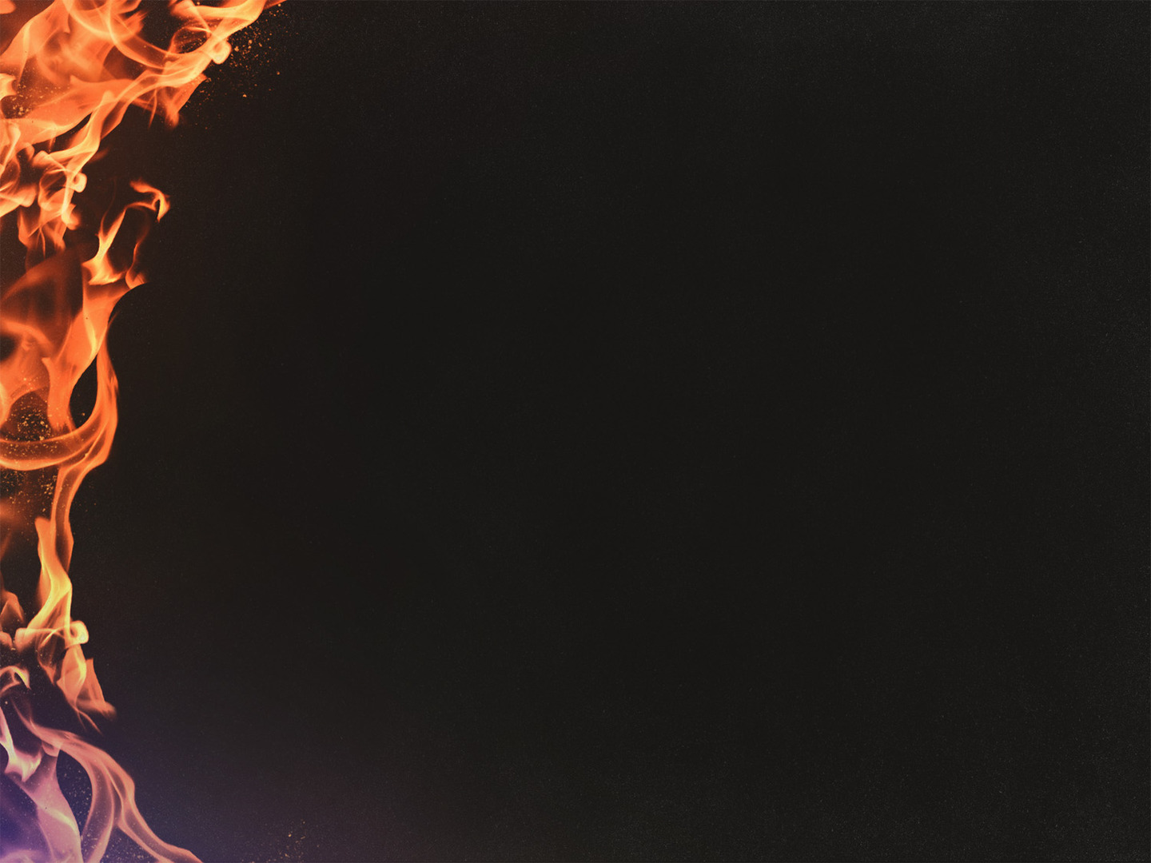
MOUNT SINAI
“You have not come to a physical mountain, to a place of flaming fire, darkness, gloom, and whirlwind, as the Israelites did at Mount Sinai” (Heb 12:18)
The purpose of this awesome physical display was to remind Israel of the absolute unapproachableness of God
“For they heard an awesome trumpet blast and a voice so terrible that they begged God to stop speaking” (Heb 12:19)
Notes:
“You have not come to a physical mountain, to a place of flaming fire, darkness, gloom, and whirlwind, as the Israelites did at Mount Sinai (Heb 12:18) -The temptation that was being thrown in the faces of the audience of Hebrews was to go back to Judaism, to go back to Mount Sinai, and so the author of Hebrews addresses this by reminding them of exactly what happened at this mountain - All the way back in Exodus 19 and in Deuteronomy we are given this awesome display of God atop of Mount Sinai just before He gave the people of Israel the 10 Commandments - Imagine the people of Israel, at the foot of the mountain witnessing all this, witnessing the holiness of Yahweh, the God of Israel. And then imagine being Moses, the mediator for Israel, right there before this holy God, and watching these events unfold before your very eyes
The purpose of this awesome physical display was to remind Israel of the absolute unapproachableness of God - It was to remind Israel of the seriousness of sin. That sinful man could not come near him and live - That while God dwelled on the mountain, we could only gaze from afar at the foot of the mountain, WAY down there - It was emphasising God’s holy distance from sin, for God in His holiness and perfection, cannot be where sin is
“For they heard an awesome trumpet blast and a voice so terrible that they begged God to stop talking” (Heb 12:19) - Let us turn in our Bibles to Exodus 20:18-21 - They were so terrified that they were concerned that if they were to even hear God’s voice they would die, for such is the majesty of God and the display that was unfolding before their eyes - This is not a God to be messed around with, to play games with. This is an infinitely holy and all-powerful God, a consuming fire

Slide 3
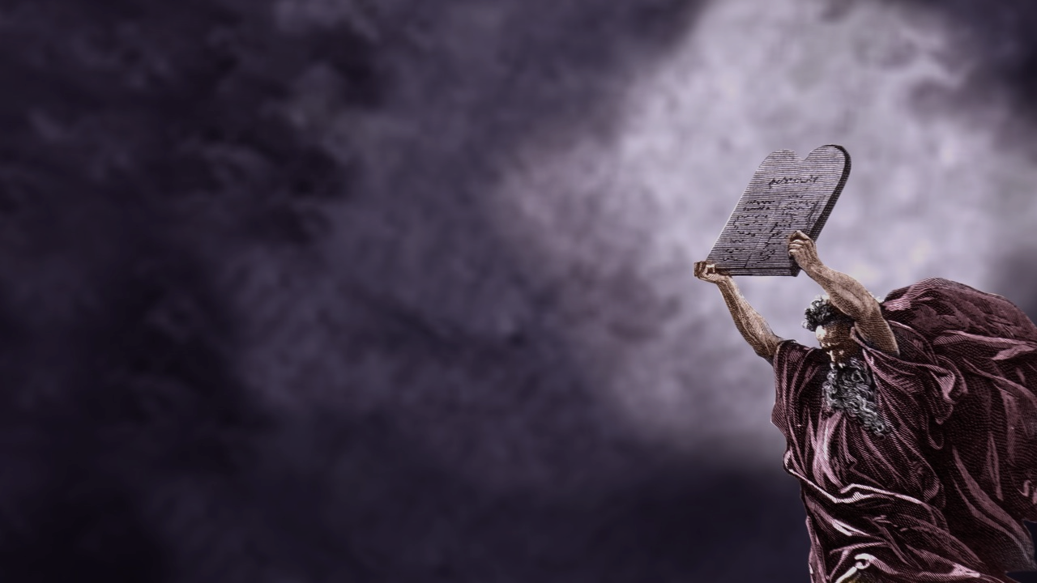
“They staggered back under God’s command: “If even an animal touches the mountain, it must be stoned to death” (Heb 12:20)
At the foot of Sinai, sinful and unforgiven man stands before an infinitely holy and perfectly just God
Sinai is closed to all, because no one is able to please God on Sinai’s terms – perfect fulfillment of the law
Notes:
“They staggered back under God’s command: “If even an animal touches the mountain, it must be stoned to death” (Heb 12:20) - So as if God’s voice wasn’t terrifying enough, then God utters this command, that “if even an animal touches the mountain, it must be stoned to death” - It’s as though the mountain is so charged with God’s holiness, that for anyone to touch it would mean certain death - God’s presence consecrated the place and He was set apart from sinful people - The severity of the command demonstrates the costliness of sin, of uncleanness in the midst of God’s holy presence
At the foot of Sinai, sinful and unforgiven man stands before an infinitely holy and perfectly just God - God is WAY up there, and is so transcendently ‘other’, so perfectly good and holy, that you better not even think about touching the mountain upon which He dwells - The writer of Hebrews is saying to his readers that “if you want to go back to Judaism then this is what awaits you, you go back to being bound to a covenant of law, of fear, of judgement, and ultimately death’
Sinai is closed to all, because no one is able to please God on Sinai’s terms which is perfect fulfillment of the law - To approach God by the law, by our own works and declare to God “I think I have done enough good things to enter your presence” is to be disappointed and is to face death - Sinai reminds us of Romans 3:23 – for all have sinned and fall short of the glory of God. No one can measure up, no one can perfectly obey the law, no one can ever stand before God based on their own works and expect to enter into His presence and live - We ALL fall short, and if this was the end of the story, we would have no hope - The author is painting this terrifying picture of Sinai for his readers, to get them to turn their eyes away from Sinai towards a better mountain

Slide 4
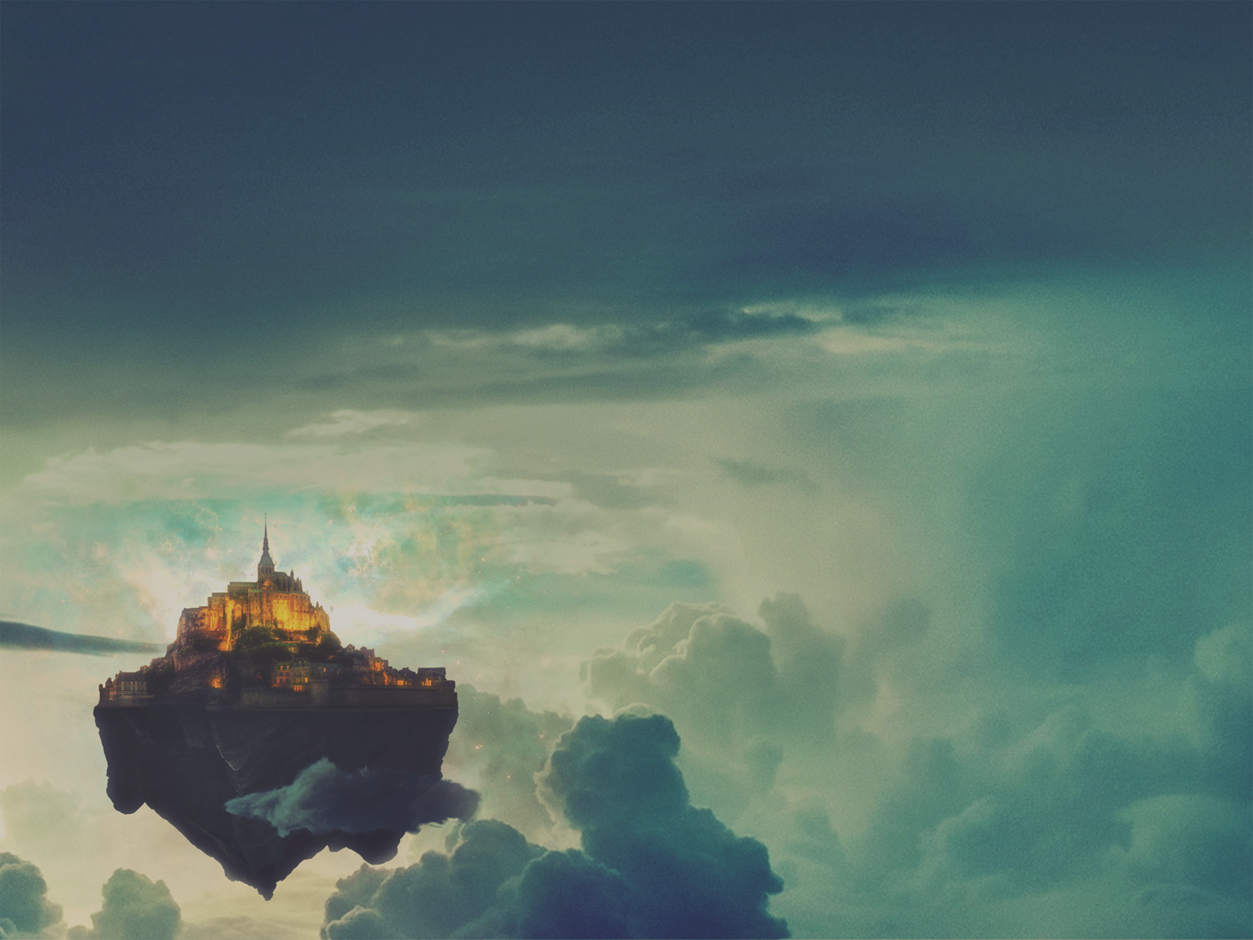
MOUNT ZION
“No, you have come to Mount Zion, to the city of the living God, the heavenly Jerusalem” (Heb 12:22)
On this mountain we are met by angels, assembly of God’s firstborn children, the spirits of the righteous ones who have now been made perfect
“You have come to God himself, who is the judge over all things” (Heb 12:23)
Notes:
“No, you have come to Mount Zion, to the city of the living God the heavenly Jerusalem” (Heb 12:22) - In 2 Samuel 5 we read of David defeating the Jebusites at Zion and taking the stronghold. - Zion was the hill on which Jerusalem was built, and Jerusalem was the place where the Ark of the Covenant was brought and thus understood to be the holy mountain where God dwelled - And so here we have the heavenly, completed version of what Zion is. It is the city of the living God, the heavenly Jerusalem - And so, this is the mountain that by faith, we come to, and on this mountain is all sorts of amazing things
On this mountain we are met by angels, assembly of God’s firstborn children, the spirits of the righteous ones who have now been made perfect - The angels who often blow the trumpets of judgement are now depicted as joyfully worshipping God, and one day we will join with them in their praises in heaven - On this mountain we see the assembly of God’s firstborn children, which all who come to Christ are now considered firstborn children and receive all the privileges that go with it. - In heaven we are not inferior to Abraham, Moses or Elijah, because we will all be equal in righteousness , because our only righteousness is the righteousness of Jesus Christ - And it is by his righteousness, and by his power that we are made perfect
“You have come to God himself, who is judge over all things” (Heb 12:23) - The same God of Mount Sinai, the law-giving God, the God of the 10 commandments, the God who we couldn’t even bear to hear His voice, sits atop this mountain - This time though we do not witness from afar gazing at God’s holiness and majesty, wondering what it would be like, but we stand side by side with the Creator God - Some of you may be thinking well what’s changed, how come on one mountain I can’t even touch the base of it or else I will die, and yet on this one I will be able to gaze directly into the face of God

Slide 5
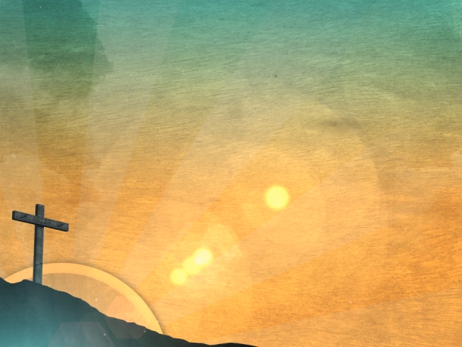
“You have come to Jesus, the one who mediates the new covenant between God and people, and to the sprinkled blood, which speaks of forgiveness” (Heb 12:24)
No one can be saved by the law, but anyone can be saved by grace
This is not just a future reality, but is your present reality if you believe in Jesus Christ as Lord and Saviour
Notes:
“You have come to Jesus, the one who mediates the new covenant between God and people, and to the sprinkled blood, which speaks of forgiveness” (Heb 12:24) - The difference is the mediator. On one mountain we have Moses, imperfect mediator, but on Mount Zion we have Jesus, the Son of God, who died for the sins of all who will believe - You see unlike Moses, Jesus is a greater Saviour than you are sinner. - And we are not just forgiven, but made perfect in Christ, and because of that we can come to Mount Zion by the power of God’s saving grace, no longer fearing death, but being given life instead - The only reason we receive forgiveness, is because of the sprinkled blood of Jesus Christ, the Son of God, who came to earth as a man and died for all who will believe.
No one can be saved by the law, but anyone can be saved by grace - The law of Mount Sinai still needed to be obeyed, still needed to be fulfilled. - So Jesus Christ came and lived the perfect life, without sin, and because he fulfilled the law completely, and because his death and resurrection are sufficient we can be saved - We did nothing to earn it, and if you try to do it apart from Jesus, you won’t find yourself at Mount Zion, but at the foot of Mount Sinai where if you even try and touch the mountain you will be killed - It is by grace alone, through faith alone, in Christ alone, that is the only way
This is not just a future reality, but is your present reality if you believe in Jesus Christ as your Lord and Saviour - This is one of those “now and not yet promises” of the Bible - Mount Zion is the place that awaits all who believe in Jesus Christ when we are raised one day to be with him forever - And yet it is ours now because the promises of the New Covenant are so sure and so true because they are in Jesus. And Jesus now lives in all who belong to him - This is where our treasure is, our inheritance is, our hope is, it is in Jesus Christ in whom we will one day dwell in the city of the living God where we spend the rest of eternity glorifying Him

Slide 6
UNSHAKABLE KINGDOM
“Be careful that you do not refuse to listen to the One who is speaking” (Heb 12:25)
If the gospel message is refused, judgement will follow
“Now he makes another promise: ‘Once again I will shake not only the earth but the heavens also.’ This means that all of creation will be shaken and removed, so that only unshakable things will remain” (Heb 12:26-27)
Notes:
“Be careful that you do not refuse to listen to the One who is speaking” (Heb 12:25) - ‘The One’ here refers to Jesus, but what could he possibly be speaking? Whatever it is, is clearly of utmost importance. It concerns your soul, your everlasting destiny, it concerns God’s way of mercy, and it ultimately concerns the gospel. - That’s what Jesus is speaking to us all. - A man by the name of Voddie Baucham, once described the gospel something like this, and I want to paraphrase him because he explained it in such a powerful way: - The gospel says that we have all gone astray like sheep, each going our own way, all lost. - We are all sinners who have fallen short of God’s glory - We all stand at the base of Mount Sinai, WAY down here, while God in all his holiness, and majesty is WAY up there, with no hope of getting to Him in our own strength - And because God is holy and God is just, sin has to be dealt with, but if we get justice, we all die. - But God in His mercy sends Jesus, who wraps himself in flesh, and is born of the virgin Mary - And he lives the life we never could, perfectly meeting all the requirements of the law, and Jesus takes our sin, and he is nailed to the cross. And while he is on that cross he takes the full weight of God’s wrath and God’s justice and the Son of God dies for all who would believe in him - And so not only is God just but He is also the justifier - And Jesus rises again on the third day that we may be justified, that we may be saved and declared innocent, that all who would believe in Jesus Christ would be called children of God - And that same gospel that saves us, is the same gospel that sanctifies us, that conforms us to the image of Jesus Christ. - But you see something else happens when we believe in Jesus Christ as Lord and Saviour. He didn’t just take our sins, but he then also gives us his righteousness, his perfection. - So that one day when we come to Mount Zion and come into God’s presence we are not just saved from the penalty of sin, not just saved from the power of sin, but one day when it’s all said and done, we are saved from the very presence of sin - That’s the gospel that is the power of God unto salvation, and that’s the gospel that saves
If the gospel message is refused, judgement will follow - John Piper once told a story that described this really well. He went to visit a man named Dick Teegan, with his son Karsten when his son was 6 years old. - He had a dog at the door when they opened the door, and he looked Kartsen eyeball to eyeball. This is a giant dog. And John sent Karsten back to the car to grab something he had forgotten, and the dog went running up behind Karsten - And as you can imagine Karsten was terrified. Dick leaned out the door and shouted to Karsten, “Karsten, maybe you better not run. He doesn’t like it when you run away from him” - That’s the way it is with God, we need to keep our eyes fixed on Jesus, walk side by side with him, embrace him. God is horrifically dangerous to run away from, and we should be terrified to run away from God. For if we do, we will spend an eternity in hell apart from Him - But if we will stay with Him, and believe in the gospel of Jesus Christ, we will spend eternity in heaven with Him
“Now he makes another promise: ‘Once again I will shake not only the earth but the heavens also.’ This means that all of creation will be shaken and removed, so that only unshakable things will remain” (Heb 12:26-27) - One day this present created realm will be shaken by God, leaving only the eternal things that are of Him - All the things of this world that people live for and strive toward will ultimately come to nothing - And those who have their salvation rooted in the things of this world will be brought to utter ruin with it, - But those who have their salvation, their hope, their faith, rooted in Jesus Christ will live forever in God’s unshakable kingdom

Slide 7
“Since we are receiving a Kingdom that is unshakable, let us be thankful and please God by worshipping him with holy fear and awe” (Heb 12:28)
“For our God is a devouring fire” (Heb 12:29)
In Christ alone your sins are dealt with completely, and when he comes again you will not be shaken
Notes:
“Since we are receiving a Kingdom that is unshakable, let us be thankful and please God by worshipping him with holy fear and awe” (Heb 12:28) - When we truly understand the reality at Mount Zion, and gaze at this mountain by faith, how can we do anything but be thankful and live the rest of our days for His glory - God offers us an inheritance in His kingdom by the free gift of grace. But in turn it is the costly devotion of our heart that he seeks. - We must lose our lives in order to save them, we must give up the world to gain the kingdom of God. We must love our enemies. And the reality is we can’t do these things. - But by the grace of God and the same power that brought Jesus back from the dead we are able to. - We succeed in the Christian life by relying completely on the gospel, by relying completely on Jesus Christ.
“For our God is a devouring fire” (Heb 12:29) - I truly appreciate the fact that the author of Hebrews put this verse in here - This casts our minds back to Mount Sinai where there was flaming fire and thunder - And it reminds us that the God of Mount Sinai is the same God of Mount Zion. That He is still a consuming fire, perfectly holy and just and majestic. None of that has changed, it’s just that instead of Moses at the top of the mountain we now have Jesus.
In Christ alone your sins are dealt with completely, and when he comes again you will not be shaken - All who have believed in Jesus Christ are declared innocent. Your sins have been paid in full. - The law could never save us, but Jesus can - Jesus did and can save us because he took the full brunt of God’s consuming fire instead of us, he took the full wrath of God instead of us, and Jesus was killed instead of us - But he rose again defeating death, defeating sin and proving that he truly is the Son of God and he cannot be shaken - So that when Jesus comes again all those who are in him will never truly die, or ever truly be shaken because we belong to an unshakable God and an unshakable Kingdom

Slide 8
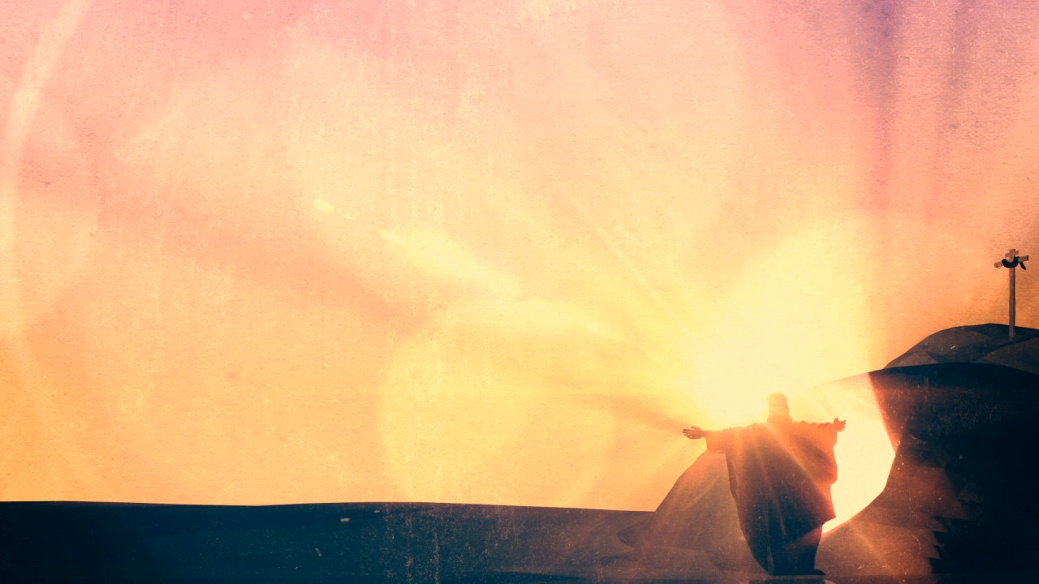
SUMMARY
To come into God’s presence at Sinai was to die, because the law could never save us
To come into God’s presence at Zion is to live because of Jesus and his perfect obedience to the law of God
To believe in the gospel of Jesus Christ is to inherit an unshakable kingdom and have the blessed assurance of an eternity spent with the one true God
Notes:
To come into God’s presence at Sinai was to die, because the law could never save us - God’s holiness will not allow anything that is impure to enter - The law was good, but it could not save us, but instead it was pointing to the one who would
To come into God’s presence at Zion is to live because of Jesus and because of his perfect obedience to the law of God - Perfect obedience to the law was still required, but because we could never do that, Jesus came down and lived a sinless, perfect life - And he did that so that he would be an acceptable sacrifice before God for our salvation, and so that all who will believe in the finished work of Jesus Christ would be saved
To believe in the gospel of Jesus Christ is to inherit an unshakable kingdom and have the blessed assurance of an eternity spent with the one true God - Everything that is holy, by the blood of Jesus Christ will endure the fire, but all who have rejected the gospel, all that is impure, will be consumed by the fire - Jesus said I am the way the truth and the life, and no one will come to Father except through me. The hope and joy of an eternity on Mount Zion awaits all who will turn to Jesus Christ for their salvation

Slide 9
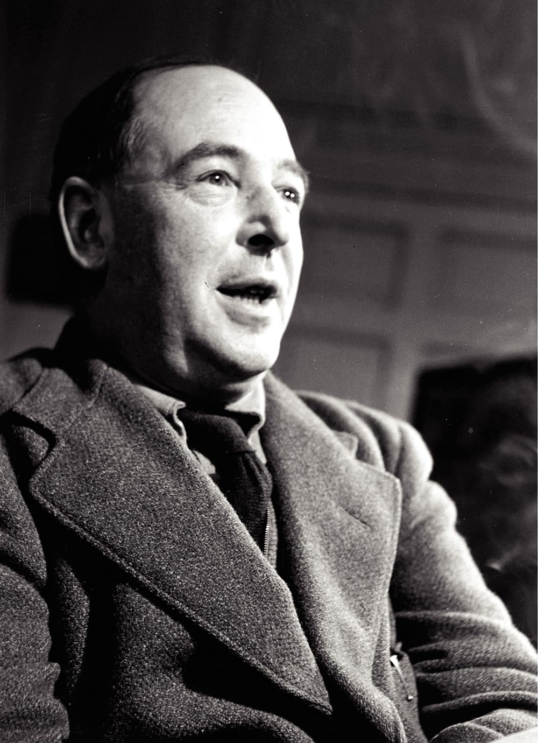
If you read history you will find that the Christians who did the most for the present world were just those who thought most of the next. It is since Christians have largely ceased to think of the other world that they have become so ineffective in this - C.S. Lewis
Notes:
If you read history you will find that the Christians who did the most for the present world were just those who thought most of the next. It is since Christians have largely ceased to think of the other world that they have become so ineffective in this. C.S. Lewis
As we press on towards the prize that awaits us on Mount Zion, let us not become ineffective for Jesus Christ because we have taken our eyes off him atop Mount Zion
Let us not forget the gospel, the gospel which assures of an eternity spent with Jesus Christ our Lord and Saviour, and guarantees us a new heaven and new earth free from the presence of sin
If we keep our eyes and hearts fixed on Jesus Christ and the world that is to come, all of our lives spent here will be well spent doing fruitful work for the kingdom of God. So let’s keep our eyes on Jesus. Let’s pray

