Slide 1
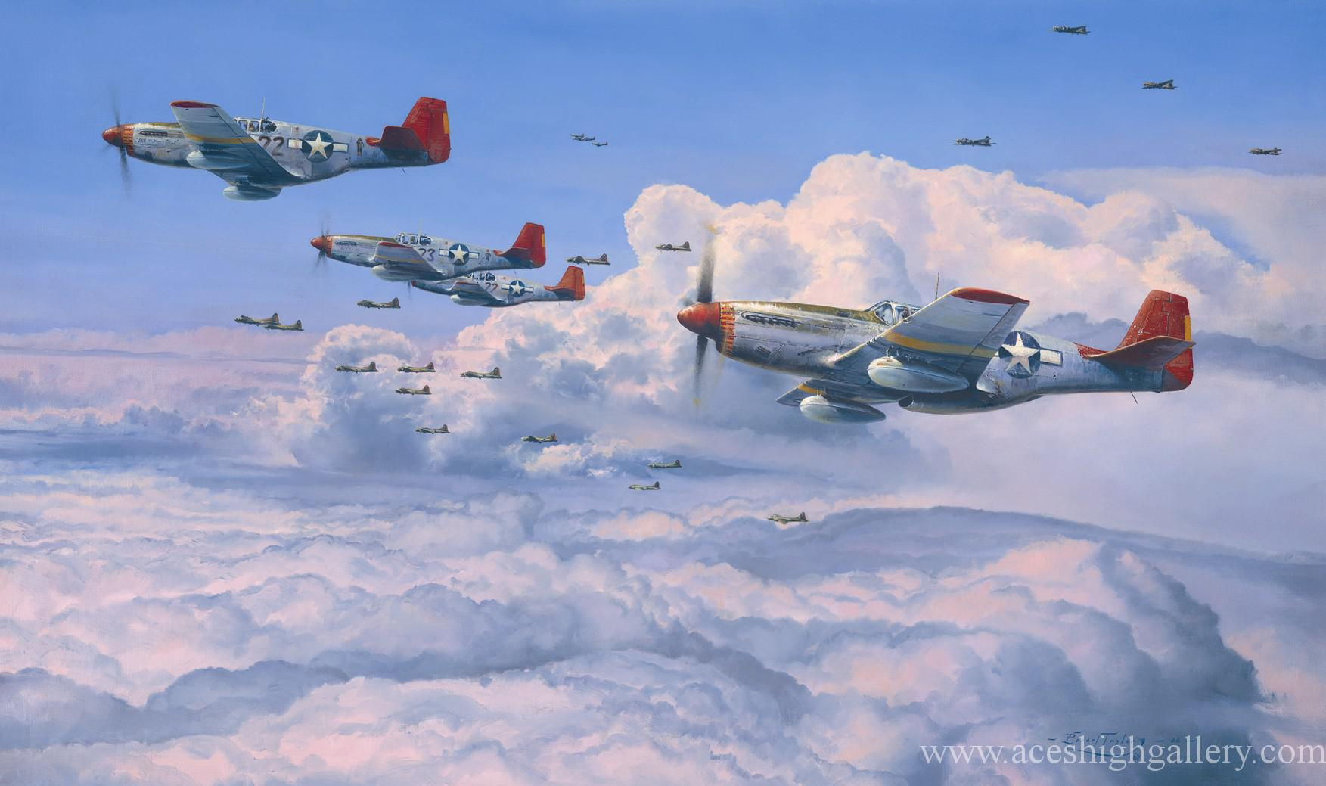
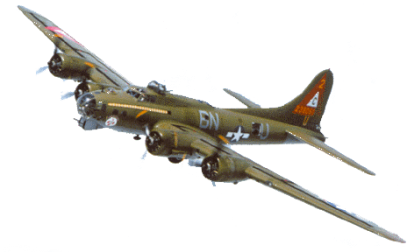
“We will never waver in our duty. No matter what happens we will stay faithful to our calling.”
TUSKAGEE AIRMEN (Red Tails)
“To the last plane, the last bullet, the last man, the last minute, we fight.”
Notes:
In 1944 World War 2 was raging and the Allied forces were striving to get the upper hand against Germany. The US Airforce was looking to break the resolve of the Germans by bombing their cities and ammunition/supply factories. To do this they were sending in B17 flying Fortress bombers but the cost was high. On average they were losing 46 planes (460 crew) due to attacks from enemy fighters. These attacks were also harassing the bombers to the point that their bombing was extremely inaccurate. Although the bombers were protected by their own fighters, those pilots would not stay with the bombers, but rather go chasing the glory by chasing after and engaging the enemy fighters. The German’s first wave of fighters would lure the American fighters away from the bombers so a second wave could attack the bombers without protection. But things changed when the Tuskegee Airmen (Red Tails) were given a chance to protect the bombers. The Tuskegee Airmen were African American pilots who finally got an opportunity to prove themselves in battle. Their commanding officer begged the Air Force to give them a chance – promised that they will never waiver. They were determined to never waver in their duty to protect the bombers. Of the 179 missions they flew they only lost a total of 26 bombers on 7 of those missions. Their motto that they shouted before they went on each mission was – “to the last plane…” These faithful warriors changed the outcome of the war.

Slide 2
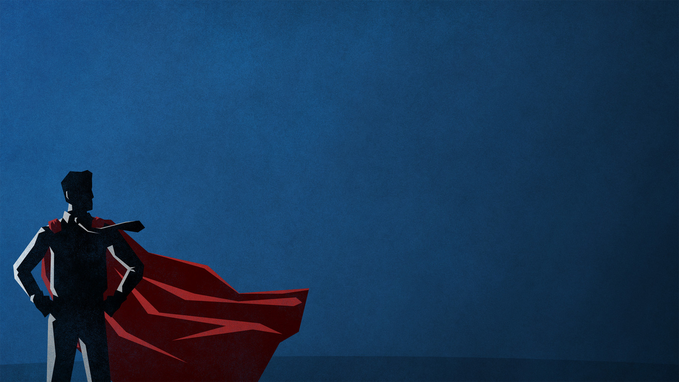
“It is impossible to please God without faith…” (Hebrews 11:6).
“Faith is the cure for a wavering heart. Without it we will drift further and further from God and the calling he has on our life.” (Michael Kruger)
HEBREWS 11
THE MARKS OF TRUE FAITH
(Hebrews 11:23-40)
Notes:
Last week and this week we will be looking at Hebrews 11. In Hebrews 11:6 we are reminded about the importance of faith – it is the way we please God. The readers of Hebrews were wavering in their faith and the author of Hebrews knows how impacting that can be. Theologian Michael Kruger puts it well when he says that the only cure for a wavering heart is faith – it is the key to living the Christian life and pleasing God – the key to fighting in the spiritual war that we are in. In this second half of the chapter we discover some important clues as to what are the marks of true faith.

Slide 3
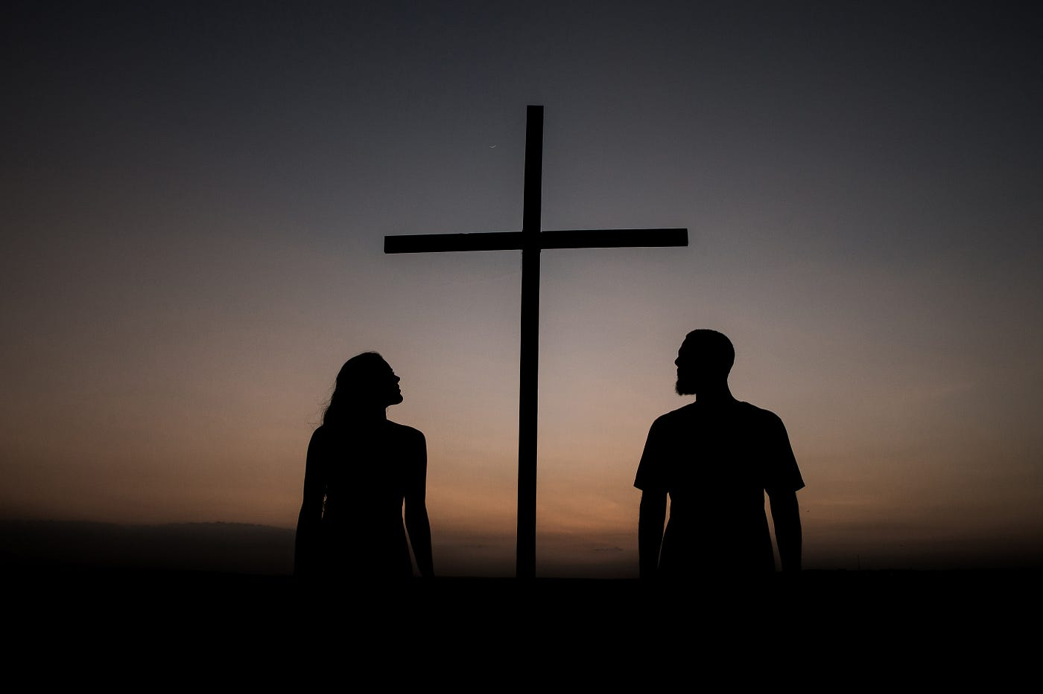
FAITH DOESN’T FEAR MAN – “It was by faith that Moses’ parents hid him for three months… they were not afraid to disobey the king’s command.” (v23)
“We must obey God, rather than any human authority.” (Acts 5:29)
“It was by faith that Moses left the land of Egypt, not fearing the king’s anger… because he kept his eyes on the one who is invisible.” (v27) = trusting God, the king maker (Daniel 2:21).
“Fearing people is a dangerous trap, but trusting the Lord means safety.” (Prov 29:25)
The faith filled life is not a ‘fear driven life’ – it’s looking at Jesus, not the storm.
Notes:
Pharoah (the king of Egypt) was the most powerful man on the planet at the time and he had cruelly given an order that all male Jewish babies were to be killed. It required serious resolve and courage for a Jewish slave to disregard the king’s command. That’s not say that we are to always disobey human authorities – in fact we are commanded to obey (Romans 13:1-2). But if those decrees are against God’s will and Word then we must obey God rather than man. When he had grown up, Moses also refused to fear the power of the king. Why? Because he kept his eyes on the invisible one – God who is the king maker (Daniel 2:21). I am so concerned that Christians today seemed to driven by fear of conspiracies and the ‘new world order’ – distracts them, paralyses them from following Jesus and sharing the gospel. Keener to bunker down and look at the fearful storm more than Jesus (just like the disciples did when they were in the boat with Jesus – and he asked them Where is your faith?”) Jesus is bigger than any king, opposition, world order, opposition that we will face. We need to stand firm in faith – confident in the power and promises of Christ.

Slide 4
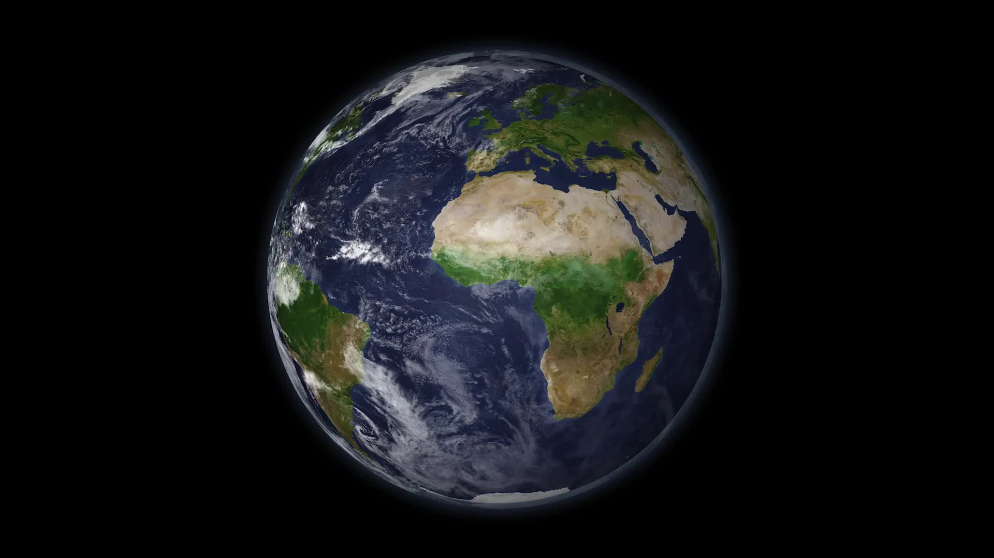
FAITH SAYS NO TO THE WORLD – “It was by faith that Moses refused to be called the son of Pharoah’s daughter. He chose to share the oppression of God’s people instead of enjoying the fleeting pleasures of sin. He thought it was better to suffer for the sake of Christ than to own the treasures of Egypt, for he was looking ahead to his great reward.” (vs 24-26)
Saying yes to God always = saying no to this world. You can’t serve two masters. (Matthew 7:24)
Faith says, “Although I have been offered everything I could possibly dream of, Jesus is still better.”
“A person is a fool to store up earthly wealth, but not have a rich relationship with God.” (Luke 12:23)
Notes:
As the adopted daughter of Pharoah’s daughter, he could have been a prince of Egypt. He could have had all the pleasures and treasures this world values – comfort, power, desires, satisfaction and every indulgence. Instead he chose to align himself with slaves – to be one of God’s children, rather than one of the world. But nothing this world offers lasts – it promises a lot but never delivers. It never truly satisfies. He was once again looking forward to God’s promised great reward to come. If you are a true pleasure and treasure seeker then choose Jesus.

Slide 5
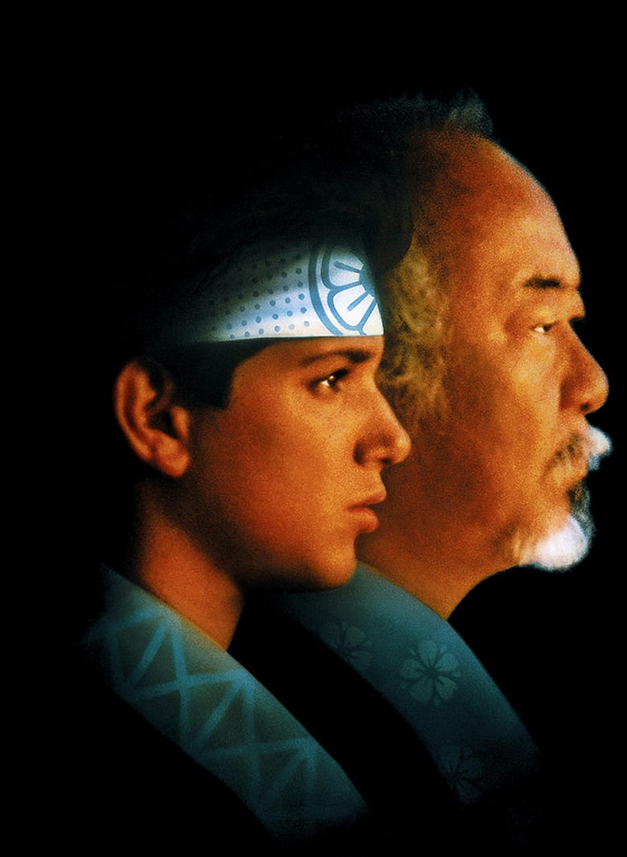
FAITH BELIEVES, EVEN WHEN THINGS DON’T MAKE SENSE.
“It was by faith that the people of Israel went through the Red Sea as though they were on dry ground…” (v29)
“It was by faith that the people marched around Jericho for seven days and the walls came crashing down.” (v30)
“It was by faith that Rahab the prostitute was not destroyed with the people of Jericho… for she had welcomed the spies.” (v31)
We won’t always understand what God is doing until it’s over and we look back with a new perspective. We just have to trust Him.
Notes:
If we are honest, there are times when obeying God doesn’t seem to make much sense – when we wonder how God’s will can lead to something good. God has a long history of asking people to do things which don’t make sense.
Red Sea crossing – sure people thought what was God doing to lead them to the shores of the red Sea as they were being pursued by the Egyptians. But God did it to display his power and glory – the Egyptians were destroyed. To even cross over as the water rose high above them, threatening to wash over them at any time. But they stepped out in faith. If they hadn’t they would have been destroyed and/or taken as slaves again.
Walls of Jericho – these were formidable and I am not sure that the Israelites knew how they were going to destroy the city. But I can guarantee that marching, trumpets and shouting was not on their mind. That was not a normal military strategy. But it worked and God revealed his power and glory again. It was all Him – Israelites could claim no glory.
Rahab befriends foreign spies – God asks her to turn against her own people and trust a God she hardly knew anything about. But she was afraid of a God who could part the Red Sea and let them escape from the Egyptians and could help them defeat the Amorites (Joshua 2:10-11). Didn’t make a lot of sense – imagine if she had sought the advice of others regarding her decision. They would have thought she was crazy. She didn’t know the spies or the Israelites but she knew God and was willing to put her faith in Him.
Why does God often work in a way that doesn’t make sense? Because when the dust settles he alone gets the glory.

Slide 6
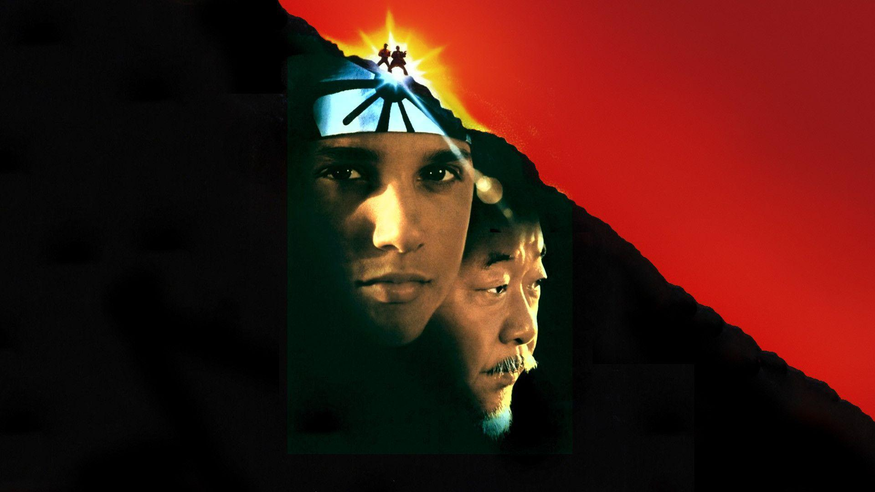
Why does God sometimes work in ways we don’t understand?
So that when all the dust settles, He alone gets the glory.
So that our faith will grow. We are forced to trust God when
it doesn’t make
sense.
Notes:
Why does God love to work like this? Two reasons. So he gets the glory and so that God can stretch our faith – like a muscle that’s how it grows.

Slide 7
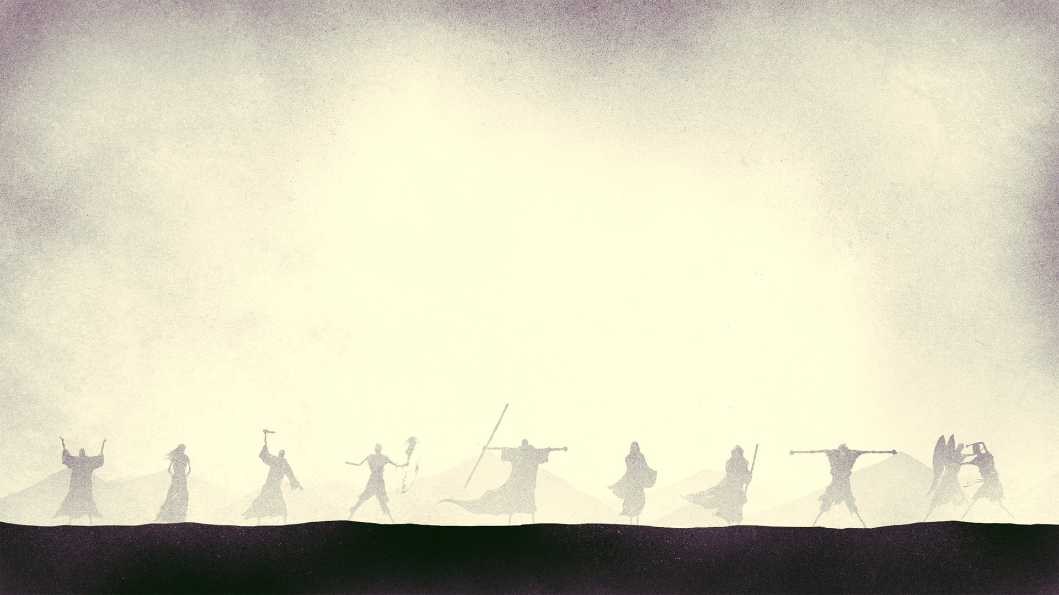
FAITH LEADS TO MIGHTY DEEDS – “How much more do I need to say? It would take too long to tell the stories of the faith of Gideon, Barak, Samson, Jephthah, David, Samuel & the prophets.” (v32)
“By faith they overthrew kingdoms..” (v33) = Gideon, a frightened farmer, and his 300 men defeated a vastly superior enemy with trumpets, torches and jugs.
Barak, the reluctant general, defeated a vastly superior enemy, when God bogged their chariots.
Samson, the immature, arrogant, womaniser who God blessed with great strength, defeated his enemies with his bare hands.
David, a shepherd boy, defeated Goliath with a sling and a rock.
Notes:
Being a faithful follower of Jesus means that we can and will do mighty deeds for God. The author is running out of time – doesn’t want to preach too long so starts to summarise his closing arguments. And briefly covers the faith stories of Gideon, Barak, Samson, Jephthah, David, Samuel and the prophets.

Slide 8
“They ruled with justice…” (v33) = blessed communities & nations through godly leadership (Samuel, David, Esther, Daniel..).
“They shut the mouths of lions.. (v33) = Samson, David, Daniel. “quenched the flames ..” (v33) = Shadrach, Meschach & Abednego.
“They escaped death by the edge of the sword. Their weakness was turned into strength. They became strong in battle and put armies to flight.” (v33) – Israelites and the Amelekites (Exodus 17)
“Women received their loved ones back again from death.” (v35a) = Elijah at Zarapheth (1 Kings 17) & Elisha at Shunem (2 Kings 4).
Faith = mighty deeds by relying on God’s power alone (2 Cor 12:10).
Notes:
They ruled with justice – impacted communities, saved lives. They shut the mouth of lions and endured the flames. They escaped the sword and received children back from the dead. None of these mighty deeds were done by human strength and power. Its all God. They were made strong in their weakness by the grace of God and power of the Holy Spirit. Paul affirmed this in 2 Corinthians 12:10 when he said for when I am weak, then I am strong. When I rely on God I can do anything – when I depend on him, understand I have nothing, then God can do great things through me.

Slide 9
FAITH ENDURES PAIN AND SUFFERING – “But others were tortured, refusing to turn from God in order to be set free. They placed their hope in a better life after the resurrection.” (v35b)
“Some were jeered at.. whipped… and chained in prison. Some died by stoning.. Were sawn in half and… killed with the sword. Some went about wearing animal skins, destitute, oppressed and mistreated…. wandering over deserts and mountains, hiding in caves and holes in the ground.” (vs 36-38)
We have God’s favour when we do great deeds and when we endure trials.
These heroes were willing to take the worst the world could throw at them, because they knew God had the best waiting for them in the future (v40).
Notes:
The others here are still faithful heroes – we probably see ourselves more as these others, rather than those doing great deeds for God. Doesn’t say ‘others who weren’t faithful’. This is not a great advert for Christian living and destroys the false teaching of prosperity gospel – which says that God only wants the best for you. God doesn’t say that if we follow him we will have bigger bank balances, dream homes, perfect families, wonderful jobs, popularity etc. As heroes of faith you may face opposition, suffering and pain. These champions of faith were willing to love Jesus more than anything else in this world, If you follow God you don’t get it all now. You get it all on the final day when we see Christ and he looks at us and says well done good and faithful servant. Can we do that? Can we endure the worst now knowing for certain that the best is yet to come. Or are you focused on wanting the best now?

Slide 10
3 IMPORTANT FAITH LESSONS FROM HEBREWS 11 =
1. FAITH ENLISTS ALL KINDS OF SERVANTS = men & women + old and young + official people & common people + high borne and no pedigree + a farmer, soldier, shepherd, priest, prostitute, son of a prostitute. God used them all & he can use you.
2. FAITH EMPLOYS ALL KINDS OF STRATEGIES = God does His work in strange and different ways for His glory & our growth. He works uniquely = don’t copy others. Look for God’s will for you.
3. FAITH ENJOYS ALL KINDS OF SUCCESS = we can be good and faithful servants by achieving something great for God AND by enduring something great for God.
Notes:
1 Faith enlists all kinds of servants. We see this in all of chapter 11. If you are a Christian God has called you and gifted you to serve him. He has something for you to do. Don’t know what that is? Then ask others and ask God. Find out what you are good at and do it.
2. Faith employs all kinds of strategies. That’s why its not a good thing for churches to copy what other churches do – it may not necessarily work for them. Seek God’s will for your life and church. Don’t wish your congregation or pastor could be like others.

