Slide 1
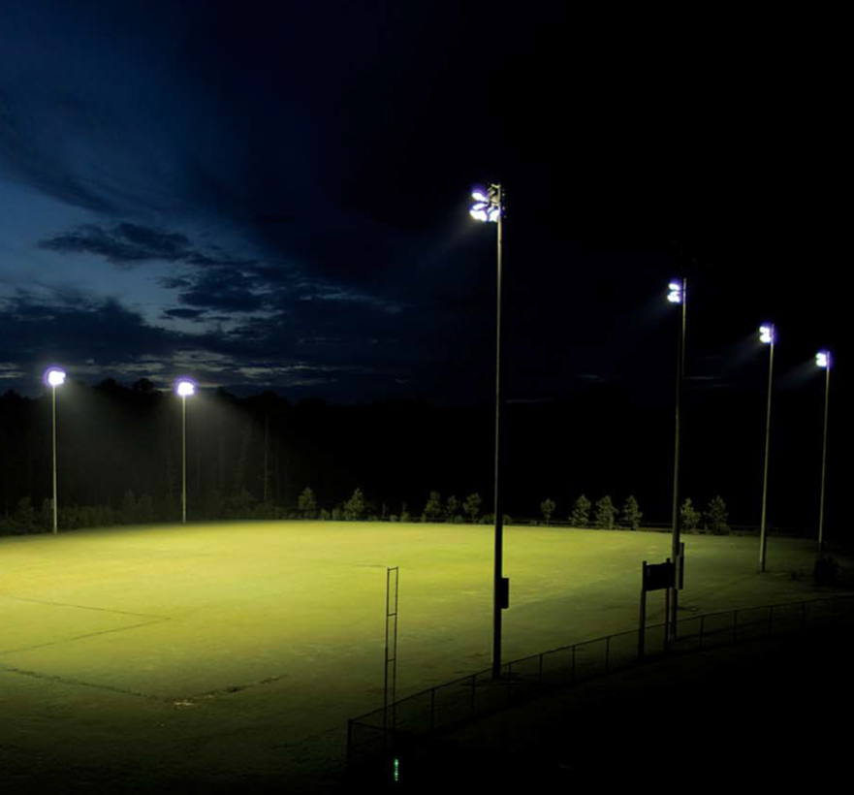
14TH OCTOBER 1878
U11 EELS & SEALS TRAINING AT 5.30PM
Notes:
I want to highlight an important date in the history of soccer. The 14th October 1878 = the first soccer game played under lights. Up until that time all the games had to be played during the day. AFL didn’t play their first game under lights until August the following year (just shows how much better soccer is). Lights have changed the way we play sport – particularly in winter-time when the days are shorter. When we have light we can see the ball, where we should be going, the sidelines (boundaries), the opposition players (threats) etc. When it’s dark we can’t see these things. Our two U11 teams got to experience that first hand this year as there are no lights at the Coolum Beach Christian College and so they had to attempt to play in the dark. We even have a picture of them as they tried to practice in the dark.

Slide 2
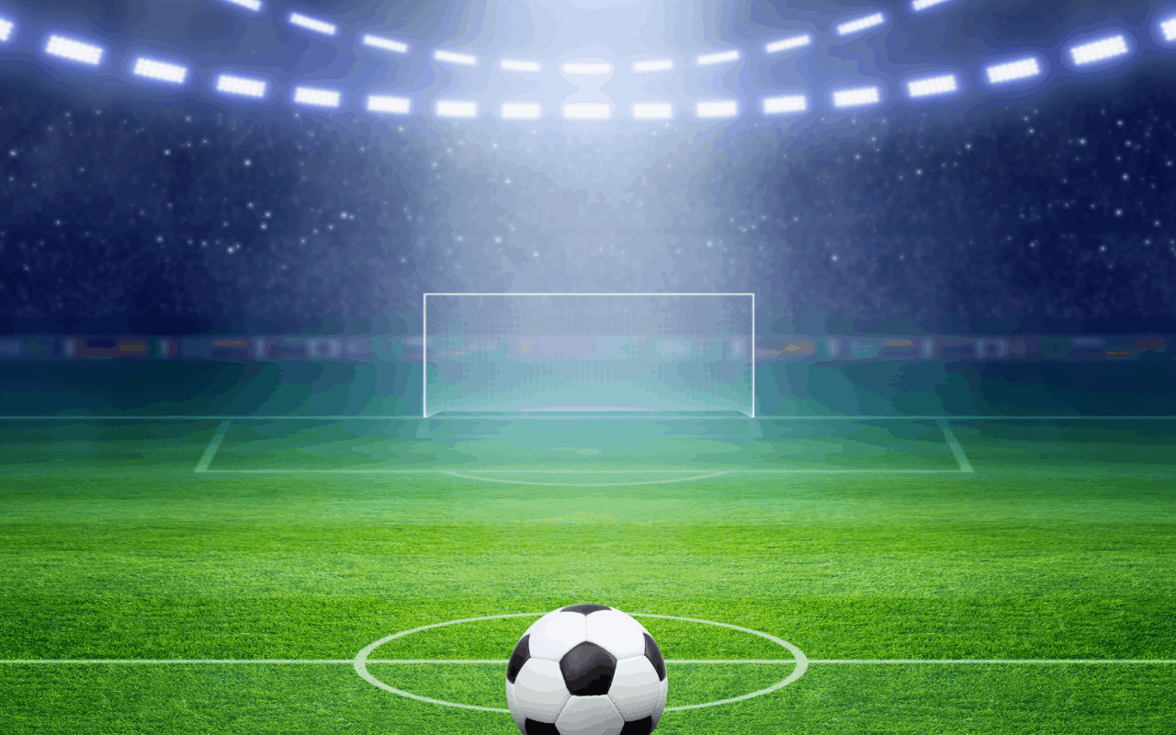
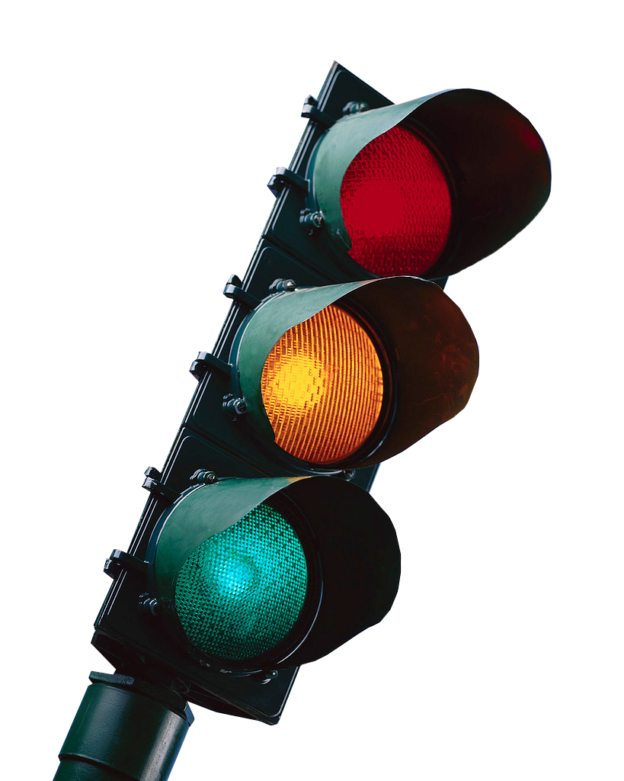
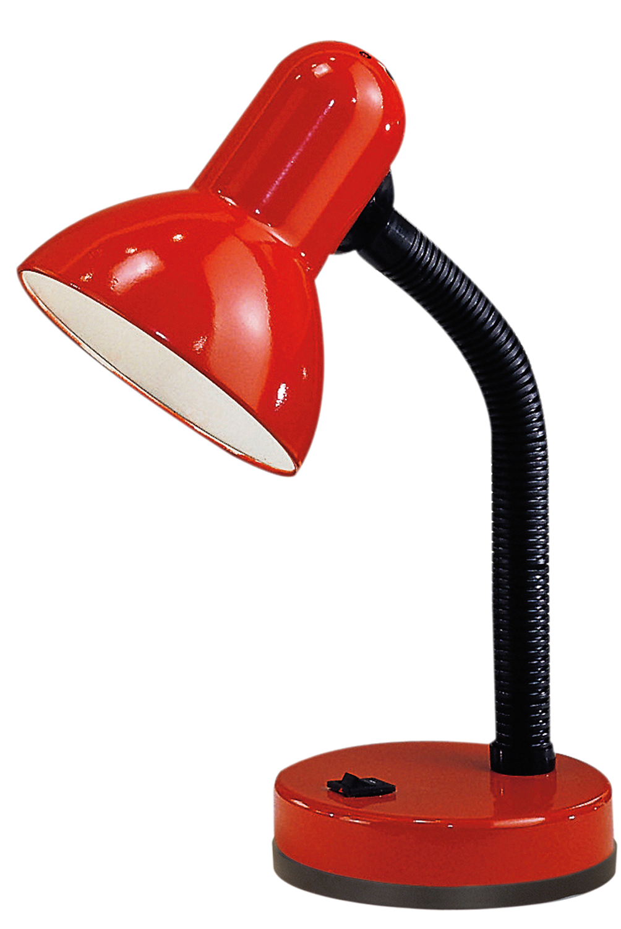
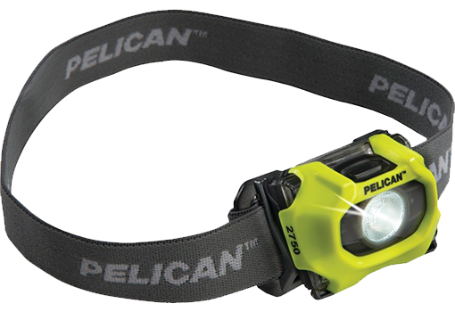
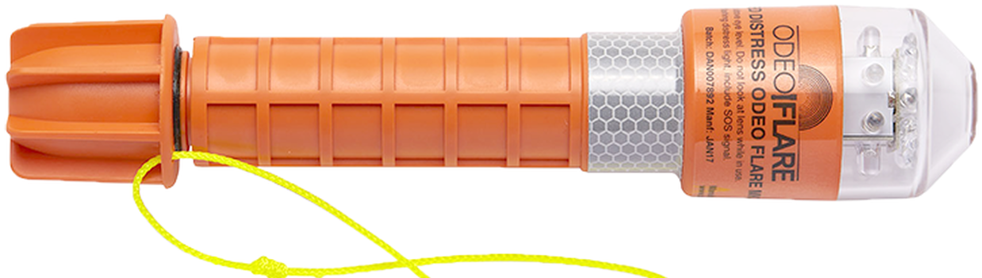
JOY
WARMTH
POWER
WARNING
LIFE
VISION
TRUTH
RESCUE
CONFIDENCE
PROTECTION
DIRECTION
Notes:
In reality we don’t just need light to play soccer. Light also makes a big difference in so many other areas of our life. As I bring up these pictures I want you to tell me what sort of light they are and how they help us in life.
Sun light = warmth, power, life.
Traffic lights (for vehicles and pedestrians) = direction, protection.
Lighthouse = warning, protection. Don’t keep going the way you are going, or it won’t end well.
Study light = truth, read, learn. Not kept in the dark.
Torch (mining, camping) = vision, confidence to see in darkness, know where we are going.
Flare – rescue
Christmas, party lights = joy, makes us feel like celebrating. Things always seem better when the sun comes up. Sundowning = dementia gets worse as it gets dark. Black, darkness – words associated with depression.

Slide 3
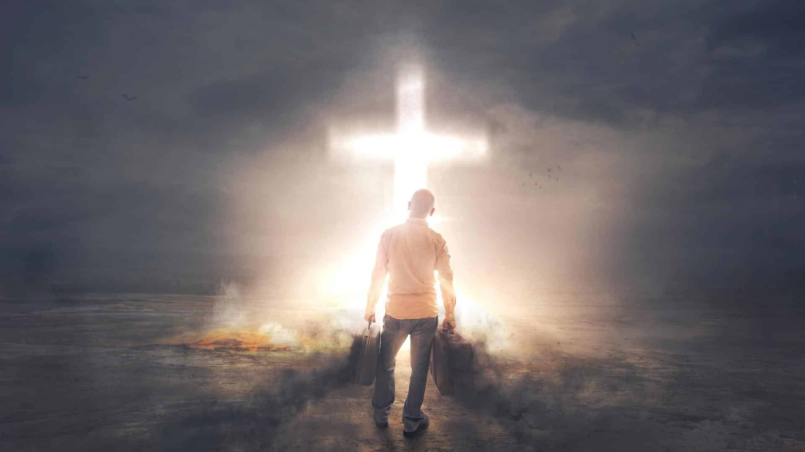
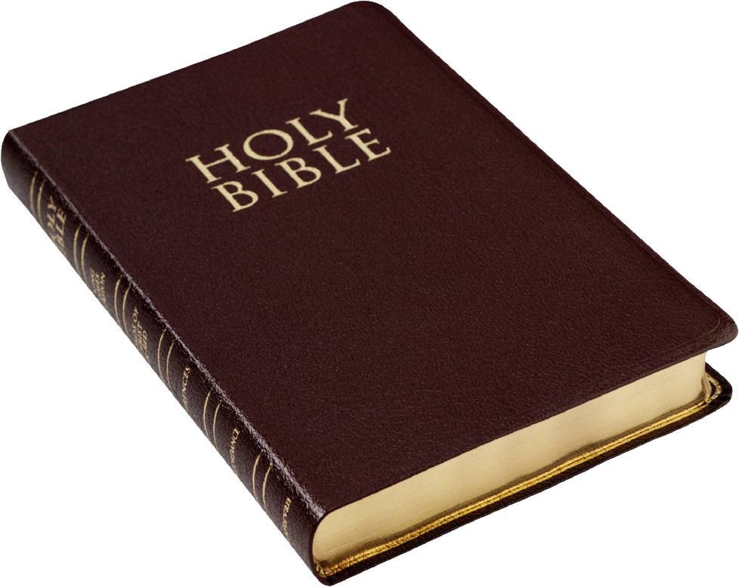
“I am the light for the world! Follow me, and you won't be walking in the dark. You will have the light that gives life.” (John 8:12)
LIFE - now & forever, celebrating on God’s winning team.
JOY – not based on ‘goals’, but on being on the ‘championship team’.
RESCUE – we have all been ‘red carded’ but Jesus took our penalty.
CONFIDENCE - we can’t get kicked off God’s ‘championship team’.
TRUTH & DIRECTION - just because it feels good doesn’t make it right.
POWER & PROTECTION – Jesus is always with us.
Notes:
Jesus is the light of the world – he is all those lights in one + more. Bible talks about light and darkness – spiritual sense. Light = good (God) and darkness = evil. We can choose which side we want.
Life – not just life, but abundant life. Jesus promises us new life and eternal life with him.
Rescue – this is how we get that life that Jesus promises. We need help to get it. Can’t get it on our own. Bible says we have all sinned (broken the rules and been disqualified from getting God’s blessings and love.) But Jesus took our punishment on cross. Because of him we can receive God’s love and promised rewards.
Truth – just because it feels good, doesn’t mean it is right. World says truth is what you make it – not sure what you believe. Being sure of what you believe helps you to stay on track – not waver or doubt. We all think we know best (want to be striker, don’t have to get fit) but we don’t.
Joy & confidence - never alone or forgotten. Even when we fail he still loves us, still on his team. Nothing can separate us from his love. Not about winning the final but being in the hall of fame (faith) forever. God wins in the end – not about getting goals that the world says are valuable. None of that matters if you lose it all in the end.
Power and protection– gives us all we need to keep going. He cares about us, always know what’s happening. Nothing we go through that he didn’t go through himself. Doesn’t tell us to run 5kms and hope we make it back – goes with us and helps us get there,

Slide 4
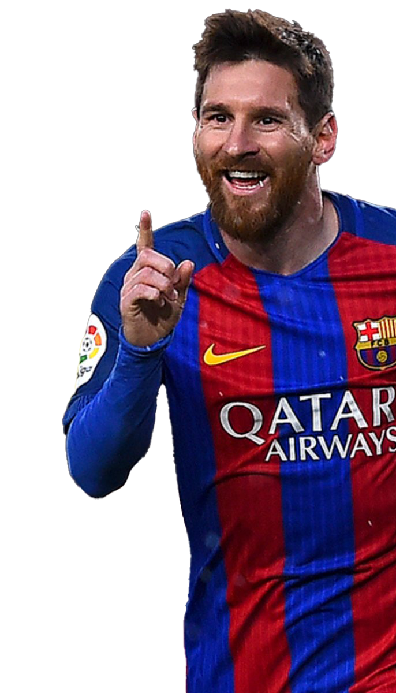
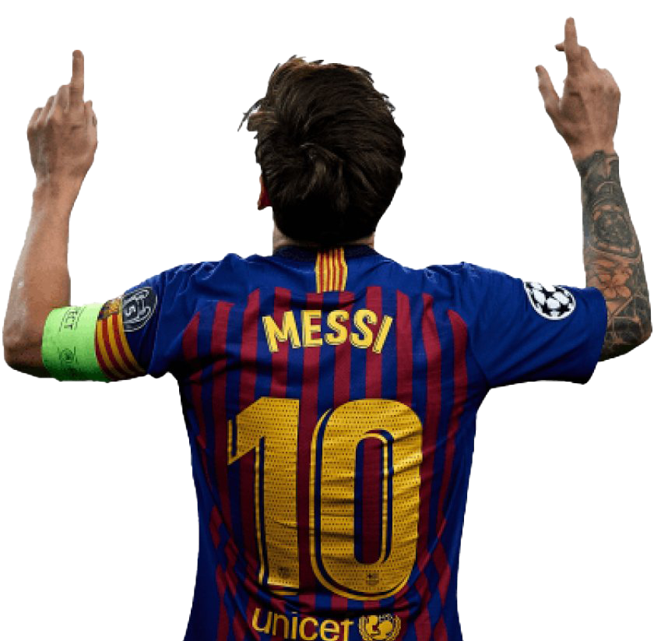
“It was God who made me play this way. He gave me my gift and the strength to use it. Without his help I would not be here today.” (Lionel Messi @ 2022 World Cup)
24th JUNE 1987
“I am thinking of my grandma and thanking Jesus because without him I would have nothing.” (Lionel Messi - goal celebration)
Notes:
I started this message with an important date relating to soccer. I want to close with another date – 24th June 1987. That’s the day that this soccer player was born – do you know who he is? Lionel Messi was born in a poor and dangerous part of Argentina and at the age of 5 his grandmother asked the coach of a local U6 team to let her grandson play. They were short one player, but the coach was concerned about how small he was. Eventually he let him play but told his grandmother, “I will put him on your side of the field so that you can get him off when he gets hurt. Well Lionel scored two goals that day and the rest is history. Last year Lionel Messi led his beloved Argentinian team to world Cup glory. In an interview after the game Lionel Messi paid tribute to God – not himself. Lionel also has a tattoo of Jesus on his right should. Despite all his fame, fortune and success Messi never takes his focus off Jesus – nor should we. On a day where we come to remember another great season of soccer it is good for us to thank Jesus for all he has done and will do for us. Let’s pray.

