Slide 1
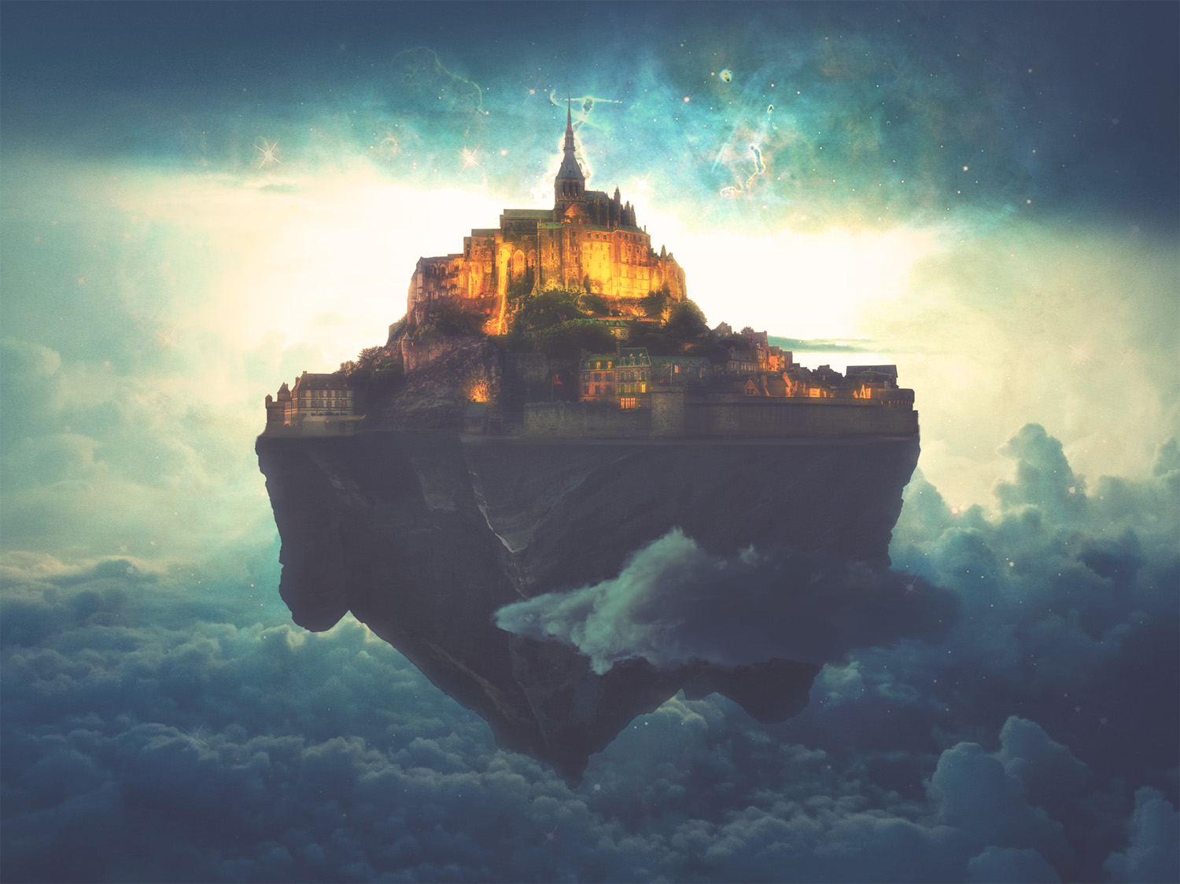
A BETTER HOME
Hebrews 11:1-22
Notes:
Good morning all. I hope you are all doing well
I must confess to you that the entirety of my message does not focus entirely on heaven, because there is only a handful of verses that actually deal with the idea of a better home in this passage
So, I will also be touching on 2 other sections of these 22 verses
ILLUSTRATION: There was once a man named D.L. Moody. Thousands came to faith in Christ through Moody’s meetings. As he approached the end of his life Moody wrote: - “Some day you will read in the papers that D.L. Moody of East Northfield, is dead. Don’t you believe a word of it! At that moment I shall be more alive than I am now; - I shall have gone up higher, that is all, out of this old clay tenement into a house that is immortal—a body that death cannot touch, that sin cannot taint; a body fashioned like unto His glorious body. I was born of the flesh in 1837. - I was born of the Spirit in 1856. That which is born of the flesh may die. That which is born of the Spirit will live forever.” - Every Christian that has invested their life in eternity can share that attitude toward Heaven and so it is my prayer for all of us in this building today, that we will leave today rejoicing in the Lord and with eyes that are fixated on our better home

Slide 2
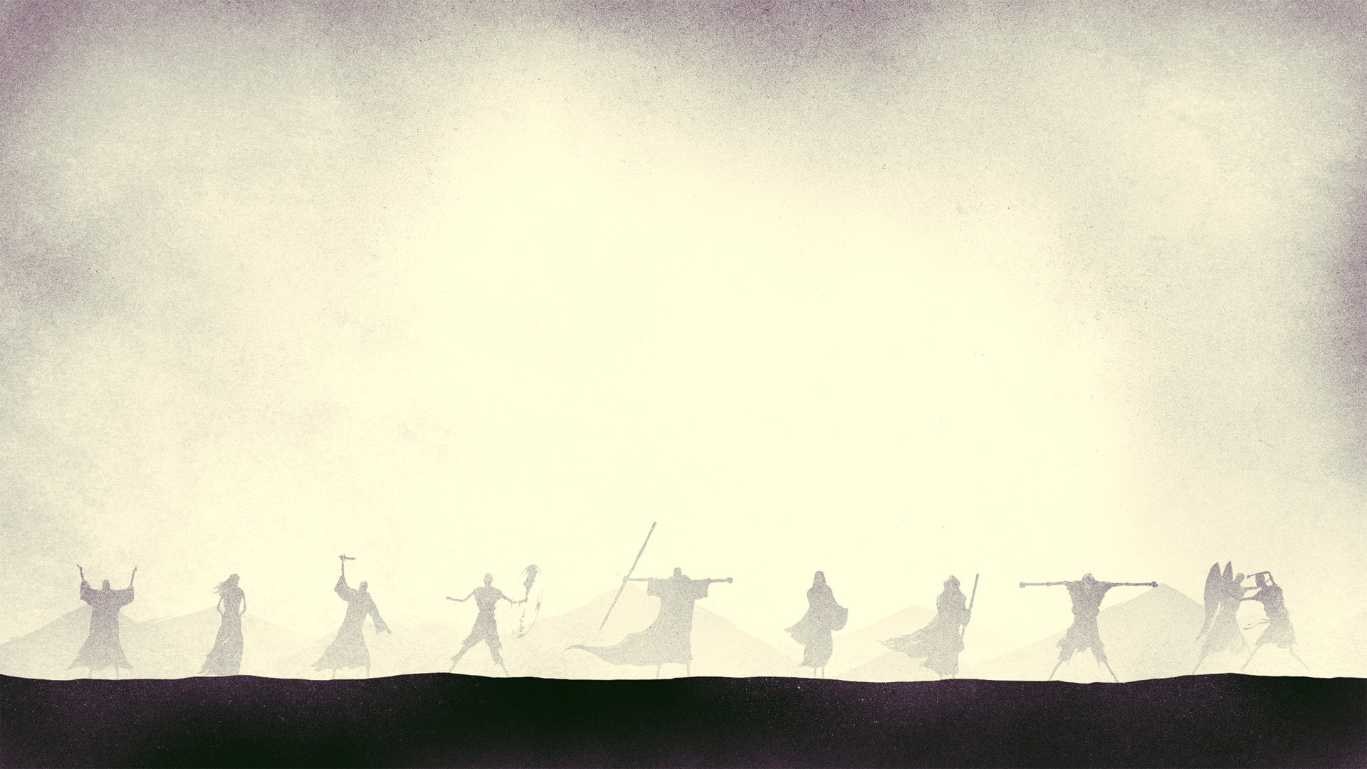
FAITH IS…
“Now faith is the assurance of things hoped for, the conviction of things not seen” (Heb 11:1)
Faith in a one-word definition = certitude
”For by it the people of old received their commendation” (Heb 11:2)
Notes:
“Now faith is the assurance of things hoped for, the conviction of things not seen” (Heb 11:1) - First, I did majority of my sermon prep and study in the ESV translation of the Bible so I decided to stick with that for the PowerPoint - Secondly, this verse is not an exhaustive definition of faith, or everything that faith encompasses in the Bible, so please don’t treat it as such, but it is definitely a really important aspect of faith that cannot be missed - Faith takes place when things are hoped for but not yet possessed - True faith is neither brainless nor a sentimental feeling. It is a solid conviction resting on God’s words that makes the future present and the invisible seen
Faith in a one-word definition = certitude - Faith means to be certain of something, to be confident of something - Faith is the confidence in those things that are not present to us but are promised in the Word of God - And it is only by faith that we receive a foretaste of what awaits us
“For by it the people of old received their commendation” (Heb 11:2) - To receive a commendation is to receive an award for very good performance - So the author of Hebrews is saying that only on the basis of faith will we hear those words on our final day “well done, good and faithful servant” - God’s commendation to anyone is only ever on the basis of faith, it is not one of many ways, but the only way to receive the blessings of God

Slide 3
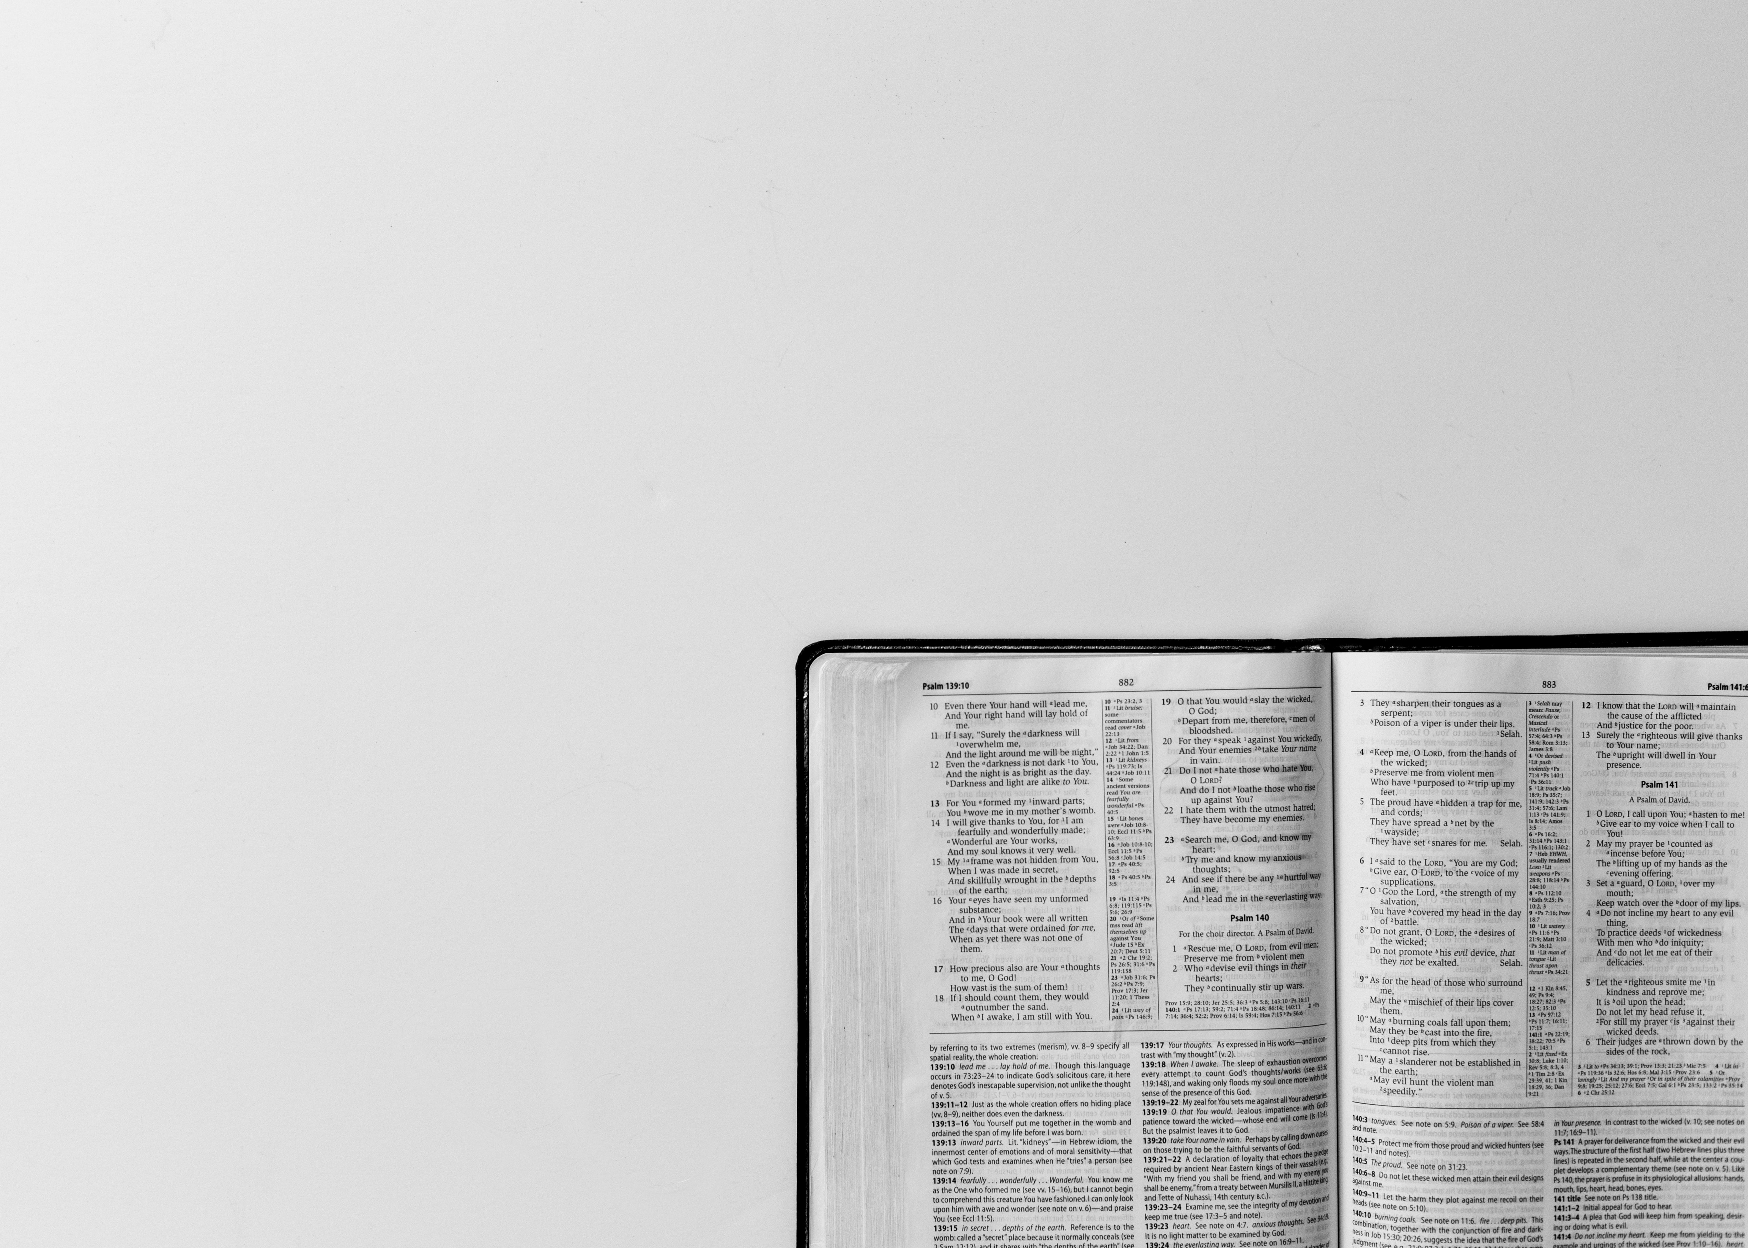
“By faith we understand that the universe was created by the word of God, so that what is seen was not made out of things that are visible” (Heb 11:3)
If God’s Word was capable of creating everything out of nothing, then surely that Word is a sufficient ground for our hope
“Faith is the root of a real Christians character. Let your root be right, and your fruit will soon abound. Your spiritual prosperity will always be according to your faith” – J.C. Ryle
Notes:
“By faith we understand that the universe was created by the word of God, so that what is seen was not made out of things that are visible” (Heb 11:3) - Faith is not just about future things, but about things of the past. Our very understanding and belief of creation rests in faith. - It rests in the fact that we have faith, that we are certain, confident, in the fact that by the very words of God our universe began to exist - We believe that the visible universe was not made out of equally visible raw material, it was called into being by divine power, by God Himself, who was and is, and is to come. - The universe was formed from nothing by the Word of God, who alone existed before creation
If God’s Word was capable of creating everything out of nothing, then surely that Word is sufficient grounds for our hope - If God’s Word has withstood the test of time, is one of the most historically reliable sources, in which it tells of the resurrection of Jesus Christ, which is one of the most historically reliable events from antiquity, then surely that same Word is sufficient grounds for our hope - Let me ask you a couple questions. Do you believe that the Bible is inspired by God, that it is breathed out by God? Do you believe that it is infallible, that it is wholly useful and true, completely trustworthy? - Do you believe that it is inerrant, that it is without error? That it is useful for equipping us for all things pertaining to godliness? For a lot of us, I think we can answer those questions with a resounding yes from our heads, and yet there would be a deafening silence from our hearts - That we know these things to be true, but we don’t live as though they are. We look no different from the world around us because we don’t let the Word of God go to war against our sin, we don’t let His Word infiltrate our hearts, and penetrate the deepest darkest corners of our souls and take our lives captive
“Faith is the root of a real Christians character. Let your root be right, and your fruit will soon abound. Your spiritual prosperity will always be according to your faith” – J.C. Ryle - If we get our root right our spiritual fruit will abound. - The world would have us believe that we ought to have faith in ourselves, that we should be confident in ourselves. - But in and of myself I am nothing but a wicked sinner, deserving nothing but to be cast into the pits of hell. There will be no good fruit if that is where I place all my hope, and all my confidence and all my faith

Slide 4
PERFECT SACRIFICE OF JESUS CHRIST
Our faith is based upon the finished, perfect and sufficient sacrifice of Jesus Christ
“But when Christ had offered for all time a single sacrifice for sins, he sat down at the right hand of God” (Heb 10:12)
Our faith can only rest in Christ alone
Notes:
Our faith is based upon the finished, perfect and sufficient sacrifice of Jesus Christ - This is the only thing that could ever please God, that could ever satisfy God’s wrath for my sin and your sin - What makes faith so powerful is the object of our faith, and if my faith is in who I am and what I have done, then there is no hope - But if I place my faith in the all-sufficient sacrifice of Jesus Christ, he takes my sin and gives me his righteousness and his perfection, and in him I have the guarantee of eternal life and my hope is not in vain
”But when Christ had offered for all time a single sacrifice for sins, he sat down at the right hand of God” (Heb 10:12) - Christ died once for all time, the just for the unjust, the righteous for the unrighteous, and he is now at the right hand of the Father, he sits because there is no more work to be done - Christ is there making intercession for all who believe. By the grace of God and by the blood of Jesus Christ I am no longer guilty but declared innocent, free to live a life that is pleasing to God - The gospel is that we are sinners in need of a Saviour. You and I are those sinners and Jesus Christ is that Saviour
Our faith can only rest in Christ alone - You can place faith in your own ability and in your own deeds, but God has said all have fallen short of His standard, we all need a Saviour - You can try and find another way to God, another path, but Jesus said “I am the way, the truth, and the life and no one comes to the Father except through me” - We are saved by grace alone, through faith alone, in Christ alone, as revealed by Scripture alone, to the glory of God alone. Our faith must rest in Christ alone

Slide 5
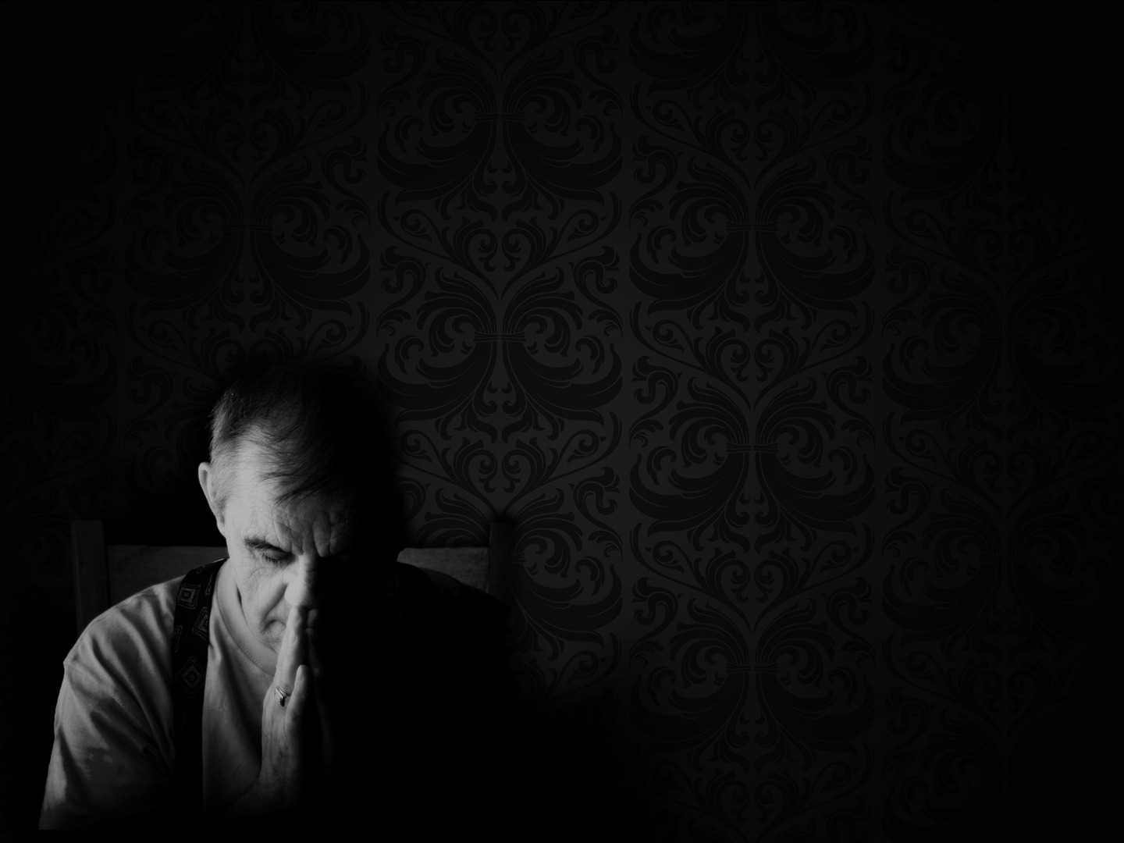
BY FAITH…
“And without faith it is impossible to please him” (Heb 11:6a)
Faith is not one way to please God but the only way
“for whoever would draw near to God must believe that he exists…” (Heb 11:6b)
Notes:
“And without faith it is impossible to please him” (Heb 11:6a) - In verse 5 in this chapter it had just been stated that Enoch had pleased God - That the God of the universe whose standard we all fall short of, Enoch was able to please Him, and that’s because Enoch’s faith was in God - If you choose not to place your faith in God than you will never please Him. Nothing you ever do will ever be good enough
Faith is not one way to please God but the only way - It was by faith that Abel offered to God a more acceptable sacrifice. It was by faith that Enoch was taken to be with God and never see death - It was by faith that Noah constructed an ark in obedience to God’s command. It was by faith that Abraham obeyed when called to go out to the promised land and it was by faith that Sarah received power to have her baby boy - The one thing they all have in common, is FAITH. All is meaningless and worthless apart from faith
“for whoever would draw near to God must believe that he exists…” (Heb 11:6b) - This is not saying that you simply must believe in the existence of a god, but believe in the existence of the God who once declared His will to the patriarchs through the prophets and in these last days has spoken in His Son - Belief in God involves 3 levels. The first level is that He exists. - Second level is belief in the God of the Old Testament as the God who exists; which is the Creator God in Genesis, He is the personal God who knit us together in our mother’s womb, and He is the miracle working God of the Old Testament who split the Red Sea, parted the Jordan River, brought down the walls of Jericho - The third level is belief in the God of the New Testament as revealed in Christ the Son. - So when it says we must believe God exists, it means we believe yes that He exists, but that God is all that He says He is and all that He reveals Himself to be in all of Scripture and in the person of Jesus Christ

Slide 6
“… and that he rewards those who seek him” (Heb 11:6c)
A life that pleases God begins with the certain recognition of God and His character
Those who put their trust in God receive a full reward, and that reward must belong not to this temporary world, but to the eternal world
Notes:
“… and that he rewards those who seek him” (Heb 11:6c) - We must believe and have faith in the fact that God is judge and the arbiter of our destiny and fortune - God will always recognise and reward faith in Him with salvation. - With faith we receive forgiveness, a new heart, eternal life, true joy, peace, love… everything - The reward desired by those who seek Him is the joy of finding Him, He himself proves to be our exceeding joy
A life that pleases God begins with the certain recognition of God and His character - A life that pleases God is always on the basis of faith in all that He says He is and all that He says He has done, is doing and is going to do - Nothing is so honouring and glorifying to God as a life of faith, in fact nothing honours Him BUT the life of faith - A life of faith is one of continued joyous fellowship with the Lord for the rest of our lives walking with Him for the rest of our days, and I can endure all that the world, all that Satan may throw at me because if I have God I have all that I need
Those who put their trust in God receive a full reward, and that reward must belong not to this temporary world, but to the eternal world - Our faith and hope and joy are not in things of this world but in our eternal life spent with God - Paul says in Philippians 3:13 – “But one thing I do: forgetting what lies behind and straining forward to what lies ahead, I press on toward the goal for the prize of the upward call of God in Christ Jesus - We persevere in faith, we press on in faith, to achieve our reward which is Christ Jesus himself.

Slide 7
FAITH IN A BETTER HOME
“These all died in faith, not having received the things promised, but having seen them and greeted them from afar” (Heb 11:13a)
“And having acknowledged that they were strangers and exiles on the earth” (Heb 11:13b)
”This world is our passage, not our portion” – Matthew Henry
Notes:
“These all died in faith, not having received the things promised, but having seen them and greeted them from afar” (Heb 11:13a) - The first thing I want us to see here is that true saving faith perseveres unto death. Those who live by faith will die in faith - The second thing to notice is that faith allows us to see the unseen, to peer into eternity. - In John 8:56 Jesus is talking to the Pharisees about Abraham and says this, “Your father Abraham rejoiced that he would see my day. He saw it and was glad”. Obviously being a bit confused about this they asked how it was possible for Jesus to have seen Abraham and Jesus’ response was that ”before Abraham was, I am” - Abraham greeted the promises from afar. He never saw them with his physical eyes but with spiritual eyes as he looked by faith to the promises of God, he saw it in the revealed Word of God - Faith takes a long look into the future and sees what God has promised and believes and lives by it
“And having acknowledged that they were strangers and exiles on the earth” (Heb 11:13b) - Other translations say that they were aliens. But you get the gist of it, these men and women are acknowledging that this world is not their home, that they walk around as foreigners - The word for strangers in Greek literally translates to ‘Their home was elsewhere’ - Strangers are always outsiders, they never fit-in, they are avoided by people around them.
“This world is our passage, not our portion” – Matthew Henry - This world is not your home. This world is the path that we must take to enter heaven, to enter the inheritance that has been given to all who believe in Jesus Christ - We are pilgrims, and a true pilgrim carries nothing but that which is necessary for their journey. - We live our lives not storing up treasures here where moth and rust destroys, but in heaven where moth and rust can’t destroy and where thieves cannot break in and steal. For where you treasure is there your heart will be also - Because by the power of God at work in all who place their faith in Christ, you have been born-again. And because you have been born-again you will not fit into a once-born world

Slide 8
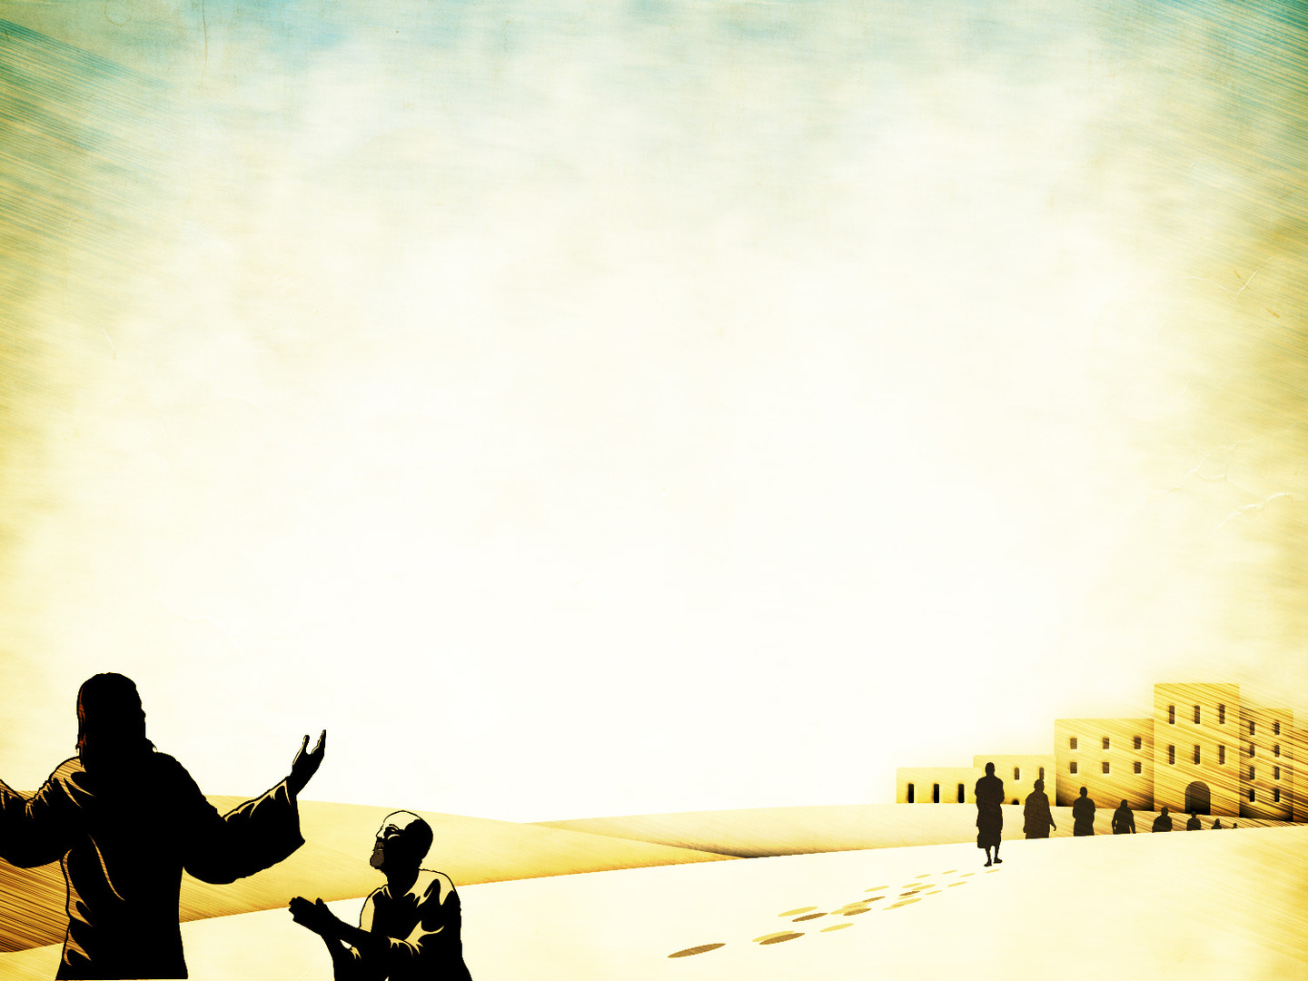
“For people who speak thus make it clear that they are seeking a homeland” (Heb 11:14)
“Therefore God is not ashamed to be called their God, for he has prepared for them a city” (Heb 11:16b)
Those who place their faith in Christ are those whom God receives
Notes:
“For people who speak thus make it clear that they are seeking a homeland” (Heb 11:14) - Christians, we are increasingly to think of ourselves in terms of where we are heading, in terms of Him who calls us and those with whom we will spend eternity in heaven with - Would you turn with me to Revelation 21:18-27 – Amen. Come Lord Jesus - That’s the glory that awaits all who have faith. And we therefore echo the words of Jonathan Edwards, and pray that we would “Stamp eternity upon our eyes”.
“Therefore God is not ashamed to be called their God, for he has prepared for them a city” (Heb 11:16b) - One of the more common phrases in the Bible is that God refers to Himself as the God of Abraham, Isaac and Jacob - Abraham and his sons were willing to be called men of God and live as men of God, not men of the world, and therefore God was not ashamed to be called their God - And the same is true for everyone in this room who has faith in Jesus Christ and He has prepared for us a city in which we will dwell with Him forever
Those who place their faith in Christ are those whom God receives - Faith is the only way to draw near to God, it is the only ticket for entrance into this better home - There is a cost, you will be a stranger and an exile in this world, you will be scorned, mocked, rejected, disappointed, but it is worth while for the glory of God and to one day dwell in His glory in a better home -Charles Spurgeon once put it like this - "The grave—what is it? It is the bath in which the Christian puts on the clothes of his body to have them washed and cleansed. Death—what is it? It is the waiting room where we robe ourselves for immortality; it is the place where the body bathes itself in spices that it may be fit for the embrace of its Lord. Death is the gate of life; I will not fear to die, then." - If you know Jesus Christ as Lord and Saviour you need not fear death, but if you don’t then the opposite is true, this world is all you got and a place of eternal torment awaits you upon death, called hell

Slide 9
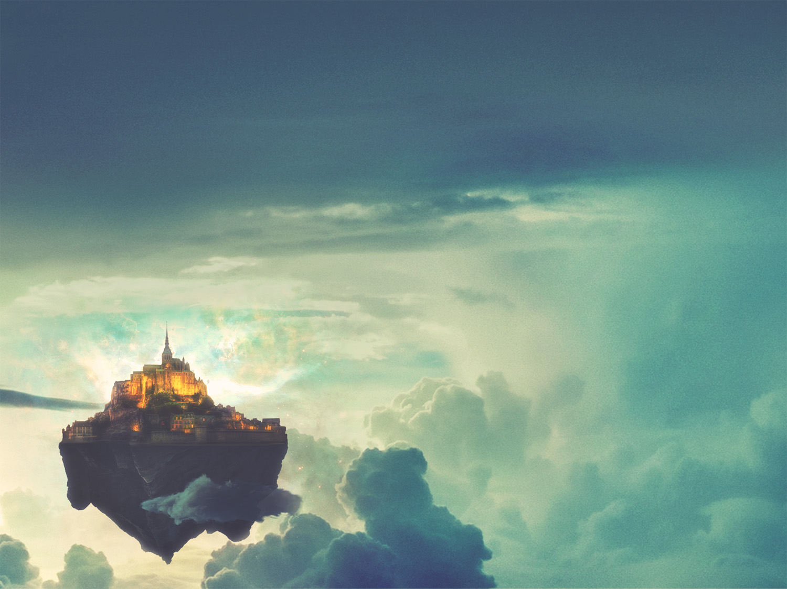
SUMMARY
Faith is the assurance of things hoped for. We can be certain because of the object of our faith… God
It is only by faith in the all-sufficient sacrifice of Jesus Christ, that we can ever please God and receive the reward of Christ Jesus himself
We are pilgrims, strangers, exiles in this world, so we look to a better home, a heavenly home
Notes:
Faith is the assurance of things hoped for. We can be certain because of the object of our faith… God - We hope for Christ’s return, we hope for the resurrection, we hope for the day we receive our new immortal bodies, we hope to reign with God - Our hope will not return void because our faith is in God, and God is always faithful and always true to His Word
It is only by faith in the all-sufficient sacrifice of Jesus Christ, that we can ever please God and receive the reward of Christ Jesus Himself - This is perhaps all sounding a little daunting, perhaps a little hard, perhaps you may not feel strong enough - But you see the gospel message is not that you must be strong, but you must grow in weakness. - God wants weak men and women, for in our weakness God’s grace is made perfect, and in our weakness we can do nothing but declare ‘yet not I but through Christ in me’, God gets the glory - As we grow in godliness, we don’t become more autonomous, more independent, but rather more dependent upon the grace of God and we find ourselves evermore before the cross which saved us. - Because the same gospel that saved us, is the same gospel that sanctifies us, that conforms us to the image of Jesus Christ. Weakness is the secret to godliness
We are pilgrims, strangers, exiles in this world, so we look to a better home, a heavenly home - Christians whose faith does not extend to heaven will have their eyes on the things of this world and will wonder why they are not happier in the Lord - We must look forward, straining towards the prize that awaits. Look to the second coming of Jesus. God promises a heavenly city, a heavenly kingdom and we are guaranteed this city in Christ

Slide 10
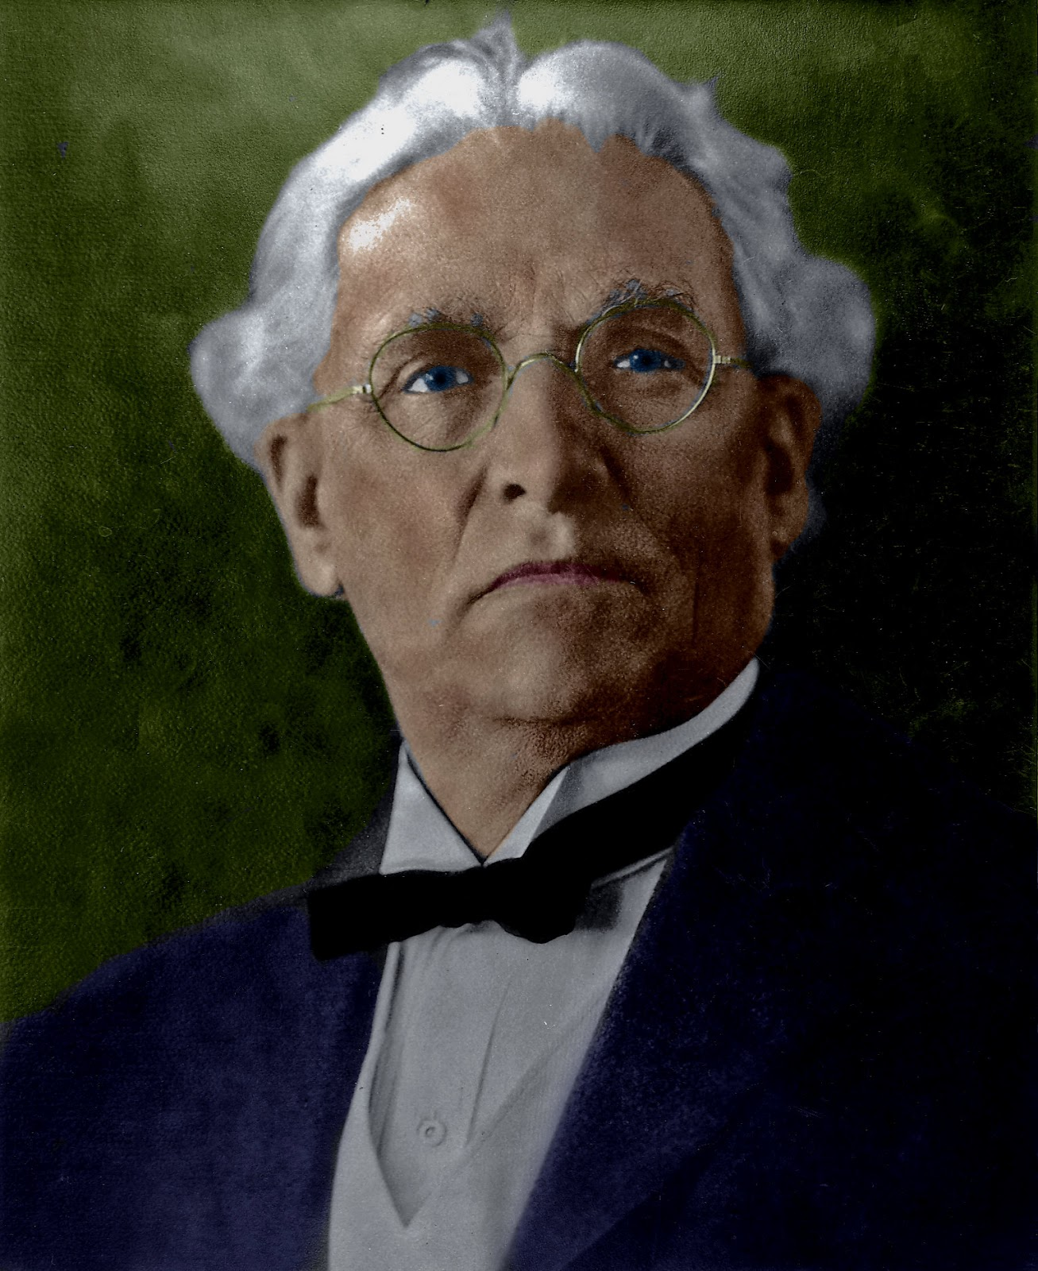
“Henry, you have forgotten something, you’re not home yet!”
Notes:
Henry C. Morrison was a great missionary who served the Lord in Africa for over 40 years. On the way back to United States, he began to wonder “will anyone remember us? Will anyone recall who we are? Will anyone meet us at the boat?”
Well, unknown to Henry Morrison and his wife, Teddy Roosevelt, President of U.S., was also on board that ship. He had gone to Africa for a hunting trip
When the ship pulled into New York harbour he looked to see if anyone had come to welcome them back home. Thousands of people were there cheering. Bands were playing. There were signs, banners, and billboards everywhere saying, “Welcome Home”.
Henry and his wife were so excited about the crowds of people that were there to welcome them home and they went down to get their luggage, came back to the deck of the ship to get off and they realised that the parade of people were already gone. They had come to welcome Teddy Roosevelt.
Henry Morrison went to his hotel room with a heavy heart. As he sat there on the bed, he asked his wife, “Honey, I just don’t get it...for 40 years we poured our lives into ministry and service. And yet we come back to America and not a single soul comes to welcome us home!”
His wife came and sat down next to her husband, she put her hand on his shoulder, and comforted him with words that he would never forget, “Henry, you have forgotten something, you’re not home yet!”
Brothers and sisters in Christ, push through the trials and temptations of this world, don’t give into this world and don’t grow weary of doing the will of God and bringing Him glory, YOU’RE NOT HOME YET!
Let’s pray

