Slide 1
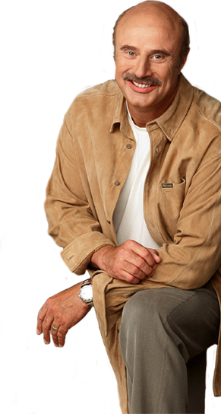
“It’s so much easier to tell people what they want to hear, instead of what they need to hear.” (Dr Phil McGraw)
“And let us run with endurance the race God has set before us.” (Hebrews 12:1)
Race (agon) = contention, strife, peril and toil = no fun run.
A BETTER FOCUS
(Hebrews 12:1-13)
FOUR THINGS EVERY RUNNER NEEDS TO LOOK AT.
Notes:
Dr Phil once said its easier to tell people what they want to hear… As a pastor and shepherd there are a number of things I would like to tell you but I can’t. The reason I can’t is because of my commitment to the truth of and authority of scripture. I would love to tell you that you don’t need to pray for your unsaved family members because hell doesn’t exist, but I can’t. I would love to tell you that God is love and as long as you love others He is OK with everything else. But I can’t. I would love to tell that if you become a Christian that you don’t ever have to worry about pain and suffering and hardship anymore, but I can’t. The author of Hebrews was writing to Christians who were going through tough times and in chapter 12 he is telling them that its not unusual that they are doing it tough and that they should expect suffering and hardship because the Christian life is a tough race - an ultra marathon that requires perseverance toughness. The word for race is agon, from which we get agony. It is a difficult and demanding race. If we are to run this race there are four things we need to focus on – four things to look at in order to help us run the race and finish well, This is no fun run.

Slide 2
1. THE FANS CHEERING YOU ON – “Therefore, since we are surrounded by such a huge crowd of witnesses to the life of faith…” (vs 1a).
2. FREEING YOURSELF FROM ENTANGLMENTS – “Let us strip off every weight that slows us down, especially the sin that so easily trips us up. And let us run with endurance the race God has set before us.” (vs 1b)
3. THE CHAMPION OF OUR FAITH – “We do this by keeping our eyes on Jesus, the champion who initiates and perfects our faith. Because of the joy awaiting him, he endured the cross, disregarding its shame. Now he is seated in the place of honour beside God’s throne.” (vs 2)
Notes:
THE FANS – Therefore = the heroes of faith in chapter 11, the famous, the unnamed, the men , the women, the old, the young, the ones who did great things for God, the ones who suffered for God. Not referring to those who are watching in the stands but those who have stadiums named after them – at SCG = Bradman, Churchill, Trumper, Messenger. At Tennis in Melbourne – Rod Laver and Margaret Court. Those who have gone before and run the same race. You wear the same uniform – when you think you can’t finish, can’t push past the pain, not good enough – think of them.
THE ENTANGLEMENTS – be intentional about getting rid of anything that will slow you down. Every weight is not necessarily things that are sinful = things, relationships, career, TV, fear, anxiety, the unknown, the unlikely, the uncontrollable, religion (trying to earn your salvation)… The sin refers to a besting sin, the biggest sin in our life (we all tend to have one). Don’t justify it (we can do because this is our favourite sin, most used to it, and are desensitised to it). We can delude ourselves into thinking we can deal with it.
EYES ON JESUS – Don’t get distracted. Our salvation, power, endurance and prize all come from Him. Can’t do it on our own. He has won – victory is guaranteed. Only through his power did heroes of faith do what they did – same with us. At the 1954 Commonwealth Games in Vancouver there was the miracle mile - Roger Bannister vs John Landy and Landy lost because he looked to the side right near the finish line.

Slide 3
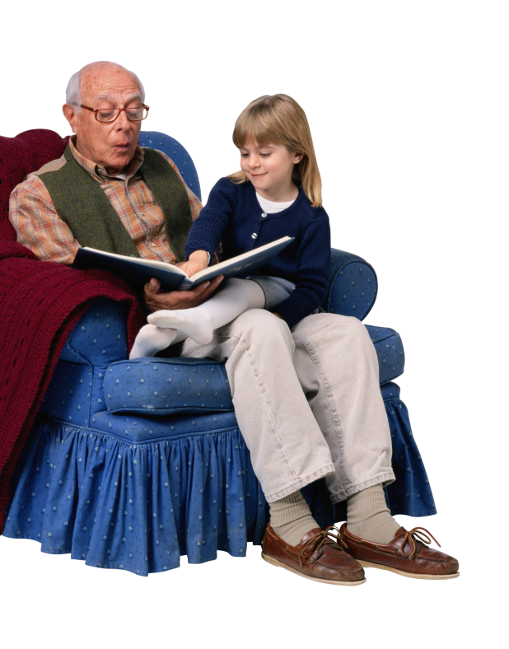
4. GOD’S ‘FATHERLY’ DISCIPLINE (verses 4-13)
“We often don’t want God to be a father in heaven, but rather a grandfather in heaven.” (C.S Lewis) = Why would God let me go through pain and suffering?
“When a grandparent enters the door, discipline flies out the window.” – Ogden Nash
“A loving parent uses discipline to get their child’s attention, to train them and to help them solve a problem.” (L.R Knost)
God is our Father who accepts us as we are. But He loves us too much to leave us where we are = He disciplines us (3 reasons).
Notes:
I get what C.S Lewis is saying. For many Christians we can tend to say that if God really loved me then why wouldn’t he take away all my pain and suffering? Why doesn’t he give me all I ask for? Why does he allow me to lose my job, get that diagnosis, go through a divorce… Why does he let those thing happen to me? As a grandfather I know my grandkids get away with a lot more when I am with them. As Pa I am more concerned about fun, than discipline. I am there to make them happy and have fun. Ogden Nash (US poet) said it well. But discipline is important and US author L.R Knost put it well. God is our Father not grandfather – he loves us even when he disciplines us. Bible tells us He does this for three reasons. Now we might ask which one is God doing in my life now? Doesn’t matter, because we can trust in our loving and good God because he knows what we need.

Slide 4
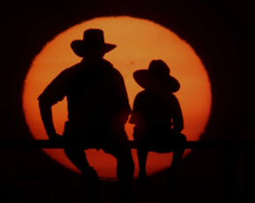
a) To punish us – “Why, then, have you despised the word of the Lord and done this horrible deed? For you have murdered Uriah the Hittite… and stolen his wife. Because of what you have done, I will cause your own household to rebel against you.. and your child will die.” (2 Samuel 12:9-11)
b) To protect us – “… I received wonderful revelations from God. So, to keep me from becoming proud, I was given a thorn in my flesh, a messenger from Satan to torment me and keep me from becoming proud. Three different times I begged the Lord to take it away. Each time he said, “My grace is all you need. My power works best in weakness.” So now I am glad to boast about my weaknesses, so that the power of Christ can work through me.” (2 Corinthians 12:7-9)
Notes:
God disciplines us to punish us for something we have done (sin). Not all suffering is punishment for sin. Blind man that Jesus healed is a classic example – blind to show Jesus’ power. A classic example is with David. He was called a man after God’s heart but he still needed discipline when he disobeyed God. After that sin, his household was never the same again – filled with death, heartache and brokenness.
God also uses discipline (pain and suffering) to stop us from doing something wrong – from sinning. See this with Paul. God was using and blessing him in so many ways that he sent him a thorn in the flesh – something to keep him from the sin of pride, arrogance and self reliance.

Slide 5
c) To purify us – to train, educate, equip and grow us in order to bring us to where He wants us to be.
“God whispers to us in our pleasures, speaks to us in our conscience, but he shouts to us in our pain. It is his megaphone to rouse a deaf and doubting world.” (C.S Lewis)
“As I look back on my life, I realise that the one thing that really taught me most about life was not success or happiness, but suffering and affliction. Adversity is a great tool in the hands of God. He uses it to grow us and draw us closer to Him.”
(Malcolm Muggeridge)
Let’s look deeper into God’s purifying discipline.
Notes:
To purify us – the one he most often uses and which is what this passage is referring to. God’s goal (the goal of any loving parent) is to train and strengthen us – to grow and equip us. Malcolm Muggeridge – English journalist and satirist.

Slide 6
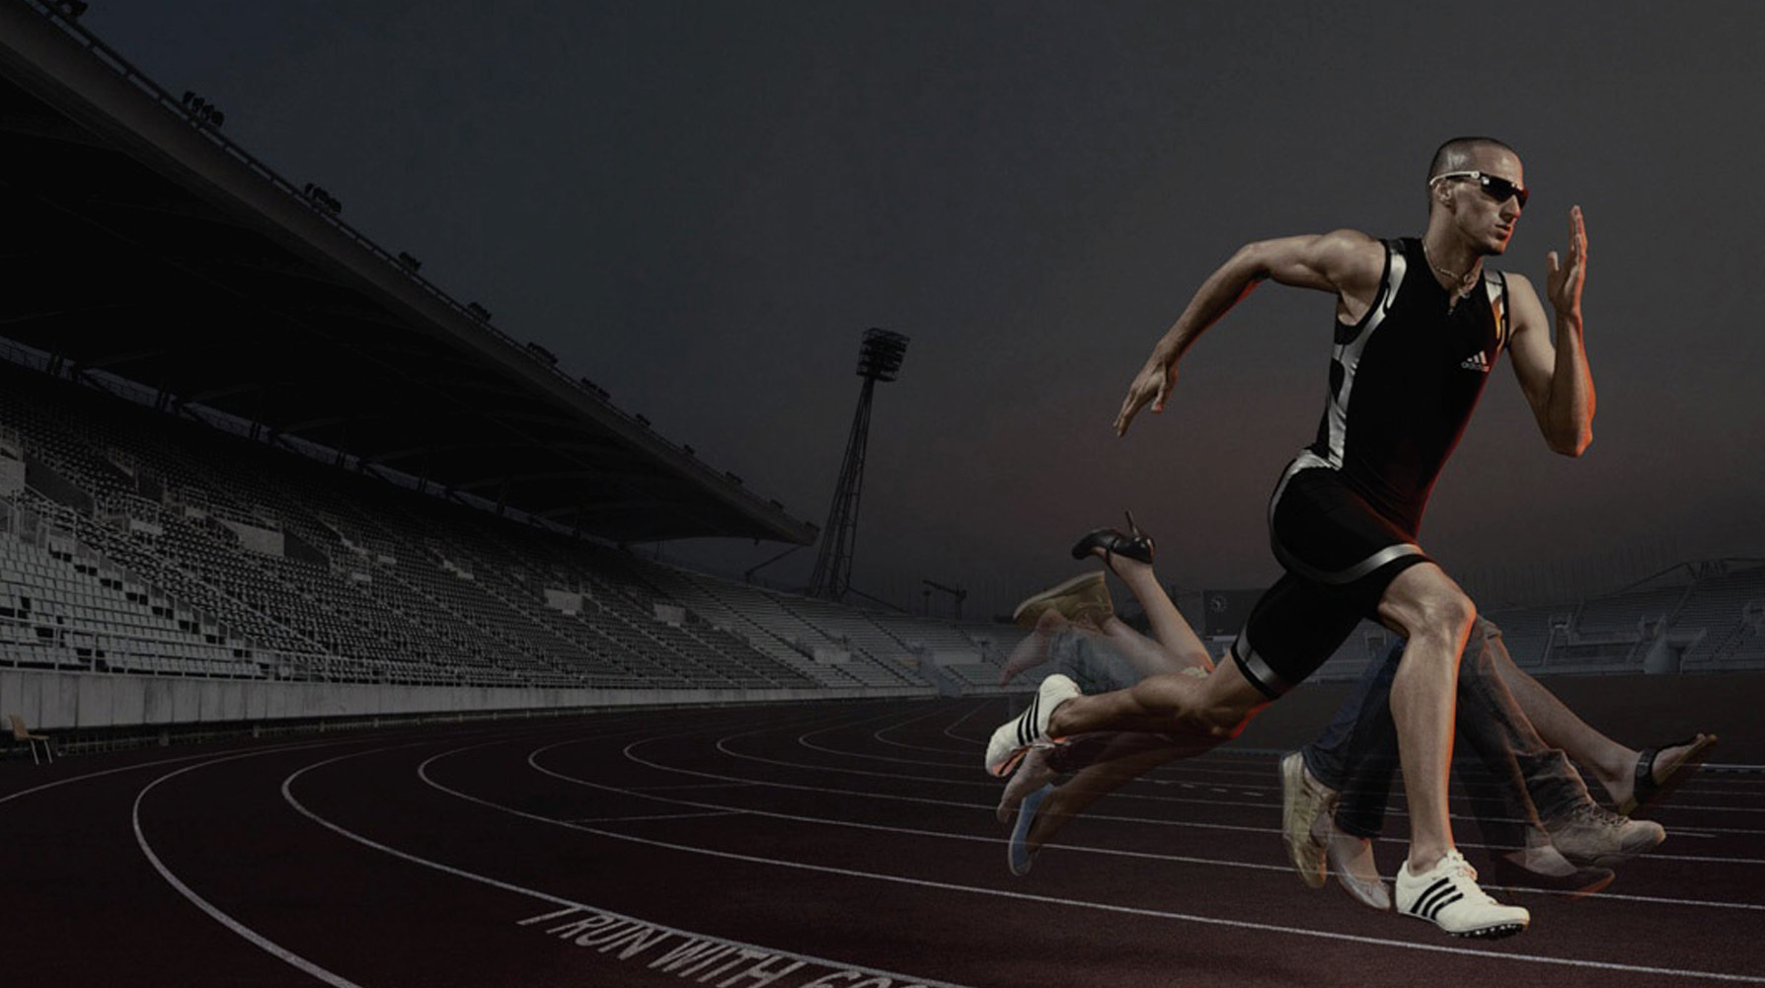
The REALITY of His discipline = “For the Lord disciplines those he loves, and he punishes each one he accepts as his child. As you endure this divine discipline, remember that God is treating you as his own children. Who ever heard of a child who is never disciplined by its father? If God doesn’t discipline you as he does all of his children, it means that you are illegitimate and are not really his children at all.” (vs 6-8)
All of humanity are destined to receive his punishment, but only His children receive His discipline = you are loved.
“No discipline is enjoyable while it is happening - it’s painful! But afterward there will be a peaceful harvest of right living for those who are trained in this way.” (v11)
Notes:
The reality of His discipline = its ironic that the very thing over which we question God’s love is the very thing that proves it. There are many ways to know you are a Christian (joy of the Lord, the Holy Spirit lives within you) but one of them is the presence of discipline is in your life – you are facing adversity. Opposite is true – no adversity = not a child of God. Rejoice in fact that it proves you belong to God. Not saying that its not painful. Its never easy to appreciate discipline at the point of impact BUT AFTERWARDS = blessing will always come. God’s discipline always has a good purpose (He is not a vindictive God who gets pleasure out of our suffering.)

Slide 7
Our REACTION to His discipline – “And have you forgotten the encouraging words God spoke to you as his children? He said,
“My child, don’t make light of the Lord’s discipline, and don’t give up when he corrects you.” (v5)
Don’t be indifferent to it – it has a divine, loving, perfect purpose. “And we know that God causes everything to work together for the good of those who love God and are called according to his purpose for them.” (Romans 8:28) = transformation, building up.
Don’t be intimidated by it – don’t get discouraged, overwhelmed or disillusioned. “Why am I discouraged? Why is my heart so sad? I will put my hope in God!” (Psalm 42:11)
Evidence of his presence in your life. Trust Him & be instructed!
Notes:
Our reaction – we need to respond in the right way to God’s discipline. Firstly, don’t be indifferent – don’t dismiss it and think its not important. God is doing it for a reason. He is looking to build us up, not tear us down. To equip us not see us get disqualified. He is looking to transform us - not leave us where we are at. Don’t be intimidated by it and quit. Psalmist was going through this (easy to do in times of trial) and identified the danger of it. His remedy was to put his hope in the goodness, mercy, power and purposes of God – which are all perfect. Remember that his discipline is the evidence of his presence in your life – he has not abandoned you (even though Satan tries to convince you of that lie). Not saying it won’t hurt – but it will transform. Trust him and be instructed.

Slide 8
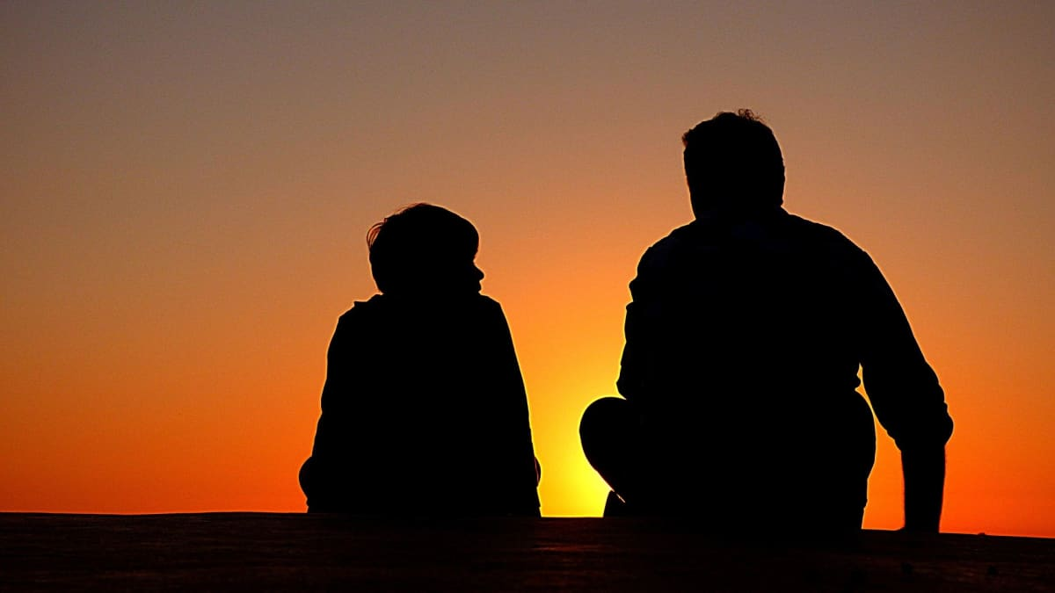
The RATIONALE for His discipline – “Since we respected our earthly fathers who disciplined us, shouldn’t we submit even more to the discipline of the Father of our spirits…? For our earthly fathers disciplined us for a few years, doing the best they knew how. But God’s discipline is always good for us..” (vs 9-10)
“Poor parenting is having a serious impact on our children and on our society. We need parents to be intentional in disciplining their children.” (American Academy Of Pediatrics)
We expect earthly fathers to discipline so should expect our heavenly Father to do it.
Earthly discipline is flawed. God’s discipline is perfect in firmness, fairness, purpose….
Notes:
Rationale = if we thinks it good and right for earthly fathers to discipline their children, then how can we question our heavenly Father doing the same for us spiritually. I grew up in a home where I was disciplined – I knew there were boundaries put in place and when I crossed those lines I was quickly reminded not to do it again. As we grew older most of us looked back and respected the discipline our parents gave us – appreciative of how they helped to shape us and help us be who we are. If we do that with earthly fathers we should do it with God – even more so. Continuing the comparison between human and heavenly discipline writer makes it clear that God’s discipline is far superior. As human parents we do the best we can – but we are guilty of under discipline, over discipline, failing to discipline, wrong time, wrong child, wrong way, wrong motive etc. But God’s discipline is perfect.

Slide 9
The RESULTS of His discipline – “But God’s discipline is always good for us, so that we might share in his holiness. No discipline is enjoyable while it is happening - it’s painful! But afterward there will be a peaceful harvest of right living for those who are trained in this way.” (vs10-11)
Holiness – the most important goal God has for us (1 Thess 4:7) = to become more like Christ (Rom 8:29).
Righteousness – living a life that honours God & blesses others.
Peace – the absence of anxiety, the reality of the joy of the Lord and a sense that all is right.
Learning to trust and treasure God comes through His ‘training’ - not just Bible reading, prayer, church …

Slide 10
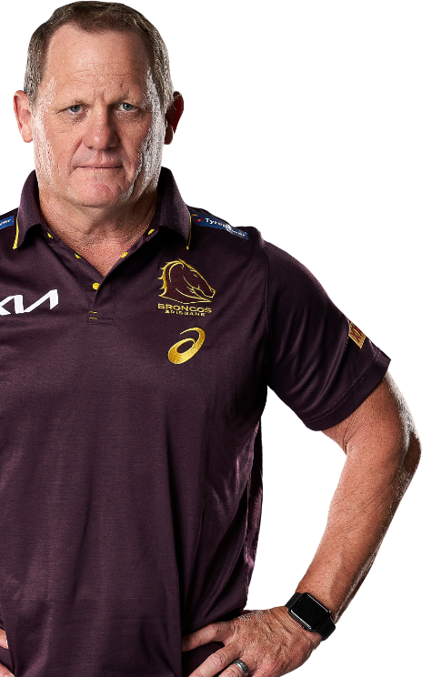
“I remember when dad just ripped the bandaid off and told me that he’s not going to make it easy for me. I had to play at dummy half and focus on my tackling and kicking. It was tough to hear, but I knew he wanted the best for me, and he promised he would be with me all the way.” (Billy Walters)
“I always knew he had this level of football in him. It just required some tough love to convince Billy that he could actually go and do it.” (Kevin Walters)
“The job of a good coach is to push his players to do what they don’t want to do, in order to help them be what they always wanted to be.” (Tom Landry – NFL coaching legend)
Notes:
Kevin Walters (coach of the Broncos) knew that signing his son Billy would leave him open to criticism. But he never gave Billy an easy ride. Billy had played at Melbourne Storm and Wests Tigers but had struggled to cement a position in 1st grade in NRL. His father knew that he could make it but he also knew that Billy would need tough love – would need discipline to make it. He told him he had to forget about playing in his preferred position in the halves – sees him more as a hooker. Same with God. He loves us but knows he needs to stretch and grow us – best way to do that is through tough love. If Billy wanted to make it he had to persevere and work hard.

Slide 11
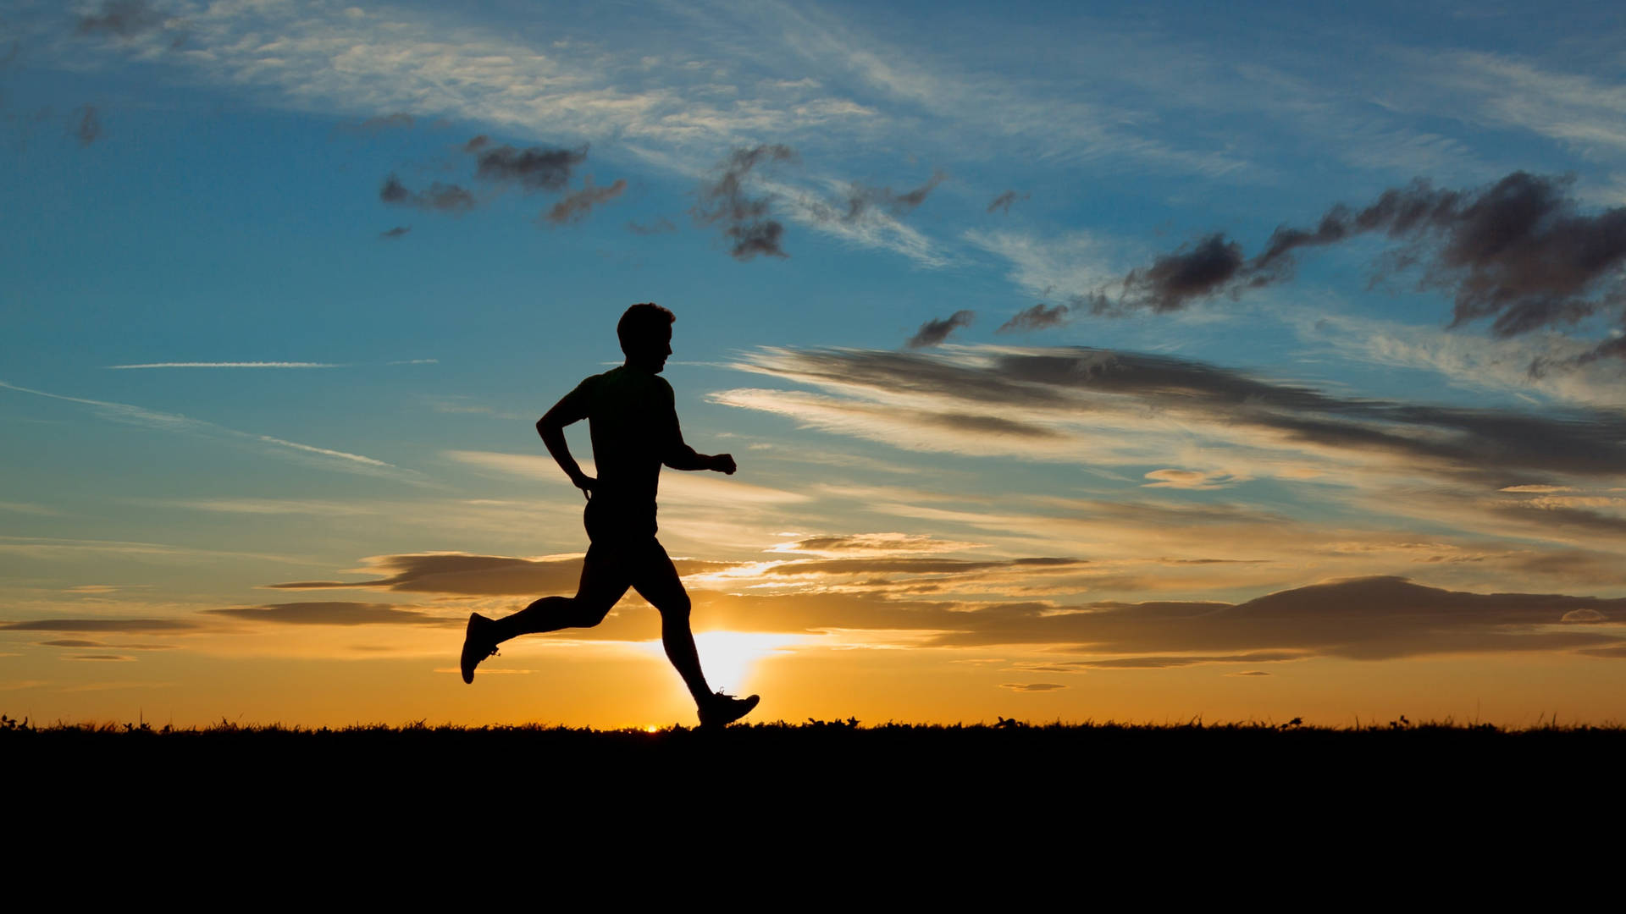
God will never discipline (train & grow) us & abandon us.
To Moses – “I will be with you.” (Ex 3:12)
To Joshua – “I will not fail you or abandon you.” (Joshua 1:5)
To Israel – “When you go through deep waters, I will be with you.” (Isa 42:2)
To Jeremiah – “For I will be with you and will protect you.” (Jeremiah 1:8)
To Shadrach, Meschach & Abednego – he went into the furnace with them (Daniel 3:25).
To Paul - “Don’t be afraid! Don’t be silent! For I am with you, and no one will attack and harm you.” (Acts 18:9-10)

Slide 12
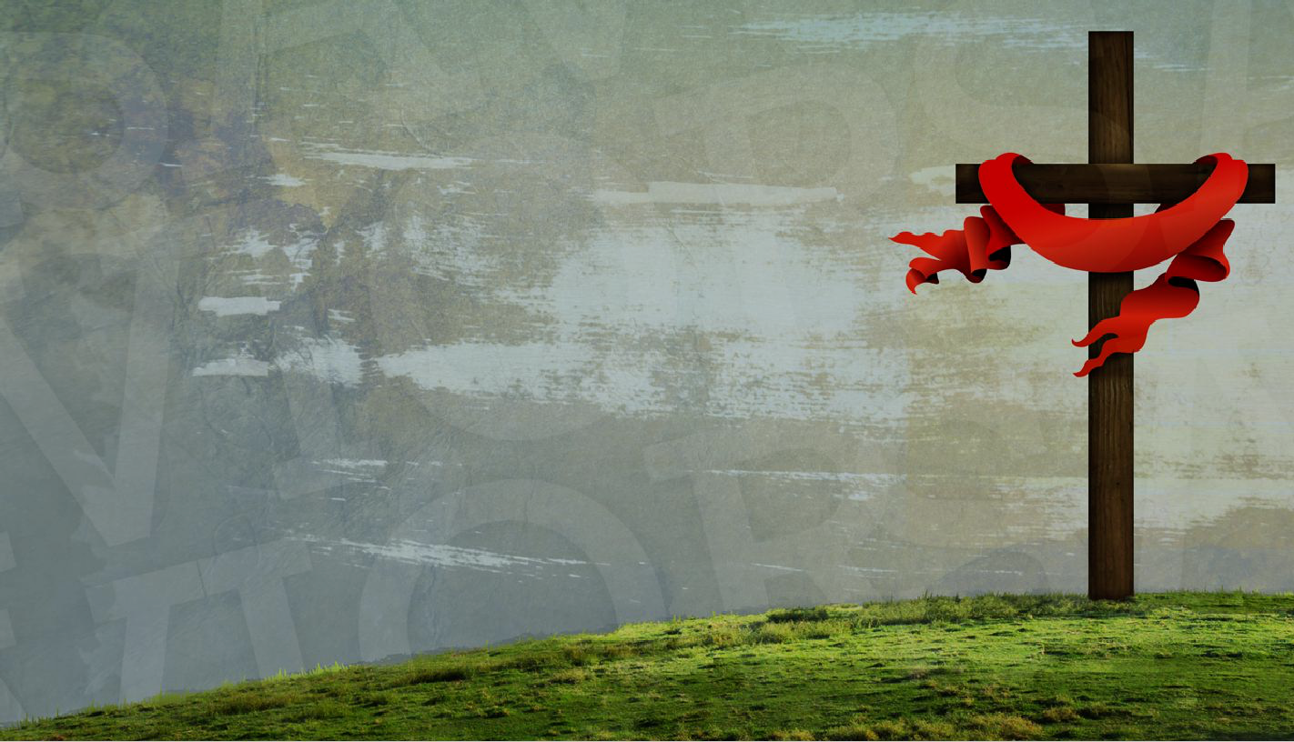
“God doesn’t promise to keep us out of the furnace, but he does promise to go into the furnace with us.” (David Jeremiah)
If God is with you, you have all you need – strength, truth, hope, peace, power & victory.
“So take a new grip with your tired hands & strengthen your weak knees.” (v12) = I know it’s tough, but don’t quit.
“Mark out a straight path for your feet so that those who are weak and lame will not fall but become strong.” (v13)= Stay in your lane and lean on Christ! Don’t divert from the track & head towards wickedness.

