Slide 1
LOVE YOUR
ENEMIES
Luke 6:20-36

Slide 2
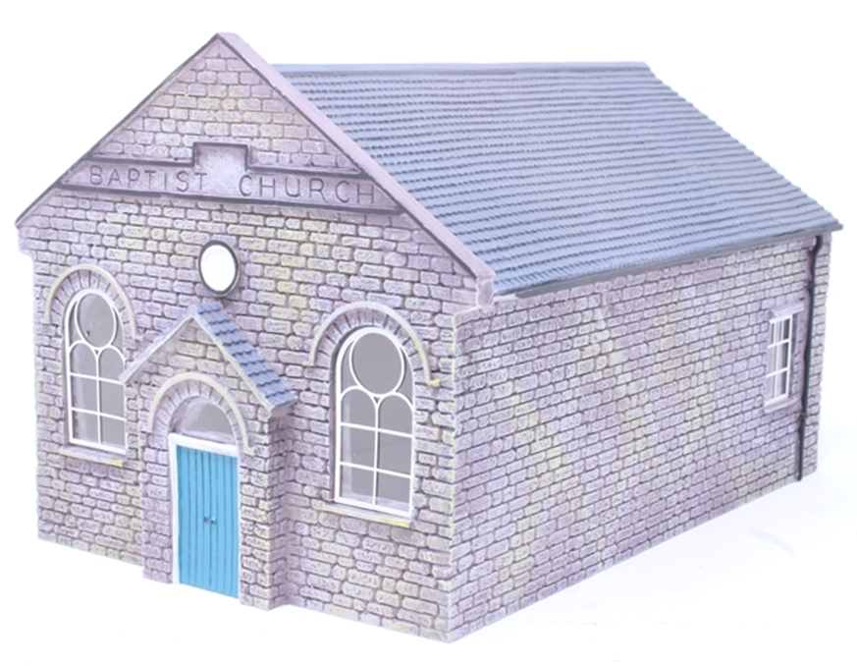
‘If we think we have God totally figured out then we have created an idol.’ Glynn Cardy
Baptist Box
Romans 9:20, 21
²⁰ But who are you, a human being, to talk back to God? “Shall what is formed say to the one who formed it, ‘
Why did you make me like this?’” ²¹ Does not the potter have the right to make out of the same lump of clay some pottery for special purposes and some for common use?

Slide 3
Pope John Paul 2nd
Yasir Arafat
Uday and Qusay Hussein
Grand Ayatollah of Baghdad
Israel’s Chief Rabbis
Lord George Carey

Slide 4
Interview by Mary Wakefield
‘It’s not that he’s perfect, but that he’s guileless. He’s pure of heart in the way few people over five ever are. It makes sense that he’s spent two decades as a peace-maker, negotiating with tyrants and psychopaths, because he’s utterly disarming.’

Slide 5
How on earth do you reconcile factions who think each other literally Satanic?
‘You listen to their stories,
‘You get to know each person
and love them.

Slide 6
St George’s - Baghdad
Alexandria Declaration

Slide 7
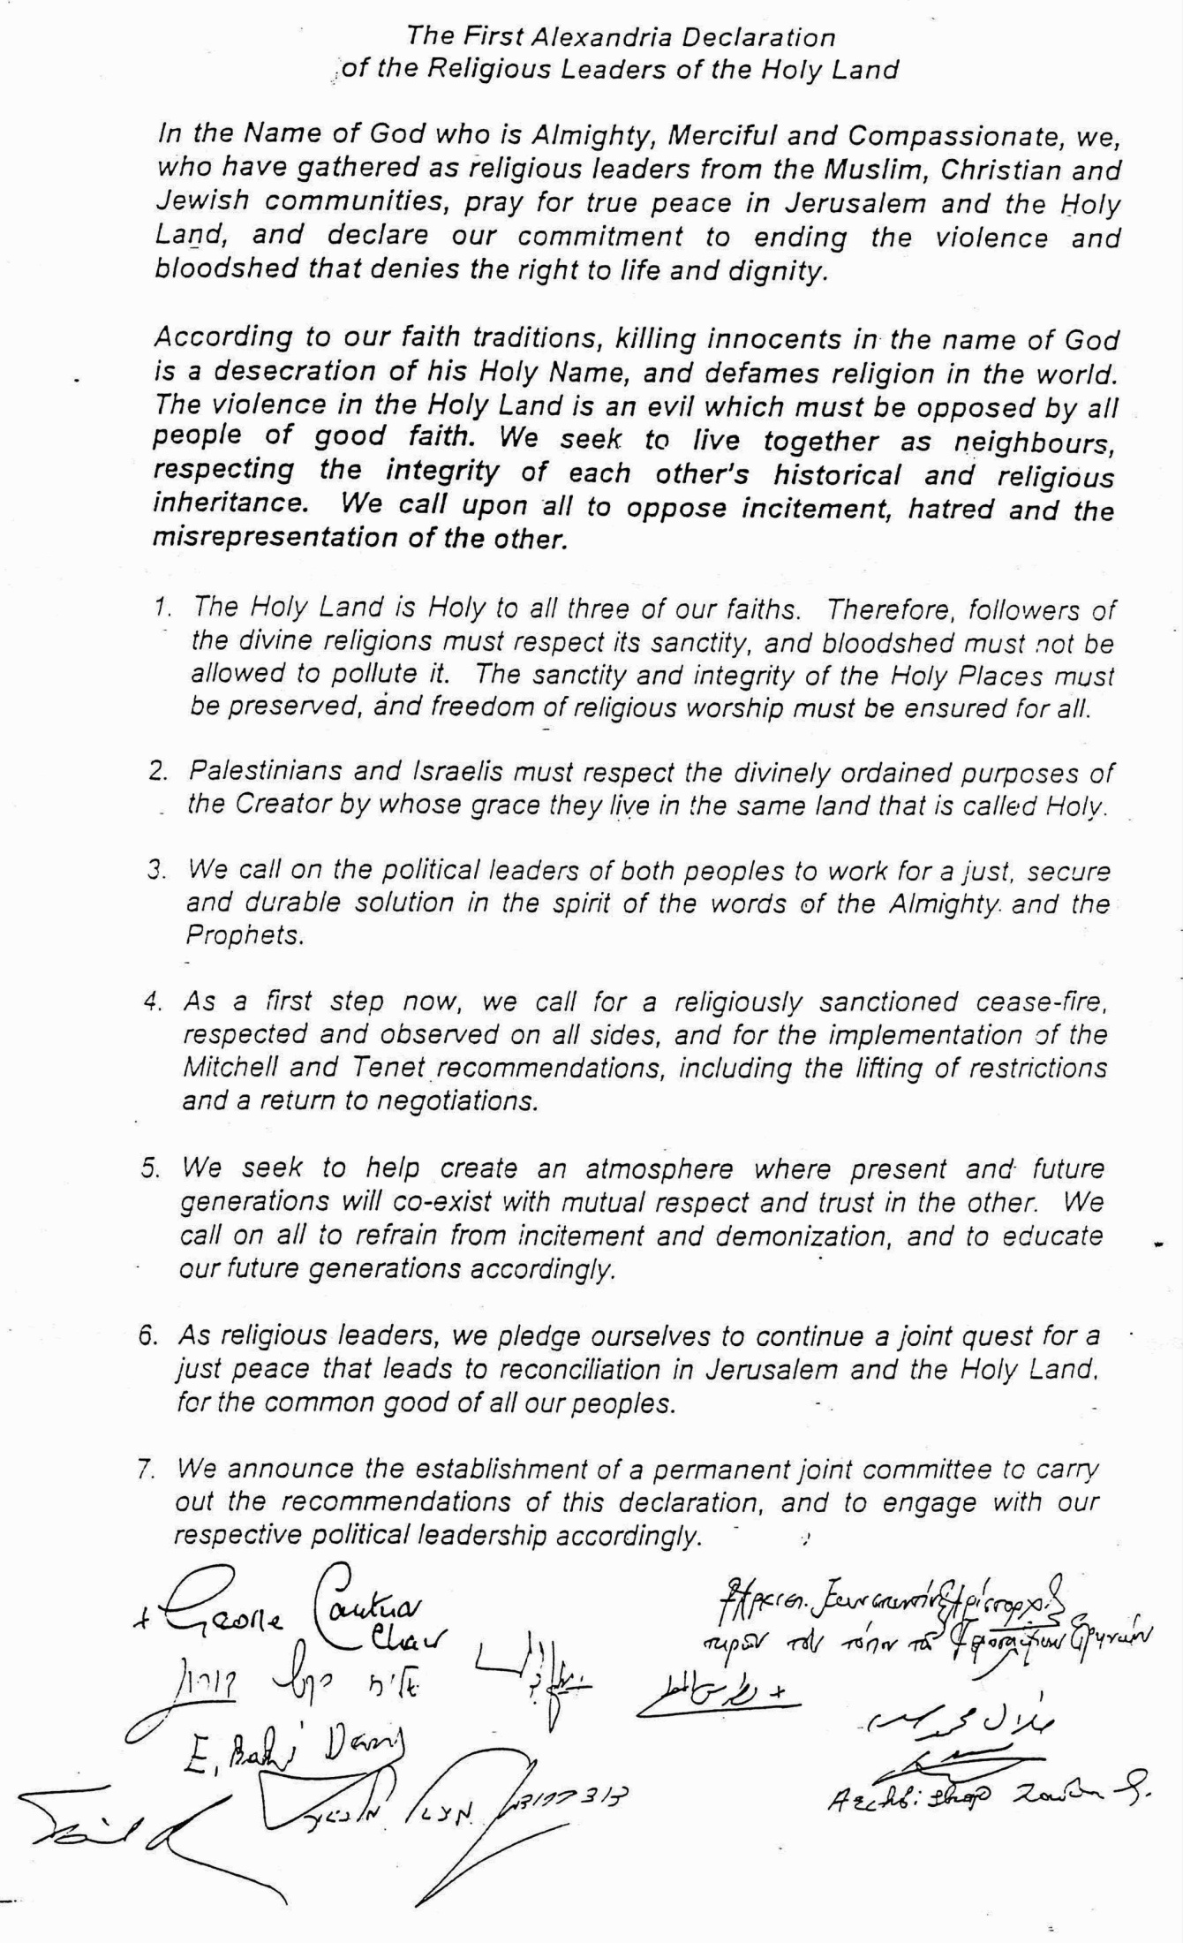

Slide 8
Salvation
Hundreds of people came to know
Christ during Andrew’s ministry
Miracles
People healed, visions of angels and Jesus and people raised from the dead

Slide 9
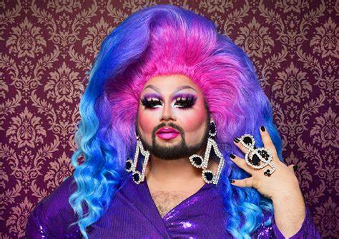
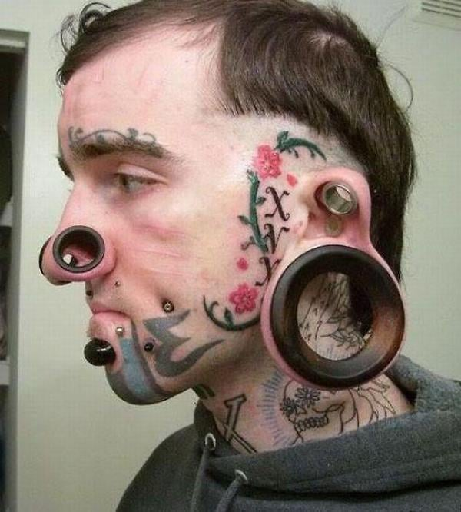
Andrew White loves people the way Jesus does
“But to you who are listening I say: Love your enemies, do good to those who hate you, ²⁸ bless those who curse you, pray for those who mistreat you.” Luke 6:27
How much do we love those who oppose us?
Do we recoil from those who make us
uncomfortable?

Slide 10
Who did Jesus spend
time with?
Disciples
Family
People
Samaritans
Publicans/Tax Collectors
Romans
Sick and needy
Lepers

Slide 11
How can we love people the way Jesus does?
Listen
Do Good
Pray
Don’t Judge
Love
Bless

Slide 12
Does Anybody Hear Her
She is running A hundred miles an hour in the wrong direction
Does anybody hear her? Can anybody see? Or does anybody even know she's going down today
Under the shadow of our steeple with all the lost and lonely people Searching for the hope that's tucked away in you and me Does anybody hear her? Can anybody see?
She is yearning for shelter and affection That she never found at home.
She is searching for a hero to ride in To ride in and save the day
And in walks her prince charming and he knows just what to say Momentary lapse of reason and she gives herself away

Slide 13
Does anybody hear her? Can anybody see?
If judgement looms under every steeple If lofty glances from lofty people Can't see past her scarlet letter And we never even met her
Does anybody hear her? Does anybody see? Or does anybody even know She's going down today Under the shadow of our steeple With all the lost and lonely people Searching for the hope that's tucked away in you and me
He is running A hundred miles an hour in the wrong direction

