Slide 1
Hebrews 10: 19 - 39
Notes:
Hebrews 10:19-25 is a wake-up call for professing the Christian who
might not live for Christ. It is a humbling reminder for those who have been saved by grace to act like it. Ultimately, it is a warning and exhortation to stop playing games with God and commit to the Lord Jesus Christ.

Slide 2
Be BOLD, CONFIDENT & EXUBERANT
ENCOURAGING
NOT RENOUNCING Your FAITH (Apostasty)
Hebrews 10: 19 - 39
Notes:
At its core is 3 Main Issues;
Being BOLD, CONFIDENT & EXUBERANT
ENCOURAGING
RENOUNCATION OF FAITH – APOSTASTY or Back Sliding

Slide 3
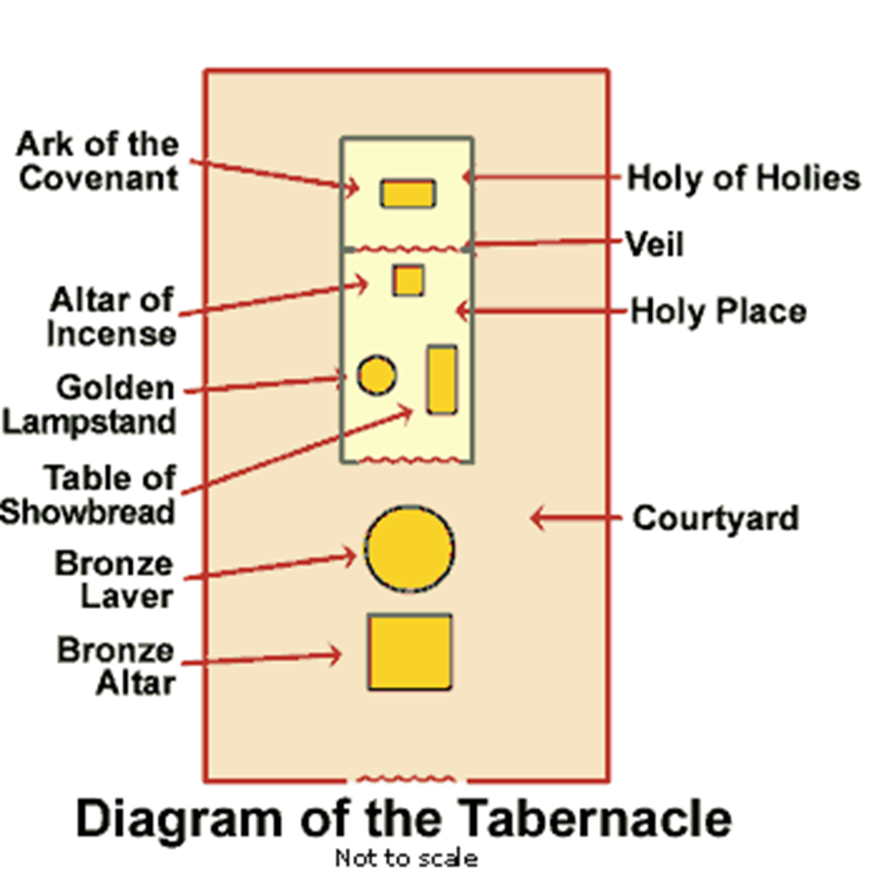
Tabernacle
Notes:
The Law of Moses said that once a year, on Yom Kippur, the high priest must bring the blood of sacrifices into the Holy of Holies to atone for his sin and the national sins of the people of Israel. On that Day of Atonement, before entering the tabernacle, the high priest was to bathe and put on special garments (Leviticus 16:4),

Slide 4
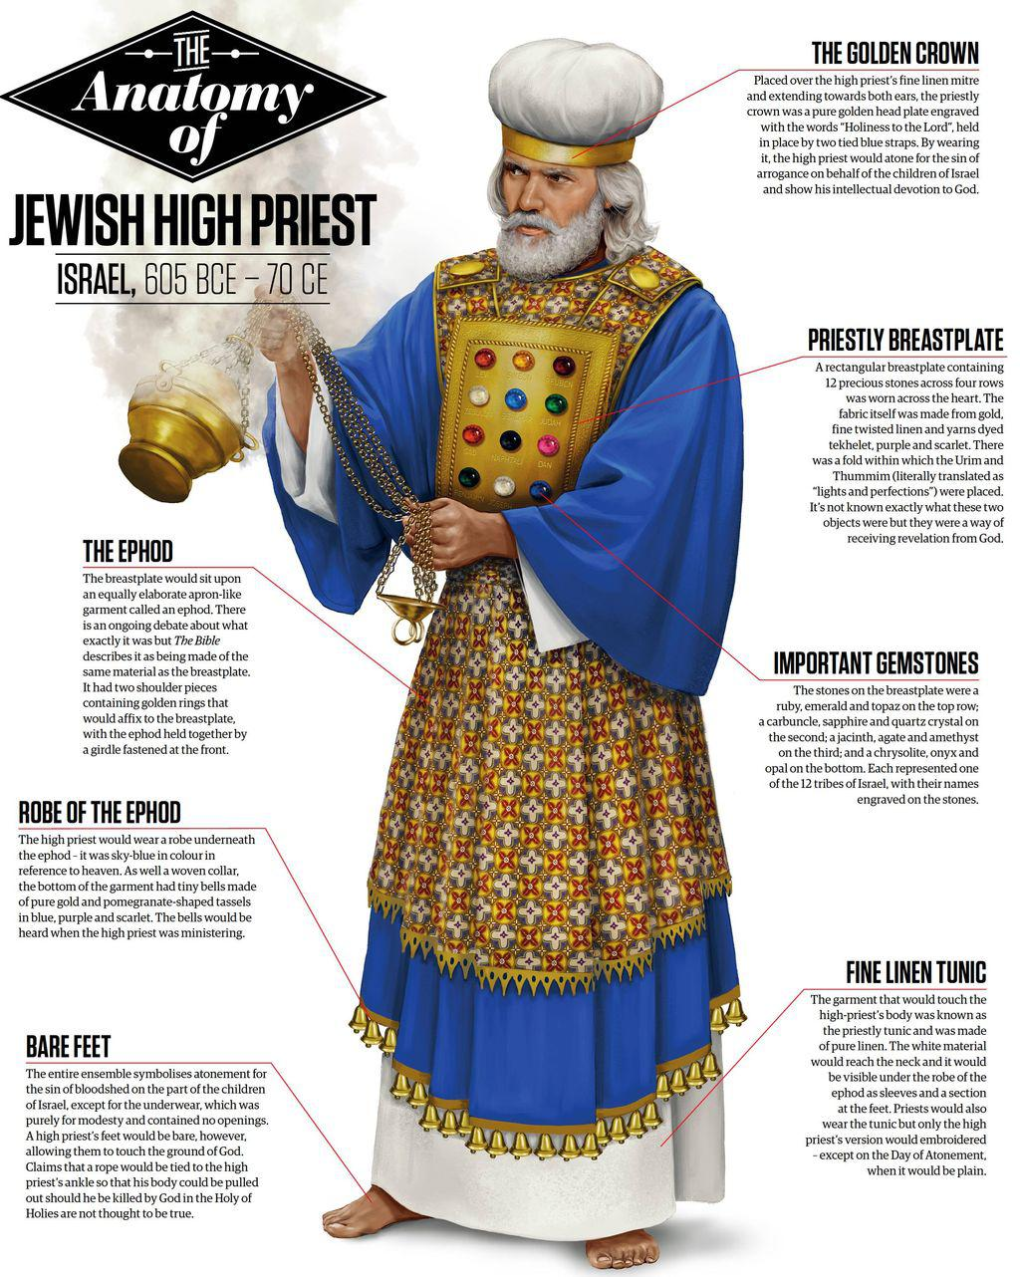
Exodus 28:
VS,33 - 35
Notes:
Exodus 28:33–35 specified that bells (and knitted pomegranates) were to be worn on the hem of the high priest’s garment so that “the sound of the bells will be heard when he enters the Holy Place before the Lord and when he comes out” (verse 35). The bells provided an audible cue to those outside the tabernacle of the high priest’s whereabouts.
No Rope
THEY WERE SCARED – Get it wrong & DEAD

Slide 5
Verse 20: “by the new and living way that He opened for us through the curtain, that is, through His flesh.”
This new and living way is wrapped up in Jesus’ life, death, burial, resurrection, and ascension.
Be bold
What right do we have to open the door and address God with boldness, determination, and confidence?.
Notes:
JESUS. It is ONLY Jesus and what He has done for us that allows us to be BOLD, & CONFIDENT

Slide 6
Verse 20: “by the new and living way that He opened for us through the curtain, that is, through His flesh.”
This new and living way is wrapped up in Jesus’ life, death, burial, resurrection, and ascension.
We have been given direct access by the blood of Jesus (Hebrews 9:12).
His sacrifice is the key to entering God’s presence.
Be bold
What right do we have to open the door and address God with boldness, determination, and confidence?.

Slide 7
Verse 20: “by the new and living way that He opened for us through the curtain, that is, through His flesh.”
This new and living way is wrapped up in Jesus’ life, death, burial, resurrection, and ascension.
We have been given direct access by the blood of Jesus (Hebrews 9:12).
His sacrifice is the key to entering God’s presence.
We do not enter fearfully, but confidently.
We don’t crawl to the throne or inch our way to God with our tail between our legs. We have been given Confidence, Courage, and Certainty.
Be bold
What right do we have to open the door and address God with boldness, determination, and confidence?.

Slide 8
Be bold
How Are We to Be Bold Before God, Having Determination, and Confidence?
There is a boldness with which we approach God (Hebrews 4:16).
This boldness is a complete contrast to the way the High Priest entered the Holy Place under the Old Covenant. He went with fear and trembling, because, if he had neglected the smallest item prescribed by the law, he could expect nothing but death.
By stirring up one another to love and good works.

Slide 9
Be bold
How Are We to Be Bold Before God, Having Determination, and Confidence?
There is a boldness with which we approach God (Hebrews 4:16).
This boldness is a complete contrast to the way the High Priest entered the Holy Place under the Old Covenant. He went with fear and trembling, because, if he had neglected the smallest item prescribed by the law, he could expect nothing but death.
By stirring up one another to love and good works.
We should not sit on a rock and contemplate our navels. We put our minds to work by considering how to stir up one another to love and good works.

Slide 10
Encourage one another
What right do we have to open the door and address God with boldness, determination, and confidence?.
Hebrews 10 is a wake-up call for the uncommitted Christian to get off the bench and back in the game.
Notes:
1) We have loved ourselves, and worshipped pleasure. By our own merit, none of us have the right to knock on God’s door all due to our Sin (let alone enter in with confidence).

Slide 11
Encourage one another
What right do we have to open the door and address God with boldness, determination, and confidence?.
Hebrews 10 is a wake-up call for the uncommitted Christian to get off the bench and back in the game.
Hebrews 10:25 is about actively encouraging one another away from apostasy.
Notes:
Maybe your commitment to the Lord at the moment is luke-warm, coming with strings. You might come to church, but refuse to share your faith; or you might give in the offering, but your time is too valuable to serve.

Slide 12
Encourage one another
What right do we have to open the door and address God with boldness, determination, and confidence?
Hebrews 10 is a wake-up call for the uncommitted Christian to get off the bench and back in the game.
Hebrews 10:25 is about actively encouraging one another away from apostacy.
Because of our new position in Christ, we should draw near to God in faith, hold fast the confession of our hope, and consider how to stimulate one another to love and good deeds.
Notes:
Christian faith will flourish more when we fellowship together. Stir each other on. Therefore, every opportunity of coming together must be welcomed for encouragement of each other.

Slide 13
Encourage one another
What right do we have to open the door and address God with boldness, determination, and confidence?.
“Therefore encourage on another and build each other up, just as in fact you are doing.” (1 Thes 5: 11)
“But encourage one another daily, as long as it is called Today, so that none of you may be hardened by sin’s deceitfulness.”
(Heb 3: 13)
Notes:
Paul.
There are numerous verses about meeting together. Encouraging each other. And through ALL of this, is to do it regularly. NOT when the mood takes us, or when nothing else is on.
Sometimes of a Sunday as I look out over the ocean, yes I would rather be down in the water catching a good wave. But, I know I need encouragement from not just the message each Sunday, But the interaction of each one of you. We are designed by God to be in fellowship with each other.

Slide 14
Back sliding (apostasy)
What Does Back Sliding or Apostasy Look Like?
As Paul exhorted the Galatian Christians, "You were running well; who hindered you from obeying the truth?" (Galatians 5:7, RSV).
# Trampled the Son of God under foot.
# Treated as an unholy thing the blood of the covenant that sanctified Him.
# Insult the Spirit of grace.
People today in Church want the Hype type of experience. They want to be entertained, rather than know and learn more of Jesus.
Notes:
1. Sustained defiance towards God -- apostasy – This is what Paul in Galatians was referring to, that is, turning deliberately away from faith in Christ and returning to their former Judaism, as if Jesus were not the Messiah at all. This is not your garden-variety sin, but flagrant, deliberate back-sliding or turning away from their faith. The reason we can be sure of this is the harsh way he describes the sin of apostasy in verse 29: Of Hebrews 10

Slide 15
Back sliding (apostasy)
What Does Back Sliding or Apostasy Look Like?
Jesus said, “I am the way, and the truth, and the life. No one comes to the Father except through me” (John 14:6).
Do you treat the Church as non-essential in your life? Do you skip services? Do you come 10 minutes late or perhaps 30 minutes late? Do you put Church after your dream job, your big client meeting, your family road trip? Do you treat the worship service as nothing more than a music concert or entertainment? Do you think some sermons are no different than self-help psychology? Unfortunately, many Christians have long treated Church as non-essential, that’s why the world sees through our hypocrisy. We are not here to win a debate. We are here to win souls.
Notes:
1

Slide 16
Application of Hebrews 10
I WONDER HOW MANY OF US HAVE STALLED IN OUR FAITH OR COME IN DANGER OF STALLING BY NOT FULLY TRUSTING IN THE LORD?
Stop reading everyone’s opinion online and start reading your Bible.
Notes:
1. Draw near to the Lord. He should be our strongest pursuit. After all, we were made to worship Him. If you have a hard time believing in the faithfulness of God, study the Scriptures for yourself.

Slide 17
Application of Hebrews 10
I WONDER HOW MANY OF US HAVE STALLED IN OUR FAITH OR COME IN DANGER OF STALLING BY NOT FULLY TRUSTING IN THE LORD?
Stop reading everyone’s opinion online and start reading your Bible.
A change of heart will produce a change in action.
Notes:
2. Unfortunately, our churches are full of people who prefer the adrenaline rush of drama and conflict over love.
If I left the church, would anyone miss me? Do I long for the fellowship of like-minded believers or am I enjoying some sort of break. Have I stirred up others to love and good works with phone calls, emails, cards, meals, etc.? What am I doing to encourage others to stay the course and cling to Christ?

Slide 18
Application of Hebrews 10
I WONDER HOW MANY OF US HAVE STALLED IN OUR FAITH OR COME IN DANGER OF STALLING BY NOT FULLY TRUSTING IN THE LORD?
Stop reading everyone’s opinion online and start reading your Bible.
A change of heart will produce a change in action.
Like Peter, “be all the more diligent to confirm your calling and election” (2 Peter 1:10).
Notes:
3. Am I someone who keeps the seats warm on Sunday, but does little to serve the body. Get off the fence. Get off the bench and into the game. Stop messing around. You can approach God with confidence, as a great sinner washed by a great Saviour. Wake up and draw near to Jesus.

Slide 19
Application of Hebrews 10
I WONDER HOW MANY OF US HAVE STALLED IN OUR FAITH OR COME IN DANGER OF STALLING BY NOT FULLY TRUSTING IN THE LORD?
Stop reading everyone’s opinion online and start reading your Bible.
A change of heart will produce a change in action.
Like Peter, “be all the more diligent to confirm your calling and election” (2 Peter 1:10).
To the committed Christian, hold fast to your confession.
Notes:
4. Each successive Christian generation is called upon to live as the generation of the end-time, if it is to live as a CHRISTIAN generation. We can still consider, provoke, and encourage one another. Because of Jesus, we have direct access and divine advocacy.

Slide 20
Word of encouragement
· We gather to receive something from God.
· We gather to give something to God.
· We gather to encourage each other by our shared faith and values.
· We gather to bless one another.
· We gather to work together.

