Slide 1
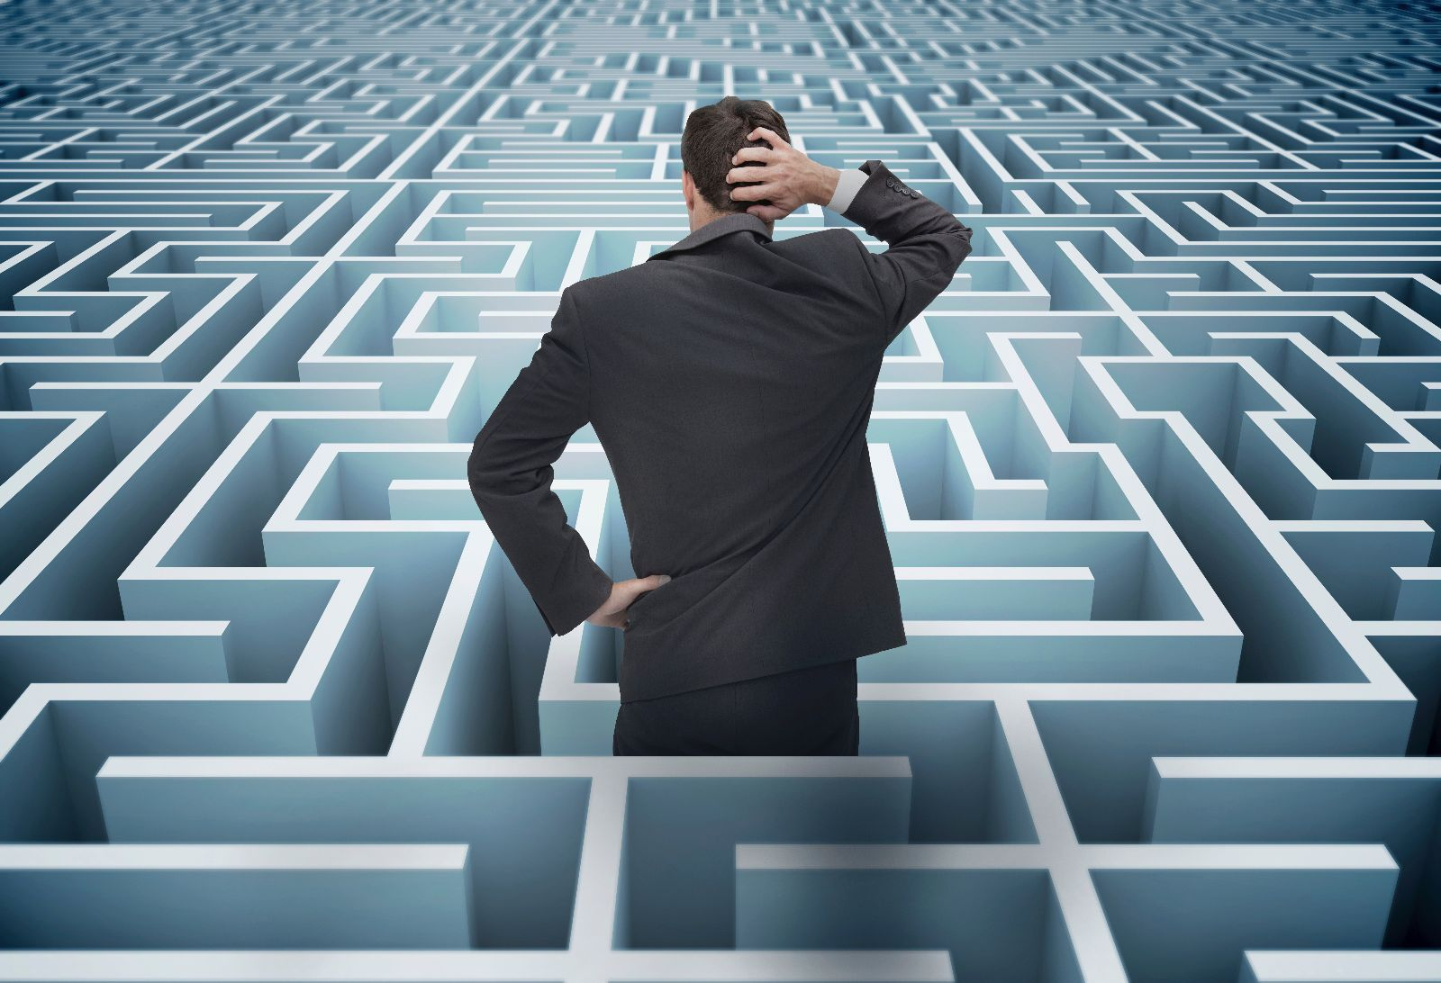
TABERNACLE
TECHNOLOGY
BLOOD SACRIFICES
COST OF LIVING
GLOBAL WARMING
HIGH PRIESTS
PANDEMICS
COVENANTS
FAMILY PRESSURES
MELCHIZADEK
God controls and directs history to reveal the truth about who He is and who we are. These ancient names, activities and symbols point to Jesus and the peace, hope & joy He alone can give us.
Notes:
As we commence the second part of our journey through Hebrews, I will be the first to admit that it easy to say “what does any of this have to do with life in 2023? Just like the passage we are looking at today it is filled with language, images and symbolism that is so strange and removed from our current day context. What does blood sacrifices, covenants, High Priests, lampstands etc and the mysterious figure of Melchizadek have to with a modern world dominated by science and technology, the threat of recession and global warming, pandemics, war etc. Where is the practical benefit in studying this book? Some of you may be tempted to close your Bibles, turn off and doze through this sermon. But in times when we are thinking like this, we need to remember that God controls and directs history to reveal the truth about who god is and who we are. ancient names, activities and symbols point to Jesus and the peace, hope & joy He alone can give us.

Slide 2
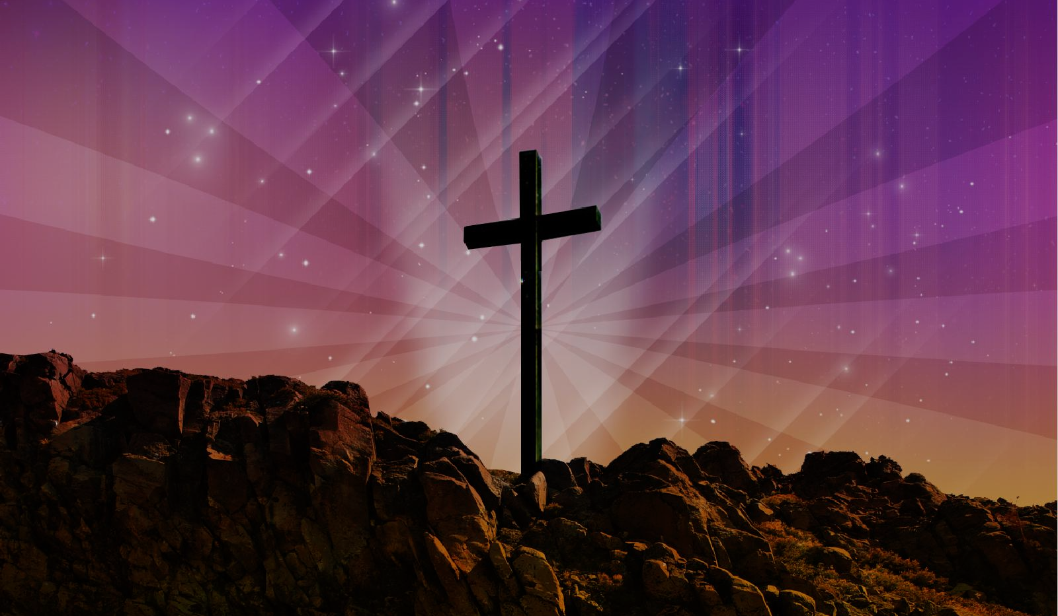
“Under the old system, the blood of goats and bulls and the ashes of a heifer could cleanse people’s bodies from ceremonial impurity. Just think how much more the blood of Christ will purify our consciences from sinful deeds (dead works) so that we can worship (serve) the living God. For by the power of the eternal Spirit, Christ offered himself to God as a perfect sacrifice for our sins.” (Hebrews 9:13-14)
A BETTER SANCTUARY – ETERNAL REFUGE FROM A DIRTY CONSCIENCE
(Hebrews 9:1-14)
WHAT IS OUR CONSCIENCE?
A QUICK TOUR OF THE TABERNACLE
GLORIOUS CONTRASTS
Notes:
To clarify the main point of this passage we need to go to the last few verses that we read this morning – verses 13-14. The only way you can enter into God’s presence and enjoy Him, and know that he enjoys you, is by the blood of Christ. The only way we can find refuge from our biggest danger – wrath and judgement of God – is by the blood of Christ. Jesus is the only way we can deal with a dirty conscience.

Slide 3
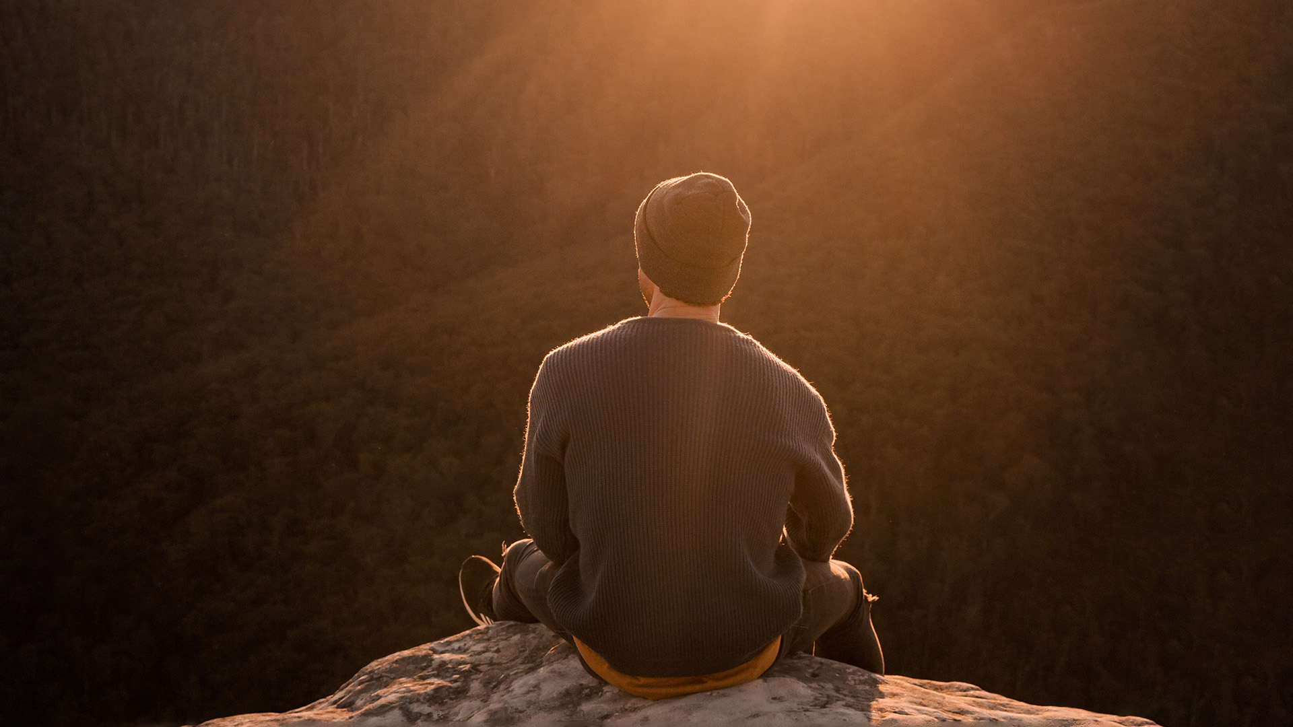
WHAT IS OUR CONSCIENCE AND WHY IS IT A PROBLEM?
“It is the image of God permanently printed on our souls by which we feel guilt and conviction when we do wrong and joy and comfort when we do right.” (Tim Challies)
It’s what you feel and sense when you rest and reflect back on the day’s events = realising God’s holiness and our sinfulness = we have to keep trying harder to be good enough.
“As different as the ‘old covenant’ world is from our world today, we all have the same struggle – a dirty conscience that makes us feel wicked, wayward, guilty, distant and unworthy.
”A clear conscience
Notes:
Some would define it as our moral compass but it’s a bit more than that. It is a gift from God, – we all have conscience and like the rest of our being, it is impacted by sin and attacked by Satan. It’s what you feel when you look back on the day’s events – your words, actions, thoughts, lies, pride, not giving God a moment’s thought, greed, lusts, ambitions, idolatry, broken dreams and relationships etc.

Slide 4
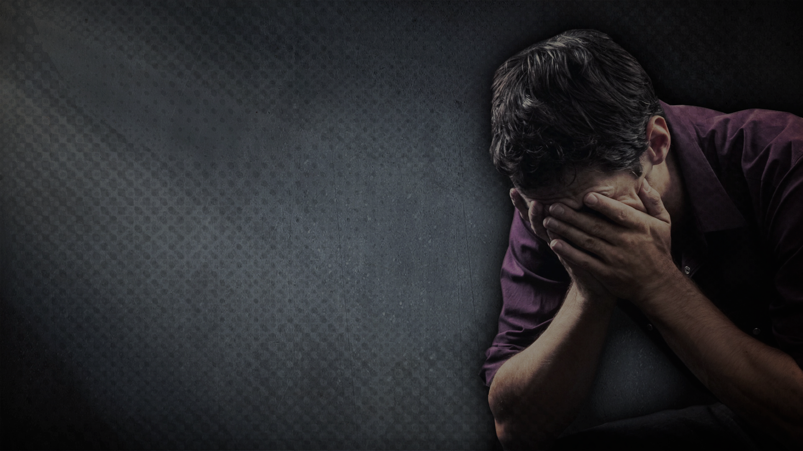
“The torture of a bad conscience is the hell of every living soul.” (John Calvin)
“A clear conscience is the sign of a bad memory.” (Mark Twain)
Why do we struggle with a dirty conscience? The Word of God ‘exposes our innermost thoughts and desires’ (Hebrew 4:12) + the lies & accusations of Satan (John 8:44, Rev 12:10).
Hebrews 9 is the solution to the problem of our dirty conscience – the ‘blood of Christ’ is the only thing that will purify your conscience so that you can enjoy God, and know He enjoys you.
That’s exactly what the tabernacle and the priestly activities are designed to teach us – that Jesus is better.
Notes:
Why do we struggle with bad conscience – because God’s Word reveals sin and Satan loves to attack our conscience. A dirty conscience robs of the joy we should have as Christians – gets us to take our eyes off Jesus and put it on ourselves. Makes us forget his promises. Hebrews 9 teaches us that Jesus is better, that the (sanctuary) refuge he gives us is better, That we have no reason to be ruled by a dirty conscience. Understandable under the old covenant (continual sacrifices) but not under the new covenant.

Slide 5
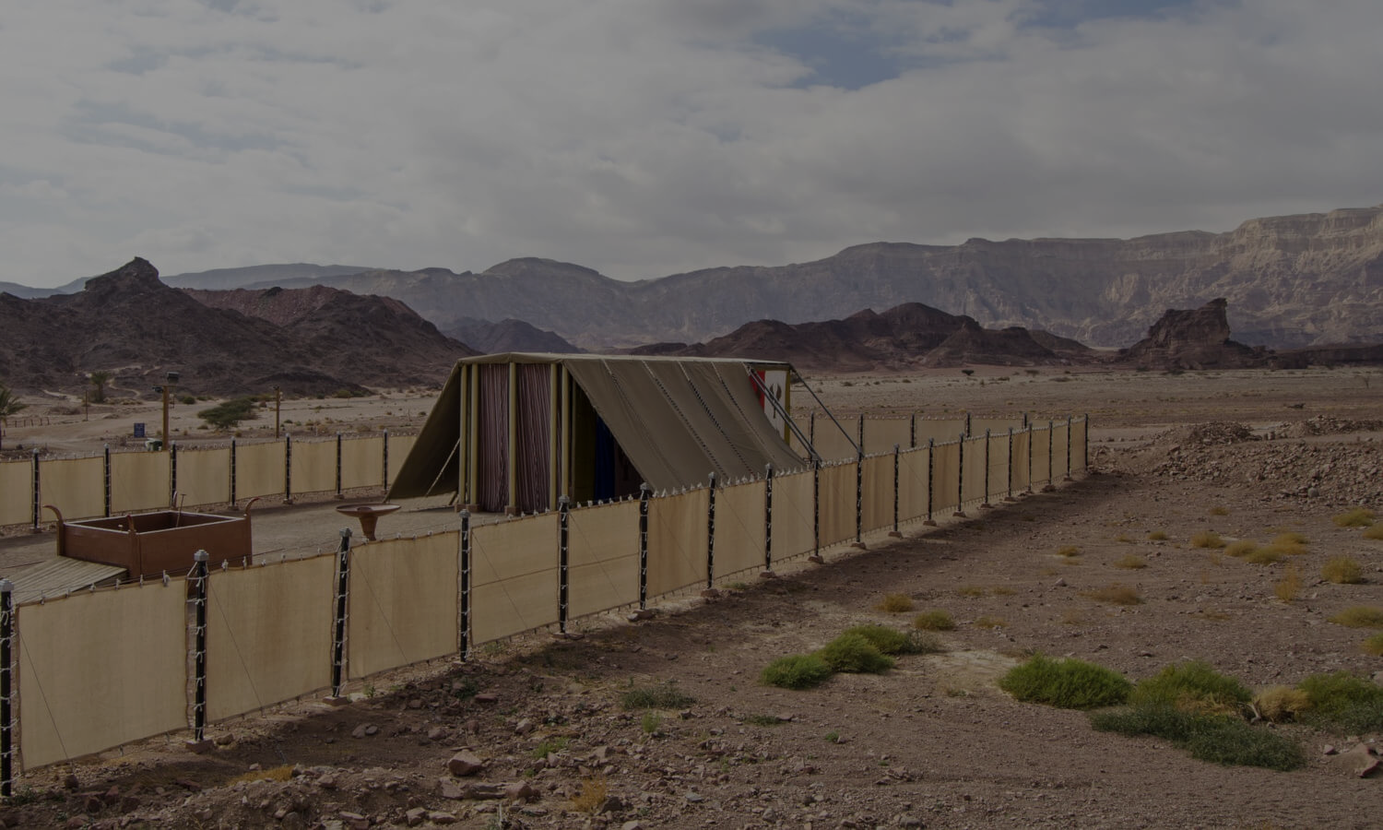
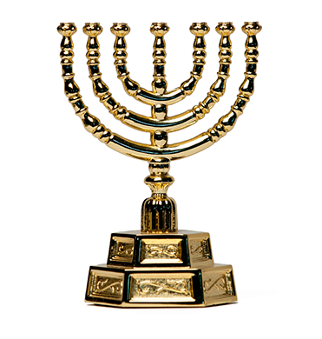
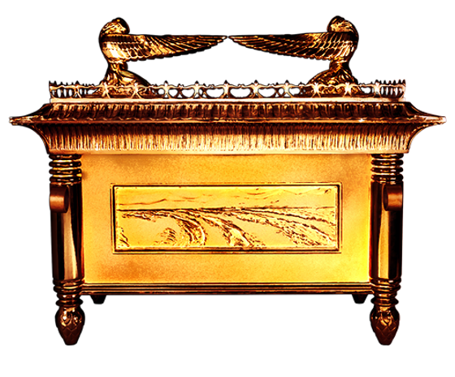
A QUICK TOUR OF THE TABERNACLE - a portable temple, the God designed earthly place of sanctuary & worship (vs 1-10).
Room 1 = Holy Place with a golden lampstand, gold table with 12 loaves of bread on it and a golden altar.
Room 2 = Most High Place or Holy of Holies, separated from Holy Place by a thick curtain, containing the golden Ark of The Covenant (God’s presence) with stone tablets, manna and Aaron’s staff.
Gold Mercy seat (God’s throne) with gold cherubim fitted perfectly on top of the Ark – place of atonement.
Notes:
The author of Hebrews goes into some very brief details regarding the tabernacle that God instructed the Israelites to build while they were in the wilderness after escaping Egypt. It was essentially a portable temple with a courtyard and two rooms. We will firstly look at the rooms and furnishings in the tabernacle. The first room was known as the Holy Place (13m x 4.5m x 4.5m) had a golden lampstand gave light to all the activities carried out inside as there was no windows. There was also a golden table which 12 loaves of bread placed on it. These loaves were baked fresh and replaced each Sabbath (old loaves eaten by the priests). The altar was also included in this room (see Ex 30:1-10), even though the author seems to include it in the next room. Then there was a thick curtain separating the two rooms – blue, purple and scarlet with golden threads making image of cherubim. It was very heavy and thick. The next room was called Most Holy Place and contained the Ark of the Covenant representing God’s presence. The Ark was wooden box overlaid with gold. Fitting perfectly on top of the Ark was the mercy seat with two cherubim (heavenly creatures) This on each side (all gold again). This represented God’s presence – where he would judge from.

Slide 6
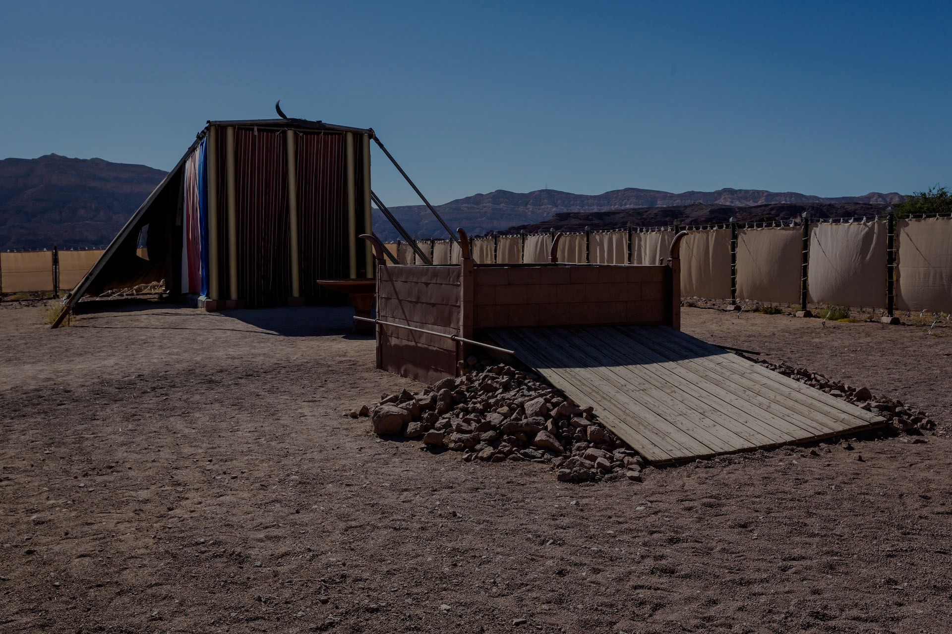
Only priests could serve in the Holy Place. Only the High Priest, after offering blood for his own sin, could enter the Holy of Holies once a year to offer blood for the people’s sin of the people = Day of Atonement.
All the sacrifices, symbols and activities of the priests & the Tabernacle could not fully cleanse their conscience & heart – it all had to be repeated again & again. It was good but incomplete.
It was a visual declaration of the glory and splendour of God + pointed to the holiness & grace of God + human sinfulness + pointed to Christ who is the light of the world (John 9:5), the bread of life (John 6:35) who “became human and made his home (tabernacled) among us.” (John 1:14)
Notes:
Entrance into and service in the Holy Place was limited to the priests. People had to stay out in the courtyard. Entrance into God’s presence was limited only to the High Priest – who firstly had to offer blood for his own sins. All this activity and symbolism was pointing to the need for something better. It was good but incomplete. That something better = Jesus. The exquisite detail of the tabernacle and its furnishings – the intricate design, gold, vibrant colours, the luxury of the materials – are all designed to be a visual declaration of the glory, splendour and majesty of God. The limitations and need for blood proved the holiness of God and the seriousness of sin – only the perfect and poor could approach him. But the establishment of blood sacrifices and priesthood and day of atonement = God’s grace. He provides a way – reaches out to meet us. But it also shows the extent of human sinfulness – everything about the Tabernacle shouted stay away, or approach cautiously and fearfully or else you will die. Access to God was only given to one man on one day of the year and only if he had sacrificed blood for his own sin and others. Most importantly the tabernacle and everything in it pointed to Christ – the light of the world, the bread of life. He is the representation of the grace, glory and faithfulness of God (John 1:14). The word for “made his home” = tabernacled with us.

Slide 7
GLORIOUS CONTRASTS BETWEEN THE OLD & NEW (vs 11-14)
a) The earthly temporary Tabernacle made of human hands, with limited access into God’s presence VS the ministry of Jesus in the eternal, heavenly Tabernacle, through whom we have guaranteed, unlimited access into Gods presence (Heb 4:16).
b) The High Priest who had to enter with a blood sacrifice year after year VS Jesus offering himself as the ‘once for all’ sacrifice.
c) The ineffective animal sacrifices, only offering annual redemption VS Jesus’ own precious blood, offering eternal redemption.
d) The blood of animals, only offering external cleansing VS the blood of Christ that cleanses our conscience & brings full & final forgiveness.
Notes:
In these verses we see a number of amazing contrasts between Jesus and the old covenant – the Tabernacle and priests. The Tabernacle (place of refuge, sanctuary) of old covenant was temporary and offered limited access into God’s presence. The heavenly, eternal tabernacle where Jesus ministers now – offering unlimited access to the presence of God. The old High Priest could only minister on behalf of others if they offered sacrifice for their sins too. They had to do that year after year. Jesus did it once and for all time. His blood is better – it cleanses our conscience not just the outside.

Slide 8
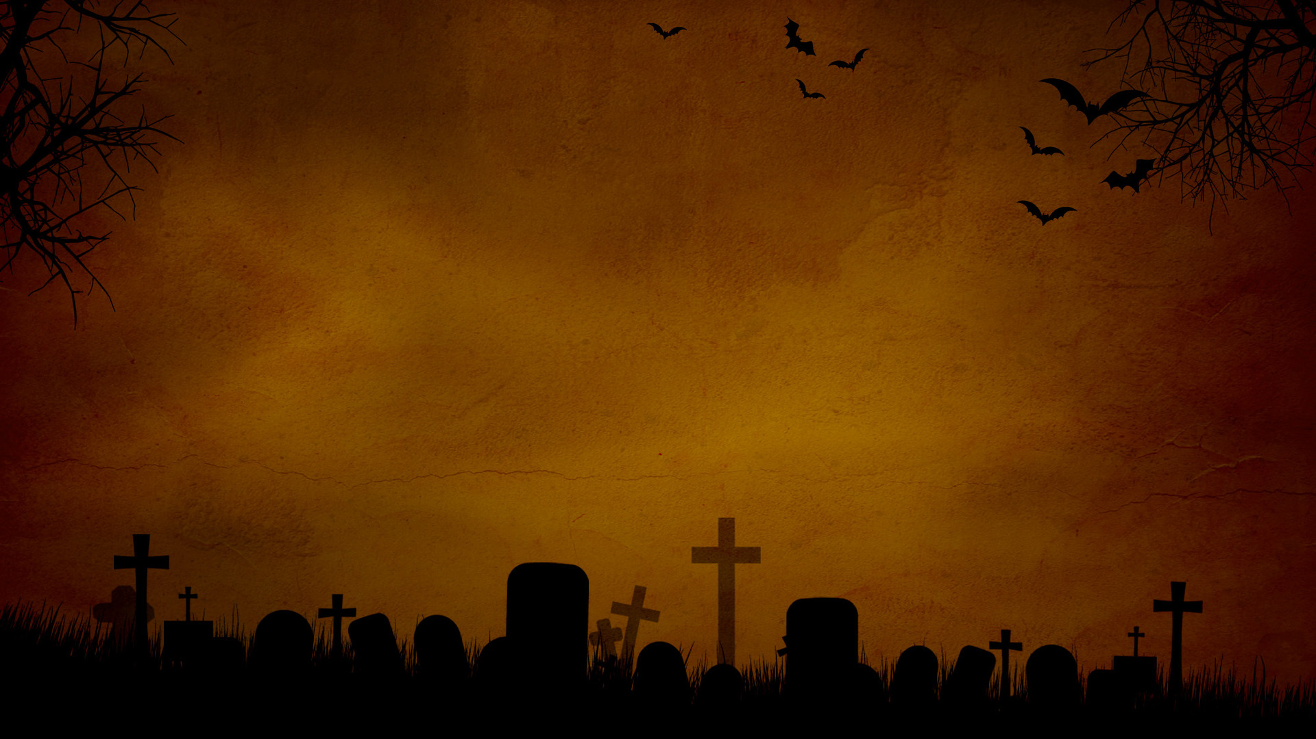
“Purifies our conscience from sinful deeds (dead works)” = thinking that we can earn our salvation and find peace of mind by what we do, think, say, give or promise = religion.
“Sinful and dead’ because they have no power to reconcile us to God & they still leave us feeling hopeless and guilty.
Religion = You are feeling guilty, dirty and defiled so you need to be good = you need to give more, pray more and serve more. Gospel = You are guilty, and you can never be good enough = you need to receive by faith what Jesus has done for you.
Jesus is the only solution for a dirty conscience (pride, failure, despair and hopelessness) that hinders our worship & service.
Notes:
What do we mean by purifying our conscience from sinful deeds? Thinking we can earn our salvation. Dead works = religion. Sinful and dead because they have no power to reconcile you to God – the more we try and rely on our goodness, the more we fail and feel guilty and hopeless. Jesus is the only solution to a dirty conscience. Taken our guilt – no need for despair and hopelessness.

Slide 9
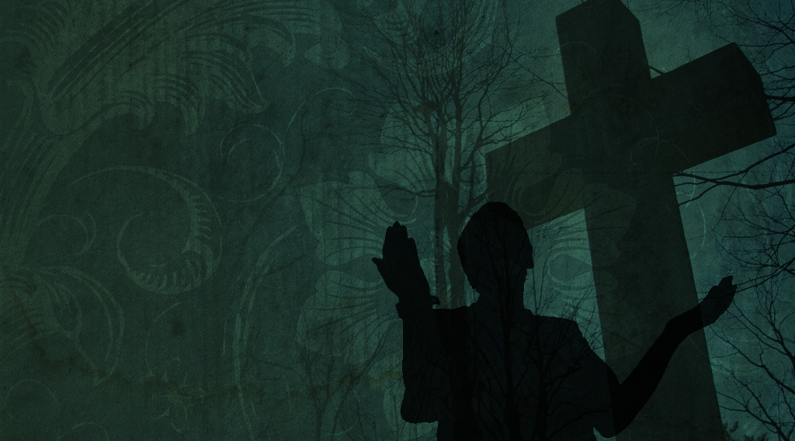
“What must I do to be saved?”
“Sorry, it’s too late.”
“It’s too late because it’s already been done. Jesus has done everything for your salvation. His once and for all sacrifice is complete, perfect and eternal.”
We are never sinless, but because of Jesus we are always guiltless. We will fail in our righteous living, but because of Jesus we will never fall from our righteous position before God.
Once you repent and accept Christ as your Lord and Saviour there is nothing left to do. You can’t earn more of God’s love, grace and forgiveness. Your dirty conscience is wiped clean. So, so humbly draw near to Him - worship & serve Him without fear.
Notes:
An evangelist was cleaning up the room after one of his meetings, when he was approached by a young man who asked him, “What must I do to be saved?” The evangelist replied, “Sorry it’s too late.” The man was disappointed and replied Is that because the meeting is over?’ The evangelist replied, “No its because its already done….” We don’t have to justify ourselves – Jesus has done it all.

