Slide 1
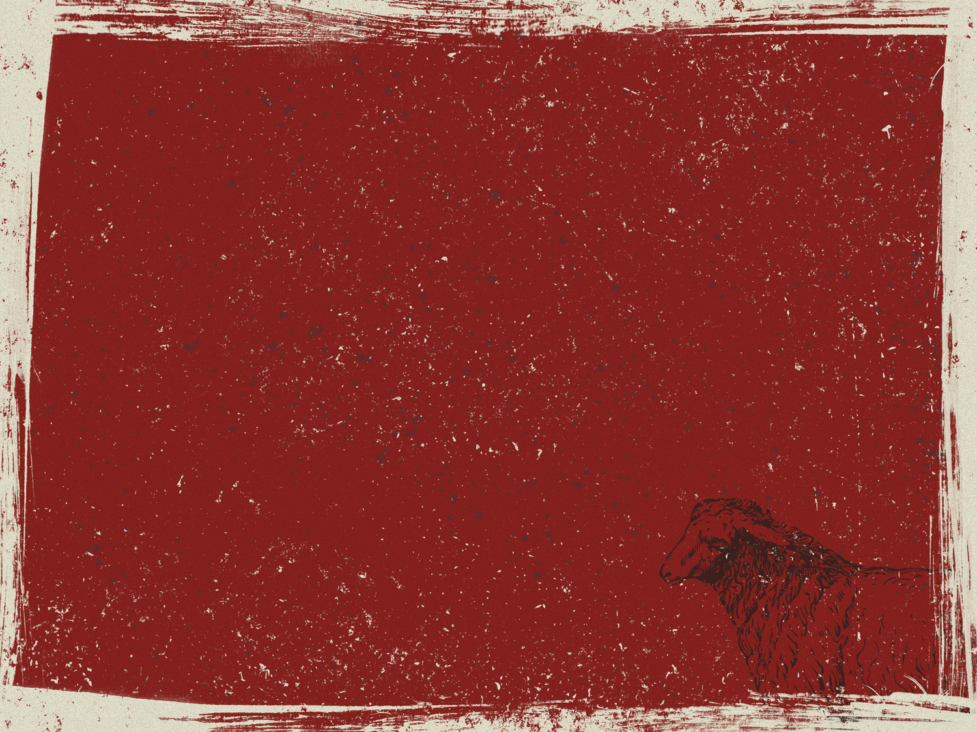
A BETTER SACRIFICE
Hebrews 10:1-18
Notes:
Good morning everyone. Isn’t that such a rich passage? I know that this message and this passage talks a lot about the sacrifice of Christ, something we all have probably heard many times, for it is the centre of the gospel, the very message of our salvation
But I pray that we would never grow tired of hearing of the cost of our salvation
That we would never grow tired of hearing of the sufficiency of Christ’s sacrifice
That we would never tire of gazing at the cross and seeing the love of God being poured out for all who will believe
And that we would always cherish the grace of God which was displayed on the cross
ILLUSTRATION: Most weeks, on Tuesdays I will usually stay at home to put Ewan to sleep while Jess goes and sets up for playgroup - This week, while Jess was setting up I put Ewan to sleep while walking him around in the pram around the soccer fields out the back. - So I thought this would be a great time for sermon prep. I put in my earphones with every intention of listening to those 18 verses from Hebrews on repeat while Ewan was asleep, but after about 20 minutes of listening to the passage, I couldn’t help but stop and pause, put on one of my favourite worship songs and begin thanking God for the sacrifice of Jesus Christ. - I don’t tell you this to brag, for there have been too many times in my life where I respond as though it is just another average, boring day when hearing this gospel truth - But I tell you this to say that our response to God when hearing about the sacrifice of Jesus Christ should always be one filled with worship, and giving God all the praise and honour

Slide 2
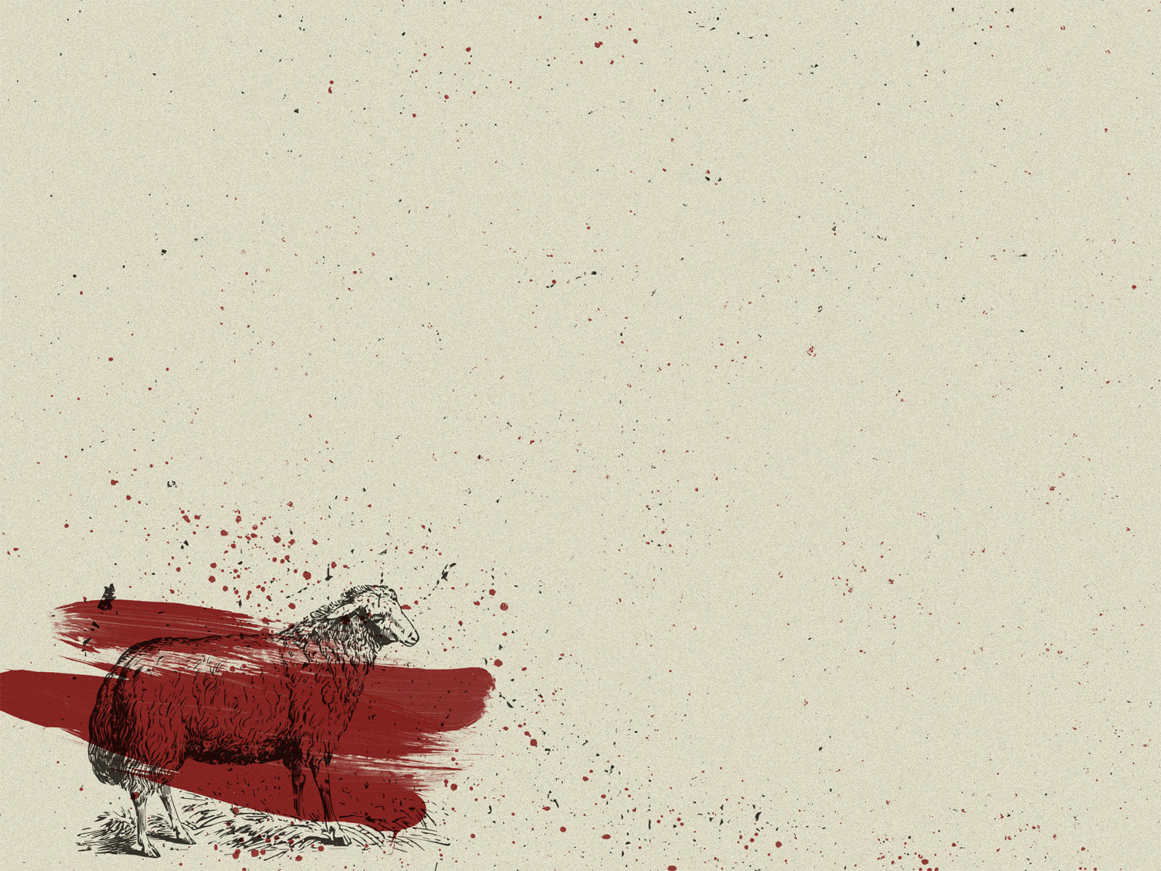
THE LAW AND GUILT
“The old system under the law of Moses was only a shadow, a dim preview of the good things to come…” (Heb 10:1a)
“The sacrifices… were never able to provide perfect cleansing for those who came to worship” (Heb 10:1b)
“Those sacrifices actually reminded them of their sins year after year” (Heb 10:3)
Notes:
”The old system under the law of Moses was only a shadow, a dim preview of the good things to come...” (Heb 10:1a) - The 10 commandments, the tabernacle, the priests, the sacrifices, were good, but only a dim foreshadowing of Christ - The whole point of the law and the old covenant was to point us to Christ. The law was never supposed to be the end result, Christ was always the main plan - The first will of God was that there be an age of shadows, a kind of 2000 year lesson history book, to prepare us to understand what Christ really did for us on the cross - That’s the whole point of Hebrews and what the author is trying to get at. - The author is continuously asking “Why are you so fixated on the shadow when you have the image of the invisible God who is infinitely better?” - And that’s the whole point of what we are trying to communicate in this series, is don’t get caught up in the things of this world, because Jesus is better
“The sacrifices… were never able to provide perfect cleansing for those who came to worship (Heb 10:1b) - It goes on to say that if they could provide the cleansing we needed then the sacrifices would have stopped, but they didn’t, they continued up until Christ. They were repeated again and again, year after year - Never removing sins permanently, but covering sins temporarily. The sacrifice existed to point people to the salvation to come, to make God’s people expectant. To remind God’s people that the penalty for sin is death - The sacrifices were frustratingly inadequate. They did not perfect the people. They did not deal with sin decisively, finally, once for all
“Those sacrifices actually reminded them of their sins years after year” (Heb 10:3) - Could you imagine, every time the Day of Atonement would roll around each year, you would be thinking, “Here we go again, that time of year where I am reminded just how wicked and wretched I am, and how an animal has to die in my place for my sins”, only to have to do it all again next year - And because sin had not been dealt with once for all, you always would have been left feeling guilty, like the sacrifice was insufficient, because there was always another offering to be made - But that’s because it was insufficient. Even the prophets and heroes of the faith in the Old Testament knew this. - In Isaiah 53 we read of someone who is going to bear our griefs, carry our sorrows and he is to be wounded on our behalf for our transgressions, to bear the sins of many. - Why did a Saviour need to come and do this? Because the sacrifices were insufficient, they were not enough

Slide 3
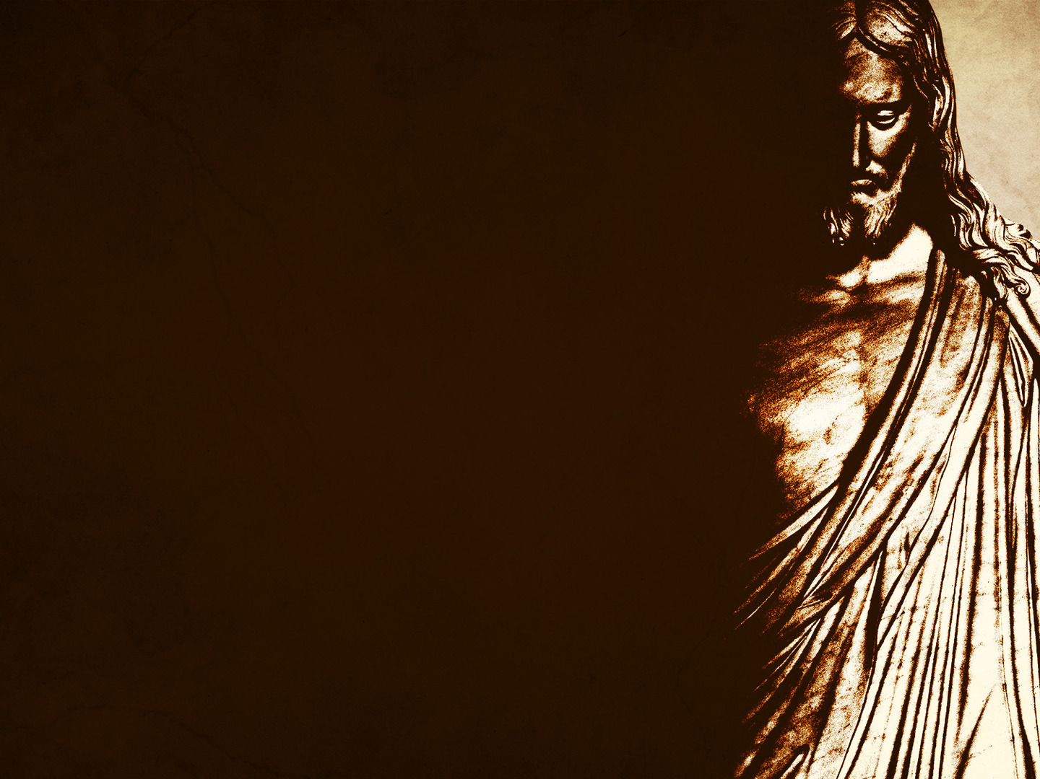
THE OBEDIENCE OF CHRIST
“You did not want animal sacrifices or sin offerings. But you have given me a body to offer” (Heb 10:5b)
“Then he said, “Look, I have come to do your will.” He cancels the first covenant in order to put the second into effect” (Heb 10:9)
“For God’s will was for us to be made holy by the sacrifice of the body of Jesus Christ, once for all time” (Heb 10:10)
Notes:
“You did not want animal sacrifices or sin offerings. But you have given me a body to offer” (Heb 10:5b) - We read in Psalm 51, of how God has always delighted not in sacrifices, but in one with a broken and contrite heart. - God’s delight was always in those whose hearts were clean, and obedient and faithful. - God did not send Jesus down to us and tell him to offer as many sacrifices as he could, or saying “I want you to really show them how they ought to be sacrificing bulls and lambs and goats” - No! Instead Jesus became the Word made flesh, God incarnate, he was given a body to offer
”Then he said, “Look, I have come to do your will.” He cancels the first covenant in order to put the second into effect” (Heb 10:9) - In order to be saved, we would need someone who had never sinned, who was perfect, who would never disobey God, but we could never do that, we were all deserving of condemnation and to spend eternity in hell - But by the grace of God, He sent His one and only Son to die for us. Jesus came to do the will of God. To do what had always pleased God. - Jesus had come to do the will of God, and he would do it perfectly. For only through the perfect obedience of Jesus Christ can we know that his sacrifice would be enough to pay the price for our sins - Jesus was the perfect sacrifice because it was offered in perfect, joyous obedience to God
“For God’s will was for us to be made holy by the sacrifice of the body of Jesus Christ, once for all time” (Heb 10:10) - Or other translations say “By this will we have BEEN SANCTIFIED through the offering of the body of Jesus Christ, once for all” - Been sanctified is past tense. Now what that means is because of the sacrifice of Jesus Christ, every believer in this room, God looks at you and sees Jesus Christ, - He looks at you and sees the righteousness of Christ, He sees the perfection of Christ, He sees the obedience of Christ, and declares a wretched sinner like you and me, innocent, spotless, and holy - We will get into this later, but this does not mean that we will never sin again, or that we will ever be perfect in this life - But because the old is gone, it has been crucified with Christ, and we are now clothed in Christ, God sees us through His Son and His perfect sacrifice, and declares us His children

Slide 4
MANY SACRIFICES VS. ONE SACRIFICE
“Under the old covenant, the priests stand and ministers before the altar day after day…” (Heb 10:11)
Old sacrifices were never done and never effective
“But our High Priest offered himself to God as a single sacrifice for sins, good for all time. Then he sat down..” (Heb 10:12)
Notes:
“Under the old covenant, the priests stand and ministers before the altar day after day…” (Heb 10:11) - It is said that there was no chairs in the tabernacle for the priests to sit on, because they could never rest from their work - They would stand ministering day after day, offering the burnt offerings, and the peace offerings, and the sin offerings and the grain offerings, time after time, the same sacrifices which could never completely remove sin, because God was never completely satisfied with the sacrifice
Old sacrifices were never done, and never effective - They became a ritual for people to make themselves feel better, instead of being done in obedience and out of love and faith towards God - There was no rest for priests because the sins were too great and the sacrifices too little - They were never done because the sacrifices were insufficient and could never measure up to God’s glorious standard. - All the priests could do was sacrifice in obedience to God’s command and point people to the coming of Christ
“But our High Priest offered himself to God as a single sacrifice for sins, good for all time. Then he sat down…” (Heb 10:12) - Jesus Christ came and offered one sacrifice and sat down at the right hand of God - Why? How could we have 2000 years of a history littered with sacrifices and Jesus comes down and offers one sacrifice and all of a sudden he sits down, he stops, he rests. - Because in that one sacrifice the sins of all who would believe were paid for. - Jesus took on the sins of the world, was separated from the Father, but just before he breathes his last breath, what does he say? He declares that “It is finished”. - No more sacrifices, the blood of the perfect Son of God, being poured out for all who will believe is sufficient, it satisfied the requirements of the law, it satisfied the wrath of God, and it was sufficient to not just cover sin, but remove the stain completely. - Christ sat, because his work is finished, his work is complete, and there is never another sacrifice needed

Slide 5
“There he waits until his enemies are humbled and made a footstool under his feet” (Heb 10:13)
“For by that one offering he forever made perfect those who are being made holy” (Heb 10:14)
Jesus has done upon the cross what no priest of Israel could ever have done, and what no world religion could do today
Notes:
“There he waits until his enemies are humbled and made a footstool under his feet” (Heb 10:13) - Listen to me! Christ’s death was sufficient, by saving us from sin and death. Jesus Christ turned Satan’s worst into God’s best. - By dying in our place and for our sins, Jesus Christ took death upon himself, and now all who believe have eternal life - And so we can be sure that the gates of hell will not prevail. That the next time that Jesus returns it will not be to offer another sacrifice but to crush the enemy, once for all. - Jesus rests enthroned, waiting for the day of his final triumph!
“For by that one offering he forever made perfect those who are being made holy” (Heb 10:14) - Earlier I was talking about how we are viewed as complete, perfect, and yet incomplete and imperfect - In Christ, every believer has been made perfect, we are a beneficiary of Christ’s perfection. - And yet there is a process, we will always be being made more into the image of Christ, never reaching perfection until the day we enter the presence of God - But a believer’s final sanctification, final perfection is so certain of achievement that it is now viewed as accomplished, for such is the sufficiency and perfection of Christ’s sacrifice
Jesus has done upon the cross what no priest of Israel could ever have done, and what no world religion could ever do - The priests of Israel had to keep coming back and offering sacrifices. Other religions say, that your good must outweigh your bad. That you must to an extent work your way into heaven - But listen, we can never work our way into heaven. God’s standard is perfection, and our works are but filthy rags. - But the cross, the glory of the cross is that there is nothing for you to do but repent and believe, and keep on looking at the cross for the rest of your life. - For the cross is our only hope for eternal life with our Lord and Saviour Jesus Christ

Slide 6
A NEW COVENANT
“This is the new covenant I will make with my people on that day… I will put my laws in their hearts, and I will write them on their minds” (Heb 10:16)
“Then he says, “I will never again remember their sins and lawless deeds.” (Heb 10:17)
“And when sins have been forgiven, there is no need to offer any more sacrifices” (Heb 10:18)
Notes:
“This is the new covenant I will make with my people on that day… I will put my laws in their hearts, and I will write them on their minds” (Heb 10:16) - Instead of laws on stone, we are given new hearts, we are born again, the old has passed and the new has come - The law is now at the very centre of a believer’s being, so that there is an inner impulse that both delights in knowing God’s law and doing His will - You see we are now temples for the Holy Spirit and the very power of God is at work in us, and transforming us, and it is the life of Christ that animates, that breathes life into me - A sinner who was once dead to God, but by the sacrifice of Christ and power of God at work in you and me, we are now alive to God - God Himself writes His laws on the hearts and minds of all believers. You see a Christian’s obedience is the result of God’s sovereign and gracious inscription on our heart and mind. - For it is no longer I who lives but Christ who lives within me, and because it is only possible by the power of God, I freely and joyfully choose to surrender my life to him
“Then he says, “I will never again remember their sins and lawless deeds.” (Heb 10:17) - Can you just do me a favour, and re-read that verse. - What this verse is saying is that every believer in Christ is as clear before God as though they had never sinned - My sins, past, present and future have been put away from the sight of God, why? - Because Christ’s death was so powerful, and so all encompassing that when we believe in Jesus and are washed clean by his blood, God can’t help but look at us and say “This is my child, and they are innocent before my sight because of the death of my one and only Son Jesus Christ” - God will remember our sins no more, that is why there need not be a guilty conscience for the child of God. Hate sin, be sorrowful over sin, repent of your sin, think as badly of sin as you can - But think of highly and gloriously of Christ as you can, for there is no sin, however hellish or devilish, which the blood of Jesus cannot take away
“And when sins have been forgiven, there is no need to offer any more sacrifices” (Heb 10:18) - You can add nothing to your salvation, there is no sacrifice you can offer to make it up to God for your sins. - All God asks is that you repent, that you fall before the cross, confess your sins, and He will be faithful and just to forgive you - There is no more sacrifice for sin, because Christ has done it all

Slide 7
There was thief on the cross who believed in Jesus and said “Jesus, remember me when you come into your kingdom.” (Luke 23:43)
“We must celebrate with a feast, for this son of mine was dead and has now returned to life. He was lost but now he is found” (Luke 15:23b-24)
“He will not have you and your good works, but He will have you and your sins…” – Charles Spurgeon
Notes:
There was a thief on the cross who believed in Jesus and said “Jesus, remember me when you come into your kingdom.” (Luke 23:43) - The crucifixion was reserved only for the worst of people. This man for all we know had been a criminal for all his whole life, the worst of the worst - A man who very well may have never done a single good work in his life, but where did he go, what did Jesus say to him? - Jesus said, “Today you will be with me in paradise”. How is that possible, that someone so wicked could enter the holy of holies, the very presence of God. - Because the grounds of the thief’s admission into heaven was perfect. The grounds of his admission was Christ’s work, and that is the exact same for how you and I will enter heaven, because Christ’s work is finished and perfect
“We must celebrate with a feast, for this son of mine was dead and has now returned to life. He was lost but now he is found” (Luke 15:23b-24) - This passage is from the story of the prodigal son. And if like the prodigal son you will come all unworthy and undeserving as you are, all hopeless and ruined. - If you will acknowledge yourself as a wandering sheep and sinner deserving His anger, then He will meet you, and when you are yet a long way off He will come to you, and will fall upon you and wrap His arms around you, and declare you a child, perfect and being perfected in Christ
“He will not have you and your good works, but He will have you and your sins” Charles Spurgeon - “He will not have you and your riches, but He will have you and your poverty. He will not have you and your fullness, but He will have you and your emptiness. He will have you as you are, just as you are” - You see the question is not are you good enough, smart enough, or strong enough to trust in Christ. The question is are you weak enough to trust in Christ? To repent and believe in Jesus Christ as your only hope for salvation

Slide 8
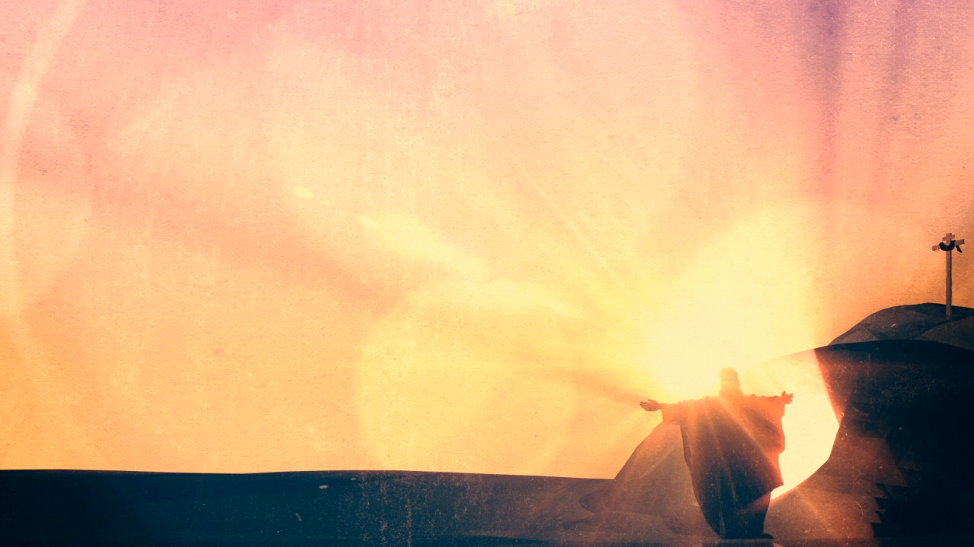
SUMMARY
Christ came and obeyed God perfectly, and in him we find no guilt, no condemnation, but a declaration of innocence and freedom
Christ’s sacrifice is sufficient and effective for all who will believe, for all time
Now, by the power of God at work in us and submitting to Christ, we can live a life that is pleasing to God
Notes:
Christ came and obeyed God perfectly, and in him we find no guilt, no condemnation, but a declaration of innocence and freedom - In Christ you will find no condemnation because Christ has obeyed the will of God perfectly, and lived the life we never could - All of this, the life, death and resurrection of Jesus Christ was to accomplish the will of God, to bring Him glory. And it was for our salvation and our freedom. For whom the Son sets free is free indeed
Christ’s sacrifice is sufficient and effective for all who will believe, for all time - There are no more sacrifices to be made. Christ is sitting at the right hand of God because “It is finished” - It was and is and always will be enough. Sin can no longer provide an obstacle to an enduring covenantal relationship with God. Because of Christ’s sacrifice we are now able to enjoy unhindered access to God in worship
Now, by the power of God at work in us and submitting to Christ, we can live a life that is pleasing to God - Faith in the new covenant says “Christ, today I have sinned. But I hate my sin. For you have written the law on my heart, and I long to do it. And you are working in me what is pleasing in your sight. And so I hate the sin that I still do - And in this hatred of my sin and my meagre advancements in holiness I rejoice that according to your Word by your grace, I have been perfected for all time by a single offering, your precious self”

Slide 9
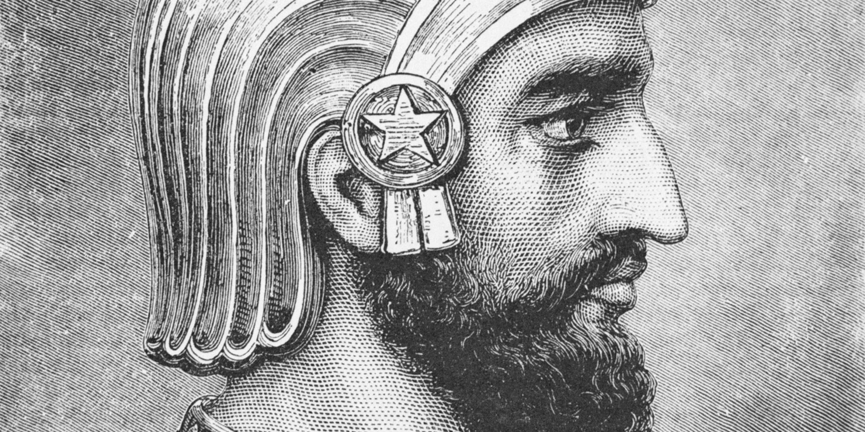
"I didn't notice. I could only keep my eyes on you the one who was willing to give himself for me."
Notes:
It is said that Cyrus, the founder of the Persian Empire, once had captured a prince and his family. When they came before him, the monarch asked the prisoner, "What will you give me if I release you?" "The half of my wealth," was his reply.
"And if I release your children?" "Everything I possess." "And if I release your wife?" "Your Majesty, I will give myself." Cyrus was so moved by his devotion that he freed them all.
As they returned home, the prince said to his wife, "Wasn't Cyrus a handsome man!"
With a look of deep love for her husband, she said to him, "I didn't notice. I could only keep my eyes on you- -the one who was willing to give himself for me.”
This ought to be our response to the sacrifice of Jesus Christ. That we spend the rest of our lives with our hearts and eyes fixated on Jesus Christ, the one who was willing to give himself for us.

