Slide 1
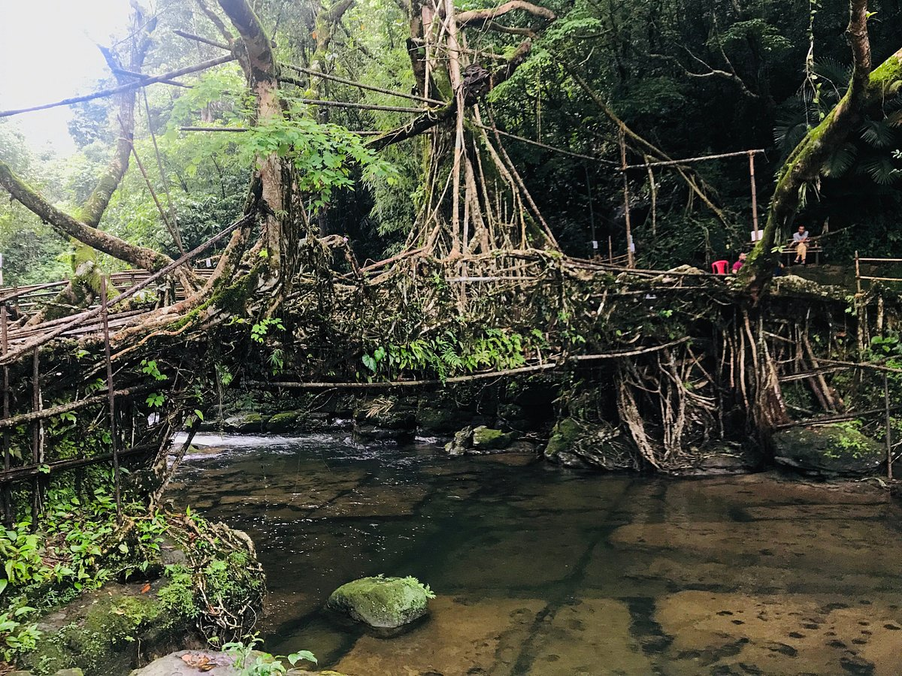
11871mm average annual rainfall.
Meghelaya, northwest India
“For, there is one God and one Mediator who can reconcile God and humanity - the man Christ Jesus.” (1 Timothy 2:5)
A BETTER MEDIATOR
(Hebrews 9:13-28)
Mediator = intervenes in a dispute between two parties.
Reconcile = to restore friendly relationships between 2 parties.
Notes:
Meghelaya is a remote and mountainous region in northwest India – the wettest place on earth with an average yearly rainfall of 11871mm. This means that villages are often cut off by flooded rivers and creeks. In order to get access to this region the locals have developed an amazing system of bridges. Wooden bridges wash away and almost impossible to get concrete and steel into the region. So over the generations the locals have planted strangler trees on one side of a river and once they have grown large enough they start to cultivate the growth so that it starts growing over the river. Eventually when it reaches over to the other side they plant the branches/roots into the ground on that side. Then the tree continues to grow, they intertwine the branches and over time they build a living bridge that withstands the rigours of flood and allows for significant foot traffic. These living bridges connect the communities to each other and the outside world. From a spiritual perspective, the Bible tells us that Jesus is our living bridge to God – he is our living bridge from death to life. Sin has separated us from God and we need to be reconciled to him – we need a mediator, a go between, someone who can can bring us back to God. Only Jesus can do that. Reconcile = to restore friendly relationships between two parties. Mediator = intervenes in a dispute between two parties.

Slide 2
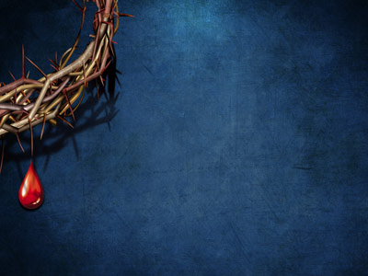
THE REASON FOR A MEDIATOR? – “That is why he is the one who mediates a new covenant between God and people..” (v15a)
We can’t minimise God’s holiness & rationalise our sin.
Sin = separates us from God, makes us his enemy & the penalty is death (Ezekiel 18:4, Romans 5:10, 6:23).
“That is why… (for this reason)” = the old covenant rested on a sea of blood – a gory reminder that sin demands death. Sacrifices were repeated & only High Priest (mediator) could enter God’s presence.
The only hope of any of us having a relationship with a Holy God is for the penalty (death) to be paid. Sin is a monumental issue & it needs a monumental solution = Jesus.
Notes:
Why do we need a mediator between us and God? We may think that we don’t have a problem with God but he has a problem with us. And that problem is sin. Too often we can be guilty of minimising God’s holiness (he will overlook it because he is loving) and rationalise our sin (not too bad, others do worse, I am mostly good). See that in SCCSA – every time there is a red card or a club breaks by-laws there is an expectation that as a Christian organisation we should not put any consequences in place - forgiveness and grace. But sin is serious and it separates us from God – makes us his enemies and the penalty is death. Normally when it comes to mediation there will often be a tendency to find a compromise to reach a solution. But God can’t compromise. There is no common ground between a holy God and sinful humanity. So why do we need a better mediator – verse 15 is looking back at previous verses (which we looked at last week) and saying blood was everywhere under the old covenant. It was built on a sea of blood – millions of sacrifices over 1000 year old covenant – bull had an average of 45 litres of blood. It was a gory and visceral reminder that sin demands death. Ezekiel 18:4 the soul that sins shall die, the wages of sin is death. These sacrifices were repeated every year and covered the previous years sins. Only the mediator (the High Priest) could enter into God’s presence – not everyone.

Slide 3
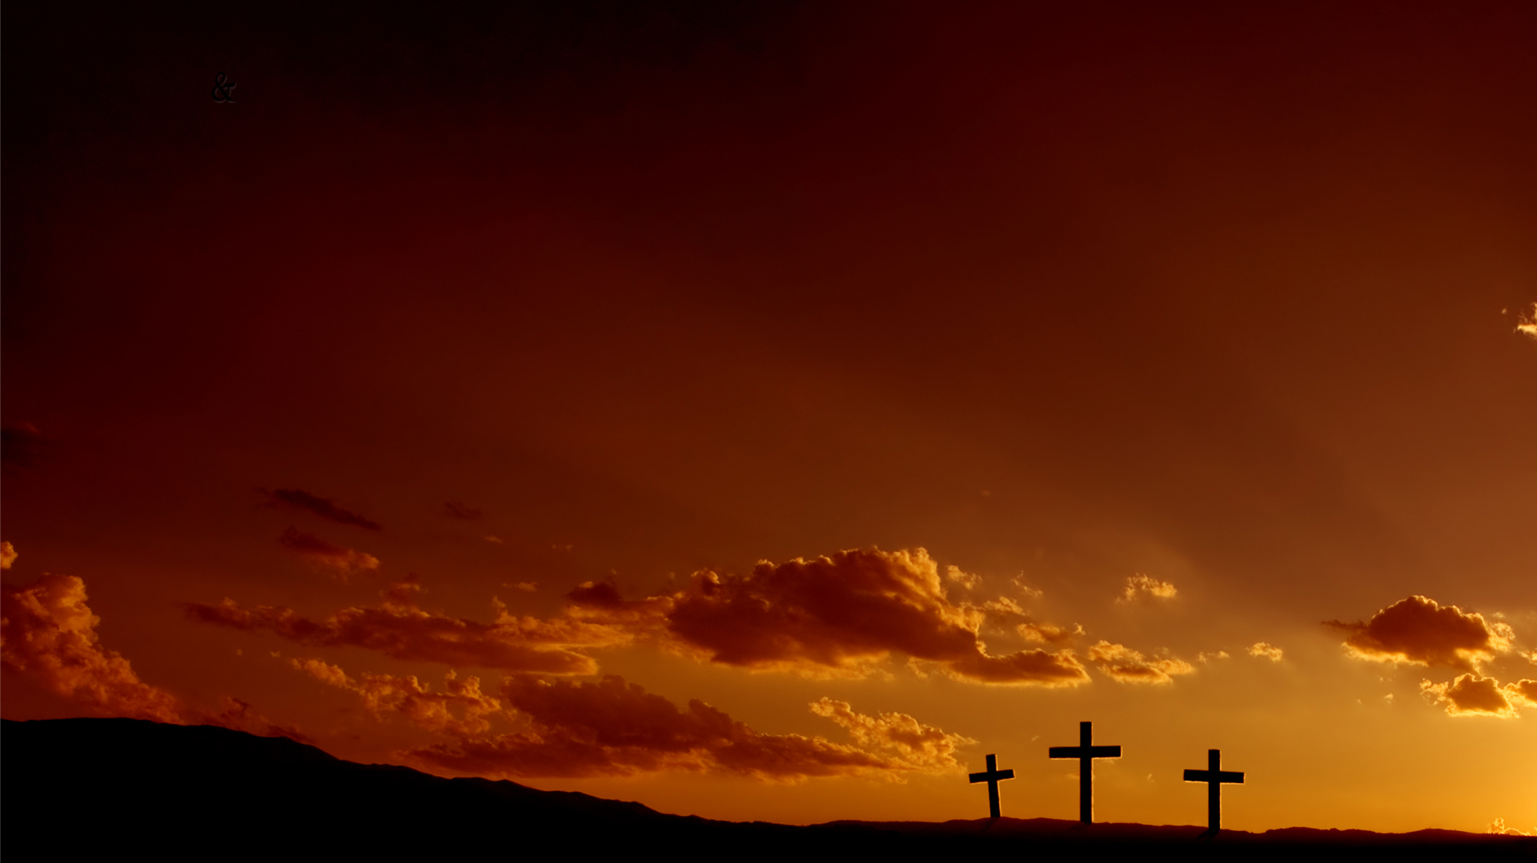
THE RETRO (AND PRO) ACTIVITY OF THE MEDIATOR
How are old covenant believers saved? “I am the way, the truth & the life. No one comes to the Father except through me.” (Jn 14:6)
“… for Christ died to set them free from the penalty of the sins they had committed under that first covenant.” (v15b) = all believers back to Adam & Eve are saved through Christ.
By faith they all trusted in the blood of the ‘incomplete’ sacrifices to save them. Saved on credit – penalty fully paid when Christ died.
Jesus’ sacrifice is also proactive – not just our past sins, but present and future sins too. All believers are forever made perfect by Jesus’ once for all time sacrifice. (Hebrews 10:10-14)
Notes:
One of the big questions people often ask is how are Old Testament believers saved – those living under the old covenant before Jesus came to live a die? Bible tells us there is only one way to be saved – one way to get eternal life and get to heaven = Jesus. But Hebrews 9:15b tells us they are saved by same way we are saved – blood/death of Christ. Such is the power of Jesus sacrifice that it covered all of history – back to those who lived under the old covenant and even back to Adam and Eve. You might say that seems strange but its what the sacrifices given on Day of Atonement did – they sought forgiveness of sins for the past year. But those sacrifices didn’t fully pay the debt – only Jesus could do that. But the awesomeness of what Jesus has done is not just that his death covers our past sins (like under the old covenant) but our present and future sins too.

Slide 4
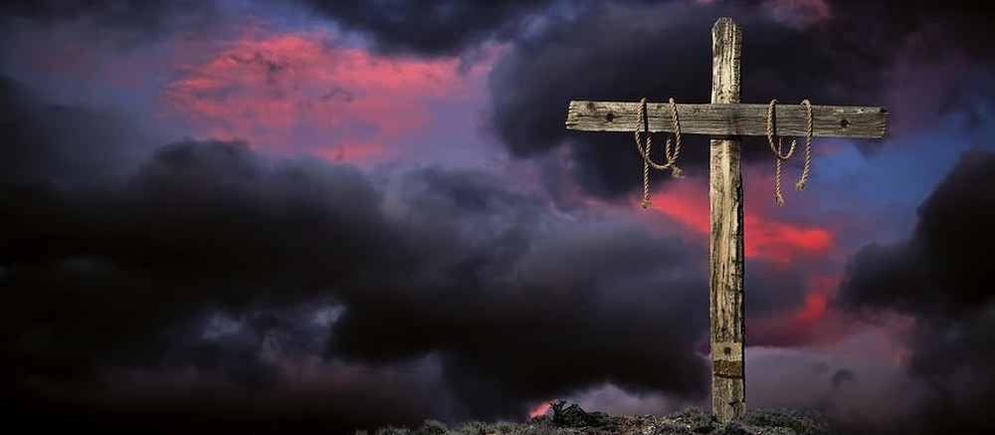
THE REQUIREMENT OF THE MEDIATOR
“How do you get to heaven?”
“You gotta be dead.”
“Now when someone leaves a will, it is necessary to prove that the person who made it is dead. The will goes into effect only after the person’s death. While the person who made it is still alive, the will cannot be put into effect.” (vs 16-17)
“I give them eternal life, and they will never perish.” (John 10:28) = “..a priceless inheritance that is kept in heaven for you, pure & undefiled, beyond the reach of change and decay.” (1 Peter 1:4)
“Christ’s death activated his incredibly rich will. An eternity in the presence of God and the glory of heaven.” (R Kent Hughes)
Notes:
A Sunday School teacher asked her class, how do you get to heaven. One by one the students replied – you have to be good, go to church, believe in Jesus, love God (all the answers you would expect). But all of a sudden one of the students loudly said, you gotta be dead. A lot of truth in that. Death plays a significant part in getting into heaven – but its not our death that matters. Its Jesus death. In verses 16-17 the author of Hebrews talks about the blessings that can flow to others when someone dies – an inheritance. In order to activate an inheritance the person has to die. You can have an inheritance of $5 million dollars, a new Toyota, season tickets to the Cowboys – the most valuable things in the world. But it doesn’t have any value until the person dies. God has a priceless, eternal inheritance for us – Jesus died so that Will would be activated.

Slide 5
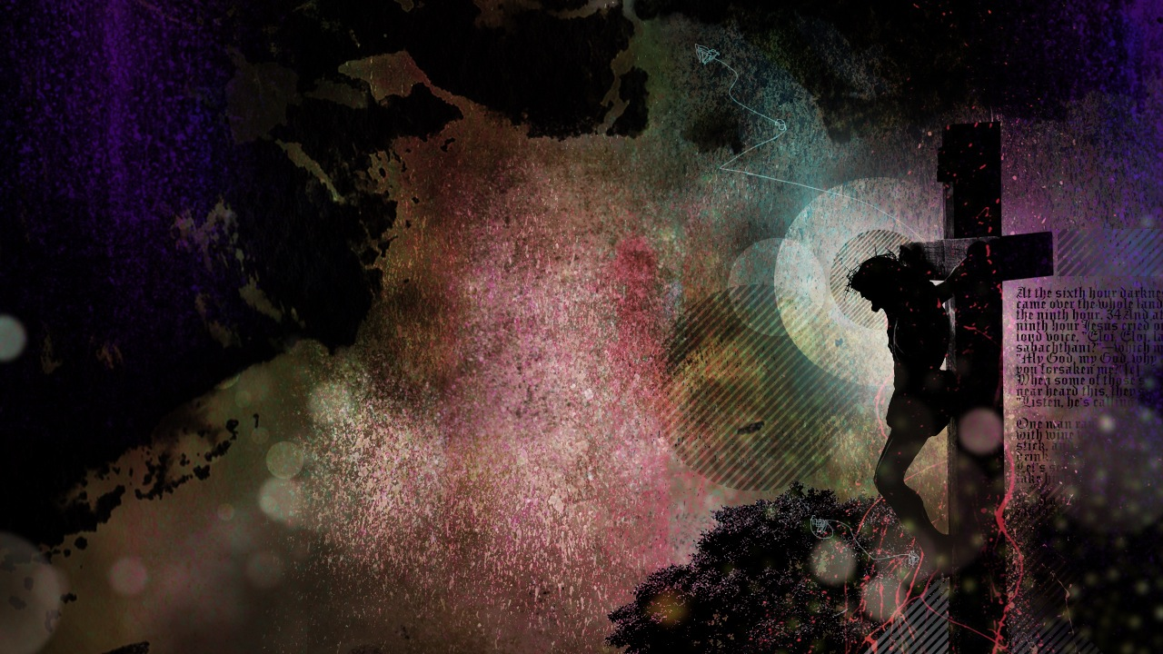
THE RITUAL OF THE MEDIATOR
“That is why even the first covenant was put into effect with the blood of an animal. For after Moses had read each of God’s commandments to all the people, he took the blood… and sprinkled it on the book of God’s law and all the people.. on the Tabernacle and on everything used for worship. In fact, according to the law of Moses, nearly everything was purified with blood. For without the shedding of blood, there is no forgiveness.” (vs 18-22)
Gory reminder that God takes sin seriously. Blood = death, the only thing that can free us from the penalty of sin (forgiveness).
Gospel = you have a choice. Pay it yourself or let Jesus pay it for you. Trust in Him as Lord and Saviour & you won’t die spiritually.
Notes:
Sin is serious – God can’t just set it aside, forget about or let it slide. Blood is not the thing that saves us – blood itself is not miraculous. Otherwise, they could have just bled an animal. But God commanded them to sacrifice an animal – to kill it. Taking the blood = taking the life = Death. Blood is not the penalty being paid. Death is.

Slide 6
THE RESULTS OF THE MEDIATION (what makes Jesus better).
A. A better righteousness – “For God made Christ, who never sinned, to be the offering for our sin, so that we could be made right with God through Christ.” ( 2 Cor 5:21)
B. A better representation – “For Christ did not enter into a holy place made with human hands, which was only a copy of the true one in heaven. He entered into heaven itself to appear now before God on our behalf.” (Heb 9:24)
Jesus represented us on the cross, and now represents us in heaven (advocate) = No one can condemn us. (Rom 8:34)
Notes:
A better righteousness – made right before God. He sees Jesus perfection in us – why we pray in Jesus name. I have no standing in God’s presence in my own name. Jesus righteousness is perfect, beyond question. A better representation – he is our advocate as well as our mediator. Advocating in God’s presence – in heaven itself.

Slide 7
C) A better remission – “He did not enter heaven to offer himself again and again, like the high priest here on earth who enters the Most Holy Place year after year with the blood of an animal…. But now, once for all time, he has appeared at the end of the age to remove sin by his own death as a sacrifice. And just as each person is destined to die once and after that comes judgment, so also Christ was offered once for all time as a sacrifice to take away the sins of many people.” (vs 25-28a)
The problem of sin has been fixed forever – Jesus fully absorbed the penalty of our sin and the wrath of God on the cross.
“There is not a court in the land that can touch those who he has forgiven.”
Notes:
The old covenant was many times over and over again. But with the new covenant, with our better mediator it is once, never to be repeated. There is no need to revisit the problem of our sin again. A doctor in a small rural town served his community faithfully for many years. After he died his wife was going through his books and found a number of entries where he had written, “Forgiven. Too poor to pay.” Perhaps it was due to her grief but the wife did not have such a generous spirit and decided to take legal action to get those debts paid. When she appeared in court the judge asked her, “Is this your husbands handwriting in red?” Yes it is your honour. Then the judge said there is not a court in the land that can touch those who he has forgiven. Because of Jesus life and death = our sin is all settled. Yes we will all die one day and face judgment – but because of Christ we will be declared righteous.

Slide 8
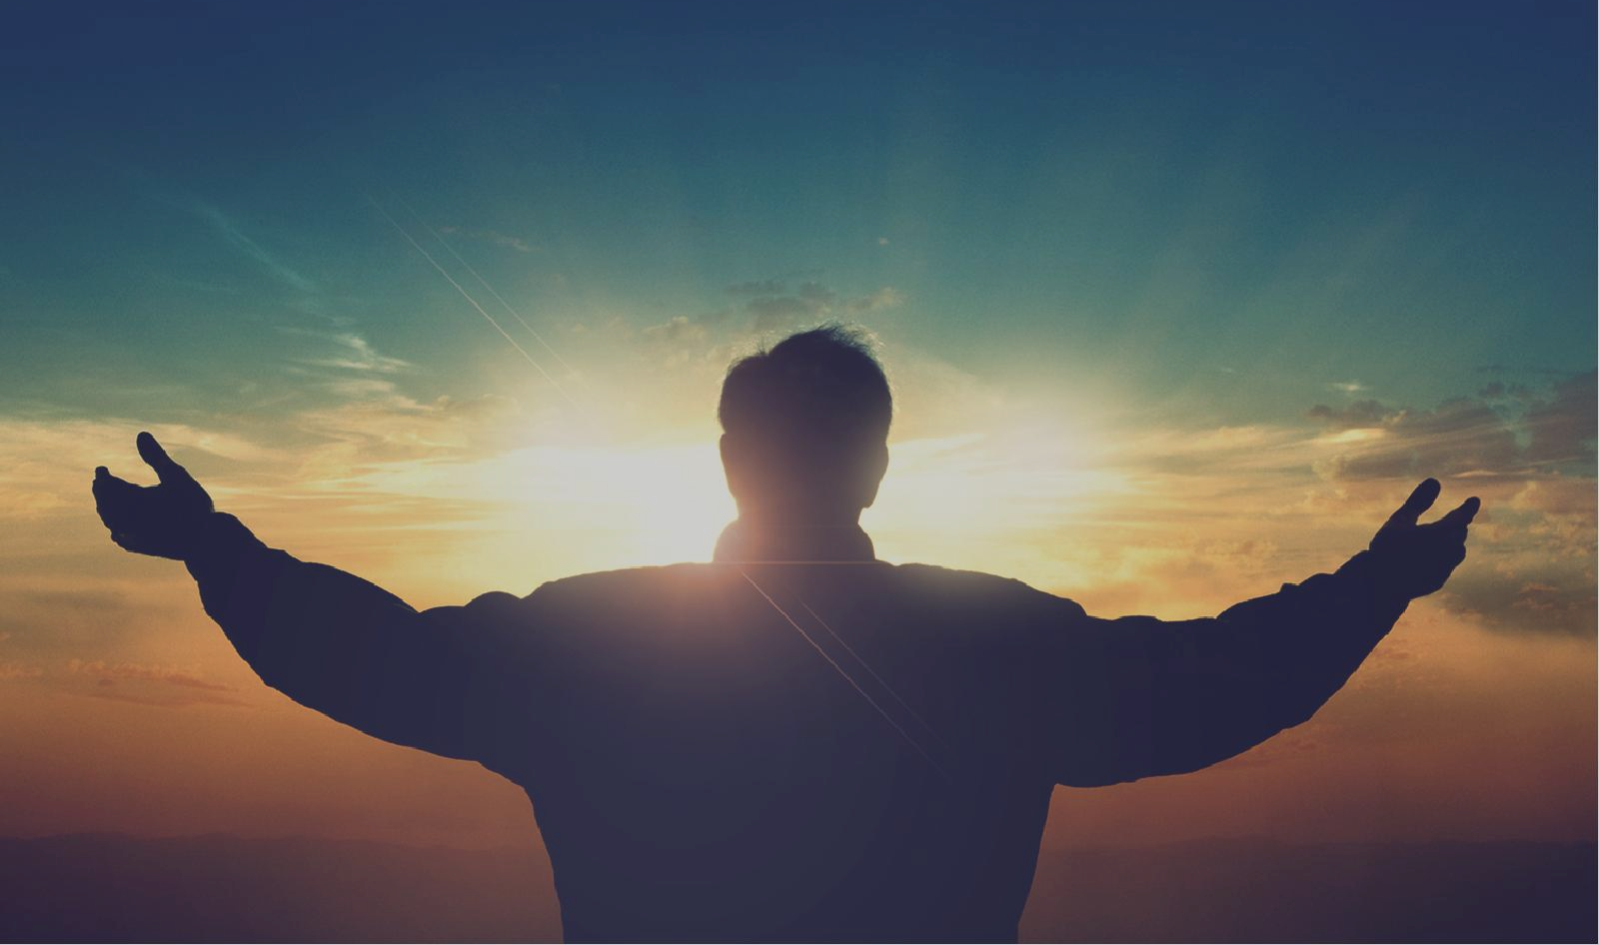
D. A better return – “He will come again, not to deal with our sins, but to bring salvation to all who are eagerly waiting for him.” (v28b)
We should be living in joyful anticipation – eagerly waiting for Jesus to return. How do we do that?
Don’t grow too comfortable in, and dependent on, this world. It’s not your forever home.
Get rid of sinful patterns in your life – replace them with works of righteousness.
Regularly stir your affections for Jesus – read His word, talk to Him, give thanks & worship Him = be satisfied in Him (Ps 17:15)
“Waiting with longing expectation for Christ’s return is one of the distinguishing characteristics of a sincere believer.” (John Owen)
Notes:
Under the old covenant on the Day of Atonement, the people would wait with anticipation as the high Priest entered the Holy of Holies with a basin of blood to seek their forgiveness. They would watch and wait hoping to see him again because it would mean that their sacrifice had been accepted – that they had been forgiven. We too should be eagerly looking forward to the return of our mediator Jesus Christ. Don’t grow too comfortable with this world - the more we look at this world, the less we will look for Christ. Honour God by the way we live – shine our light for him, unlike the bridesmaids who had let their light go out (Matthew 25:1-13). When I worked in the public service I would often go away and I know Shauna would stir her affections for me – stare at my photo, read my texts – eager for me to return. We must do the same with Jesus. We don’t know the day he is coming back but we know he is coming back – we should be excited by that, while we wait, worship and serve him. Be satisfied in him – what satisfies you? New clothes, job, relationship, house, car, fun times, holidays? May our highest satisfaction be found in him.

Slide 9
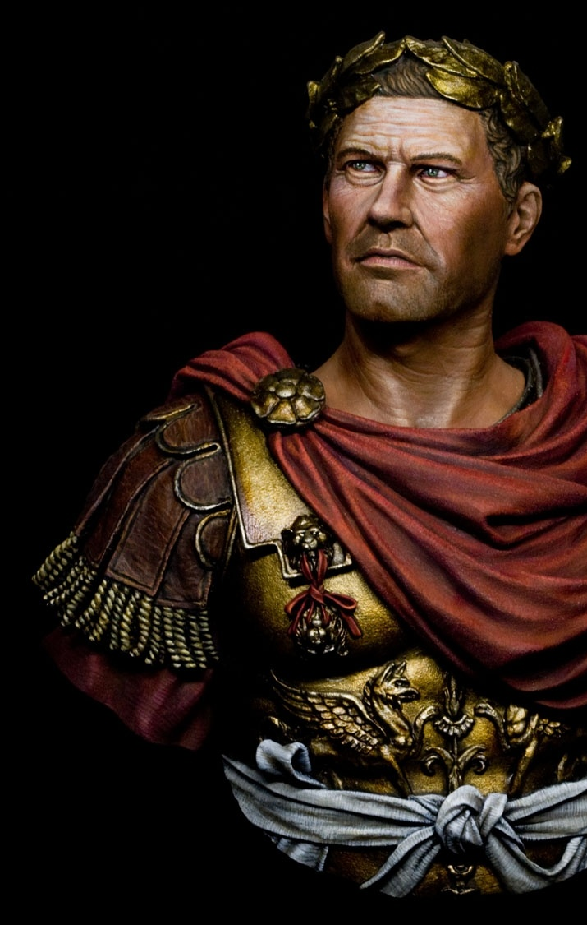
“Friends, Romans and countrymen, lend me your ears… Caesar was accused of being ambitious and dangerous, yet he cared for the poor and refused to accept the crown that was offered to him three times. Was this ambitious and dangerous?”
“Here is Caesar’s will. To every Roman he gives 75 drachmas (2.5 months of wages) and to the city he leaves all his estate.”
“Most noble Caesar, O royal Caesar!” – the people rose up & drove all, who had conspired against Caesar, out of the city gates.
Notes:
Julius Caesar was assassinated on 15 March 44BC at the age of 55. He was betrayed and murdered by the Senate who feared he had become too ambitious and dangerous. His friend, Mark Antony asked if he could say something at the funeral and the senate agreed on the proviso that he didn’t praise Caesar too much. But he didn’t pay attention to their request. He gave one of the most famous speeches in history. In his opening statement he eloquently started to turn the crowd toward Caesar. He then told them about his Will – where he had left ¼ of his vast wealth to the people. Upon hearing the joyous news of the inheritance they had received the crowd started to praise his name and rose up in mutiny to drive out all of Caesar's enemies from the city. If the people of Rome felt compelled to celebrate because of a few months’ wages and some museums, gardens and art galleries and be filled with zeal to drive out the treacherous villains who had put him to death, how much more should we rejoice with an eternal inheritance – lift our heart and voice in praise and worship. How much more should we rise up against the things that put Jesus to death – our sins and drive them beyond the gates of our hearts.

Slide 10
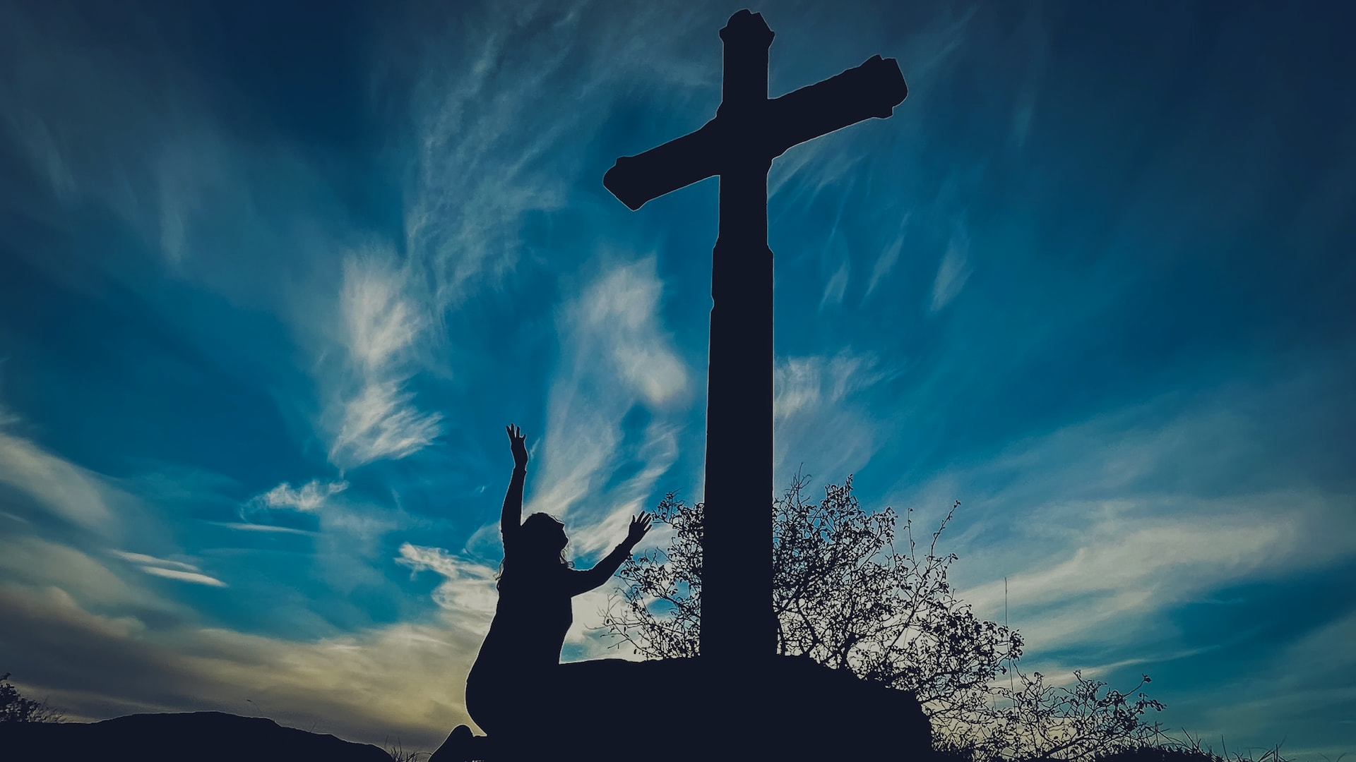
We have a far greater inheritance from Jesus our better mediator. How much more should we praise Him + rise up against the enemy (sin) that put him to death + drive it out from our hearts.

