Slide 1
TRUE WITNESSES
”You must not testify falsely against your neighbour” (Exodus 20:16)
Notes:
Jesus returned to the Mount of Olives, ² but early the next morning he was back again at the Temple. A crowd soon gathered, and he sat down and taught them. ³ As he was speaking, the teachers of religious law and the Pharisees brought a woman who had been caught in the act of adultery. They put her in front of the crowd.
⁴ “Teacher,” they said to Jesus, “this woman was caught in the act of adultery. ⁵ The law of Moses says to stone her. What do you say?”
⁶ They were trying to trap him into saying something they could use against him, but Jesus stooped down and wrote in the dust with his finger. ⁷ They kept demanding an answer, so he stood up again and said, “All right, but let the one who has never sinned throw the first stone!” ⁸ Then he stooped down again and wrote in the dust.
⁹ When the accusers heard this, they slipped away one by one, beginning with the oldest, until only Jesus was left in the middle of the crowd with the woman. ¹⁰ Then Jesus stood up again and said to the woman, “Where are your accusers? Didn’t even one of them condemn you?”
¹¹ “No, Lord,” she said. And Jesus said, “Neither do I. Go and sin no more.”
Today’s command along with all the other commands, should cause us to look inwardly and see that we have fallen short, that we are sinners, and we need to put down our stone. That we ought not be so quick to judge others without first seeing the log in our own eye
The 9th command is a call for us to reconcile and to embrace our neighbours, to forgive rather than accuse, slander, and gossip against our neighbour
My hope and prayer is that you will leave today, gazing so intensely at the cross, and that as you see your sins being paid for, you will walk out so in love with Jesus, and so full of the grace of God, that God’s praises will be on your lips
That we will see that not only are we the accusers, but we are also like the woman, that yes we are sinners, but because of what Jesus has done, if we will repent and believe, we are no longer slaves to sin, or slaves to falsehood, but free in Christ, where we find no condemnation

Slide 2
DO NOT BEAR FALSE WITNESS
Each command is summed up by giving the worst form of the sin
God forbids His chosen people to be a people of falsehood
Lying, falsehood and deceit have been around since the beginning
Notes:
Each command is summed up by giving the worst form of the sin - God says, “You shall not murder”, the worst way of breaking the 6th commandment, but Jesus tells us it isn’t the only way, it is also broken by hating someone in your heart - God says “You shall not commit adultery”, which is the worst way of breaking the 7th commandment, but Jesus tells us that if you lust after someone you have also sinned - And so with the 9th commandment the worst thing you can do is bear false witness in a court of law, where someone could be sentenced to death because of your lie, but in reality it deals with all manner of falsehoods
God forbids His chosen people to be a people of falsehood - Our God is the God of truth, no lie will ever be spoken by Him or found in Him. Jesus said I am the way THE TRUTH and the life - And so for Israel who are God’s chosen people, the people chosen to represent Yahweh to the nations, He is commanding them to represent Him well by speaking truth - Why? Because lies hurt people deeply. We all know that saying “Sticks and stones may break my bones, but words will never hurt me” but it just isn’t true. God cares about verbal justice, and in its broadest application this command is dealing with sins of speech. Speech that tears down our neighbour - This command was meant to protect marriages, relationships, property, life, reputation and honour
Lying, falsehood and deceit have been around since the beginning - We see lies in the Bible from start to finish. Let me list a few for you: - Satan lied in deceiving Adam and Eve. Cain lied after murdering Abel, stating he didn’t know where Abel was. Abraham lied claiming Sarah was his sister instead of his wife - Sarah lied to the 3 angelic visitors and the king of Gerar. Isaac lied by denying Rebecca was his wife. Rebecca and Jacob lied in their conspiracy to defraud Esau of his birthright - All of these lies and we aren’t even out of the first 27 chapters of Genesis - Lying, deceit and falsehood is clearly a big problem, something that I would be willing to say all of us have done and maybe still struggle with
ILLUSTRATION: A minister, one Sunday morning, said to his congregation, "Next week I plan to preach about the sin of lying. In preparation for that message, I'm asking all of you to read Mark 17 this coming week.
The following Sunday, he stood up to preach and asked, "How many of you took the time to read Mark 17 this past week?" Nearly every hand went up.
The minister smiled and said, "That's very good, but Mark has only 16 chapters. I will now proceed with my message on the sin of lying."

Slide 3
THE OLD SELF
“So put to death the sinful, earthly things… sexual immorality, impurity, lust, and evil desires. Don’t be greedy” (Col 3:5)
“But now is the time to get rid of anger, rage, malicious behaviour, slander, and dirty language” (Col 3:8)
“Don’t lie to each other, for you have stripped off your old sinful nature and all its wicked deeds” (Col 3:9)
Notes:
“So put to death the sinful, earthly things… sexual immorality, impurity, lust, and evil desires. Don’t be greedy” (Col 3:5) - In this list of sins we can clearly see that Paul is referencing a lot of the other commandments we have already talked about, but I want us to take particular notice of the start - We are to put to death the sinful, earthly things, and we do that by believing in Jesus, by repenting of our sins, for Christ was nailed to that cross for our sins. For our old earthly selves are crucified with Christ, and the penalty of our sins have been paid - But stripping ourselves of our sinful, earthly things, repenting of our sins, is not a once off thing, but continual, daily surrender to Christ and allowing Holy Spirit to work in us
But now is the time to get rid of anger, rage, malicious behaviour, slander, and dirty language” (Col 3:8) - All the sins in this list are social, they are sins committed directly against other people - The first 3 words, anger, rage and malice are all very similar in many ways, and Paul has done that to portray an attitude of anger and ill will towards others which leads to obscene talk, to hasty and nasty speech. - It is when we are angry that we are most prone to lie, to bring someone down, to harm their reputation, which is all slander, and which is exactly what this command of bearing false witness and harming your neighbor's reputation is all about. - We are not to harm people, with our words, who have been made in the image of God. We are not to be quick to damage people’s reputation, for who are we to cast that stone. We must be slow to judge others, for with the measure we use in judging others, is the measure which we will be judged by
Don’t lie to each other, for you have stripped off your old sinful nature and all its wicked deeds” (Col 3:9) - All who believe in Jesus Christ as Lord and Saviour no longer belong to Satan who is the father of lies, for the old has gone. You are a new creation in Christ - Lying should not be something that defines who we are, but rather truth, for we are indwelt by the Spirit of truth - As a church let us not be liars, but rather let us speak the truth in love, let us build up one another and let us urge one another on by the truth of God’s Word

Slide 4
Habits of the old life are but a breath away
God hates it when we as Christians tell lies about others or to others to make ourselves look more righteous than we really are
“Put on your new nature, and be renewed as you learn to know your Creator and become like him.” (Col 3:10)
Notes:
Habits of the old life are but a breath away - We have died to sins penalty, death has lost its sting, and if you believe in Jesus Christ as your Lord and Saviour you will spend eternity with him - But sin’s power still can be strong because our flesh is weak. When we aren’t fully leaning on Christ, when we aren’t being saturated by the Word of God, Satan will be right there, trying to get a foothold in your life and you may find yourself in dangerous territory - And that is exactly what happened in the case of Ananias and Sapphira. They were forced neither to sell their field, nor give all the proceeds of the property once it was sold - But instead of just telling the truth, they lied about the charity, they wanted to be seen as better Christians, they wanted to be like Barnabas, they wanted the name change, they wanted to be noticed for how generous they were being, and their lie ended up costing them their lives
God hates it when we as Christians tell lies about others or to others to make ourselves look more righteous than we really are - Spiritual deception is heinous to God. When we lie to believers, we are lying to the Lord, and when we lie to God we devalue the cross where Jesus traded places with us, the liars - To act like we have it spiritually together is a lie. But even more than that it is a denial of the grace of God, which alone has the power to save us - When we put up a façade, tell lies about how spiritual we may be, we undermine our testimonies. My testimony is not one of my goodness, my works, my righteousness. My testimony is one of grace and mercy, of my unrighteousness - But when are willing to admit to ourselves and others our sins, we point people back to the grace of God. We are beckoning people to stand side by side with us as we gaze at the cross and see the love of God poured for all who will believe
“Put on your new nature, and be renewed as you learn to know your Creator and become like him.” (Col 3:10) - So put on Jesus Christ, strip off your unrighteousness, your sins, every bit of falsehood, give that to Christ and receive his perfection, his righteousness - You will be renewed, your heart and mind will be transformed, not by your good works, but by knowing your Creator, through an intimate relationship with your heavenly Father, by reading His Word and allowing it penetrate the darkest pits of your soul. - As you draw close, the Holy Spirit gets to work in renewing you day by day, making you more and more like Jesus Christ

Slide 5
NEW SELF
“Since God chose you… you must clothe yourselves with tenderhearted mercy, kindness, humility, gentleness, and patience” (Col 3:12)
“Make allowance for each others faults, and forgive anyone who offends you” (Col 3:13)
God has given us the capacity to speak so that we can praise Him and bless others
Notes:
“Since God chose you… you must clothe yourselves with tenderhearted mercy, kindness, humility, gentleness, and patience” (Col 3:12) - These characteristics are the clothing of saints, the wardrobe of those who have been born again - Now these are the opposite traits of the ones that belong to the sinful nature, which was anger, wrath, malice, slander, obscene talk - And just as when we are filled with anger and hatred so will our speech be. But as we are being renewed inwardly day by day, with all of these traits, out of our mouths will flow loving words, words that build up, words that encourage one another and spur us on towards Christ, out of our mouths we will speak the truth in love. We will speak words that show love towards our neighbour rather than hurt them
“Make allowance for each others faults, and forgive anyone who offends you” (Col 3:13) - It is not enough to put up with each other, to refuse retaliation, we must truly forgive and recall the immense forgiveness of Christ in our own lives - Someone who is merciful, and kind, and patient and loving will make allowance for other people’s faults, because as the grace of God is at work in our lives, how can we do anything but show that same grace to others
God has given us the capacity to speak so that we can praise Him and bless others - In James chapter 3 when he is talking about the power of the tongue he says that “With it we bless our Lord and Father, and with it we curse people who are made in the likeness of God. From the same mouth comes blessing and cursing. My brothers, these things ought not be so” - So often we come to church and sing the praise of God and declaring His goodness and that we love Him so. And yet probably before we even leave the building are gossiping and slandering and mocking the very people who have been made in the image of God - To reflect the character of God is to love others in deed and in speech. We must speak true words and take great pains to say the truth and nothing but the truth

Slide 6
“Remember, the Lord forgave you, so you must forgive others” (Col 3:13b)
We must live our lives as true and faithful witnesses for Christ
How do we do this impossible task?
Notes:
“Remember, the Lord forgave you, so you must forgive others” (Col 3:13b) - I love that Paul, and ultimately God put this in here, because it brings us back to the first verses of the 10 commandments where God reminds the people of Israel of their deliverance. He reminds them of their salvation from the darkness of Egypt, from the bondage of slavery and into the light, into the freedom that comes with living for God and belonging to His kingdom - So for us today we are to remember the forgiveness that has been shown to us in Christ. We should forgive because Christ has forgiven us, we can love because Christ first loved us, and we speak the truth because our salvation rests in THE truth, Jesus Christ - Don’t hold onto your grudges, don’t bring your neighbour down, don’t speak ill against them, or slander or gossip about them because they have hurt you. - Rather reconcile with them, embrace them, and remember the gospel, remember the grace that has been shown to you
We must live our lives as true and faithful witnesses for Christ - D. L. Moody once said “Out of 100 men, one will read the Bible, the other 99 will read the Christian”. Those we are surrounded by want to know what makes us different, what makes our God different - Speaking the truth in love to our neighbours is important, because truth is the nature of God Himself and thus it pleases Him when we as His ambassadors, His representation live as faithful witnesses, portraying Him as the one true God to others
How do we do this impossible task? - Some of you may be thinking how can we do this? How am I to love those people, and speak well of those who genuinely hate me, who are always speaking ill about me, or who just outright annoy me - Well, firstly, it is impossible in your own strength, it is not enough to just try harder, or to just try and think before you speak - I promise you, that you will fail if you attempt to accomplish this task in your own strength

Slide 7
CHRIST IS THE ANSWER
“For you died to this life, and your real life is hidden with Christ in God” (Col 3:3)
“And let the peace that comes from Christ rule in your hearts” (Col 3:15)
“Let the message about Christ, in all its richness, fill your lives” (Col 3:16)
Notes:
“For you died to this life, and your real life is hidden with Christ in God” (Col 3:3) - The impossible task of being obedient to God and His Word, and being people who speak truth is only possible when we die to ourselves and live in Christ - For it is no longer I who lives, but Christ who lives within me. - Paul says to set our minds on things above, on Christ and not the things that are on earth
“And let the peace that comes from Christ rule in your hearts” (Col 3:15) - Romans 5 tells us that because we have been justified, because we have been declared righteous in Christ by faith, we have peace with God, a peace that surpasses all understanding - This peace is the peace of the presence of Christ, it is the ceasing of hostility with God, that we can truly sing, no matter what our circumstances may be, “it is well with my soul” - And we are to let that peace rule our hearts and amidst the busyness and conflicts of life let Christ guide our words, let Christ guide us into truth - If we all did this, we would be a people slow to speak falsely, slow to bite back in hatred, but quick to speak truth
“Let the message about Christ, in all its richness, fill your lives” - Let your heart and mind be saturated in the Word of God, so that out of your mouths may flow the truth of God’s Word - We must hold Scripture close to our hearts. We must preach the gospel to ourselves and build one another up in His wisdom and His Word - There is one name in each of the last 3 dot points, it’s not mine, and it’s not yours. It’s Jesus Christ, he is the answer to the impossible task of obedience to the 10 commandments. It is Christ + nothing

Slide 8
SUMMARY
To love others, we must not tell lies about them, or do anything to ruin their reputation
The problem is that we are all liars (Rom 3:4)
In Christ, we are transformed, made new, and given a brand-new wardrobe that we must ‘put on’ continually
Notes:
To love others, we must not tell lies about them, or do anything to ruin their reputation - We are to be careful with our words, for the tongue is very dangerous and holds a lot of power - God has given us this command because He wants to protect relationships between people, He doesn’t want relationships to be built on lies and mockery
The problem is that we are all liars (Rom 3:4) - Lying is part of our sin nature, it has always been around and even as Christians we will still struggle with this - We see this even in Peter, one of the twelve disciples, who 3 times denied knowing Jesus, lied about his relationship with Jesus - And yet we see at the very end of the gospel of John, He is forgiven and told to go and be a leader for God’s people. Why? Because…
In Christ, we are transformed, made new, and given a brand-new wardrobe that we must ‘put on’ continually - Satan is out to get us, sin is strong against our flesh. It’s going to be a fight, but if you daily surrender, commit, and put on Christ you will find victory - Equally as good though is the promise and truth that because the Holy Spirit is now living inside us, when we sin, we will not find condemnation, but forgiveness - The commandments were a guide for Israel to live and do right by God and others, and it is only in Christ that we can truly do this

Slide 9
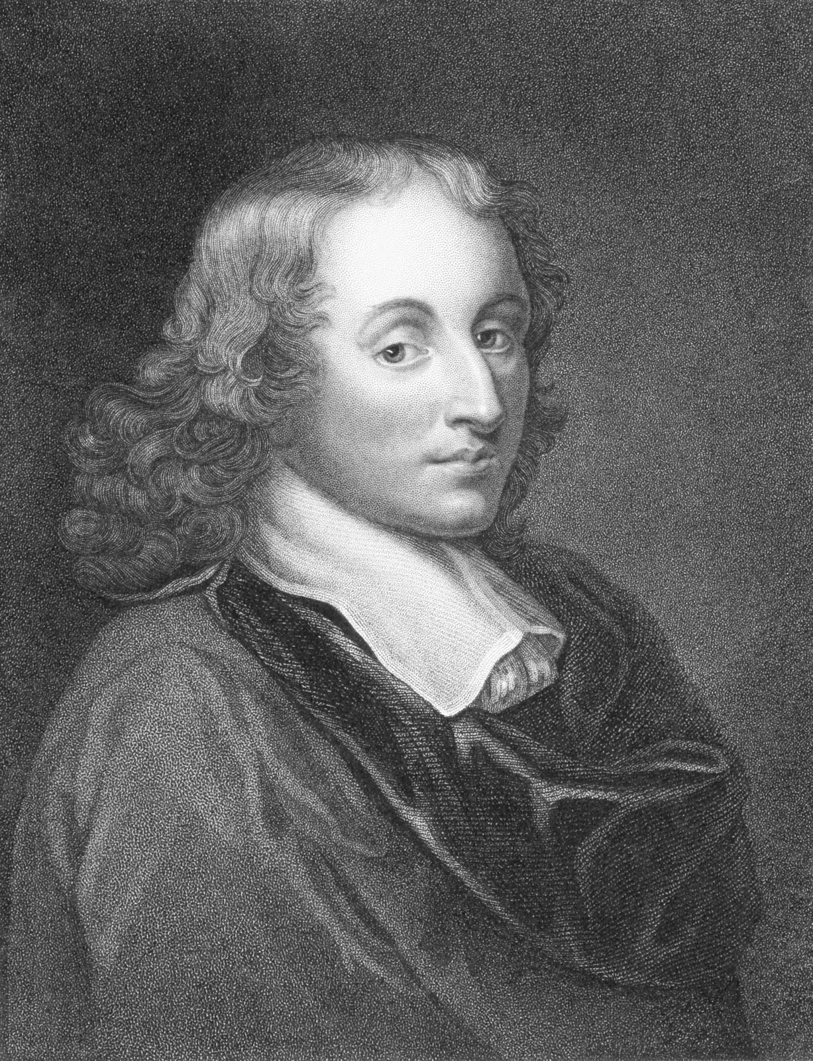
”Truth is so obscure in these times, and falsehood so established, that, unless we love the truth, we cannot know it.”
Blaise Pascal
Notes:
”Truth is so obscure in these times, and falsehood so established, that, unless we love the truth, we cannot know it.” Blaise Pascal
Don’t bear false witness about your neighbour speak well of them, speak the truth about them. But ultimately, let us not bear false witness about God
May we know THE truth, who is Jesus Christ, and may we love the truth, and speak the truth, boldly and in love, in a time where falsehood permeates our society. Let us be a source of truth for all those around us.
Let me close with the words of our Lord and Saviour. “If you abide in my word, you are truly my disciples, and you will know the truth, and the truth will set you free… So if the Son sets you free, you will be free indeed”
Let’s pray

