Slide 1
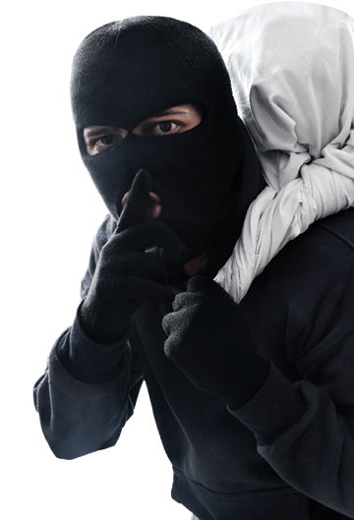
“You must not steal.” (Ex 20:15) = the 8th commandment.
LET THE THIEF STEAL NO LONGER
(Malachi 3:6-12, Ephesians 4:17-32)
1. THE WAY WE ARE SUPPOSED TO LIVE
2. WRONG TAKING
3. WRONG KEEPING
4. HOW DO WE LIVE AS WE SHOULD?
Notes:
Start this morning by sharing three stories. In America, a 40 year old man (James) walked into a bank in Illinois and handed the bank teller a threatening note which read, “Be quiet! Be quick! Fill up my bag with money or I will shoot you.” The teller did what he was told and the thief walked out with the money. His big mistake was that he wrote the threatening note on the back of his pay slip which had his name and address on it. In England (Alex) a thief walked into a corner store and approached the cashier – putting $20 on the counter and asked for the cashier to give him four $5 dollar notes. Once the cashier unlocked the cash drawer he pulled a knife and demanded all the money. The casher gave him all the money and the thief ran off. The only problem was that he only got $15.75 – less than the $20 he left on the counter. Another thief in Australia (unknown name) reached into a parked car at a shopping centre and pulled a bag from the back seat. The problem he had was that the car belonged to Brad McDonald, a snake catcher, and there was a venomous snake in the bag. The thief got a rude shock once the bag started wriggling in his hand and he quickly discarded it when he realised what it was. While these are humorous stories about some incompetent thieves, we must be careful that we don’t minimise the seriousness of stealing. God thinks its serious because he includes it in the 10 commandments (no. 8). As we look at this commandment we are going to see that there is more to it than we think and that it may be more real in our life than we know. Look at four things.

Slide 2
1. THE WAY WE’RE SUPPOSED TO LIVE
“Fill the earth and govern it. Reign over the fish, birds and all the animals. Look! I have given you all the seed-bearing plants and fruit trees for your food.” (Gen 1:28-29)
“The Lord God placed the man in the Garden to tend and watch over it.” (Gen 3:15)
Everything we have comes from God (1 Chron 29:14) = we were created to appreciate & care for things.
Stealing = taking something that doesn’t belong to us = trampling on the caretaking rights of others.
Notes:
You shall not steal tells us something profound about human nature. When God created Adam and Eve he didn’t just tell them to be fruitful and multiply. He told them to look after his creation – to care for the awesome things he had made. He gave them food supply to look after – he gave them the garden of Eden to care for. It was theirs to watch over – to manage and care for. In 1 Chronicles King David recognised that everything we have ultimately comes from God – he gives us good things to care for. God loves to blesses us with things to care for – he is not stingy, not against giving us amazing wealth to care for.. We were made to appreciate and care for material things. That’s why we get a sense of worth and significance out of having things and caring for them. That’s why we feel so violated when someone takes things from us. That’s why God hates stealing so much – because it tramples on the caretaking rights of others. There are two ways that the Bible says we can steal – by taking something wrongfully and by keeping things wrongfully.

Slide 3
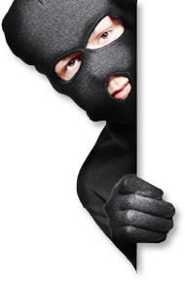
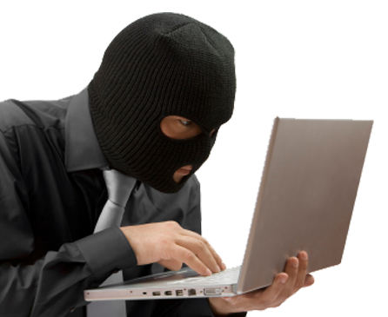
2. WRONG TAKING
a) Unlawful taking of someone else’s property (personal, intellectual or corporate) – theft, robbery, scamming, shoplifting, illegal downloading/streaming, plagiarism…
b) Unlawful taking of people – slavery or kidnapping. “Kidnappers must be put to death, whether they are caught with their victims or have sold them as slaves.” (Ex 21:16)
c) Devious business practices – “The Lord detests the use of dishonest scales..” (Prov 11:1) = price gouging, high surcharges, fraud, enticement, exorbitant interest, unfair wages…
d) Devious personal practices – false tax, insurance or welfare claims, gossip or slander (steal reputation).
Notes:
There are a number of ways we steal by taking wrongly from others.
a) Unlawful taking of property – not just from individuals but also corporations, businesses, clubs, motels. In this digital age we see stealing when it comes to streaming (sharing passwords and not paying for product), plagiarism (intellectual property). An area of increased theft today relates to people taking parcels from front door of homes.
b) Unlawful taking of people – Joseph was ‘ganabed’. God hates slavery, He rescued Israel from slavery and didn’t want them to enslave each other. This was different from indentured servitude where people could commit themselves to someone in order to be housed, fed and protected. Indentured servitude is very different from slavery we know in the world (as we saw in early American history).
c) Devious business practices – price gouging , unnecessarily high surcharges (e.g. on eftpos machines – experienced fluctuation of prices at the Bundaberg show recently), exorbitant credit card or loan interest rates. Exodus 22:25 seems to indicate we shouldn’t charge any interest at all but Jesus encouraged putting money into the bank to earn interest in the parable of the good and faithful servant (Matthew 25:26-27) – so it must mean unfair interest rates. Don’t take advantage of people who have fallen on hard times. Don’t entice people into buying things they don’t need (a more expensive model). Don’t knowingly sell false or faulty products. Some of these may not be illegal but they are sinful in God’s eyes.
d) Devious personal practices – false claims for insurance, taxes or welfare (thinking they won’t miss the money, I have paid my dues over time – they owe me). We can also steal someone’s reputation through gossip or slander.
Looking at that list, how do we think we are going? Any areas of concern? Perhaps not! But I’m not so sure we will be as confident when we look at the next way we can steal = wrong keeping.

Slide 4
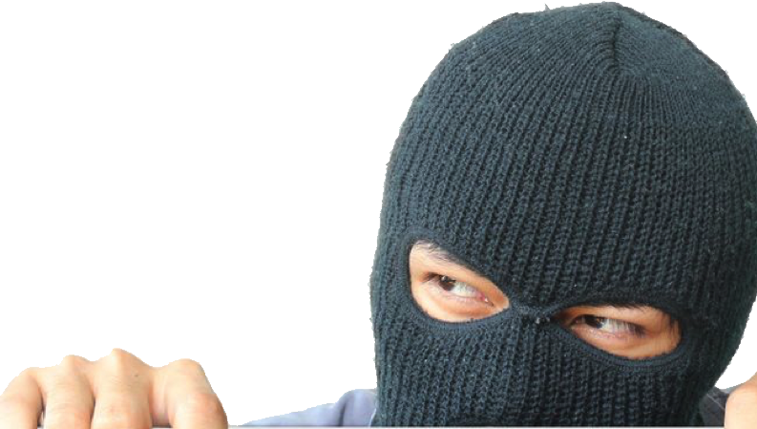
3. WRONG KEEPING - “If you are a thief, quit stealing. Instead, use your hands for good hard work, and then give generously to others in need.” (Ephesians 4:28)
You are either a thief or you are radically generous person – there is nothing in between. Everything you have is a gift from God, given to you to care for according to His priorities.
We don’t own what God gives us – we’re His trustees, managers.
“Will a mere mortal rob God? Yet you rob me. “But you ask, ‘How are we robbing you?’ “In your tithes and offerings. You are under a curse because you are robbing me.” (Malachi 3:8-9)
Notes:
There is an old joke that says when is a door not a door? When its ajar! When is a thief, not a thief? When he has stopped taking. No! Paul would say you have not stopped being a thief when you stop taking. You have only stopped being a thief when you have become radically and joyfully generous in your giving to others. As long as you treat everything you have as your own, and justify hanging onto it for yourself and spending it on yourself (and your priorities) then you are a thief. Imagine if I was the grounds keeper and manager of the soccer fields and shed. That would mean I have been given a lot of authority to maintain and care for the facility – I have complete run of the place. All the keys and all the usage of the facility needs to be checked with me. But it’s not mine. If I start to sell off some of the equipment or say I’m not going to let anyone use the fields until its perfectly ready or suitable then I am starting to act like a thief. I have been given that authority and facility to use for the priorities of the club – to play soccer and be enjoyed by others (players and parents and coaches). That is wrong keeping. That’s the accusation that God makes against his people in Malachi 3:8-9. They were holding onto some of God’s gifts to them and not giving back to him as he asked – not submitting to his priorities. He had said give me a minimum of 10% of what I give you – but they weren’t doing that. Note that he doesn’t just call them stingy – he calls them robbers.

Slide 5
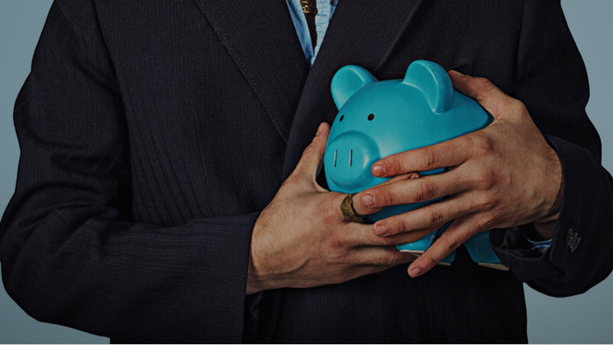
God’s priorities = the poor (Deuteronomy 15:7-11), the mission of His church (1 Corinthians 16:1-2), those who lead or work in the church (1 Corinthians 9:9-14), the needs of other believers (1 John 3:17) and family (1 Timothy 5:8).
You are a thief if your attitude to your finances isn’t right – if you see it as yours to use according to your priorities.
Is that fair? I worked hard for that money! I earned it! But what did you earn it with? Talents, mind, strength, opportunities, health, time… All gifts from God.
To misuse what God has entrusted us with for ourselves = stealing. Not stealing = giving radically, joyfully and generously.
Notes:
What are God’s priorities? God wants us to care for those in need and struggling in our community. He wants us to collect money for the mission of his church i.e., ministries, missionaries, resources – all we need and use to share the gospel. Those who teach or are paid to lead/manage the church, the needs of other believers (none should be struggling) and our families should be provided for. How do those priorities align with our budget? I wonder if many of us think more that is the priority for the 10% but not so much with the rest. We think we have met our obligation to meeting God’s priorities in our %10 or whatever amount we have decided in our heart to give to God. We will pray and seek God’s guidance on how we use the 10% but its none of God’s business with what I do with the rest. We can quibble over a $30,000 sign (is it good stewardship?) but spend $30,000 on a holiday without too much thought.

Slide 6
4. HOW DO WE GET THERE? - “If you are a thief, quit stealing. Instead, use your hands for good hard work, and then give generously to others in need.” (Ephesians 4:28)
Three options = steal to have (illegal), work to have (legal) or work to give (radical). The first two are driven by selfishness and greed/discontent
- not pleasing to God (sinful).
Working in order to have is an Australian ideal, but its not a Christian ideal. Don’t steal, work and give = God’s radical financial plan. How do we get there?
Notes:
Working to have is an Australian ideal – it is engrained into our mindset, dare I say particularly for the Baby Boomer era. We have been seeing the news lately as the boomers battle the millennials over interest rates. Boomers boast of how they did it tough in their early years (high interest rates, borrowed furniture, no holidays) and have earned the right to have their money and indulge themselves. But its not God’s ideal for us – its not his financial plan for us. His plan is radically different. So how do we get where we should be when it comes to being joyfully generous with all that God has given us. Not by guilt. My intention this morning is not to guilt you into not stealing, working and giving. Guilt only works for a little time.

Slide 7
a) A changed heart and a new focus – “You know the generous grace of our Lord Jesus Christ. Though he was rich, yet for your sakes he became poor, so that by his poverty he could make you rich.” (2 Corinthians 8:9)
Jesus stripped himself of everything for you – the pain it cost Him is far greater than the pain it will cost us.
We have riches in Christ that can’t be destroyed or stolen (Matt 6:20) – salvation, no condemnation, glory of eternal life with God, prayer, Holy Spirit ….
We all think about money too much. We love it too much and we let it define us – let Christ define you.
Notes:
a) First way to achieve this radical generosity is to focus on Christ – on his grace and the riches we have in him. Christ gave everything for us – it cost him more than we can ever understand. The cost of a lost holiday, renovation, new car, subscription etc., is nothing compared to what Christ has done for us. Once we truly grasp the “riches” we have in Christ then we will never salivate over the things of this world again.

Slide 8
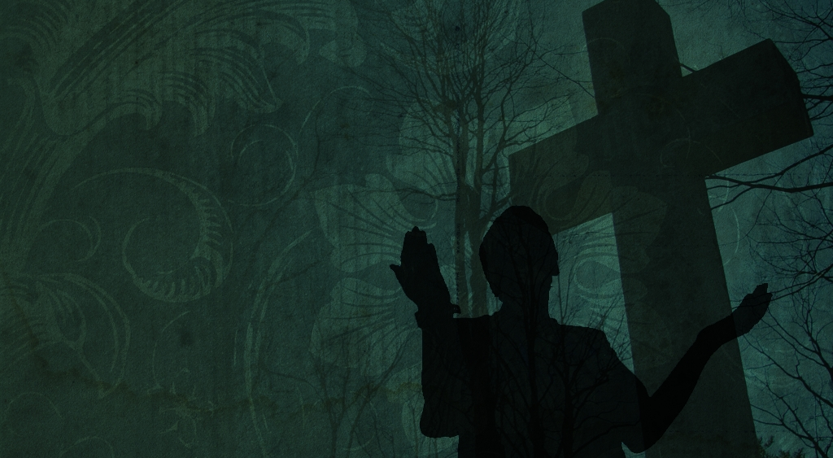
b) Faith – “Don’t love money; be satisfied with what you have. For God has said, “I will never fail you. I will never abandon you.” So we can say with confidence, “The Lord is my helper, so I will have no fear. What can mere people do to me?” (Hebrews 13:5-6)
Discontent and unbelief = ‘steal to have or work to have’. To walk by faith = ‘work to give’.
“I know the Lord is always with me. I will not be shaken, for he is right beside me. No wonder my heart is glad, and I rejoice. My body rests in safety… for you will show me the way of life, granting me the joy of your presence and the pleasures of living with you forever.” (Psalm 16:8-11)
God alone (not money) = true security, life, joy & pleasure.
Notes:
When we struggle to give God control of our money and be radically generous then it means we don’t really trust in his promises and provision. It means that we struggle to truly believe that the God who owns the cattle on a thousand hills, rules the world, sustains all of creation, who didn’t spare his son , the Lord of Lords and King of kings, can look after us. That we need to use our own discernment just in case he has made a mistake – to store up treasures on earth just in case God is wrong.

Slide 9
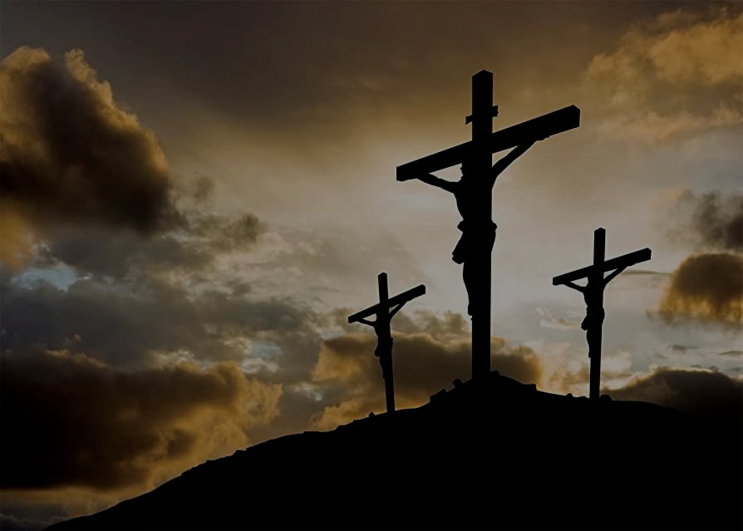
c) Assurance – all of us stand before God guilty in some way of breaking this commandment. But remember what Christ has done.
“Then the thief said, “Jesus, remember me when you come into your Kingdom.” And Jesus replied, “I assure you, today you will be with me in paradise.” (Luke 23:42-43)
A great way to be a light for Jesus, to be radically different in this world = “Don’t steal to have, don’t work to have but (in the grace & power of Christ) work to have, so that you can give.”
DO NOT STEAL = DON’T LIVE TO GET! LIVE TO GIVE!
Notes:
Up till now you are probably thinking “I thought you weren’t going to use guilt? Why do I feel so guilty?” I would say that is the conviction of the Spirit, or Satan trying to condemn you. But don’t let that happen. Be reminded of the assurance of salvation that we have in Christ. When Jesus was crucified he was nailed on a cross and died between two thieves. One of those thieves turned to Jesus and repented – hear Jesus’ response. The power and promise of the cross is that every thief who repents and turns to Jesus for forgiveness will be saved. Jesus calls us to go into the world – to be a light that shines the power of His grace and promises into a world that desperately needs it. I know this will be hard for us but if we strive to be obedient in this it would transform the testimony of the power of the gospel to the world around us.

