Slide 1
“I am 24 and I have never known contentment. I am forever in pursuit and I don’t even know what I am chasing. I now have just 10 lonely seconds to justify my existence.” (Harold Abraham)
‘If only’ and ‘the next thing’ dominates our world = crave and spend for the kingdom of self is here = comparison, wanting more & dissatisfaction.
“The quarrels and fights among you come from the evil desires at war within you? You want what you don’t have, so you scheme and kill to get it. You are jealous of what others have, but you can’t get it…” (James 4:1-2)
Notes:
In the 1981, Academy Award winning movie Chariots of Fire is an historical sports drama following the lives two British athletes as they prepare for the 1924 Olympics in Paris. One of those athletes was a Jewish sprinter named Harold Abraham. He is a character with a huge chip on his shoulder, always serious and focused on winning. As he prepares to run in the 100 metre there is a powerful moment when he is talking to one of his friends and says I have never known contentment…” In essence his comments reflects the reality of many in our world today – always pursuing but never being satisfied. Always striving to achieve or get something in order to justify their existence. If only and the next thing dominate our thinking – getting and consumption is the way of life for many. You deserve more and you deserve it now. It leads to life of constant comparison, never ending wanting and constant dissatisfaction. But sadly its not just in the world – if only and the next thing is also in the church, a problem for God’s people.

Slide 2
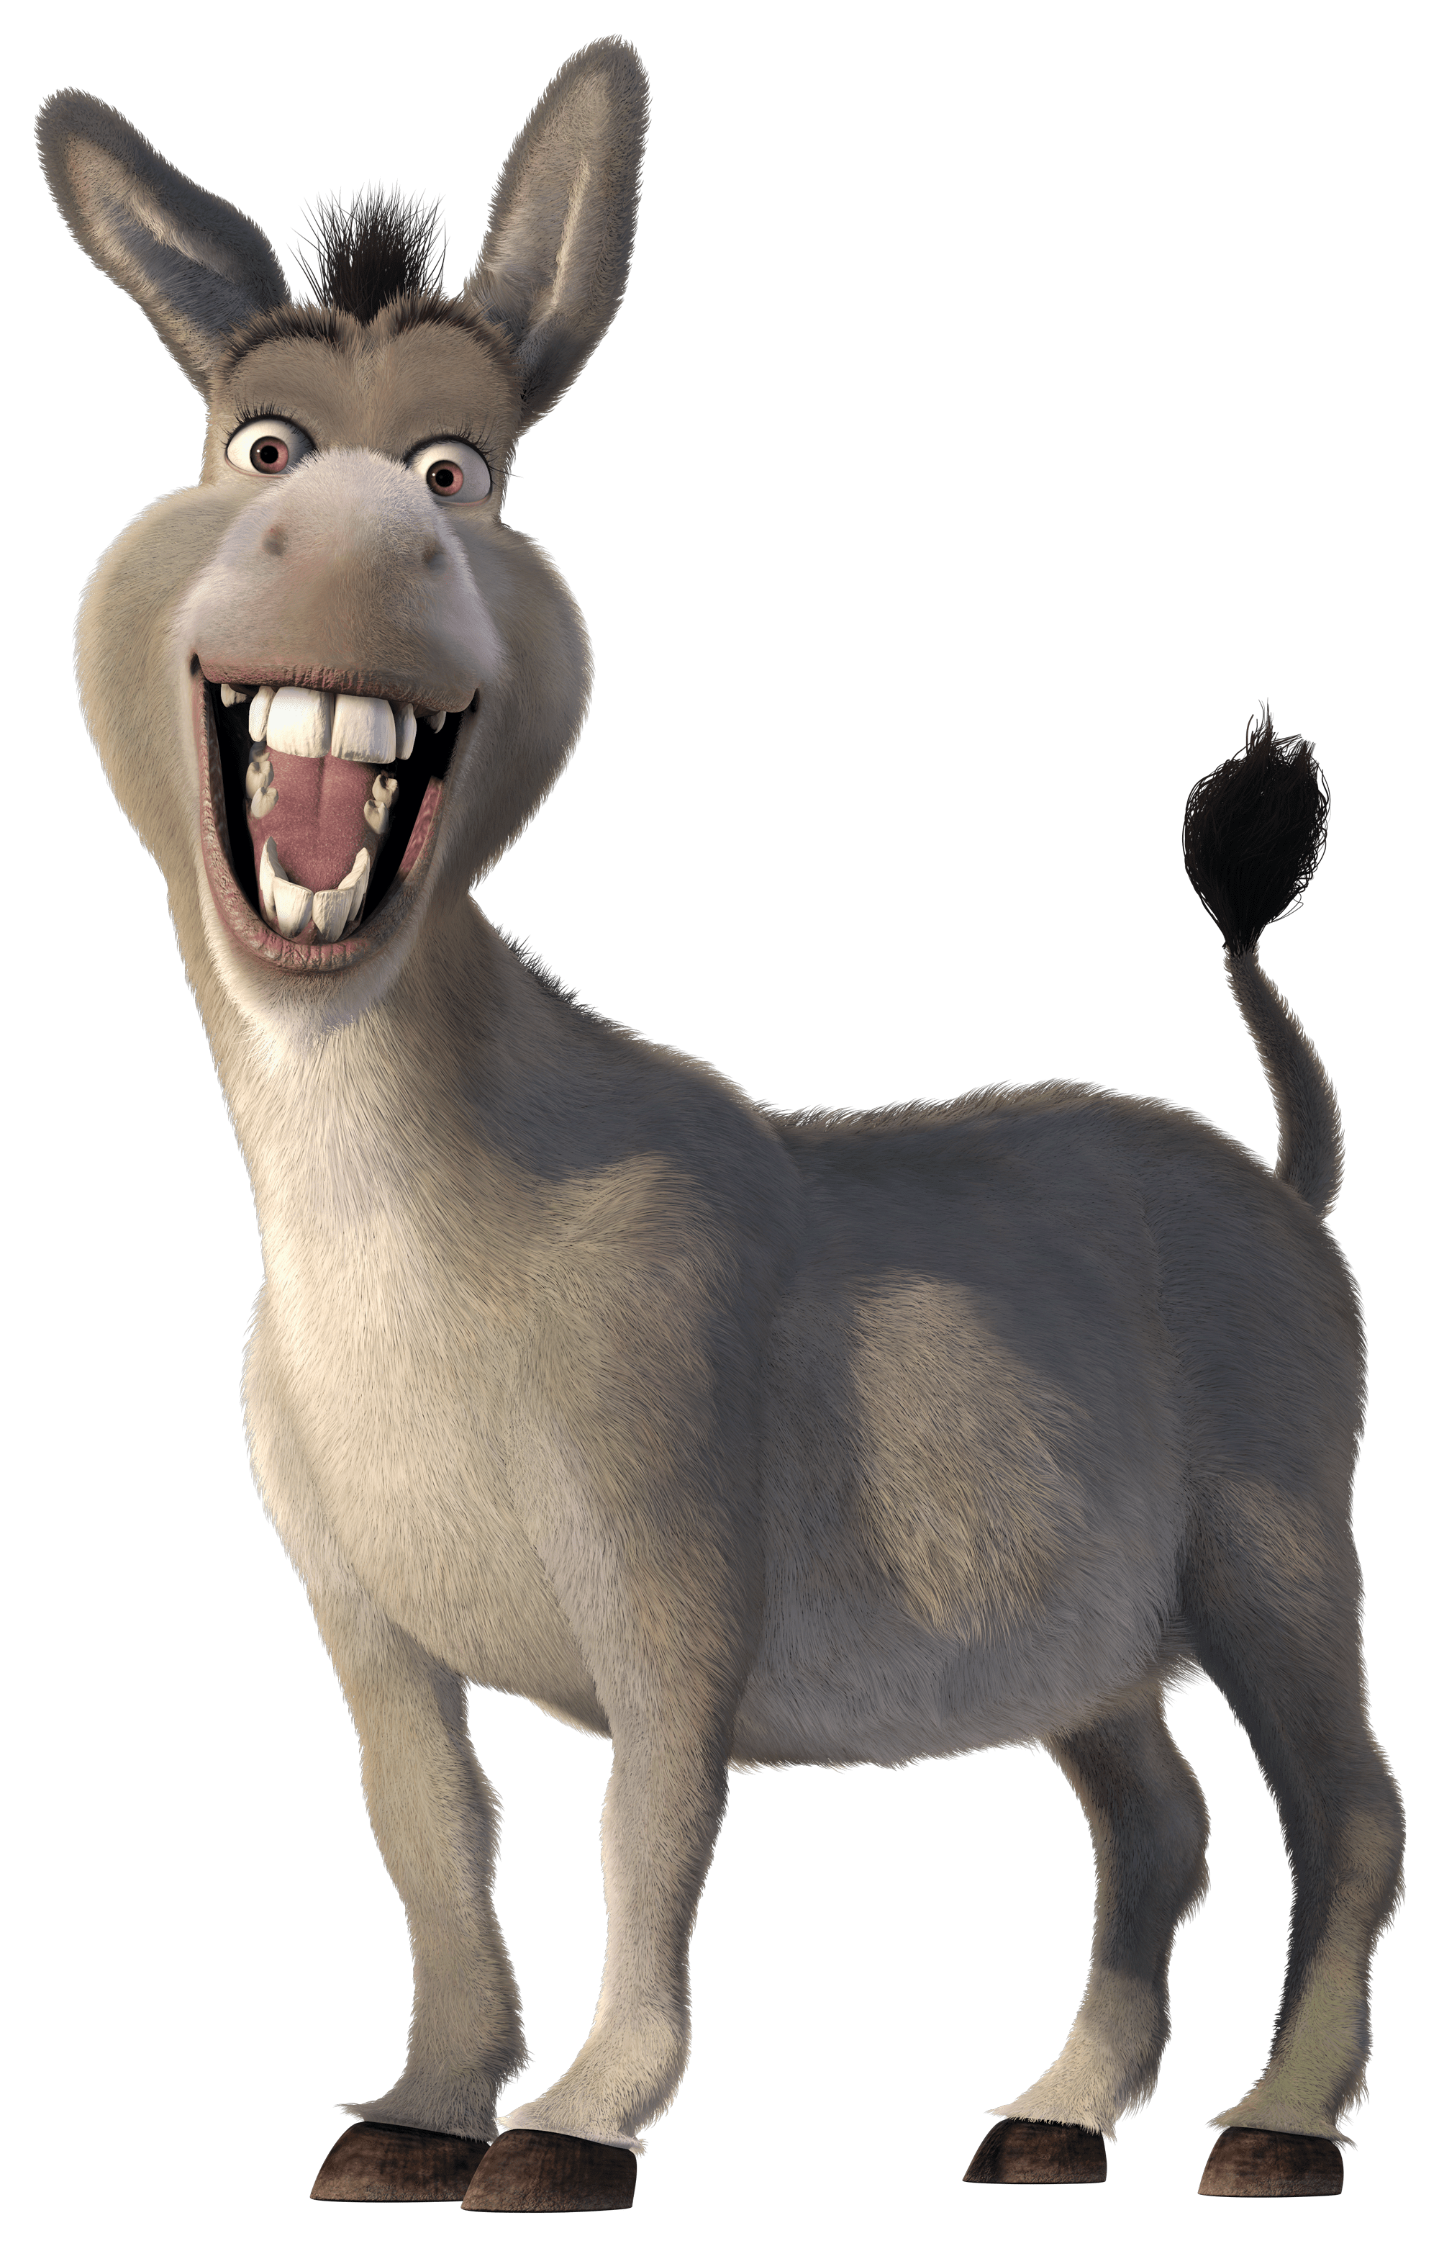
“You must not covet your neighbour’s house. You must not covet your neighbour’s wife, servant, ox or donkey, or anything else that belongs to your neighbour.” (Exodus 20:17)
“For I have learned to be content with whatever I have.” (Philippians 4:11)
DO NOT COVET – THE FREEDOM OF CONTENTMENT
(Luke 12:13-21, Philippians 4:10-20)
WHAT IS COVETING & CONTENTMENT? + HOW DO I GET FROM COVETING TO CONTENTMENT?
Notes:
God knew that sin created this problem – which is why he included it in the ten commandments. The tenth and final commandment is do not covet – that’s the requirement of God in a negative way. Paul puts a positive slant on this commandment by saying I have learned to be content. Contentment is the opposite of coveting. To not covet means to love God enough to be content in all circumstances. So we will look at what is coveting, what is contentment and how do we get that contentment.

Slide 3
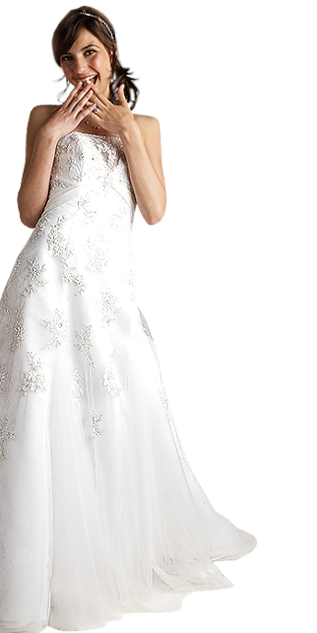
WHAT IS COVETING?
It’s the craving after something that belongs to someone else. It’s not just wanting something, but really, really, really wanting something (wrong way, wrong time, wrong reason).
“You must not have any other god but me” (1st) = “Do not covet” (10th). Not obeying them is the reason you break the rest - idols, lie, dishonour, lust, steal, hate, neglect and misuse.
The other 9 commandments = what we do (action). Do not covet = what we want to do (heart).
Coveting convicted Paul of his sin (Rom 7:7-8) and his desperate need for a Saviour.
Notes:
Coveting – its not wrong to want or desire something. Not all desires are sinful. Desires for food remind us to eat. Desire to be useful, motivates us to work. The desire for friendship draws us into a community. Our desire for intimacy may lead us into getting married. The first and tenth commandments are bookends to the other 8. If you really have no other gods in your life then you won’t covet anything – you will be content in all that God gives you. If you don’t covet anything = you are content and proves you have no other gods. Not obeying these two leads to the others – you have idols because you think God isn’t enough. You covet because you don’t value the sufficiency of God (his grace, his promises, his love). You lie to protect what you don’t want to lose, you lust because you aren’t getting what you think you deserve (value, appreciation, better option…) you steal (take and keep wrongly) because you don’t trust God enough, you neglect Sabbath (must keep striving and misuse Gods name for your own benefit) – its all you. In Romans 7 Paul actually shares the amazing truth that it was the 10th commandment that convicted him of his sin. As a good Jewish church leader he thought he was OK with all the other commandments. Until he realised that he wasn’t content – that he was coveting – then he realised he was guilty of breaking all the commandments. He was a sinner who couldn’t earn his own salvation – he needed a saviour because his own record would doom him to condemnation.

Slide 4
Coveting believes the delusion that true contentment lies in marriage, children, the right house, the right look, the perfect career, achievement, power, travel…(if only, the next thing).
“Do not love this world nor the things it offers you, for when you love the world, you do not have the love of the Father in you. For the world offers only a craving for physical pleasure, a craving for everything we see, and pride in our achievements and possessions. These are not from the Father, but are from this world. And this world is fading away, along with everything that people crave. But anyone who does what pleases God will live forever.” (1 John 2:15-17)
Notes:
Coveting is believing that God is not sufficient – you need other things to find contentment and purpose. But it’s a forever in pursuit never achieving reality (just as Harold Abraham found out). These things of the world are good things but they are not God things. We may think contentment lies in marriage (some in marriage might think it lies in singleness) or in children (parents sometimes think it is in no children). But John makes it vey clear that distorted wanting, coveting, is not from god. The things of this world are from God (marriage, children , career, achievement, houses etc) but the intense desire for them and the hope that we place in them is not from God.

Slide 5
“Present Tense” (Jason Lehman)
I was a child, but it was adulthood I wanted - the freedom, and the respect.
I was 20, but it was 30 I wanted - to be mature, and sophisticated.
I was middle-aged, but it was 20 I wanted - the free spirit of youth.
I was retired, but it was middle age I wanted - the presence of mind without limitations.
My life was over, and I never got what I wanted.
“It was spring, but it was summer I wanted - the warm days, and the great outdoors.
It was summer, but it was fall I wanted - the colourful leaves, and the cool, dry air.
It was fall, but it was winter I wanted - the beautiful snow, and the joy of the holiday season.
It was winter, but it was spring I wanted - the warmth, and the blossoming of nature.
Notes:
In 1989 a young 14 year old boy from America was struggling to understand why there was so much depression and anxiety in a nation where there was plenty. After listening to the complaints of his family and friends he was led to write a poem called Present Tense and it is an incredibly insightful look at one of the biggest problems we face in life – discontent.

Slide 6
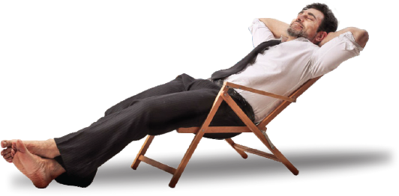
WHAT IS CONTENTMENT?
Contentment = to be fully satisfied, not needing anything else.
Christian contentment = the ability to say ‘God you are enough’. It’s being pre-occupied with Him (love, promises, grace, salvation, goodness, justice …) more than our circumstances.
Paul’s contentment = “It matters very little how I might be evaluated by you or by any human authority. I don’t even trust my own judgment on this point… It is the Lord himself who will examine me and decide.” (1 Cor 4:3-4) I am steady in the love and acceptance of Christ = he will supply all I need (Phil 4:19).
Notes:
The Greek word for contentment = full, satisfied, happiness. Very similar to how dictionaries define contentment. Christian contentment is be able to say God you are enough no matter what circumstances we may face. Resting and trusting in his promises, his salvation, his love, his justice and grace and goodness – that he is fair, that there is always a purpose, that he knows what I am going through, that he will give me all I need etc. In 1 Corinthians 4 Paul gives us some insight into the reason why he is contented – why God is enough. He knows it doesn’t matter what others think of us, even those in authority. It doesn’t even matter what we think of ourselves because we can be wrong (think we are too good or too bad). The only opinion and standard that matters is Jesus’ opinion and standard. That’s why Paul is confident – because he knows that we are loved and accepted because of what Christ has done for us. When we put our trust in him and accept the gift of forgiveness and his righteousness than there is no condemnation, we have all the promises of God, nothing can separate us from his love and from his kingdom and eternal life. Contentment is complete faith and trust in God, not ourselves or others or things.

Slide 7
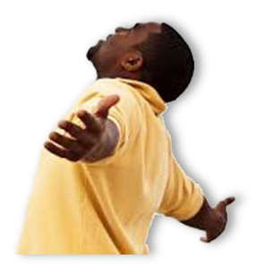
HOW DO WE GET FROM COVETING TO CONTENTMENT?
Paul’s life & ministry = being beaten, put in prison, stoned by angry mobs, working to exhaustion, enduring sleepless nights, going without food, facing conflict from every direction, having battles on the outside and fear on the inside. (2 Cor 6:4-5, 7:5)
“I have learned how to be content with whatever I have. I know how to live on almost nothing or with everything..” (Phil 4:11-12)
a) You have to unmask coveting for what it is = you have other gods (something else giving you meaning, joy, peace, hope..). If you don’t see it as the enemy it is, it will trap you and you will never be satisfied.
Notes:
So how do we get the confidence of Paul – how do we move from coveting to contentment? We might be tempted to say we can’t but it is something God has commanded us to do. Its not just an offer or a suggestion but a command (Do not covet = be contented). So if God has commanded us to not covet and be contented, it must be possible (and it is). How can Paul claim to be content in every situation? He is in prison, chained and awaiting trial. Looking at his life and ministry he certainly didn’t have an easy life. He had more than his fair share of trials and having nothing. Yet he is joyful, thankful and content. How does he do it? Contentment doesn’t just come to us. It is not just discovered and then you have it. Finding true contentment is a process. It is learned, not in college or church, but in living the Christian life. So, what is this learning process we must follow?
a) Unmask coveting for what it is – you have other gods in your life. Breaking the 10th commandment is breaking the first commandment. So when you are unhappy, bitter, discontented or miserable about something ask yourself, “Has this thing that I am coveting (really, really, really wanting) become my salvation, my meaning, my joy, my hope and my peace? If it has then it is an enemy that will trap you and you will be in pursuit of more – never satisfied.

Slide 8
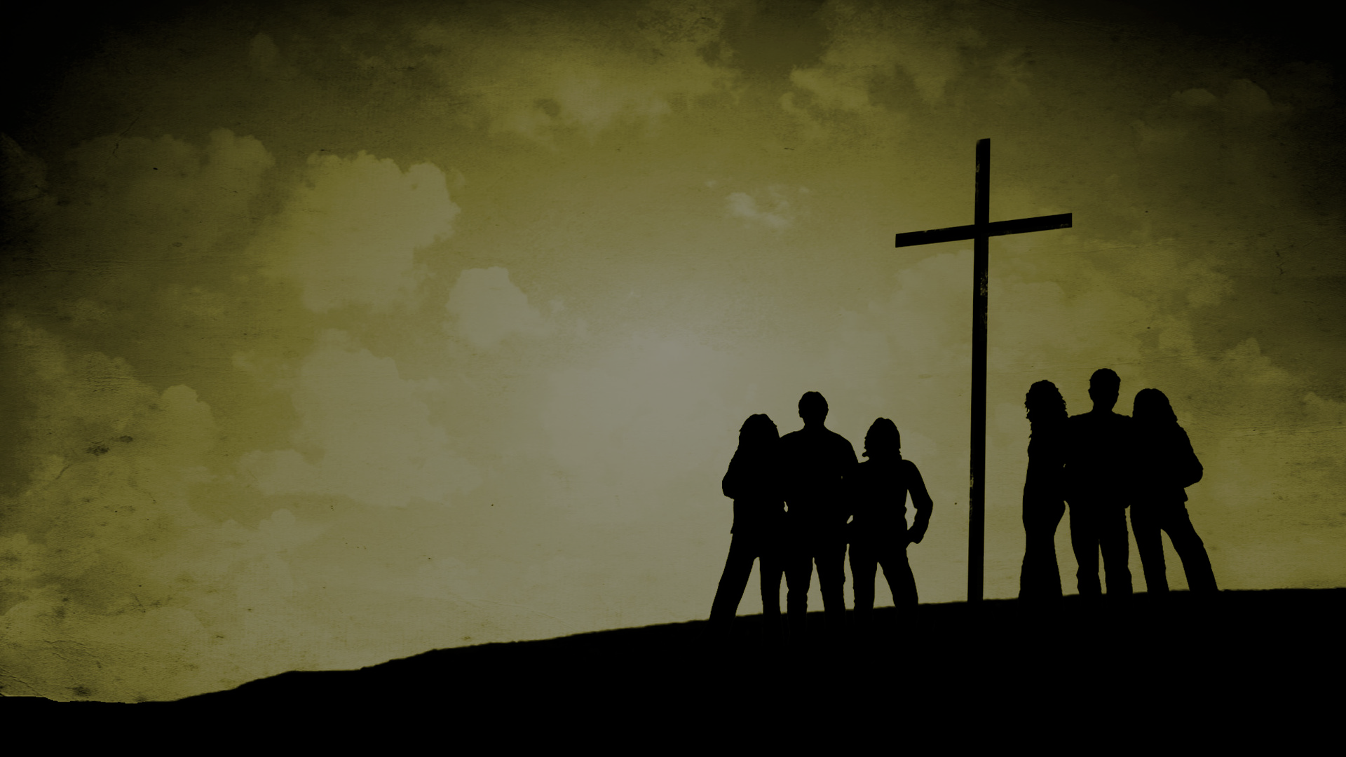
b) Preach the gospel to yourself – this thing that I long for does not give me worth or eternal hope. It is only what Jesus has done for me and what Jesus says about me that matters. True contentment = Christ alone is sufficient.
c) Live by the ‘icing principle’ = icing on a cake is good but you can’t live off it. God is not against good things & pleasure. You can enjoy icing BUT you can never worship icing.
d) Learn to focus & rely on Jesus each day – “For I can do everything through Christ who gives me strength.” (Phil 4:13)
“You either keep focusing or you end up hitting something really hard.” (Jeff Gordon – NASCAR driver)
Notes:
c) The third step in learning to be content is be led by the icing principle (from Tim Keller) – icing is great but you can’t live off it. If you do it will mess up your life eventually. God is not against wanting nice things, he is not against pleasure. Its Ok to have and enjoy icing, just don’t worship icing. Jesus alone is our protein.
d) Focus and rely on Jesus each day – be preoccupied with Him and not your circumstances. Philippians 4:13 is a famous verse but often one taken out of context. NIV translates it well when it says everything or all things = all this = being content in all circumstances. We can only do that through power of Christ. Everything and all things is often quoted by athletes as if they achieve any milestone because of Jesus, or anything we put our mind to do because of power of Jesus. True to a point – the power of Jesus is infinite. But in context this is talking about being content. So keeping focus on Jesus = learning to meditate on God, learning to seek God, learning to trust Him, learning to know Him , learning to experience his love in your heart, learning to realise the extent of his love for you. Its when we take our eyes of Jesus that we find trouble – Jeff Gordon says losing focus on a race track, the other cars and his pit crew is the same. It doesn’t end well. In the Christian life you will crash if you take your eyes off Jesus. Be wary of complacency when it comes to where your heart is – where your treasure is. Satan is just waiting for moments of complacency, loss of focus, to pounce and attack.

Slide 9
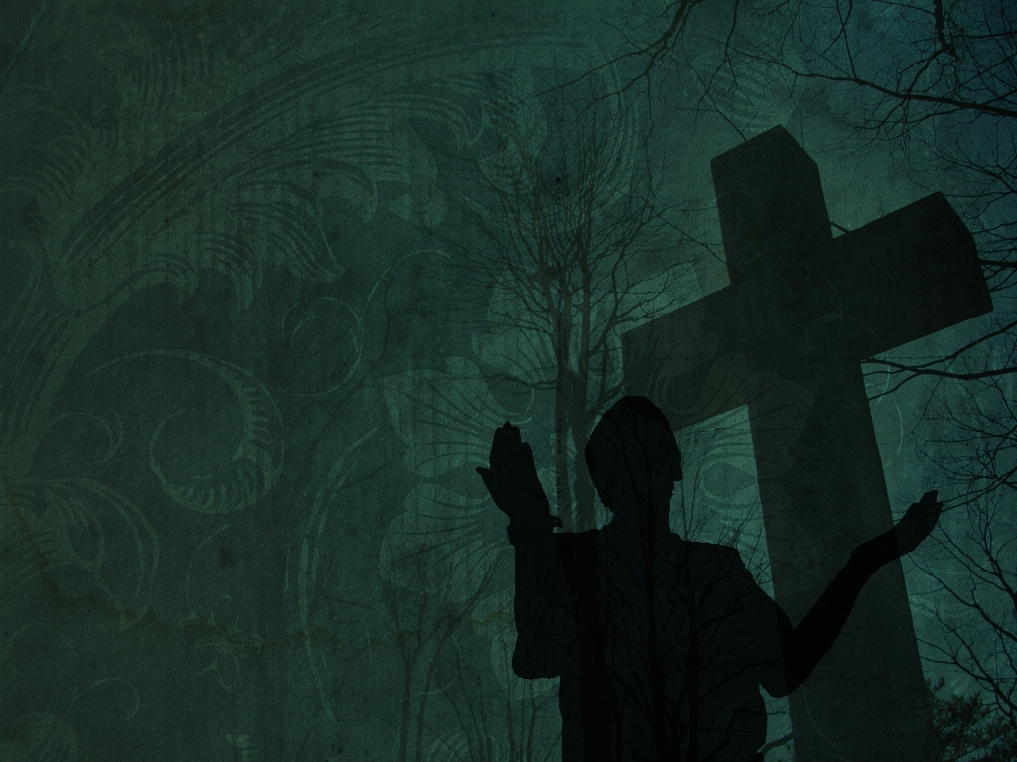
“I know God made me for the purpose of going to China. But he also made me fast, and when I run I feel his pleasure.” (Eric Liddell)
“Seek the Kingdom of God above all else, and live righteously, and he will give you everything you need.” (Matt 6:33)
“Yes, a person is a fool to store up earthly wealth but not have a rich relationship with God.” (Luke 12:21)
Do not covet = the first thing, the main thing and the only thing that matters is to trust in Jesus Christ + nothing. HE REALLY IS ENOUGH FOR US!
Notes:
In closing I would like to consider the other runner from the movie Chariots of Fire. Eric Liddell was the son of a Scottish Presbyterian minister and who had felt a call to go to be a missionary in China. He was also a champion Rugby Union player for Scotland and as a winger was very fast – fast enough to make the Great Britain athletic team for the 1924 Paris Olympics. Unlike Harold Abraham however, he knew what it was to know contentment. He wasn’t pursuing something that he didn’t know about. He wasn’t trying to justify his existence. To Eric it was all about God and his relationship to Jesus, Whether it was on the mission field or the running track he was content in the fact that he knew God. He felt God’s presence and blessing in his life at all times. That’s the secret to true contentment. He wasn’t running to prove himself, he was running to serve and please God. That’s what Jesus tells us is the secret to a contented life – good to close with his words from Matthew 6:33 and Luke 12:21. Do not covet = know contentment = trust in Christ + nothing.

