Slide 1
OBSERVETHESABBATHDAYBYKEEPINGITHOLYASTHELORDYOUR GODHASCOMMANDEDYOUYOUHAVESIXDAYSEACHWEEKFORYOUR
ORDINARYWORKBUTTHESEVENTHDAYISASABBATHDAYOFREST
DEDICATEDTOTHELORDYOURGODREMEMBERTHATYOUWERE
ONCESLAVESINEGYPTBUTTHELORDYOURGODBROUGHTYOUOUTWITHHISSTRONGHANDANDPOWERFULARMTHATISWHYTHELORD
YOURGODHASCOMMANDEDYOUTORESTONTHESABBATHDAY
“Observe the Sabbath day by keeping it holy, as the Lord your God has commanded you. You have six days each week for your ordinary work, but the seventh day is a Sabbath day of rest dedicated to the Lord your God... Remember that you were once slaves in Egypt, but the Lord your God brought you out with his strong hand and powerful arm. That is why the Lord your God has commanded you to rest on the Sabbath day.” (Deuteronomy 5:15)
Notes:
As I show this paragraph, it looks like I have made a mistake. There is no punctuation, no spaces and its all capitals. As a result, it is very difficult to read – stressful and probably likely to give up trying to read it. It might surprise you to know that is how the written language looked until about the 9th century. It was then that punctuation etc. started to come in. This is how that paragraph looks today – the spaces make all the difference – suddenly reading became a lot easier. The Sabbath is God’s space and punctuation marks in our activity of life. It is God’s way of allowing time to pause – to protect us against the impact of a 24/7 lifestyle.

Slide 2
Our world has mainly rejected the Sabbath and it’s killing us.
Christians are ignorant or confused about Sabbath – what is it, is it applicable, what day, what does it look like?
SABBATH DAY -
GOD’S GIFT OF RHYTHM, REFRESHMENT & REJOICING (Deut 5:1-15, Matt 12:1-8)
THE SABBATH THROUGH THE BIBLE
THE THREE GIFTS OF THE SABBATH
KEEPING THE SABBATH AS A GOOD GIFT
Notes:
God gave us the Sabbath as a timeless gift, not a punishment – many of us who grew up in homes where the Sabbath or Sunday was grim and strictly enforced, would probably disagree. The problem we have today is that we have largely abandoned the idea of a Sabbath and it is killing us. Even as Christians we struggle to understand the Sabbath – what is it, what day is it, is it relevant to us today (isn’t it only an OT thing). This is a big topic – and to help us get a better understanding of this commandment and the importance of the Sabbath I will do three things. First, take you on a helicopter look (brief, picture) at the Sabbath through the Bible, look at the three gifts of the Sabbath and give us some tips on how the keep the Sabbath as a good gift – keep it in a right Biblical perspective.

Slide 3
THE SABBATH THROUGH THE BIBLE
A. Creation & the Sabbath – “By the seventh day God had finished the work he had been doing and so he rested from all his work. Then God blessed the seventh day and made it holy, because on it he rested from all the work of creating that he had done.” (Gen 2:2-3)
Sabbath = cease, stop from work & exertion. A day for humans to be restored spiritually, mentally, emotionally & physically.
Six creation commands that last until Christ comes again – marriage + procreation + subdue the earth (use resources wisely) + dominion over creatures + work + Sabbath.
Notes:
Creation & Sabbath = God introduced the Sabbath even before sin entered the world and well before Moses went up Mt Sinai to hear from God. The fall of man and sin didn’t erase it – in fact only made it more necessary for us to do. God established 6 creation ordinances that are foundation for human life. And see how sin and Satan attacks them all today – marriage (same sex, gender fluidity, divorce, sex outside marriage), procreation (abortion, zero population targets), subdue the earth (greed & radical environmental views), dominion over creatures (animal rights), labour (welfare state, less work more fun), sabbath (busyness of life, 24/7 living – shops open more than they used to be)

Slide 4
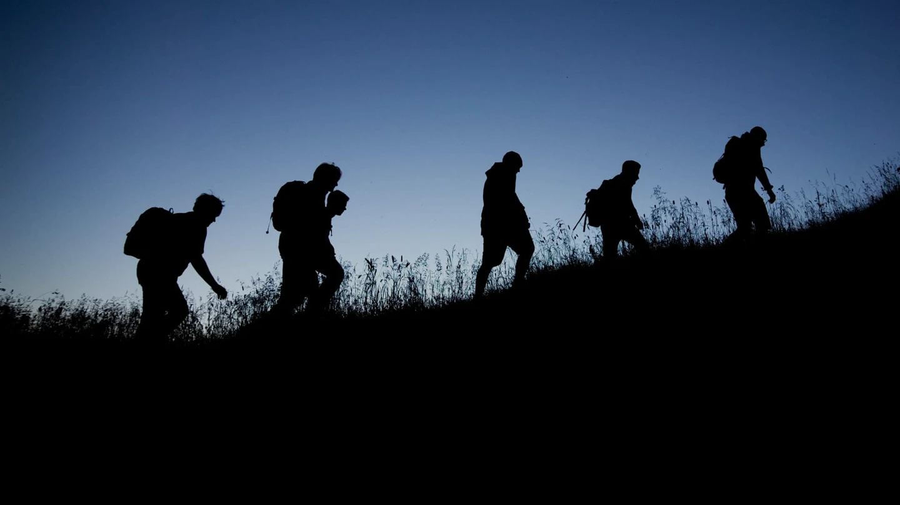
B. Israel and the Sabbath
“Each day you can go out and pick up as much food as you need for that day…. On the sixth day you can gather food and there will be twice as much as usual…. The Sabbath is the Lord’s gift to you. That is why he gives you a two-day supply on the sixth day.. On the Sabbath day you must stay in your place and not pick up food on the seventh day.” (Ex 16:4-5, 29) – thank Him for his provision.
“Remember to observe the Sabbath day by keeping it holy. You have six days each week for your ordinary work, but the seventh day is a Sabbath day of rest dedicated to the Lord your God… For in six days the Lord made the heavens, the earth, the sea, and everything in them; but on the seventh day he rested.” (Ex 20:8-11)
God (rested) was satisfied – find your satisfaction in Him.
Notes:
Israel and the Sabbath – this next stage starts when the people of Israel escape the bondage of Egypt and start journeying through the wilderness. They complain about food and God promises them manna each day. They are to collect enough for one day only (an extra would spoil the next morning) and on the sixth day God would give them twice as much so they could rest on the Sabbath. There was no manna on the Saturday. God wanted them to rest from their labours – needed to be refreshed and reminded that God is their provider – dependent on him. Remember to keep the Sabbath holy – the day God rested from his creation work. He didn’t rest because he was tired (like we get tired) but because it was all very good – he was satisfied with creation and us. We should find our satisfaction in him.

Slide 5
“Observe the Sabbath day by keeping it holy… Remember that you were once slaves in Egypt, but the Lord your God brought you out with his strong hand and powerful arm. That is why the Lord your God has commanded you to rest on the Sabbath day.” (Deut 5:12-15) – rejoice in His salvation.
C. Jesus and the Sabbath
“Then Jesus said, “The Sabbath was made to meet the needs of people, & not people to meet the requirements of the Sabbath. The Son of Man is Lord, even over the Sabbath!” (Mark 2:27-28)
Jesus is Lord & created all things (Col 1:16), including the Sabbath. The Sabbath points to Him (Col 2:17). He is the ultimate rest, provision, satisfaction & salvation we all desperately need.
Notes:
Deuteronomy account of the Ten Commandments is Moses reminding them as they get closer to the Promised Land – this one adds another dimension in regard to the saving work of God. Their freedom from slavery had nothing to do with their work, it was all God’s grace. As slaves they weren’t entitled to rest, but by his power they now have that blessing. We can’t add anything to what he has done.
Jesus and the Sabbath – Jesus famously clashed with the Pharisees over the issue of the Sabbath – 6 times they accused him of breaking the Sabbath. Picking wheat on the Sabbath (Mark 2:23-28) and other five times were healing on the Sabbath (Luke 13:10-17, Mark 3:1-6, Luke 14:1-6, John 5:1-9, John 9:1-41). The Pharisees had invented over 1500 rules relating to the Sabbath – none of them from God. They had turned God’s good gift into an unbearable, joyless burden. On one of those occasions he responded to their accusations with these profound words – the Sabbath is not about you earning your own rest. Its about God giving you the rest. And I am the fulfillment of all that it is. Jesus never abolished the sabbath – he fulfilled it. He only cancelled the baseless traditions of the Pharisees.

Slide 6
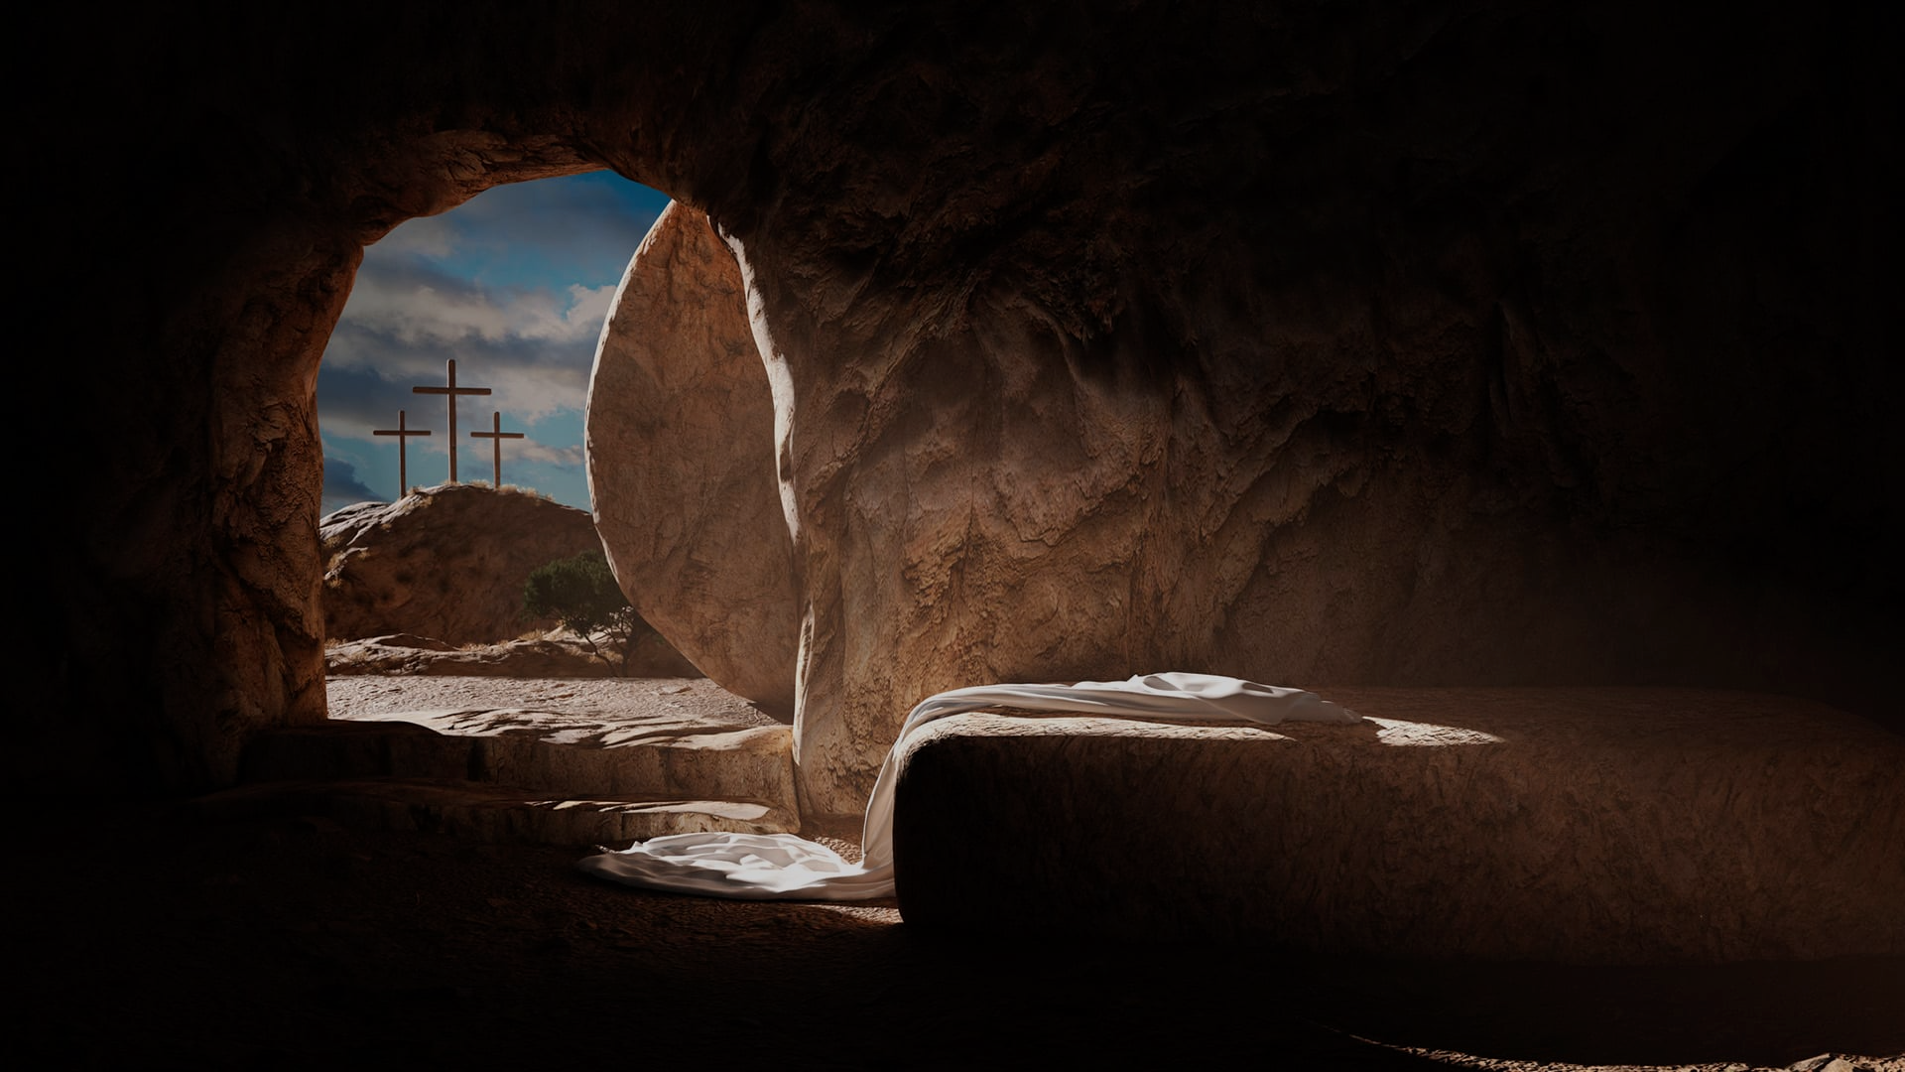
D. The Resurrection and the Sabbath.
Prior to Jesus’ resurrection, He and his disciples observed the Sabbath on the 7th day (Saturday). The day before the resurrection the disciples were resting on the Sabbath (Luke 23:56).
After Jesus’ resurrection, the early church started to meet, rest and worship on the Sunday, the Lord’s Day. The only mention of the Sabbath was as a tolerated option for Jewish believers (Rom 14:5) or when Paul shared the gospel with the Jews (Acts 13:41).
This change of day didn’t cancel the Sabbath (creation command) – “Christ took the Sabbath into the grave with Him and bought the Lord’s Day out of the grave with Him.” (B.B Warfield)
Notes:
Resurrection and the Sabbath - prior to his resurrection we read how Jesus and his disciples (as with all Jews) kept the Sabbath on the 7th day – the Saturday after Jesus death and before his resurrection the disciples were resting on the Sabbath. The Sabbath has changed day but it hasn’t been cancelled.

Slide 7
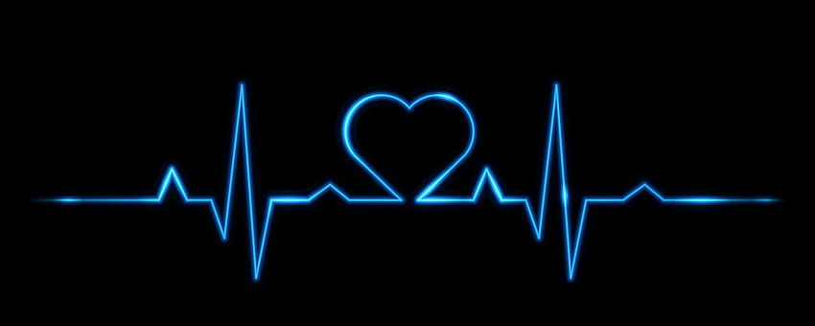
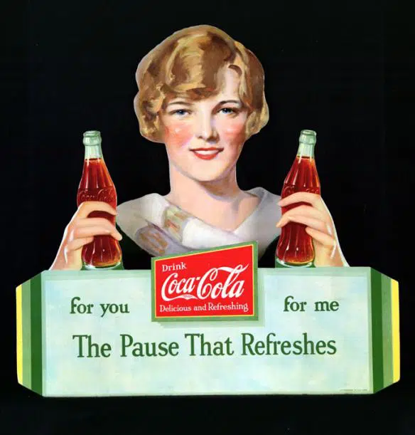
THE THREE GIFTS OF THE SABBATH
A. Rhythm = a strong, regular repeated pattern of movement.
“There is a time for every activity under heaven..” (Eccles 3:1)
“A life without rhythm turns into a rut.” (Steve Farrar) – we’re not created to work 24/7. The Sabbath is our maintenance schedule – to be physically, emotionally & spiritually tweaked.
B. Refreshment – fresh energy & strength, to take a deep breath (Hebrew).
Pausing to be refreshed is more than just stopping work.
Notes:
THE THREE GIFTS OF THE SABBATH –When we make a commitment to remember and keep the Sabbath (subscribe) in our lives then we get three gifts delivered to our doorstep. Gifts are not just for you as individuals, but for families and couples to do together. A 24/7 lifestyle can pull families and relationships apart – no time to share together.
Rhythm of the Sabbath – God has put rhythm into his creation – a time for everything.. Sunrise and sunset, four seasons, age from toddler to childhood, to adolescence to adulthood. But in all that we are not made to work 24/7. But we live in a world that loves to be busy, that celebrates achievement, where technology allows us to work anywhere, anytime. Where we love to prove ourselves. Where we need more and more to be satisfied – but never really satisfied.
Refreshment – in 1929 people were struggling financially, economy was on the brink of collapse, anxiety and fear everywhere. Coca Cola thought of an advertising slogan to make people buy their drink. The Pause that Refreshes was a success. That’s what the Sabbath is to us. It is a God given pause to refresh us. But the pause from work needs to be more intentional than just stopping work. The Hebrew word for refresh is to breathe deeply.

Slide 8
Resting – from work, stress, achievement & competition.
Reflection – unstructured, unplanned time to think and feel whatever comes into your mind and heart.
Recreation – spend time in nature, exercise, crafts, art … (good to make it avocational).
“Rabbi, how have the Jews managed to preserve the Sabbath over thousands of years.” (BBC Commentator)
“It is not the Jews who have preserved the Sabbath over thousands of years. It is the Sabbath that has preserved the Jews over thousands of years.” (Rabbi)
Notes:
Be mindful of competitive activities if you are competitive person – playing sport on Sabbath is OK but if its representative sport might not be so relaxing. Good to make your recreational time avocational – not related to your normal work. If you mow yards, don’t mow on Sabbath. If you preach, don’t read commentaries etc.. To others it might be relaxing, but not if its your job. The great reformer John Calvin loved to play lawn bowls on Sunday after he had preached. It was his favourite way to be refreshed.

Slide 9
C. Rejoicing – the Sabbath should cause us to stop and be reminded that we are ultimately dependent on God (our creator and redeemer) for everything.
“But seek first his kingdom and his righteousness…” (Matthew 6:33) = a great way to start the week by focusing on his truth, provision, grace, mercy, power and promises.
From the time of Moses through to the early church, the Sabbath = corporate worship. “And let us not neglect our meeting together, as some people do..” (Hebrews 10:25)
What do we say when we regularly forsake Sunday worship to kick a ball, sleep in, party, fish, have family time...?
Notes:
Rejoicing – praising and worshipping God is a great way to start the week. Seek him first on the first day of the week. What lies ahead may be uncertain but we can stand confidently – be sure it will all be OK. In 1998 a Rabbi was being interviewed by a journalist from the BBC and he was asked about the Sabbath.

Slide 10
KEEPING THE SABBATH AS A GOOD GIFT
“So don’t let anyone condemn you for what you eat or drink, or for not celebrating certain holy days or new moon ceremonies or Sabbaths.” One person considers one day more sacred than another; another considers every day alike. Each of them should be fully convinced in their own mind. (Romans 14:5)
Sabbath principle = dedicate one day a week to have a time of rhythm, refreshment & rejoicing. How you celebrate that is between you & the Lord – a matter of choice and conscience.
The God who sees all will notice when you are truly seeking him first “and he will give you everything you need.” (Matthew 6:33)
Notes:
Keep it a good gift. Be careful of adding our own rules and preferences. Paul tells us there is latitude and freedom in the how, the what and even the when of the Sabbath.

Slide 11
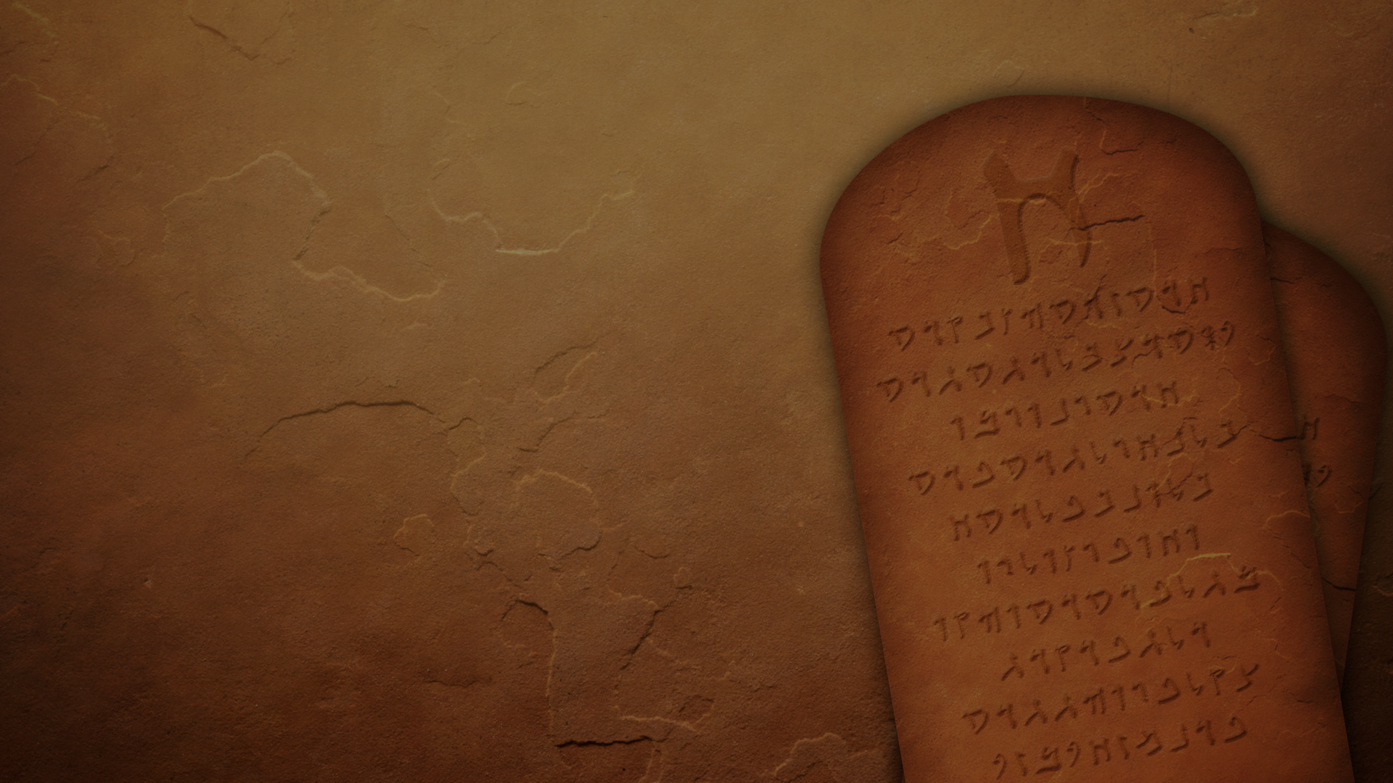
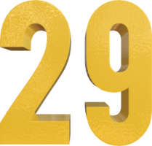
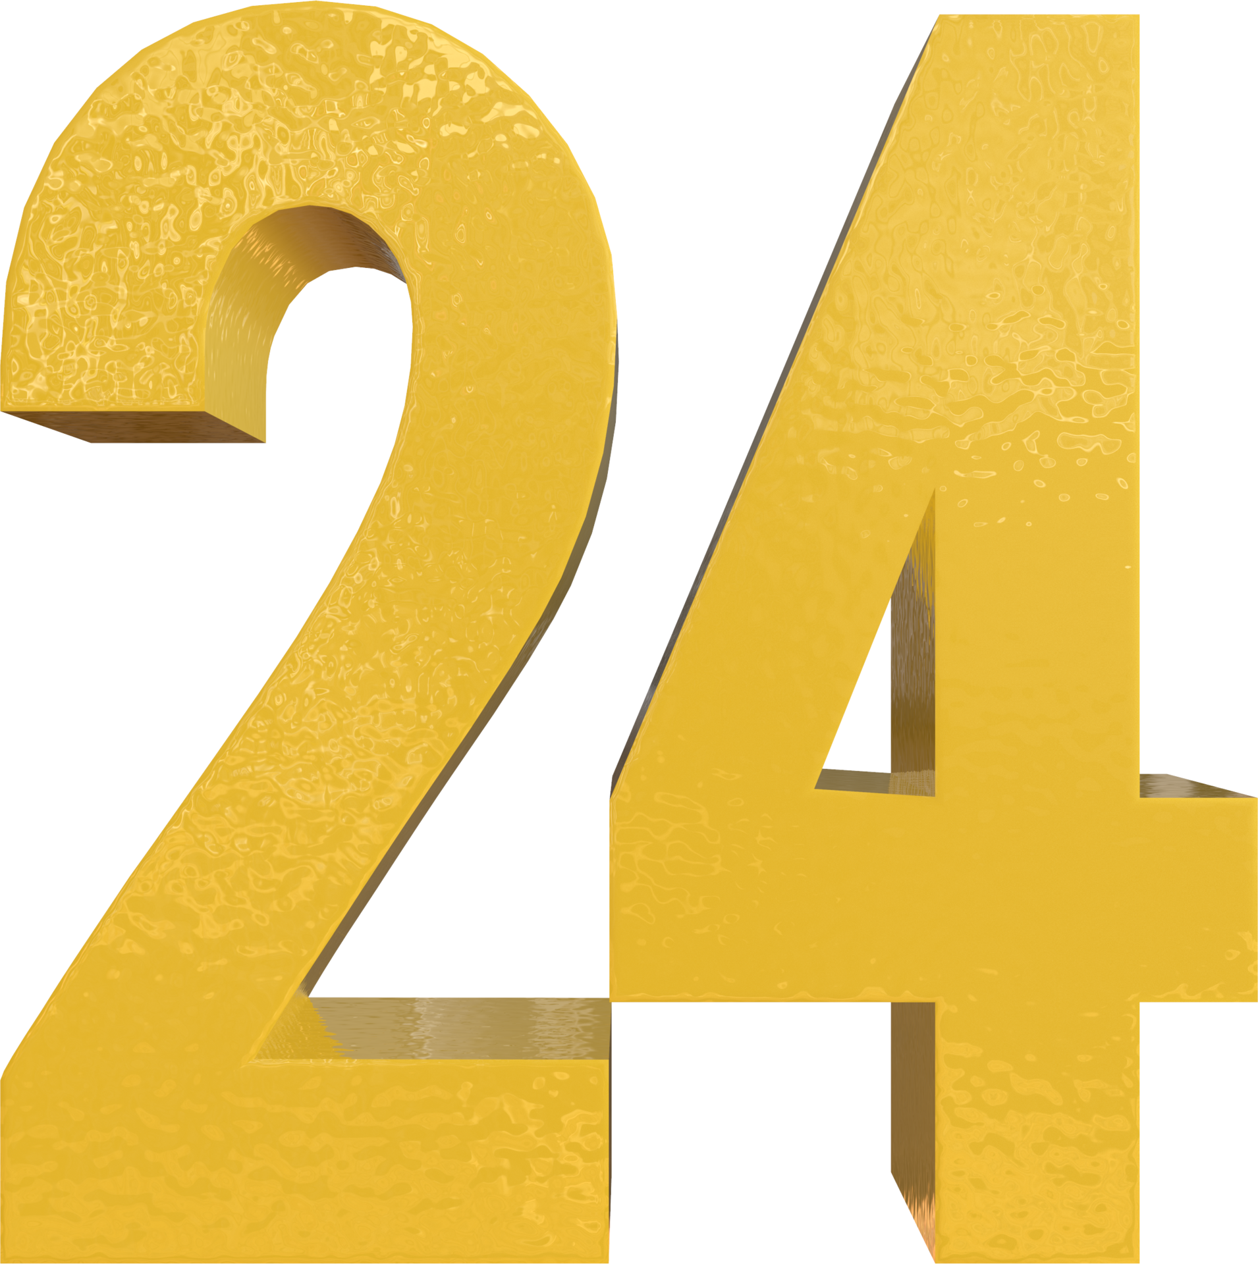
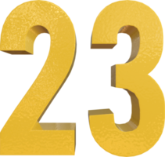
WORDS TO TALK ABOUT MURDER & STEALING
WORDS TO TALK ABOUT ADULTERY
WORDS TO TO TALK ABOUT COVETING
WORDS TO TO TALK ABOUT LYING
WORDS TO TO TALK ABOUT HIS NAME
WORDS TO TALK ABOUT NO OTHER GODS
WORDS TO TALK ABOUT HONOURINGPARENTS
WORDS TO TALK ABOUT HAVING NO IDOLS
Notes:
At the start of my message, I asked you to look at some capital letters. As I conclude this message, I want us to look at some random numbers. When God gave Moses his ten commandments he used 4 words = murder and stealing. 5 words = adultery. 29 words = coveting. 8 words = lying. 24 words = not using his name in vain. 9 words = no other gods. 23 words – honouring parents. 103 words = no idols.

Slide 12
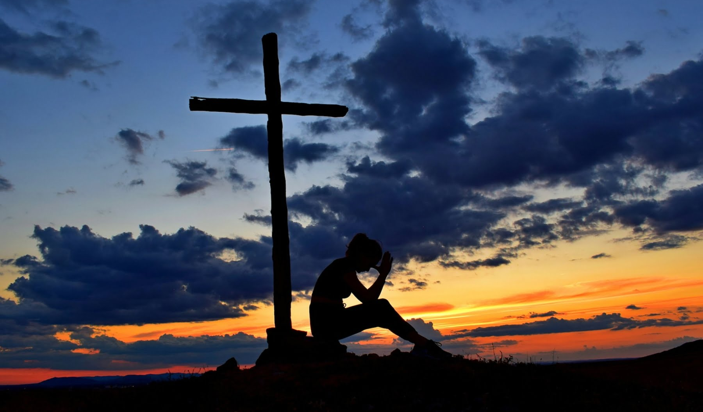
WORDS TO REMIND US TO LET GOD BE GOD & ACCEPT THE GOOD GIFT OF THE SABBATH = RHYTHM, REFRESHMENT & REJOICING.
Remember you don’t have to earn or prove anything. Your salvation does not depend on you - praise God for His grace.
Remember that God is the creator of the universe and He will meet all your needs – rejoice & give thanks for His provision.
Remember Jesus’ invitation, “Come to me, all who are weary & burdened, and I will give you rest.” Take Him at His word - believe Him, trust Him & find perfect & eternal joy & rest in Him.
Notes:
That’s how serious this is to God. Not just a coincidence that God talks the most about this commandment. Its critical to us living an abundant life on earth. Remember the sabbath – let God be God. Rest in Him, what he has done and what he has promised to do.

