Slide 1
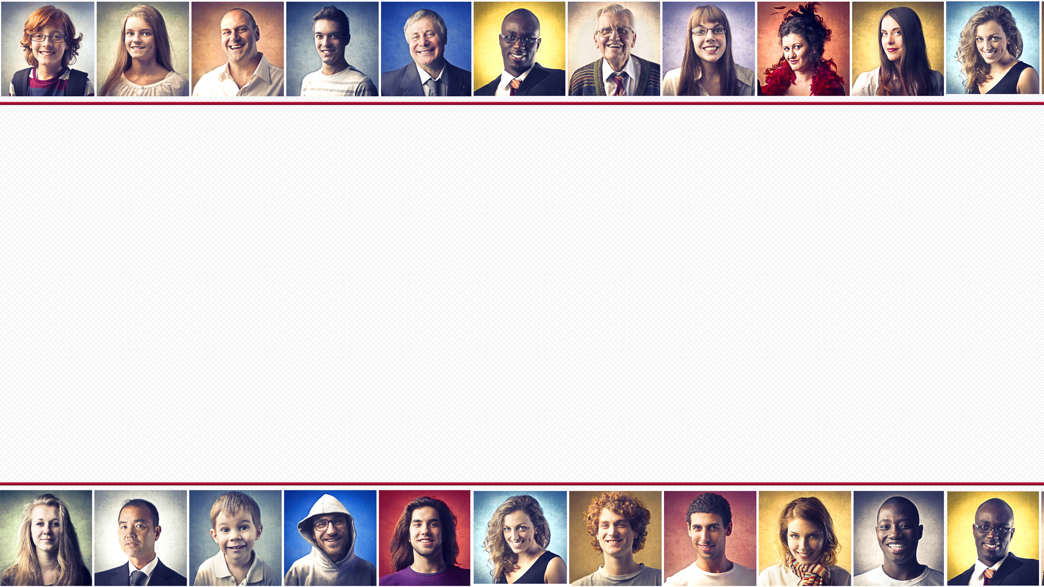
“That which we call a rose by any other name would smell as sweet.” (Juliet – William Shakespeare)
“Our names are an important part of our identity. They give us a sense of who we are. That is why any intentional misuse of a name can negatively hurt and affect people. Such misuse of a name can be experienced as a microaggression, leading to anxiety and resentment between two parties.”
(HR Department, Drexel University)

Slide 2
Exodus 20:1-7, Matthew 7:15-29
“You must not misuse the name of the Lord your God. The Lord will not let you go unpunished if you misuse his name.” (Exodus 20:7)
WHAT IS GOD’S NAME?
GOD IS SERIOUS ABOUT PROTECTING HIS NAME.
HOW CAN WE MISUSE GOD’S NAME?

Slide 3
WHAT IS GOD’S NAME (IDENTITY, REPUTATION)?
“God replied to Moses, “I AM WHO I AM. Say this to the people of Israel: I AM has sent me to you.” God also said to Moses, “Say this to the people of Israel: Yahweh, the God of your ancestors - the God of Abraham, the God of Isaac, and the God of Jacob has sent me to you. This is my eternal name,
my name to remember for all generations.” (Ex 3:14-15)
I AM = self existence, self sufficiency, supreme authority, eternal and personal (relational) = promise keeper, trustworthy, all powerful, all present and all knowing.
Notes:
God’s name is not just a convenient way to address him. It is his identity, the very essence of who he is. God revealed his name long before the day he gave the Israelites the Ten Commandments on Mt Sinai.

Slide 4
Majestic (Psalm 8:1) & glorious (Ps 29:2) = fully worthy of honour & praise.
Holy (Isa 57:14, Matt 6:9) = sinless, blameless, perfect, trusted.
“I am Yahweh! The LORD! The God of compassion & mercy! I am slow to anger & filled with unfailing love & faithfulness. I lavish unfailing love to a thousand generations. I forgive iniquity, rebellion & sin. But I do not excuse the guilty.” (Ex 34:6-7)
Wonderful Counsellor, Mighty God, Everlasting Father, Prince of Peace (Isa 9:6).
Saviour
(Matt 1:21).
“At the name of Jesus every knee will bow.. & every tongue will declare that Jesus Christ is Lord.” (Phil 2:10-11) – sovereign.
Notes:
Majestic and glorious – the pomp and pageantry that the world gave King Charles (with limited power Commonwealth) at his coronation yesterday is nothing compared to the honour and praise God deserves. If you are wondering why I am including references to Jesus, because he has the same name as God. Philippians 2:10-11 tells us that at the end of history God declares Jesus Christ is Lord. If he is given that honour then , he deserves it now!

Slide 5
GOD IS SERIOUS ABOUT PROTECTING HIS NAME - “You must not misuse the name of the Lord your God. The Lord will not let you go unpunished if you misuse his name.” (Exodus 20:7).
Misuse = treat his name as being empty or worthless or say his name in a careless and thoughtless way.
Punishment = not specified but it is serious (Lev 24:16)
“In modern terms, God has trademarked his valuable name & graciously licensed the use of his name to anyone who will use it according to his written instructions. There is no public domain. All violations will be prosecuted to the full limit of the law. The prosecutor, judge , jury and enforcer is God.” (Gary North)
Notes:
Literally is saying “You must not lift up the name of the Lord your God for nothingness.” He gives a stern warning to anyone who disobeys this commandment. The precise punishment is left unspecified but its serious. Called a meiosis – less is said but more is intended. Like saying “I wouldn’t do that if I was you.” – can be more threatening without saying it.

Slide 6
HOW CAN WE MISUSE GOD’S NAME?
1. Blasphemy = mock, insult and disrespect. Thoughtlessly using it (or an intentional euphemism) as a swear word while angry, surprised or hurt (Lev 24:11) – OMG, jeez, gosh, gee….
2. Empty or false oaths and declarations eg. “As surely as the Lord lives I will..”, “Praise the Lord!”, “God bless!” (Lev 19:12).
3. Prophesying in his name to advance our own agenda = falsely attaching God’s name to our visions, revelations, plans (Jer 14:14-15, 23:25-27) & ministry (Acts 19:13-16). Just because we feel strongly about something doesn’t mean we can claim divine authority for it – God will not be controlled or manipulated.
Notes:
The Bible talks about a number of ways we can misuse God’s name – use it in vain. I will list 6 of them and some will probably be applicable – don’t write this off as me just being legalistic. These are God’s standards – we need to be very cautious about being too lazy and free with the use of God’s name.
The most obvious way is to blaspheme his name. Leviticus 24:11 – young man used it while in a fight. But also using his name carelessly – or even intentionally using a euphemism such as jeez (Jesus), gosh, gee (God) – although many don’t probably know that when you don’t mean it at all.
Adding God’s name to oaths and promises – particularly when they don’t intend to keep them.
Attaching God’s name to our plans (God told me to build a café at the church), purchases (God wanted me to have that expensive car) That’s why I have never claimed God told me to build a café and extensions. The best we can say is that I have sought the Lord’s will and looked at all the options and as your leaders we feel that this is the right move for our church and we think God will be honoured if we move forward together. – in Acts 19 the sons of Sceva wanted to get the same fame as the disciples by claiming to drive out demons. When they tried to command the evil spirits to come out in the name of Jesus, the spirits said we know Jesus but we don’t know you. Then the demon possessed man attacked them , beat them and stripped then naked in public.

Slide 7
Honouring, not manipulating God’s name = His kingdom grows.
“The story of what happened spread quickly through all Ephesus and a solemn fear descended on the city and the name of the Lord Jesus was greatly honoured. So the message about the Lord spread widely & had a powerful effect.” (Acts 19:17-20)
4. Cutting corners in worship = we claim to love God but our sacrifices, service & obedience is all about convenience (Mal 1:12-14) – constantly distracted in our worship (idols).
5. Forcing God to remove his blessings from us = living a rebellious, disobedient life that brings God’s discipline = people question God’s love, power and protection. (Ezek 36:16-23)
Notes:
After the embarassing event regarding the sons of Sceva the name of Christ was feared and honoured and it had a powerful effect on the city. Instead of trying to grow God’s kingdom by manipulating and controlling God – using our plans, not his, the best way to grow his kingdom and impact our community is by honouring God’s name.
4. Convenient worship – the priests and worshippers were bringing second rate sacrifices, selectively obeying His commandments and claiming that it was often too hard to serve the Lord. The things we cut corners for are the things we prefer over God = idols. The areas where we may keep the best for ourselves – time, financial blessings, talents..
5. Forcing God to punish us – Israelites hadn’t obeyed God and so he let them go into captivity as a punishment. They were scattered and God said that his name would be shamed (character and strength questioned) because other nations would say These are the people of God and yet God couldn’t keep them safe in their own land.

Slide 8
6. Living a phony Christian life = the scariest verses in the Bible.
“Not everyone who says to me, ‘Lord, Lord,’ will enter the kingdom of heaven, but only the one who does the will of my Father who is in heaven. Many will say to me on that day, ‘Lord, Lord, did we not prophesy in your name and in your name drive out demons and in your name perform many miracles?’ Then I will tell them plainly, ‘I never knew you. Away from me, you evildoers!” (Matthew 7:21-23)
Misusing = “These people say they are mine. They honour me with their lips, but their hearts are far from me. And their worship of me is nothing but man-made rules learned by rote.” (Isaiah 29:13) = claiming His name, but having no real relationship with Him.
No relationship = not submitting to His will or grasping His grace.
Notes:
6. This last one comes from what many call the scariest passage in the Bible. This is perhaps the one most relevant to us – on that day I return there will ‘many’ (probably from churches) who will say my name Lord, Lord but will be saying it in vain – they will be misusing it. These are people with good theology – calling Jesus Lord, acknowledging his divinity. They are also emotionally engaged – Lord, Lord. In Jewish culture you show the intensity of your emotion by repeating the name. Like David did when his son Absalom was killed (2 Sam 18:33) or Jesus said to Martha when he wanted to lovingly correct her after she accused Mary of not helping her (she chose to listen to Jesus teaching instead). They are also heavily engaged in ministry – preaching the gospel (prophesying), healing, doing miracles etc. That could describe most of us – it should describe most of us. But theology, emotion and being active don’t necessarily mean that you have a true relationship with Jesus, Judas did those things too but was a phony follower of Jesus. Jesus is saying you are misusing his name if you don’t have a real relationship with him. You can’t just claim his name because he is exciting, relevant and can meet all your needs (he is all those things) but not before he is your King and Lord = you must give him your independence – let him into, and rule your life. Misuse of his name by not honestly seeing him as Saviour (instead, having yourself). You must renounce being your own Saviour.

Slide 9
“Whatever you do, whether in word or deed, do it all in THE NAME OF THE LORD Jesus, giving thanks to God the Father through him.” (Colossians 3:17)
“… word or deed, do it all …” = there should be no event, activity, endeavour, hope, goal, plan, belief, relationship, purchase, word, thought … where Jesus’ NAME isn’t considered.
“There is not one square inch in all the universe over which Jesus Christ does not say: ‘Mine!’” (Adrian Kuyper)
Doing all that we do in Christ’s NAME, for Christ’s NAME and through Christ’s NAME is proving that His is the NAME we value - the NAME we love and the NAME that is above all names.
Notes:
A simple summary of what God is saying in the 3rd commandment is Colossians 3:17. By using the term “word or deed” Paul is not ignoring thoughts or anything else that isn’t a word or deed. The term span the spectrum of all possible activities, whether they be physical, mental, spiritual, vocal, or whatever. Living as followers of Jesus and children of God = speaking and doing everything according to the family name. There is no event, activity, endeavour, or goal that is exempt from the Lordship of Jesus. There is no idea, aspiration, dream, or belief that does not come under his sovereign sway. There is no achievement, accomplishment, work, or word that does not exist for the glory of the Son of God. This passage covers all the grey areas that the Bible doesn’t specifically talk about – all human endeavours and all human experiences. There is no secular (where we can leave our Christianity at the door and live as if we know nothing of Jesus) or sacred. It all needs to be done in name of Jesus. WE can’t compartmentalise our life. Every square inch includes your mind, your thoughts, your will… - everything about you.

