Slide 1
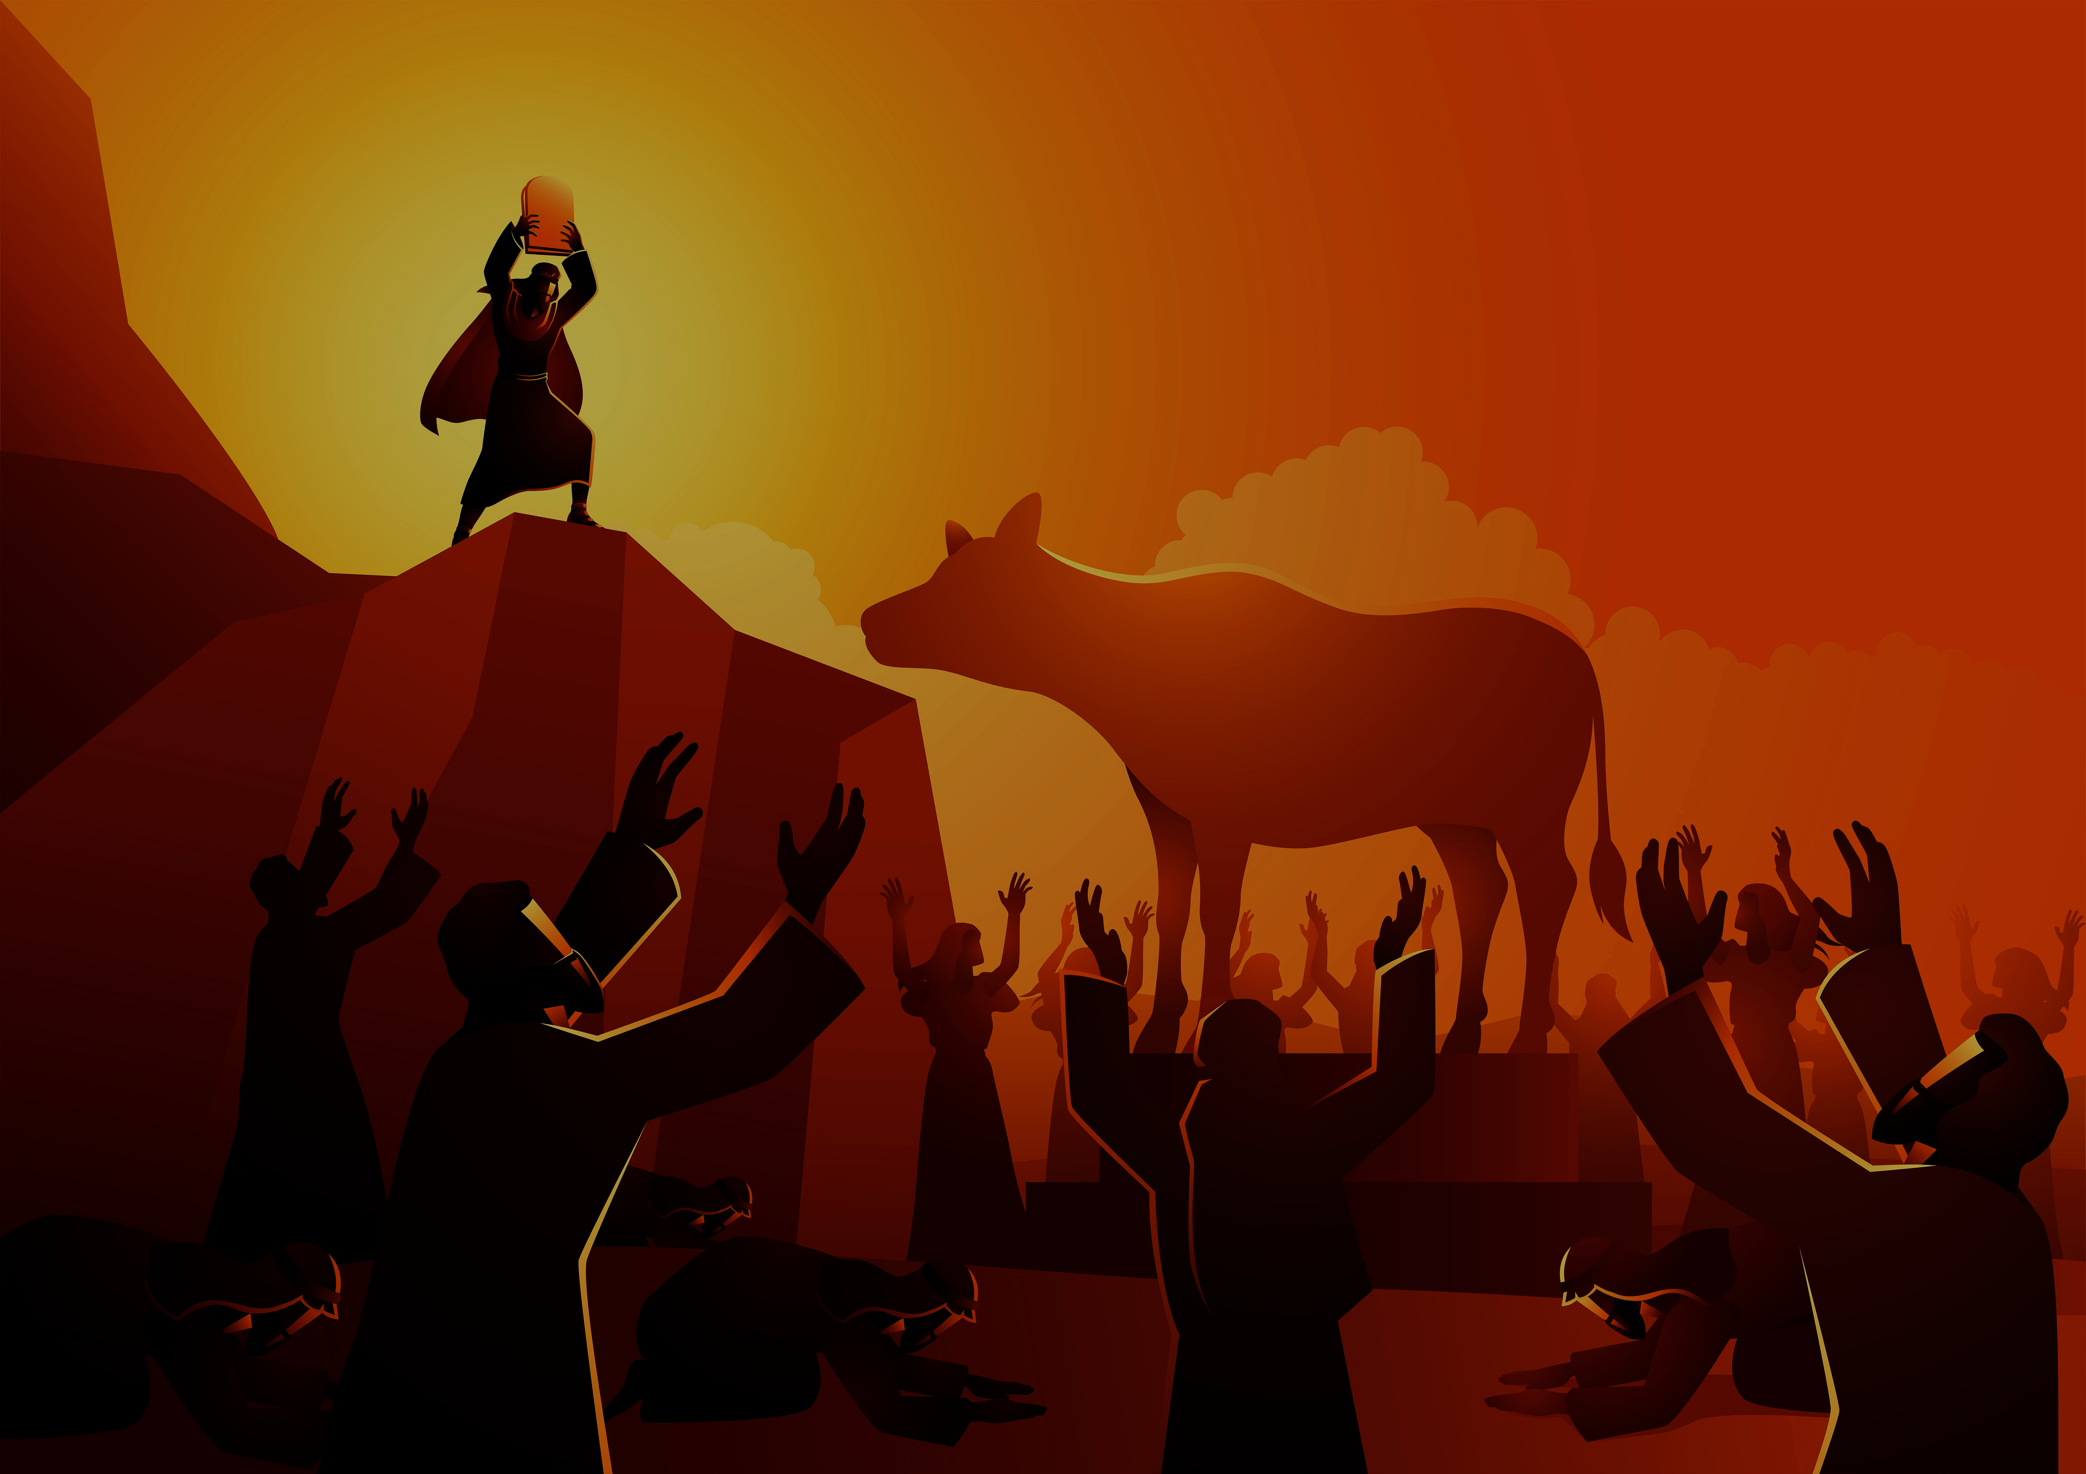
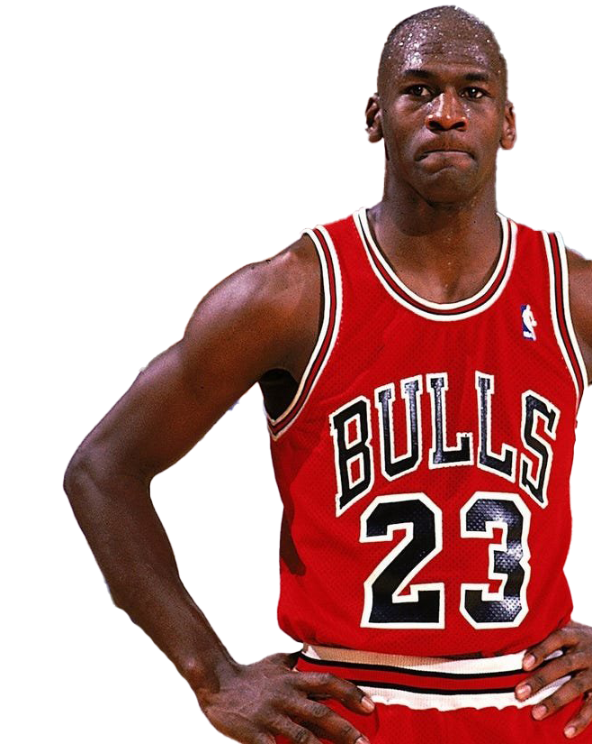
“Don’t ever let me see you in any other sports gear, other then Nike. You can’t ride the fence and keep your options open.” (Michael Jordan)
“You must not make for yourself an idol… and bow down and worship them.. for I am a jealous God.” (Ex 20:4-5)
THE ZEALOUS LOVE OF OUR JEALOUS GOD
(Exodus 20:1-6, Psalm 106:19-48)
OUR GOD IS A JEALOUS GOD.
A WARNING & A PROMISE.
WHAT IS HE JEALOUS ABOUT?
Notes:
In his book ‘Driven From Within’ Michael Jordan shares an amazing story about a time he visited a friend’s home. The two of them were getting ready to go out for dinner when Jordan said, “It’s getting cold outside. Can I borrow one of your jackets?” The friend said he could and Jordan went down the hall to get a jacket from the bedroom. When Jordan looked in his friends closet he saw a lot of Nike merchandise, which he had given his friend because Nike was Jordan’s main sponsor. But he also noticed a lot of jackets, shirts and caps with the Puma brand. He angrily grabbed all the Puma gear and took it back out to the loungeroom and threw them on the floor. He then went into the kitchen, got some scissors and started to cut up all the Puma gear. When he had totally destroyed it all he picked it all up, took it outside and threw it in the bin. He then went back into see his friend and said, “Here is the number of my Nike representative. Call him tomorrow and they will replace all the gear that I destroyed. But don’t ever let me see you in any other sports gear then Nike. You can’t ride the fence and keep your options open.” Essentially saying there is only one option and it has to be Nike. We live in a world that loves to keep its options open – where commitment doesn’t necessarily have a long term tenure attached to it. We change jobs, homes, cars every few years – we commit ourselves to dates and rosters but always with a view that if a better option comes along we will cancel. Michael Jordan wouldn’t accept that attitude and neither does God. Last week we looked at the first commandment where God reminded us that there can be only one god in our lives – Him. In this second commandment he backs that up by saying you can’t have other options – can’t make other idols. It has to be me. But he says this out of love – wanting the best for us, not the worst. It is motivated by his zealous love for us. We will look at three aspects this morning

Slide 2
OUR GOD IS A JEALOUS GOD – “… I am a jealous God.” (v5)
“Do not worship any other god, for the Lord, whose name is Jealous, is a jealous God.” (Ex 34:14) = part of God’s character.
‘Quanna’ = jealous and/or zealous (energetic and passionate pursuit of an objective) and being red in the face.
His jealousy IS NOT based on envy, pettiness, insecurity, wounded pride, selfishness, bitterness, abuse, hate or control.
“Jealousy in God is not a green-eyed monster, but a red-faced lover. He knows what’s best for his people and will have no rivals in his relationship with them.” (Sam Storms)
Notes:
There are over 30 verses in the Bible that tell us God is a jealous God. Perhaps the clearest verse on this is Exodus 34:14 – God tells us his name is Jealous. This means that jealousy is as much a part of God’s character as holiness, mercy, love, justice, omnipotent…. He is how jealousy should look. He is the epitomy of jealousy. But how can that be? Isn’t jealousy a bad thing. In reality jealousy can be sinful but it can also be holy. The Hebrew word for jealous is ‘quanna’ which also means zealous – used interchangeably. Unlike sinful, human jealousy the jealousy of God does not come from being insecure that someone or something is better than him. It doesn’t become resentful, hateful anger (green eyed monster) – there will be anger but it will be angered love (love is never lost) that wants the best for us. Its not about controlling us – w do have a choice to love and follow Him only – no other options. God wants to preserve something extremely precious. He will seek to protect it and also avenge it when it is broken.

Slide 3
A WARNING AND A PROMISE (vs 5-6)
Warning = “I lay the sins of the parents upon their children; the entire family is affected - even children in the third and fourth generations of those who reject me.”
Not a generational curse – “The person who sins is the one who will die. The child will not be punished for the parent’s sins, & the parent will not be punished for the child’s sins.” (Eze 18:20)
Is a reminder that unconfessed sin can impact & influence others in our community & our family (Joshua 7, 1 Cor 5).
Is a guaranteed consequence for those who follow the example of their parents and intentionally sin, disobey & reject God.
Notes:
As we mentioned earlier God’s jealousy is not about controlling us – we all have a choice to choose God as being our only option – idols are all about our heart. God wants our heart not robotic obedience. But there are consequences that come from our choice and God highlights these consequences with a warning and a promise. Warning is not a generational curse (as some think) where God unjustly punishes children for the sins of the parent. I know that because the Bible is filled with verses which clearly tells us that we all have individual responsibility for our sin – Bible never contradicts itself. God will never judge and condemn us because of other people sin. But it does remind us of the community/family impact that individual sin can have. Look at Achan who disobeyed God and took some plunder from Jericho when it was destroyed – made an idol of wealth. As a result, God withdrew his blessing from the Israelite army and 36 soldiers died in the next battle against Ai which should have been an easy victory. Achan’s family were also punished for the sin – not because they were innocent, but because they were complicit in their father’s sin. They would have known what he had done (he buried it in their tent) and went along with it. They were not innocent. Just as individual sin can impact families (adultery, domestic abuse, drunkenness, laziness) with the consequences of pain and suffering or by influencing the children to live the same way = generational sin (repeat the same pattern of sin). This is also referring to children who copy their parents sin and willfully reject God themselves – when that happens they will share in the same punishment because they share in the same sin. Look at the Corinthian church in 1 Corinthians 5 where they were tolerating a man living in sexual immoraility in their church – Paul said deal with it because sin is like yeast and will spread through the dough

Slide 4
Promise = “But I lavish unfailing love for a thousand generations on those who love me and obey my commands.”
Not a guarantee that all future generations will automatically be made righteous & blessed by God = only a personal faith in God.
Is a reminder that living a God glorifying life can bless and influence others around us (Gen 39:5. 1 Kings 11:13).
Is a promise for those who strive to love God and obey Him – more powerful than the warning + blessings last forever.
What is God doing in your family – warning or promise? What do you worship? What legacy are you leaving for others?
Notes:
Promise – just as with the warning, this is not negating personal responsibility. Just as we can’t be condemned by our parent’s sin, we can’t also be saved because of their faith. But it does remind us that when we live a God pleasing life then others can be blessed. See that with Potiphar’s house because of Joseph (Gen 39) and Solomon because of his father David – God would hold off on punishment because of David. The other big difference is that consequences of rejecting God don’t have to necessarily be forever – you can change that by accepting God – getting rid of all other options and giving God supremacy in your life. But once you do surrender yourself to God – love and obey him – then nothing will ever come between God’s love and promises for you. These numbers of generations are not meant to be an exact, literal number. They illustrate the magnitude of the warning and promise. So the challenge today is what is God doing in your family/ Are they being blessed or warned because of your example and influence. Do others see that your treasure is your financial account, your career, your sport, your achievements, your home, your health and looks, your relationships – is that what they seek the most too?

Slide 5
WHAT IS GOD JEALOUS ABOUT?
“God’s jealousy is His zeal to take action against whoever or whatever threatens His enjoyment of what he loves and desires.” (J I Packer) = two things.
1. God is most jealous about His glory and honour – maintaining the supremacy of His name in our world, nation, church and life.
This is a supreme act of love. He wants to give us the best, most beautiful, most satisfying, most enjoyable, most unfailing and eternal gift in world = Himself.
“Do not make for yourself an idol or any kind of an image to worship..” = don’t make & worship a poor substitute of me.
Notes:
So what does God love and desire the most? There are two things. The first thing is his reputation – not ours. His first concern is for his glory not ours. But doesn’t that sound selfish and proud, even though we said his jealousy wasn’t built on selfishness and pride. In reality it is a supreme act of love – because he wants to give us the most perfect gift we can ever have. Himself! That’s why he forbids us to make a poor quality substitute of him – it only takes away the glory of his wondrous gift. The first commandment forbids the worship of anyone or anything other than God. This second commandment forbids the making and worship of any representation of the one true God.

Slide 6
He is Spirit and doesn’t have a body (John 4:24) – it is not for us to make the invisible God visible, and then worship that image.
God reveals Himself in his Word (Deut 4:12) and faith comes from hearing his word (Rom 10:17) – not from seeing him.
God has given us images that reveal his character & glory in human beings (Gen1:26-27) & creation (Rom 1:20) – created, finite & marred by sin. Not to be worshipped.
“Christ is the visible image of the invisible God. He existed before anything was created and is supreme over all creation.” (Col 1:15) – infinite, sinless & perfect. Jesus brings us into the presence of God = true worship.
Notes:
Why is he so adamant about no idols? There are a number of reasons. He is Spirit – don’t make invisible God visible, We limit God and put him in a box if we define him. Doesn’t mean we need to get rid of nativity scenes or all artwork etc., but we shouldn’t bow down and pray to it. God has revealed himself in His word – why our worship should be word centred and not too focused on the visual (worship today loves to have the visual – smoke, lighting, colours, backdrops etc.,). We get a glimpse of the character and wonder of God in humanity and creation although both are marred by sin, created by the creator – limitations that mean we don’t worship them. Jesus is the perfect image of God – his mercy, grace, justice

Slide 7
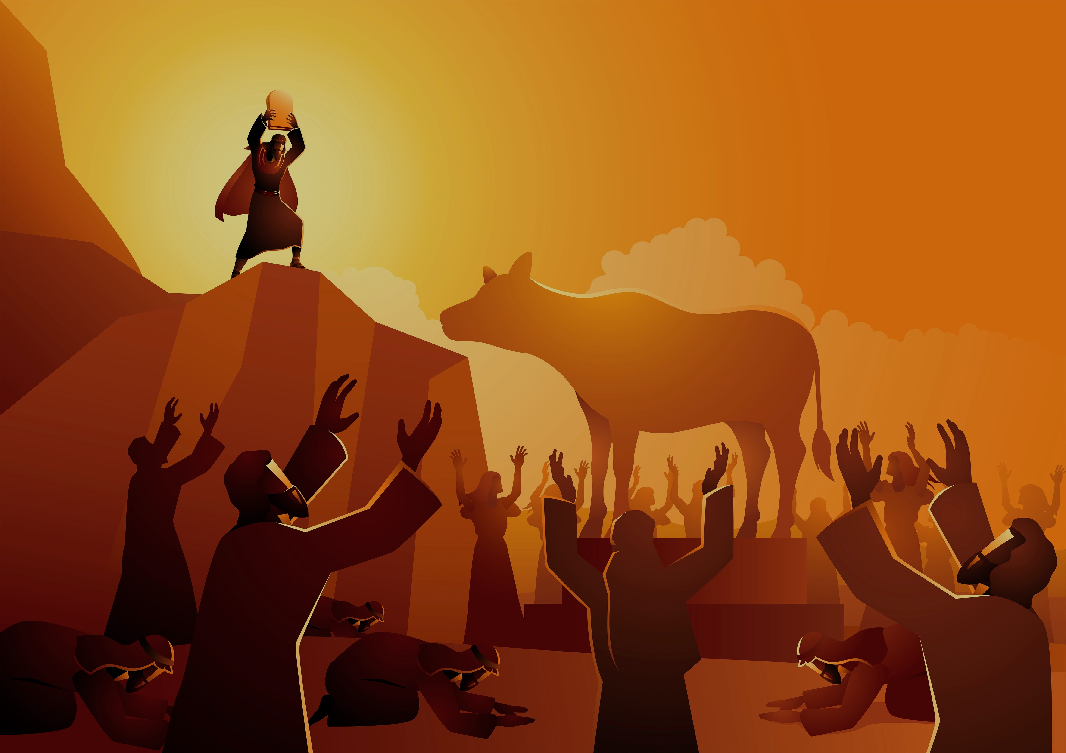
“God will not be captured, limited, contained or managed by anything or anyone, for any purpose. God wants us to trust and obey him, not to use him.” (Phillip Ryken)
His blessings are much greater than money, relationships, health, career, homes, reputation etc.
Be careful we don’t control or shape him to suit our purposes = If I do this, he will do that. If I pray this, I will unlock his blessing. If I read the right translation or sing the right song, I will draw closer to him….
Be cautious of elevating one attribute over another - justice over mercy, grace over truth, …
Notes:
When we put our joy, hope and peace in the things God gives us, rather than in him we don’t do him justice. When we measure his love and blessings by the things of this world we devalue him. When we think God’s purpose is to give us the desires of our heart we devalue who he is. The treasures of earth are nothing compared to treasures of heaven – the greatest prize of all being in presence of God and Christ. We can sometimes worship the Bible more than God – think that knowing the Bible is better than knowing him (relationship). Not saying that translation of Bible or song choices don’t matter (some are dubious in their accuracy and intent). But need to be cautious of elevating them to being equivalent to being godlike – that he can only work through those and no other)

Slide 8
2. God is jealous for our hearts – our devotion and supreme love for Him (heart, strength, soul & mind).
It grieves him when we choose substitutes that are disgustingly and shockingly inferior (toilet water compared to living water).
Idolatry offends God – it is like adultery (Hosea 3:1). His jealousy = his great love for us & His commitment to our relationship.
“I will not tolerate your affection for any other gods.” = “There is no co-habitation or open marriage. There can only be Me!”
Notes:
It grieves God when we choose poor substitutes instead of him. He knows the good plans he has for us Like a dog that drinks from the toilet bowl and thinks that this is as good as it gets. Idolatry is like adultery to God – it offends him. Adultery is the greatest betrayal, rejecting love of God for cheap substitute. A spouse who doesn’t get jealous when their husband or wife is flirting with another person is not committed to that relationship. Imagine if you saw me having a candlelight dinner at a restaurant with another woman and you stopped and asked me what I was doing. Imagine if I said, “Oh I am on a date.” And you the said, “But what about your wife?” And I said, “What about her. I love her too and I have taken her out plenty of times. I just feel like a change at the moment.” I am sure you would be horrified and disgusted – and rightly so. And can you imagine me getting home from that date and Shauna meeting me at the door and saying, “Hi darling. Did you have a good time on your date?’ It wouldn’t happen. She would be hurt and devastated by my betrayal. She would be jealous and want to seek out that other woman and smash her. I would be concerned if she didn’t act that way – it would show how much she loves me. That’s what idolatry does to God

Slide 9
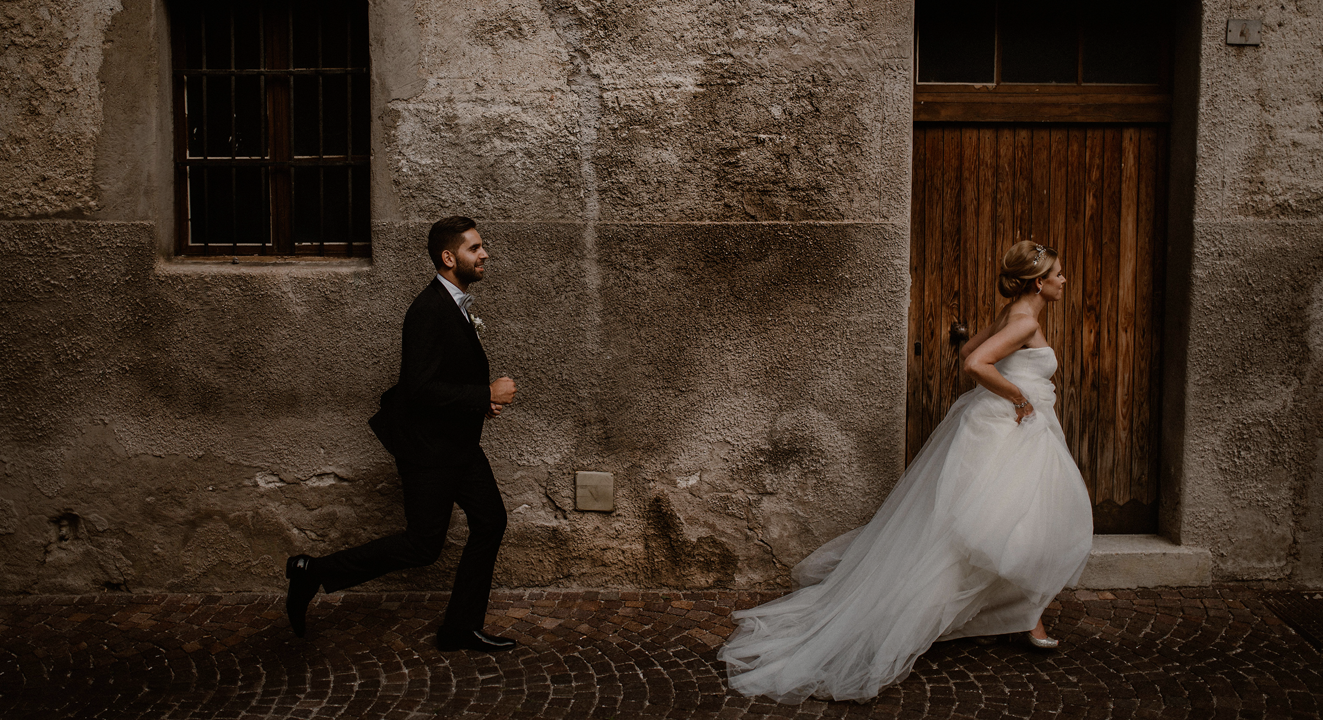
God’s jealousy is not just shown by the offense he takes at our idolatry, but also in his zealous (relentless) pursuit of our heart.
“They defiled themselves by their evil deeds and their love of idols was adultery in the Lord’s sight…. But again and again he rescued them, but they still chose to rebel against him… Even so, he pitied them in their distress and listened to their cries. He remembered his covenant with them and relented because of his unfailing love. He even caused their captors to treat them with kindness.” (Psalm 106:39, 43-46)
The zealous love of our jealous God = he will never give up on us. “But God showed his great love for us by sending Christ to die for us while we were still sinners.” (Romans 5:8)

Slide 10
The cross = the jealous, zealous love of God relentlessly chasing after us as sinners & his enemies. It is proof that He will never stop pursuing us as his bride and friend.
The cross reminds us that God hates everything that –
becomes an obstacle between him and us.
that takes our eyes off him.
that keeps us from hearing his voice & praising his name. He will stop at nothing to destroy anything that hinders our relationship with him.
The cross = He gave everything for us. In light of his jealous & zealous love he demands that we joyfully & willingly give all we have to Him – no more keeping our options open.
Notes:
The cross of Christ is the greatest symbol we have of the jealous, zealous love of God. If God chased after us when we were sinners and his enemies, he will definitely chase after us as his bride and friend. God will never cease doing whatever it takes to destroy our idols.

