Slide 1
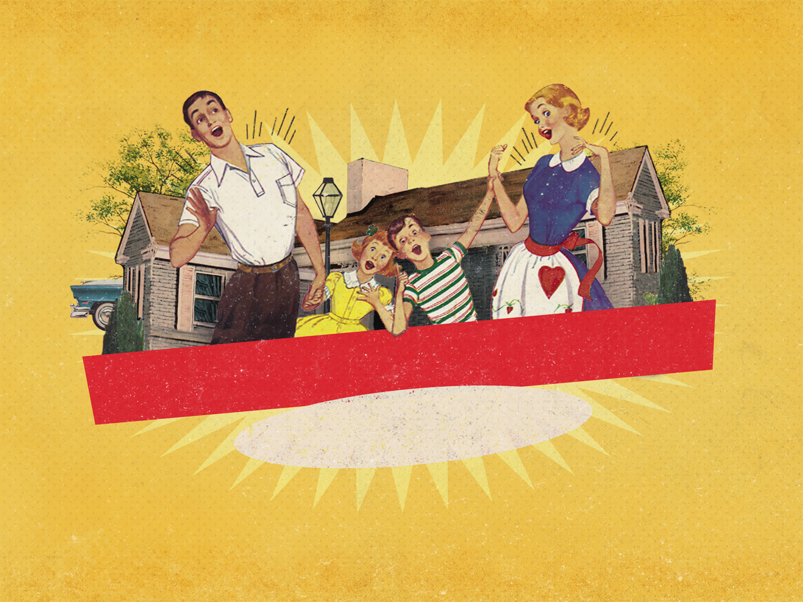
GOD’S FAMILY PLAN
“Honour your father and mother. Then you will live a long, full life in the land the Lord your God is giving you.” (Exodus 20:12)
Notes:
Good morning all and happy mother’s day to all the mothers out there
Today I have the privilege of preaching on the 5th commandment, which is honouring your father and mother
We are all at different stages in life, and we are all in different family situations, but I pray that we will all be able to get something out of today’s sermon
But I thought I would begin today with a nice reminder

Slide 2
“Youth today have luxury. They have bad manners, contempt for authority, no respect for older people, and talk nonsense when they should work. Young people do not stand up any longer when adults enter the room. They contradict their parents, talk too much in company… and tyrannise their elders.”
Socrates
Notes:
One man complained, “Youth today have luxury. They have bad manners, contempt for authority, no respect for older people, and talk nonsense when they should work. Young people do not stand up any longer when adults enter the room. They contradict their parents, talk too much in company… and tyrannise their elders.”
This may surprise you, but the man who wrote this quote was Socrates, who lived 400 years before Christ
It reminds us that every generation of young people have had their issues with their parents

Slide 3
WHAT DOES IT MEAN TO ‘HONOUR’?
This is the first command that deals with ‘loving others’
Kabod (Honour) = Old Testament word for “glory” or “weight”
All of God’s people, no matter the age of the child or parent, are to honour their parents
Notes:
This is the first command that deals with ‘loving others’ - The first 4 commands, deal with loving God, 3 of which we have done, but we moved it around to work in with mother’s day - So we have looked at how we are to have no other God, do not worship idols, don’t take the Lord’s name in vain, and the one we are yet to do is remember the Sabbath - They all deal with our love for God, and it is important that loving God comes first, because God is love and only in and through Him can we truly love others - The first command, the first relationship that deals with our love for others, involves the family, involves the relationship of children to parents. That is significant. - That says that before you go out and love the lost, you need to learn to honour your parents. - Before you can deal with the sinner who is angry with God, you need to get the family relationship right. We will be talking about that more later on. - First let’s take a look at what it means to honour your parents
Kabod (Honour) = Old Testament word for “glory” or “weight” - Kabod is the Hebrew word used here for honour, and it means glory, or weight, or to be heavy - It was the word the Old Testament uses to describe the glory of God, the weightiness of His person - And the Greek word for obey used in Ephesians, means to hear under, to submit to, to listen attentively. So we are to listen under something heavy. – We are to listen not because the parent deserves the honour, but because God has given parents an honourable position
All of God’s people, no matter the age of the child or parent, are to honour their parents - The Ephesians command to obey is to young children, but as we grow up, get married and move away from our parents, we are still to always honour them - There are times when children should disobey our parents, but the only time that is, as with any other authority, is when it goes against the Word of God -I chose that passage about Saul and Jonathan, because Jonathan was a son, who despite the fact that his own father tried to kill him and wanted to kill his best friend, always honoured his father, even in correction - There are a lot of children today, maybe sitting here today, who had parents who weren’t worthy of honour, but God says that by the grace, and love, and power of God at work in us, we are to be a people committed to His Word and therefore honouring our parents

Slide 4
WHY SHOULD WE ‘HONOUR’?
“Children, obey your parents BECAUSE YOU BELONG TO THE LORD” (Ephesians 6:1a)
“… Because you belong to the Lord, FOR THIS IS THE RIGHT THING TO DO” (Ephesians 6:1b)
Some would say we should do it: because flesh and blood, out of gratitude, because parents are wiser etc.
Notes:
“Children, obey your parents BECAUSE YOU BELONG TO THE LORD” (Ephesians 6:1a) - Children must obey and honour their parents because God commanded it, period! It’s part of divine law for us to do so - As Christians, as people who belong to the Lord, what other reason do we need - It’s part of our devotion to Jesus to honour our mum and dad.
“… Because you belong to the Lord, FOR THIS IS THE RIGHT THING TO DO” (Ephesians 6:1b) - The second reason we should obey and honour our parents is because it is the right thing to do - Most if not all, cultures across the world would say that honouring your parents is the right thing to do - It is part of the moral order of the universe that God has put in place, it is part of the natural law. - So it not only accords with divine law, but also with natural law
Some would say we should do it: because flesh and blood, out of gratitude, because parents are wiser than the kids etc. - There are situations out there where the parents aren’t wiser than their kids, where there is very little gratitude owed because there was very little given - And as for the flesh and blood sentiment, one of the central themes of the gospel is that we are adopted into the family of God. - That an adopted father, an adopted child, brothers and sisters in Christ can be just as much a real family bond as a natural or biological one - Why should we honour? The 2 main reasons are right here in the Word of God, because God says so, and because it is the right thing to do

Slide 5
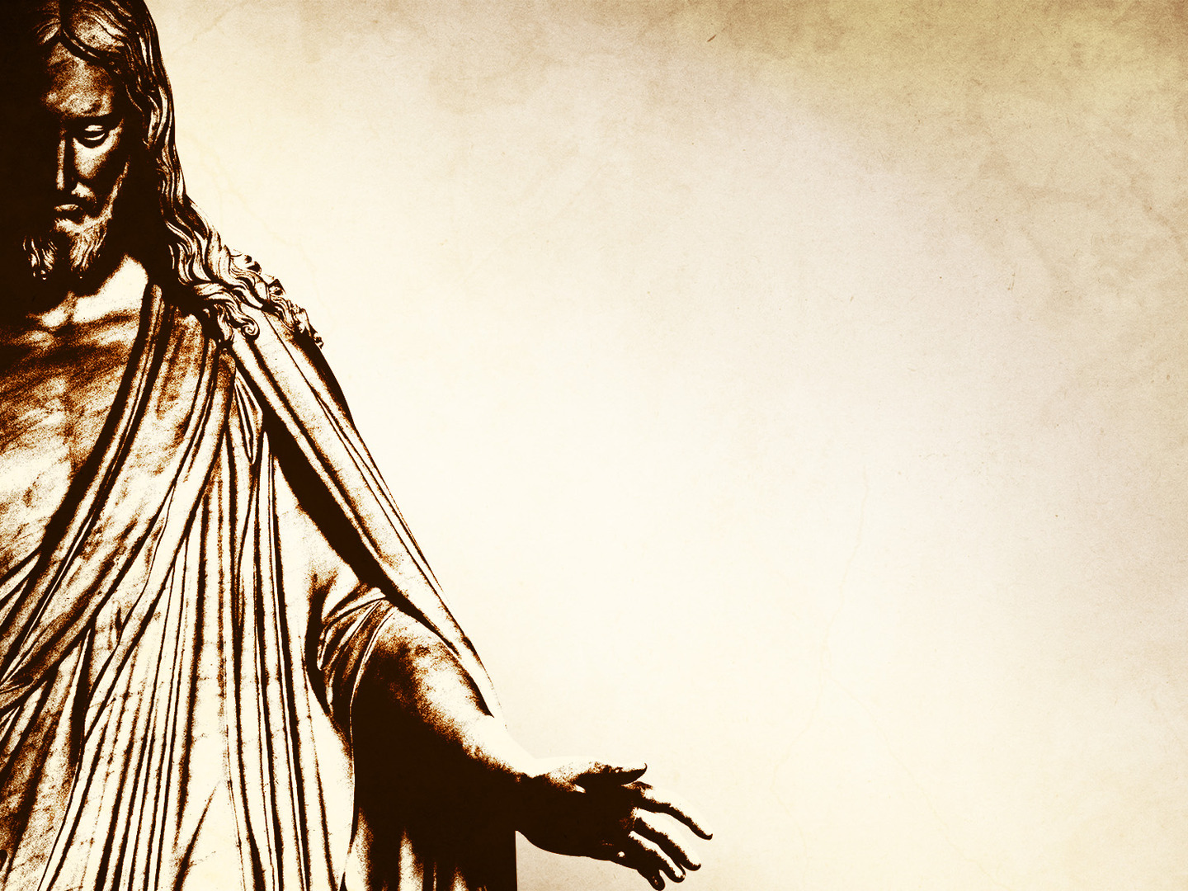
“Then you will live a long, full life in the land the Lord your God is giving you.” (Exodus 20:12)
Jesus was honourable from the cradle to the cross
God begins the ‘love others’ section of commandments with ‘honour your parents’ because it is the key to all relationships in society
Notes:
“Then you will live a long, full life in the land the Lord your God is giving you.” (Exodus 20:12) - I love this, it shows where we get this parenting idea from. God knows that children find it easier to obey, and honour, and do the right thing when there is a reward on the line - Now for Israel the reward was saying that if you want to enjoy the full blessings that God has in store for you in the Promised Land, you will honour your mum and dad - For us today it is saying if you want God’s blessing, if you want the abundant life that God’s Word promises then honour your parents. Spiritual blessing always follows on from obedience to God’s Word - Isn’t it great how God motivates us to holiness. He could have just said, “Honour your father and mother, or else”. - Instead He says, “let me lay this out for you. You’re not going to want to do this. It’s not within your sin nature to do it, but don’t you want to live long in the land? Don’t you want to experience blessing in life?” - God gives us a path toward that end and it starts with honouring your parents
Jesus was honourable from the cradle to the cross - Jesus is our perfect example, Jesus is the one whom we are to model our lives after, and if we do that, we will notice that Jesus was the perfect Son, always obeying and honouring his parents - When Jesus was found teaching in Nazareth while his parents were frantically looking for him, they asked him to come home, and without a fight, he joyfully submitted to his parents wishes - One of the last words that Jesus speaks on the cross, is making sure his mother Mary was going to be looked after by one of his disciples John. Jesus was the perfect child, not only to his earthly parents but also to God the Father, obedient even unto death, for the sake of you and me
God begins the ‘love others’ section of commandments with ‘honour your parents’ because it is the key to all relationships in society - This was not randomly placed, nothing God does is random. It is by the relationship between child and parent that a child learns how to navigate the world that they live in - It is by learning to respect authority that a child learns to submit to governments, bosses, teachers, and leaders, even when they may tick them off - It’s the foundation upon which love for our neighbour is built. As children we learn what it is to have someone in authority over us, to listen to people, to honour them and do things we sometimes don’t want to do - Children need a mother and a father, who will stand firm on God’s Word and give them the gospel

Slide 6
HOW SHOULD WE ‘HONOUR’?
We joyfully obey/ respect our parents
Being a person of good character
Being grateful to them
Apologising and forgiving
Notes:
We joyfully obey/ respect our parents - Young children honour their parents by listening attentively and doing what is asked of them with joy, sounds odd, but doing it kicking and screaming is not honourable - Prompt and cheerful obedience, even just with a smile would be a good start - Those who no longer are young children, this means you need to respect your parents, talk well of them to others and speak kindly to them
Being a person of good character - We all end up not only looking like our parents in some way, but behaving like them as well - Honour your parents by being children of good character, who represent the name of your parents well - Upright children become a precious crown to an old, gray head
Being grateful to them - Thank them for everything they have ever done for you, how they may have provided for you - In return provide for them in their old age when it is needed. To neglect your parents is to dishonour them and live under the disapproval of God
Apologising and forgiving - Honour your parents by confessing when you have messed up, by apologising for all the times you fell short - Don’t be afraid of saying “I’m sorry” - You will also be honouring your parents by forgiving them when they mess up, because they also are not perfect. Don’t hold on to grudges, forgive them

Slide 7
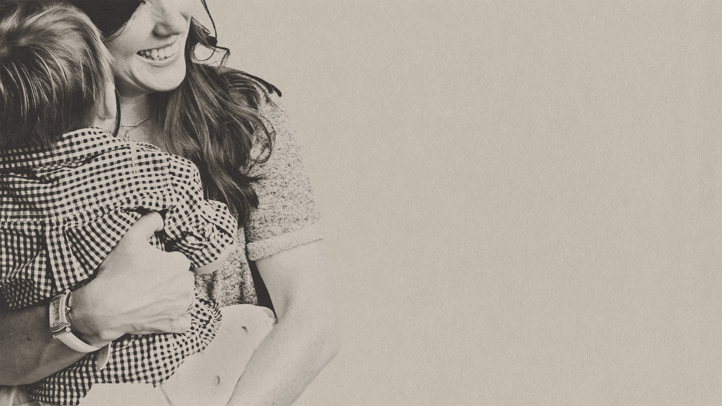
PARENTS, BE WORTHY OF HONOUR
“Rather, bring them up with the discipline and instruction that comes from the Lord” (Ephesians 6:4)
Discipline = To keep accountable Instruction = To counsel , verbal instruction, verbal warning
Parents ought to completely commit themselves to the godly teaching and training of their children
Notes:
“Rather, bring them up with the discipline and instruction that comes from the Lord” (Ephesians 6:4) - Parents, you have big job to do, an honourable position bestowed upon you by God - With great privilege comes great responsibility. There is no greater privilege, apart from knowing Jesus Christ himself, than being able to be a parent, but there is also no greater responsibility - You are to bring your kids up, to nourish and feed them. - To raise them up, not keep them dependent on you, but on God, to get them to a place where they can make decisions for themselves. - To raise them up to one day leave as men and women who can hopefully be mighty ambassadors for Jesus Christ.
Discipline = To keep accountable. Instruction = To counsel, verbal instruction, verbal warning - To discipline means to keep accountable, to hold their feet to the fire, to punish when needed. It sounds harsh but discipline produces practical righteousness, we all need discipline in our lives, none more so than children - Parents are also to instruct, to teach and to warn them about the things of the world. To teach them what is right and wrong. It’s the job of the parent to pass along their values - Children need solid discipline, clear verbal instruction, all wrapped in nourishing tenderness. This is a time when lives are made or broken
Parents ought to completely commit themselves to the godly teaching and training of their children - Completely and tirelessly commit yourselves to the godly teaching and training of your children, as though their lives depended on it - It is important that kids go to school and learn how to read and write and do mathematics. It is important that kids do sport and exercise. - But there is nothing more important than teaching our kids the Word of God and what it means to have a relationship with their heavenly Father - That is where our priority ought to be. The family unit is taking hits from every which way in the world. Build them up and plant their feet firmly in the one true foundation of Jesus Christ

Slide 8
3 ESSENTIALS TO RAISING CHILDREN
1. It takes a church to raise kids, so turn up
2. It takes the gospel to raise kids, so speak up
3. It takes God to raise kids, so pray up
Notes:
It takes a church to raise kids, so turn up - Jess and I will often say to each other that we are so grateful that Elijah and Ewan get to grow up in the church. It’s like having a whole heap of uncles, aunts, grandmas and grandpas all in the one place, and all who love the Lord Jesus Christ. - It is truly such a blessings. But you don’t reap the full reward of that if you don’t bring your kids along to church - When I say church, I don’t just mean any old church either. You want your kids to be going to a church where they hear the gospel preached, where the Word of God is revered and preached in its fullness. - Where God’s grace is heralded from the pulpit and where they will hear how sinful they are and just how much they need Jesus Christ - It is a joy and privilege to be a part of the body of Christ, remind children of that by being present at church
It takes the gospel to raise kids, so speak up - Nothing can change the wickedness of our hearts except for the power of God, the gospel that takes a broken wretch like myself, and by the grace of God I am made whole in Jesus Christ - If there is one thing your kids need to hear, young or old, it’s that they are sinners, but Jesus died for them because such is the love of God, and only in Him can they find forgiveness - Teaching them how to be functioning members of society is important, but teaching them how to be members of the Kingdom of God is infinitely more important
It takes God to raise kids, so pray up - Parents, we will never be perfect. Children will also never be perfect - But God is perfect, He is the perfect Father, and you will need His power, His grace, His patience to raise your kids - SO PRAY, Pray leaning fully into God’s grace

Slide 9
GOD IS WORTHY OF HONOUR
Love for God comes first. We cannot truly love unless we love God
We all need family love, unconditional love.
Parents, point to THE Parent. The Father who gave up His one and only Son for a sinner, His enemy, so that we could be adopted as children of God
Notes:
Love for God comes first. We cannot truly love unless we love God - Jesus sums up all the commandments into two, and the first of the two greatest commands is to love God - We love God, not because we need Him so we can be better parents, or because He blesses us if we love Him, we love Him because He alone is worthy of honour, because He is our only hope for salvation - Remember your salvation, remember who it is that is worthy of all the honour and all the glory. God is love, and only by dying to ourselves and His love to work in us can we truly love others
We all need family love, unconditional love. - Love that says despite all your sin, all your failures, I love you. That can only be found in God the Father - This reminds me of Luke 15 the prodigal son. The son says to the Father “I don’t want to wait for you to die, I want your inheritance now”. So the son takes the inheritance and goes and squanders on living a licentious lifestyle - But he runs out of money and sees his sin. And he decides to go back to his Father, not as a son, but as a slave, as he feels that is all he is worthy of - He says, “I will just come to my father and I will say, ‘Father I have sinned against heaven and in your sight, I’m not worthy to be called your son, but make me a slave.’ - Do you remember what happens though? Before the son even gets his confession out of his mouth the Father comes running down to him and says, “My son! My son! Put on the best robe. Put on my family ring again. Let’s kill the fattened calf, let’s have a banquet because you have returned - That’s the unconditional family love we all crave and long for
Parents, point to THE Parent. The Father who gave up His one and only Son for a sinner, His enemy, so that we could be adopted as children of God - If there is one thing we should want our kids to know, it’s the gospel, it’s the love of a Father who would love them by sending His one and only Son to take the punishment they deserved, and only by the grace of God through Jesus Christ and his life, death and resurrection do they get to experience the love of the Creator of the universe, each and every single day of their lives - Use every day situations to remind them of God’s grace, of God’s justice, point them to Jesus Christ, for this is their only hope in life - Parents you don’t have to be perfect, and when you mess up point them to the Father who is perfect. Children you will mess up, but God sent Jesus to die for all your failures all your sins. God alone is worthy of honour

Slide 10
SUMMARY
Children, obey and honour your parents because it pleases the Lord and it is right
Parents, bring your children up in the Lord, show them and tell them about the greatest story ever told
We all fail as children and parents. God never has and never will fail you. He is worthy of ALL the honour
Notes:
Children, obey and honour your parents because it pleases the Lord and it is right - We honour our parents, not because they deserve it, not because of anything they have done - We honour them because God’s Word tells us it is pleasing to Him and it is the right thing to do
Parents, bring your children up in the Lord, show them and tell them about the greatest story ever told - The responsibility of raising kids is massive, but the greatest responsibility and God given privilege you have is to tell them about your Lord and Saviour Jesus Christ - Seize every opportunity to read the Bible with them, to pray with them, and to show them the love that you have for your heavenly Father
We all fail as children and parents. God never has and never will fail you. He is worthy of ALL the honour - You will fail, but when you do run to God, repent, fall into His arms and rediscover His grace all over again - We all strive to be and want to be honourable people, but God alone is the very definition of honourable, so in everything that you do, bring glory to Him

Slide 11
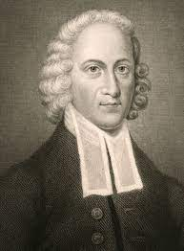
“I want you to tell your other brothers and sisters it is about time they look to a Father who does not die” Jonathan Edwards
Notes:
When Jonathan Edwards, the great theologian, preacher and evangelist died, only one of his daughters was there, and all the rest of his children and his wife were elsewhere
He said “I know I won’t last the night out,” so he turned to his daughter Lucy and he said,
“Write this down. First of all, tell my wife that the uncommon union which has so long subsisted between us is, I think, a spiritual one, and therefore one that will last forever.”
He said, “I want you to tell your other brothers and sisters it is about time they look to a Father who does not die”
That is the message of fathers who loves their children
No matter what you have been through, no matter what you may be going through, look to a Father who does not die.
This is not just a message from a parent, a child, this should be the message of the church to the world, ’Repent and turn to the true Father who loves you deeply, look to God Almighty who does not die for He is your only hope’.
Let’s pray

