Slide 1
2022
Australia = 370 victims of homicide.
USA = 26031 victims of homicide.
Notes:
Murder was the very first crime committed in history. Since that time, it has continued to be a sad blight on humanity. In 2022 there were 370 murders in Australia. But nothing compared to America. When we look at these dramatically different statistics it would be easy for us to think that Americans have a big problem with killing – that they have a seemingly greater disregard for human life than we do. In fact, as we come into this sixth commandment I would expect that nearly all of us would think that this is the commandment that we have the least problem with. However, as we look at the commandment in depth this morning, and come to understand its full implications, we find that it is potentially the most blatantly disregarded and broken commandment of them all.

Slide 2
WHY MUST WE CHOOSE LIFE?
WHAT DOES THE SIXTH COMMANDMENT FORBID?
HOW DOES JESUS TRANSFORM THE SIXTH COMMANDMENT?
“You must not murder.” (Exodus 20:13)
Notes:
The sixth commandment is very short – just four words. It is a negative command with a positive message for us – Choose life (all lives matter). God is really reminding us the value of human life and commanding us to always be striving to choose life.

Slide 3
WHY MUST WE CHOOSE LIFE?
“And I will require the blood of anyone who takes another person’s life. If a wild animal kills a person, it must die. And anyone who murders a fellow human must die. If anyone takes a human life, that person’s life will also be taken by human hands. For God made human beings in his own image.” (Gen 9:5-6)
a) Life for life = infinite value, literally will cost all you have.
b) Image of God = mirror God, His masterpiece. All humans are rational, personal & capable of love, communication and creativity above all other creatures.
There are no ordinary, mere mortal humans (Matt 25:46).
Notes:
This is part of the covenant that God made with Noah after the flood – before the Ten Commandments and still current (wasn’t cancelled by the Mosaic Covenant and Ten Commandments). In these verses God makes it very clear that we must choose life – value human life above all things. Why?
God says if a life is taken by another person, then that person must give their life. Interesting how God includes a wild animal – biblical reason to hunt down sharks, crocs, dogs etc that takes a human life. Doesn’t matter if they are following their instincts (which have been impacted by the fall). Not sure how that works – do animals realise the impact of what they have done? but leave that with God. Not my main point today. But accountability must be there. Whatever punishment we give for murder = the price we put on human life. We still give a “life” sentence for murder – does that match with God’s standards? Should we still have capital punishment? That’s another day perhaps.
Image of God – we are unique and different to all other plants and animals. Bible tells us two things last forever – Word of God (Isaiah 40:8) and human souls. When we grasp that truth we realise that there are no ordinary humans – that we have never talked to a mere mortal. Nations, cultures, Civilisations, arts – they all come and go. In the end even all creation will go (burned up) but the spirit of every human being lasts forever – an eternity in either heaven or hell, eternity in the presence of God or eternity in absence of God. Nothing is as valuable as a human being made in the image of God.

Slide 4
“Our neighbour bears the image of God. To use one of them, abuse one of them, or misuse one of them is to do violence to God himself.” (John Calvin)
c) Protects the sovereignty of God = God alone is the author and sustainer of life. He does not delegate that to anyone else. “The Lord brings death and makes alive. He brings down to the grave and raises up.” (1 Samuel 2:6)
d) Robs God of His glory = we were created not for our sake, but to glorify God (Psalm 118:17, Isaiah 43:20-21) “… whatever you do, do it all for the glory of God.” (1 Cor 10:31). Taking a life = taking away potential for them to praise God.
Notes:
c) Sovereignty of God – God is the author of life. It is his responsibility, and his alone, when it comes to deciding our days.
d) Robs God of glory he deserves – we were created to glorify God. He created and called Israel to give Him glory. He gives us life not for our sake but for his glory. Taking a life = taking away potential for that person to praise God.

Slide 5
WHAT DOES THE SIXTH COMMANDMENT FORBID?
Murder (kill) = ratsach in Hebrew. Used 46 times to describe wilful and violent actions or blood vengeance
Qatal (another Hebrew word for kill) is used hundreds of times in OT = there is a big difference between them.
To fully understand what ratsach forbids, we firstly need to understand what it doesn’t forbid.
a) Self defense = “If a thief is caught in the act of breaking into a house and…is killed in the process, the person who killed the thief is not guilty of murder. But if it happens in daylight, the one who killed the thief is guilty of murder.” (Ex 22:2-3)
Notes:
There are a number of Bible versions (such as KJV) which say “Do not kill”, but I believe murder is a more accurate translation - help us understand more the intention of God in this commandment. Word for kill = ratsach (pronounced raw-tsakh) but pronouncing it ‘ratsak’ sounds more forboding.

Slide 6
b) Capital punishment – “If anyone takes a human life, that person’s life will also be taken by human hands.” (Gen 9:6) = a defense of God’s image, not an assault on his image.
“The authorities are God’s servants, sent for your good…They are God’s servants, sent for the very purpose of punishing those who do what is wrong.” (Romans 13:4)
c) War – peace is always God’s goal, but war is sometimes necessary to defeat evil & defend peace.
In OT, God often sent Israel into battle. In NT, John the Baptist, Jesus & Peter never condemned soldiers for being in the army.
Notes:
b) Capital punishment – a contentious topic in our world today and (like the issue of animals being punished for death) I don’t intend to focus too much on that today – not my goal today. Not up to an individual to make that decision, but God has given authorities, governments the right to do this. Supported in NT.
c) War – not saying God approves of all wars, but he understands that in a sinful world wars are sometimes necessary. In OT God often sent Israel into battle and in NT we never see a roman soldier being condemned for being in the army – even though it was a godless army who had invaded and conquered Israel for national pride (not to defend peace) . In Luke 3:14 some soldiers asked John the Baptist what they must do to repent? He said don’t extort money and be content with your pay. He never said get out of the army and stop killing. In Acts 10:1-2 Cornelius, a captain the Roman army, was described as a devout God-fearing man. Peter never condemned him for being a soldier. In Matthew 8:5-10 Jesus meets a centurion who wants him to heal his servant and is blown away by his faith (greater than anyone else in Israel). Never condemned or challenged him about being in the Roman army.

Slide 7
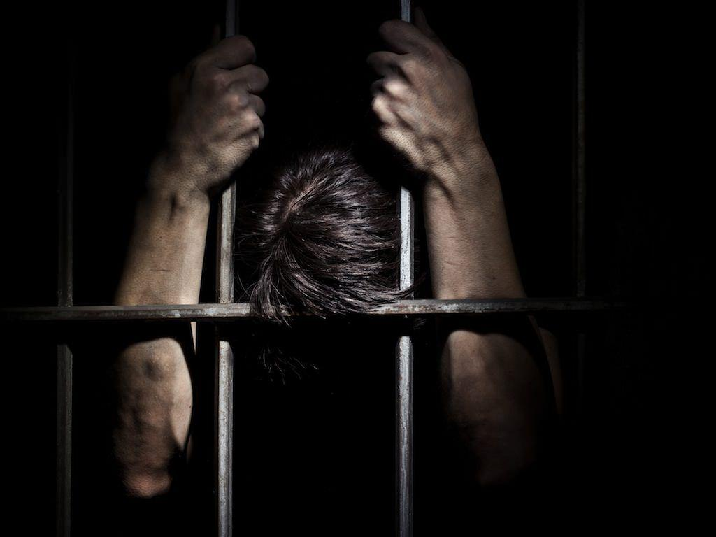
What does ratsach (6th commandment ) forbid?
a) Premeditated, intentional murder = “One day Cain suggested to his brother, “Let’s go out into the fields.” And while they were in the field, Cain attacked his brother and killed him.” (Gen 4:8)
“Then the two scoundrels came and sat down across from him. And they accused Naboth before all the people, saying, “He cursed God and the king.” So, he was dragged outside the town and stoned to death.” (1 Kings 21:13)
b) Reckless homicide & involuntary manslaughter = due to willful negligence or inaction. For example - no guardrails (Deut 22:8), an unrestrained bull (Ex 21:28-29) or withholding help.
Notes:
Premeditated murder – by an individual’s hand (like Cain to Abel) or an individual falsely framing someone and wrongly using the judicial system – like Jezebel did to Naboth because her husband King Ahab wanted his vineyard. God regarded that as murder also and judged them accordingly.
Reckless homicide or involuntary manslaughter – God took workplace health and safety seriously. If a death was caused by negligence then it was murder. Owners of homes were required to build parapets (guardrails) on their rooftops where family and guests might go to relax. If there was no guardrails in place and they fell and died, the home-owner was charged with unlawful death. Another example if someone is gored by a bull. If it’s the first time and not expected then its not deemed murder. But if the bull is known to be dangerous and attacked someone before and the owner doesn’t put safety measures in place - the owner is charged with murder. Even intentionally withholding medical or physical help that could save someone (e.g., like the priest and Levite in the Good Samaritan parable or parents letting children starve etc.)

Slide 8
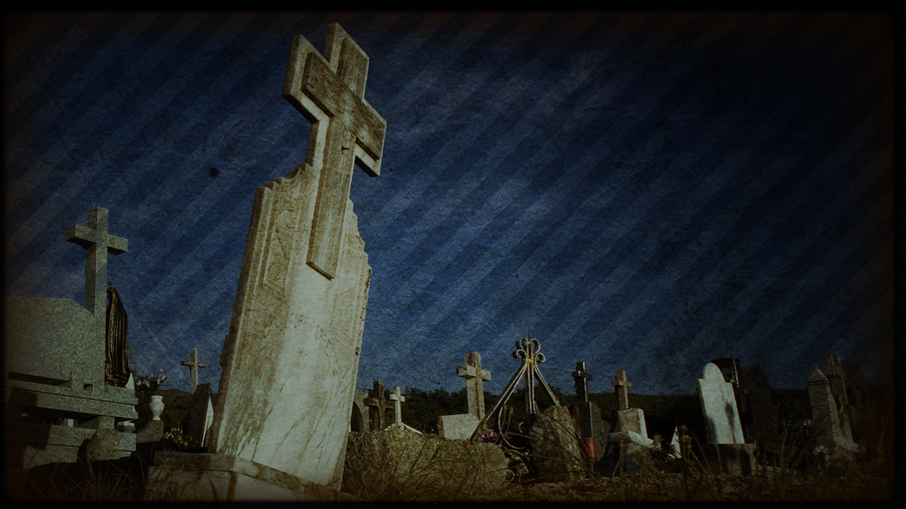
c) Suicide = self murder. It is tragic, but still a morally culpable and blameworthy choice (but not an unforgiveable sin).
There are 5 cases of suicide in the Bible (most infamous are King Saul and Judas) = all are instances of shame & defeat. Both Job & Jonah asked God to take their life & He refused.
Your life is precious to God, even when you think it is pointless.
d) Abortion – “You made all the delicate, inner parts of my body and knit me together in my mother’s womb… You watched me as I was being formed..” (Psalm 139:13, 15)
Human life & value begins at conception = scientific fact.
Notes:
c) Suicide – regarded as a sin (not the unforgiveable sin). I understand that there can be cases where people have lost capacity to right-thinking but they are still responsible. There are 5 cases of suicide in the Bible – Abimelech (Judges 9:50-57), Saul (1 Sam 31:1-7), Ahithophel (2 Samuel 17:23), Zimri (1 Kings 16:15-19) and Judas (Matthew 27:3-10)

Slide 9
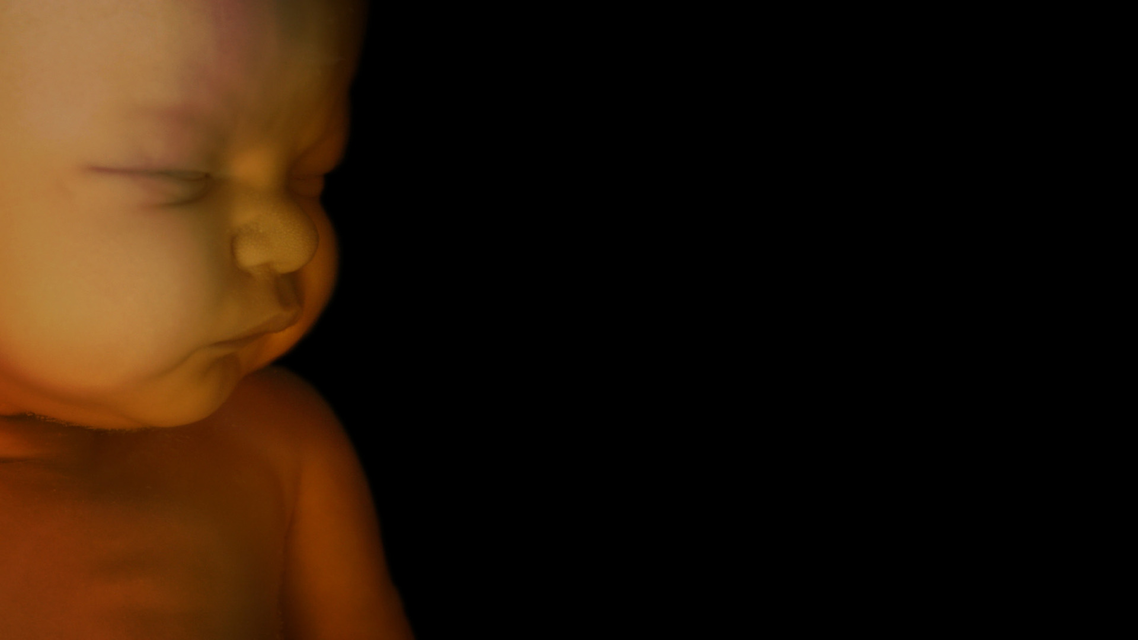
“Now suppose two men are fighting, and in the process they accidentally strike a pregnant woman so she gives birth prematurely. If no further injury results, the men.. must pay compensation.. But if there is further injury, the punishment must match the injury: a life for a life…” (Ex 21:22-25)
Chloe’s Law in NSW = protection for pregnant women who lose their child (death) at the hands of a criminal offence = the life of an unborn child needs to be valued and protected.
e) Euthanasia = assisted suicide = the termination of life, not the termination of treatment. All lives matter to God – regardless of age, ability or health.
Notes:
Law in Exodus 21:22-25 talks about the responsibility for accidently killing an unborn child. Last year (29 March 2022) the NSW government passed a law that says the same thing = recognises that a foetus = human life. Same standard as God’s standard. An unborn child = a human life made in the image of God.
e) Euthanasia – the termination of life, not treatment. There is a big difference. Not euthanasia to take someone off life support or to decide not to take treatments that may extend your life for a few days, weeks or months.

Slide 10
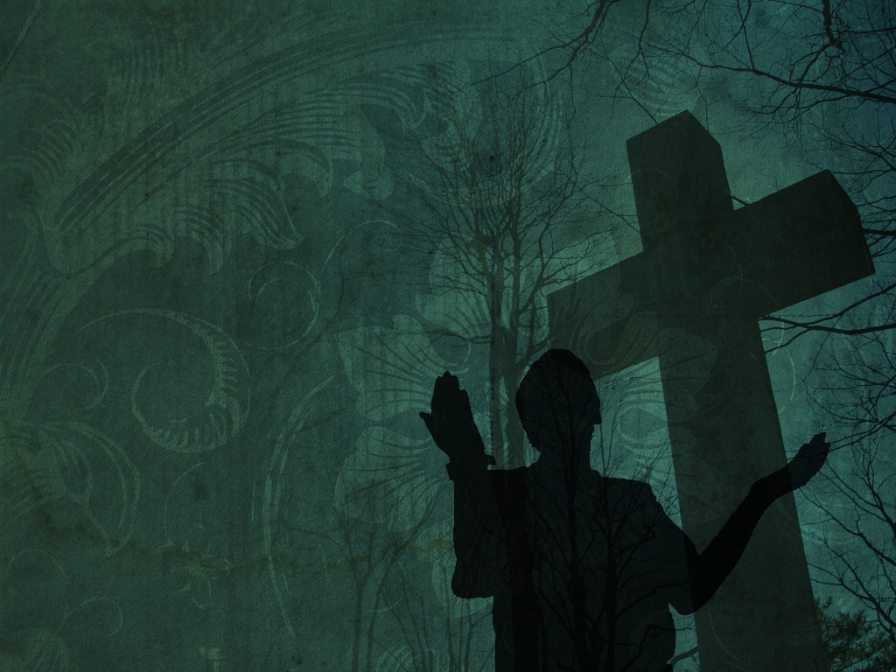
HOW DOES JESUS TRANSFORM THE SIXTH COMMANDMENT?
“You have heard that our ancestors were told, ‘You must not murder. If you commit murder, you are subject to judgment.’ But I say, if you are even angry with someone, you are subject to judgment!” (Matthew 5:21-22a)
You can be 100% murder free but still face the wrath of God if your life is marked by anger, bitterness, insult & vengeance. He prohibits hateful acts of murder & hateful intentions of the heart.
Anger (orgizo) = to swell up, brood, simmer & nurture (not a temper flare, which can be bad too) = not a righteous anger.
Notes:
Up until now I am guessing that nearly all of us are thinking that we are OK with this commandment – not a concern for us at all. That is how the Jews in Jesus day were thinking until Jesus preached his Sermon on the Mount and challenged their thinking. Its not about just prohibiting hateful acts of murder (what you do with your hands) but also hateful intentions towards others (what you do with your heart).

Slide 11
“Anyone who says to a brother or sister, ‘Raca,’ is answerable to the court. And anyone who says, ‘You fool!’ will be in danger of the fire of hell.” (Matthew 5:22b) = a ‘murderous’ heart & mind.
Raca = you idiot, you nobody, you non-person, your life is inconsequential. Fool (moros) = stupid, godless (Ps 14:1), you are unregenerate & unsaved – I have no time for you.
“You have heard the law that says, ‘Love your neighbour & hate your enemy. But I say, love your enemies! Pray for those who persecute you!” (Matt 5:43-44) = a non murderous heart & mind.
Do not murder = choose life = people are priceless = aggressive compassion = making everyone feel valued and loved. Do we?
Notes:
Jesus then goes on to give us more detail about what a murderous heart looks/sounds like. Raca = scorn and contempt for another human being, their life has no value. You are claiming superiority. Fool means you are cursing them (why NLT uses the word curse) – finding comfort and joy in the fact they are unregenerate and unsaved (which is not something we should find delight in). Finding hope in fact they may go to hell, that God won’t love them enough to save them, they are too far gone. What Jesus is saying is that we can kill people with our words and thoughts, by withholding the power to help them. A little later on in his sermon Jesus would challenge us about loving our enemies and praying for those who perscecute you. Those who mock you, reject you, condemn you, dismiss you, hate, who advocate for and do abortions, euthanasia? Its easy to value and love those who look, think, dress, act, believe, vote like you. That’s easy. But we need to remember that even the worst sinner and even our biggest and most bitter enemy are made in the image of God and that their life is priceless – that Jesus died for them too. Do not murder = we must have aggressive compassion for all people. Do we make everyone we meet feel like a million dollars? Best way to know that answer that question is to ask those around us. If you are like me – I am sure they would say no.

Slide 12
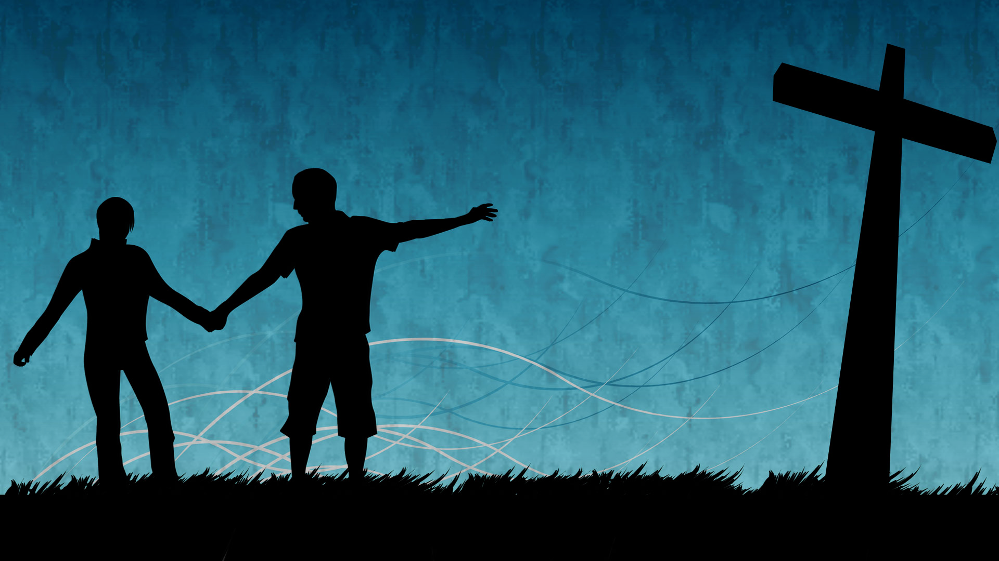
Good and Angry (Redeeming Anger, Irritation, Complaining, and Bitterness) by David Pawlinson – Chapter 2 : “Do You Have A Serious Problem With Anger?”.
If we don’t deal with our hateful and angry heart = “.. you surely won’t be free again until you have paid the last penny.” (v26)
Choose life - run to Christ for forgiveness and look to Him as our living example of ‘aggressive compassion’.
Christ loved us unconditionally – we should love others the same. Christ reconciled us – we should be reconcilers. Christ gave us perfect peace – we should be peacemakers.
Notes:
If we are all honest we can struggle with having a murderous heart sometimes – we can be guilty of not valuing people as we should, not having aggressive compassion towards others, including our enemies. In his 2016 book about anger David Pawlinson (US author and professional counsellor) writes a second chapter called Do You Have a serious Problem With Anger? The chapter has one word in it Yes! Who has been unrighteously angry in the way have spoken to their spouse, children, someone driving too slowly, saying something we don’t agree with… In verse 26 Jesus gives us a warning if we want to hang onto our murderous, angry heart – if we don’t strive to seek reconciliation and love others. Holding onto anger impacts on our relationship with others and with God. Thankfully we have Christ who shows us how to live and who gives us his Spirit’s power to conquer our sin. Christ loved, served and sacrificed for us – we should do same for others.

