Slide 1
”YOU MUST NOT HAVE ANY OTHER GOD”
Notes:
Good morning everyone
This in some ways is probably one of the easier commands to preach on. I mean it’s Christianity 101
But if I’m being completely honest, I had a lot of mental blocks. Like how do I talk for 20-30 mins on “You must not have any other God”?
What else is there to say. But here I am and I am praying that you will get something out of today
In my study this week, I got to thinking, and I think God was convicting and impressing this on me, “What if rather than reading the commands with a negative tone, I tried reading it with a positive tone”
Rather than thinking, here we go again, a list of thou shalt and thou shalt nots, reading them as a good thing
More like, “Are you kidding me, God wants me to worship Him, He is giving me the answer to a fulfilling joyous life in Him.”
When I got married I didn’t go, ah, how lame I have to spend the rest of my life with Jessica, getting to know Jessica.
No I thought, what an incredible privilege that I get to spend the rest of my life getting to know Jessica, getting to know all of her little quirks and the intricacies of her personality
That’s what God is calling us to, here in this command, He is calling us to an intimate relationship with Him and Him alone for the rest of our lives, getting to know Him through prayer and His Word, getting to be amazed at the holiness and might of my God, getting to experience His great love for me, all of this, to then one day spend forever with Him, worshipping Him in the new heavens and new earth.
I mean isn’t that amazing

Slide 2
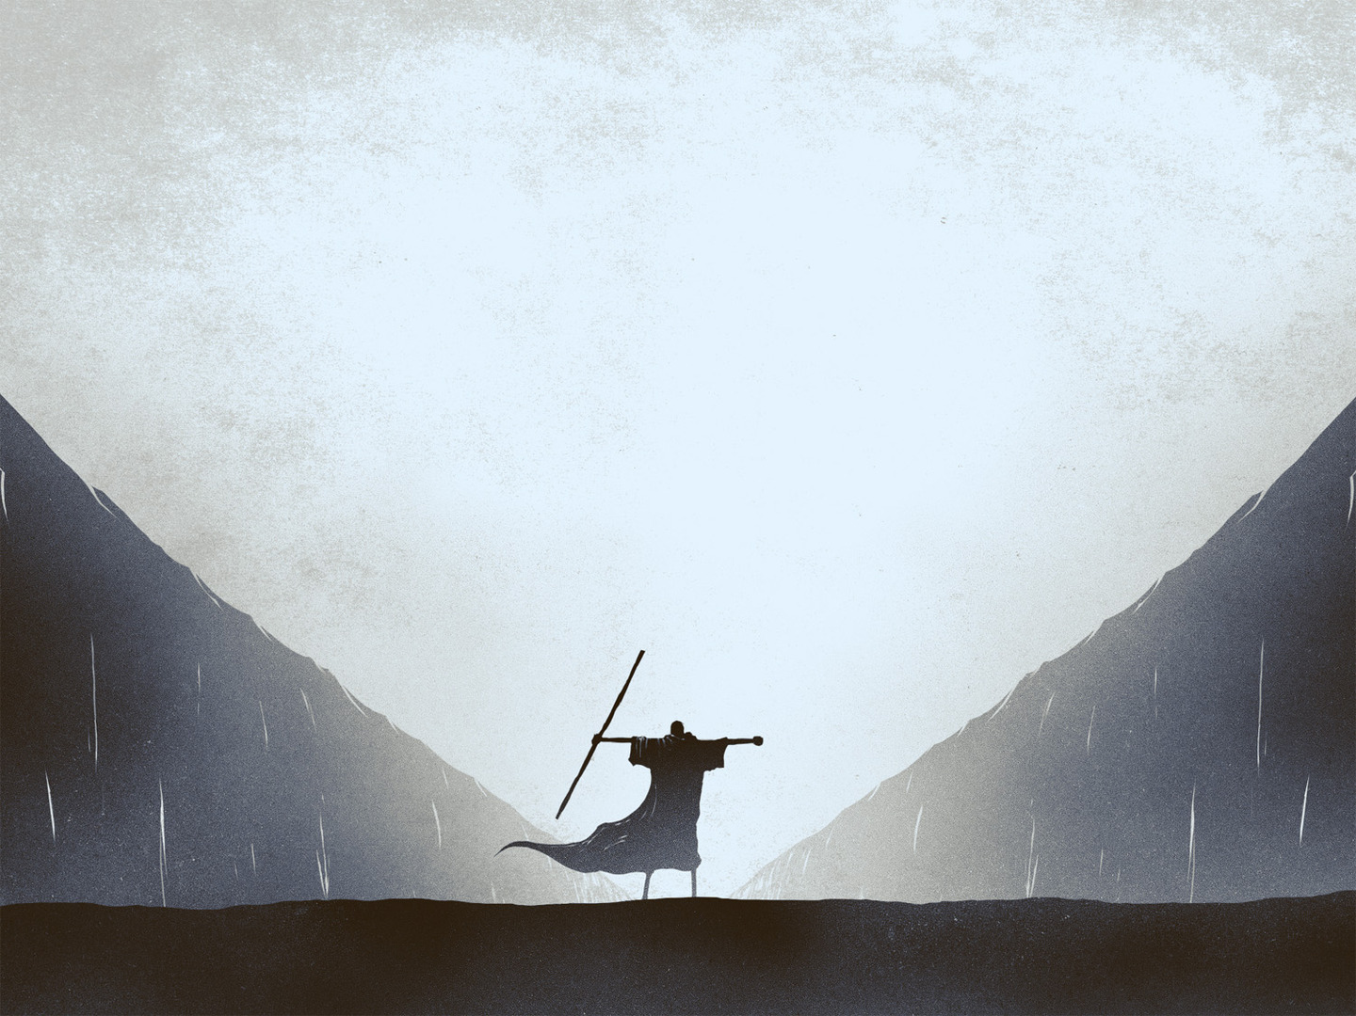
REMEMBER YOUR SALVATION
“And God spoke all these words, saying,” (Exodus 20:1)
“I am the Lord your God” (Exodus 20:2)
“Who rescued you from the land of Egypt, the place of your slavery” (Exodus 20:2b)
Notes:
“And God spoke all these words, saying,” (Exodus 20:1) - The NLT says that God gave , but I think other more literal translations capture the awesomeness of what is happening more effectively - When God speaks we listen, when God speaks the earth is created, the whole universe as we know begins to exist, when God speaks the dead live again - And so the fact that God is speaking here says to the nation of Israel at the time “Listen up, what is about to be said is important” and is still important for us today
“I am the Lord your God” (Exodus 20:2) - The word here for Lord is Yahweh which is God’s special covenant name, the Great I Am, the sovereign, eternal and the almighty Lord - God is saying here that “I am the supreme, self-existent, eternal, and unchangeable God who bound myself to Abraham, Isaac, and Jacob in an unbreakable covenant” - The reason that Israel were God’s treasured possession was firstly because of His grace unto Abraham, but secondly following on from that is because He is the faithful God
“Who rescued you from the land of Egypt, the place of your slavery” (Exodus 20:2b) - God is saying “because of my covenant with your ancestors I rescued you from the land of Egypt, the place of your slavery” - He wants His people to remember who He is, what he has done for them - He is reminding them, not so that they would owe Him, but because He alone is worthy of all that He asks of them. He is reminding them of the covenant, of His love for them, and calling to them to reciprocate this love

Slide 3
Throughout the Bible, many authors of the Bible call the readers to remember the past
Solomon forgot the role that God had played in his life
PREACH THE GOSPEL TO YOURSELF!
Notes:
Throughout the Bible, many authors of the Bible call the readers to remember the past - Time and time again God reminds the children of Israel of all that He has done for them, to call them to repentance, to call them back to this first command - Just before Israel enters the promised land, in Deuteronomy, once again Moses calls them to remember all that God has done - Many of the New Testament authors, when they see that the church is going wayward calls them to remember all that Jesus Christ has done for them, and the grace that has been poured out for them
Solomon forgot the role that God had played in his life - Solomon’s time as king began with love for the Lord, but ended in love for women and other gods - Solomon had forgotten all that God had done for him and blessed him with. He had forgotten that the only reason he was so successful as king was because God was with him - He had forgotten that the only reason he was king in the first place was because of God’s faithfulness to David - Because he didn’t take time to remember, God began to lose the place of first love in his life
PREACH THE GOSPEL TO YOURSELF! - We must always take time to remember our salvation and remember that it is only by grace, through faith in Christ alone that we can stand with assurance today that we have been saved - We must remember that before Christ we were dead in our sins, and heading for eternal destruction - I need to make time to count my blessings and to remember that only because of Jesus have I been brought out of my bondage to sin, my slavery to Satan

Slide 4
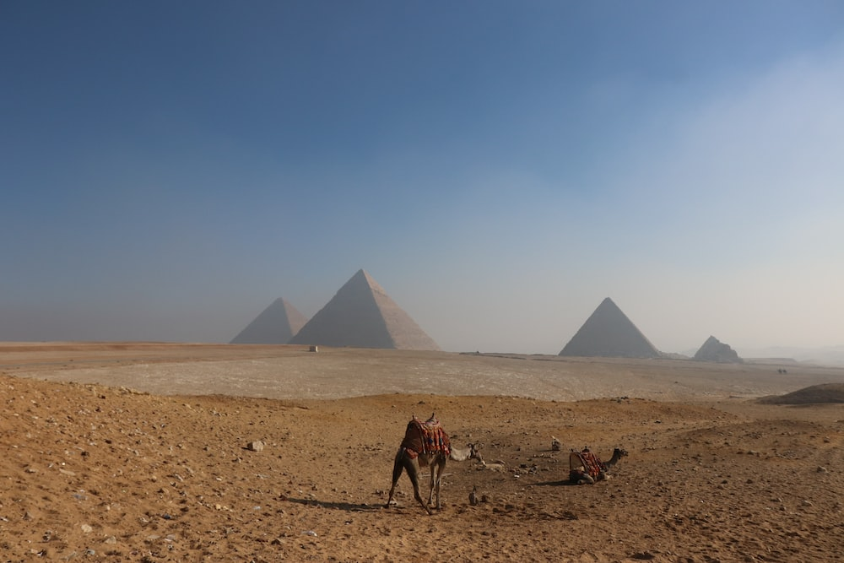
WORSHIP OF GOD EXCLUSIVELY
The Israelites had just come out of Egypt, a polytheistic culture
The land of Canaan was another polytheistic culture
“You must not have any other God but me” (Exodus 20:3)
Notes:
The Israelites had just come out of Egypt, a polytheistic culture - They were a culture that had a god for just about everything. - It is said that there are over 1400 different gods and goddesses that the ancient Egyptian's worshipped - The ten plagues attacked the Egyptians gods, and showed Egypt that in reality, their gods were no gods at all. Nothing and no one can stand against God Almighty, the great I Am - And God isn’t just showing the Egyptians this, but showing the people of Israel
The land of Canaan was another polytheistic culture - Not only did Israel come from a polytheistic culture, but they were about to head into another one - No other nation in the ancient world would have prohibited the worship of other gods. It was common practice for ancient cultures to have many gods. Think of all the major nations of the ancient times, Egypt, Rome, Greece, all had many gods that they worshipped - That is why before Israel enter the promised land, God commands that they destroy all the places of worship in the land of Canaan, because God will not share our hearts with any other, it is an all or nothing kind of deal
“You must not have any other God but me” (Exodus 20:3) - God is calling Israel to be set-apart from the world at the time, He is calling them to be holy, to be unique, to be a people who worship one God, the one true God - He is saying you have me, I have destroyed the so-called gods of Egypt, I have demonstrated my power and shown that there is one God worthy of praise and glory - This is a call of love, a call to joyful obedience. God is saying I have loved you and still love you, now would you love me by worshipping me exclusively - When we remember our salvation, when we remember the gospel, the commands of God are not burdensome, but joyous, for what greater joy in life could there be than to serve the one true God, who not only created me, but sent His one and only Son to die for me

Slide 5
This is the fundamental commandment, the one that comes before them all and lays the foundation for them all
God is to be our first and only love, for it is by the grace of God through Jesus Christ that we have salvation
He will not share His glory with any other god, because He is the one and only true God
Notes:
This the fundamental commandment, the one that comes before them all and lays the foundation for them all - This is Christianity 101 right. There is one God that we love, one God that we worship, one God that is worthy of all the glory - If we get this right, when God is the only god that we worship, when He consumes our thoughts, when we cherish His Word, when we allow Him to fill us with His power, only then can we truly live out the rest of the commands - That is why this is the first command. If you’re wanting a nation to go forth and be image bearers of God, then He needs to be their hearts only desire
God is to be our first and only love, for it is by the grace of God through Jesus Christ that we have salvation - Notice that the command does not say that God is to be the first god in your life, it doesn’t say that. It is saying that there is to be no other gods besides me - Why? Because no other god has delivered you out Egypt and chosen you as their treasured possession. No other God has cleansed you, and has made you righteous by the blood of their only Son. - Only the triune God of the Bible was there before the universe existed, and only the triune God of the Bible will be there long after this world has ended and He has ushered the new heavens and new earth in
He will not share His glory with any other god, because He is the one and only true God - When we look at Solomon we see the jealousy of God and how true it is that God will not share His glory with any other god. And dad will be talking more on the jealousy of God next week - You see Solomon began by doing what was right in God’s eyes and as his father David had done before him. But by the end of his life we see that the God of the Bible is no longer the only god he worships - Long before you see a new Chemosh chapel going up outside Jerusalem , a royal heart, the heart of Solomon had taken a turn. And I think that it’s the same for us today, that before sin is outwardly displayed, our hearts have taken a turn, we have taken our eyes off the one true God and instead looked to something else in this world to fill the hole - A story that begins with ‘Solomon loved Yahweh’ ends with ‘King Solomon loved many foreign women, and worshipped foreign gods’ - This is what happens when we make first commandment compromises, when we forget our salvation, when we don’t preach the gospel to ourselves
ILLUSTRATION – Origen of Alexandria, one of the early church theologians once said this “What each one honours before all else, what before all things he admires and loves, this for him is God” - The question that I hope to leave in your heart today is, can you declare that God is honoured before all else, the one whom you love and admire above all other things in your life?

Slide 6
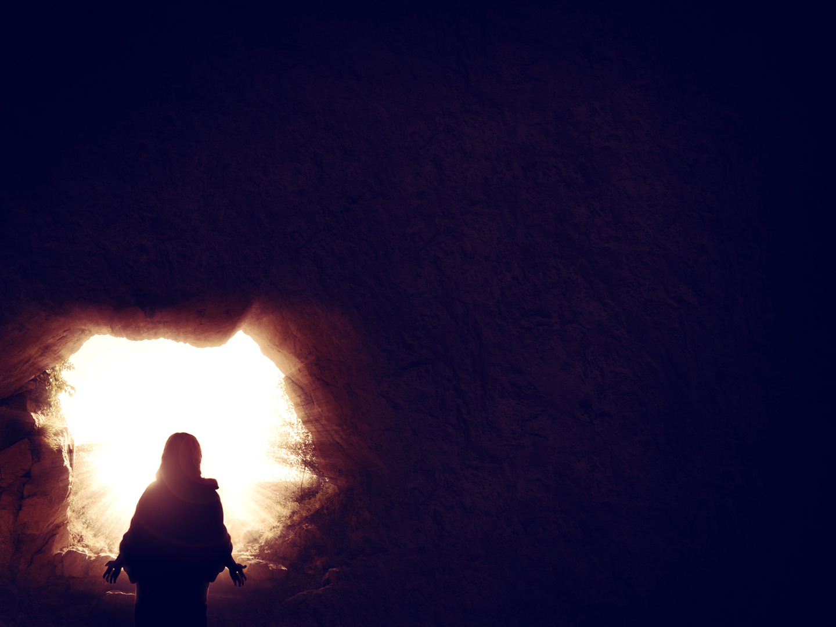
TURN TO JESUS CHRIST
The law shows sinners our need for a Saviour
Jesus fulfils the law by embodying love for God and love for others
On the other side of the incarnation, the first commandment means giving to Christ the worship he deserves
Notes:
The law shows sinners our need for a Saviour - We know that we could never be saved by the law, the law is good, but we are sinners, we are not good - We could never fulfil the law perfectly, and even as Christians we still don’t, but we aren’t saved by our works, or by our obedience to the law, but by the complete and perfect obedience of Jesus Christ, and the willing sacrifice of his own life for our sins - When we see the law, we see just how imperfect we are, we see how we all fall short of the standard that God has set. - Israel had their sacrifices to cover their sins, but that was only ever to be temporary, to point to the perfect sacrifice who would die once for all, the righteous for the unrighteous, the just for the unjust
Jesus fulfils the law by embodying love for God and love for others - If you want a biblical, perfect example of someone who worshipped God exclusively look to Jesus Christ - Every time sin tried to get in the way, every time Satan tried to block God’s plan, Jesus would show and declare that he only obeyed the Father, never turning his heart away from God - But he could only do this because he was God made flesh, the perfect son of God incarnate, sent to save, to redeem the lost
On the other side of the incarnation, the first commandment means giving to Christ the worship he deserves - Jesus is the one before whom every knee will bow and declare Lord - Jesus is the one who says that if you know me, you know God - The first commandment can no longer be properly obeyed unless we worship the one who alone shows us the one true God

Slide 7
Once we accept the depth of our sin, then we are in a position to see the glory of God’s glorious solution… Jesus
It is the grace of God that motivates us in doing the 1st commandment
Righteous in Christ, empowered by the Spirit, loved by the Father
Notes:
Once we accept the depth of our sin, then we are in a position to see the glory of God’s glorious solution… Jesus - Jesus is the one who has, by the grace and love of God, given salvation to those who will place their faith in him - Once we see just how wicked we are, how far we fall short of the law of God, we see just how loving God is in sending Jesus - By placing our faith in Jesus Christ we are declaring him Lord and Saviour, declaring that we worship exclusively, the triune God of the Bible
It is the grace of God that motivates us in doing the 1st commandment - We could never be saved by the law, but we have been set free in order that we may do what pleases God and brings Him glory - When see that Christ died for us sinners, as enemies of God in order that we could be reconciled to God and enjoy a relationship with our heavenly Father, how can we do anything but worship Him, serve Him, and love Him exclusively - We don’t obey out of obligation, but out of love. Jesus says that if you love me you will obey me. We are set free from the bondage of sin, from slavery to Satan, by grace and we now live by the power of God, to the glory of God
Righteous in Christ, empowered by the Spirit, loved by the Father - This is the reality for all who have repented of their sins and believed in Jesus Christ as Lord and Saviour - When the gospel takes root in our heart, when we turn to Christ, there is no greater privilege than to do life with and to live for God - As Christians you were saved for good works, to obey God, but it is done not in your own strength, but by the power of the Holy Spirit who dwells inside of you

Slide 8
SUMMARY
Remember all that God has done for you in Christ
We can serve only one God
Because we have been set free by God’s grace we are free to love and obey God
Notes:
Remember all that God has done for you in Christ - Never forget the blessings and promises that are to be found in the Word of God - Take time to reflect on the day that you were saved, and the grace of God that has been shown to you in your life - Keep coming back to God, search Him out in His Word, Preach the gospel to yourself, think upon the life, death and resurrection of Jesus Christ
We can serve only one God - When you remember the gospel, how can you do anything but serve one God, love one God, obey one God - With God it is all or nothing. You cannot serve two masters, God will not share His glory - Ask yourself, what consumes your thoughts? Whom do you live for and praise? Who or what do you count on? Who do you call upon in the good and the bad? Where do you look for answers? Who or what do you thank?
Because we have been set free by God’s grace we are free to love and obey God - The answer to those questions above should be God. If it isn’t we need to repent. God does not expect perfection, that’s why Jesus was sent, but he expects a heart change, a heart that no longer lives for ones self, but to the glory of God - When you sin, you will find forgiveness in Jesus, and this forgiveness, this grace motivates us to love and obey God

Slide 9
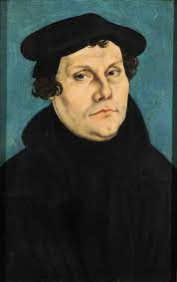
“If what you’re saying is true,” the student objected, “then we may live as we want!” Luther replied, “Yes. Now what do you want?”
Notes:
Martin Luther had been talking about God’s free grace for sinners, how our salvation does not rest upon our own good works, but upon the saving work of Jesus Christ.
“If what you’re saying is true,” the student objected, “then we may live as we want!” Luther replied, “Yes. Now what do you want?”
The apostle Peter said, “Live as people who are free, not using your freedom as a cover-up for evil, but living as servants of God” (1 Pet. 2:16).
You have been set free, not to continue in sin, but by being born again and given a new heart, our desire shifts from me to God, giving Him the glory He deserves
The 1st command is the echo of the heart of the born again believer declaring “I want no other God but you”, is this the echo of your heart?
Let’s pray

