Slide 1
John 12:1-26
Simple message – well known story - challenge

Slide 2
Which Jesus are you looking for?
This is the question I will start and finish with

Slide 3
Helpful to address some of the
Historical and cultural background at the time of our reading
During the Jewish festivals, especially Passover, Jerusalem was an exciting place
*
Scholars estimate that the normal population of Jerusalem in the time of Jesus was about 80 to 100 thousand people. About a ¼ of Sunshine Coast
But during Passover an additional 3 million people would come from all over the then world to worship in Jerusalem – just to get that into perspective…….

Slide 4
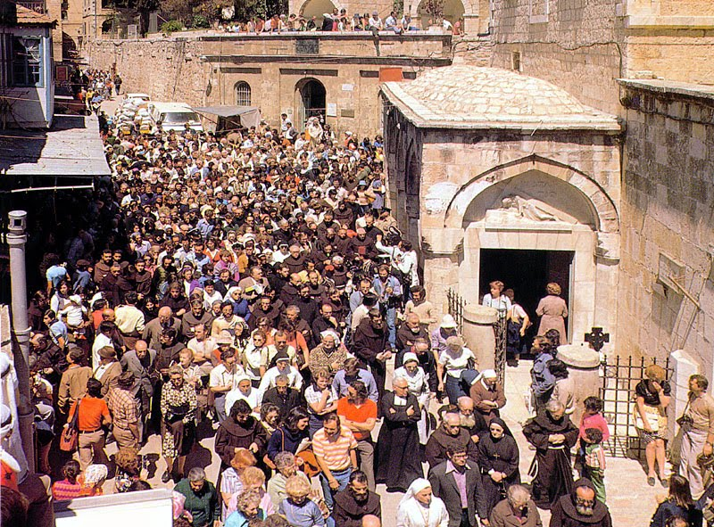
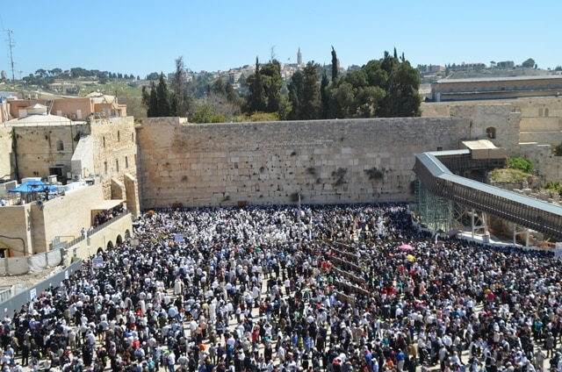
The Old walled city of Jerusalem = 64.7 hectares.
The new Maroochy CBD development = 53 hectares
*
*
*

Slide 5
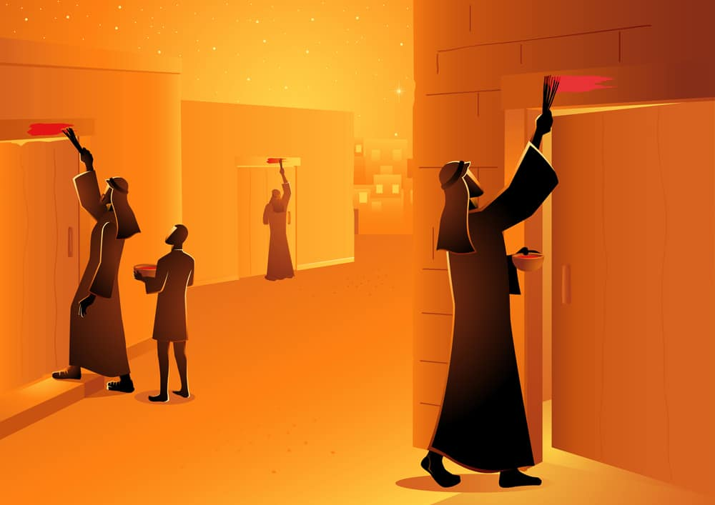
What is Passover?
Moses - Slaves in Egypt -10 Plagues – last was death of firstborn
God told them to prepare a lamb for a feast and sprinkle the lamb blood on the door post
The Angel of Death would pass over houses with the blood sprinkled on the door posts
Passover was what brought Jesus and His disciples to Jerusalem
*

Slide 6
At this time there would have been great….
Tensions and Fears:
Romans
Religious zealots
Political Jesus
Crowd Control
Fanatics spurned on by hatred not love
King -rallying point for zealots
*
Would’ve had extra soldiers
Soldiers on high alert
Jewish Leaders
Major preparations and planning
The popularity of Jesus
God’s blessing – miracles
Upsetting the Romans – uneasy truce
Loss of Authority and Power – pride and prestige
Sacrifices, services, sermons
“There’s nothing we can do. Look, everyone has gone after him!”
No man can do what you do unless God is with him
Jesus didn’t act or say the things they did and yet they knew God was with Him
They even contemplated killing Lazarus to get rid of the evidence

Slide 7
Tensions and Fears:
*
Jewish People
Millions of people from other areas – cultural clashes
Looking for a physical king to overthrow the Romans
Too many people
Maybe Jesus could help them overthrow the Romans
*
Jesus’ Disciples
Physical dangers to Jesus – they tried to dissuade Him - Jerusalem
Jesus talking about His death – In our reading twice Jesus referred to His coming death
*

Slide 8
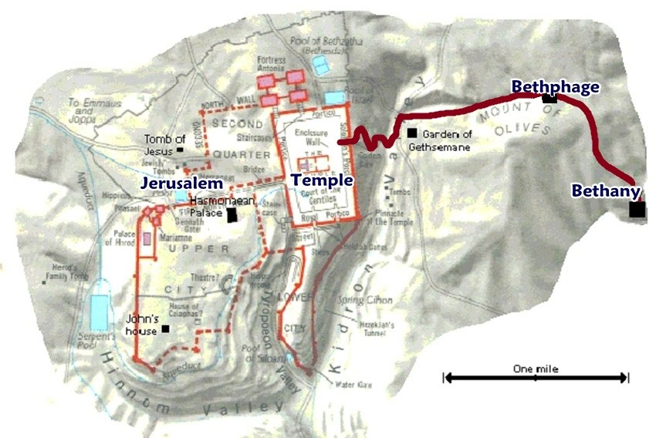
3
Matthew 21:2
Sends Disciples
2
1
Visit and Meal at
Lazarus’ House
4
Into this hotbed of tension and fear comes Jesus
*

Slide 9
Matthew 21:8-11
⁸ A very large crowd spread their cloaks on the road, while others cut branches from the trees and spread them on the road. ⁹ The crowds that went ahead of him and those that followed shouted, “Hosanna to the Son of David!”
“Blessed is he who comes in the name of the Lord!”[
“Hosanna in the highest heaven!”
¹⁰ When Jesus entered Jerusalem, the whole city was stirred and asked, “Who is this?”
¹¹ The crowds answered, “This is Jesus, the prophet from Nazareth in Galilee.”
3 million people
*

Slide 10
Symbolism
The use of a Donkey instead of a horse is highly symbolic, it represents the humble arrival of someone in peace, as opposed to arriving on a steed in war..
“Rejoice greatly, Daughter Zion! Shout, Daughter Jerusalem! See, your king comes to you, righteous and victorious, lowly and riding on a donkey, on a colt, the foal of a donkey” Zechariah 9:9-10
*
600BC
Palm branches were a widely recognised symbol of peace and victory
*
And When a king or ruler entered a city or town, people would go out of their way to lay down a carpet made of Coats
Jesus – Victorious King of Peace - Praised by the people – Worshipped by His followers
*

Slide 11
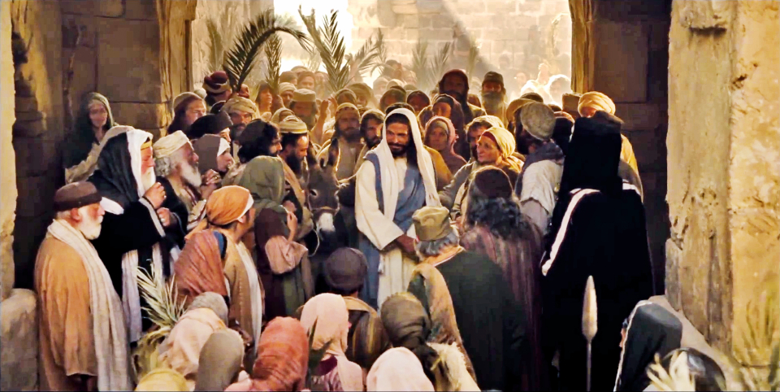
Jesus rode on the colt and received the praise of the people
Some of the Pharisees in the crowd said to Him, “Teacher, rebuke Your disciples.” But Jesus answered, “I tell you, if these become silent, the stones will cry out!” (Luke 19)
*

Slide 12
What did the crowd call out to Jesus?
The crowds that went ahead of him and those that followed shouted, “Hosanna to the Son of David!”
Hosanna literally means ‘Please save us’ but is also used to praise someone of authority
The Son of David is a reference to the coming Messiah
2 Samuel 7:12–16 1000 BC
“ For when you die and are buried with your ancestors, I will raise up one of your descendants, your own offspring, and I will make his kingdom strong. And I will secure his royal throne forever.”
Whether the crowd understood it or not, they were praising Jesus as the Saviour and Messiah
*

Slide 13
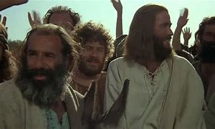
Jesus rode into Jerusalem as a humble King
The Jewish leaders thought that they understood what God had planned for the Messiah but Jesus didn’t match their ideas about who the Messiah would be
We cannot put God in a box and restrict what He will do
But lets be clear on one point though, this same humble Jesus, will soon return, but this time as rightful King of the world, ruling with total authority and righteousness
*
A few days later, Governor Pontius Pilate would recognise Him as the King of the Jews
*

Slide 14
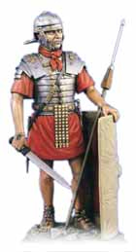
Expectations of Jesus:
Romans
Complete military and political power in Israel
People would submit to doing things their way
If Jesus could heal their soldiers then they would have an invincible army!
Jesus was a stated man of peace, perhaps He could help them to get people to submit to their authority – “Go the extra mile” - Centurion - Greatest faith in Israel
*
Overall the Romans probably had no real expectations of Jesus

Slide 15
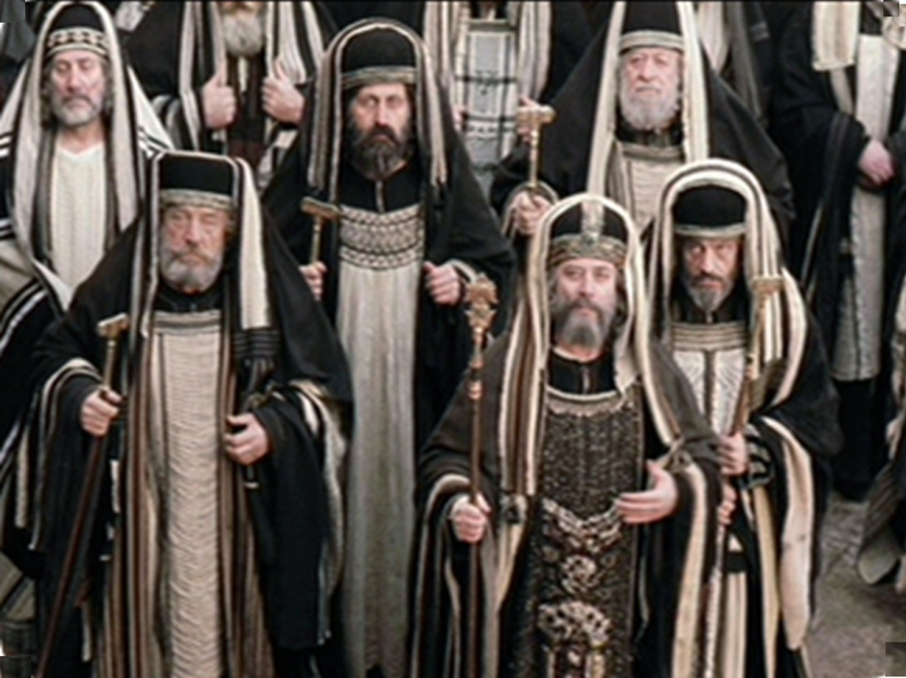
Jewish Leaders Expectations
Jesus would comply with their expectations of the Messiah
They thought they had it all worked out
They thought they understood God through their own self righteousness
Jesus would bow to their authority
They were originally of a divine order – some of the line of Aaron. They didn’t understand who Jesus really was – Son of God - blind
Jesus would agree with their teaching
Luke 11:52 “Woe to you experts in the law, because you have taken away the key to knowledge. You yourselves have not entered, and you have hindered those who were entering.”
Jesus wouldn’t rock the boat with the Romans
*
They had established a reasonable compromise with the Romans – prestige, wealth, some authority

Slide 16
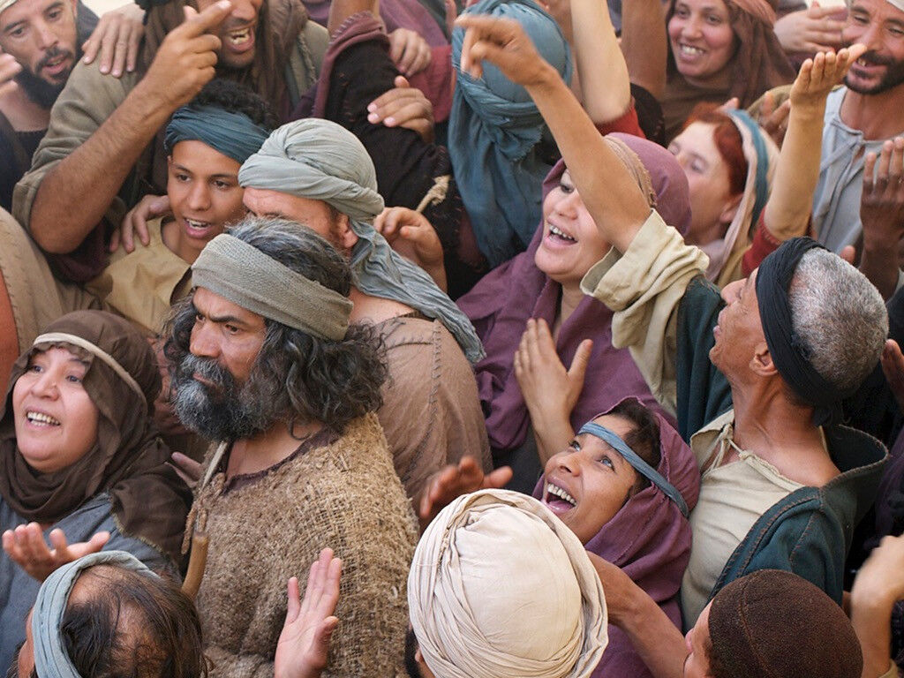
Jewish People’s Expectations
Jesus would be a physical king a ruler to stop other nations conquering them
Jesus would do miracles
– a show – Jesus as the headline act
Jesus would help them regain control over their personal life and the nation
Jesus told some followers that they had to depend on Him only
On hearing it, many of His disciples said “This is a difficult teaching, who can accept it?” Aware that His disciples were grumbling about this teaching, Jesus asked them, “Does this offend you?… John 6
They wanted Jesus to make their life better but not control it
Sometimes Jesus tells us some hard truths, are we prepared to listen and obey?
*

Slide 17
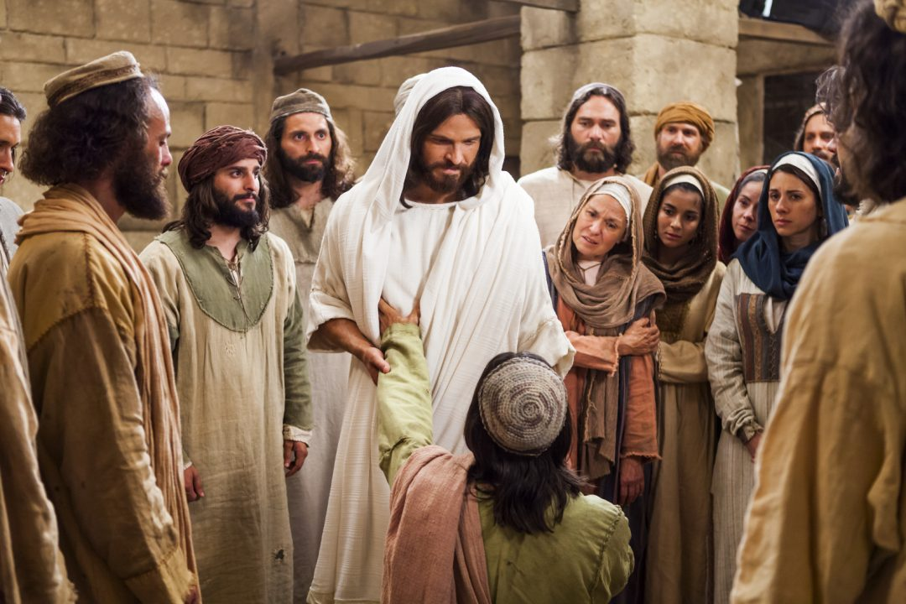
Jesus’ Disciples Expectations
Spiritual Saviour
Someone who will save
them from their sins
Lord of their Life
Someone who they would
obey regardless of their
own priorities
Teacher
Someone who teaches them the way that God wants them to follow, regardless of popular opinion
*

Slide 18
Which brings me back to my original question
Which Jesus are you looking for?
What is your expectation of Jesus?

Slide 19
Which Jesus are you looking for?
Is your Jesus one who is gentle Jesus meek and mild, one who gives peace at any cost? Please don’t talk about sin or punishment - That is not the Jesus of the Bible.
Is your expectation of Jesus that He could be your Saviour but not the Lord of your life? Jesus is always referred to in the Bible as Lord and Saviour. He must be Lord first.
Bruxy Cavey once said, “when we make Jesus Lord, we get Jesus as Saviour thrown in.”

Slide 20
Do you want a Jesus who fits neatly into your limited understanding of how God should be?
God is bigger than that – He won’t stay in our box!
Maybe Jesus to you is someone who you can call on in times of trouble, but ignore when things are going your way? Jesus is not a magician who pulls a rabbit out of a hat – He wants to be Lord of your life – in the good times and the bad times.
Or do you recognise Jesus as the Son of God the soon coming King, who currently sits at God’s right hand? To be a true disciple of Jesus we need bow to His authority and have Him as Lord of our life.

Slide 21
This is who Jesus really is. This is the Holy One
of God who humbled Himself to die
on the cross for you.
This is the Jesus of the Bible and the only one we should be searching for today.
As we come to Easter time, which Jesus are you looking for?

