Slide 1
THROUGH ONE MAN…
Romans 5:12-21
Notes:
Good morning all. What a privilege it is to be here today and to be able to share with you the message of the cross
The reason that it is such a privilege is because this same message from 2000 years ago is the same message, the same gospel that saves people today
The message of the cross is the only hope that we all have for salvation
So I pray that today as I share this message whether it’s your first time or your 100th time, that by the power of the Holy Spirit you would come before the cross, and give all the glory and honour to God for the grace and love that was poured for you and me on the cross through His Son Jesus Christ

Slide 2
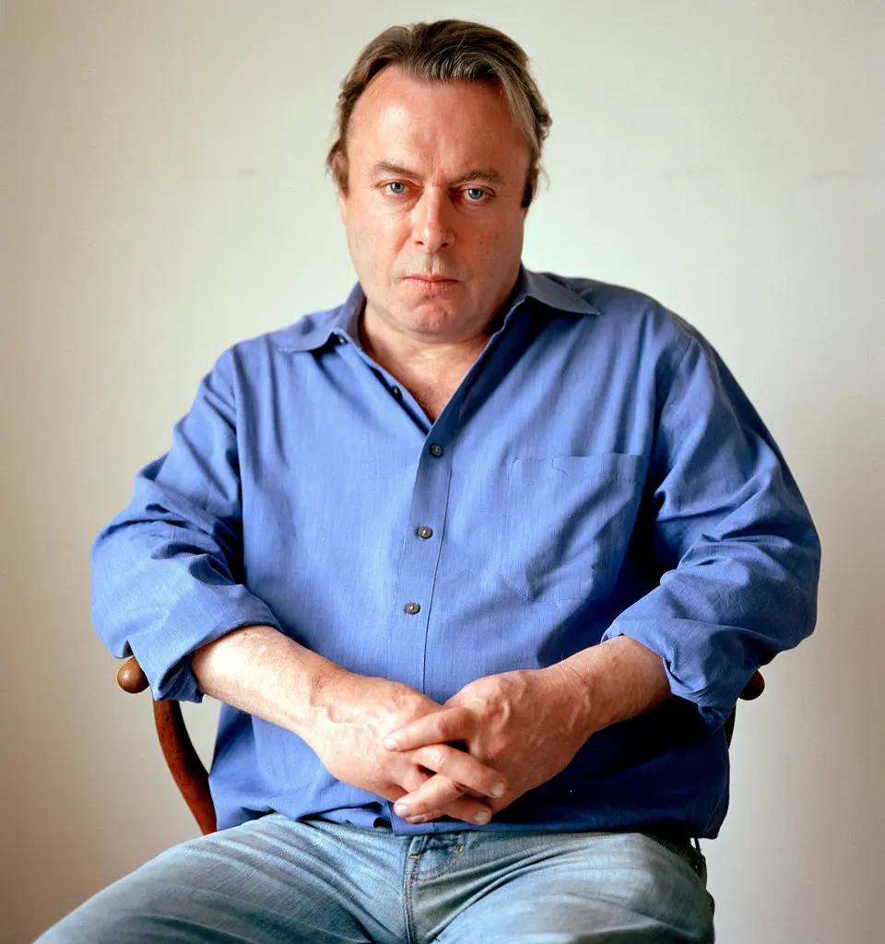
I would say that if you don’t believe that Jesus of Nazareth was the Christ and Messiah, and that he rose again from the dead and by his sacrifice our sins are forgiven, you’re really not in any meaningful sense a Christian. Christopher Hitchens (Atheist)
Notes:
In an interview, Christopher Hitchens, the fervent atheist and author of God Is Not Great, showed he has a much clearer understanding of what it means to be a Christian than the Unitarian minister, who claims to be a Christian, interviewing him. Here’s what the Unitarian minister Marilyn Sewell had to say when interviewing Christopher
Marilyn Sewell: ”The religion you cite in your book is generally the fundamentalist faith of various kinds. I’m a liberal Christian, and I don’t take the stories from the scripture literally. I don’t believe in the doctrine of atonement (that Jesus died for our sins, for example). Do you make a distinction between fundamentalist faith and liberal religion?”
Christopher Hitchens: I would say that if you don’t believe that Jesus of Nazareth was the Christ and Messiah, and that he rose again from the dead and by his sacrifice our sins are forgiven, you’re really not in any meaningful sense a Christian.
This is essentially the message that I am here to share with you today that only through the death of Jesus on the cross and believing in him do we find forgiveness for our sins
Christopher Hitchens didn’t believe in this message himself, but he certainly knew the message of the gospel. Folks, don’t be like Christopher, don’t just know about the gospel, but let it take root in your heart and may the power of God change us from the inside out, may we allow Him to breathe life into us.
Let’s get into it

Slide 3
THROUGH ONE MAN… ADAM
“When Adam sinned, SIN entered the world. Adam’s sin brought DEATH, so death spread to everyone, for EVERYONE sinned” (Rom 5:12)
We are by nature, sinners, enemies of God, right down to our very cores
“Yes, Adam’s one sin brings condemnation to everyone” (Rom 5:18)
Notes:
“When Adam sinned, SIN entered the world. Adam’s sin brought DEATH, so death spread to everyone, for EVERYONE sinned” (Rom 5:12) - To understand the significance of the cross, the reason that Good Friday is in fact good, we must go back to the beginning, back to the fall of humanity - When Adam disobeyed God, when he took a bite of the apple, sin entered the world and therefore death - If you’re looking for proof that sin exists, there is no truth more self-evident than the inevitability of death
We are by nature, sinners, enemies of God, right down to our very cores - You see a person does not become a sinner by committing sins, but rather they commit sins because they are by nature a sinner - This is one of the foundational statements of Christian theology - That we have all sinned and fall short of God’s standard, no one, by their own works, by their own merit is worthy to be called a child of God
“Yes, Adam’s one sin brings condemnation to everyone” (Rom 5:18) - One sin is it all took, but such is the holiness of God. This one sin condemned us, we are guilty and separated from our Creator, our heavenly Father - Now it is at this point that some of you may be thinking that this seems unfair, why are we punished for someone else’s sin? - Adam’s name literally means man, or mankind. A real historical person who represents the entire human race and all that descend from him have been corrupted by sin, so in Adam we have all sinned and are therefore condemned

Slide 4
“Because one person disobeyed God, many became sinners” (Rom 5:19)
Sin brings spiritual, physical, and eternal death
God hates sin, but greater even than God’s hatred for sin is His love for the sinner
Notes:
“Because one person disobeyed God, many became sinners” (Rom 5:19) - Disobedience results in sin. Many people today choose to reject the Word of God, they choose to disobey God and continue in their sin - All of us have sinned, we have all disobeyed God, and God’s standard is perfection, which none of us could ever meet - We have fallen so far from how God created us to be, and at this point we have no hope
Sin brings spiritual, physical, and eternal death - Sin brings spiritual separation from God. Those who don’t know Jesus as Lord and Saviour are alive to the things of this world, but are dead to the things of God - Sin brings physical death. We will all one day die as a consequence of sin - Sin brings eternal death. It brings not only eternal separation from God but also an eternal torment in hell
God hates sin, but greater even than God’s hatred for sin is His love for the sinner - God hates sin, He can’t stand it, it can’t exist in His presence - If God’s chief desire was to execute the penalty of sin on all of us, He would have done that already, but God is not only holy and just - He is also a loving and merciful Father, who loves those whom He made in His own image

Slide 5
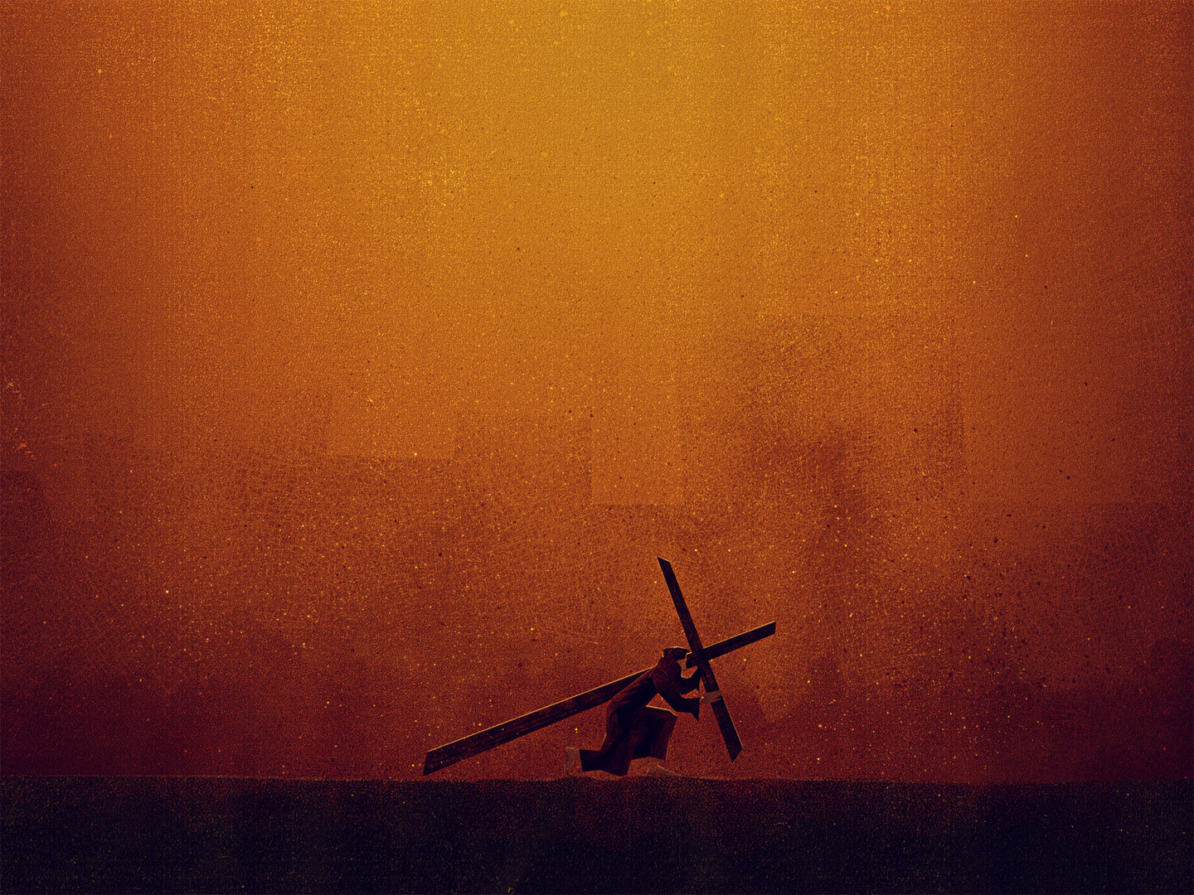
THE COST OF OUR SIN
Jesus, the Son of God, the Messiah was sent to save people from their sins
Jesus came and lived the perfect obedient life that we never could
“Carrying the cross by himself, he went to the place called Place of the Skull… There they nailed him to the cross” (John 19:18)
Notes:
Jesus, the Son of the God, the Messiah was sent to save people from their sins - Our wickedness, our sinfulness and rebellion against God had a price that we could never pay - So Jesus came down in love, to pay that price. The mission of Jesus Christ was always to save people from their sins - The reason it had to be Jesus was because the price had to be paid by someone who was spotless, who knew no sin
Jesus came and lived the perfect obedient life that we never could - He left the presence of His Father, to come and be one of us, fully man, and yet fully God - He came and was ridiculed, persecuted, mocked and spat on by His very own creation - The scenes of the crucifixion are horrifying, gut-wrenching and agonising, but it was the only way, the cost of our sin was so high - This was the price our sin demanded
“Carrying the cross by himself, he went to the place called Place of the Skull… There they nailed him to the cross” (John 19:18) - The crucifixion was regarded as the most horrible, shameful form of execution, one reserved for slaves, bandits, prisoners of war, and insurrectionists. Barabbas was an insurrectionist, he deserved it and yet they wanted to crucify the spotless, innocent lamb of God - But God is sovereign. Through man’s selfish, evil desires, God accomplishes the work of salvation - This is how all those who would believe in Jesus Christ would be reconciled to God

Slide 6
God, so rich in mercy and grace did not even spare His one and only Son
“When Jesus had tasted it, he said, “It is finished!” Then he bowed his head and gave up his spirit” (John 19:30)
Salvation is not a joint effort of God and man, but is entirely a work of God’s grace, appropriated solely by faith
Notes:
God, so rich in mercy and grace did not even spare His one and only Son - This is how we know that God loves us more than He hates our sin - God could have wiped us all off the face of the earth and would have been just in doing so, but instead He sent His one and only Son to die in our place, to take away our sins - That is love! Love that we can’t even begin to comprehend. God truly is so rich in mercy and grace! May we never forget this when looking at the cross of Jesus Christ
“When Jesus had tasted it, he said, “It is finished!” Then he bowed his head and gave up his spirit” (John 19:30) - This cry, this shout is not one of defeat, but a shout of victory, a shout of triumph - Jesus is declaring that the work he was sent for has been finished. The price of sin has been paid in full, by the shedding of his own blood - Every requirement of God’s righteous law had been satisfied; God’s holy wrath against sin had been appeased; every prophecy, every Scripture had been fulfilled. IT IS FINISHED!
Salvation is not a joint effort of God and man, but is entirely a work of God’s grace, appropriated solely by faith - The moment you stop believing that Jesus finished the work of salvation is the moment you’ll start working for your salvation - Christ’s completion of the work of redemption, of our salvation means that nothing needs to be nor can be added to it - The law can never save us, our good works are but filthy rags. But Jesus… Jesus is everything, he is our only hope - The cross was real, the nails and the whip were real, but more than anything else we see here, we see that God’s grace and love are real

Slide 7
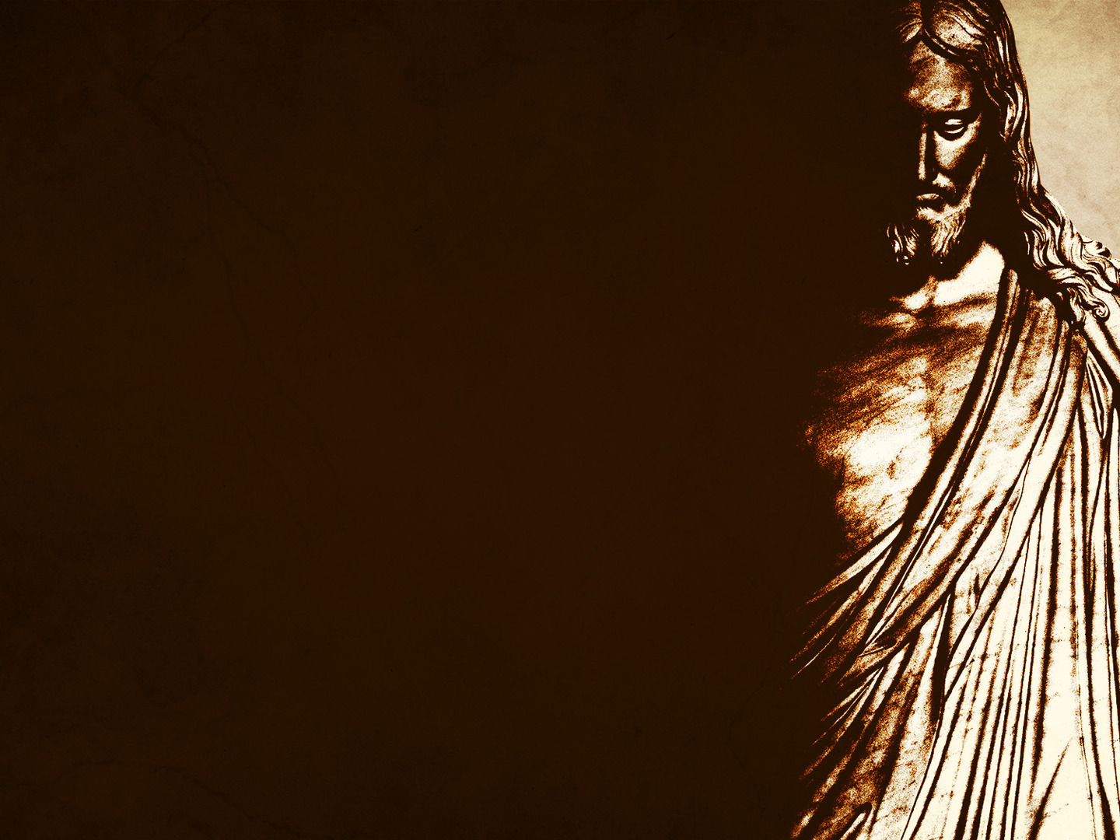
TRHOUGH ANOTHER MAN… JESUS CHRIST
The second man, Jesus Christ is far greater than the first
“Even greater is God’s wonderful grace and His gift of forgiveness to many through this other man, Jesus Christ” (Rom 5:15)
“God’s free gift leads to our being made right with God, even though we are guilty of many sins” (Rom 5:16)
Notes:
The second man, Jesus Christ is far greater than the first - The only similarity between Adam and Jesus Christ is that what they did affected countless numbers of the human race - What Jesus gives us, is infinitely more powerful, and infinitely greater than what was lost in Adam - In Christ we overcome sin, we overcome death, we overcome condemnation
“Even greater is God’s wonderful grace and His gift of forgiveness to many through this other man, Jesus Christ” (Rom 5:15) - Even though in Adam we are declared sinners, in Christ we find forgiveness for our sins - In Christ our sins are removed as far as the east is from the west - Grace means we didn’t deserve or earn it, but in Christ we can receive it, because such is the love of God
”God’s free gift leads to our being made right with God, even though we are guilty of many sins” (Rom 5:16) - Through Adam we were separated from God, condemned, declared guilty because of our sins - But while we were still sinners, while we were still enemies, Christ died for us that we can be made right with God - Christ, the one and only Son of God, died so that we may be called sons and daughters of God, so that we would no longer be alienated from God, but reconciled to Him

Slide 8
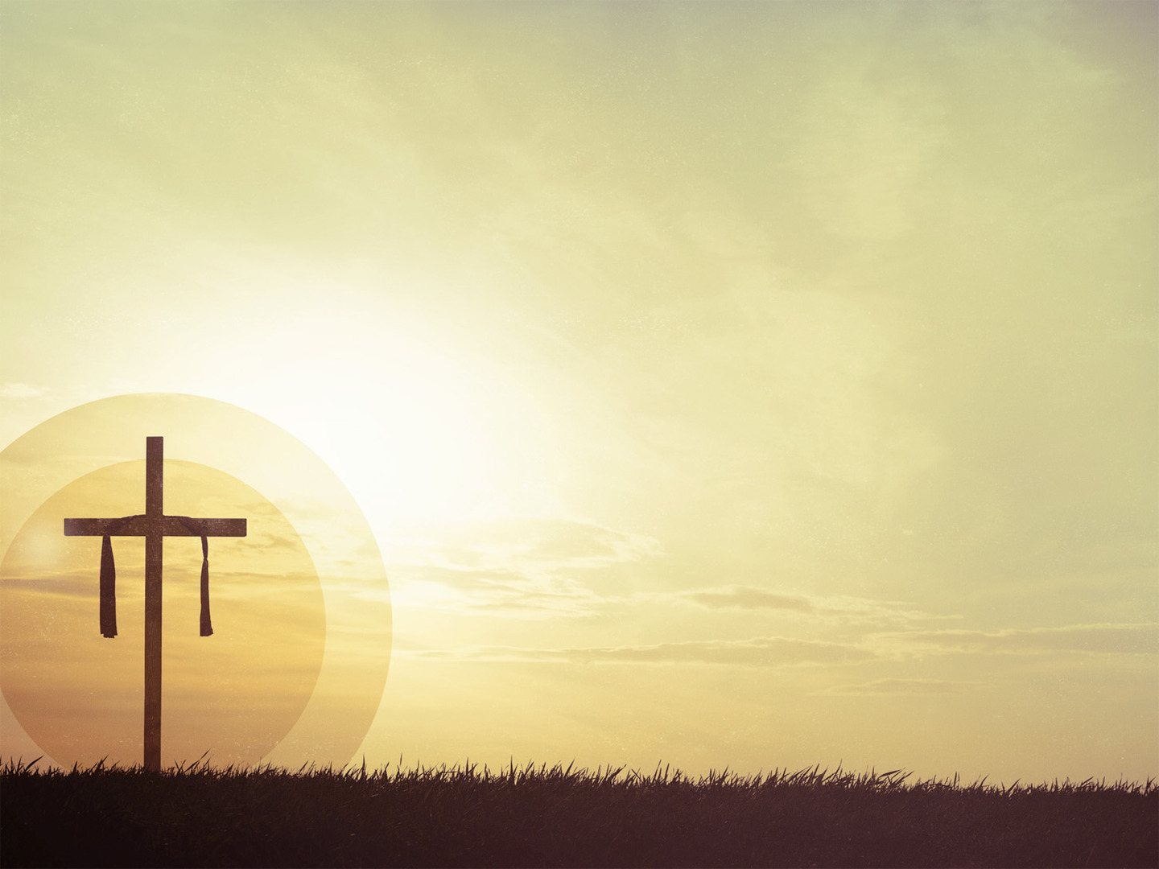
“Because one other person obeyed God, many will be made righteous” (Rom 5:19)
Jesus Christ brings life, and life to the fullest
“Now God’s wonderful grace rules instead, giving us right standing with God and resulting in eternal life through Jesus Christ our Lord.” (Rom 5:21)
Notes:
”Because one other person obeyed God, many will be made righteous” (Rom 5:19) - We could never have been righteous in our own strength, or by our own works, it just can’t happen because we are sinners - But in Christ, when we turn our backs on sin and believe in Jesus Christ we receive his perfection, his righteousness - When we believe in the finished work of Jesus Christ we are no longer declared guilty by God, but innocent, our debt paid in full by the blood of Jesus Christ
Jesus Christ brings life, and life to the fullest - Where in Adam we found separation from God, in Christ we find a heavenly Father, an intimate relationship - Where in Adam we found physical death, in Christ, death is the means by which we are ushered into glory with our heavenly Father - In Christ we will not experience hell, but an eternity in heaven with our Lord and Saviour
“Now God’s wonderful grace rules instead, giving us right standing with God and resulting in eternal life through Jesus Christ our Lord.” (Rom 5:21) - When you place your faith in Jesus Christ you are no longer ruled by sin which leads to death - God’s grace now rules and reigns in our hearts which gives us right standing with God right here and now and will one day result in eternal life, all because of what is accomplished on the cross and also in Christ’s resurrection - The power of sin can be broken, and is broken in Jesus Christ, but the power of Christ, which is salvation, cannot be broken

Slide 9
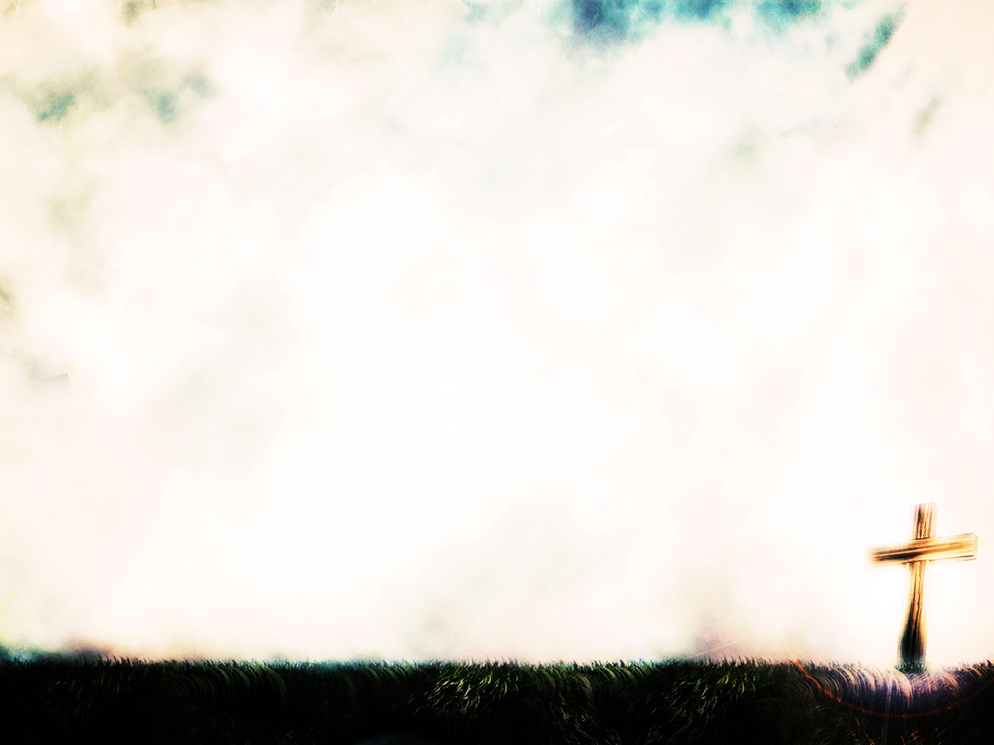
SUMMARY
In Adam there is only sin, which leads to death
Our sin was costly, but it has been paid in full
By the grace of God, in the death of Jesus Christ, you can have righteousness which leads to life = Christ is our only hope
Notes:
In Adam there is only sin, which leads to death - In Adam there is no hope - In our sin we will stand before God condemned, guilty and will be sentenced to an eternity apart from Him in hell - Something needed to happen, sin needed to be paid for
Our sin was costly, but it has been paid in full - Jesus, God’s only Son died on the cross. He died instead of you, he was condemned instead of you - He was separated from his Father instead of you. This was so that…
By the grace of God, in the death of Jesus Christ, you can have righteousness which leads to life = Christ is our only hope - Good Friday is good because only in Jesus death on the cross do we have hope in this life and in eternity - It was on the cross, the focal point of redemptive history that we see the love of God poured out for us - It is only Because of Christ’s death that we can have an intimate relationship with our Creator. - Jesus said “I am the Way, the Truth, and the Life, no one comes to the Father except through me”. He is the only way to life, but we must believe in him

Slide 10
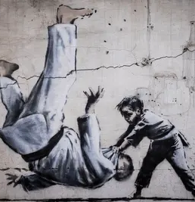
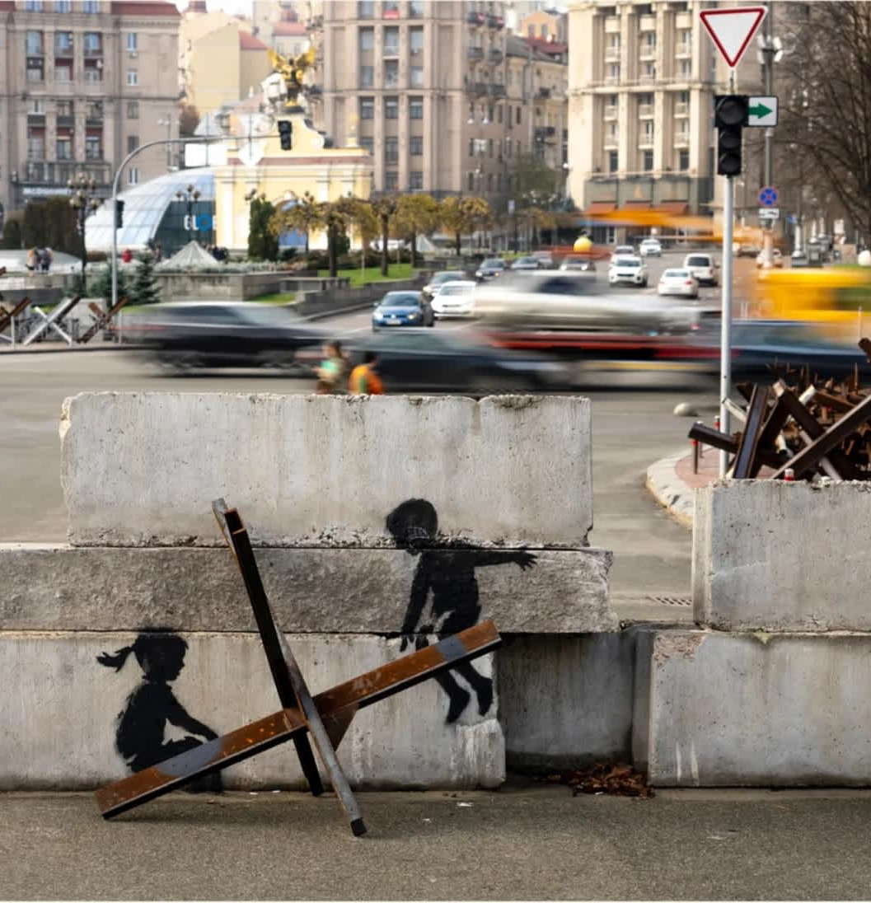
Notes:
A man by the name of Tim Challies wrote a blog on these murals and he said this. “These pieces of art were created by the mysterious artist Banksy in Ukraine. He was going to locations that had experienced the fury of war, he found broken and damaged buildings and used them as his canvas. In one a gymnast practices a handstand upon shattered walls and in another a woman who is wearing a bathrobe and who has curlers in her hair and a gas mask on her face holds a fire extinguisher next to a blown-out window. I am not clever enough to know what they all mean, but I do understand that the artist means to make a statement about the war and its many victims.
I understand this as well: that by creating these murals, Banksy has made something valuable out of what would otherwise be valueless. What was only busted-up concrete has now become an intriguing and desirable work of art. Though his canvas was one for which no one else could see any value, and though it had been assaulted and destroyed, it is now valued and treasured.
And it’s not like just anyone could do this. Had I been assigned the task I am quite certain that I would have made the mess even messier. I would leave the rubble even less valuable and less beautiful than before. It takes a skillful artist to work in the medium of rubble.
We are a stained and torn canvas, a broken and battered block of marble, a shattered pile of rubble. In the hands of a skilled artist, something broken can become beautiful, something valueless can become worth a fortune.
God takes what has been purposefully destroyed, what has been willfully ruined, what has been blown up by our own acts of sabotage, and he works upon it until it is a beautiful and precious work of art. He takes what was valueless and gives it great worth, he takes what was wrecked and wonderfully restores it.
The divine Artist is making all things new and bringing beauty from the ashes of our wrecked and ruined lives. We are the canvas upon which he displays his love, his power, his ability to redeem and restore even that which seemed to be beyond all hope.
Through one man, Jesus Christ, by his life, death, and resurrection, if we will believe in him, and surrender our lives to him, he will take us, that which is broken, and make it beautiful and whole, and take that which is old and destroyed and make it new.
Those of you who who are Christians today, may the grace of God and the finished work of Jesus Christ continue to motivate you as you live for Him.
If you do not know Jesus Christ as your Lord and Saviour, you have a choice. I pray that today would be the day that you acknowledge your sinfulness and cast it before the foot of the cross and believe in Jesus Christ, that today would be the day of salvation. Let’s pray.

