Slide 1
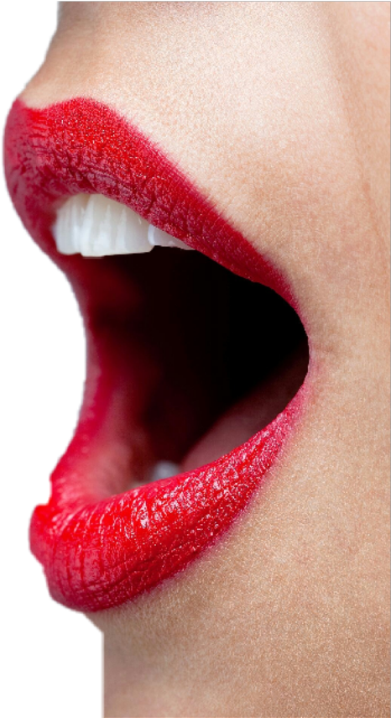
PHONESIA
DISCONFECT
Dialing a number and forgetting who you were calling before they answer.
Sterilising something that has been on the ground by blowing on it.
PANDICULATION
EXTIRPATE
Sleepily, stretching and yawning at the same time.
To eradicate, destroy or cancel something completely.
Notes:
There are a so many words in the English language – many of which we never use or which many of us have never heard of. I want to share some of those with you this morning. Phonesia – I wonder how many of us have had that at some point. Disconfect – relevant word for us at this time, particularly if we drop one of our Easter chocolates on the ground. Pandiculation – hopefully won’t see any of you do that this morning during my message. Extirpate – I think airports should put extirpated on the flight schedules instead of cancelled. But cancelled is generally not a word that we see as a positive thing. We have cancel culture etc. But this morning I want to suggest that sometimes cancelling things can be a wonderful thing. In fact in when the apostle Paul was teaching about the resurrection of Jesus in 1 Corinthians 15 he mentions the blessings that come from three things being cancelled through Jesus conquering the grave.

Slide 2
HAS
1 Corinthians 15:17-20, 51-58
GUILT & SHAME
DEATH
FEAR & APATHY
AND

Slide 3
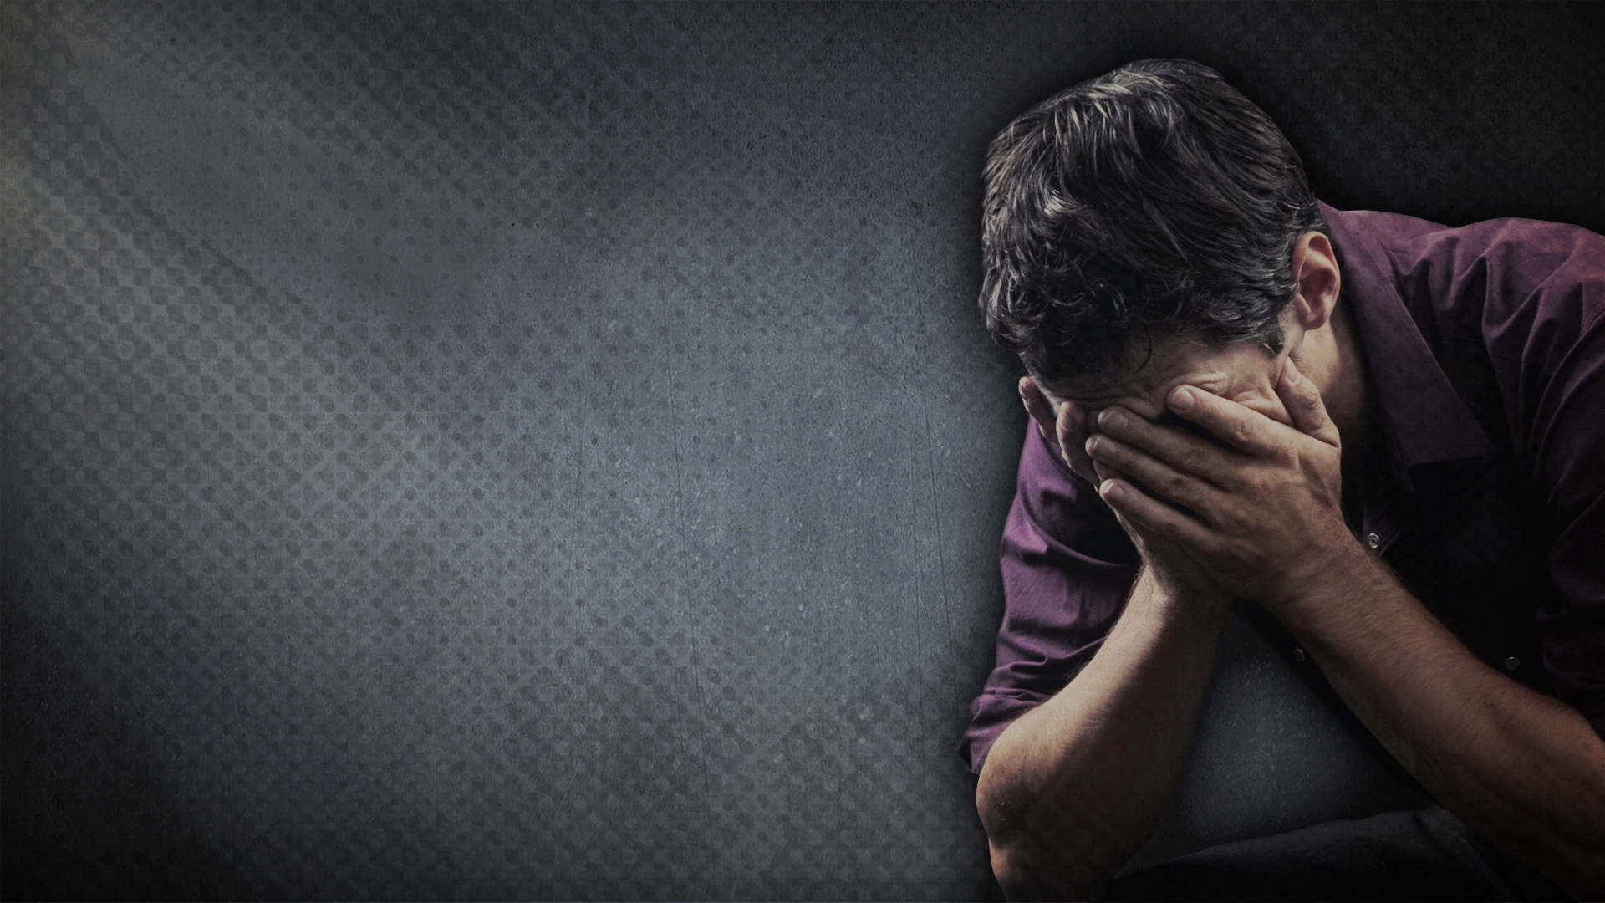
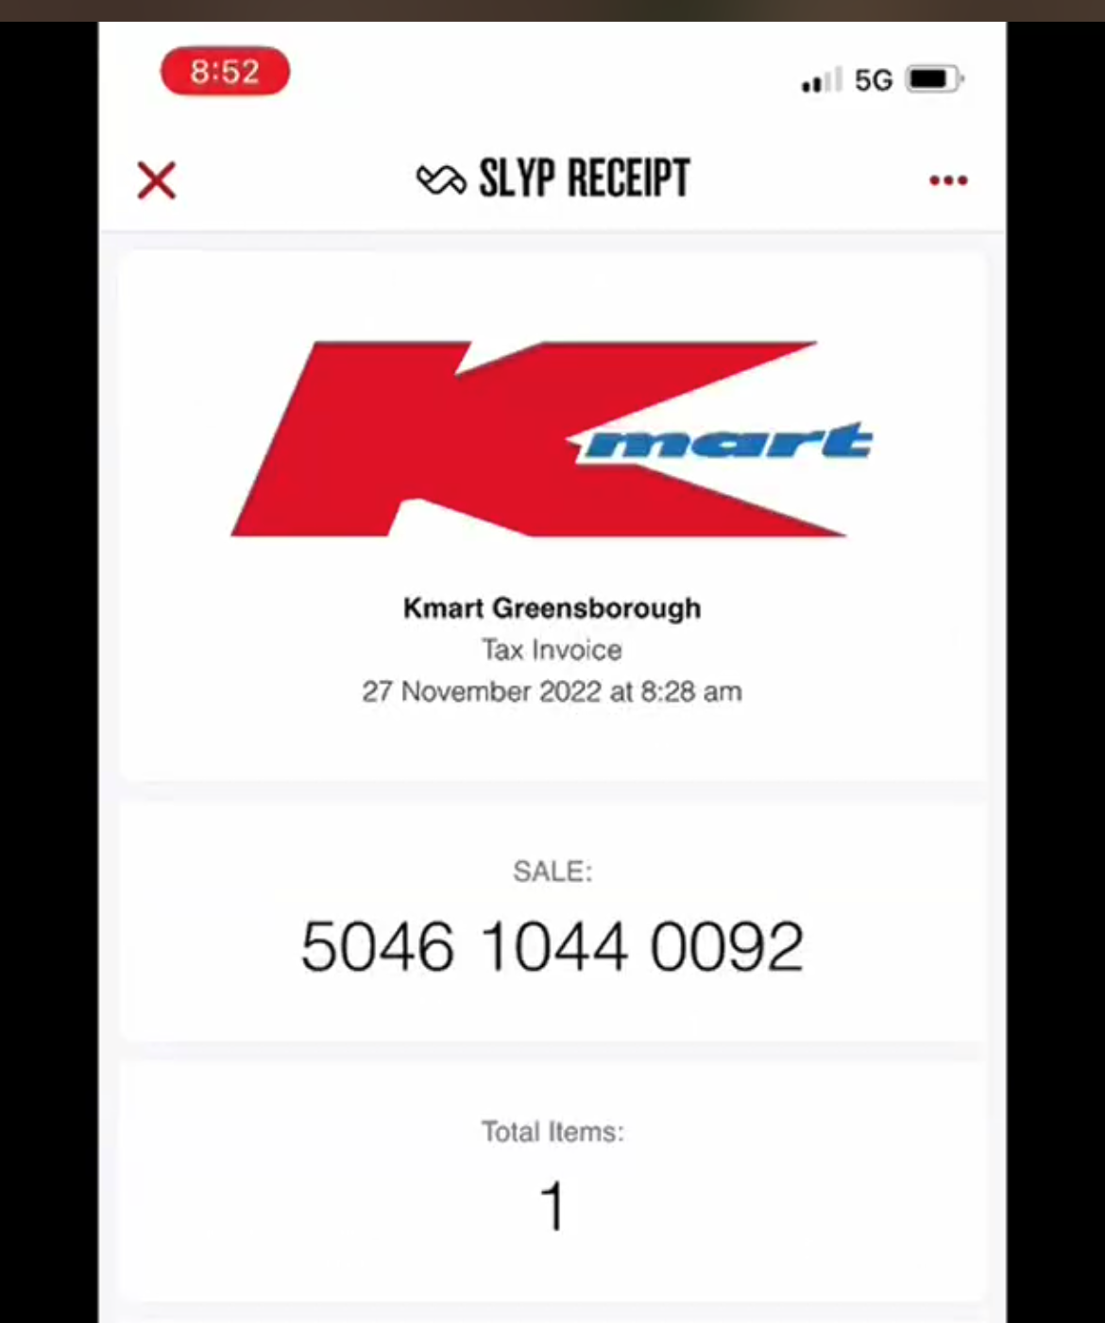
1. GUILT AND SHAME ARE
“And if Christ has not been raised, then your faith is useless and you are still guilty of your sins.” (v17) = God’s justice is not satisfied, our debt is owed, we are condemned.
“Then God made you alive with Christ, for he forgave all our sins. He CANCELLED the record of the charges against us and took it away by nailing it to the cross.” (Colossians 2:13-14)
The cross is the full payment for our sins and the empty tomb is the receipt = paid in full, no more guilt or shame.
Notes:
In verse 17 Paul makes the statement that if there is no resurrection then there is no forgiveness of sin = we are still living under the weight of our guilt and shame. But obviously Jesus has been raised and in Colossians Paul emphasis how we are made alive with Christ = our sins are forgiven. He has cancelled our debt completely by nailing it to the cross. Referring to a custom of the ancient day when a bill was paid in full it was nailed to a post. One way to think of Easter is that the cross is where Jesus makes the payment for our sin and the tomb is the receipt – proof that God is satisfied with what Jesus did. No more debt – we are free from condemnation, God will ask for no more. We are free from guilt and shame. It’s like Kmart – you go the cashier at the centre of the store, or at the photo/layby centre to make your payment. But in order to get out of the store with your purchase you need to show your receipt.

Slide 4
We all get a bill – “For everyone has sinned. We all fall short of God’s glorious standard.” (Rom 3:23) & that bill has a price we can’t afford to pay – “For the wages of sin is death..” (Rom 6:23)
What do we do with a bill we can’t or won’t pay (sin in our life)? Procrastinate, rationalise, justify, compare, deny or escape.
But none of these ultimately deal with our guilt & shame – we still get reminder notices regarding our sin (conviction from God or accusation from Satan).
Good news of Easter = ‘Christ crucified’ has conquered the grave & cancelled your guilt & shame.
Notes:
Bible tells us we all get a bill from God – might not think that yours is significant or compare it to others and it doesn’t seem too bad. But we have all sinned and fallen short of his standard and glory and deserve death (the bill). We may not think our bill is significant compared to others – but all bills end up with same outcome = death. A price we don’t want to pay, can’t afford to pay = death. God’s holiness and justice is as great as his love and he can’t overlook sin – just as a good magistrate can’t overlook crime – no matter what it is. None of us like getting a bill we can’t afford – its confronting and scary. What do we do with a bill we can’t pay? I would suggest at least 4 things – the same things we do with sin in our life. Procrastinate – put it in the drawer and hopefully deal with it later. Too much to deal with now – look at it when things are better. We know its there but won’t do anything about – but in the back of our mind we know its there and there is guilt and shame . Then we get reminder notice that reminds us we not free of our debt. Rationalise – God made me this way, he wants me to be happy and to have the desires of my heart so I am sure he is OK with what I am doing and who I am. I don’t have to explain my expenses to anyone. Justify – blame other people or situations for our predicament (parents, governments, spouse, teachers, bosses, kids…) Compare – try to make ourselves feel better by looking at what others have done,. Deny – sin isn’t even a thing. We know better than God, science tells us that its OK now, that God doesn’t even exist. Who is anyone to judge me? I’ve done nothing wrong Escape – we see areas of our life where we aren’t living as we should (husband, pastor, father, friend, follower of Jesus etc) and instead of humbling myself and confessing my sin I escape – binge TV, drinking, working, drugs, sex, shopping etc But we still get reminder notices – conviction from God telling us its not hopeless and that in his love he provided a payment/rescue for you. Accusation from Satan saying God hates you and you have no hope. The good news of Easter is that Christ who was crucified has conquered the grave to cancel guilt and shame. We must trust in Christ crucified, not just Christ the good teacher, moral person or loving friend – Christ had to die on the cross for you. You need to humble yourself and repent, turn from your sin and then you will no longer have guilt and shame.

Slide 5
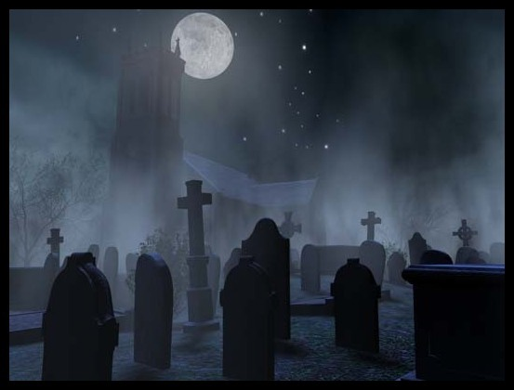
2. DEATH IS
“But let me reveal to you a wonderful secret. We will not all die, but we will all be transformed!... For our dying bodies must be transformed into bodies that will never die; our mortal bodies must be transformed into immortal bodies.” (vs 51-53)
“Death is swallowed up in victory. O death, where is your victory? O death, where is your sting?” (vs 54-55)
Resurrection = death is defeated & no longer has the final say. Jesus has taken the keys of death and hell from Satan = “..we don’t have to grieve like people without hope.” (1 Thess 4:13)
Notes:
All followers of Jesus – those who have surrendered their lives to him, call him Lord and Saviour. Jesus was the first fruits of resurrection and transformation – all believers will follow the same way. In these verse Paul is trash talking death. It no longer has the power it once had. Because Jesus conquered the grave death is not the end. Doesn’t mean that we don’t grieve and mourn over suffering a death. Jesus mourned when his friend Lazarus died (John 11:33,35). He was angry too because death was never part of God’s original plan for us, But we don’t grieve like people without hope – the hope of being transformed through Christ. As someone who has been to a number of funerals, even lead them, I have seen first hand the difference between those who grieve without Christ, without hope and those who grieve with hope. And our hope is not wishful thinking. Christian hope is a certainty of what lies ahead.

Slide 6
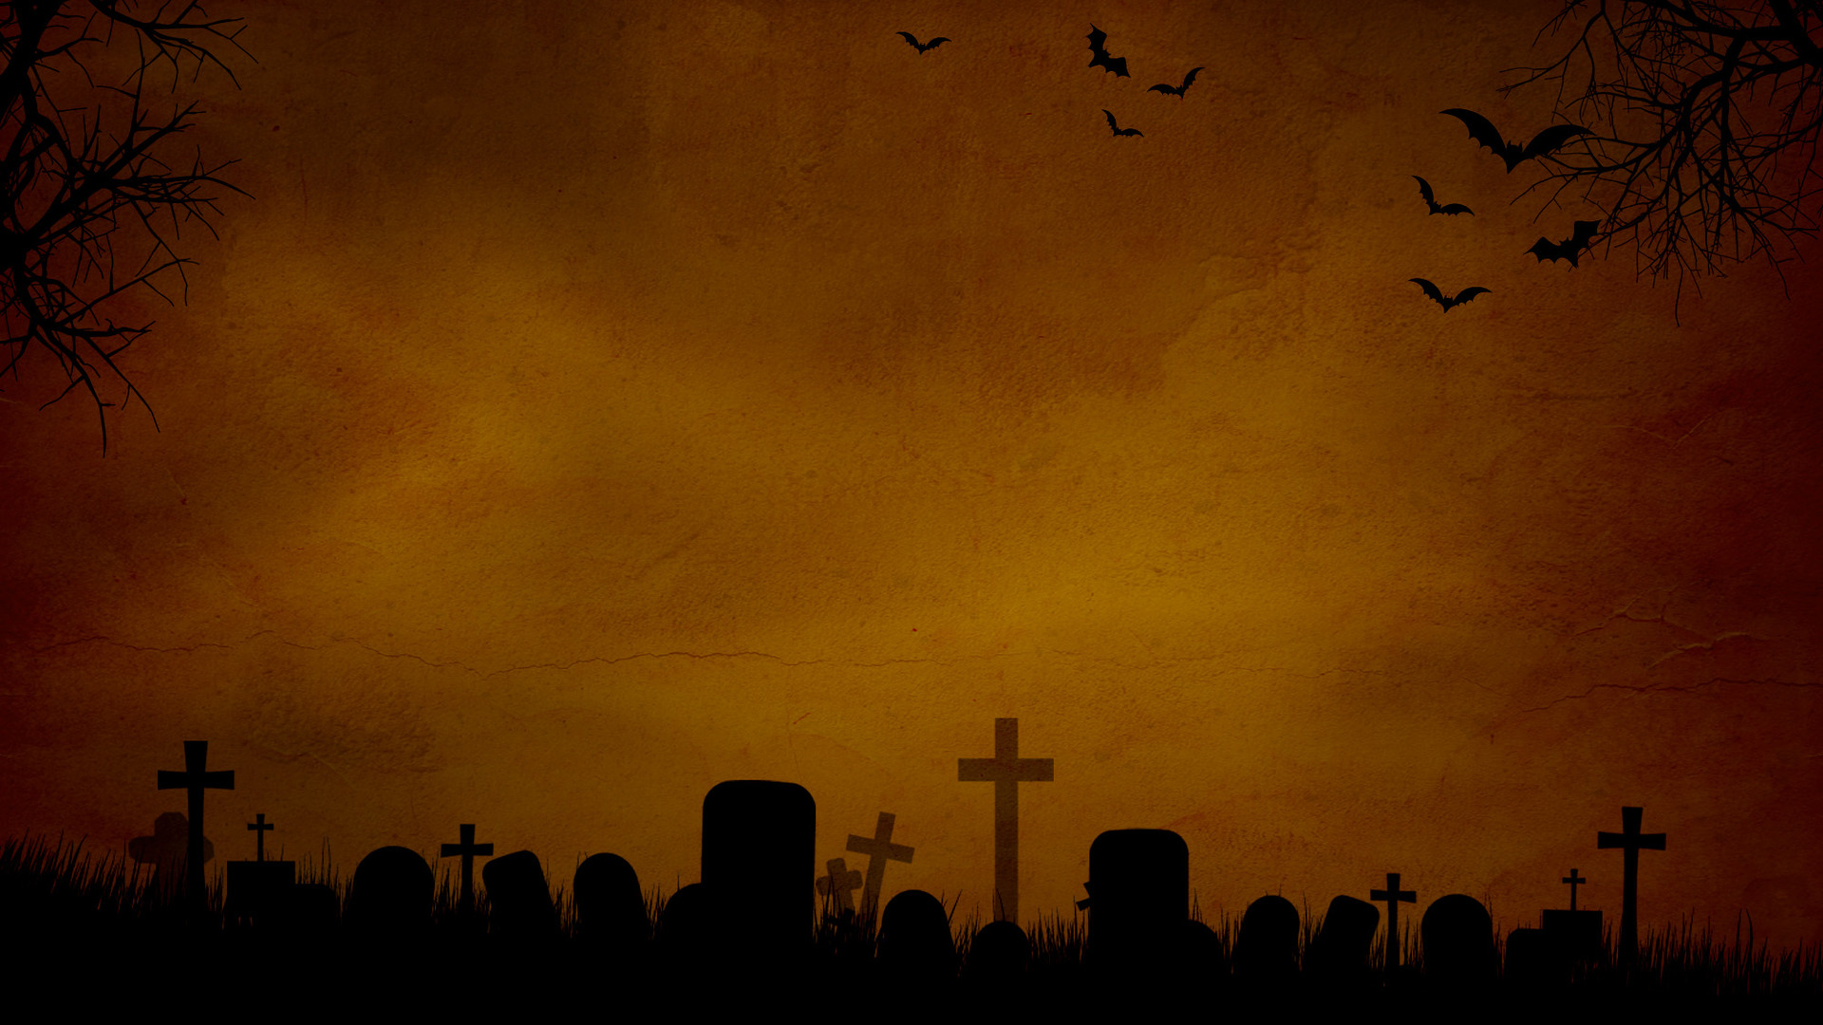
Death for followers of Jesus = bursting into God’s eternal glory, riches & presence = the greatest joy we can know.
We don’t go looking for death, but we also don’t fear it, or let it deter us.“I’m torn between two desires: I long to go and be with Christ, which would be far better for me. But for your sakes, it is better that I continue to live.” (Philippians 1:23-24)
“Soon you are going to hear that I’ll be dead. Don’t you believe it. I will be more alive & far better than I have ever been.” (D.L Moody)
“Through death He will make the feeblest and filthiest of us into a dazzling, radiant, immortal creature pulsating with power, joy, wisdom and love forever.” (C.S Lewis)
Notes:
Our hope is more than wishful thinking – it is an eternal reality. Death & suffering won’t deter us. We will take risks, sacrifice, be bold and face opposition for the gospel, for Jesus’ sake. Worst thing that can happen to us is death & it’s a good thing for us. Death for the Christian is just a gardener and no longer an executioner. May put us into the ground but we will rise again and be transformed into something even more beautiful. We are even happy to lose things (treasures) in this world because they are fleeting but the treasures of heaven are eternal.

Slide 7
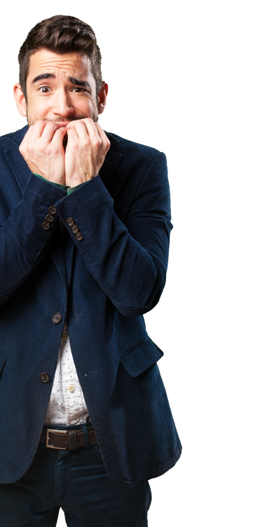
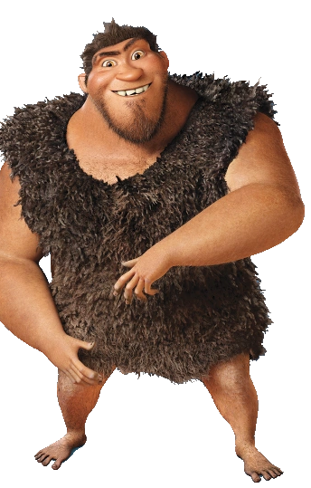
FEAR & APATHY IS
“So, be strong and immovable. Always work enthusiastically for the Lord, for you know that nothing you do for the Lord is ever useless.” (v58)
Strong = firmly seated, steadfast, sure & confident.
Immovable = unshaken, not doubting, compromising or sceptical.
Our life should reflect the joy, hope and victory we have in Christ - His salvation, truth, power, love & promises.
“Fear keeps us alive. Never not be afraid.” (Grugg, The Croods)
Notes:
Because of the resurrection – victory over guilt and shame and death (been cancelled) we shouldn’t be people who are filled with apathy and fear. To be strong is to be steadfast, and immovable is to be unshaken – not easily tossed about by every opinion or thought. Our life should reflect the joy and hope and victory we have in Christ. He proves that Gods promises are true – that God will do what he says, that God is sovereign. Yet we sadly see too many Christians live the opposite. I love a good animated movie and one of my favourites is the Croods – a stone age family who survive by living in their cave and only venturing out when necessary. The father is Grugg and his motto is all about fear. That’s how Christians seem to live in this world that is dark, chaotic and scary. We fear for our lives and the things of this earth. We fear the governments of our land and live fearful defeated lives. We fear missing out on something better. We compromise to stay alive or at least to stay relevant and popular. We should grieve and watch out for the evil in this world but not fear it, let it control us. We can be lured by latest trends and would rather a gospel that doesn’t challenge us. We must ignore the doubters, mockers and opposition we face. Be wary of Satan’s attacks and temptations. Nothing can separate us from his love.

Slide 8
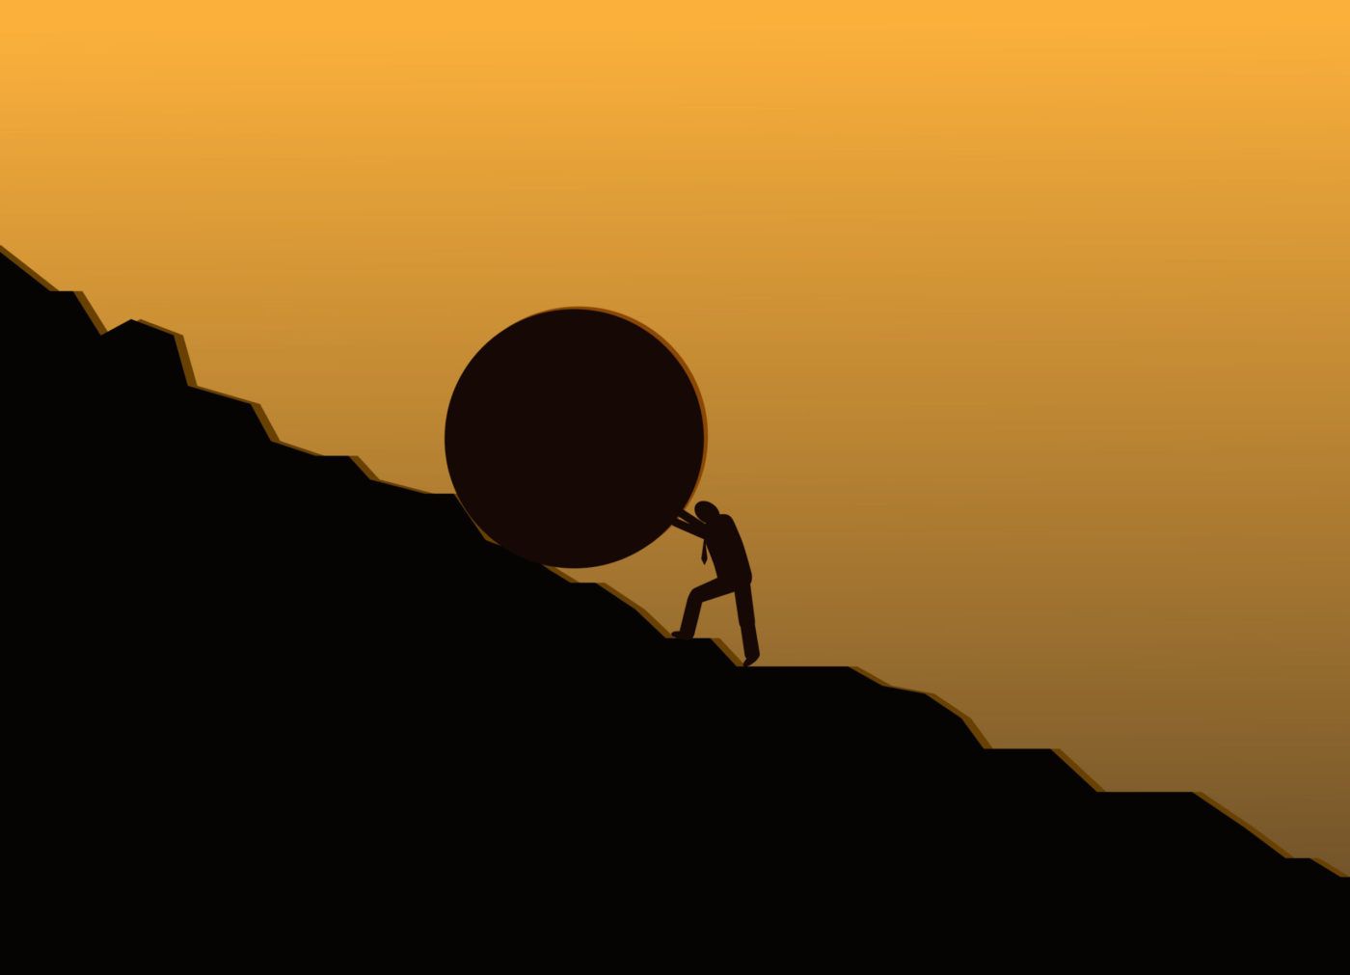
We should never be passive or half hearted about working for Jesus. Nothing we do for Him is ever unrecognised or unrewarded.
Keep serving, praying, loving, forgiving, encouraging, teaching, standing, sharing, giving, caring ….. The resurrection gives us three reasons to do that.
A. Jesus gave everything to save us, we should be willing to give everything to thank Him – take up our cross each day (Matt 16:24).
B. Cross & empty grave = not everything is as it seems.
C. The best is yet to come. Invest in heavenly treasures, not in “lets feast and drink for tomorrow we die.” (v32)
Notes:
Unfortunately we live in a world where it is all about results, numbers and rewards. We want it now.

Slide 9
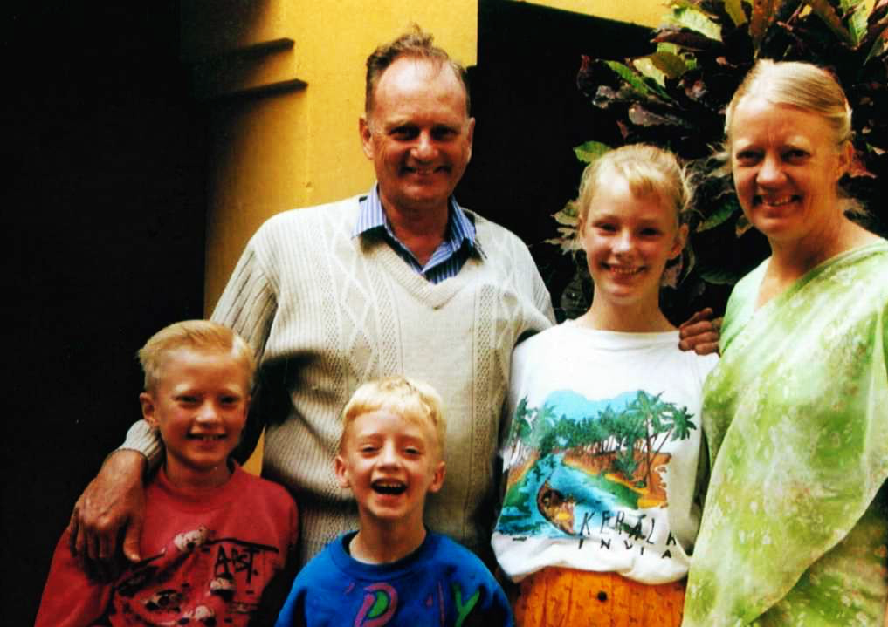
“I have only one message for the people of India. Although I am grieving, I am not angry, uncertain or afraid. My one great desire is that each citizen of this country should come to know Jesus Christ
GRAHAM & GLADYS STAINES
who gave his life for their sins. I want to spread the flame of Christ’s love because He is the one and only hope that will never disappoint.”
(Gladys Staines)
Notes:
Gladys and Graham Staines and children were missionaries in India. In 1999 Graham and his two sons were trapped and burned to death in their car by Hindu extremists. After the tragedy Gladys released a statement to the world.

Slide 10
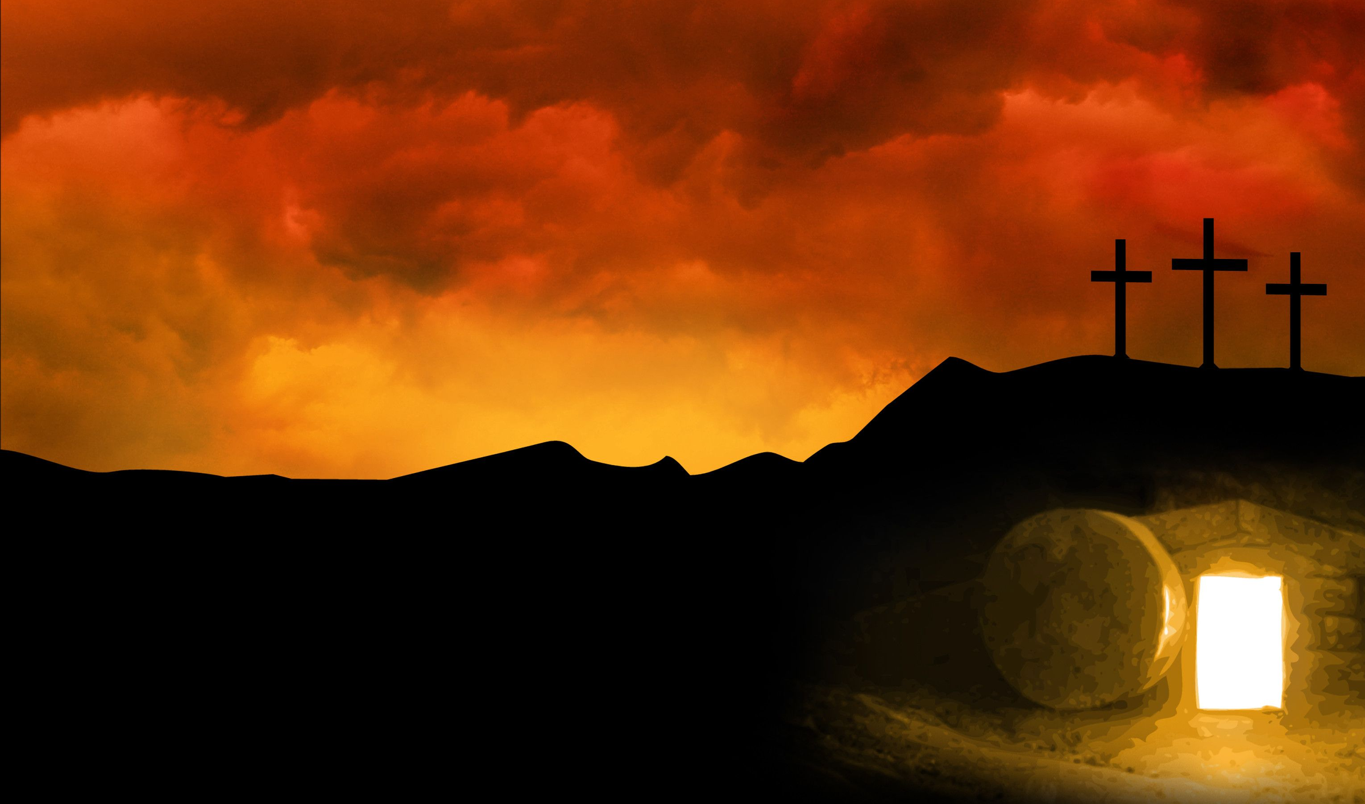
Are you carrying the weight of guilt, shame, death, fear, apathy, failure & hopelessness & tried a lot of ways to deal with it?
The Easter story tells us that Jesus Christ is the one and only hope who doesn’t disappoint – the perfect, gracious, loving eternal hope you are looking for.
Put your faith in Him – He conquered the grave and through His awesome power and amazing grace He has EXTIRPATED you guilt, shame, death, fear, apathy and failure FOREVER.
Be hope filled - strong, immovable and enthusiastic FOREVER.
Notes:
Our world is in desperate need of hope. I don’t know how people do it without him – and you don’t have to. Run to him today, surrender your life to him. If you have lready done that but still struggle with guilt, shame etc, then I encourage you to turn your eyes back to Jesus and rest in his amazing power and grace

