Slide 1
$287 million polar research vessel – National Environment Research Council.
“Boaty McBoatface” & “It’s #@%$# Cold Down Here”
Sir David Attenborough
Notes:
We live in our world that is too often ruled by the internet and social media – finding your way in the world by using public opinion is not always a very good idea. In 2019 the British Government Agency, Nature Environment Research Council went out to the community to invite them to name their new $287 million polar research vessel. They offered suggestions such as Shackleton, Endeavour and Falcon but public opinion had different ideas. The two most popular choices were Boaty McBoatface and It’s Bloody Cold Down Here. Faced with an embarrassing situation the CEO chose to go with the 5th most popular option which was Sir David Attenborough. As a compromise they named one of the ships automated submarines Boaty McBoatface. The wisdom of the world is not always wise.

Slide 2
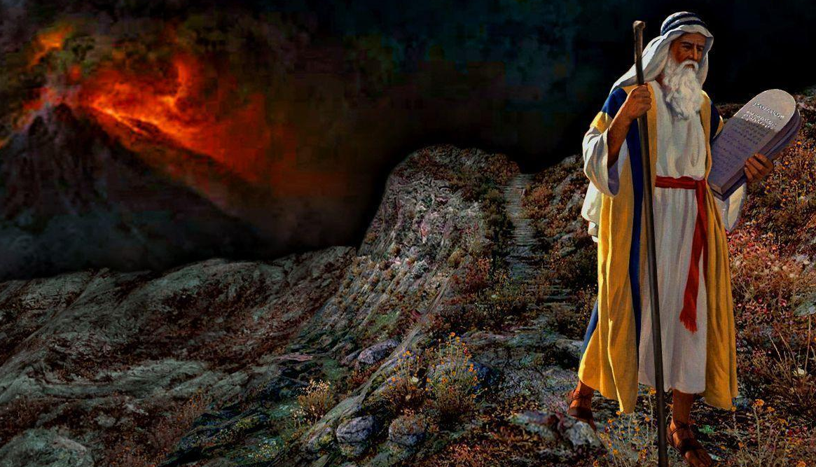
“The fear of the Lord is beginning of wisdom.” (Prov 9:10) Knowing what’s right or wrong, how to honour God and how to live a good life that blesses others = doing things God’s way.
THE WAY TO LOVE GOD, LOVE OTHERS & LIVE AN ABUNDANT LIFE.
EXODUS 19:1-8, 20:1-17
10 THINGS TO KNOW ABOUT THE 10 COMMANDMENTS
Notes:
The Bible says the fear of the Lord is the beginning of wisdom. The way to find your way forward in this world is not by relying on your heart or your gut feel, but by knowing and doing things God’s way. And that means paying attention to the Ten Commandments. Before we get into the commandments over the next few weeks, I will look to lay some important groundwork and look to emphasise why the Ten Commandments are so important for us to look at - they are still relevant for us today. We will look at 10 reasons we should learn the Ten Commandments.

Slide 3
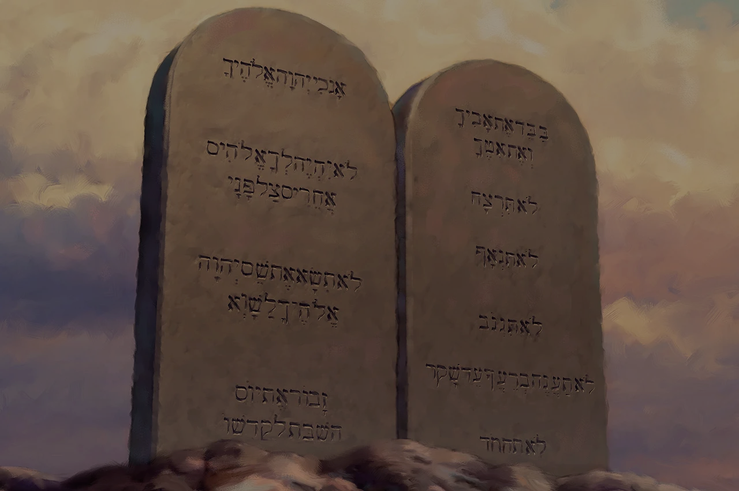
1. WE MAY NOT KNOW THEM AS WELL AS WE SHOULD.
2018 Church survey in USA = 24% knew 10 Commandments, 28% knew 7 Big Mac ingredients, 33% knew names of 6 Brady Bunch children & 75% knew names of 3 stooges.
2. THEY SHOW US WHO GOD IS - “I am the LORD… (20:2)
The “I AM” God, God of the plagues, the Red Sea & wilderness manna = it would be foolish/dangerous to think we know better.
His law is an expression of His heart & character & tells us what matters to Him. To reject/doubt the law = disrespect the lawgiver.
Notes:
We may not know them as we should. If people in church don’t know them, we can be certain that outside world doesn’t know them. Church goers in USA knew more about old TV characters than they did the commandments. These are arguably the most influential laws ever given – whether we agree with them or not, they should not be ignored.
They show us who God is. The opening verses of Exodus 20 make it clear who is giving the law = the Lord. He is the God who spoke to Moses at the burning bush declaring I AM WHO I AM (Ex 3:14) – sovereign, self existent, eternal, almighty creator. He is God of the plagues, the parting of the Red Sea and the manna in the wilderness. If there truly is such a God like the Scriptures reveal then it would be foolish and dangerous to think we know better. He is not a God to be trifled with. The ten commandments reveals God’s heart and character to us – his honour, worth and majesty. His law tells us what matters to him. Showing disdain for the law is to disrespect the lawgiver. We can’t regard his law as foolish and question its purpose and validity without disrespecting Him.

Slide 4
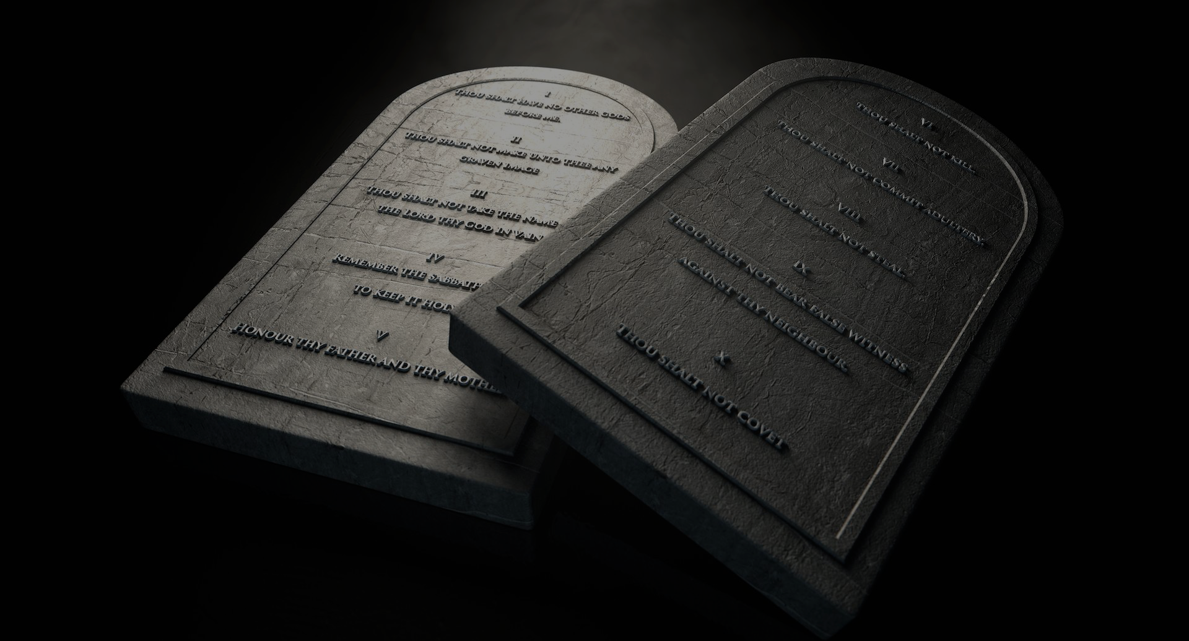
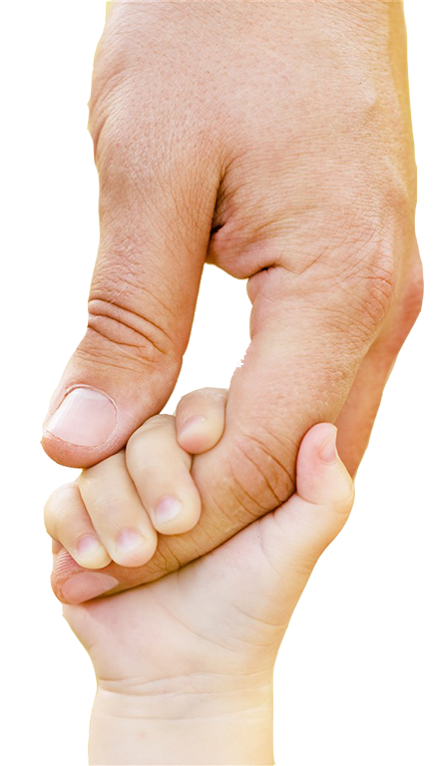
3. THEY SHOW US WHO WE ARE – “I am the LORD your God…” (20:2)
We are his treasured possession, set apart to live according to His way (priests & a holy nation) – Exodus 19:5-6, 1 Peter 2:9.
The God of absolute power is not an uncaring tyrant who has no regard for his people. He is a loving, personal Father who is on our side (Romans 8:31) = He gives us His commands for our good.
Notes:
3. They show us who we are – we are treasured and called to live for Him (a call given to both the Israelites and the church). We must be prepared to stand alone, to look and live differently and to have standards the world doesn’t understand. Of course we aren’t always going to be the holy people we should be but its still what he has called us to strive to do. That’s who we are.

Slide 5
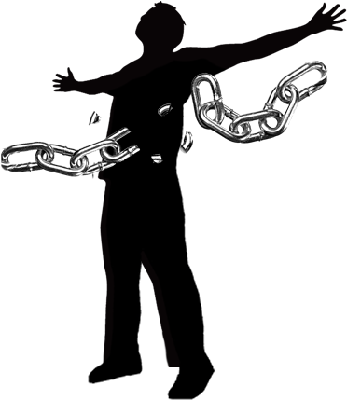
4. THEY GIVE US FREEDOM, NOT TAKE IT AWAY.
World’s freedom = doing whatever you want. Bible’s freedom = enjoying the benefits of doing what God wants us to do.
God wants to give us “a rich and satisfying life” (John 10:10) and for us “to be free indeed” (John 8:36) = “we should find delight in the law of God.” (Psalm 1:2)
Imagine how different life would be if everyone strived to keep the ten commandments? (No locks, passwords, courts, contracts, prisons, divorce, poverty, wars…)
“The ten commandments are not prison bars, but traffic laws.” (Kevin DeYoung) = law & order, safety & freedom.
Notes:
4. They give us freedom, not take it away. The world looks at the ten commandments and think that God is trying to constrain us, keep us down, stop us from fulfilling our dreams and reaching our potential.
Imagine there were no traffic laws or that we didn’t have to obey them (I know that’s how some of us drive). It would be chaos if we didn’t know when to stop and when to go, when to drive slow and when to drive fast, what lane to be in, who to give way to etc. We don’t curse the guardrails and speed limits when we are travelling on a windy, hilly road. Yes they are designed to give us boundaries but for a good purpose. They were put there at great expense, with great discernment so that we could travel freely and safely.

Slide 6
5. THEY WERE NOT GIVEN TO EARN OUR SALVATION –
“I am the LORD your God, who rescued you from the land of Egypt, the place of your slavery.” (20:2)
The law comes after the gospel – the good news of deliverance.
“The ten commandments are not instructions on how to get out of Egypt. They are rules for a free people to stay free – a new way to live for those who love God.” (R Kent Hughes)
“If you love me, obey my commandments.” (John 14:55) = Salvation is not the reward for obedience. Salvation is the reason for obedience.
Notes:
5. They were not given to earn our salvation. The law comes after the gospel – after the good news of deliverance. God doesn’t come to the Israelites while they are slaves in Egypt and then say I have some commandments for you. If you obey them, then I will love you and rescue you. But that’s how some people see God’s commandments. If I obey them then God will love me and he will be obliged to rescue me - I will deserve to live in the Promised Land, in heaven with God. The Exodus story is that the people of Israel are captives in Egypt. God loves them and hears their cry for help. He rescues them and sets them free. He then says here is a new way to live. When Jesus was with his disciples he washed their feet and then told them if you love me, obey my commandments. He didn’t say I will love you if you obey my commandments. We love Gods laws and strive to obey them because we have been saved, not in order to be saved. Obedience = honouring and praising God for what he has done for us.

Slide 7
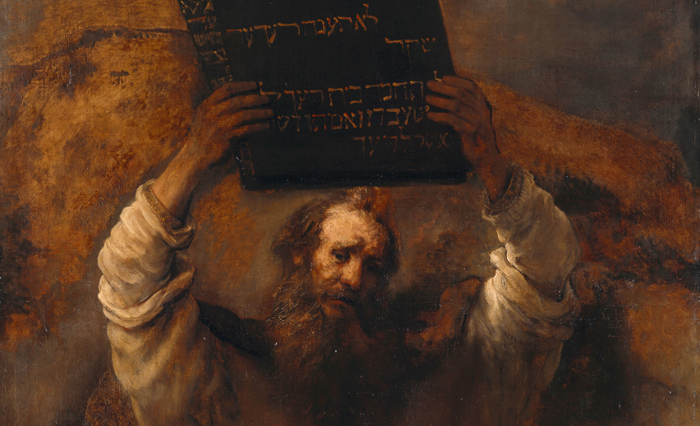
6. THEY ARE MORE TRUSTWORTHY THAN OUR INTUITION OR CULTURAL CODE.
Our world says, ‘right and wrong is what you decide for yourself’, yet they still have a moral code. To challenge that code = racist, phobic, Karen, intolerant, misogynist…
“There is a way that seems right to a man, but its end is the way to death.” (Prov 14:12)
“.. the law itself is holy, & its commands are holy & right & good.” (Rom 7:12)
Knowing right from wrong, living an abundant life, living a life that blesses others & honours God = doing things God’s way.
Notes:
6. They are more trustworthy than our intuition or cultural code. World says there is no right or wrong – you can’t judge me because I decide what’s wrong and right. My gut. My heart. My feelings. There is no such thing as absolute truth – which is a statement of absolute truth itself. But they won’t tolerate any challenge to their code – they will judge others and rebuke them. But if we want to know right and wrong, live a life that blesses others and honours God then we need to do things God’s way, pay attention to the ten commandments.

Slide 8
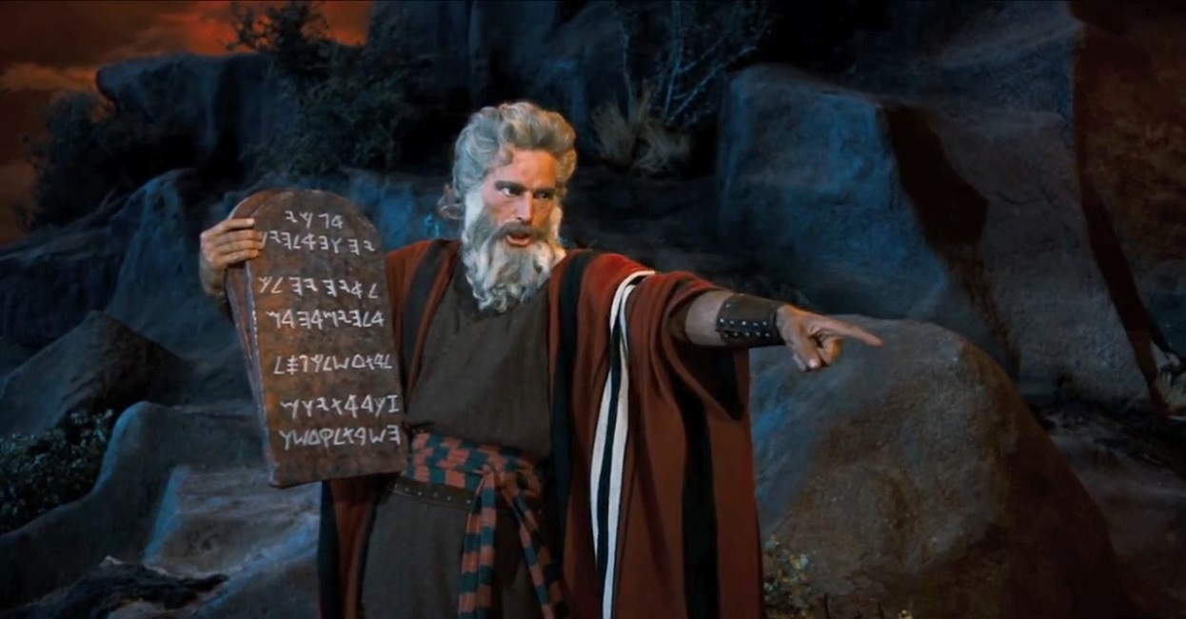
7. JESUS SUMMARISED THEM AS THE GREATEST COMMANDMENT FOR US TO TEACH & DO.
“You must love the Lord your God with all your heart, soul and mind.’ This is the first and greatest commandment. A second is equally important: ‘Love your neighbour as yourself.’ The entire law and all the demands of the prophets are based on these two commandments.” (Matt 22:36-40)
8. THEY WERE FOUNDATIONAL TO THE OT LAW.
Of the 600+ laws that God gave the Israelites, these are the only ones that all the people heard God speak (Deut 5:22-27).
They were kept in the Ark of the Covenant (Hebrews 9:4).
Notes:
7. Jesus summarised them as the greatest commandment for us to teach and do. Jesus summarised the 10 commandments into the greatest commandment. Love God = first 4 commandments (God alone, no idols, no blasphemy and finding rest in God) and others = last 6 commandments is love others as yourself. (honour parents, no murder, adultery, stealing, lying and coveting.) Throughout history these commandments have influenced catechism and creeds, If you ever wonder what we teach our kids and people, how we evangelise (tell people about who God is and who we are) – answer is fundamentally the ten commandments.
8. They were foundational to OT law – like the constitution for Israel. God gave them over 600 laws (according to jewish custom) but these were not only the first, but also the only ones that all the people heard God speak. They were too terrified after that and begged God to just talk to Moses from now on – which is what happened. The stone tablets were kept in the ark of the covenant because they were regarded as the words of the covenant..

Slide 9
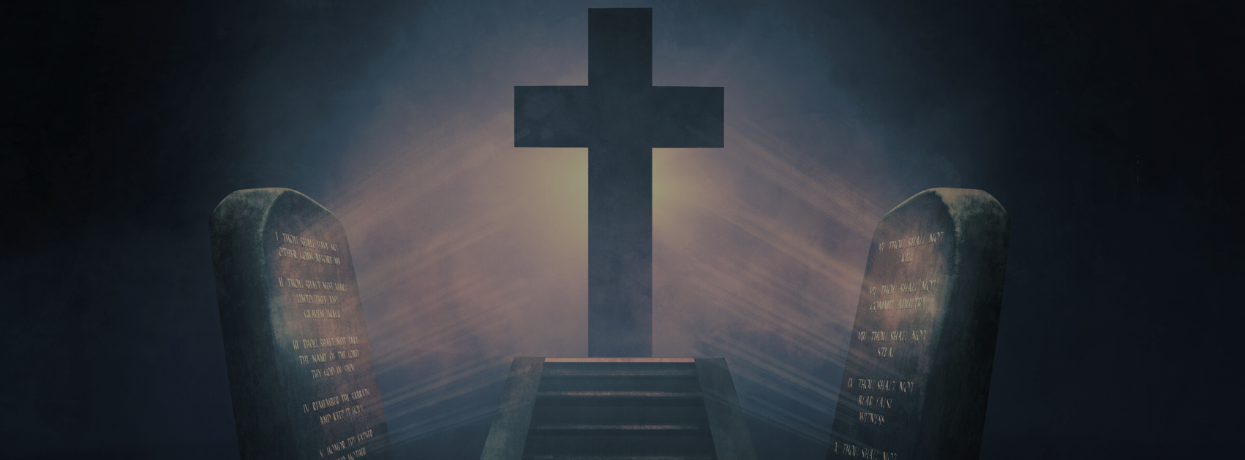
9. THEY ARE CENTRAL TO THE ETHICS OF NEW TESTAMENT.
Jesus uses the Commandments to prove the rich young ruler’s need for a Saviour (Mk 10:17-22).
Paul uses them to teach the importance of loving others (Rom 13:8-9, 1 Tim 1:8-10).
10. THEY ARE RELEVANT FOR CHRISTIANS TODAY.
The law shows us the way to love God, love others & live for Him. It also shows us our sin (Rom 3:20) & leads us to the cross.
Jesus didn’t abolish the law, He fulfilled it (Matt 5:17) - we can only keep them in and through Him.
If we want to love Him as he deserves, and as he desires, we will keep his commandments (John 14:15) – our duty & delight.
Notes:
9. They are central to the ethics of the New Testament. When the rich young ruler comes to Jesus and asks him about eternal life Jesus uses 5 of the last six commandments to assess his genuine love for God (misses out coveting) Jesus knows that’s his weakness and uses it to challenge his love for God. Romans 13 is teaching about how we are to love others and uses the Commandments to illustrate what that looks like – no adultery, murder, stealing or coveting. In 1 Timothy 1 Paul once again uses the commandments to define the love and a pure heart (1 Timothy 1:5) and to say that Christianity is more than knowing the law – must do it. Law says we should love others as well as God.
10. Are they relevant for Christians today? Absolutely, If they are central to the ethics of NT then they must still be applicable to us. Jesus didn’t trample on them, he fulfilled them. He transposed them – they are in a new key, transformed. Jesus makes a way for us to obey them. We are a new creation – to obey is not just our duty but our delight. We are not in a covenant of love and grace that negates law (as some say). This side of the cross the ten Commandments are still relevant – just in a different way.

Slide 10
If we want to honour God, live an abundant life & influence our community, then God’s law needs to be reinforced, not redefined.
“Obey them completely so that you will live… and display your wisdom and intelligence among the surrounding nations. When they hear all these decrees, they will exclaim, ‘How wise and prudent are the people of this great nation!’” (Deut 4:1, 6-7)
“When the world says that Christians should be progressive & keep up with the times, I am shocked. They are there to present the teachings of Jesus, & their values should clash
with the values of popular culture. If they just start making it up as they go along, then what do they have to offer? They would be just like every other human institution.”
Notes:
As the children of Israel were nearing the Promised Land, Moses encouraged them to dedicate themselves to obeying God’s commands, just as they had promised. In Deuteronomy 4 he reinforces the fact that there is no room for them to be redefined (add or subtract) Moses also shared that standing out from other nations will help them to be an influence amongst the nations. We live in a world that tells us that there is no place for God’s commandments – no idolatry, only one God, no blasphemy, sexual morality only in marriage between a man and woman, not coveting…. Sadly this has lead many Christians and churches to redefine God’s standards in the hope that they will be popular and have an influence. But that’s not what God calls his people to do. We are to stand out, be separate and stand firm. I want to read you a quote I read recently. Guess who said that. Andrew Bolt – journalist who is not even a Christian. God has called us to be holy and dedicated to him but he has also called us to be joyful serving him – loving others humbly knowing that we too are sinners made righteous only by the blood of Christ.

