Slide 1
‘Going and telling’ (sowing) in a messed up world that hates Jesus, is not easy.
Going & telling (sowing) = setting captives free & recapturing the hearts of people for God = warfare.
How do we ‘go and tell’ effectively in a hostile world?
SOWING
Indirect engagement through our prayers.
Direct engagement through our actions & words.
Colossians 4:2-6
Notes:
‘Go and tell’ is God’s plan A for all believers – to go out, know people, talk to people and sowing the seeds of the gospel. But its not easy. It is a lot easier to stay in our Christian circles and study God’s Word (to concentrate on knowing God – the first, important, foundational step for all believers). Its even easy enough to just get to know people and build a relationship with them (help them , pray for them etc,) That’s not too confrontational. But to start telling people about Jesus and why they need him.. That’s another matter. That is confrontational and starts to cause us problems. We live in a messed up world – a world that hated Jesus and a world that hates us and the gospel. Besides that, going out to share the gospel is equivalent to striving to set captives free = spiritual warfare against a formidable enemy. So how do we do that in a messed up world? Paul gives us some vital advice on the best way to sow – to tell people about Jesus. We get some positive advice on personal evangelism in a messed up world. Paul and early church lived in a time when the world was hostile to the gospel and to Jesus. The Romans ruled and it was a cruel and wicked world. Christians and the church were not respected, and the world wanted nothing to do with them. It cost something to be a Christian. So, Paul gives us two ways to go about sowing – not a choice between one or the other. We might be better at one, but we need to be able to do both.

Slide 2
1. BY INDIRECT ENGAGEMENT THROUGH OUR PRAYERS.
“Devote yourselves to prayer with an alert mind and a thankful heart. Pray for us, too, that God will give us many opportunities to speak about his mysterious plan concerning Christ. That is why I am here in chains. Pray that I will proclaim this message as clearly as I should.” (vs 2-4)
We can often feel weak in our prayers because we can be guilty of using them only as an ATM or domestic intercom, rather than a wartime single channel radio for spiritual battle (Eph 6:18-20).
Prayer = the link between active soldiers and their command HQ, which has unlimited firepower, air cover & strategic wisdom.
Notes:
Paul is writing the letter of Colossians from prison – the enemy has captured him and think he has won a tactical victory. But Paul manages to smuggle a letter out of his prison camp to the soldiers on the front line – the church. In this passage he asks them to get on their radio to HQ and ask them to blast open doors to his prison cell and in the enemy’s frontline so that they can all get on with their rescue mission. Many times we can be guilty of using prayer like an ATM where if we put in the right code (do the right thing and say the right words) then God owes us. Or even as a domestic intercom – order what we need to be comfortable, to address any concerns when our ‘experience’ is not what we think it should be. God is here to help me have the best life. Prayer is the key to spiritual warfare – pray in the spirit at all times (Ephesians 618). Colossians 4:2-5 is almost exactly the same as Ephesians 6:18-20 – the closing part of Paul talking about the armour of God.

Slide 3
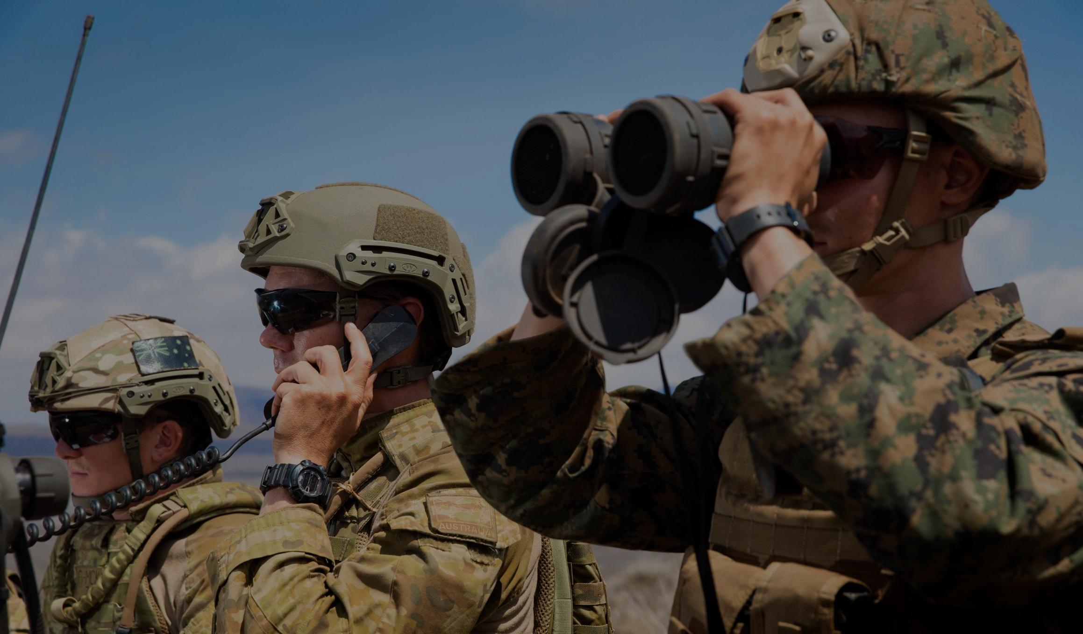
THREE WAYS WE SHOULD PRAY, WHEN IT COMES TO SOWING (vs 2).
A. Persistently (devotedly) = committed, continual, active & bold. Prayer increases in power the more we use it.
Keep the radio always in the ‘on position’ and ask God again and again for guidance, wisdom, courage, words, power, awareness of opportunities, protection & victory.
B. Watchfully = mental alertness and spiritual vigilance.
No watchfulness = an easy target for Satan’s constant attacks & deceptions (busyness, weariness, pride, doubt, despair…)
Notes:
Persistently – unlike our mobile phones today (which lose power the more you use them), prayer is the opposite. It increases in power the more you use it. Ask God for guidance through minefields of temptation and despair etc. Watchfully – like a military sentry, pacing the perimeter at night, alert to every sound and movement. Satan will try to jam the airwaves (filling out lives with clutter of non-essentials = no time or too tired to pray), deceiving us into thinking God doesn’t hear or care – the radio is broken. Thinking we can do it in our own power.

Slide 4
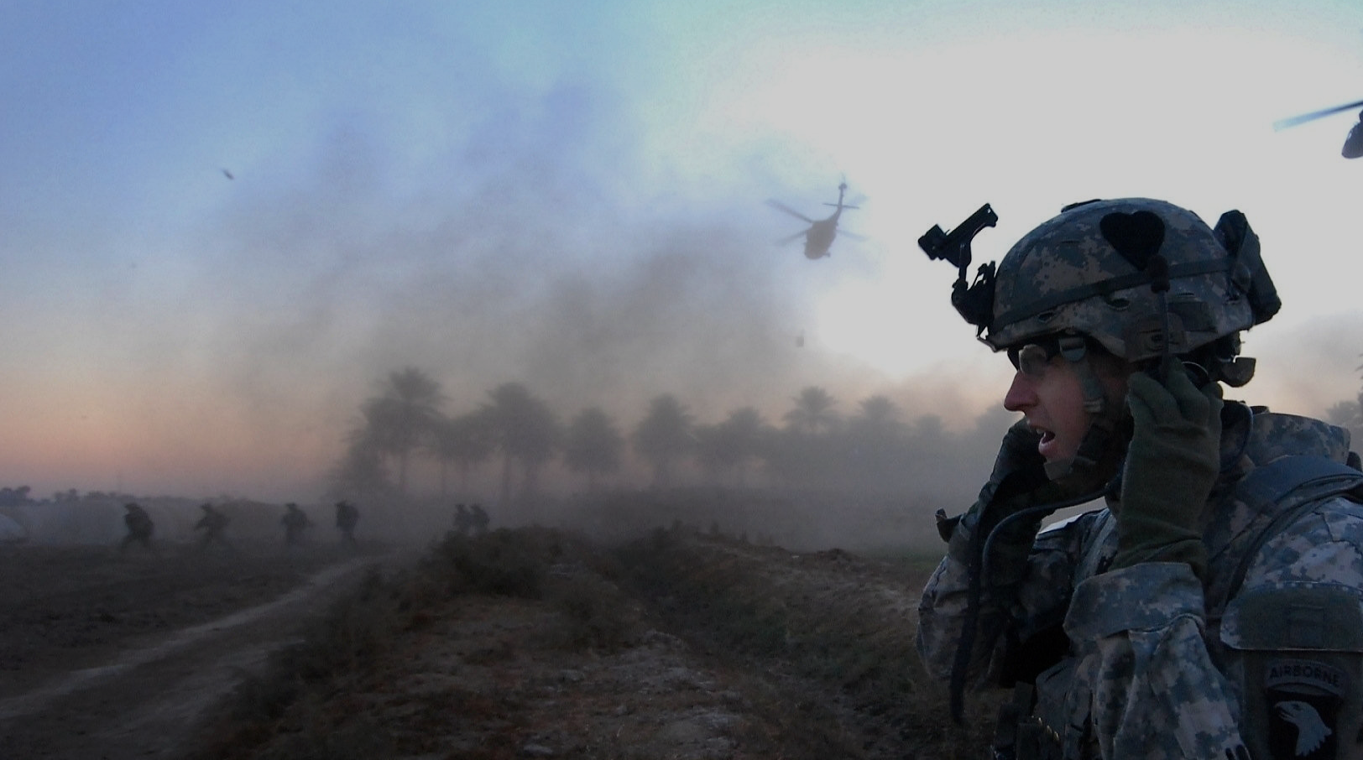
C. Thankfully – for God’s plans (Romans 8:28), presence
(Psalm 23), provision (Acts 27:35), pardon (Romans 6:17) & promises (2 Corinthians 1:20).
Knowing that God (HQ) is in control + He is always with you + progress is being made on all fronts + the battle is the Lord’s + Christ has defeated sin & death + God wins.
“We can be thankful because we do not fight as losers or even as those who are uncertain.” (John Piper)
Notes:
Thankfully – the first two (watchfulness and vigilance) might signify that the Christian life is filled with nervousness, perspiration, adrenalin and fear. We don’t fight with a heart always filled with fear and dread.

Slide 5
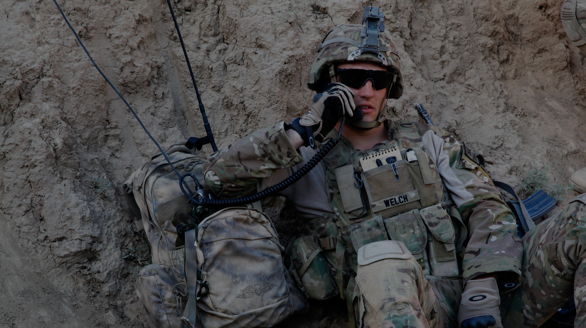
THREE THINGS WE SHOULD PRAY FOR, WHEN IT COMES TO SOWING (vs 3-4).
A. For the front line soldiers – “Pray for us too..” While all believers are soldiers and have radios (priesthood of all believers) there are some differences in our field assignments.
“Now these are the gifts Christ gave to the church: the apostles, prophets, evangelists, pastors and teachers.” (Eph 4:11)
B. For open doors – “..that God will give us many opportunities.” = Gentiles (Acts 14:27), in Ephesus (1 Cor 16:8-9) & Troas (2 Cor 2:12). “God, blow the doors open in Coolum, Australia, PNG…”
Notes:
Paul then goes on to tell us the three things we should pray for as we support the frontline of evangelism.
For the front line soldiers – even in prison, Paul sees himself as being in a powerful position to sow the seeds of the gospel – to tell people about Jesus. Ephesians 4:11 lists the front line soldiers – every one of us should be praying for missionaries, pastors, teachers, evangelists. For open doors – Paul knew that it was God who opens up the opportunities. When God opens a door we need to go through it.

Slide 6
C. For the message of the Gospel to be made clear - ”..to speak about his mysterious plan concerning Christ…. Pray that I will proclaim this message as clearly as I should.”
Mystery = what was hidden in the OT, now revealed in the NT (Col 1:25-26) = “For God so loved the world that he gave his one and only Son, that whoever believes in him shall not perish but have eternal life.” (John 3:16)
2. BY DIRECT ENGAGEMENT THROUGH OUR ACTIONS & WORDS – “Live wisely among those who are not believers and make the most of every opportunity. Let your conversation be gracious and attractive so that you will have the right response for everyone.” (vs 5-6)
Notes:
The goal of evangelism (sowing) is to make the mystery of Jesus clear. Even Paul acknowledged he couldn’t do that without God’s help (as learned, experienced and gifted as he was). Paul never took it for granted. The mystery = Jesus came to die in the place of sinners, even though he was sinless + He rose from the dead & reigns in heaven today + we’re all sinners & can only be saved by faith in Christ. Once saved, Christ dwells in our hearts & seals us for glory.

Slide 7
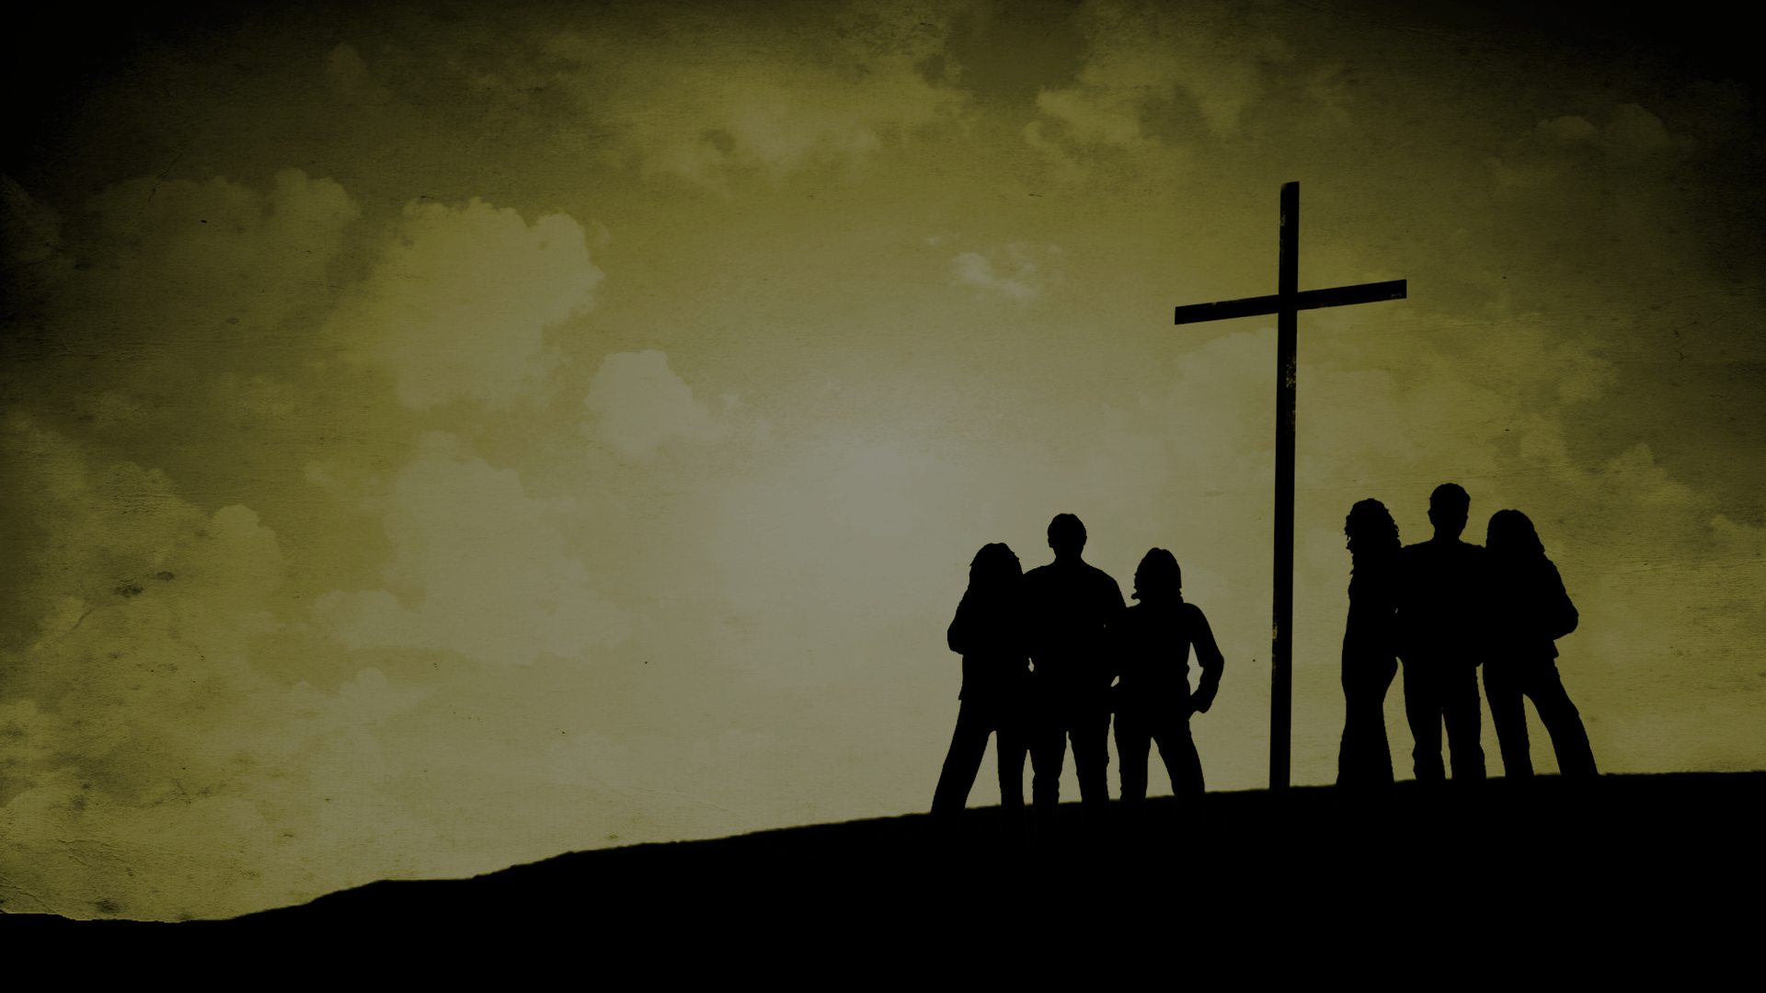
THREE WAYS TO MAKE THE MOST OF EVERY OPPORTUNITY.
A. Live wisely = how you live, gives credibility to what you say.
“You’ve got the right to say anything you like, but people are under no obligation to listen to what you say. Your right to speak is guaranteed, but you must earn the right to be listened to. And that depends on your integrity.” (Richard Howerson, US Senate Chaplain)
“Living wisely is properly evaluating every circumstance and making godly decisions. It is living a careful, consistent, righteous Christian life.” (John MacArthur)
Notes:
This is the daily direct engagement in evangelism that all believers should do. This is about making the most of every opportunity. Live wisely = if we are legalistic, jealous, have selfish ambition, love money, have idols that are the source of our hope and joy, live in fear and despair, filled with anger and resentment, vengeful, deceitful, not joyful or hopeful – if we live like the world lives people will shun the gospel (1 Cor 5:12-13)

Slide 8
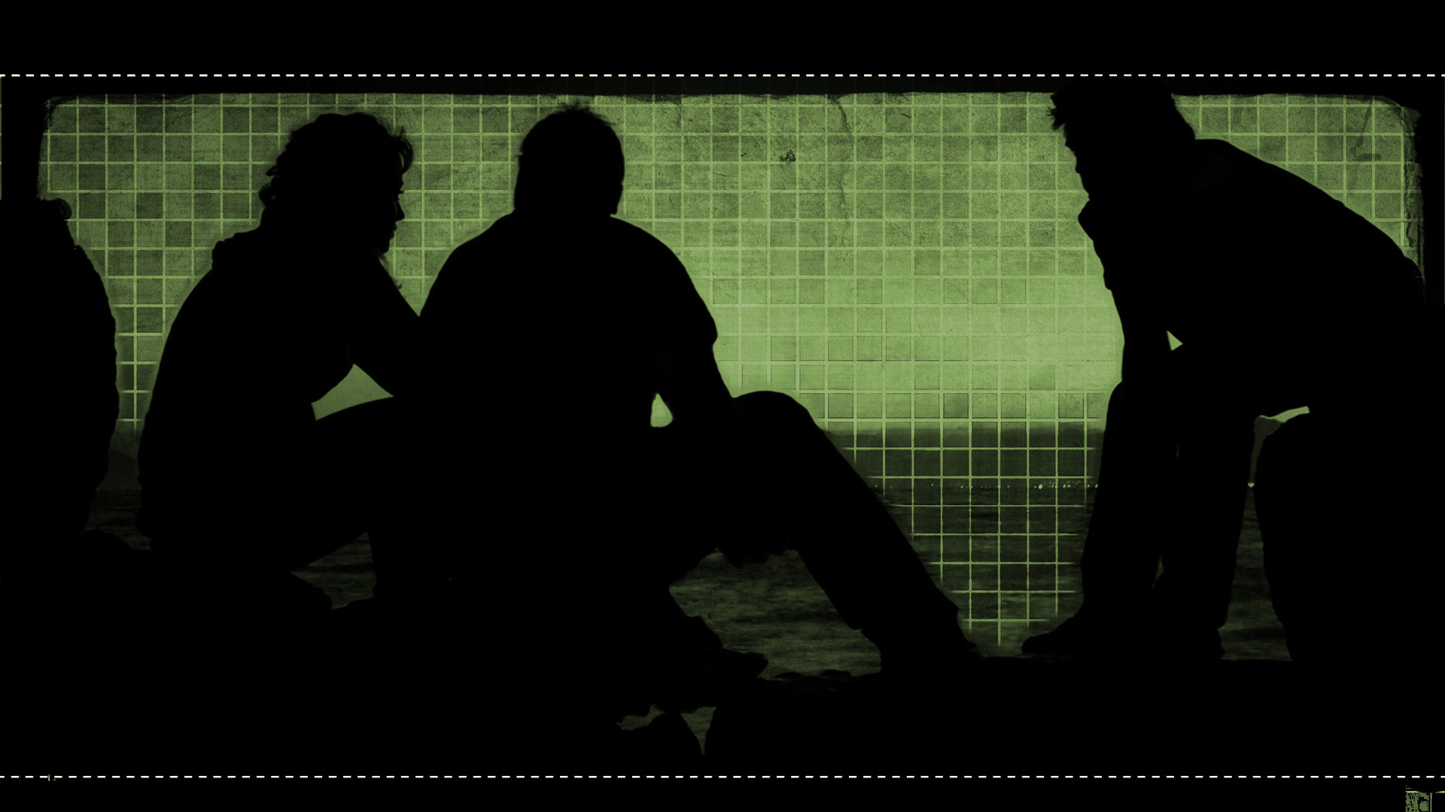
Our sources of wisdom = God’s Word (Col 3:16), prayer (James 1:5), godly instruction (Col 1:28), worship and fear of God (Prov 9:10) and Christian life experience (Heb 5:14).
B. Let your conversation be gracious and attractive (salty) = speak with truth and grace (kind, humble, sensitive). Salt can sting, prevent decay, add flavour and create thirst.
We must enjoy the satisfying taste of Christ ourselves if we are to be effective at telling others about Him.
C. Have the right response for everyone – give individual attention when you’re sowing. While the gospel is the same & Jesus is the same, each person & situation is different (wisdom).
Notes:
Sources of wisdom = meditating on God’s Word, praying for it when you need it, Need wisdom to know how best to deal with each individual situation.

Slide 9
1949 = George & Elizabeth Wood left the church in northwest China & Tibet with 200 baptised believers.
1988 = 1500 baptised believers. How?
“Oh! We just pray a lot and we preach that Jesus Christ is the same yesterday, today and forever.” (Pastor Mung)
2006 = over 15,000 baptised believers.
May we pick up our single channel radio & support the front line soldiers with persistence, watchfulness & confident gratitude.
May we make the most of every opportunity with wise living, salty speech & individual attention - as we share the good news of Jesus.
Notes:
In 1949, George Roy and Elizabeth Wood, an American missionary couple serving in northwest China and Tibet, were forced to leave the area. A local leader named Pastor Mung took over the church of 200 people. The Woods returned to America and by 1985 both of them had passed away without ever knowing what had happened to the church they started.
In 1988 the Wood’s son George returned to China and met with Pastor Mung and his wife, who were now in their 80’s. For 28 years the Communist government had done their best to extinguish the church. Pastor Mung wasn’t allowed to preach and he spent nine of those years in prison for his faith. It was illegal to baptise or “indoctrinate” anyone under 18. When the government finally allowed Pastor Mung to reopen the church in 1983 there were only 30 (mostly older) people in attendance. Assuming that the church was on its last leg, George Wood asked, “Pastor Mung, how many believers do you have today?” Pastor Mung’s wife brought them a cardboard roll held together by yarn. The first page was filled with writing – five columns: name, age, gender, address, occupation. There were around 20 names. George Wood continued turning over page after page with the names of the baptised. Finally, he asked the Mungs, “How many believers do you have now?” He said, “One thousand five hundred believers.” In disbelief George Wood asked, “How did this happen?”
Pastor Mung smiled as he shared his secret for church growth. It wasn’t a technique or a program. He simply said, “Oh! Jesus Christ is the same yesterday, today and forever. And we pray a lot!” Then he went on to describe what the Lord had done. Pastor Mung died in 2006 at the age of 96. But when he passed, the number of baptised believers stood at over 15,000!

