Slide 1
HOSTILE
UNFORGIVING
INTIMIDATING
SHOWING UP
Paul’s effective evangelism 101 -
HIS MESSAGE
1 CORINTHIANS 2:1-5
HIS POWER
(& DEPENDING ON JESUS)
HIS MOTIVE
Notes:
Mount Everest – the highest mountain in the world. It is the most formidable, challenging climb in the world. The elements are hostile and unforgiving. Its not for the fainthearted. There are 17 different paths to the summit of Mt Everest, but the most popular path used is the one pioneered by Sir Edmund Hillary in 1953 – the first to climb the mountain. Its not the only one but it’s the proven way to go. Its an incredible legacy of leaving a route up the highest mountain in the world. In some ways Paul has done the same for us – the pioneering evangelist gives us a great tried and true path to effective evangelism. Going out into a hostile, unforgiving, challenging world (environment) – where success is not guaranteed, to share the gospel Paul gives us honest and real advice that should encourage us. Plan A is not an easy plan for us to follow but we need to keep showing up and always, always depend on Jesus.

Slide 2
HIS MESSAGE – “When I first came to you.. I didn’t use lofty words and impressive wisdom to tell you God’s secret plan. For I decided that while I was with you, I would forget everything except Jesus Christ, the one who was crucified.” (vs1-2)
a) Was clear and simple – not using lofty words & impressive wisdom. It wasn’t about him being heard, but about the gospel being understood. The response he was seeking was not “what a wonderful sermon” but rather “what a wonderful Saviour.”
“You can impress people with your cleverness, or you can impress people with Jesus. It’s very hard to do both.”
(James Denney, Scottish Theologian)
Notes:
Two things we learn about Paul’s message as an evangelist, preacher and teacher.
1. Clear and simple – Corinth was a Greek city, and as such they loved lofty words and impressive wisdom. If you wanted to be popular as a speaker, if you wanted to draw crowds you needed to have cleverly crafted speeches, witty, charming and brilliant. You needed to dazzle and amaze people with your wisdom and oratory power. Paul could have easily done that – he was a very smart man and was very comfortable using lofty words and impressive wisdom. James Denney was a Scottish theologian who understood the danger of pastors, preachers teachers and evangelists need to be very wary of ‘showing off’ when we share the gospel – need to keep the focus on Jesus, not us. It doesn’t matter if you don’t have an impressive testimony to share or whether you are a skllled public speaker. Clear and simple is all you need when telling others about Jesus.

Slide 3
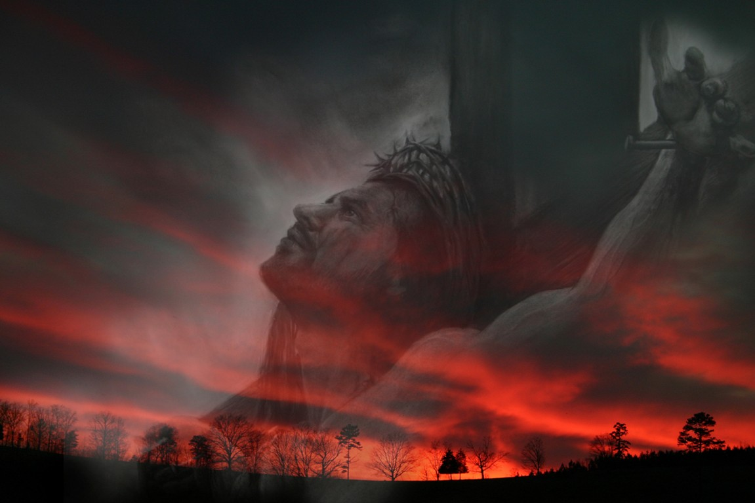
b) Boldly, intentional – “I decided…” = a conscious choice to not let anything get in the way of the gospel. Not human opinions, current affairs, theories or theologies – it’s Christ + nothing.
“… Jesus Christ, the one who was crucified” = what people need, but not what they want. But there is no power in saying “be nicer, try harder, clean yourself up, give more, go to church more, pray more, love wins, you are good enough or God understands.”
“… Jesus Christ, the one who was crucified” = John 3:16 = we’re guilty sinners, separated from God & deserving death. But in His love, God sent Jesus to die for us, save us & bring us back to Him.
Our goal is not the applause of people, but the souls of people.
Notes:
2 Boldly intentional – its Christ plus nothing. Not human opinions, even theologies (predestination, end times etc.,) – not that any of those are bad. But we must be careful not to let those get in the way of the gospel and bringing people to Christ. All those others are good to grow people in their faith. He was intentional about pointing people to Christ, who was crucified. That can be challenging – people don’t mind talking about Jesus the moral teacher, healer, great leader, the one who loves you, miracle worker etc. That’s what they want because that Jesus doesn’t challenge them , that Jesus means that they are good enough on their own to get to God. But as we know (particularly as parents) to give people what they need doesn’t always mean that you give them what they want. When my sinuses flair up I still want my snack foods, but what I need is more water and less sugar & dairy (which gives me more mucus). Because Shauna loves me she denies me the sugar and gives me the water. The cross is offensive to people, its foolishness to the world – to say they are too wicked and need saving is abhorrent, but its what they need. If we substitute the gospel with anything else then it is false, its wrong, its misleading and its dangerous. It might tickle their ears and make you popular but it’s the only way.

Slide 4
HIS POWER – “I came to you in weakness - timid and trembling. And my message and my preaching were very plain. Rather than using clever and persuasive speeches, I relied only on the power of the Holy Spirit.” (vs 3-4)
Paul was opposed, insulted (Acts 18:6) & mocked for his lack of ’presence’ (2 Cor 10:10) = frightened & discouraged.
“Do not be afraid; keep on speaking, do not be silent. For I am with you, and no one is going to attack and harm you, because I have many people in this city.” (Acts 18:9-10)
Fruitful evangelism is ultimately dependent on God’s presence, power and will - not ours. Salvation belongs to Him (Rev 7:10).
Notes:
Paul did not have an easy time in Corinth. In Acts 8 we read how he faced fierce opposition from the Jews and from the Corinthians who didn’t deem Paul’s physical presence to be very inspiring – remember they very much valued charisma and presence in a leader. So, if you feel a bit afraid, unqualified and discouraged when it comes to evangelism than join the club (Paul is the president of the club). In his despair God sent him a vision which he records in Acts 18:9-10. He reminds Paul of a few very important truths that evangelism is built on. God is with us (always), God will protect us and God is already aware of the many who will hear the gospel, repent and surrender their lives to Jesus. These are the other sheep (Gentiles) that Jesus refers to in John 10:16.

Slide 5
“I am glad to boast about my weaknesses, so that the power of Christ can work through me. That’s why I take pleasure in my weaknesses, and in the insults, hardships, persecutions, and troubles that I suffer for Christ. For when I am weak, then I am strong.” ( 2 Cor 12:9-10)
Our ‘gospel sharing’ thinking shouldn’t be a hesitant, “What good can I do for Christ?” but rather a confident, “What good can Christ do through me?”
The power of the Spirit = words (Lk 12:12, Acts 4:8, 1 Cor 2:13), boldness (Acts 4:31), courage (Acts 4:29-31), encouragement/joy in trials (Acts 13:50-52) & opportunities (Acts 8:29, 16:6-7).
Notes:
We are in no position to disqualify ourselves from sharing the gospel. Paul came to rejoice in his weaknesses and sufferings (as long as they are for Christ’s sake – not because we have been jerks or selfish – e.g. suffering because we are brash, proud and belligerent etc., or because we made dumb decisions, or taking militant and confrontational action (being abusive outside of abortion clinics etc.) We must realise that we can’t disqualify ourselves because we aren’t gifted, or an extravert or not equipped, not popular, have tried and it never works etc. God will not take “But..” as an excuse. Holy Spirit gives us words to say, boldness to get out of our comfort zone, courage to stand against the odds, encouragement to keep going even in times of suffering and despair, and opportunities (closes and open doors).

Slide 6
HIS MOTIVE – “I did this so you would trust not in human wisdom but in the power of God.” (v5)
Human wisdom = thinking we can achieve and maintain a position where we can boast before God. It despises the cross – it’s offensive and foolish to say we can’t earn our salvation.
Power of God = divine, gracious power unleashed by the death and resurrection of Christ – to justify and save sinners and allow God to bring us home. Boasting in Christ + nothing.
The only power on which our eternal joy, life and hope is built - not military, financial, academic, achievement….
Notes:
Human wisdom leads people away from the cross of Christ – we can be good enough to earn our salvation. As long as our good deeds outweighs our bad deeds we are deserving of heaven. Power of God is the cross and empty tomb. No other power can save us. Nothing can separate us from or destroy that power.

Slide 7
Only the power of God can take a person trapped in sin and set them free.
Only the power of God can take a heart of stone and replace it with a heart of flesh.
Only the power of God can give life in the place of death.
That power is only unleashed when we faithfully preach Christ crucified. Sin is the problem & the cross is God’s only solution – His Plan A, His good news for all the world.
The Gospel in 10 words = “CHRIST DIED FOR OUR SINS AND HE ROSE FROM THE DEAD.” = enough truth to save the whole world.
Notes:
Repeat those 10 words. It’s a good start for Plan A.

Slide 8
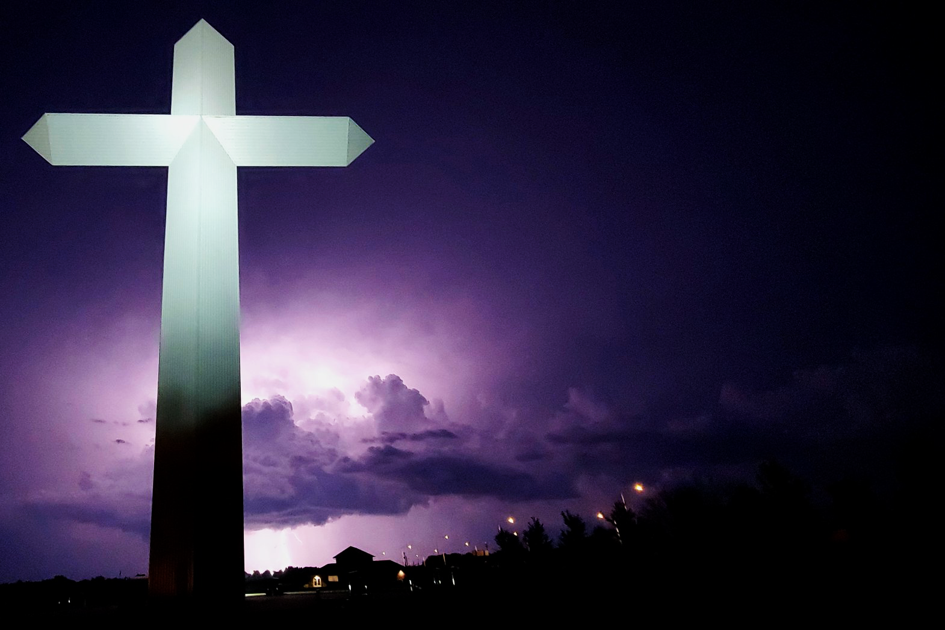
“Take me to the cross and I can find my way home.”
Effingham, Illinois
Our unique mission (Plan A) = point lost and confused sinners to the cross of Christ so that He can lead them home to God.
What you win people with, you win them to. No cross = no salvation, no hope.
May we never be ashamed of the cross of Christ. May we keep ‘showing up’ & always be dependent on the power and presence of God.
The Cross at the Crossroads.
Notes:
Late last year, a police officer was doing a nighttime routine foot patrol in Effingham, Illinois (pop of 12000) when he heard a child crying. Turning the corner he saw a young boy sitting on the footpath with tears running down his cheek. When he saw the police officer he said “I ran away from home but now I am lost. Can you please take me home?’ The officer said, “I will be glad to take you home. Where do you live?” The boy was so tired and scared that he couldn’t remember. So the officer started to name some nearby streets in the hope that he could help the boy remember his address. Then the officer thought of the biggest landmark in Effingham, which is a 61 metre high cross called the Cross at the Crossroads. The policeman mentioned the cross and asked, “Do you live anywhere near there?” The little boys face immediately lit up and he said, “Yes sir. Take me to the cross and I can find my way home.” That is the mission God has given us – Plan A = we are to point people to the cross and the cross will lead them safely home to God. It is said that what you win people with, you win them to. Attracting a crowd can be easy if you give them what they want – e.g., in Youth Group with pizza, fun, excitement etc. But when the pizza disappears, so do they. Jesus experienced that when crowds followed him for the miracles, healing and great teaching. But as soon as he pointed them to the cross they abandoned him. See that in Christian circles today – many people drawn to the emotion and excellence but eventually wander away when they no longer get that. When we strive to win people with the cross we will get a smaller crowd but they are more likely to become disciples. If we win them with a false gospel that doesn’t include the cross then we win them to a false and useless hope.

