Slide 1
ROWING
PARTNERING WITH OTHERS
Notes:
Good morning everyone. I hope you are all doing well
This morning’s sermon is an interesting one. Because the intention of the series is to equip us to go out into the world to proclaim the gospel
And yet today’s sermon is inward focused in one sense. It focuses on the fact that we are to love and serve one another to the glory of God
But I think that if we are to be effective in our witness we need to go out together and come back together
We need to build one another up so that in Christ we can overcome all that the world and Satan has to throw at us together. We need a church that is united by the gospel so that we can go out and proclaim the gospel
ILLUSTRATION: There was once a pastor who brought about ten people onto the stage at his church and assigned them roles to play on an imaginary fire truck.
One person was assigned to drive; another controlled the siren; one manned the hose; and one turned that strange little steering wheel in the back.
After getting them all in place and having them commence their roles, he asked each of them, “Now, what is your purpose, again?” Each answered by repeating the name of whatever job he had given them. After they were done, he said, “You’re ALL wrong! Your purpose—every one of you—is to put out fires!”
We have many giftings, but given by one God with one goal, to glorify Him, and a big part of that mission is inviting people to believe in the risen King, Jesus

Slide 2
BACKGROUND
1 Peter is a book that is addressing Jews that have been dispersed, and they are having a hard time
Peter reminds his readers that they will suffer because Jesus Christ suffered
He reminds them that those who are in Christ “…now live forever with God in Spirit”
Notes:
1 Peter is a book that is addressing Jews that have been dispersed, and they are having a hard time - They are being persecuted, and being mocked, and slandered, and they are losing friends - They are going through some very tough things, but why? Because they declare Jesus as Lord and Saviour - But Peter writes this letter to encourage them, to bring them hope, and he does this by doing what we all should do in similar situations, he points them to Christ
Peter reminds his readers that they suffer because Jesus Christ suffered - He reminds his audience that persecution and suffering was the predetermined pathway for God’s Son to bring salvation to all who will believe - That suffering, trials, persecution, are means that God uses to refine us and cause us to lean on His grace, to shape us into the image of Jesus Christ - But by no means is it going to be easy, it’s not always easy to see the light at the end of the tunnel when we are in the middle of these things, but we must fixate our eyes and hearts on the cross and ultimately the resurrection of Jesus
He reminds them that those who are in Christ “…now live forever with God in Spirit” - Because of Jesus Christ the Holy Spirit being poured out into our hearts, we have nothing to fear in Christ! We have nothing to fear in embracing suffering in this life - Peter calls us to arm ourselves with the genuine hope of the reality of our eternal life which is secure in Jesus Christ - As believers we will one day suffer physical death but our spirits will remain alive and enter into the promise of eternal life. That’s what we cling to in the struggles of this life, and that’s what Peter is urging his readers to do

Slide 3
END OF ALL THINGS
“The end of the world is coming soon” (1 Pet 4:7)
“Therefore, be earnest and disciplined in your prayers” (1 Pet 4:7b)
In light of these verses Peter commends love
Notes:
”The end of the world is coming soon” (1 Pet 4:7) - What Peter is referring to here is the second coming of Christ. No one knows the exact day and hour - We do know that the promised Messiah has come, lived, died and has risen and is alive, and we now await his second coming - Peter is saying the end is imminent, we wait, and live in eager expectation of this final glorious day when we will see Jesus Christ
“Therefore, be earnest and disciplined in your prayers” (1 Pet 4:7b) - Other verses say be of sober-mind and self-controlled in your prayers - Peter is saying be clear headed, be spiritually observant and be constantly in prayer - We are to watch and pray. And as we look at the world, as we read and allow the Word of God to penetrate our hearts we will be driven to our knees in earnest prayer
In light of these verses Peter commends love - As we read the Word of God and see that there will come a day when we all will be judged and Jesus Christ will come again and we will reign forever in his presence - As we come to see that our time is short, that as we go out into the world together proclaiming the good news, he commends to the body of Christ, a deep love - You see what Peter wants in the last days is a “one another” kind of life, a life that builds up the body of Christ and God’s Kingdom

Slide 4
LOVE EACH OTHER
“Most important of all, continue to show deep love for each other” (1 Pet 4:8)
Genuine Christian love is sacrificial and requires a stretching of every spiritual muscle
It is love that should characterise the church above all
Notes:
“Most important of all, continue to show deep love for each other” (1 Pet 4:8) - In these last days we ought to love each other fervently, to love each other deeply - Nothing will turn an unbeliever off the church more quickly than division and hatred amongst the body of Christ - We are to be a unit, a family, and just like our biological family, sometimes it can be hard to love our fellow brothers and sisters in Christ but we do it because Christ first loved us
Genuine Christian love is sacrificial and requires a stretching of every spiritual muscle - Sometimes it is going to be hard, sometimes there are going to be those people in the church, who just seem hard to love - But this is why, like I preached last time, we always come back to the gospel and we remember how we were enemies, we were unlovely and we were only worthy of the wrath of God, but in Christ we receive grace and so this is to be our attitude to everyone, but particularly our fellow believers - Apart from Christ, loving like this is impossible, but in Christ we can show deep love for one another
It is love that should characterise the church above all - The book of John tells us that “by this all people will know that you are my disciples, if you have love for one another” (John 13:35) - For if God is love and we are called to be His image bearers, then it makes sense that we should be known for our love for one another - We go out in the world together sharing the good news of Jesus, knowing that we also come back together to worship God together and build one another up and love one another. - For whilst the world may hate us, slander us, and persecute us, the church should be a place where we are loved and edified, a place where we pray together, share one another’s burdens, encourage one another, to confess our sins before God and one another, to read and study the Bible together, a place where we come to rest in the grace of God - This is when our evangelism will be most effective, when we love each other and serve one another just as Christ did

Slide 5
SHOW HOSPITALITY
“Cheerfully share your home with those who need a meal or a place to stay” (1 Pet 4:9)
Hospitality, though a Christian duty, is to be offered without complaint
And in our hospitality we are to be inclusive not exclusive
Notes:
“Cheerfully share your home with those who need a meal or a place to stay” (1 Pet 4:9) - Back in biblical times travellers avoided inns and motels and sought accommodation with private parties - And particularly persecuted and weary Christians would look for places where they could be assisted and encouraged - Peter is encouraging us, whilst using discernment, to open our homes to one another, to the believer and unbeliever
Hospitality, though a Christian duty, is to be offered without complaint - We open our homes because it is our joy to share God’s blessings and goodness that He has given to us with others - Hospitality doesn’t just include the act of inviting people over but an unselfish attitude, no matter the sacrifice it is done cheerfully, without complaint - Throughout Scripture, the virtue of hospitality is stressed and deemed very important. Opening your home to others shows a sense of vulnerability and a desire to love and care for one another
And in our hospitality we are to be inclusive not exclusive - We are to invite those who we might struggle to get along with - The act of opening your home or going into someone else’s home is great way of engaging in deeper discussion and might just be the best bridge between believer and unbeliever - As Christians we have received mercy and grace and therefore we are entrusted with passing this onto others

Slide 6
USE YOUR GIFTS
“As each has received a gift, use it to serve one another, as good stewards of God’s varied grace” (1 Pet 4:10)
The church is a family with each member supporting the others by using their gifts
2 broad categories of gifts here, the speaking gifts and the serving gifts
Notes:
“As each has received a gift, use it to serve one another, as good stewards of God’s varied grace” (1 Pet 4:10) - We each have received a gift from the Holy Spirit upon being born again - Whatever that gift may be, it is to be used by the power of the Holy Spirit for the good of the body of Christ, for serving one another - And just as God’s grace is richly varied, so too are the gifts flowing from His grace
The church is a family with each member supporting the others by using their gifts - As members of the body of Christ we are to be good stewards of our gifts, to use them wisely and obediently - Because how we share and use our gifts impacts the image and reputation of God in the eyes of others - It is a great privilege and honour to be able to use the gifts that God has bestowed upon us for the sake of the church, so we should be quick to do so, not hesitant
2 broad categories of gifts here, the speaking gifts and the serving gifts - I believe that what Peter is doing here is taking what is spoken about in other sections of the Bible about spiritual gifts and just placing them into two broad categories - When he refers to speaking in this passage he isn’t just talking to preachers who get up in front of the church, but Sunday School teachers, youth and children’s volunteers, evangelists, small group leaders, wherever it may be that you are teaching from the Word of God - But hopefully you get the point here, that whatever gift God has given you, do it with everything that you have and the confidence that God is working in you,

Slide 7
”Do it with all the strength and energy that God supplies” (1 Pet 4:11)
“Then everything you do will bring glory to God through Jesus Christ” (1 Pet 4:11)
We work together, using the gifts that God has given us, through the power of God, to the glory of God, for the building up of His kingdom
Notes:
“Do it with all the strength and energy that God supplies” (1 Pet 4:11) - You see God gives us the gifts, the abilities, the family to serve, all the while giving us the strength and energy as well, if we will put our faith in Him to do so - The work depends on His strength. God’s strength isn’t just needed in sharing the gospel, but our work in loving one another and serving one another - We will be most effective amongst those who don’t know God when we are using our gifts to serve and love those who do know God
“Then everything you do will bring glory to God through Jesus Christ” (1 Pet 4:11) - And since in Jesus Christ we are given the gifts, abilities, opportunities and strength then it is only right that God also gets all the glory - The fact that these 5 verses fall right in the middle of chapter where either side of these verses the church is enduring persecution, slander, mockery, loss of friends for the sake of Jesus Christ is no coincidence - If we are going to endure and if we are going to be effective witnesses we are to love one another
We work together, using the gifts that God has given us, through the power of God, to the glory of God, for the building up of His kingdom - Listen, the Church was born to be sent. Whilst everyone’s goal is the same we do not need to be the same. In fact, God deliberately made us different from each other. - But we need to be united by Christ and his mission - And when we remember that the purpose of our lives, the purpose of everything we do is to bring glory to God, then little else matters

Slide 8
SUMMARY
The end of all things is near, so love each other
Use your gifts for the body of Christ, and for the building up of His kingdom
We live by the grace of God to the glory of God
Notes:
The end of all things is near, so love each other - The last days insist that our love be sincere towards one another - To make the best use of our time we must live in light of the second coming of Christ - Love for others is to characterise the body of Christ, and such love is to be fervent, deep, tenacious and genuine love, flowing out of an intimate relationship with our heavenly Father
Use your gifts for the body of Christ, and for the building up of His kingdom - We are a people given different gifts. We bring different experiences, skills and abilities to the table - But that’s the beauty of being part of the church. We are different parts of one body with Christ as our head - We use each of our gifts not for the building up of our own kingdom, but the building up of God’s kingdom. Though all different, we all share one common purpose and goal in life
We live by the grace of God to the glory of God - Peter says that when we use our gifts, relying on God’s strength and power, “Then everything you do will bring glory to God” - We no longer live for ourselves, we live for the glory of God - We no longer live by our own strength, but by Christ in us - When we live to serve and love God, and in turn serve and love others, then we will be a great witness to the grace of God - It is when we are united as a church, that we can go out in confidence and boldness knowing that whatever the world may throw our way, we have God on our side and we have the family of God right there, ready to pick us up when we fall

Slide 9
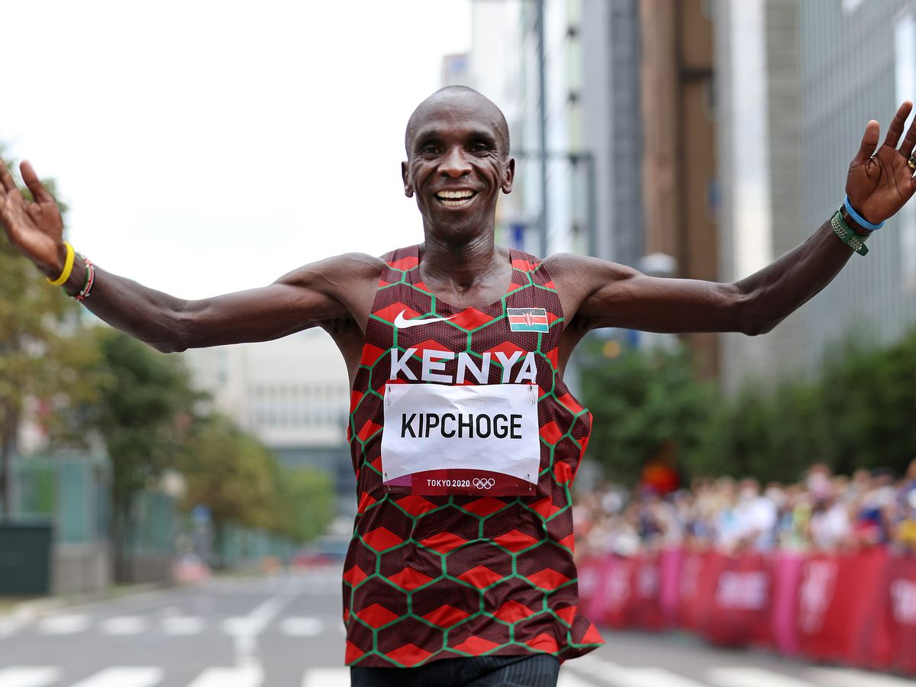
Eliud Kipchoge
Notes:
This man’s name is Eliud Kipchoge. He is a marathon runner from Kenya
Eliud is not just any marathon runner, he’s the world record holder for the marathon at a time of 2 hours 1 minute and 39 seconds
But Eliud and a team of others began to wonder if it could be humanly possible for the marathon to be run in under two hours.
So a team came together to see if a human could run the marathon in under 2 hours. On their first attempt, they failed. Eliud crossed the line in 2hours and 26 seconds - that’s one second per mile that he was off the pace.
So the team got together and tried again. And on the 12th October 2019, Eliud and his team did what was considered humanly impossible. He ran the marathon in under 2 hours - 1 hour 59 minutes and 40 seconds. Eliud said it was like man making it to the moon. And just like Neil Armstrong didn’t make it to the moon on his own, Eliud was part of a team that achieved this.
On his own Eliud was maxed out at 2hours 1 minute and 40 seconds. To get under 2 hours took a whole team of people. A team of runners ran with Eliud, people on bikes brought him food and drink, some people drove cars to set the pace, scientists were innovating and creating new shoes and better cars and better food.
And they brought in a crowd of people to cheer - to give Eliud that psychological boost.
Eliud is an incredible athlete - the world record holder in fact. But to run a marathon in under 2 hours took a team of people. It took people partnering together, each using their different gifts and passions, but working towards a common goal that made the impossible happen.
We need each other, God has given us the church because the Christian life is not one to be done in isolation
We are called to be on mission together, to a partnership in the gospel. We are invited to carry out God’s plan A as a team and to take the gospel out to the world and live out the gospel as the body of Christ
“Then everything you do will bring glory to God through Jesus Christ. All glory and power to him forever and ever!” Let’s pray

