Slide 1
ARE WE A SEEKER FRIENDLY CHURCH?
Contemporary music, marketing, programs, non-offensive & positive messages, numbers matter, repentance = “Jesus, I believe in you and receive you, Amen.”
“No one is seeking God.” (Romans 3:11)
“For no one can come to me unless the Father who sent me draws them to me..” (John 6:44)
“For the Son of Man came to seek & save those who are lost.” (Luke 19:10)
OUR SEEKER IS JESUS & WE STRIVE TO BE FRIENDLY, JUST LIKE HE WAS.
Notes:
Seeker friendly church movement started in the 90’s – lead by Bill Hybels and Willow Creek Church . Adopted by churches across the world but it has faded out a lot these days. Why? Premise was that people are seeking Christ and we need to be ‘attractional to get them in. Repentance (from one of their prayer books) = I believe in you and receive you. No mention of sin and repentance – sometimes even asked people to close their eyes so people who want to ask Jesus into their lives can do so without worrying about what others think. The result was churches were a mile wide and an inch deep – lots of people attending but no real salvation or growth in faith. Now there is nothing sinful with contemporary music, marketing or programs but the reality is that the Bible says that no one seeks God on their own. Our human, sinful heart has a natural tendency for rebellion, self interest and disobedience (Romans 7:18-19). The only way people can start to seek God is if the Holy Spirit stirs their heart and softens their mind towards Jesus. A bit like the love description in 1 John 4:19 – we can only truly love each other because Christ first loved us. Because people can’t seek God on their own, God (in his love) sent Jesus to seek and save them. So are we a seeker friendly church? Today I want us to be able to say Yes! Our seeker is Jesus and we strive to be friendly just as he was.

Slide 2
KNOWING
“Therefore, go (as disciples) and make disciples of all nations….” (Matt 28:19)
START WHERE PEOPLE ARE
LOVE THEM
GO DEEPER
JOHN 3:1-21
JOHN 4:1-30

Slide 3
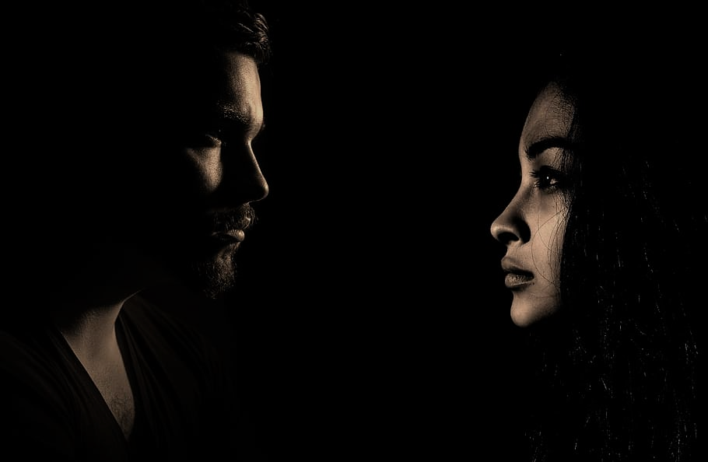
1. START WHERE PEOPLE ARE.
“God forbid that I should travel with anyone for 15 minutes without speaking of Christ to them.” (George Whitefield)
No one is off limits to God. Nicodemus & the women represent the whole of humanity – man + woman, Jew + Samaritan, insider + outcast, powerful + powerless, wealthy + poor.
Jesus touched people with leprosy, ate with sinners, befriended tax collectors, associated with prostitutes, talked with Romans = we need to be ready to joyfully engage with whomever God brings into our lives.
Notes:
George Whitefield – English cleric and evangelist, one of the founders of Methodist church.

Slide 4
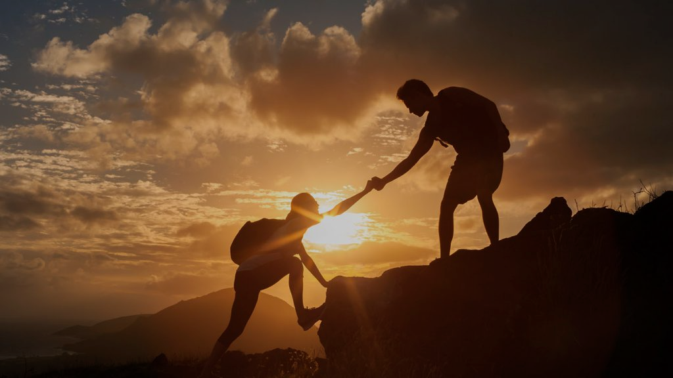
No time is off limits. Nicodemus came to Jesus late at night + Jesus encountered the woman at the well in the blistering heat of the day = we need to be ready to share the gospel when people are ready, when the Holy Spirit opens doors.
No ‘barrier’ is too big. Nicodemus was an ‘enemy’ of Jesus, one of the Pharisees seeking to discredit & destroy Him = safety risk, opportunity to condemn.
The woman was a Samaritan, an adulterer & despised by her village = cultural and social divides.
“It is the duty of every Christian to be Christ to his neighbour. No matter who they are, where they are or what they are.” (M Luther)
Notes:
Nicodemus came late at night hungry for the truth. The woman was thirsty and thinking about religious matters during the middle of the day. Our opportunities are not always going to come at convenient times – during our scheduled ministry events or times. Jesus was happy to start with what was on their heart and mind – not all dependant on his agenda. Both times also allowed for good conversations without interuptions. No risk or boundary too big – no self respecting Jew would even travel through Samaria – they would prefer to go around. Jews despised Samaritans – considered them half breeds, worse than pagans. When Assyrians conquered northern kingdom of Israel in 721BC they took many as captives but also re-populated the area with other gentile nations from their empire. The Israelites who remained intermarried and mixed with gentiles – idolatry. Israelites deemed Samaritans as impure, traitors, worse than pagans. Would avoid contact with them , pass on the other side of the road (avoid shadows). The woman was also married six times (not told what happened, but probably divorce – in those days divorce was deemed to be the woman’s fault. The fact she was a woman – culturally wrong for a Jewish man to talk with a woman in public, even more so for a Rabbi to speak to a Samaritan woman. The fact the woman was getting water alone at midday indicates that she was shunned by other women in the village (women normally went in groups in the cool of the morning).
From aids shelters, homeless shelters, atheists, drug addicts, prisoners, felons, slaves - no one is untouchable or unreachable in the eyes of God. Jesus was a rule breaker who shattered social barriers – we need to be willing to do that as well.

Slide 5
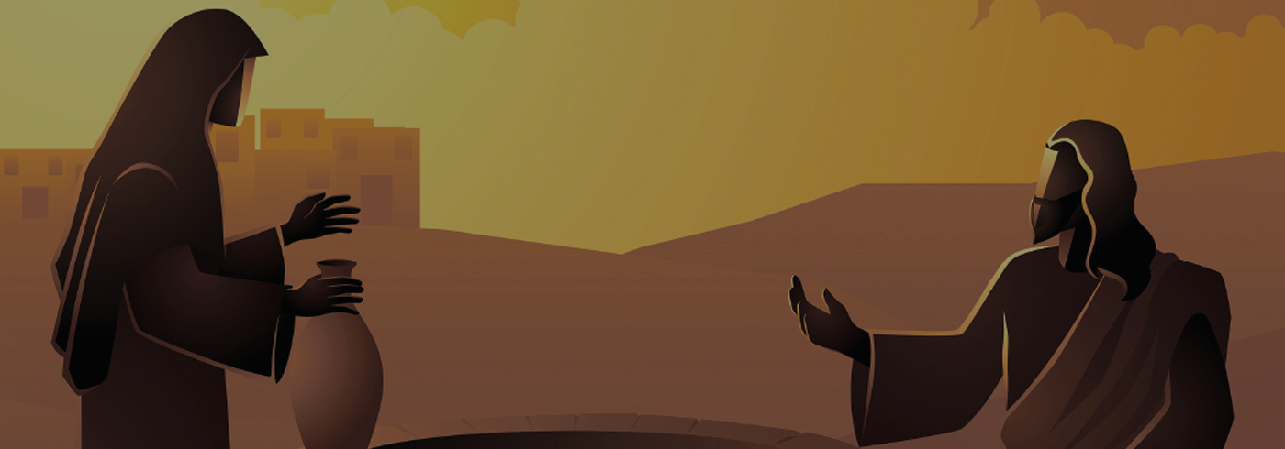
2. LOVE THEM – long to see their eyes opened and hearts softened to the good news of the gospel (to be born again, to drink the living water that will quench their ‘thirst’ forever).
“Sharing the gospel is one beggar telling another beggar where to find bread.” (N.T Niles) = no place for us to have pride and superiority, just love and compassion.
Knowing and sharing starts ‘naturally’ with a conversation - listening, hearing and responding to the heart and mind of those you are reaching. Nicodemus wanted to understand more about the Kingdom of God (doubting). The Samaritan woman was thirsty, weary and confused.
Notes:
It is impossible to read John 3 and 4 and not sense the authentic love that Jesus had for Nicodemus and the Samaritan woman. He wanted to see Nicodemus born again and the woman have her soul’s thirst quenched by the living water of the Holy Spirit. Outreach is not a chore or a duty. People are not just a ‘project’ or a quota to fulfill. We must be willing to love and invest in their lives.

Slide 6
3. GO DEEPER – after the initial connection, Jesus finds the right time and opportunity to go deeper.
Ask the hard questions (be direct, but humble and gentle). To Nicodemus – “You are a respected Jewish teacher and yet you don’t know these things… But if you don’t believe me when I tell you about earthly things, how can you possibly believe if I tell you about heavenly things?” (John 3:10-12
To Samaritan woman – “Can I meet your husband?” (Jn 4:16).
There can’t be salvation without repentance that involves the sorrow for, and turning from, sin. (Acts 26:19-20, 1 Thess 1:9).
Notes:
We need to challenge them like Jesus did. Even though he was perfect and sinless, he was still gentle (motivated by love). We are sinful so we need to be humble and gentle as we challenge others about their sin. No room for pride or superiority. Both these hard questions were designed to get them to both be honest about their sin. Nicodemus was proud and unteachable, thinking that the Law and his works could save him. The Samaritan woman needed to understand that she was living in adultery with a man who wasn’t her husband. The Good news of salvation is only good news if we understand how lost we are – doomed to be condemned and facing the wrath and judgement of God. I saw a video the other day of a swimmer in the ocean who was being stalked by a shark. The video was taken by lifeguards on the cliff overlooking the bay. They could see the shark, the swimmer couldn’t. They kept yelling at him to get out but he looked at them and waved them off. Its only when the shark surfaced near the man and he saw it that he turned and started to franticly swim towards the beach and get out of the water. He needed to appreciate the reality of his situation, and the danger it presented, before he acted. Same with sinners – why we need to ask tough questions. They need to understand that sin matters. God is just and has to deal with sin.

Slide 7
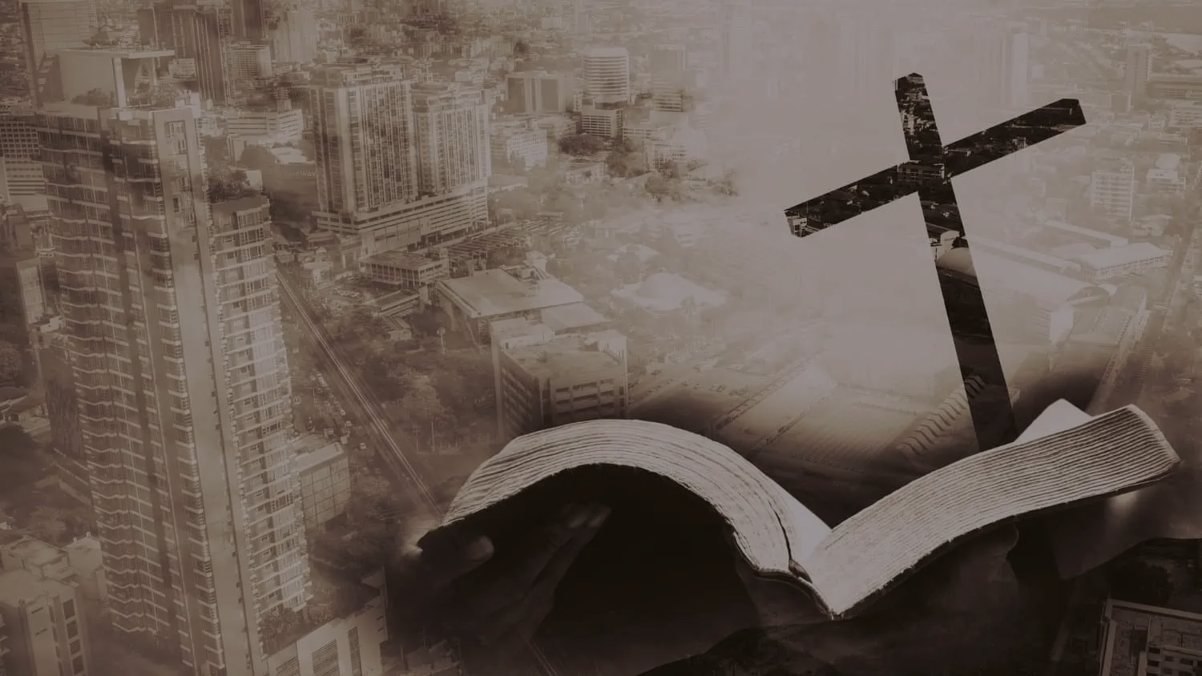
Asking tough questions > conversation goes deeper > speak the hard truth.
To Nicodemus, “I tell you the truth, unless you are born again, you cannot see the Kingdom of God.” (3:4)
To the Samaritan woman – “If only you knew the gift God has for you…” (4:16) “Those who drink the water I give you will never be thirsty again. It becomes a fresh bubbling spring within them, giving them eternal life.” (4:14)
Every sinner needs rebirth and living water = regeneration, reconciliation + salvation, forgiveness and the desire to live an obedient life that glorifies God = no longer lost.
Notes:
The hard truth is that we can’t keep living in sin, rejecting God and receive the gift of eternal life (forgiveness and salvation). We can’t get the blessings of the good news that God has for us. Living water – salvation, forgiveness of sin and desire to live an obedient life that glorifies God. Only way to overcome your doubts, fears, weariness, rejection and defeat is to surrender to Christ. W all need new beginnings, to be refreshed and start again.

Slide 8
“Glenda was an RI teacher at my High School who had the courage to invite our entire class to her home to chat about God over a hamburger and milkshake. Some of my classmates were drug users, bullies and petty thieves. She was wealthy, intelligent and married to a leading Australian businessman. What was Glenda thinking inviting us for a meal and discussion? Glenda’s style was completely relaxed and incredibly generous. Even when her VCR went missing, she made almost nothing of it. As we ate and drank and talked, it was clear this was no missionary ploy on her part. She truly cared for us and treated us like friends or, more accurately, like sons. As a result, over the course of the next year, she introduced several of us from the class to the ultimate "friend of sinners," Jesus.”
JOHN DICKSON
Notes:
John Dickson is an Australian writer, speaker, academic and advocate for Christianity. He shares a story about an RI teacher named Glenda who lead him to the Lord – by becoming a friend to sinners. By being willing to step out in faith and courageously get to know him.

Slide 9
Jesus was a ‘friend of sinners’ (Luke 7:34). He met them where they were – in their sin, fears, doubts & defeat. He shared the gospel and gave them truth, love, care, value, hope & life.
1. Sharing the gospel is urgent, so look for the opportunities – “Don’t say its four months until harvest. Wake up and look around. The fields are ready for harvest now.” ” (John 4:35)
2. Sharing the gospel will be inconvenient – “Jesus had to pass through Samaria… and he stayed two days so that many more could hear his message and believe.” (John 4:4, 40)
3. Nothing will satisfy you like the enlightened eyes of a lost soul – “My nourishment comes from doing the will of God...” (Jn 4:32)
Notes:
Jesus was a friend of sinners and he asks us to do the same. If we are to do that there are a number of challenges we need to understand.
1. May we realise that sharing the gospel is urgent – opportunities can slide by quickly. To wait and put off sharing the gospel until a better day is to invite eternal ruin for those who do not know Christ. May we open our eyes to the opportunities around us – see that the fields are ready for harvest. The disciples were reluctant to be in Samaria and while they were there, their concern was only about finding food, thinking of themselves and their physical discomfort and needs (buying food to eat). They had no concern for the spiritual needs of those around them. We need to be different to them – we can easily move through a day focusing on our agenda and needs without a thought or prayer for those that we know are lost.
2. May we accept that sharing the gospel requires being inconvenienced. Jesus was willing to go against social and cultural taboos. He was just passing through Samaria but was willing to stay two days to teach the Samaritans. We need to be willing to give up much (our plans, time, reputation, money etc,) to become a friend to sinners, just like Jesus.
3 May we understand that nothing will satisfy us like the enlightened eyes of a lost soul – saving souls gives us eternal purpose and makes eternal difference. That is true food. Be careful of seeking satisfaction in earthly treasures and even in ministries. The will of God for Jesus was to seek and save the lost (Luke 19:10).

